Slide 1
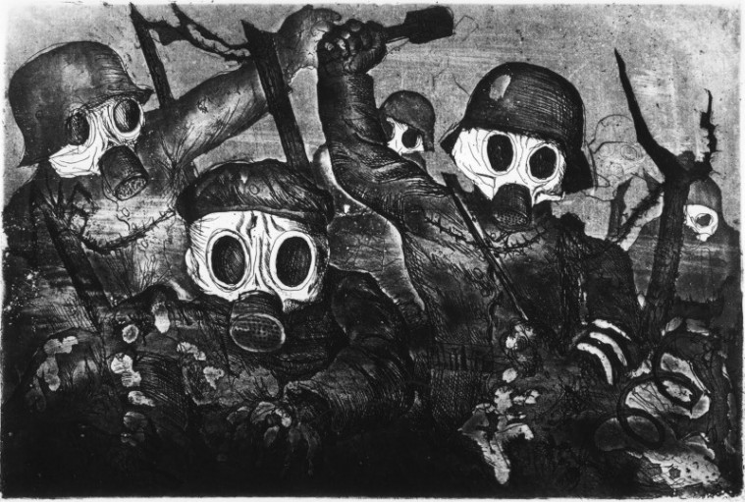
Lesson 1: The Great War
Europe in 1914: the origins of the First World War
The July crisis: from war of movement to trench warfare
Civil and military power, the economy of war
New countries join in the war
Fighting the war: pacifism and mutinies, the crisis of 1917
Ending the war. The victory of Allies

Slide 2
Course Plan
Location: via Beniamino Andreatta 4, Aula Magna
Time: Tuesday 13-15 and Wednesday 15-17
Breaks: 1th november
Written exam (partial): 29th november, 13-15

Slide 3
Franz-Joseph I of Austria-Hungary
Kaiser William II
Tsar Nicholas II of Russia
Jean Jaurès
Schlieffen Plan
Cossaks
Paul von Hindenburg, Erich Ludendorff
Ypres
Giovanni Giolitti, Antonio Salandra
Battle of Verdun, Battle of the Somme River
Zimmerwald
Pétain Clemenceau
Mustapha Kemal

Slide 4
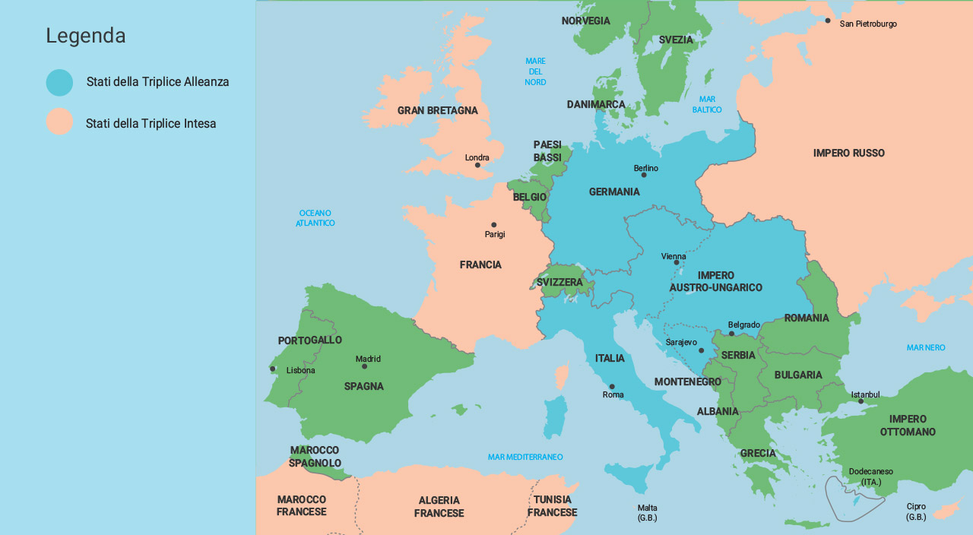

Slide 5
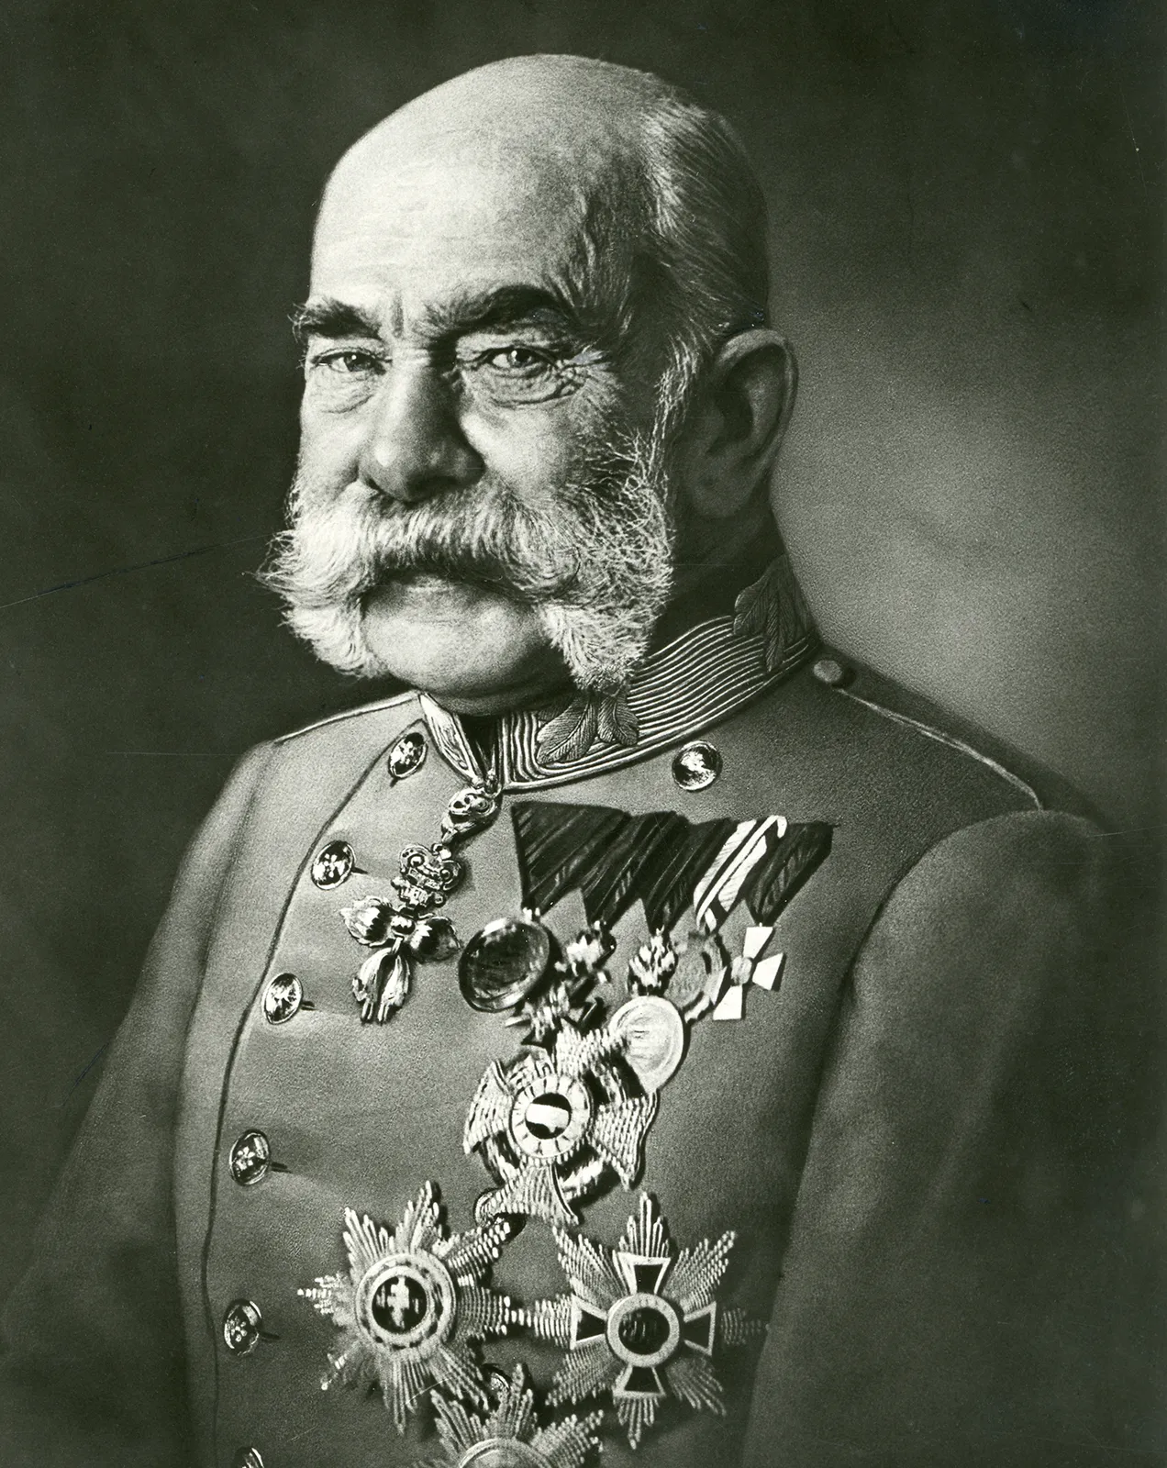
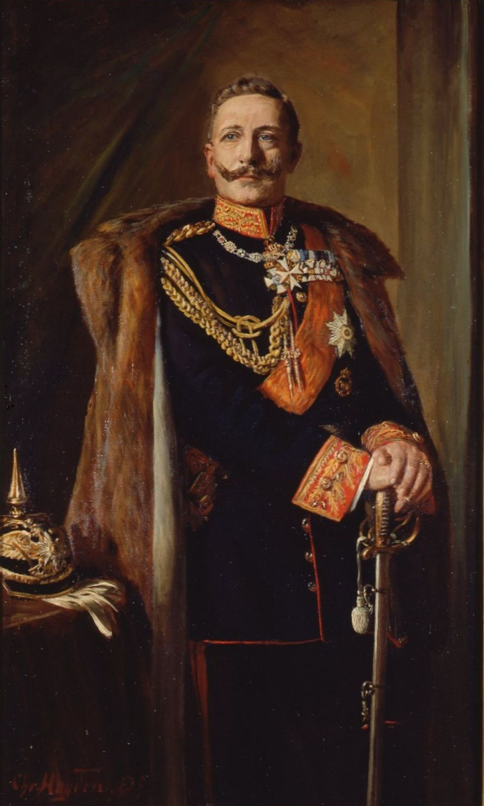
Franz-Joseph I of Austria-Hungary
Kaiser William II

Slide 6
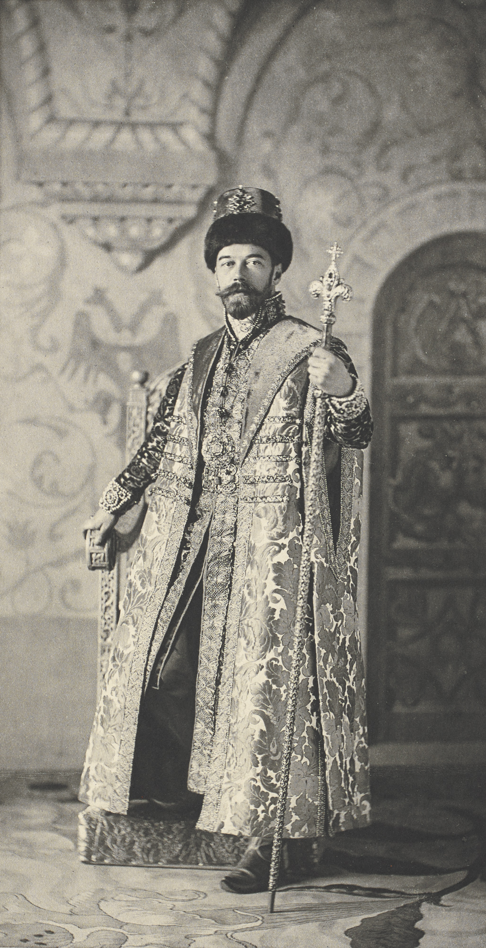
Tsar Nicholas II of Russia

Slide 7
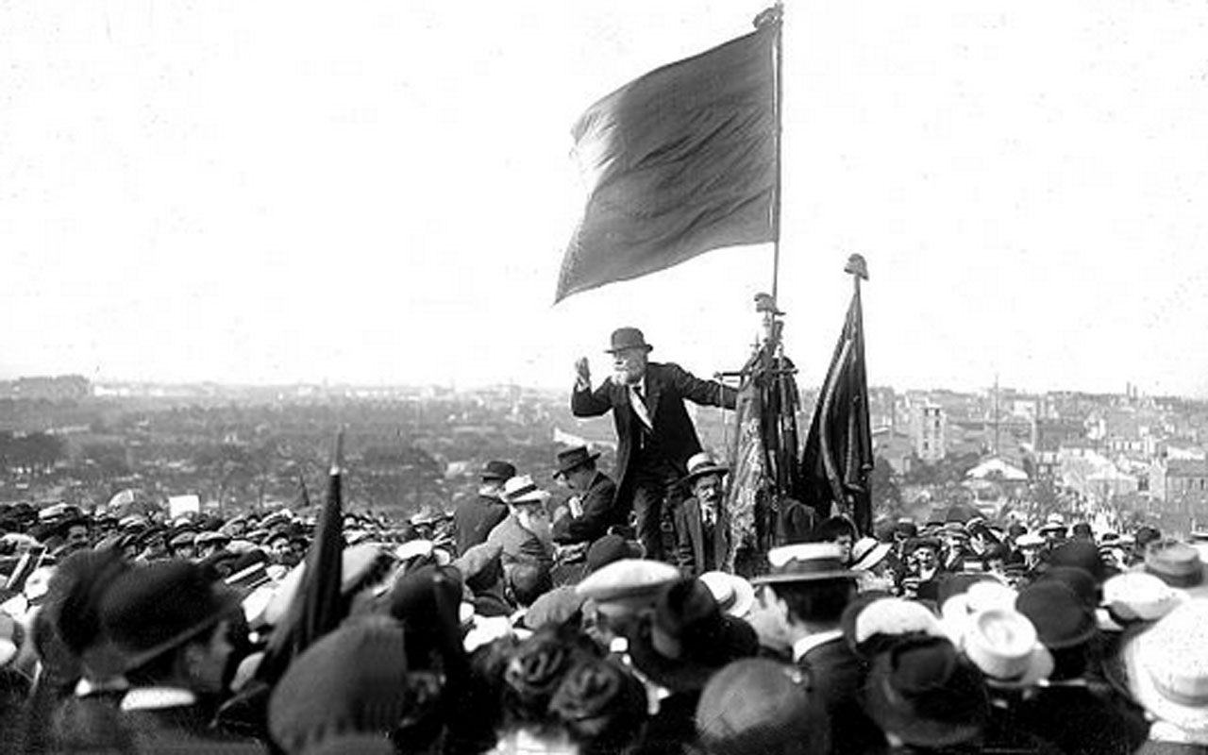
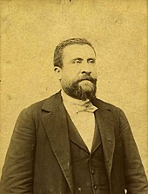
Jean Jaurès

Slide 8
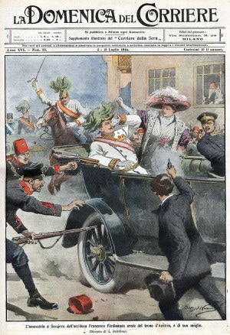
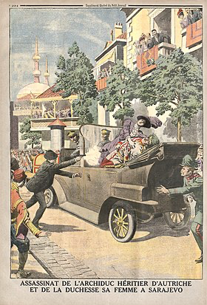
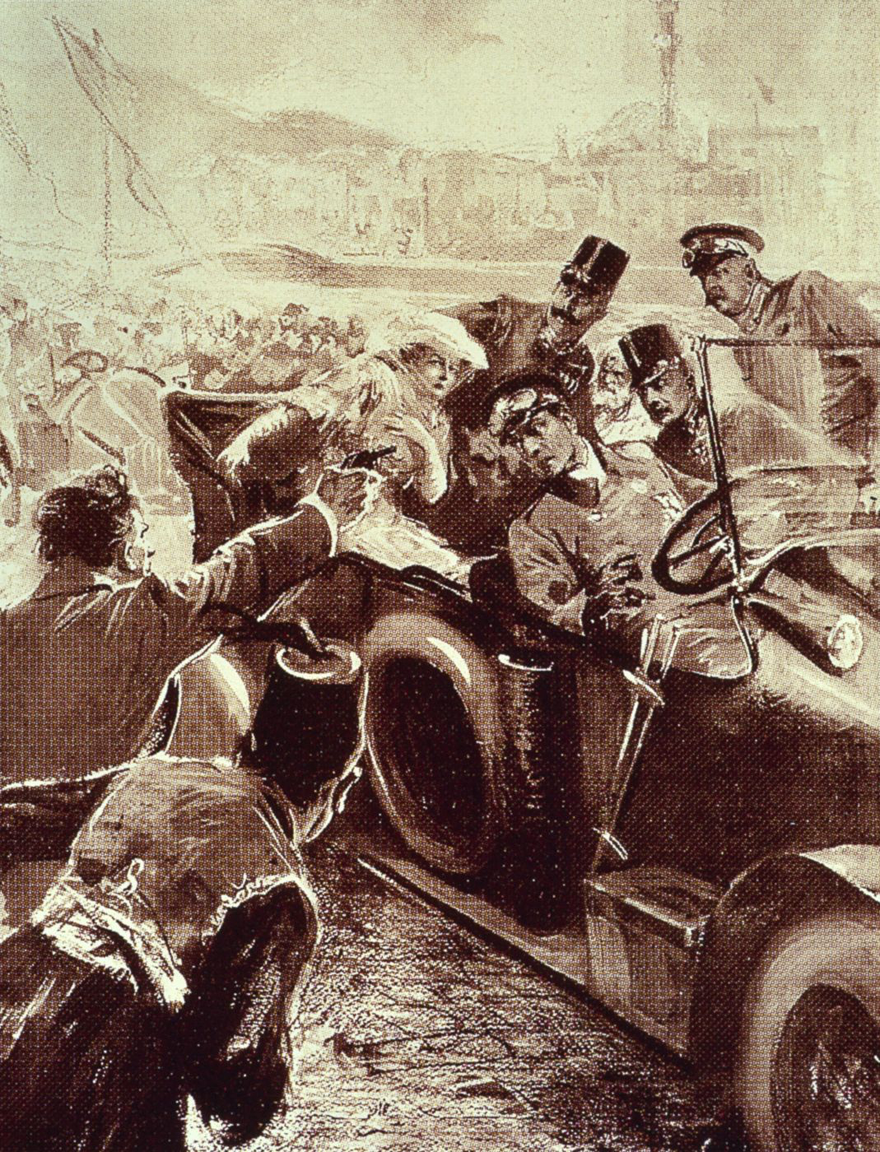
From «La Domenica del Corriere»
From «Le Petit Journal»
From «Leipziger Illustrirte Zeitung»

Slide 9
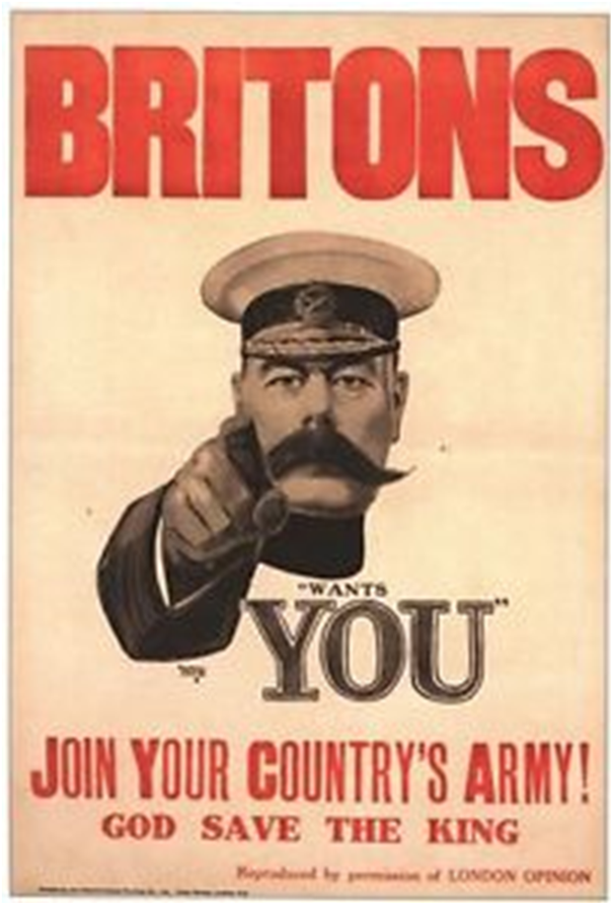
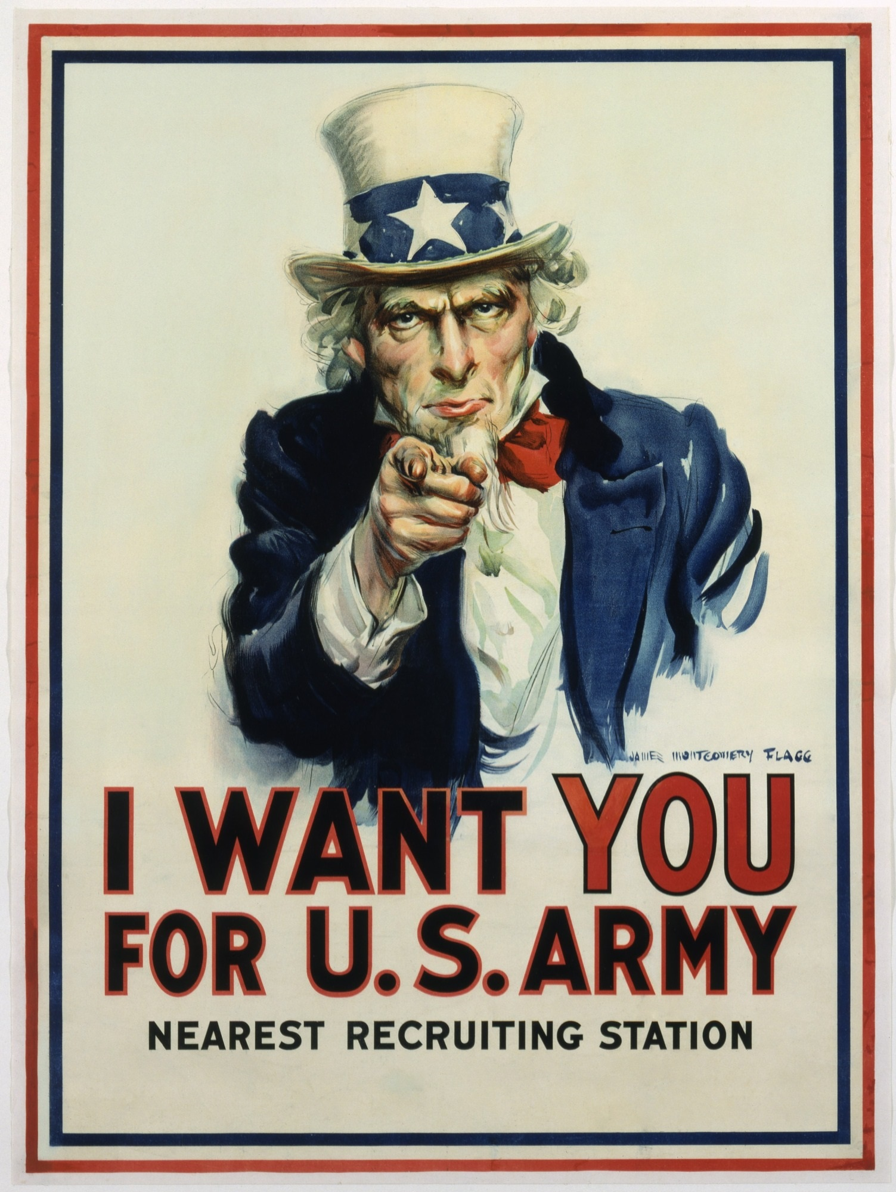

Slide 10
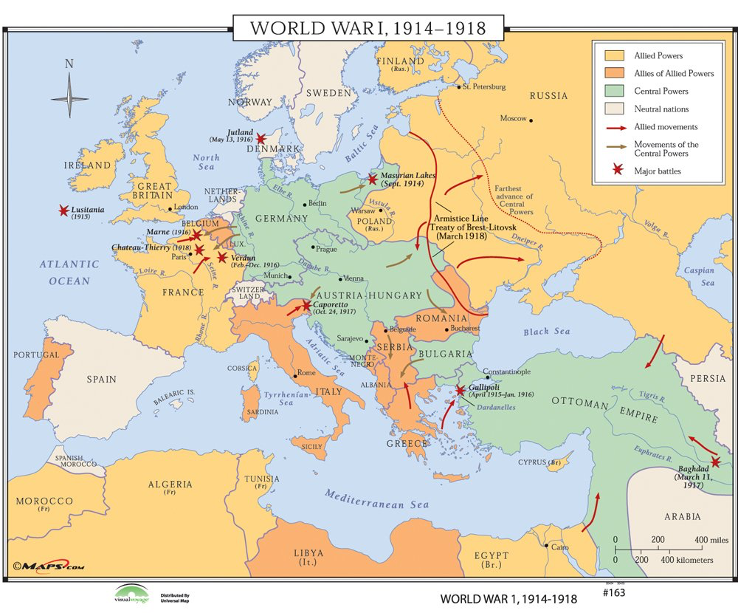

Slide 11
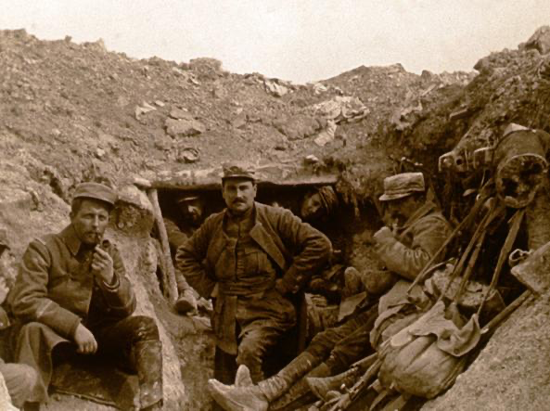
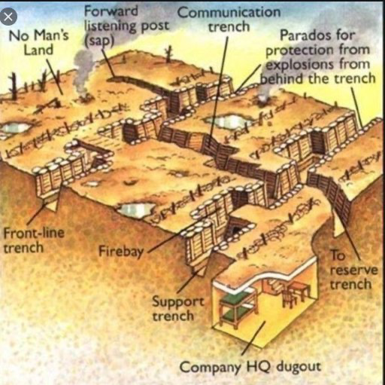
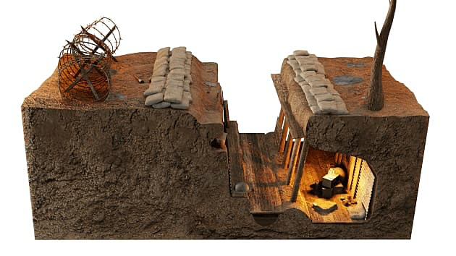

Slide 12
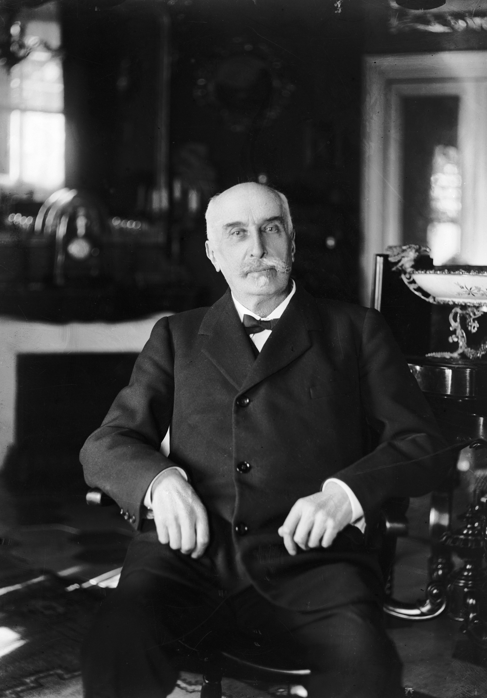
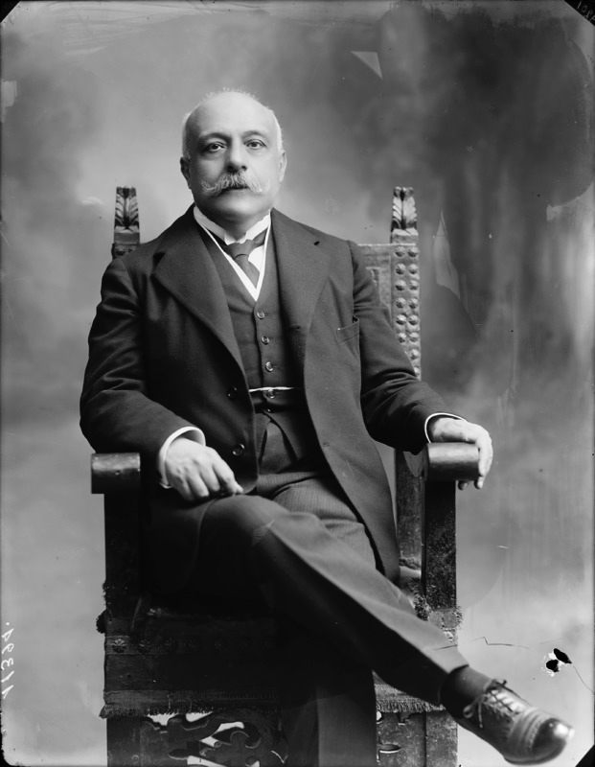
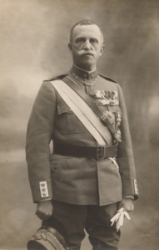
Giovanni Giolitti
Antonio Salandra
Vittorio Emanuele III

Slide 13
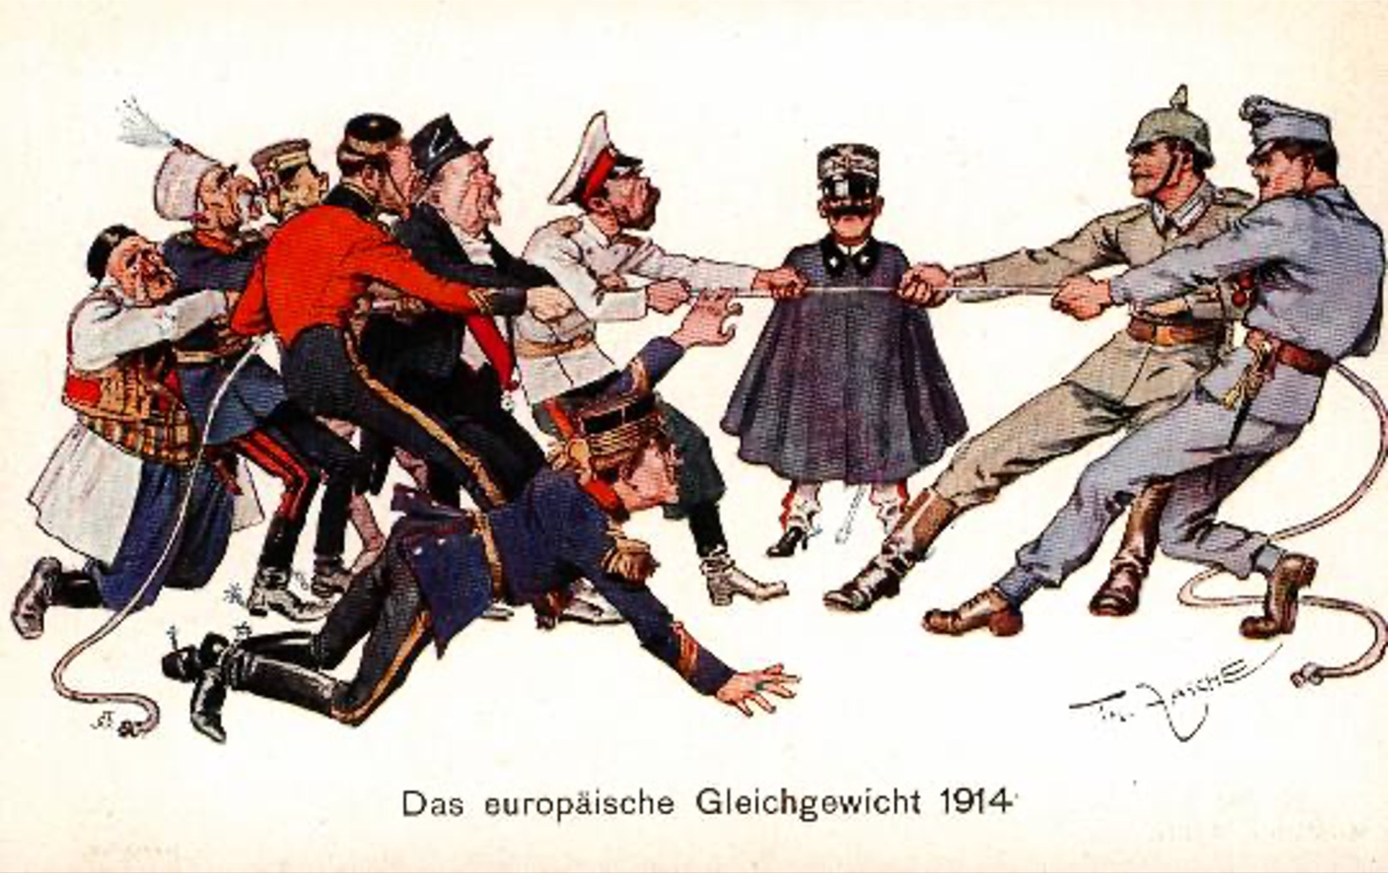
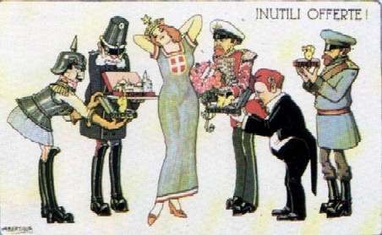

Slide 14
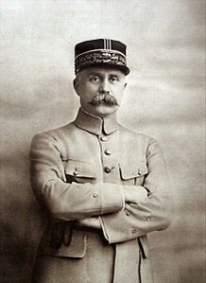
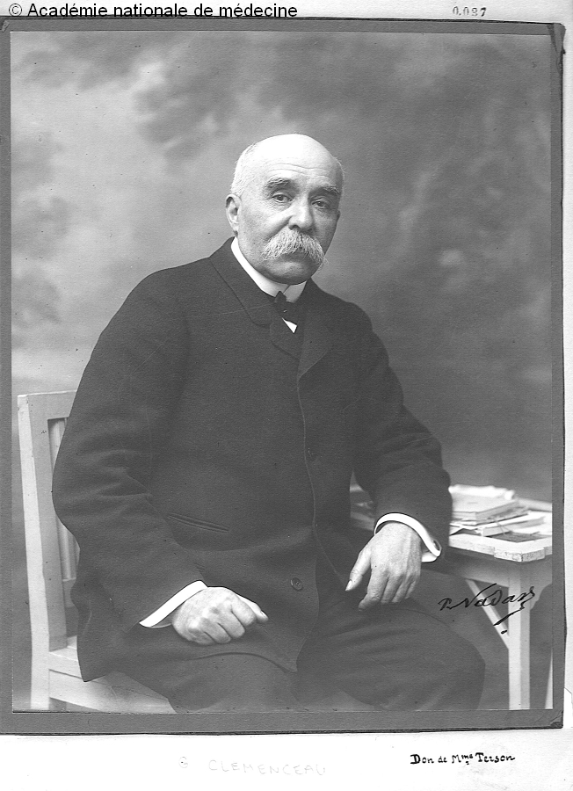
Philippe Petain (1856-1851)
Georges Clemencau (1841-1929)

Slide 15
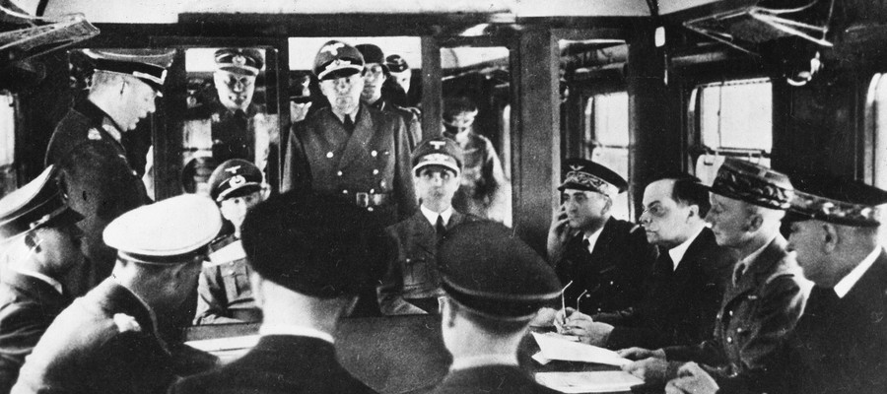
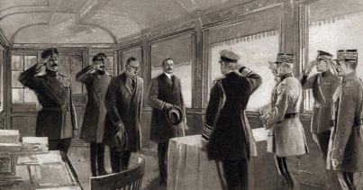

Slide 16
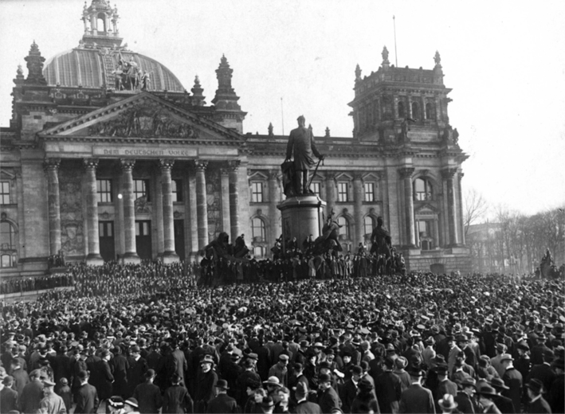
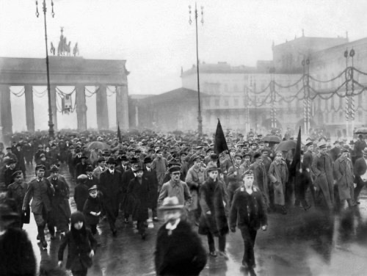

Slide 17
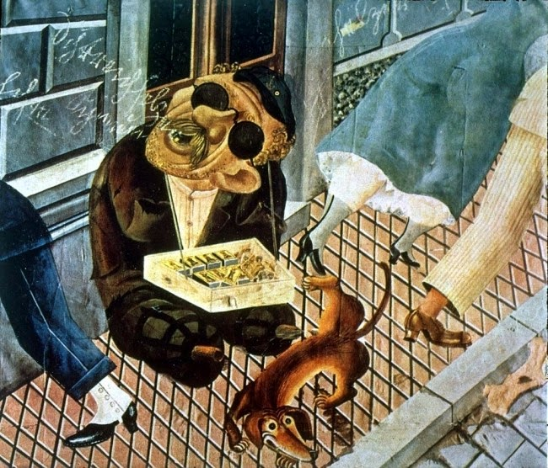
Otto Dix, Il venditore di fiammiferi, 1920

