Slide 1
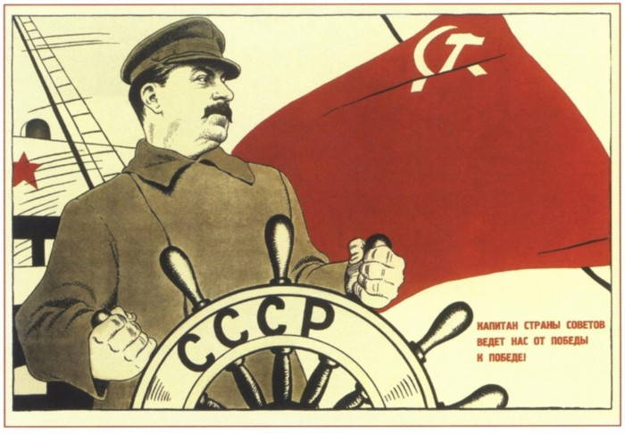
Lesson 3: From Russia to the USSR
The revolution of February 1917
The Bolsheviks rise and the October revolution
Failed revolutions : Germany (Spartakists), Hungary (Bela Kun, Italy (biennio rosso),
Russian civil war and war against Poland
From Lenin to Stalin
Collectivisation and the Dekulakisation

Slide 2
Romanov
Gregory Rasputin
Mensheviks
Bolsheviks
Aleksander Kerenski
Kornilov
Vladimir Ilyich Ulyanov known as Lenin
Lev Trotsky
Brest Litovsk
Rosa Luxembourg and Karl Liebknecht
Miháli Károli
Béla Kun
Miklós Horthy
Joseph Pilsudski
Grigori Zinoviev
Nicolai Bukharin
Joseph Jughashvili known as Stalin
Sovkhoze and kolkhoze

Slide 3
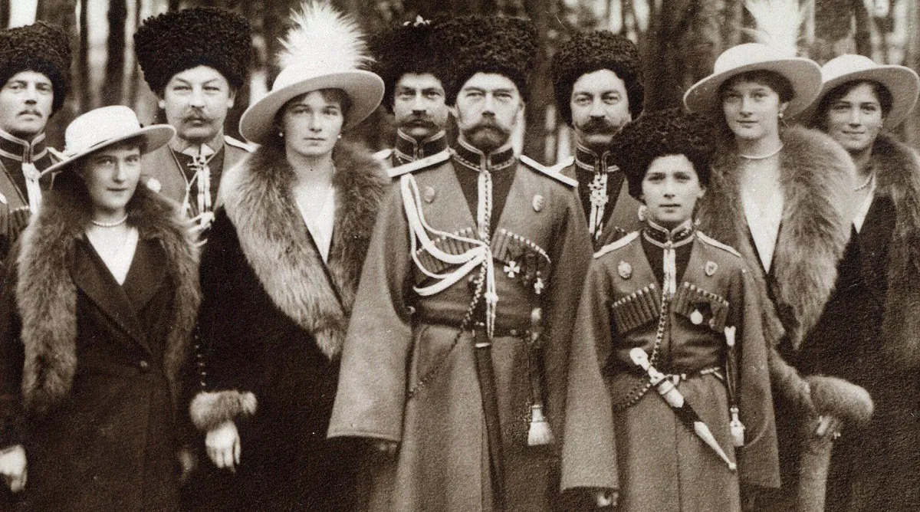
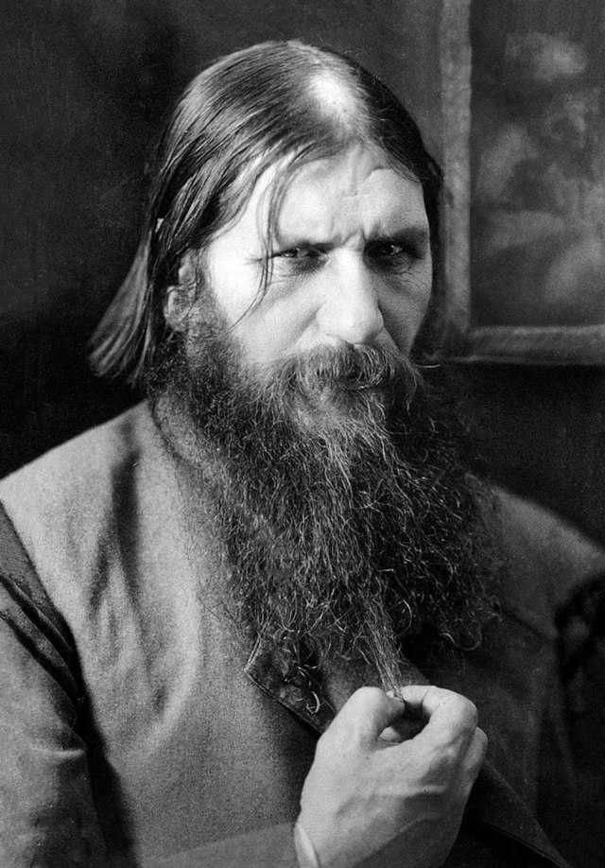
Tsar Nicholas II and his family (Romanov)
Grigorij Rasputin (1869-1916)

Slide 4
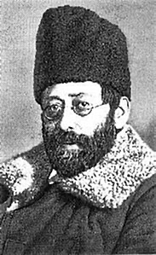
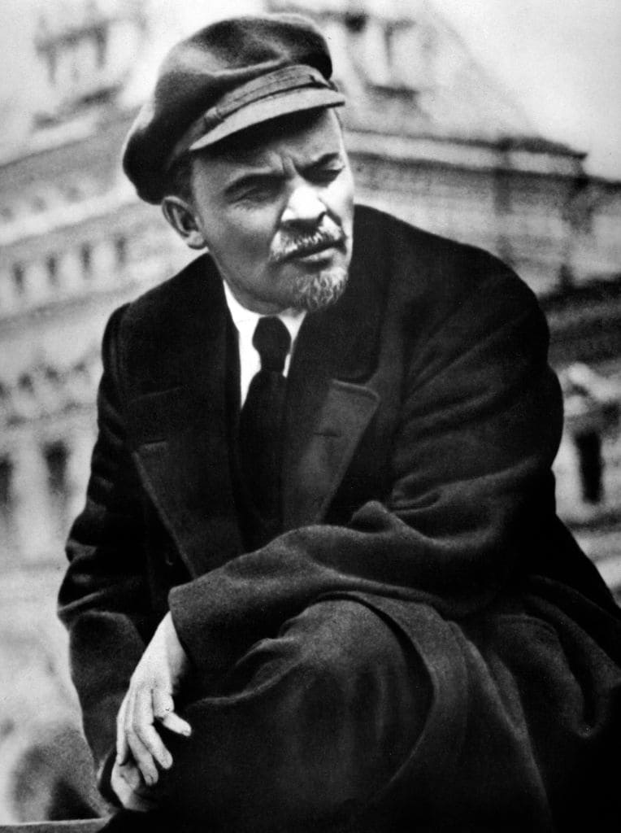
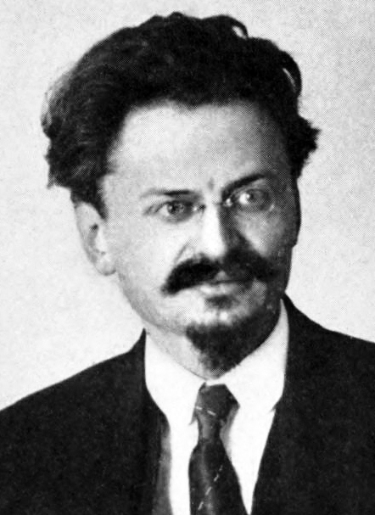
Vladimir Lenin (1870-1924) and Leon Trotsky (1879-1940) leaders of the Bolsheviks
Julij Martov (1873-1923), leader of the Mensheviks

Slide 5
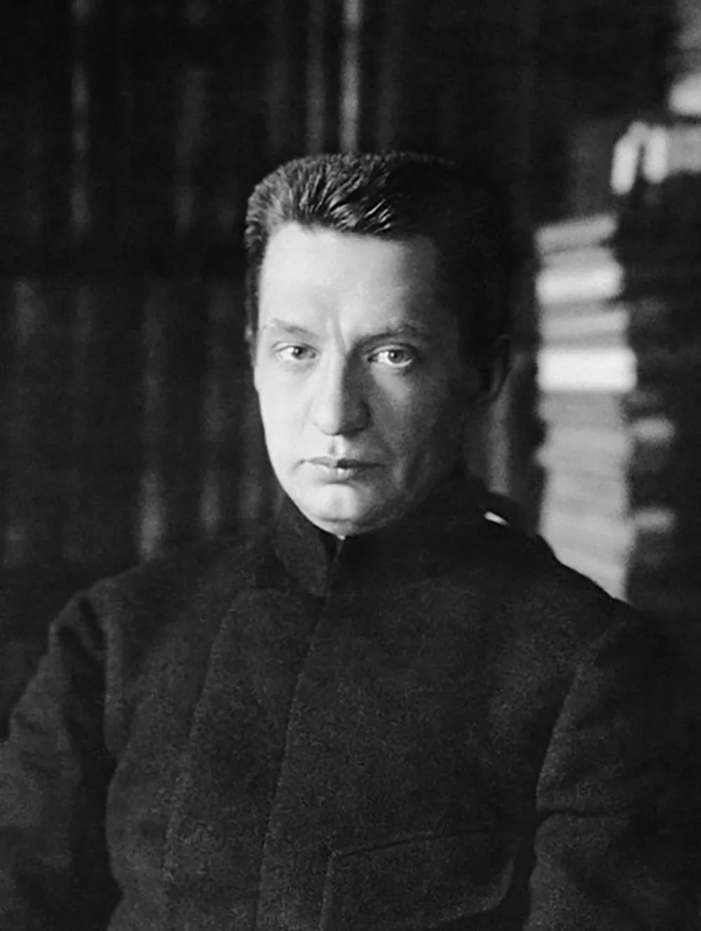
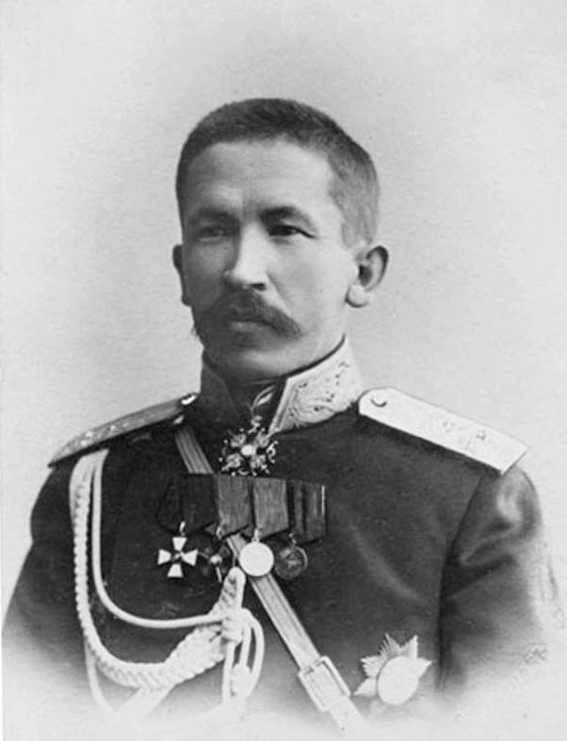
Alexander Kerensky (1881-1970)
Lavr Kornilov (1870-1918)

Slide 6
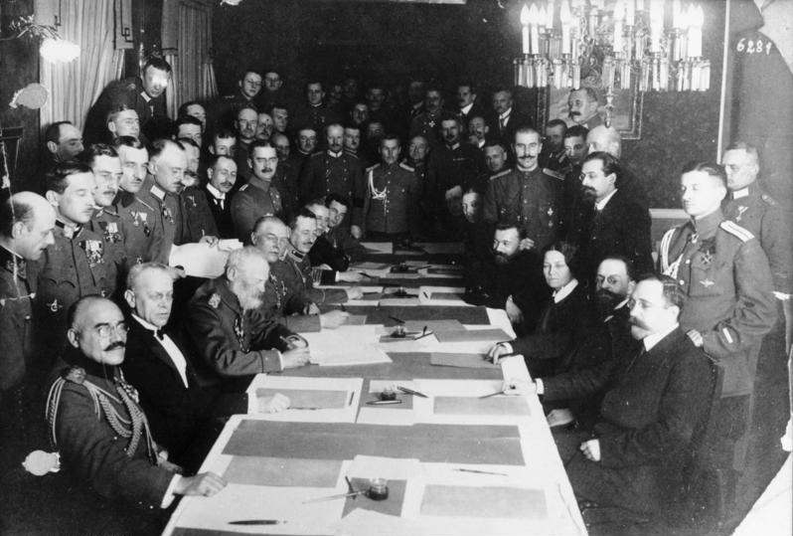
Signing of the Armistice of Brest-Litovsk - 3 March 1918
(the woman on the Russians’ side is Anastasia Bitsenko, known as the woman who killed the Russian Minister of War Viktor Sacharov in 1905)

Slide 7
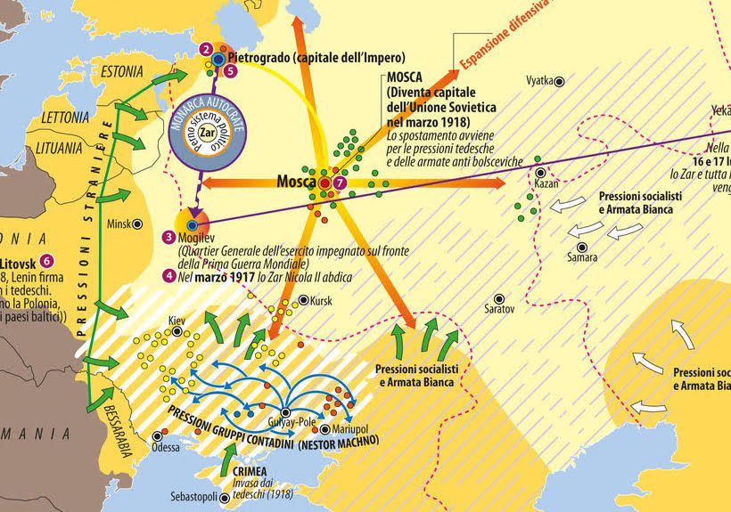

Slide 8
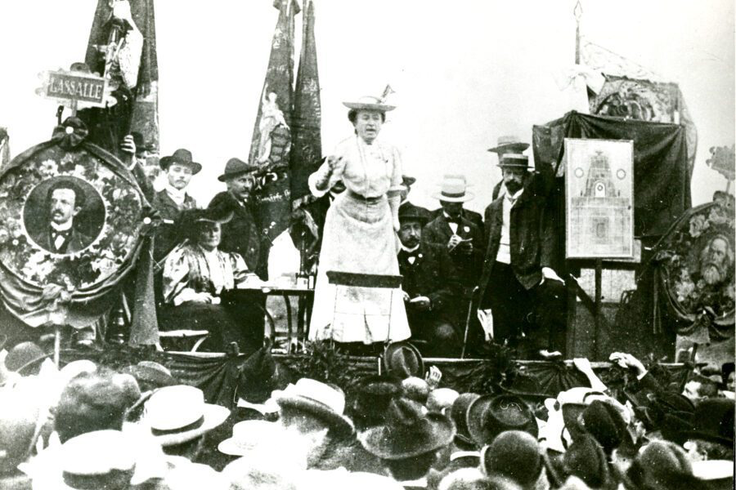
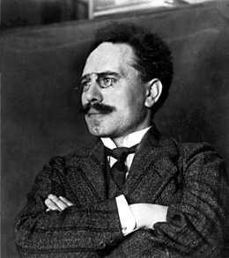
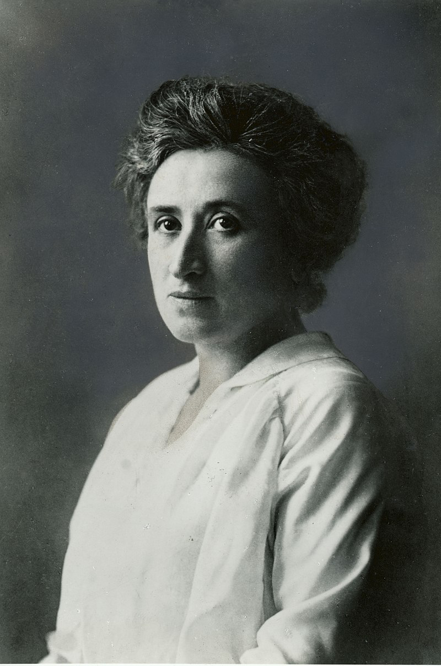
Karl Liebknecht (1871-1919)
Rosa Luxemburg (1871-1919)

Slide 9
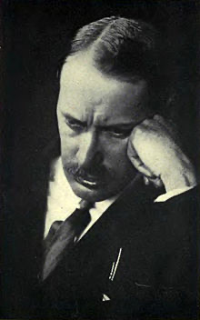
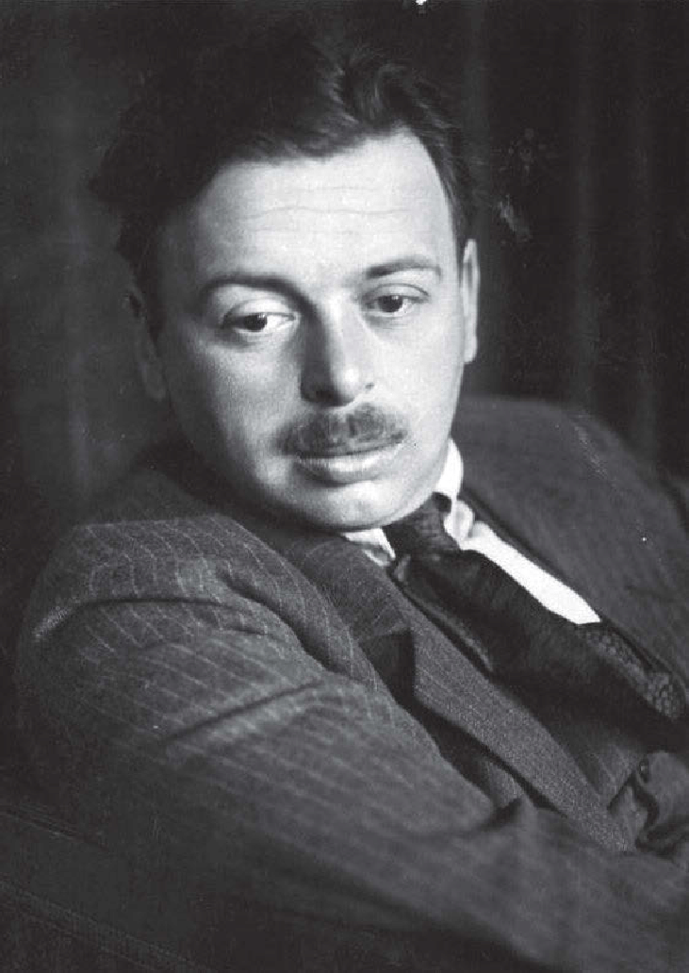
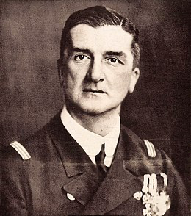
Mihàly Kàrolyi (1875-1955)
Bela Kun (1886-1938)
Miklòs Horty (1868-1957)

Slide 10
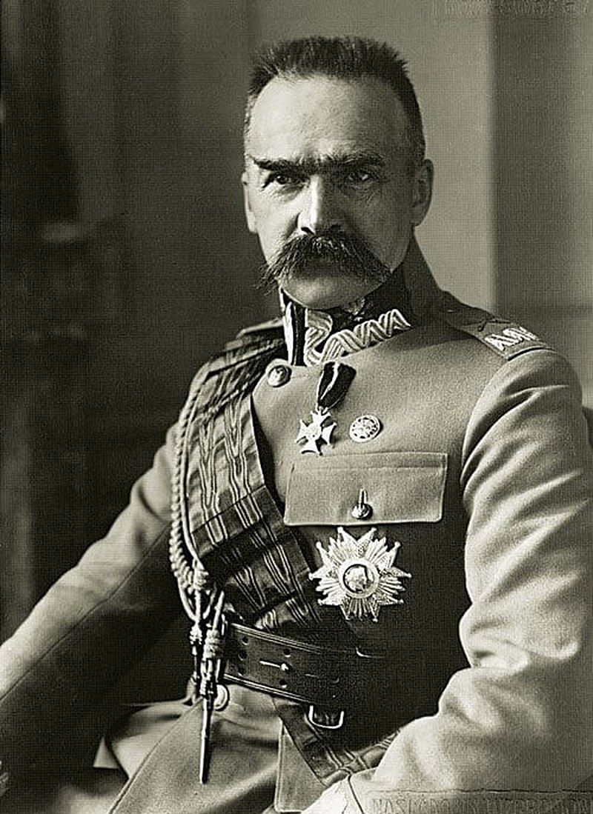
Jòzef Pilsudski (1867-1935)

Slide 11
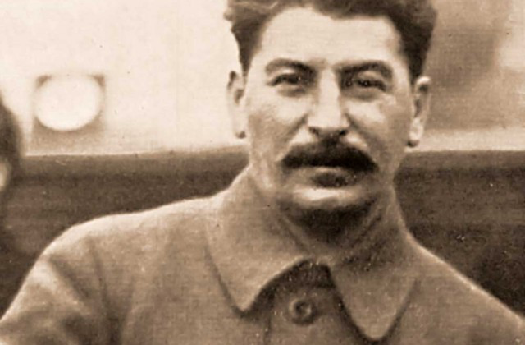
Joseph Stalin (1878-1953)

Slide 12
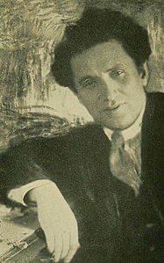
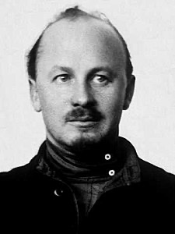
Grigorij Zinov’ev (1883-1936)
Nikolaj Bucharin (1888-1938)

Slide 13
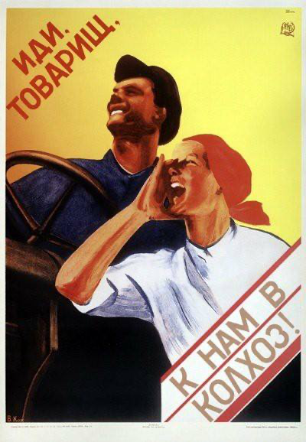
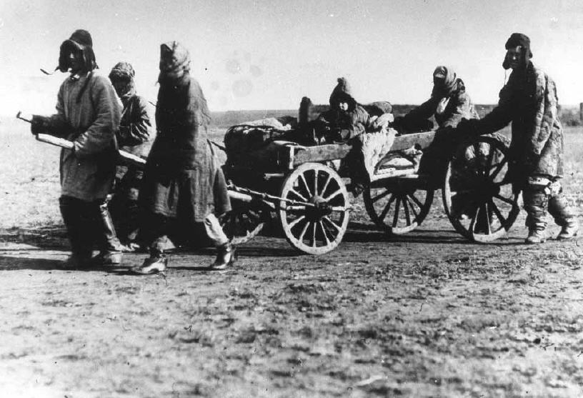
«Come, comrades, to our kolchoz!» (propaganda poster, 1930)
Peasants in Kazachstan moving because of the collectivisation process (1930s)

Slide 14
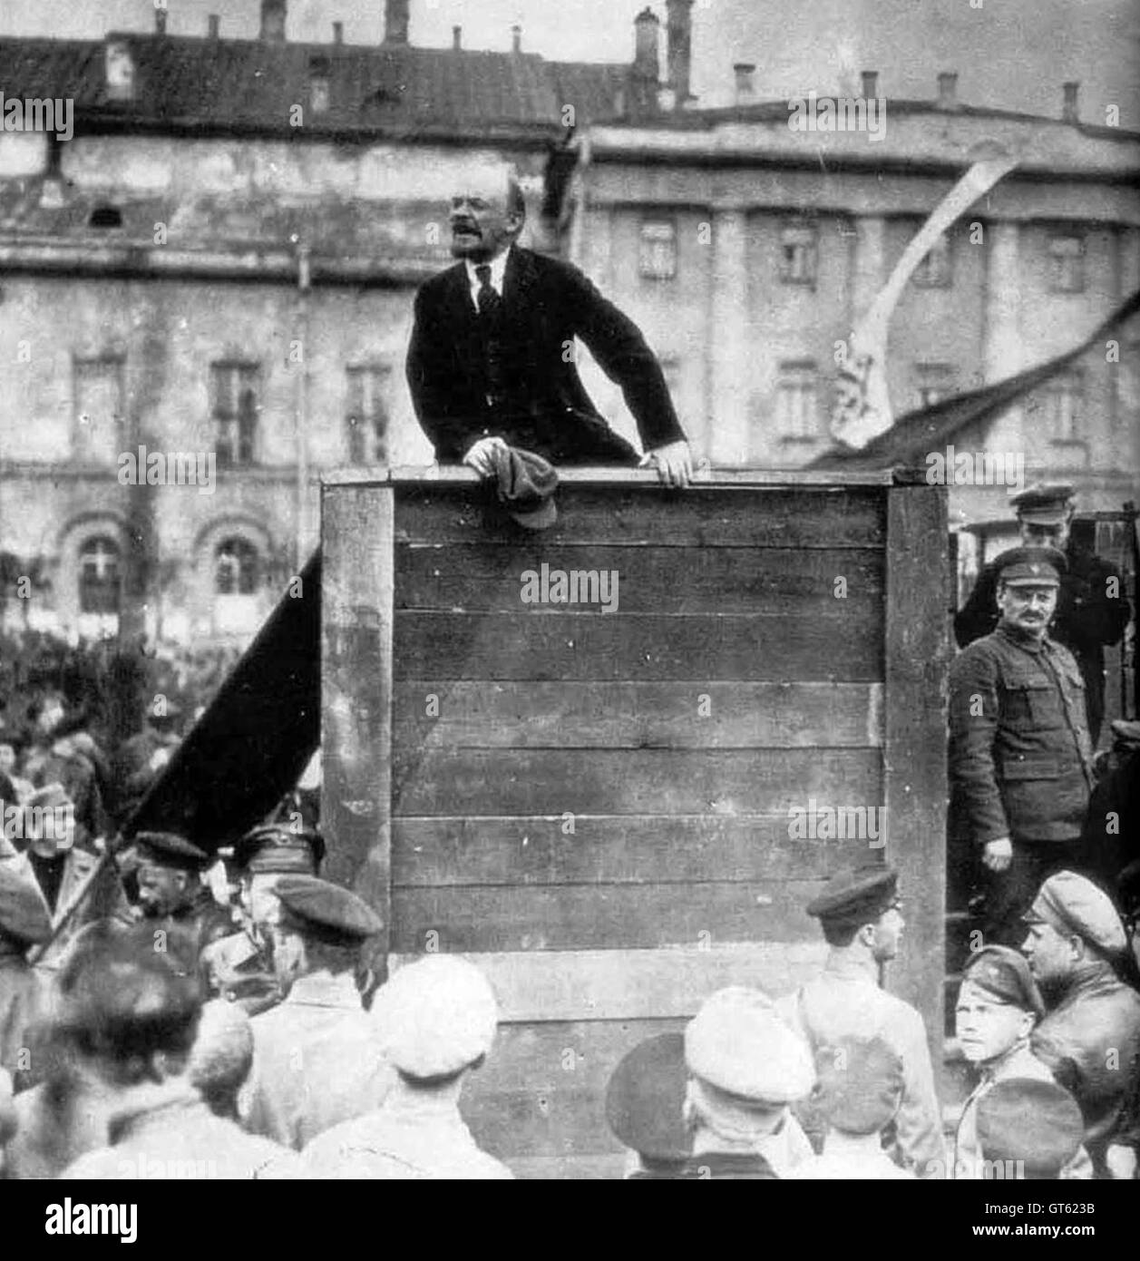
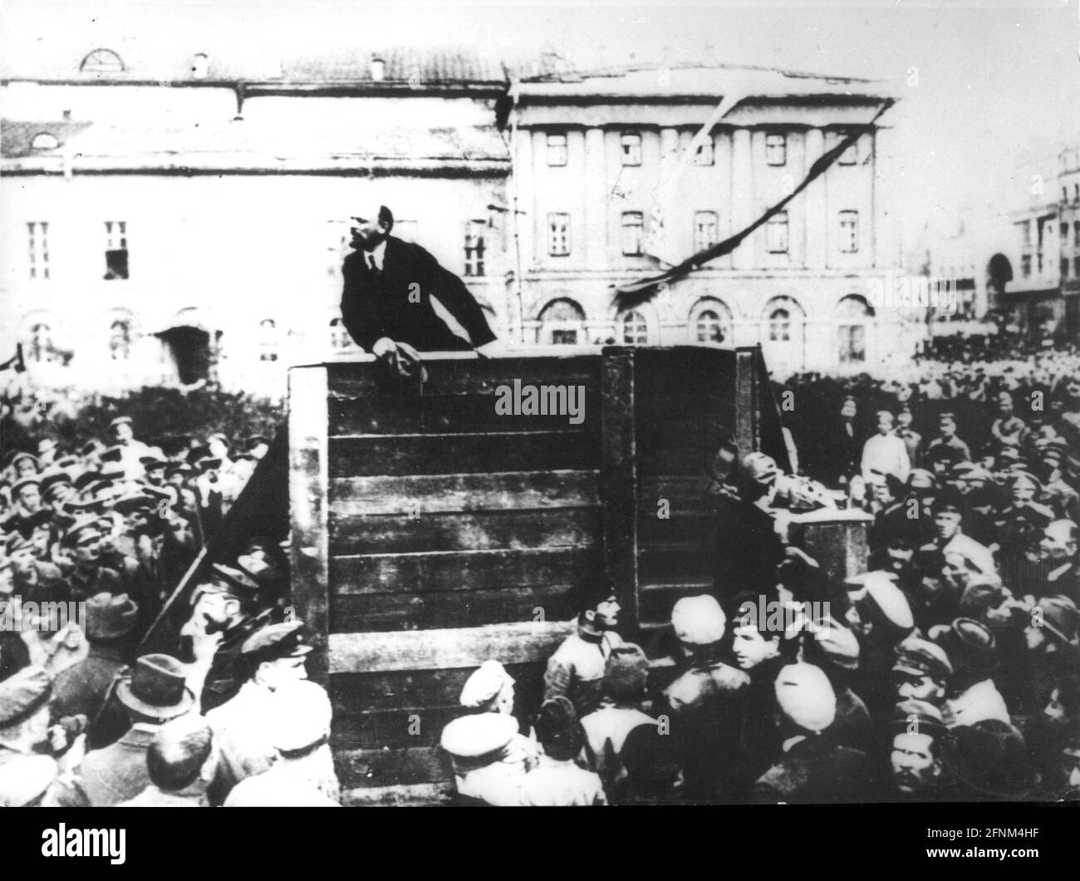
Lenin, Trotsky, Kamenev (1920)
Lenin (before 1924)

Slide 15
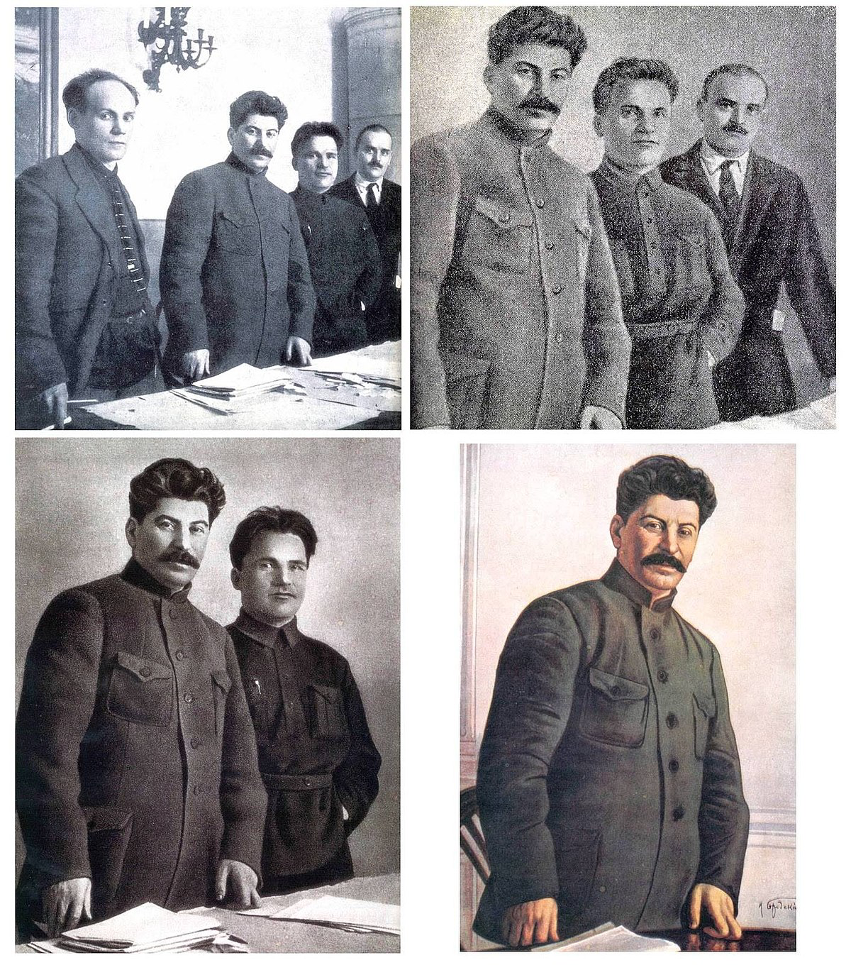
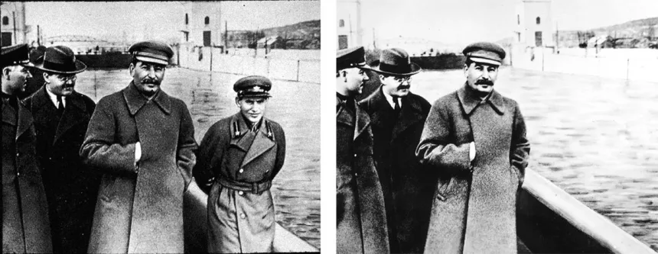
Stalin and Yezhov (1939 circa)
Left to the right: Antipov, Stalin, Kirov, Shvernik (1926-1937)

Slide 16
