Slide 1
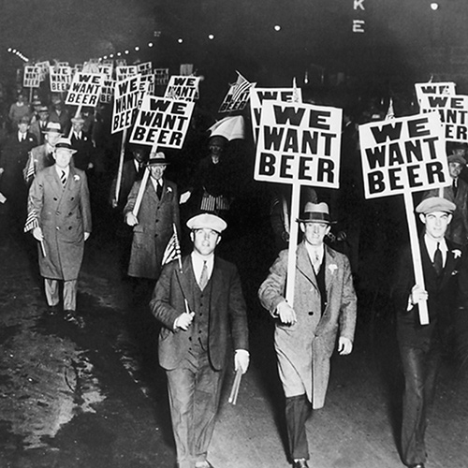
Lesson 4: Hopes and disappointments of the roaring 20s
From Wilsonism to the creation of the League of Nations
Great Britain and the independence of Ireland
The Republic of Weimar
The problem of German reparations
The era of Locarno and the spirit of Geneva

Slide 2
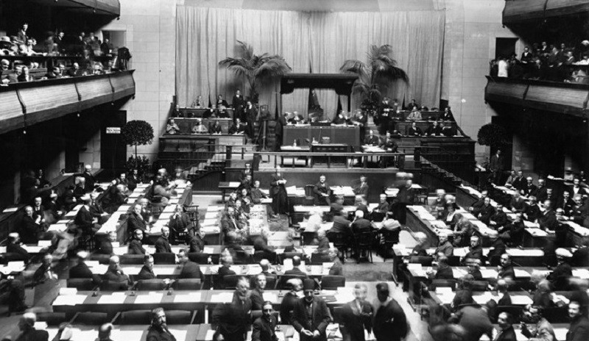
The League of Nations

Slide 3
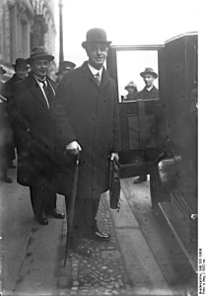
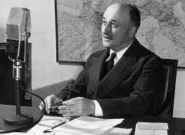
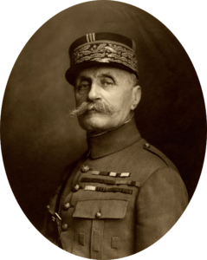
Jean Monnet (1888-1879)
Eric Drummond (1876-1851)
Ferdinand Foch (1851-1929)

Slide 4
Covenant of the League of Nations (25 articles)
ARTICLE 1.
The original Members of the League of Nations shall be those of the Signatories which are named in the Annex to this Covenant and also such of those other States named in the Annex as shall accede without reservation to this Covenant. Such accession shall be effected by a Declaration deposited with the Secretariat within two months of the coming into force of the Covenant. Notice thereof shall be sent to all other Members of the League.
Any fully self-governing State, Dominion or Colony not named in the Annex may become a Member of the League if its admission is agreed to by two-thirds of the Assembly, provided that it shall give effective guarantees of its sincere intention to observe its international obligations, and shall accept such regulations as may be prescribed by the League in regard to its military, naval and air forces and armaments.
Any Member of the League may, after two years' notice of its intention so to do, withdraw from the League, provided that all its international obligations and all its obligations under this Covenant shall have been fulfilled at the time of its withdrawal.
ARTICLE 2.
The action of the League under this Covenant shall be effected through the instrumentality of an Assembly and of a Council, with a permanent Secretariat.
ARTICLE 3.
The Assembly shall consist of Representatives of the Members of the League.
The Assembly shall meet at stated intervals and from time to time as occasion may require at the Seat of the League or at such other place as may be decided upon.
The Assembly may deal at its meetings with any matter within the sphere of action of the League or affecting the peace of the world. At meetings of the Assembly each Member of the League shall have one vote, and may have not more than three Representatives.

Slide 5
ARTICLE 7.
The Seat of the League is established at Geneva.
The Council may at any time decide that the Seat of the League shall be established elsewhere.
All positions under or in connection with the League, including the Secretariat, shall be open equally to men and women.
Representatives of the Members of the League and officials of the League when engaged on the business of the League shall enjoy diplomatic privileges and immunities.
The buildings and other property occupied by the League or its officials or by Representatives attending its meetings shall be inviolable.
ARTICLE 8.
The Members of the League recognise that the maintenance of peace requires the reduction of national armaments to the lowest point consistent with national safety and the enforcement by common action of international obligations.
The Council, taking account of the geographical situation and circumstances of each State, shall formulate plans for such reduction for the consideration and action of the several Governments. Such plans shall be subject to reconsideration and revision at least every ten years.
After these plans shall have been adopted by the several Governments, the limits of armaments therein fixed shall not be exceeded without the concurrence of the Council.
The Members of the League agree that the manufacture by private enterprise of munitions and implements of war is open to grave objections. The Council shall advise how the evil effects attendant upon such manufacture can be prevented, due regard being had to the necessities of those Members of the League which are not able to manufacture the munitions and implements of war necessary for their safety.
The Members of the League undertake to interchange full and frank information as to the scale of their armaments, their military, naval and air programmes and the condition of such of their industries as are adaptable to war-like purposes.
ARTICLE 10.
The Members of the League undertake to respect and preserve as against external aggression the territorial integrity and existing political independence of all Members of the League. In case of any such aggression or in case of any threat or danger of such aggression the Council shall advise upon the means by which this obligation shall be fulfilled.

Slide 6
ARTICLE 11.
Any war or threat of war, whether immediately affecting any of the Members of the League or not, is hereby declared a matter of concern to the whole League, and the League shall take any action that may be deemed wise and effectual to safeguard the peace of nations. In case any such emergency should arise the Secretary General shall on the request of any Member of the League forthwith summon a meeting of the Council.
It is also declared to be the friendly right of each Member of the League to bring to the attention of the Assembly or of the Council any circumstance whatever affecting international relations which threatens to disturb international peace or the good understanding between nations upon which peace depends.
ARTICLE 12.
The Members of the League agree that, if there should arise between them any dispute likely to lead to a rupture they will submit the matter either to arbitration or judicial settlement or to enquiry by the Council, and they agree in no case to resort to war until three months after the award by the arbitrators or the judicial decision, or the report by the Council. In any case under this Article the award of the arbitrators or the judicial decision shall be made within a reasonable time, and the report of the Council shall be made within six months after the submission of the dispute.
ARTICLE 16.
Should any Member of the League resort to war in disregard of its covenants under Articles 12, 13 or 15, it shall ipso facto be deemed to have committed an act of war against all other Members of the League, which hereby undertake immediately to subject it to the severance of all trade or financial relations, the prohibition of all intercourse between their nationals and the nationals of the covenant-breaking State, and the prevention of all financial, commercial or personal intercourse between the nationals of the covenant-breaking State and the nationals of any other State, whether a Member of the League or not.
ARTICLE 17.
In the event of a dispute between a Member of the League and a State which is not a Member of the League, or between States not Members of the League, the State or States not Members of the League shall be invited to accept the obligations of membership in the League for the purposes of such dispute, upon such conditions as the Council may deem just. If such invitation is accepted, the provisions of Articles 12 to 16 inclusive shall be applied with such modifications as may be deemed necessary by the Council.
ARTICLE 20.
The Members of the League severally agree that this Covenant is accepted as abrogating all obligations or understandings inter se which are inconsistent with the terms thereof, and solemnly undertake that they will not hereafter enter into any engagements inconsistent with the terms thereof.

Slide 7
ARTICLE 22.
To those colonies and territories which as a consequence of the late war have ceased to be under the sovereignty of the States which formerly governed them and which are inhabited by peoples not yet able to stand by themselves under the strenuous conditions of the modern world, there should be applied the principle that the well-being and development of such peoples form a sacred trust of civilisation and that securities for the performance of this trust should be embodied in this Covenant.
The best method of giving practical effect to this principle is that the tutelage of such peoples should be entrusted to advanced nations who by reason of their resources, their experience or their geographical position can best undertake this responsibility, and who are willing to accept it, and that this tutelage should be exercised by them as Mandatories on behalf of the League.
ARTICLE 23.
Subject to and in accordance with the provisions of international conventions existing or hereafter to be agreed upon, the Members of the League:
(a) will endeavour to secure and maintain fair and humane conditions of labour for men, women, and children, both in their own countries and in all countries to which their commercial and industrial relations extend, and for that purpose will establish and maintain the necessary international organisations;
(b) undertake to secure just treatment of the native inhabitants of territories under their control;
(c) will entrust the League with the general supervision over the execution of agreements with regard to the traffic in women and children, and the traffic in opium and other dangerous drugs;
(d) will entrust the League with the general supervision of the trade in arms and ammunition with the countries in which the control of this traffic is necessary in the common interest;
(e) will make provision to secure and maintain freedom of communications and of transit and equitable treatment for the commerce of all Members of the League. In this connection, the special necessities of the regions devastated during the war of 1914-1918 shall be borne in mind;
(f) will endeavour to take steps in matters of international concern for the prevention and control of disease.

Slide 8
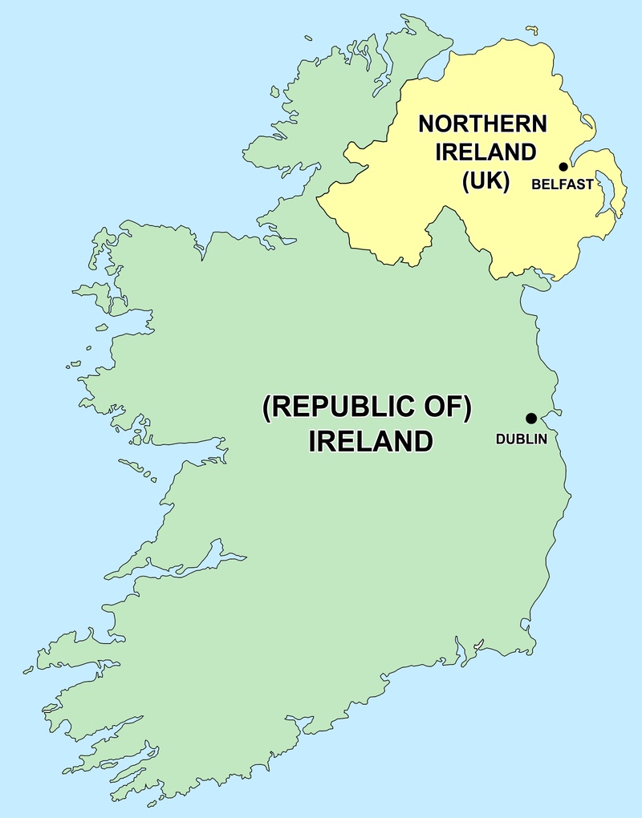

Slide 9
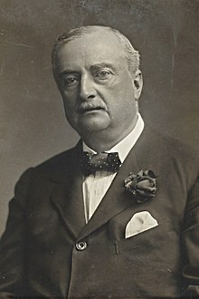
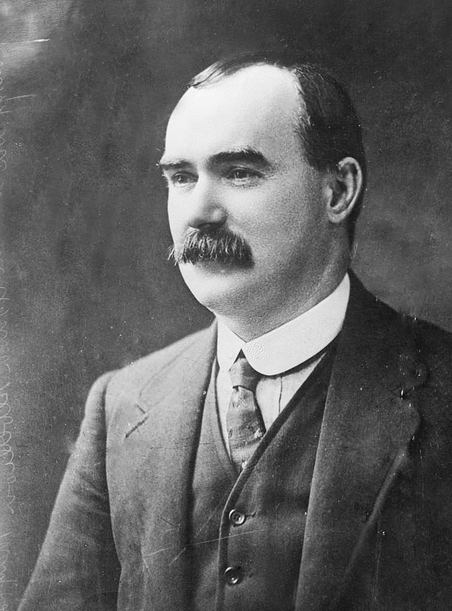
John Redmond (1856-1918)
James Connolly (1868-1916)

Slide 10
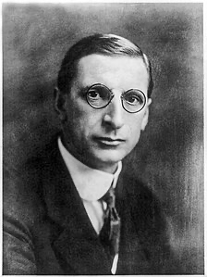
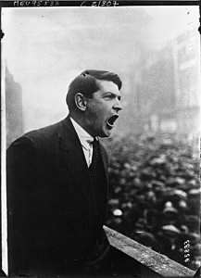
Eamon de Valera (1882-1975)
Michael Collins (1890-1922)

Slide 11
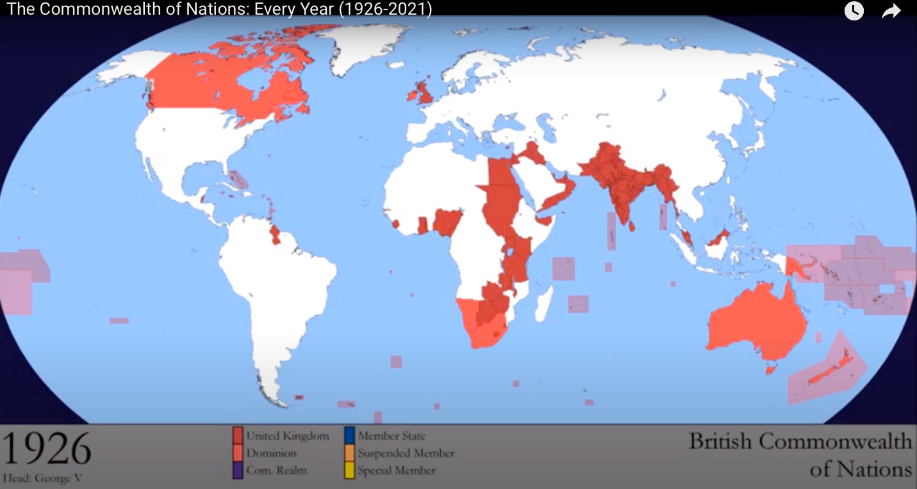
https://www.youtube.com/watch?v=qfcYf5sSee4

Slide 12
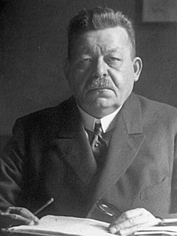
Friedrich Ebert (1871-1925)

Slide 13
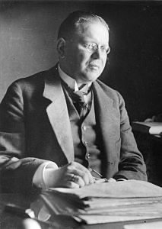
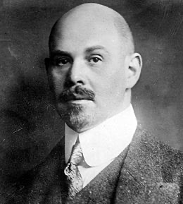
Walter Rathenau (1867-1922)
Mathias Erzbeger (1875-1921)

Slide 14
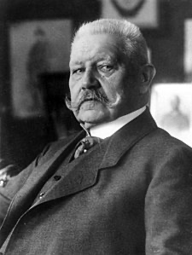
Paul Von Hindenburg (1847-1934)

Slide 15
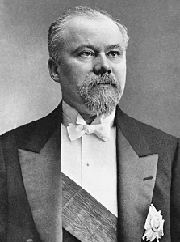
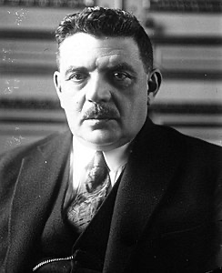
Raymond Poincaré (1860-1934)
Eduard Herriot (1872-1957)

Slide 16
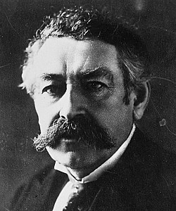
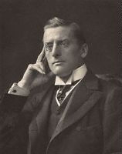
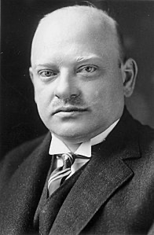
Austen Chamberlain (1863-1937)
Aristide Briand (1862-1932)
Gustav Stresemann (1878-1929)

Slide 17
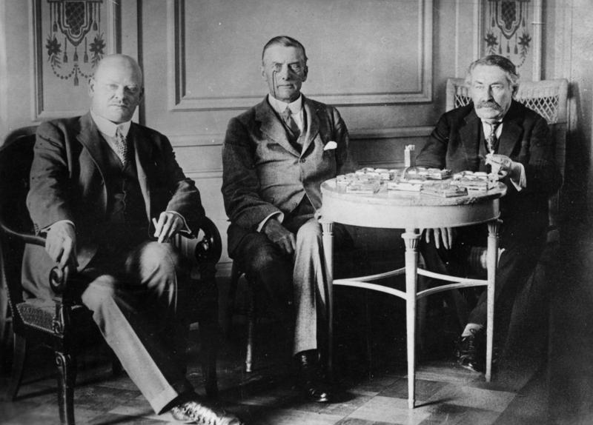
Stresemann, Chamberlain and Briand in Locarno for the elaboration of the pact (1925)

Slide 18
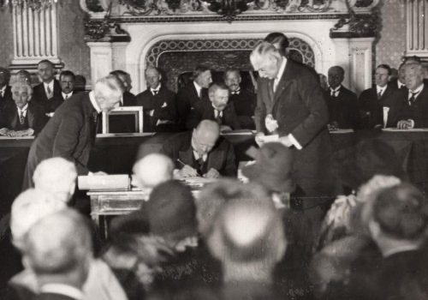
Signing of the Briand-Kellogg Pact

Slide 19
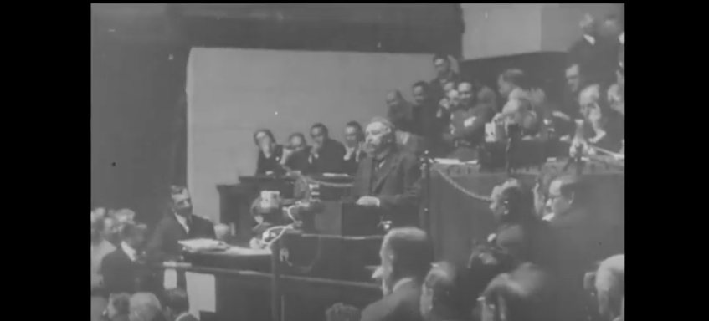
https://www.youtube.com/watch?v=R06VJTNUw4E
Aristide Briand at the League of Nations in Geneva (1929)

