Slide 1
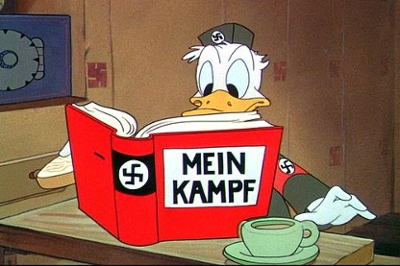
Lesson 5: Fascism and Nazism: The totalitarian regime in Europe
Benito Mussolini, from socialism to fascism
The fascist dictatorship
The Great Depression
Fascism: a model for Europe?
The rise of the Nazis
War in Ethiopia, reoccupation of the Rhineland
Antifascism in Europe: Popular Fronts and clandestine parties
The Spanish Civil War
From the Anschluss to the Munich conference
The Molotov-Ribbentrop Pact

Slide 2
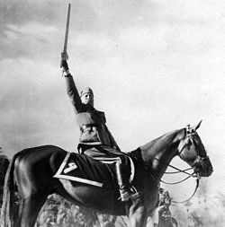
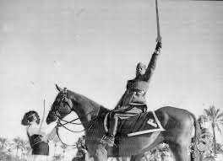

Slide 3
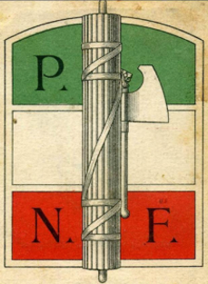

Slide 4
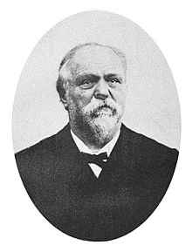
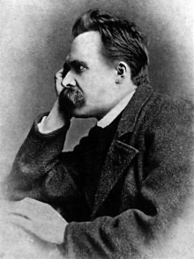
Friedrich Nietzsche (1844-1900)
Georges Sorel (1847-1922)

Slide 5
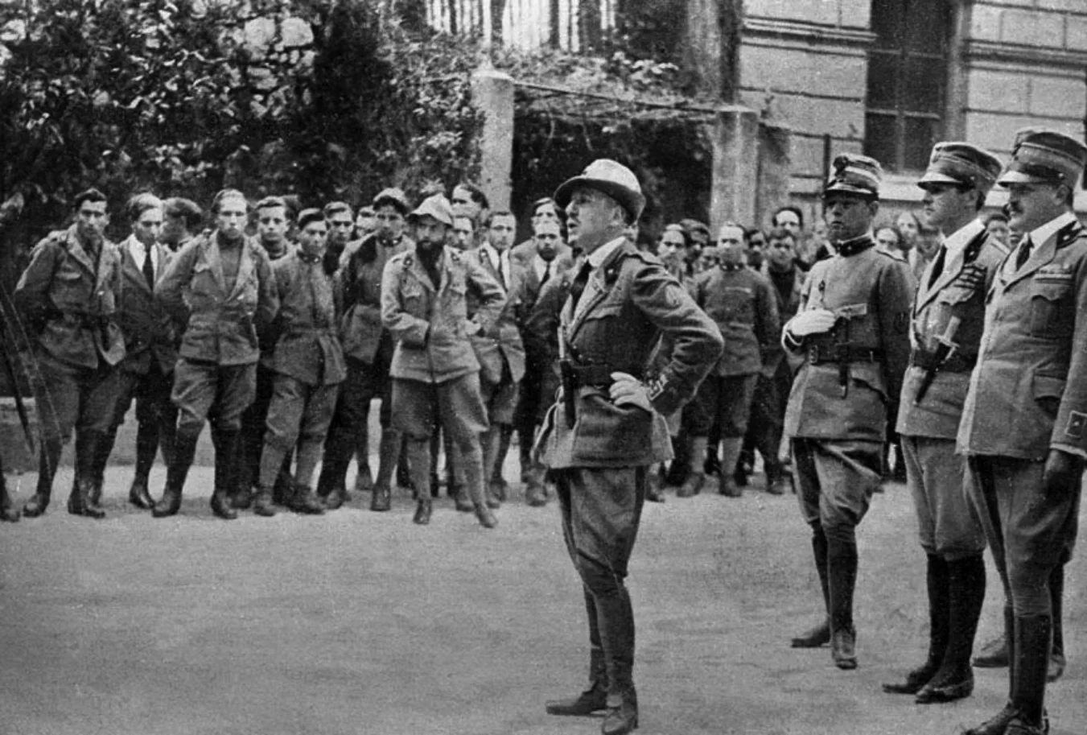

Slide 6
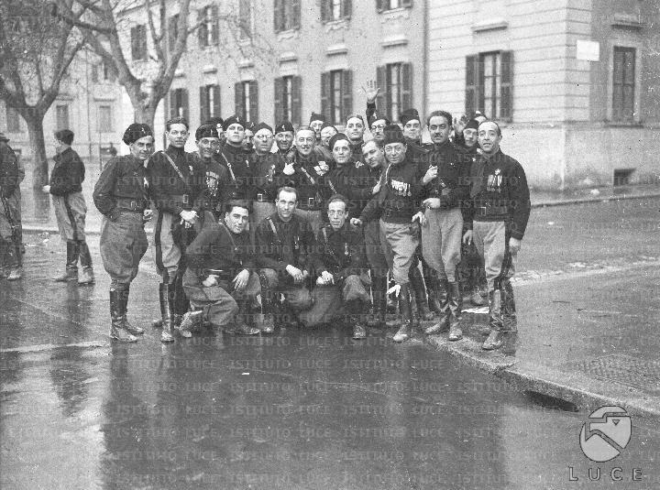

Slide 7
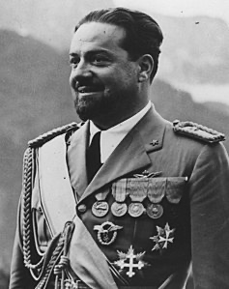
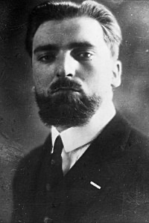
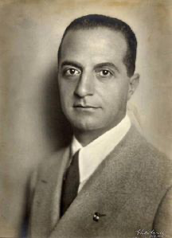
Giuseppe Bottai (1895-1959)
Italo Balbo (1896-1940)
Dino Grandi (1895-1988)

Slide 8
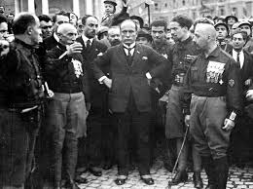

Slide 9
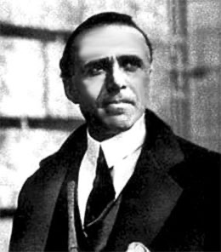
Giacomo Matteotti (1885-1924)

Slide 10
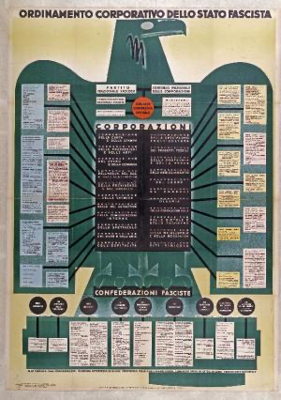

Slide 11
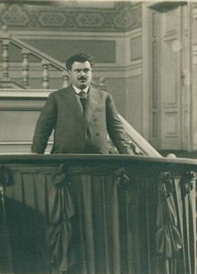
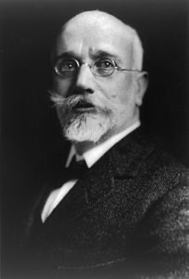
Eleutherios Venizelos (1864-1936)
Aleksandar Stamboliyski (1879-1923)

Slide 12
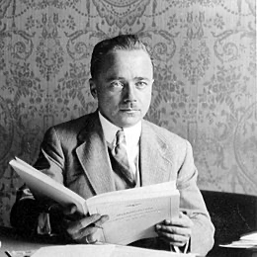
Engelbert Dolfuss (1892-1934)

Slide 13
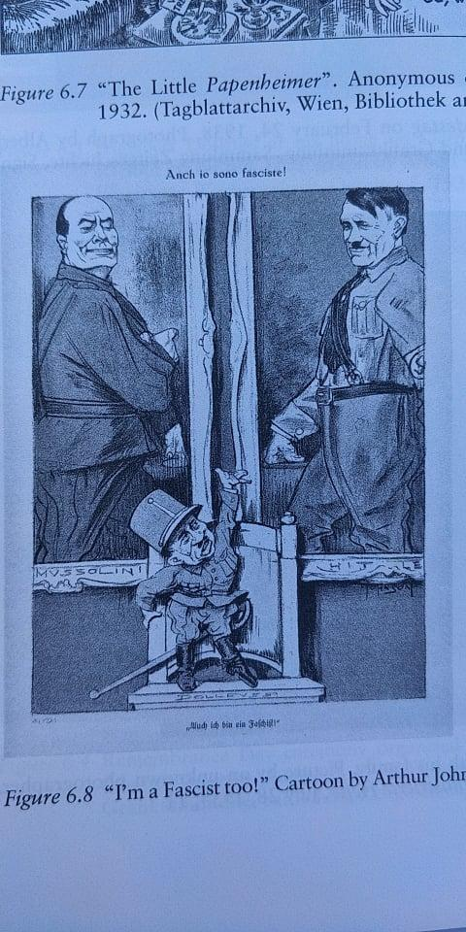

Slide 14
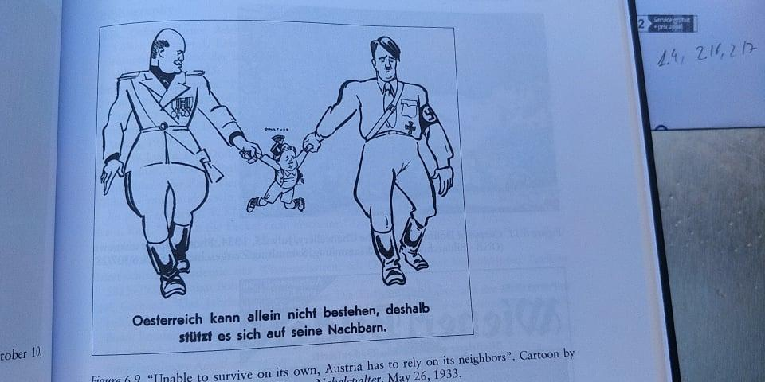

Slide 15
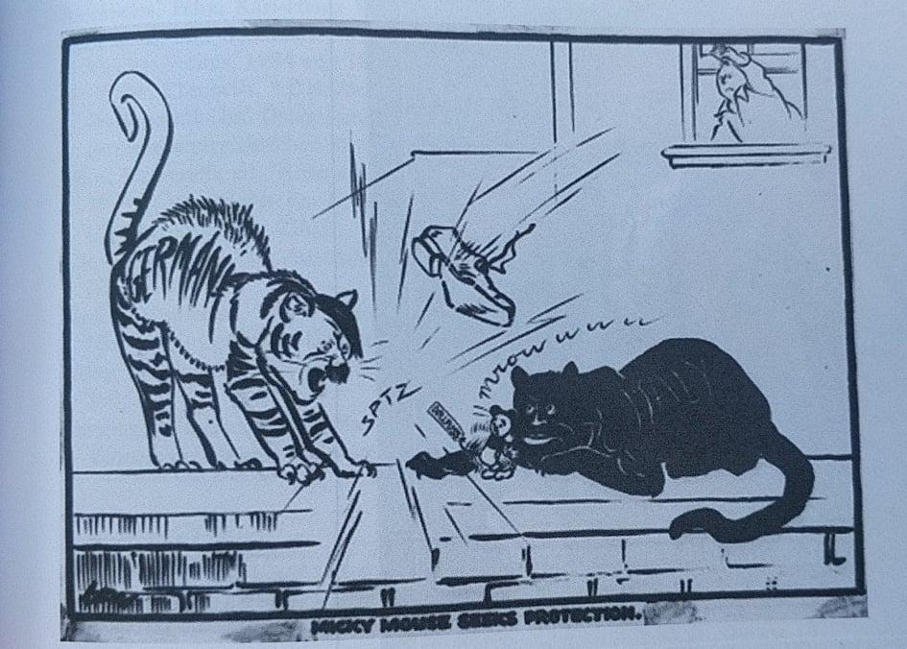

Slide 16
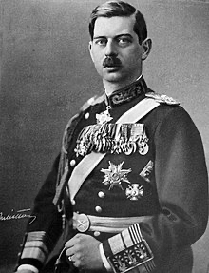
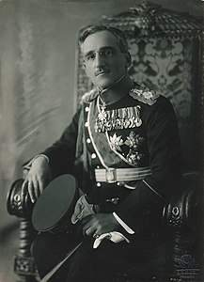
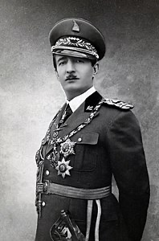
King Carol of Romania (1893-1953)
Alexander I of Jugoslavia(1888-1934)
King Zog of Albania (1895-1961)

Slide 17
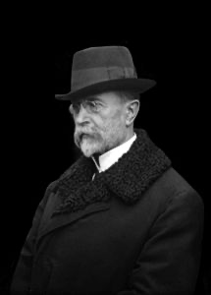
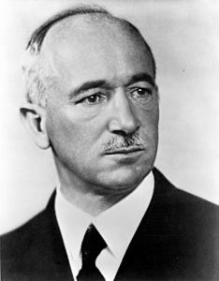
Tomas Masaryk (1850-1937)
Edvard Benes (1884-1948)

Slide 18
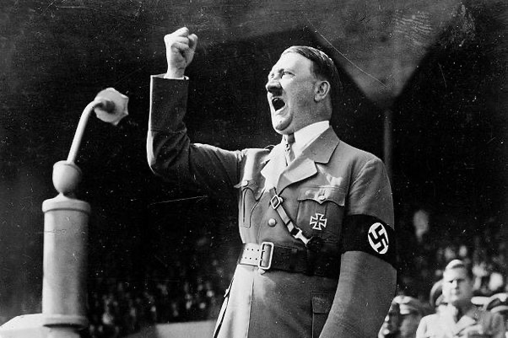
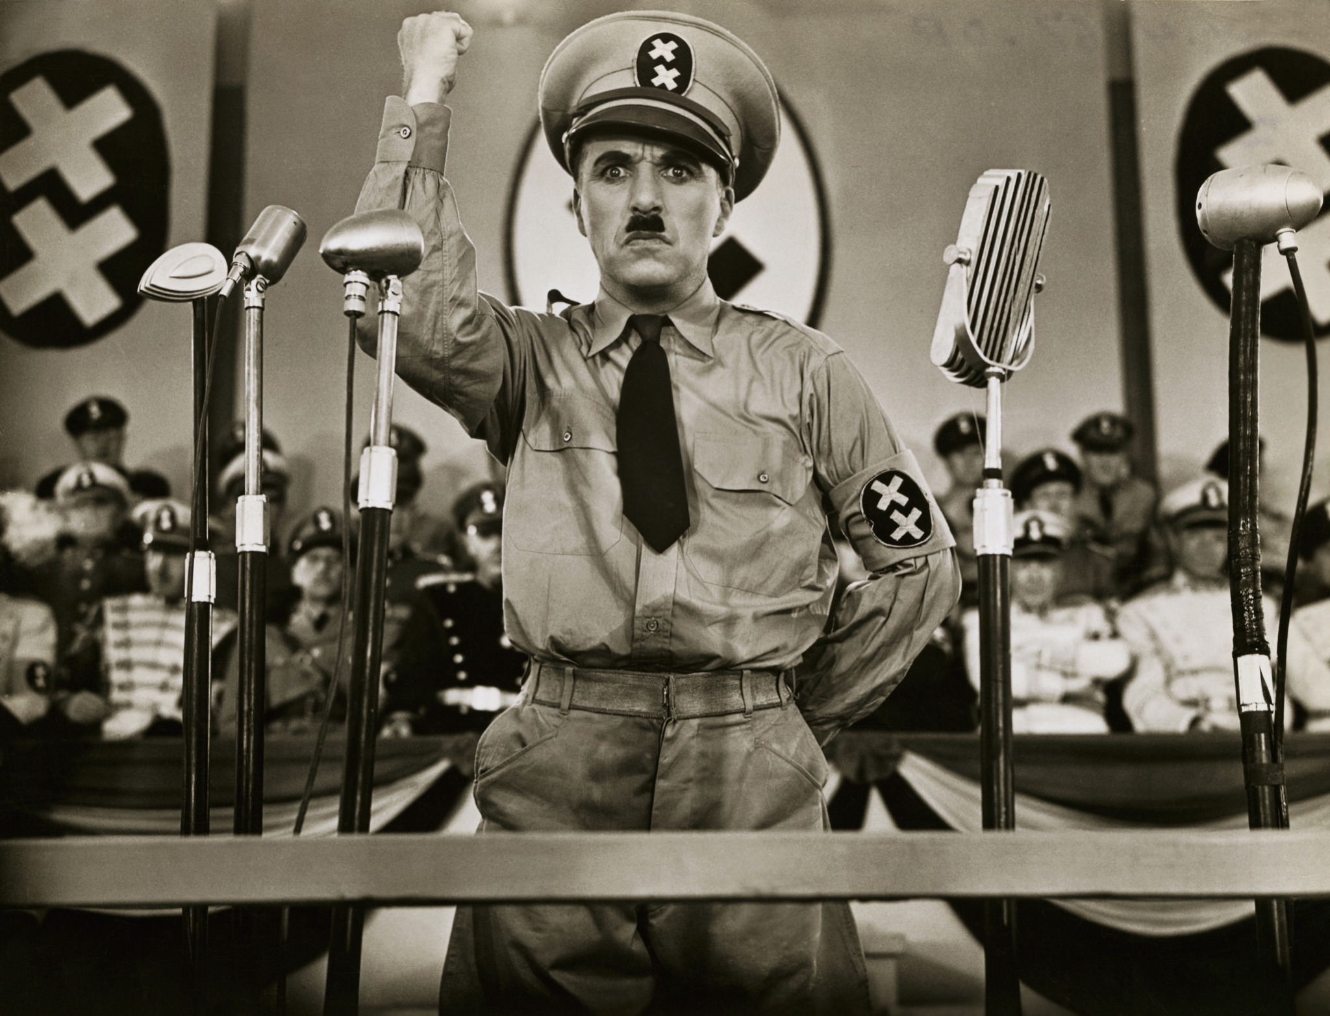

Slide 19
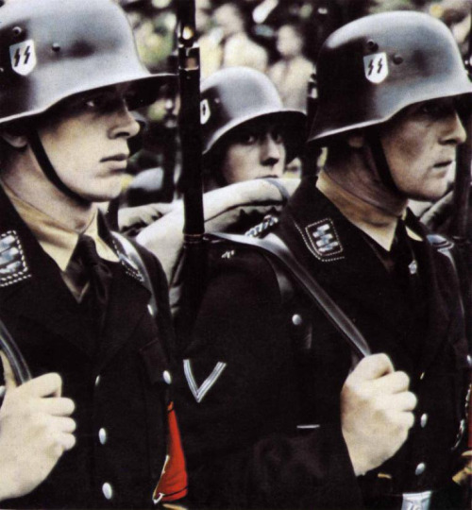
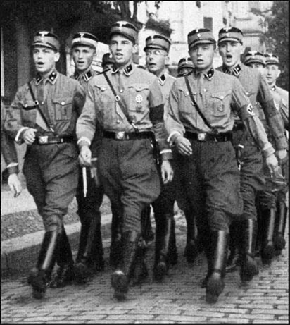
SA (Sturmabtleilung)
SS (SchutzStaffel)

Slide 20
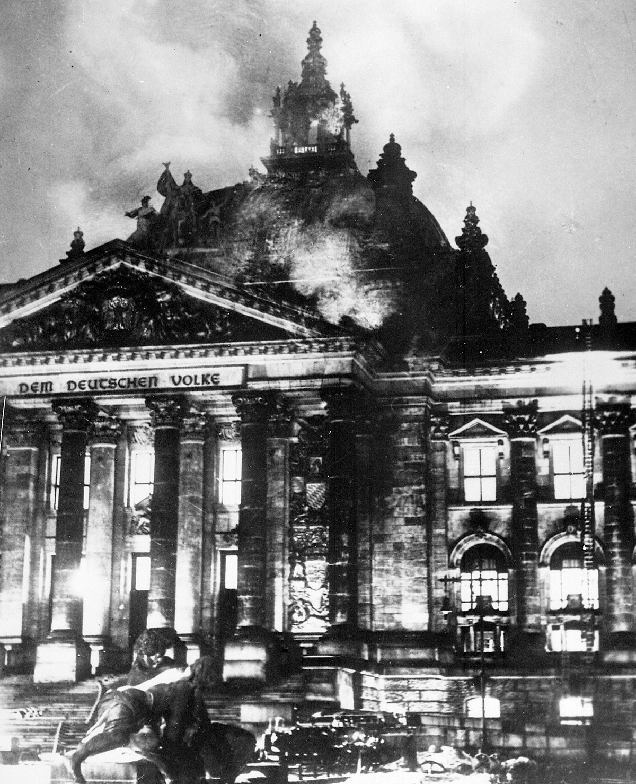

Slide 21
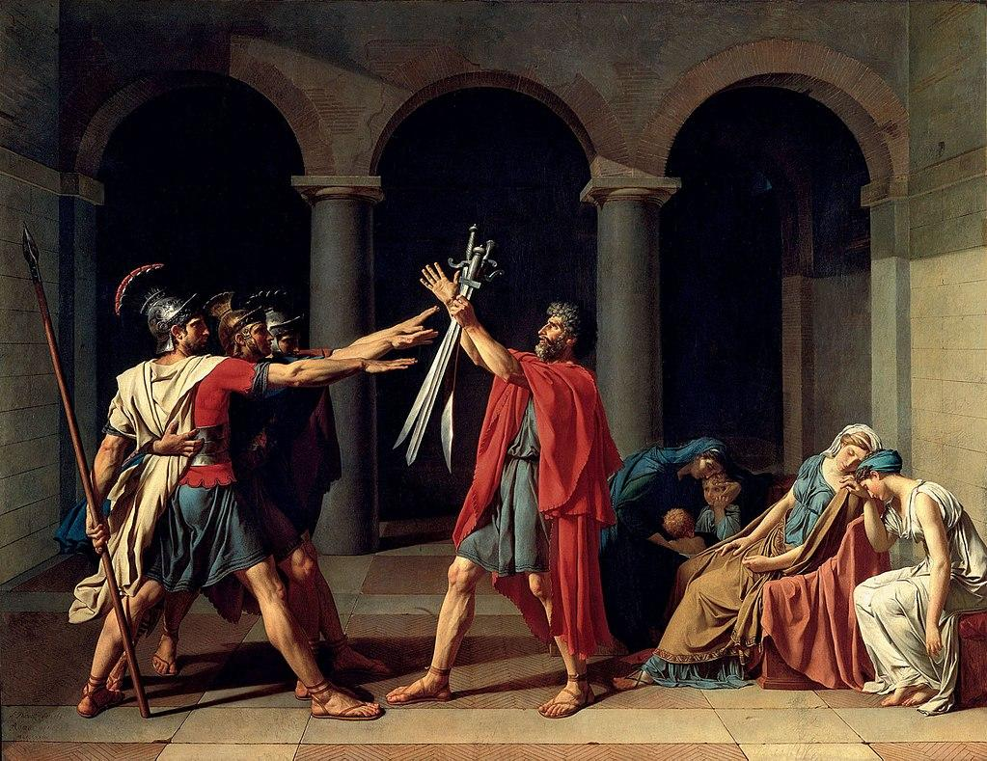
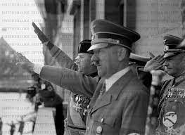

Slide 22
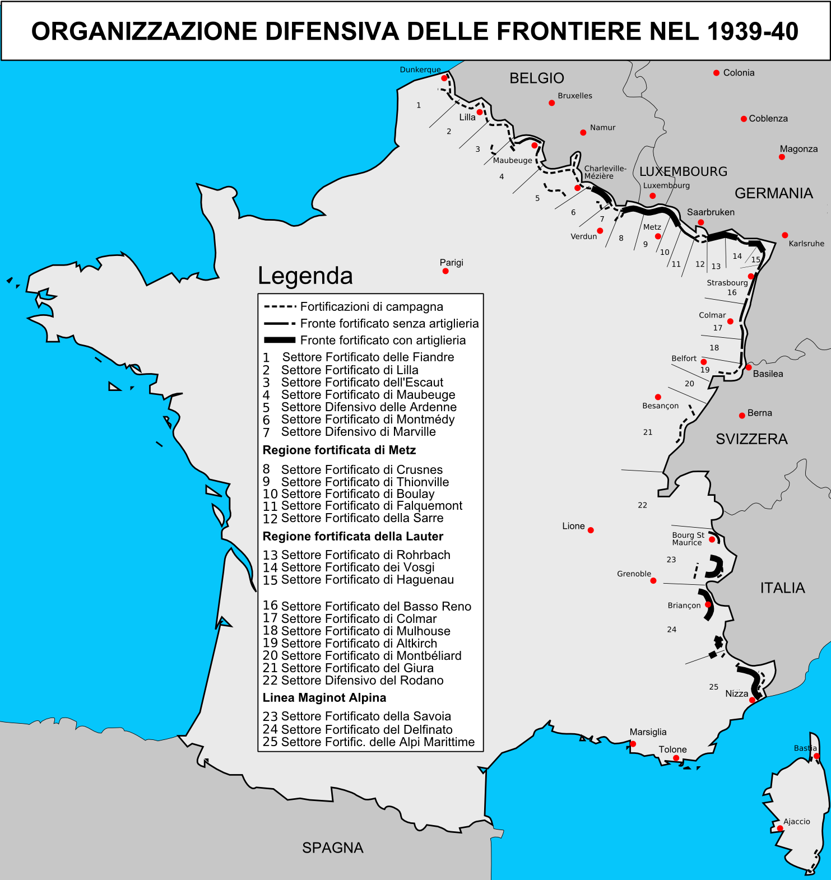

Slide 23
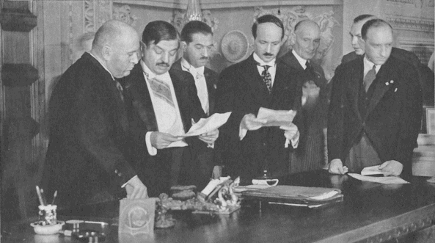

Slide 24
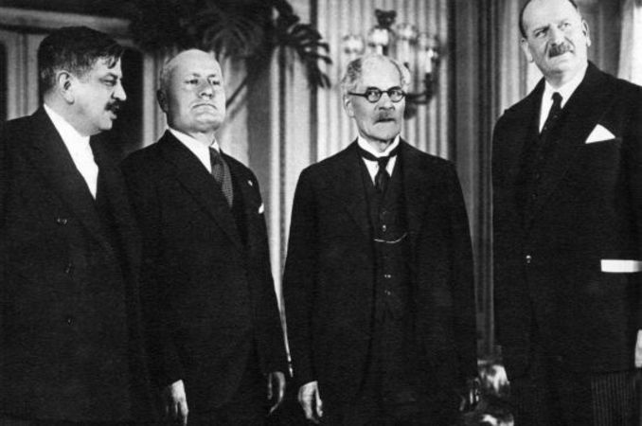
Laval, Mussolini, Ramsay Mac Donald after the Conference of Stresa

Slide 25
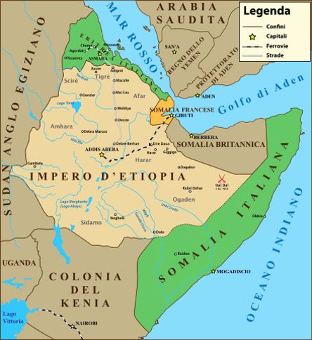

Slide 26
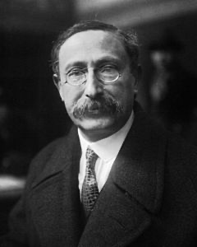
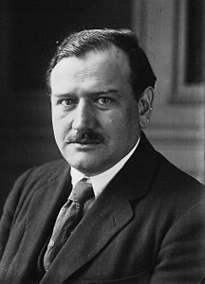
Leon Blum (1875-1950)
Edouard Daladier (1884-1970)

Slide 27
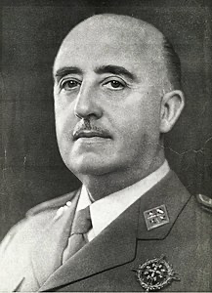
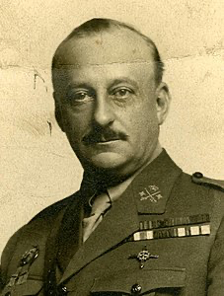
Miguel Primo de Rivera (1870-1930)
Francisco Franco (1892-1975)

Slide 28
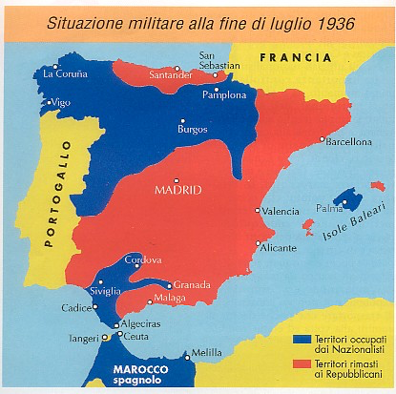

Slide 29
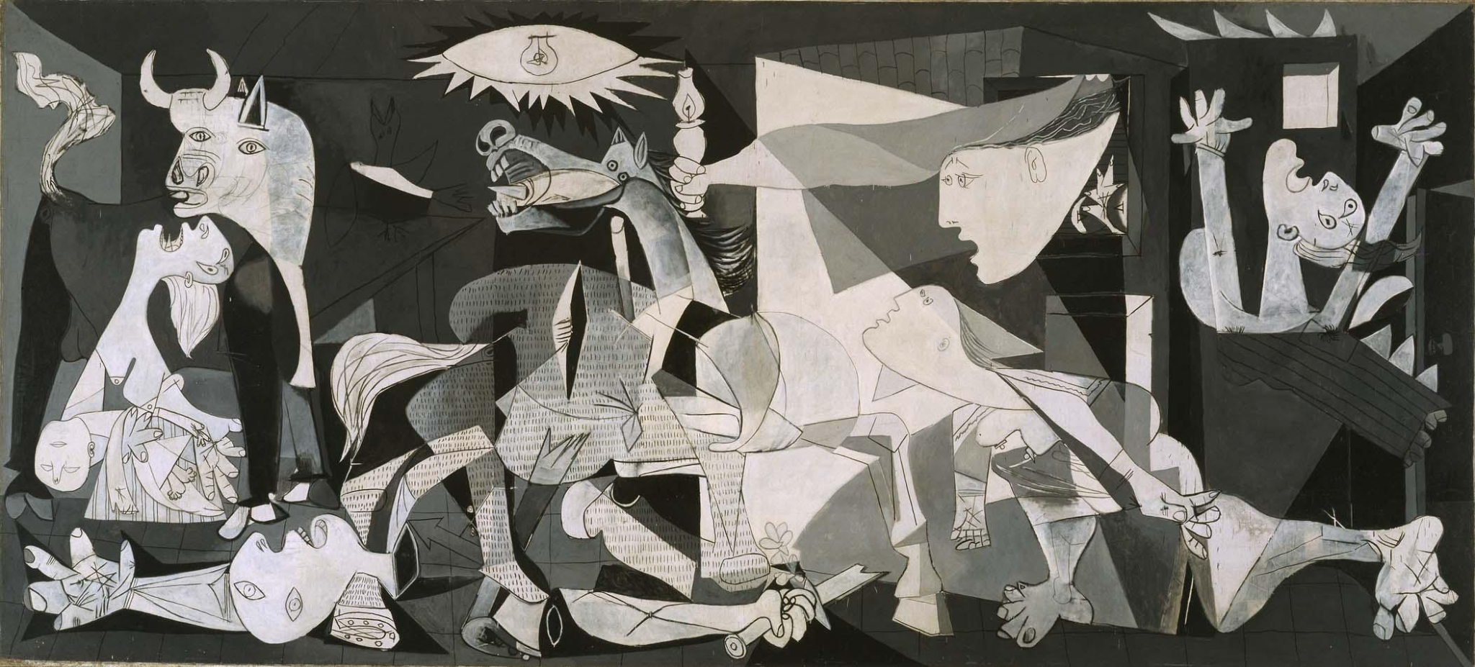

Slide 30
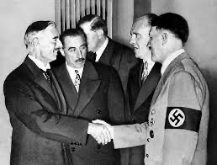
Chamberlain shake hands with Hitler

