Slide 1
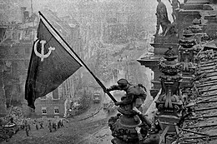
Lesson 7
EUROPE AFTER 1945

Slide 2
A continent in ruins
IIWW → TOTAL WAR
USSR → 20 MILLION deaths
POLAND → 5 MILLIONS
GERMANY →6 MILLIONS
FRANCE → 560.000
ITALY AND Uk → 400.000
EUROPE LOST 50% OF THE POTENTIAL OF ITS ECONOMY
EUROPE IN DECLINE FROM A STRATEGIC POINT OF VIEW → NEW SUPER-POWERS: USA AND USSR
GERMANS WERE THE MOST AFFECTED BY FORCED DISPLACEMENT

Slide 3
A NEW INTERNATIONAL ORDER
1941 → ATLANTIC CHARTER SIGNED BY CHURCHILL AND ROOSEVELT (BEGINNING OF UN)
CHARTER OF SAN FRANCISCO (spring 1945) → founding act of the UN
Security council of the UN; 5 permanent members: USA, USSR, GB, China and France (right to VETO) + 10 rotating members
Armed force of the UN are the BLUE HELMETS

Slide 4
THE CONFERENCES THAT RESHAPED THE WORLD
TEHERAN, 1943
YALTA, FEBRUARY 1945 (division of Yalta)
POTSDAM, JULY 1945
THE ALLIES DIVIDE THEIR ZONES OF INFLUENCE
Roosvelt dies in april 1945 → replaced by Harry Truman
Begins the “atomic” race after the bombings of Hiroshima and Nagasaki (summer 1946) → Stalin wants the atomic bomb as well → on the edge of third world war
Fulton University → Churchill speaks of an “iron curtain” cutting Europe in two

Slide 5
SETTLING WAR ISSUES: TREATIES OF PEACE AND NEW BORDERS
GERMANY WAS SPLIT IN FOUR ZONES: BRITISH, AMERICAN, FRENCH AND RUSSIAN (SOVIET)
CITY OF BERLIN WAS SPLIT IN FOUR AS WELL → HEADQUARTER OF JOINT ADMINISTRATION
3 D: DISARMAMENT, DENAZIFICATION, DEMOCRATIZATION
1946 → STALIN WITHDRAWS FROM GREECE (END OF GREEK CIVIL WAR BETWEEN COMMUNISTS AND ROYALISTS)
YUGOSLAVIA: COMMUNISTS WIN THE ELECTIONS (TITO)
AS FOR WHAT CONCERNS REPARATIONS: Objective is to avoid the mistakes of WW1 (blaming it all on Germany)
Peace Treaties are signed in Paris (february 1947)

Slide 6
EPURATION AND TRIALS OF WAR CRIMINALS
HENRY STIMSON → AMERICAN SECRETARY OF WAR: Holds Germany responsible for war and for not having respected the 1928 - BRIAND-KELLOGG PACT
WAR CRIMES AGAINST HUMANITY (first time the word is used)
term used is that of FASCIST AGGRESSION
november of 1945 → beginning of the Nuremberg Trials
GOERING AND RIBBENTROP → SENTENCED TO DEATH
ALBERT SPEER → main architect of the regime → sentenced to life prison
RUDOLF HESS → sentenced to life prison (suicidal in 1987)
DONITZ → sentenced to prison
BADOGLIO AND GRAZIANI NEVER UNDERWENT TRIAL FOR THEIR WAR CRIMES

Slide 7
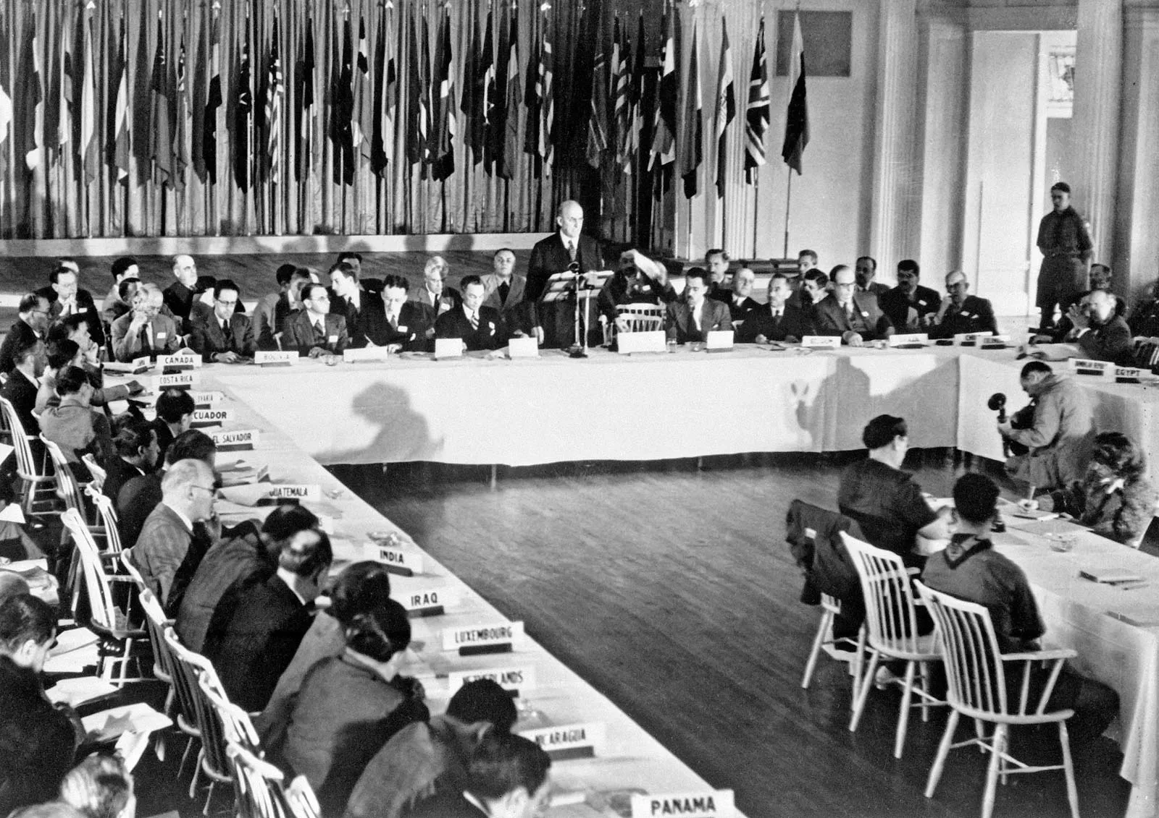
Bretton Woods Conference, 1944

Slide 8
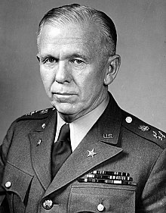
The labeling used on aid packages created and sent under the Marshall Plan.
General George C. Marshall (1880-1959)

Slide 9
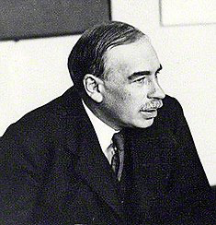
John Maynard Keynes (1883-1946)

Slide 10
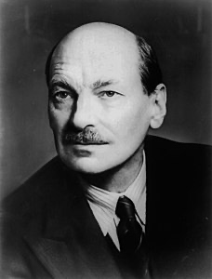
Clement Attlee (1883-1967)

