Slide 1
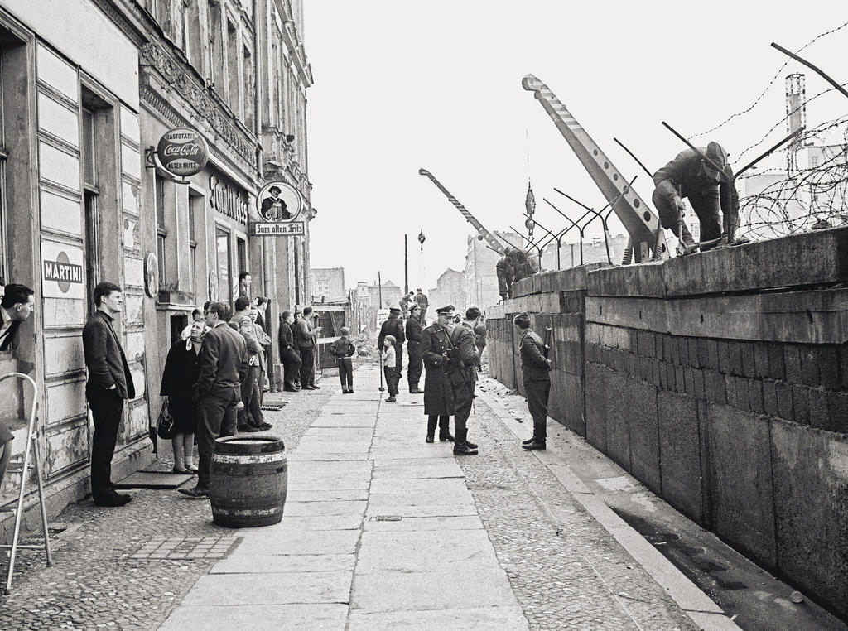
Lesson 8: Europe cut in two
Reconstructing Europe: the triumph of Keynesianism
The Cold War breaks out
NATO and Warsaw Pact
Three crises: Berlin, Budapest and Prague
a) Berlin 1948 and 1953.
B) Budapest 1956.
c) Prague 1968
Western Democracies
a) Germany: Adenauer, Bad Godesberg and the Social-democrat compromise
b) Italy
c) France
Eurocommunism

Slide 2
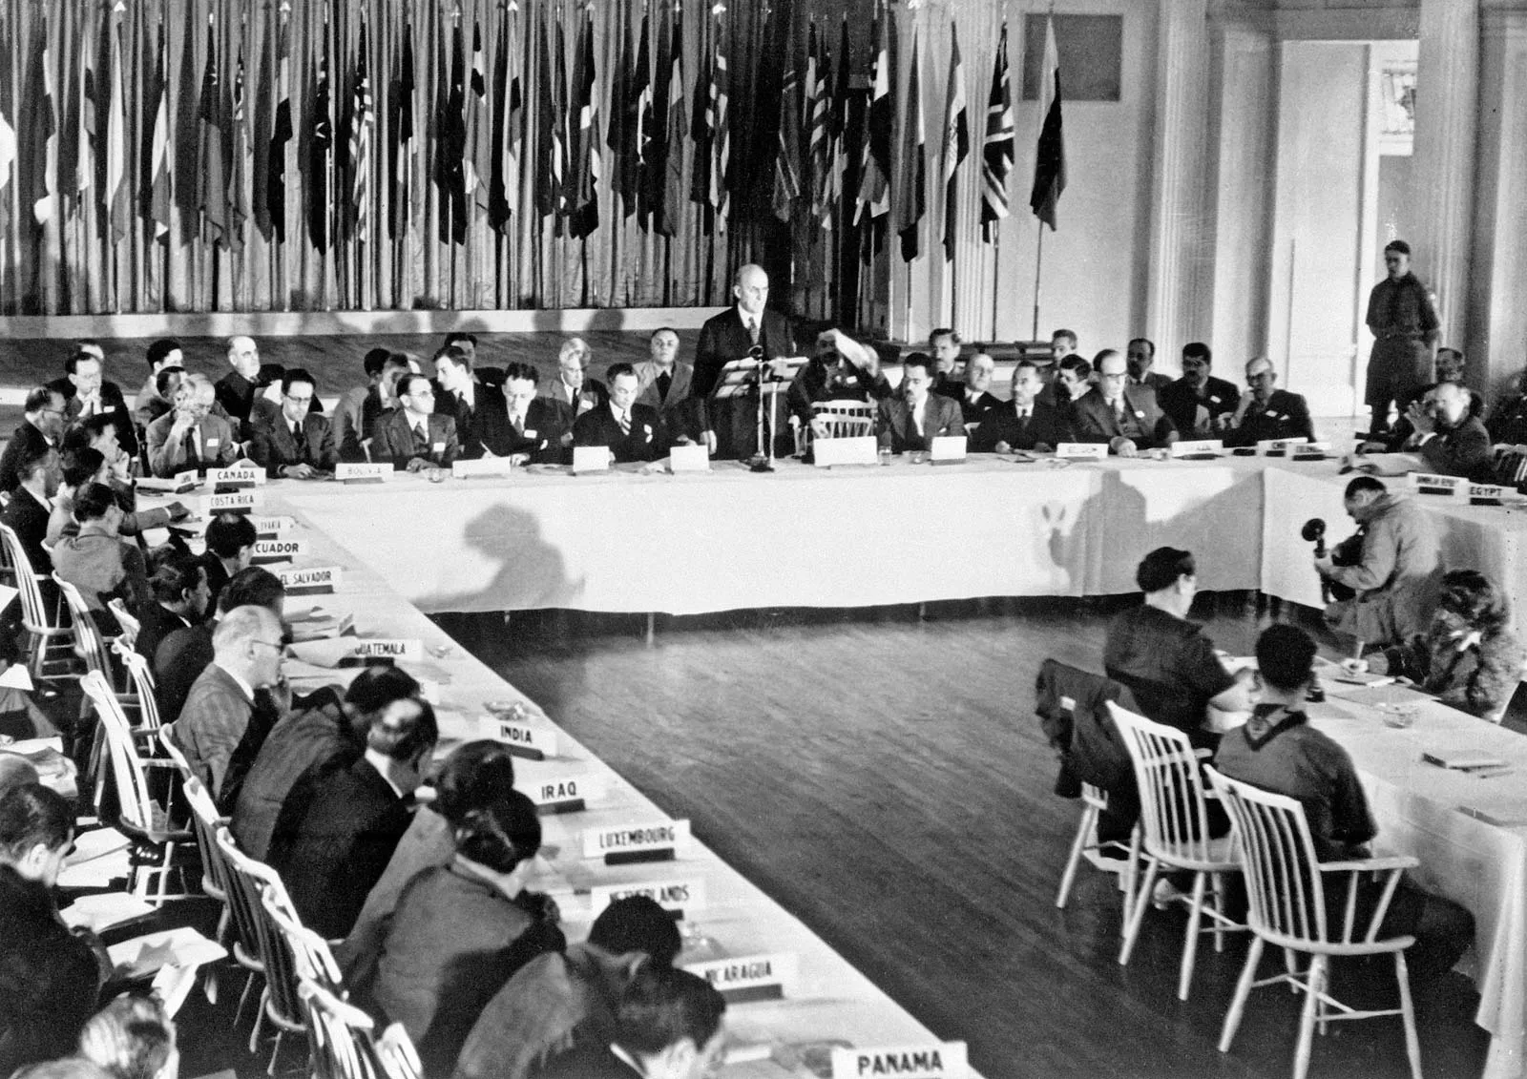
Bretton Woods Conference, 1944

Slide 3
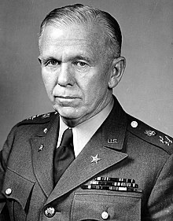
The labeling used on aid packages created and sent under the Marshall Plan.
General George C. Marshall (1880-1959)

Slide 4
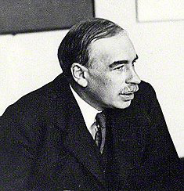
John Maynard Keynes (1883-1946)

Slide 5
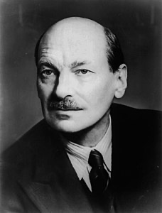
Clement Attlee (1883-1967)

Slide 6
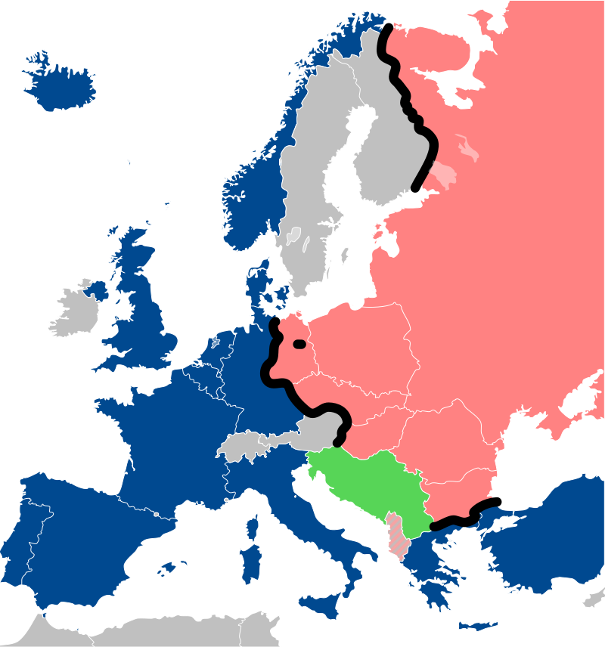

Slide 7
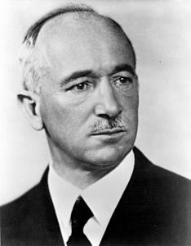
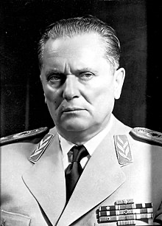
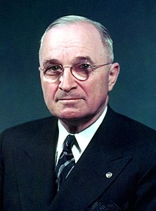
Edvard Benes (1884-1948)
Josip Broz Tito (1892-1980)
Harry S. Truman (1884-1972)

Slide 8
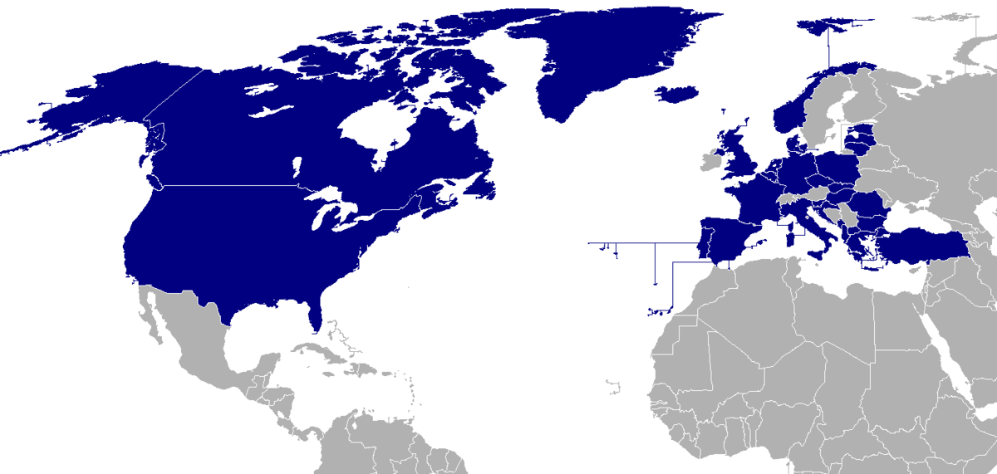
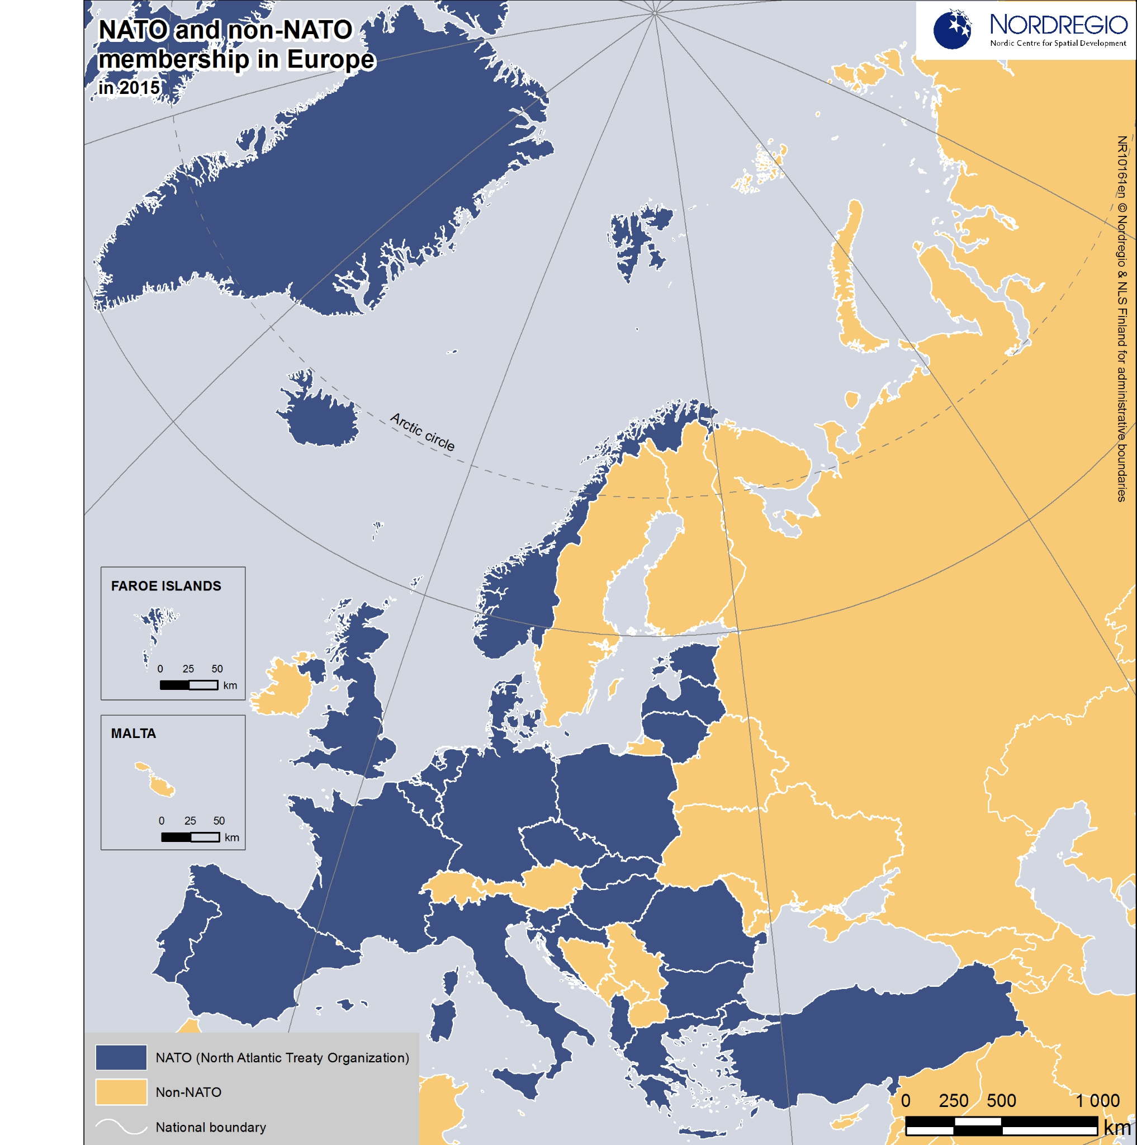

Slide 9
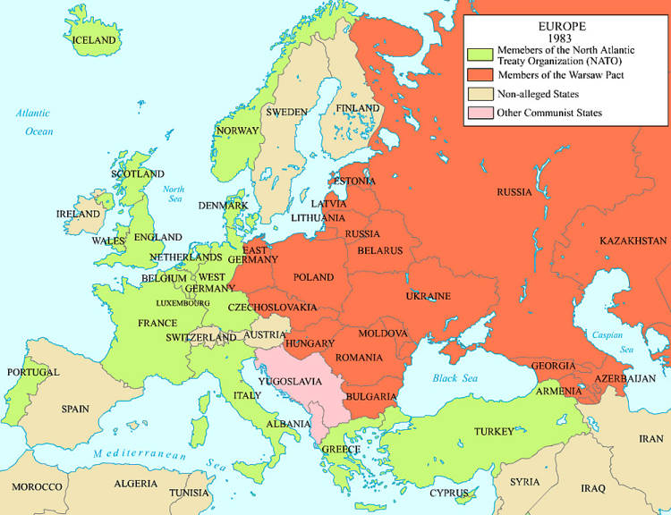

Slide 10
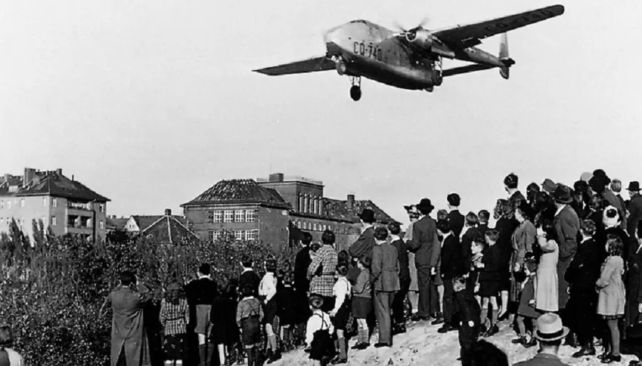
The Berlin Blockade (1948)

Slide 11
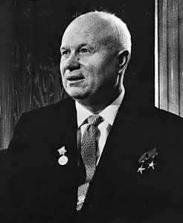
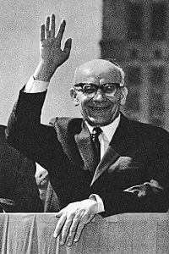
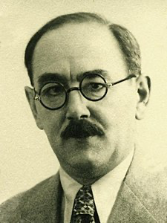
Wladislaw Gomulka (1905-1982)
Imre Nagy (1896-1958)
Nikita Krushchev (1894-1971)

Slide 12
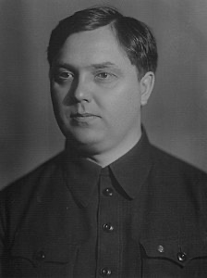
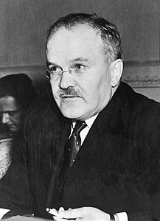
Vjaceslav Molotov (1890-1986)
Georgij Malenkov (1901-1988)

Slide 13
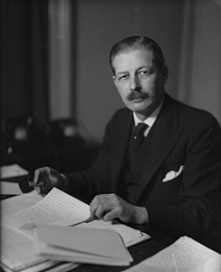
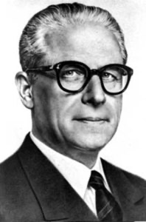
Harold Macmillan (1894-1986)
Giovanni Gronchi (1887-1978)

Slide 14
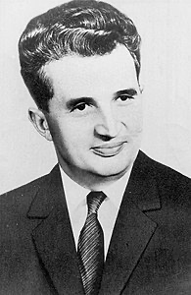
Nicolae Ceausescu (1918-1989)

Slide 15
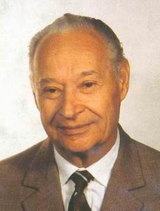
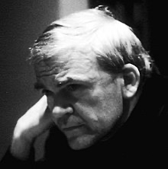
Alexander Dubcek (1921-1992)
Milan Kundera (1929 -)

Slide 16
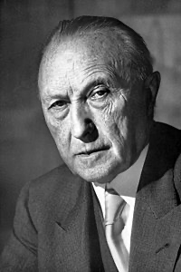
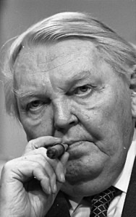
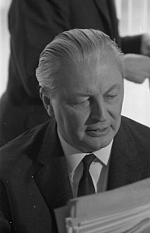
Kurt G. Kiesinger (1904-1988)
Konrad Adenauer (1876-1967)
Ludwig Erhard (1897-1977)

Slide 17
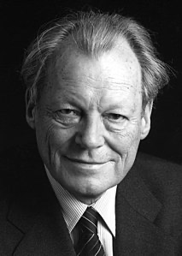
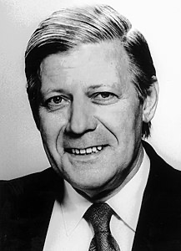
Willy Brandt (1913-1992)
Helmut Schmidt (1918-2015)

Slide 18
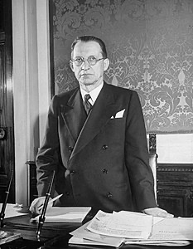
Alcide De Gasperi (1881-1954)

Slide 19
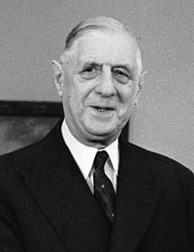
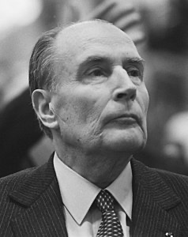
Charles De Gaulle (1890-1970)
Francois Mitterand (1916-1996)

Slide 20
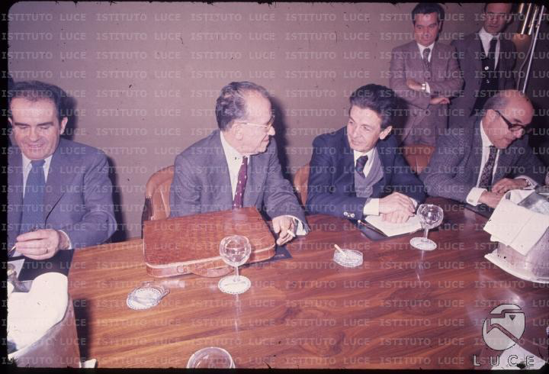
Enrico Berlinguer con Santiago Carrillo e Georges Marchais

