Slide 1
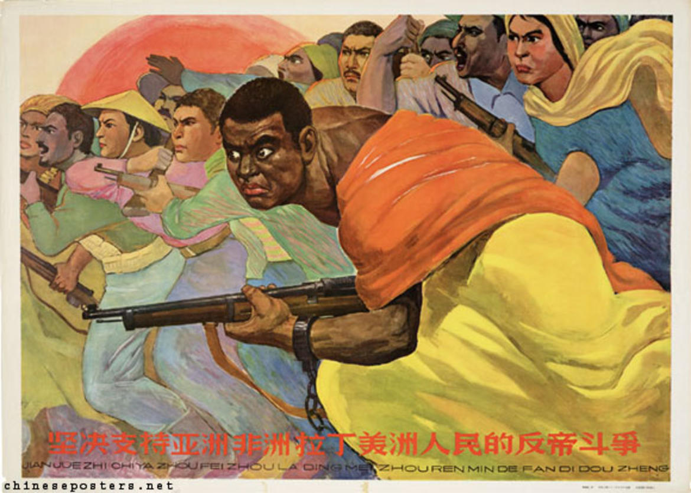
The end of European Empires?
India’s independence
Third Worldism between South East Asia and Northern Africa
Africa’s Independeces

Slide 2
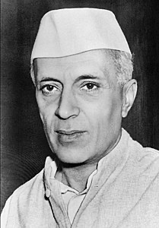
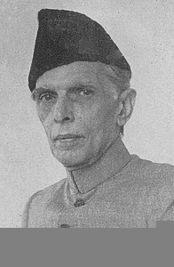
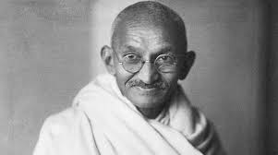
Gandhi (1869-1948)
Jawaharlal Nehru (1889-1964)
Mohammad Ali Jinnah (1876-1948)

Slide 3
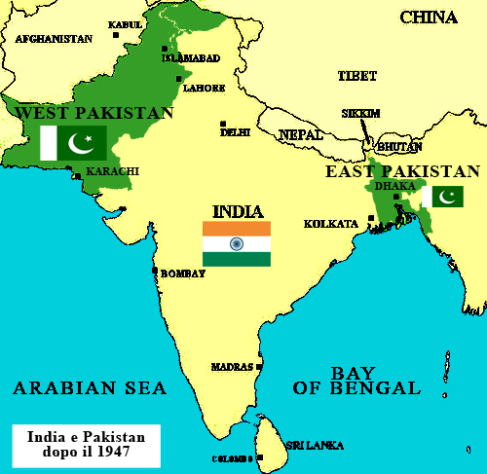
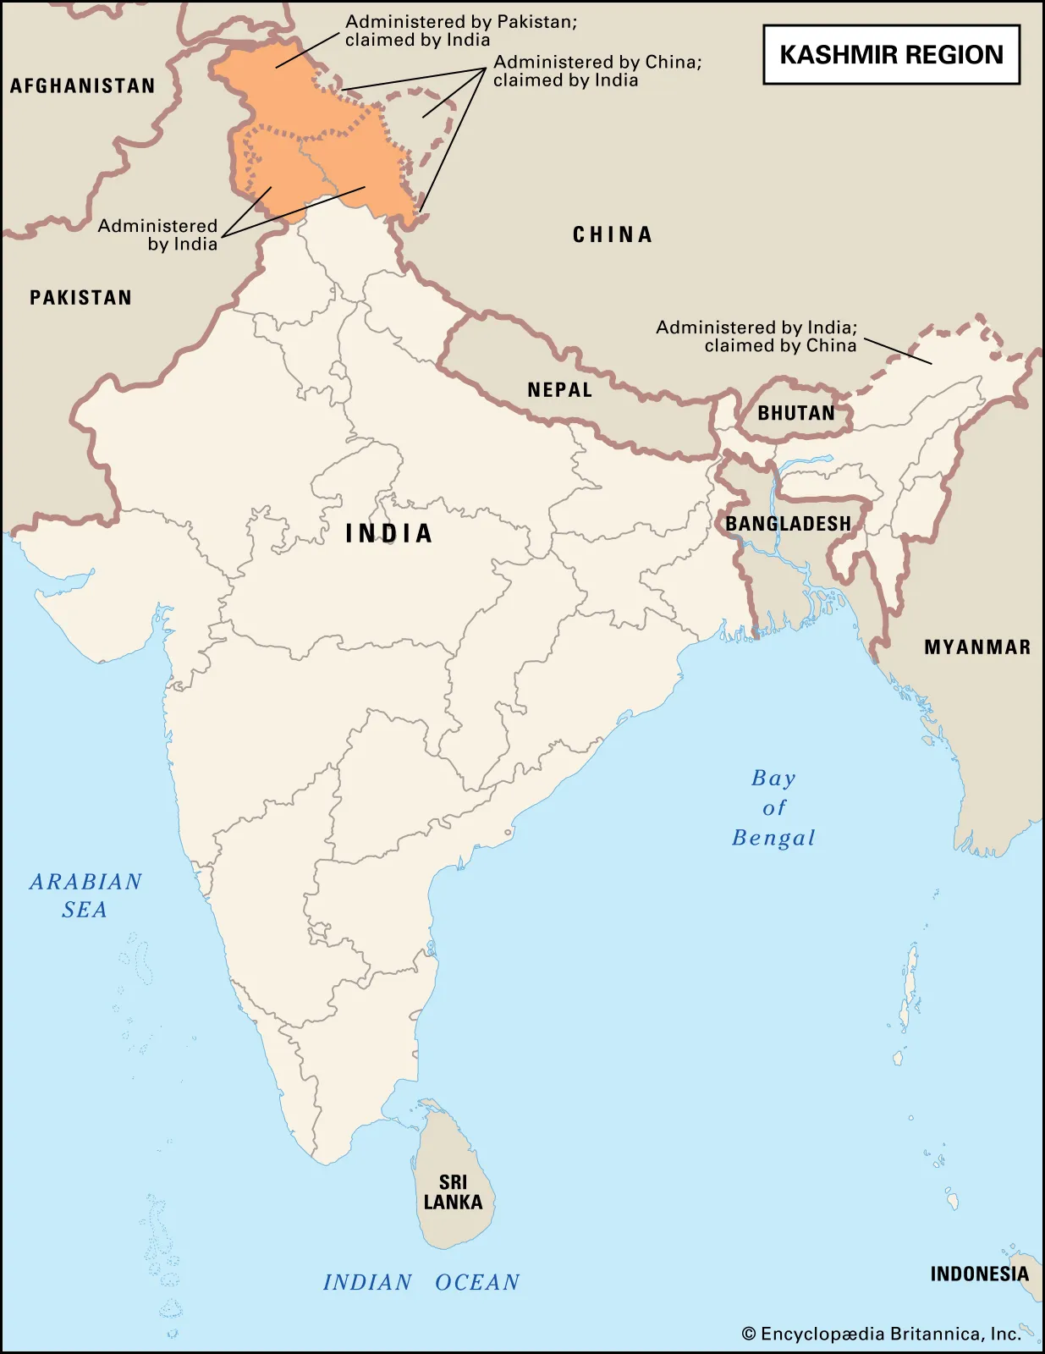

Slide 4
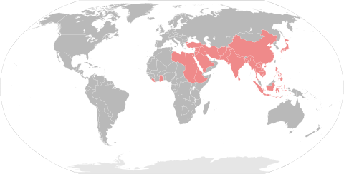
States attending the Bandung Conference (1955)

Slide 5
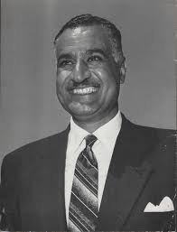
Decolonization’s main scenarios: the Suez Crisis
Nasser (1918-1970)

Slide 6
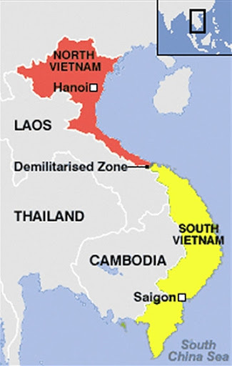
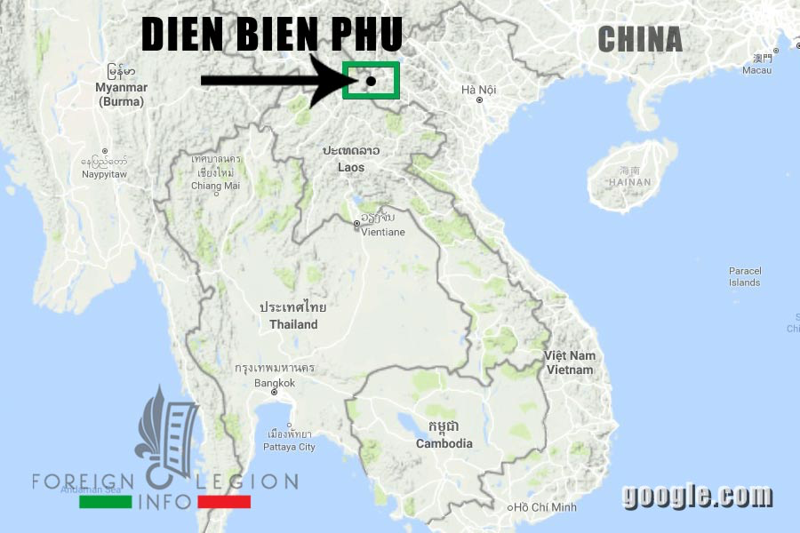

Slide 7
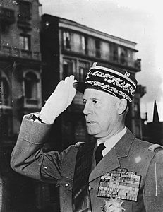
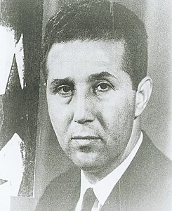
Decolonization’s main scenarios: Algeria
Raoul Salan (1899-1984)
Ahmed Ben Bella (1916-2012)

Slide 8
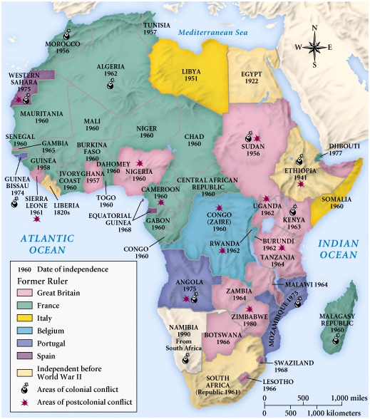

Slide 9
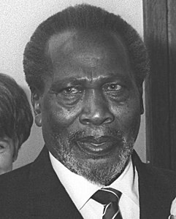
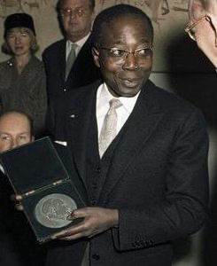
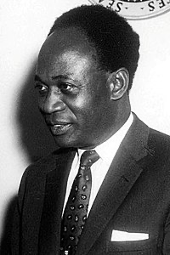
Jomo Kenyatta (1889-1978)
Leopold Senghor (1906-2001)
Kwame Nkrumah (1909-1972)

Slide 10
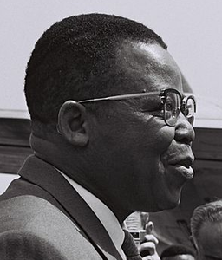
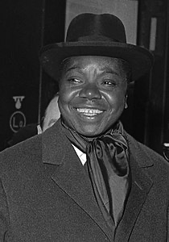
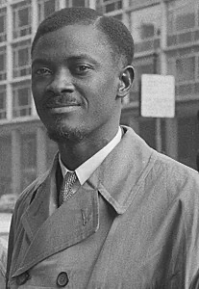
Joseph Kasa-Vubu (1915-1969)
Moise Tshombe (1919-1969)
Patrice Lumumba (1925-1961)

Slide 11
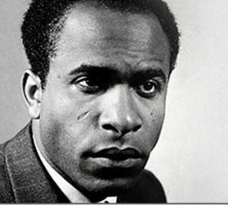
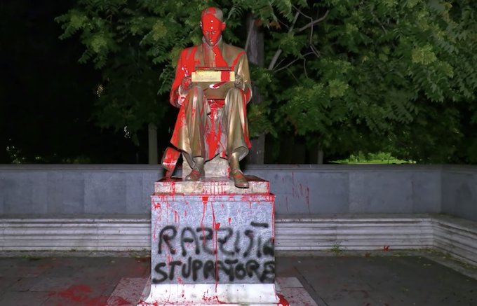
What we talk about when we talk about decolonisation
National liberation, national renaissance, the restoration of nationhood to the people, commonwealth: wathever may be the headings used or the new formulas introduced, DECOLONISATION is always a violent phenomenon.
F. Fanon, The wretched of the earth, 1963 [1961], p. 35.
Let's not reduce everything to Montanelli's statue. With this presidium we want to initiate a serious discussion on the DECOLONISATION of the city's urban space, because our metropolis is inhabited and traversed every day by a model of normality very different from the one defended by the group in power.
Non Una di Meno – Milan, June 2020

Slide 12
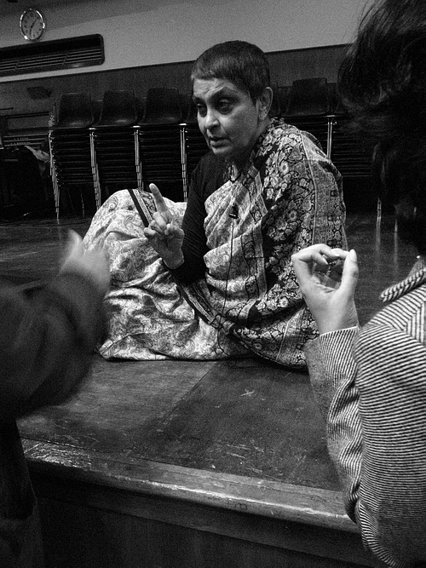
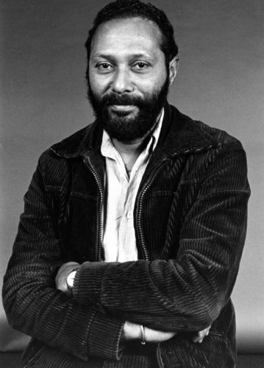
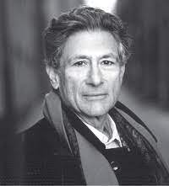
The empire strikes back?
Edward Said (1935-2003)
Stuart Hall (1932-2014)
Gayatri Chakravorti Spivak (1942)

