Slide 1
Lesson 10: Successes and failures of the European integration
From the Congress of Europe in the Hague (1947) to the Council of Europe (1949)
From the Schuman Plan to the failure of the European Community of Defense
Building Europe through the economy: the treaties of Rome
Europe of Nations: the Fouchet Plans to the Summit of the Hague (1969)
The Enlargement of the EEC, Institutional reforms (European Council, European Parliament)
The end of dictatures in South Europe: Greece, Portugal, Spain

Slide 2
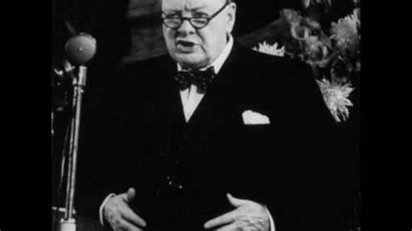
Winston Churchill (Zurich, 1946)

Slide 3
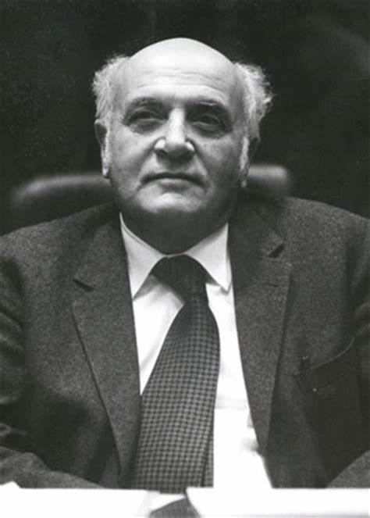
Altiero Spinelli (1907-1986)

Slide 4
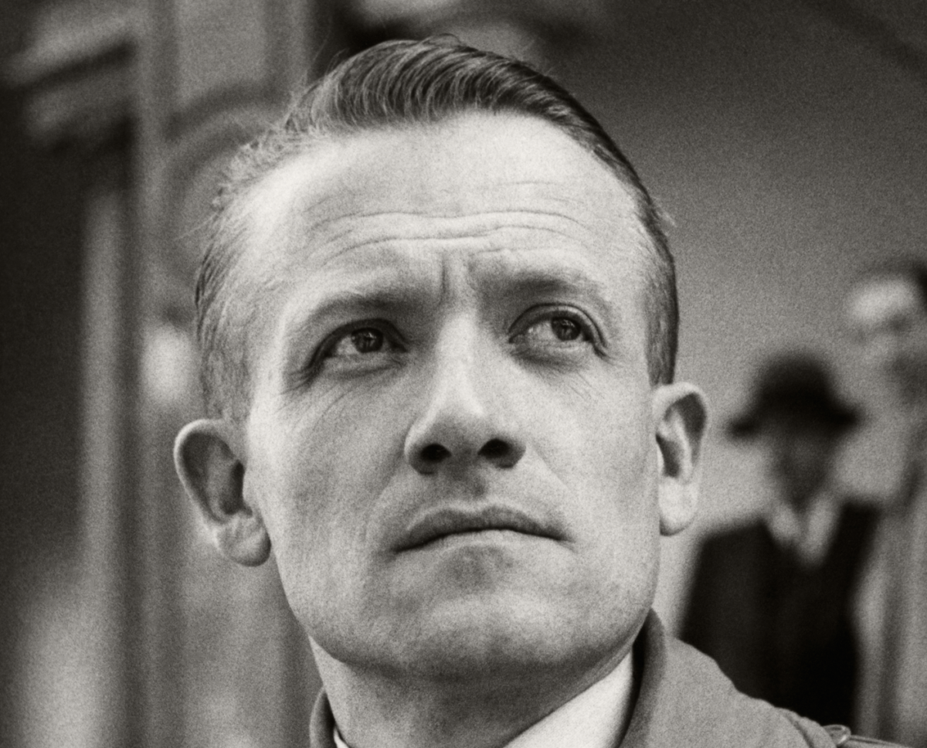
Henri Frenay (1905-1988)

Slide 5
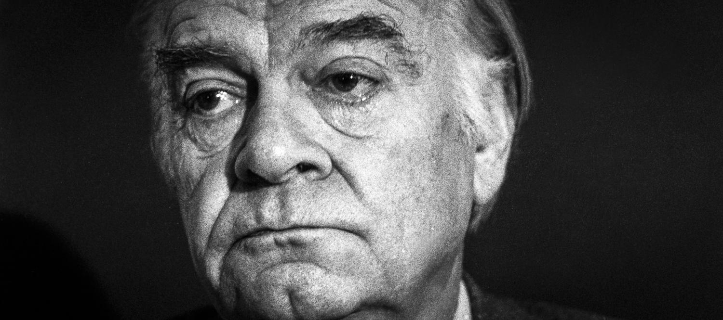
Denis de Rougemont (1906-1985)

Slide 6
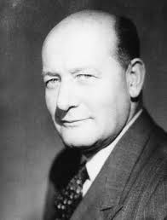
Alexandre Marc (1904-2000)

Slide 7
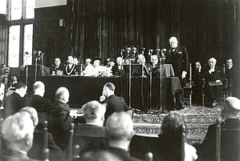
The Congress of The Hague (1947)

Slide 8
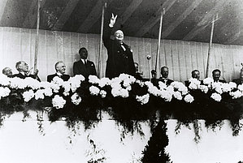
Churchill at The Hague (1947)

Slide 9
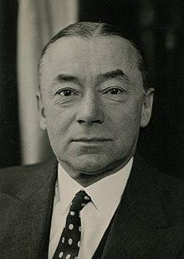
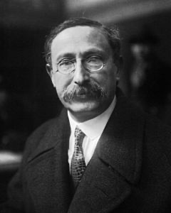
Leon Blum (1872-1950) Paul Reynaud (1878-1966)

Slide 10
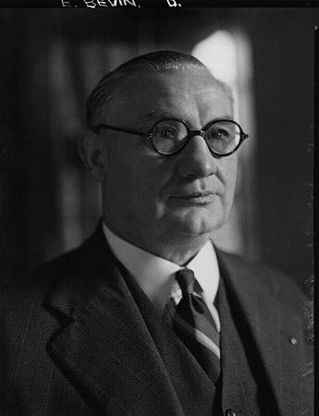
Ernest Bevin (1881-1951)

Slide 11
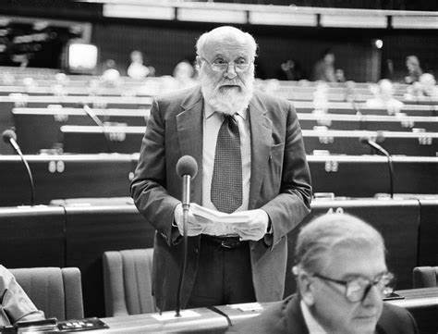
Altiero Spinelli

Slide 12
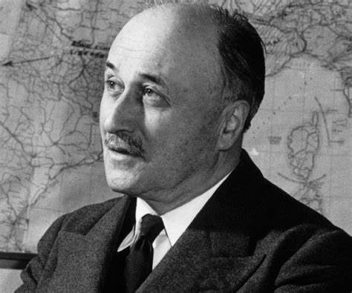
Jean Monnet (1888-1979)

Slide 13
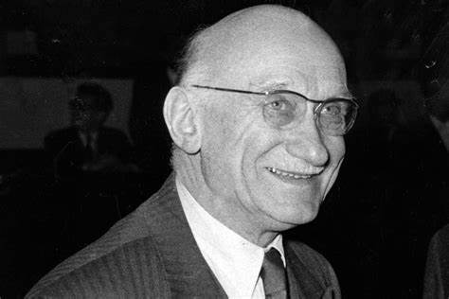
Robert Schuman (1886-1963)

Slide 14
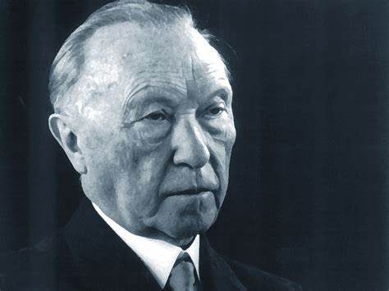
Konrad Adenauer (1876-1967)

Slide 15
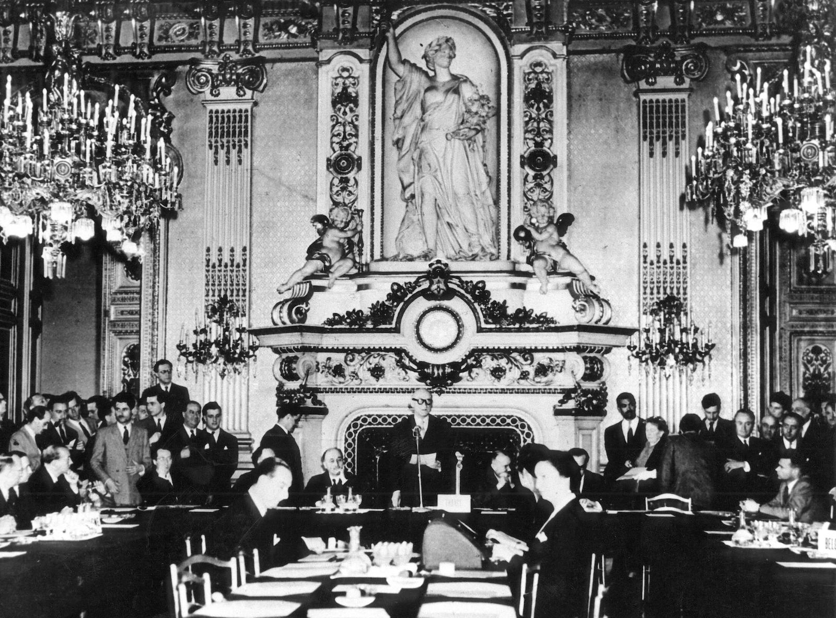

Slide 16
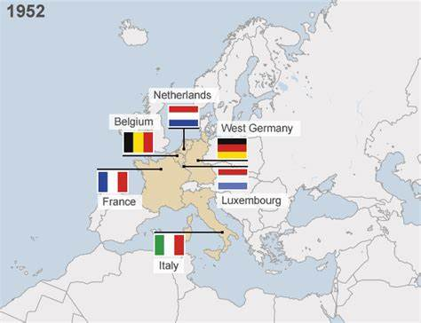
ECSC: European Coal and Steel Community (1951)
https://docs.google.com/presentation/d/1HgNy8FvmaxBfHZbRgyHG_aFXsXhAUm31/edit#slide=id.g18f31ef3985_0_42

Slide 17
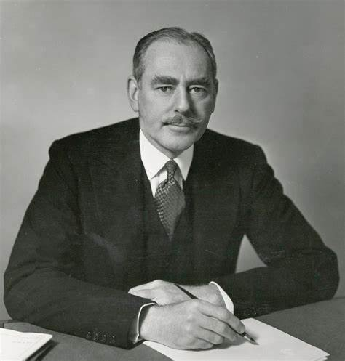
Dean Acheson (1893-1971)

Slide 18
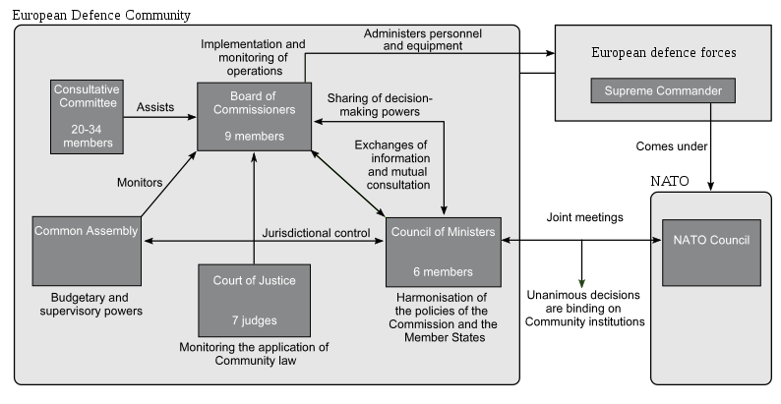
European Community of Defence (1952)

Slide 19
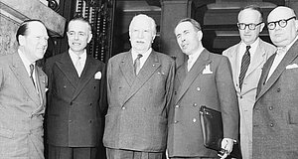
Beyen, Martino, Bech, Pinay and Spaak
at the Conference of Messina (1955)

Slide 20
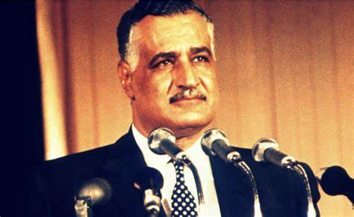
Gamal Abd-el Nasser (1918-1970)

Slide 21
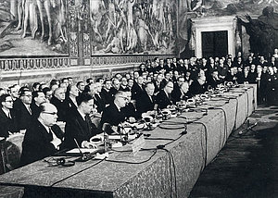
Signature of the Treaties of Rome (1957)

Slide 22
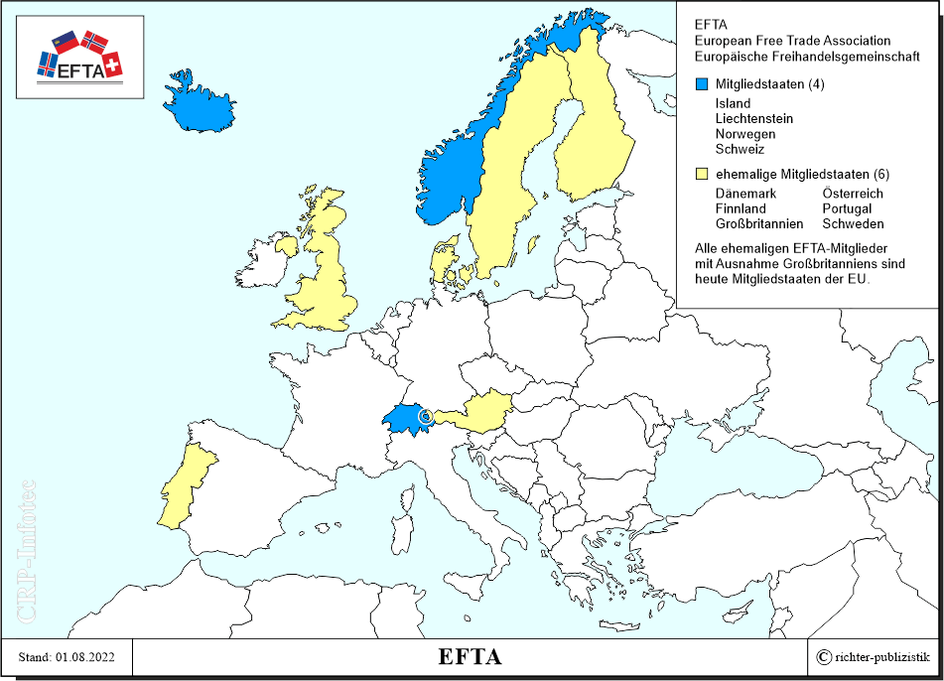
EFTA

Slide 23
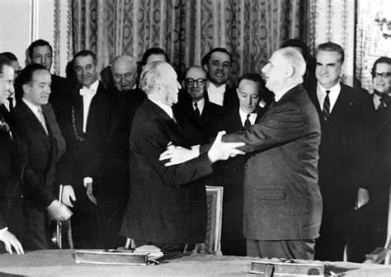
The Elysée Treaty (1963)

Slide 24
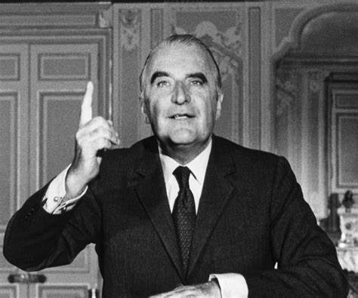
Georges Pompidou (1911-1974)

Slide 25
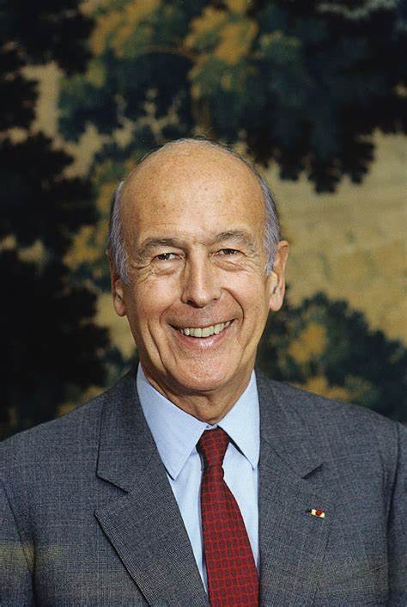
Valéry Giscard d’Estaing (1926-2020)

