Slide 1
Lesson 12: The end of the “Short Century”
The war in Afghanistan and the Euromissiles crisis
The economic decline of the USSR
A generation of new leaders
From the Single Market to the Maastricht Treaty
Glasnost and Perestroika: the Gorbachev Era
The fall of the Berlin Wall and the German reunification
The End of the Soviet Union

Slide 2
PERSHING
CRUISE (usa)
SS20 (ussr)

Slide 3
Hobsbawm, The Age of Extremes: The Short Twentieth Century, 1914-1991

Slide 4
Strategic Arms Limitation Treaty
SALT 1

Slide 5
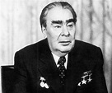
Leonid Brezhnev (1906-1982)

Slide 6
Jimmy Carter (1924-)

Slide 7
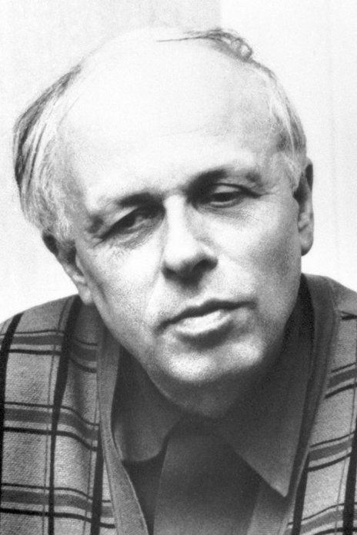
Andrei Sakharov (1921-1989) Alexander Solzhenitsyn (1918-2008)

Slide 8
The Gulag Archipelago by Solzhenitsyn

Slide 9
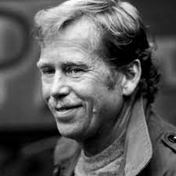
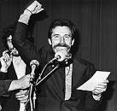
Vaclav Havel (1936-2011) Lech Walesa (1943-)

Slide 10
SOLIDARNOSC

Slide 11
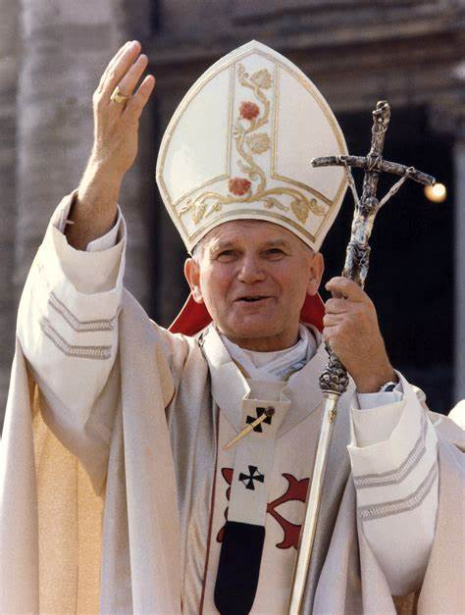
Pope John Paul II (1920-2005)

Slide 12
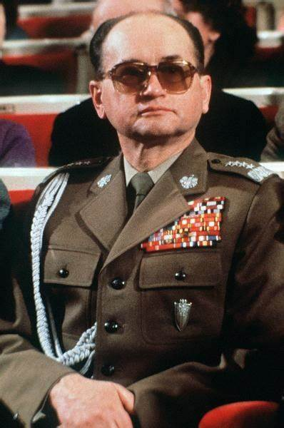
General Wojciech Jaruselski (1923-2014)

Slide 13
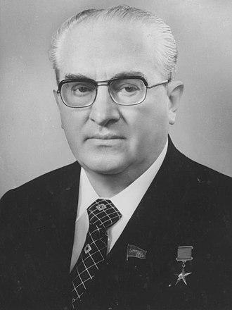
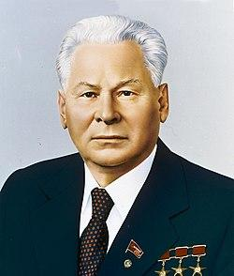
Yuri Andropov (1914-1984) Konstantine Chernenko (1911-1985)

Slide 14
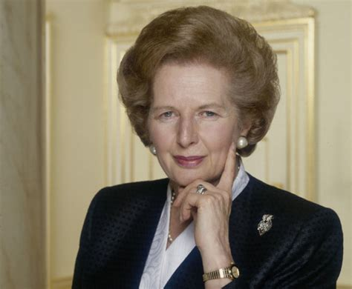
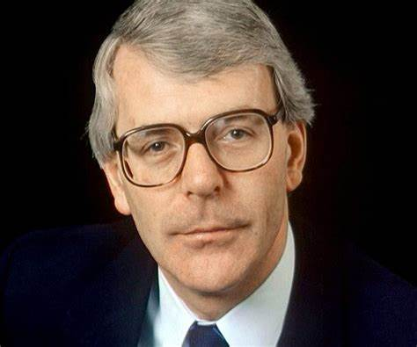
Margaret Thatcher (1925-2013) John Major (1943-)

Slide 15
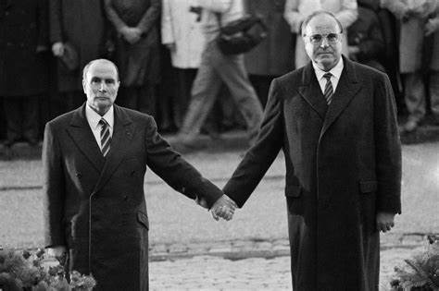
François Mitterrand (1916-1996) and Helmut Kohl (1930-2017)

Slide 16
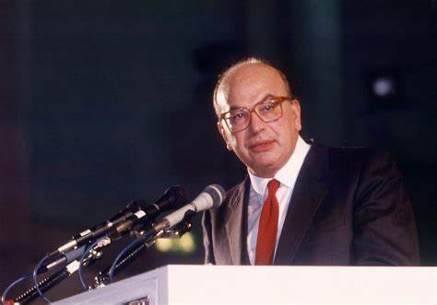
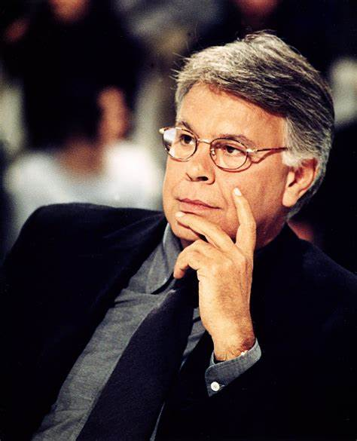
Bettino Craxi (1934-2000) Felipe Gonzales (1942-)

Slide 17
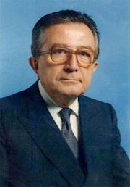
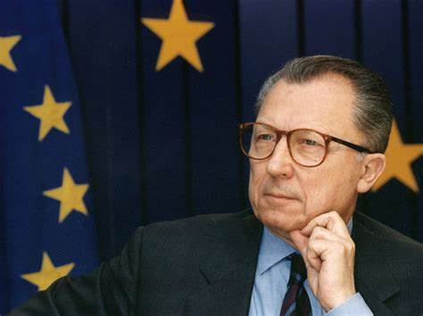
Giulio Andreotti (1919-2013) Jacques Delors (1925-)

Slide 18
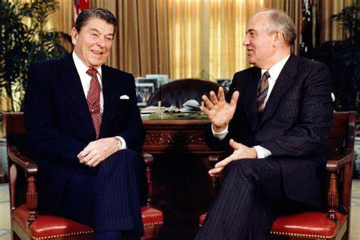
Ronald Reagan (1911-2004) and Mikhail Gorbatchev (1931-2022)

Slide 19
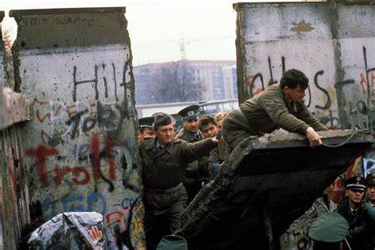
The Fall of the Berlin Wall

Slide 20
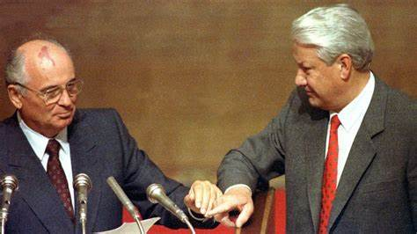
The end of the USSR

