Slide 1
Research Methods Prof. Matthew Loveless Introduction: The Scientific Method University of Bologna Autumn 2023

Slide 2
Outline
An Introduction
Aims of the Course
Scientific Method
Questions?

Slide 3
Why Quantitative Methodology?
Ugh.
So what?
One Reason: A lot of what we know about the world is discovered and often explained in the language of quantitative methods.
e.g. Voting: A, B, & C and X, Y, & Z → Voting
e.g. Conflict: D, E, & F and R, S, & T → Conflict
Another Reason: Participation – often higher participation - in a broader set of job sectors
“you will need a passing if not working knowledge of statistics….”
Why let other people explain the world to you?

Slide 4
Your Destiny
Causality
Chi-2
Classical Hypothesis Testing (Significance Testing)
Conceptualization
Confidence Intervals
Controlled comparisons
Correlation
Cross Tabs
Degrees of Freedom
Dependent Variable
Difference of Means Test (t-test)
Dummy Variables
First order correlation coefficients [or ‘partials’]
F-test
Five Assumptions of Regression
Gamma
Generalization/ Inference
Hypothesis
Independent Variable
Interval-level Variable
Intervening Variable
Lambda
Level of Measurement
Linear Regression
Logistic Regression
Measures of Association
Measures of Central Tendency
Measures of Dispersion
Model Fit
Model Specification
Multicollinearity
Multiple Regression
Negative Relationships
Nominal-level Variable
Normal Distribution
Null hypothesis
Operationalization
Ordinal–level Variable
Ordinary Least Squares
Population vs. Sample
Positive Relationships
PRE statistics
P-Value
Adjusted-R²
Regression Coefficient
Regression Equations
Scatterplot
Standard deviation
Standard Error
Standardized and unstandardized regression coefficients
Statistical Inference
Statistical Significance
t-scores
T-Test
Theory
Unit of Analysis
Variable
Variance
Z distribution and z-scores

Slide 5
Contact Information
Prof. Matthew Loveless
Office: Via dei Bersaglieri 19
Office Hours: by appointment [Thursday 13-15]
Email: paulmatthew.loveless@unibo.it
Office Phone: …

Slide 6
Marks and Assignments
Lecture: Thursday, 11-13
‘Y’ Seminar: Friday 9-10 [Seminar Group 1]; 10-11 [Seminar Group 2]
Electronic Support: Virutale - !Sign up on Virtuale!
Marks: the final mark has 2 parts:
50% of the final grade is the mean of 9 weekly assignments (dropping the lowest).
50% of the final grade is a final exam covering material from all parts of the course.
Required Text:
Loveless, Matthew 2023. Political Analysis: A Guide to Data and Statistics. 1st edition. Sage.

Slide 7
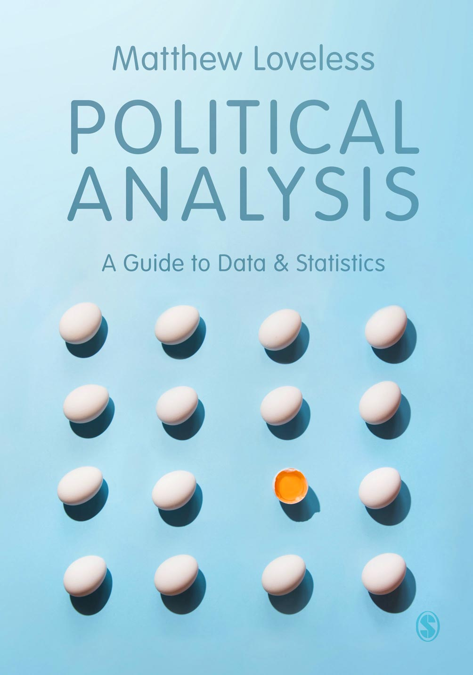
Every hero
needs a trusty
sidekick
We’ve got your back.
Your university adventure is about to begin and we’ve got your back!
Get 30% discount and free P&P on all SAGE and Learning Matters books.
Go to sagepub.co.uk
Find and add your book(s) to the shopping basket
Enter discount code UK23BOLOG at checkout and press ‘Apply’
30% OFF

Slide 8
Aims for the Course I
“Statistical Literacy”
Read, understand, and critically assess quantitative research
Use the appropriate techniques
QM abilities
Ability to generate descriptive and inferential statistics using statistical software and interpret and analyze the output.
Use statistical techniques to inform and/or support an argument and to recognize the limitations of statistical techniques
Research skills
Rigorously employ quantitative methodology to address a research question, present quantitative research in a clear, informative, and effective manner, and evaluate examples of quantitative research

Slide 9
Aims for the Course II
For us, this course is an attempt to gain an understanding of…
how Quantitative Methods summarize and represent relationships among data and variables
the theoretical underpinnings of Quantitative Methods
What They Can And Cannot Do (“WTCACD”)
Quantitative Methods’ ability to be used as a tool of the Scientific Method

Slide 10
Math Skills and Key Terms
University Student
Math Skills:
3 + 2 =
8 – 5 =
4 * 5 =
6>1.7=
5
3
20
true

Slide 11
Math Skills and Key Terms
Empirical:
Use of data to support analysis
Qualitative (Empirical) Research:
Use of data so that similar things are grouped and dissimilar things are separated by qualities or attributes
Quantitative Research:
Use of statistics, formal logic, or other computational solutions to analyse data
Quantitative Methods’ ability to be used as a tool of the Scientific Method

Slide 12
Week 1
Topic: Course’s Introduction and the Scientific Method
The Scientific Method.
The Use of Theory and Hypotheses;.
Data and Variables: Conceptualization and Operationalization.
Levels of Measurement.
Readings: Chapters 1 - 4 in Political Analysis.

Slide 13
What is Science?
It is a means to understand the world.
At the core is the assumption that the world is ultimately knowable and that we can converge on that knowledge through the application of an agreed upon and rigorous methodology.
The Scientific Method is an objective and replicable analysis of data which results in evidence which can be used to assess proposed explanations for a relationship and whether we can export the resultant explanation to other phenomena.

Slide 14
Why Science?
The Scientific study of politics is crucial
It offers analytical comparability and consistency as well as the ability to make cumulative progress in our understanding of political phenomena.
It grows by the repeated overthrow of theories with the help of evidence in an attempt to de-code the (political) world
Politics is worth knowing about
The Big Game
The Big Burning Questions

Slide 15
The Scientific Method
Or what makes research scientific?
A transparent and replicable description of the research design and analysis
An attempt to identify and explain the relationship under investigation
The ability to make appropriate inferences from the results of the research

Slide 16
Principle Number 1
The scientific method requires a transparent and replicable description of the research design and analysis.
The Scientific Method is not a tool.
A scientific study provides an accurate, comprehensive, and objective description the analysis so that others can replicate the work.
One reason is that the choice of tools can be very subjective and therefore lead to different conclusions.

Slide 17
Principle Number 1
Objectivity an attempt to eliminate or minimize the influence of our own prejudices, biases, etc…
A uniform, non-normative method of inquiry as a means to impose objectivity.
Normative—evaluative, value-laden, etc. How things should be?
Non-normative—Factual and objective. How things are?
A.K.A.: positive approach
e.g.: the study of political participation

Slide 18
Principle Number 1
The Challenge of Objectivity
Politics is inherently value-laden. Politics is loaded.
Political phenomena often represent an event and its significance.
How neutrally can we investigate inequality, war, poverty, bias, class, corruption, ethnic conflict, gender disparity?
The intensity, apathy, passion, enthusiasm, disdain, unexpectedness, division, joy, and madness of politics.
And there are fiercely competing visions of what constitutes a ‘better’ or ‘worse’ way of doing things.

Slide 19
Principle Number 1
Because choices must be made, scientific study must be a public procedure.
e.g.: ‘peer-review’
The results of research are nearly secondary to how you arrived at them.
Thus, the Scientific Method doesn’t describe what we study, it describes how we study it.

Slide 20
Transparency?

Slide 21
Principle Number 2
The Scientific Method attempts to identify, isolate, and explain the relationship under investigation.
Move from description to explanation
ONE: The first means to identify and explain a relationship is the use of theory
We seeks to identify a class of events that have applicability beyond the cases under investigation
DESCRIPTION → EXPLANATION → PREDICTION

Slide 22
Principle Number 2
DESCRIPTION → EXPLANATION → PREDICTION
EX: Before the last Bundestag elections in Germany, we ask 1,000 Germans about their education and voting and determine that within this group, people with higher levels of education voted more often.
Description: In this group of Germans in the past national election, the more highly educated voted more often than less educated ones.
Explanation: It is easier for educated Germans to gather information about politics and therefore, I make the argument that they vote more because the costs of voting are lower for them.
Prediction: What might be one of several predictive statements we could make?
Scientific knowledge is explanatory and even predictive

Slide 23
Principle Number 2
TWO: The second means to identify and explain a relationship, is through control.
In order to evaluate the nature of the relationship in which we are interested, we must control for all other potential intervening or moderating influences.
The ‘signal’ versus the ‘noise’
We are challenged not only to determine whether this relationship exists but also whether it continues to exist when we consider all of the other possible explanations

Slide 24
Principle Number 3
The Scientific Method seeks to derive and make proper inferences from the results of our research.
Levels of Scientific Debates
Epistemological – the study of knowing
Scientific method vs. post-modernism
Methodological – how we find out
Quantitative vs. Qualitative
Research technique – use of theory and proper inference
Idiographic vs. Nomothetic
EX: What can we expect to learn from a case study of Benin’s political institutional evolution and a seven country, cross-national study of sub-Saharan west Africa’s political institutions?

Slide 25
Principle Number 3
Inference is not the same as prediction.
Recall our educated German voters above.
In the next Bundestag election, more educated Germans will vote at a higher rate than less educated Germans.
OR in the upcoming Bundesrat election, more educated Germans will vote at a higher rate than less educated Germans.
OR all European countries’ national parliamentary elections, more educated Europeans will vote at a higher rate than less educated European voters in that same country.
(Causal) inference carries the explanation itself
‘…because it is easier for educated citizens to gather and process information about politics and are therefore more likely to vote because the costs of voting are lower for them.’

Slide 26
Principle Number 3
Descriptive vs. Causal Inference
Many phenomena have seemingly many correct answers
Recall: Description → Explanation → Prediction
Descriptive Inference: Discrete expectations about an unstudied group by observation of a selected group
EX: the German example of education and voting
We were trying to export from what we could describe about one group to speak to a new group or event
Causal Inference: Inferring causality from observation.
Not only <above> but we are also imposing our explanation on them

Slide 27
Principle Number 3
One of the elements of the scientific research methodology is the ability to be confident about our findings
Probabilistic: random variation exists in the world and there is nothing you can do about it.
Deterministic: given the right explanatory variables, the world is entirely predictable
It is important to understand the difference between a statement of certainty and a statement that we have a great deal of confidence in.
Water → Boiling vs. Education → Voting

Slide 28
Statistics: The Illustrious Triumvirate
Description: Statistics summarizes the nature of variables and relationships. It also takes uncertainty seriously by determining how certain (or uncertain) we can be in our results.
Inference: We can make claims about broader processes than merely the ones in our sample.
Control: Statistics can isolate and assess the relationship in which we are interested, closely resembling the standard of experimental control.

Slide 29
Doing Statistics is not doing Science
 | The Scientific Method | Statistics
Principle Number 1 | A transparent and replicable description of the research design and analysis. | Statistics has an internal formal rigor grounded in the use of mathematics as its language which eases the handling of assumptions and estimating results. As such, statistics techniques follow a formal methodology specifically to enable replicability.
Principle Number 2 | To identify, isolate, and explain the relationship under investigation. | Statistics exposes patterns. It summarizes data, variables, and relationships between variables. Crucially, outside the laboratory, statistics is the most effective method for exerting control large arrays of competing explanations in scientific studies.
Principle Number 3 | Steps to assess the appropriate inferences from the results. | Statistics has an explicit use for and reporting of variance which, in its most advanced form, is a measure (un)certainty. Using this, we have the ability to make qualified inferences about unobserved phenomena.

Slide 30
Quantitative Methodology
Where does QM fit in the Scientific Method?
Data → Information → Knowledge
Analysis turns data into information
QM is the analytical treatment of data
QM does not replace our ability to ask better questions or to think critically or creatively about a problem.
SM is one way to turn information into knowledge. QM cannot make this step.

Slide 31
Conclusion: Scientific Method
Scientific Method is a methodology to accumulate (and discard) information in order to understand an observable and ultimately knowable world.
Quantitative Methods [Statistics] is a tool, a set of mathematical manipulations, that allow us to summarize and assess relationships.
We seek probabilistic, general knowledge about political and social phenomena.
How is this achieved?
Answer: Theory and Hypotheses

Slide 32
Theory in the Social Sciences
Definition:
A systematically related set of propositions that provide possible explanations for a set of phenomena.
Theory’s Role in Social Science
ONE: Identifies relationships about the phenomenon that we are interested in.
TWO: Summarizes work that has been done on our subject.
THREE: Suggests where to look for future testing.

Slide 33
Theory in the Social Sciences
Theories are necessarily simplified models of reality
“All models are wrong, but some models are useful”
All models are simplifications of the universe as they must necessarily be.
e.g.: Models of planes, trains, or automobiles
Theories are not right or wrong.
They are weak or strong.

Slide 34
Inductive and Deductive Reasoning
Induction: Specific to general
Observation → Theory
Deduction: General to specific
Theory → Observation
EX: The Agenda Setting theory states that the issues that are most prominent in the news are also the issues that are most important in public opinion.

Slide 35
A Model of the Role of Theory
Model Deduction Potential
(Theory) Data
Induction
World Observed Data

Slide 36
Theory in the Social Sciences
Theories are not Right or Wrong.
They are Weak or Strong
Strong theories continue to generate and explain, accumulating evidence as support
Weak ones fail to do so.

Slide 37
Core Characteristics of Theory I
ONE: A strong theory is a plausible explanation for the relationship in which we are interested.
(1) Does it make sense? Is it logically sound and internally coherent?
EX: Height and Presidents
Vary

Slide 38
Core Characteristics of Theory I
ONE: A strong theory is a plausible explanation for the relationship in which we are interested.
(2) Does it correspond with reality? Are the variables measurable (i.e.: have observable empirical referents)
EX: je ne sais quoi
Not uncommon: many of the concepts in which we are interested resist easy empirical capture; e.g.: power, trust, legitimacy, representation, social capital, party identification, inequality, negative media coverage, or sovereignty
A perfectly enlightened community will produce the philosopher king

Slide 39
Core Characteristics of Theory II
TWO: A strong theory is fertile. It does a good job of explaining what we are interested in and keeps on explaining.
Why is globalization occurring? Why do countries try to become democracies? Why do people distrust the EU?
Generate as many observable implications as possible

Slide 40
Core Characteristics of Theory III
THREE: A theory should be parsimonious. The ability for a theory to explain as much as it can with as little as possible.
Perhaps we can think of this as ‘efficiency’ or ‘leverage’ as in we want to leverage greater explanatory power with a relatively simple explanation.
Theory as a model: we need all of the necessary parts.
This is theory’s heuristic function – the efficient use of knowledge

Slide 41
Criteria for Evaluating Theory
FOUR: Falsification: A strong theory must have defined parameters that tell us when they will not work.
Theories are not Right or Wrong.
They are Weak or Strong
All theories are simplifications of reality and thus always wrong. But….

Slide 42
Causation and Theory
Theory is an inherently causal argument
Why something “had to happen”
David Hume & John Stuart Mill
Contiguity between cause and effect
X and Y covary
Temporal precedence
A change in X precedes a change in Y
Constant conjunction (when Y changes, X is there)
a.k.a.: non-spuriousness

Slide 43
Causation in the Social Sciences
Theory is an inherently causal argument
Why is causality so important?
Simultaneously, causal thinking belongs completely on the theoretical level although supported empirically
This means that it is helpful to think causally and to develop models that have causal implications (even if only indirectly testable).
To be clear (again): Causality or causal laws are working assumptions or tools of the scientist rather than verifiable statements about reality.

Slide 44
Causation in the Social Sciences
Causality as a working component of theoretical thinking
Causation and the Problem of Measurement
e.g. Inequality and Democracy
Universal Causal Mechanisms
How universal is causality? What are the limits?
e.g.: CEE Mass Media
Causation as a Limit on Discovery
‘Demonstrate’ causality where we can, avoiding the messier topics
Not only where Y will be [prediction] but why it will be there [explanation].

Slide 45
For Emphasis and Clarity: Causation and Theory
X
Y
→
Theory

Slide 46
Conclusion
Therefore, a theory’s validity is determined through observation tested against competing theories which – over time - make an explanation more probable or more ‘correct’ than others.
IOW, which ones are more ‘more likely’
Theories are incomplete but useful
How do we test theories? We need real world implications – Hypotheses
and data and variables…

