Slide 1
Research Methods Prof. Matthew Loveless Hypotheses, Data, and Variables University of Bologna Autumn 2023

Slide 2
Outline
Hypotheses
Data
Variables
Conceptualization and Operationalization
Research Design

Slide 3
Hypotheses in the Social Sciences
We need to test our theories.
Except that we don’t test theories directly. Instead we test their real-world implications: hypotheses
Definition: A hypothesis is a general, non-normative, and directional statement of a relationship.
A hypothesis states how (not why) the IV will affect the DV.

Slide 4
Hypotheses in the Social Sciences
Characteristics of a good hypothesis
An explicit, non-normative statement avoids stating or implying what ought to be. Rather it is a statement about what is.
General: a class of events rather than a single event
Directional: Positive or Negative
Also, consistent with the data
Levels of analysis: Ecological Fallacy

Slide 5
What are data?
Codified observations
Mathematically tractable OR discretely categorized (separate observations into a set of comprehensive and exclusive categories).
Their quality is very important and we can only claim that it is valid and informative if and only if the data:
They are representative of the population
Measure what they are supposed to measure

Slide 6
What are data?
They are representative of the population
Samples and Populations
Randomization
Collection process

Slide 7
What are data?
Measure what they are supposed to measure
How you define (conceptualize) and measure (operationalize) your variable has a profound effect on what you will find.
The data that we intend to use must conceptually and operationally capture the phenomena that we are interested in.
IOW: Data are not your concept.

Slide 8
Data Definitions
Datum: A single piece of data.
Data: A collection of codified observations on a topic we are interested in.
Variable: The choice of indicator that draws data together conceptually and operationally.
Unit of Analysis: The subject of your study. What or who you are trying to learn about. e.g.: countries, individuals, parties, parliaments, ethic groups, etc...
Case: An included observation of the unit of analysis.
Level of Analysis: The nature of the data used to examine the units of analysis.

Slide 9
What are Variables?
But first, data must be transformed into meaningful representations of what we intend to study, managed and handled to serve our analytical approach with the ultimate goal of satisfying the demands of our research design.
Data must be transformed into variables.
Variables are meaningful representations of what we intend to study, managed and handled to serve our analytical approach with the ultimate goal of satisfying the demands of our research design.
Simply, a variable is data grouped to represent a concept.

Slide 10
What are Variables?
Commonly, we refer to variables in their relation to one another.
For example, in the simplest form of X → Y
X is the independent variable
Y is the dependent variable
All variables should vary and be what we want to explain.
The dependent variable should additionally be dependent.

Slide 11
Measurement
Do our data, transformed into variables, measure what they are supposed to measure?
Conceptualization
Connotation (i.e.: intension): characteristics and properties: This is what we mean when we refer to something.
Denotation (i.e.: extension): extension to concept: This is the object itself as opposed to something else.
Operationalization
How concepts are captured by usable, empirical referents (“the evidence”).

Slide 12
Conceptualization I
Sartori, Giovanni 1970. "Concept Misinformation in Comparative Politics," American Political Science Review 64(4): 1033-1053.
What you measure shapes the outcomes of our research.
What you claim to measure does as well.
"We are deluding ourselves if we really believe that by saying a variable we have a variable" (Sartori 1970, 1037).
Conceptual Stretching

Slide 13
Conceptualization II
Conceptual Stretching
The words we use to describe phenomena, behaviours, & institutions in political science reference concepts of which definition is required.
EX: Identifying a country as democratic because it has more than one competing party in open elections - although it scores poorly on important democratic features such as rule of law and the observance of human rights.

Slide 14
Conceptualization III
Confronted with such a problem, what should the researcher do?
Re-conceptualize his variable? Ignore it?
Or…reconsider the contest b/t the connotation and denotation of your concept…
The “Ladder of Abstraction”
Make appropriate extensional gains (denotation) without losing the precision and empirical testability (connotation).
Inversely proportional: as the attributes assigned to a concept increase, its extension is narrowed. The reverse is also true.
Therefore, our definitions must strive to be both parsimonious and adequate (a balance of connotation and denotation)

Slide 15
Operationalization
Operationalization: Choosing things from the world to represent the variables of your investigation
Reliability: Repeatedly consistent
Validity: the extent how closely aligned the concept and the measure are
What is the difference between reliability and validity?

Slide 16
Reliable but not Valid

Slide 17
Neither Valid nor Reliable

Slide 18
Reliable and Valid

Slide 19
Challenge: Democracy
How do you measure the level of democracy in a country?
How can we come up with a measurement of what democracy means, an indicator (or indicators) of it, and have some confidence that it is cross-nationally comparable?
Freedom House
Governance Scores – World Bank
Etc…

Slide 20
Freedom House: Democracy
Methodology: Measure individual freedom —the opportunity to act spontaneously in a variety of fields outside the control of the government and other centers of potential domination— in two broad categories: political rights and civil liberties.
Political rights enable people to participate freely in the political process, including the right to vote freely for distinct alternatives in legitimate elections, compete for public office, join political parties and organizations, and elect representatives who have a decisive impact on public policies and are accountable to the electorate.
Civil liberties allow for the freedoms of expression and belief, associational and organizational rights, rule of law, and personal autonomy without interference from the state.

Slide 21
Freedom House Scores | 2013
 | PR | CL | Status
Austria | 1 | 1 | F
Belgium | 1 | 1 | F
Cyprus | 1 | 1 | F
Denmark | 1 | 1 | F
Finland | 1 | 1 | F
France | 1 | 1 | F
Germany | 1 | 1 | F
Greece | 2 | 2 | F
Iceland | 1 | 1 | F
Ireland | 1 | 1 | F
Italy | 2 | 1 | F
Liechtenstein | 1 | 1 | F
Luxembourg | 1 | 1 | F
Malta | 1 | 1 | F
Monaco | 2 | 1 | F
Netherlands | 1 | 1 | F
Norway | 1 | 1 | F
Portugal | 1 | 1 | F
 | PR | CL | Status
Albania | 3 | 3 | PF
Armenia | 5 | 4 | PF
Azerbaijan | 6 | 5 | NF
Belarus | 7 | 6 | NF
Bosnia-Herz | 3 | 3 | PF
Bulgaria | 2 | 2 | F
Croatia | 1 | 2 | F
Czech Republic | 1 | 1 | F
Estonia | 1 | 1 | F
Georgia | 3 | 3 | PF
Hungary | 1 | 2 | F
Kyrgyzstan | 5 | 5 | PF
Latvia | 2 | 2 | F
Lithuania | 1 | 1 | F
Poland | 1 | 1 | F
Romania | 2 | 2 | F
Russia | 6 | 5 | NF
Serbia | 2 | 2 | F

Slide 22
World Bank: Democracy
Governance includes the process by which governments are selected, monitored and replaced; the capacity of the government to effectively formulate and implement sound policies; and the respect of citizens and the state for the institutions that govern economic and social interactions among them.
6 categories:
Voice and Accountability; Political Stability; Government Effectiveness; Regulatory Quality; Rule of Law; Control of Corruption

Slide 23
World Bank: Democracy
6 categories:
Voice and Accountability; Political Stability; Government Effectiveness; Regulatory Quality; Rule of Law; Control of Corruption
The WGI are composite governance indicators based on 31 underlying data sources. These data sources are rescaled and combined to create the six aggregate indicators using a statistical methodology known as an unobserved components model. A key feature of the methodology is that it generates margins of error for each governance estimate.

Slide 24
 | Voice and Accountability |  | Political Stability |  | Government Effectiveness |  | Regulatory Quality |  | Rule of Law |  | Control of Corruption
Country | Estimate | StdErr | Estimate | StdErr | Estimate | StdErr | Estimate | StdErr | Estimate | StdErr | Estimate | StdErr
AUSTRIA | 1.46 | 0.14 | 1.56 | 0.22 | 1.33 | 0.22 | 1.56 | 0.22 | 1.51 | 0.22 | 1.84 | 0.15
BELGIUM | 1.35 | 0.14 | 1.59 | 0.22 | 0.90 | 0.22 | 1.59 | 0.22 | 1.22 | 0.22 | 1.40 | 0.15
BULGARIA | 0.38 | 0.12 | 0.14 | 0.19 | 0.33 | 0.22 | 0.14 | 0.19 | 0.54 | 0.17 | -0.12 | 0.12
CROATIA | 0.48 | 0.12 | 0.70 | 0.19 | 0.58 | 0.22 | 0.70 | 0.19 | 0.44 | 0.17 | 0.21 | 0.12
CZECH R | 0.93 | 0.12 | 0.92 | 0.21 | 1.04 | 0.22 | 0.92 | 0.21 | 1.06 | 0.20 | 1.01 | 0.13
DENMARK | 1.69 | 0.14 | 1.97 | 0.22 | 0.90 | 0.22 | 1.97 | 0.22 | 1.79 | 0.22 | 1.85 | 0.15
ESTONIA | 1.09 | 0.13 | 0.96 | 0.21 | 0.60 | 0.22 | 0.96 | 0.21 | 1.40 | 0.18 | 1.13 | 0.13
FRANCE | 1.22 | 0.13 | 1.33 | 0.22 | 0.55 | 0.22 | 1.33 | 0.22 | 1.11 | 0.22 | 1.43 | 0.15
GEORGIA | -0.02 | 0.12 | 0.57 | 0.20 | -0.67 | 0.23 | 0.57 | 0.20 | 0.68 | 0.16 | -0.03 | 0.13
GERMANY | 1.38 | 0.13 | 1.57 | 0.22 | 0.77 | 0.22 | 1.57 | 0.22 | 1.53 | 0.22 | 1.64 | 0.15
GREECE | 0.65 | 0.12 | 0.31 | 0.22 | -0.23 | 0.22 | 0.31 | 0.22 | 0.50 | 0.22 | 0.39 | 0.15
HUNGARY | 0.72 | 0.12 | 0.62 | 0.21 | 0.67 | 0.22 | 0.62 | 0.21 | 0.97 | 0.18 | 0.60 | 0.13
IRELAND | 1.32 | 0.15 | 1.53 | 0.22 | 0.93 | 0.23 | 1.53 | 0.22 | 1.56 | 0.24 | 1.73 | 0.16
ITALY | 0.89 | 0.12 | 0.41 | 0.22 | 0.50 | 0.22 | 0.41 | 0.22 | 0.73 | 0.22 | 0.36 | 0.15
LATVIA | 0.74 | 0.14 | 0.83 | 0.22 | 0.43 | 0.23 | 0.83 | 0.22 | 1.00 | 0.20 | 0.76 | 0.14
LITHUANIA | 0.91 | 0.14 | 0.83 | 0.21 | 0.75 | 0.23 | 0.83 | 0.21 | 1.10 | 0.19 | 0.81 | 0.13
NETHERL | 1.63 | 0.14 | 1.80 | 0.22 | 1.17 | 0.22 | 1.80 | 0.22 | 1.75 | 0.22 | 1.84 | 0.15
POLAND | 1.06 | 0.12 | 0.66 | 0.19 | 1.03 | 0.22 | 0.66 | 0.19 | 0.96 | 0.17 | 0.74 | 0.12
ROMANIA | 0.30 | 0.12 | -0.31 | 0.19 | 0.07 | 0.22 | -0.31 | 0.19 | 0.54 | 0.17 | 0.02 | 0.12
RUSSIA | -0.96 | 0.12 | -0.43 | 0.19 | -0.82 | 0.22 | -0.43 | 0.19 | -0.36 | 0.17 | -0.82 | 0.12
SLOVAK R. | 0.96 | 0.13 | 0.83 | 0.21 | 1.06 | 0.23 | 0.83 | 0.21 | 1.03 | 0.19 | 0.46 | 0.13
SLOVENIA | 0.98 | 0.12 | 1.02 | 0.21 | 0.92 | 0.22 | 1.02 | 0.21 | 0.61 | 0.18 | 0.98 | 0.13
SPAIN | 1.04 | 0.13 | 1.11 | 0.22 | -0.01 | 0.22 | 1.11 | 0.22 | 0.94 | 0.22 | 1.04 | 0.15
SWEDEN | 1.71 | 0.13 | 1.94 | 0.22 | 1.16 | 0.22 | 1.94 | 0.22 | 1.89 | 0.22 | 1.93 | 0.15
SWITZ | 1.67 | 0.15 | 1.88 | 0.22 | 1.40 | 0.23 | 1.88 | 0.22 | 1.66 | 0.24 | 1.81 | 0.16
TURKEY | -0.24 | 0.11 | 0.40 | 0.19 | -1.19 | 0.22 | 0.40 | 0.19 | 0.42 | 0.16 | 0.04 | 0.13
UKRAINE | -0.29 | 0.12 | -0.58 | 0.19 | -0.10 | 0.22 | -0.58 | 0.19 | -0.61 | 0.17 | -0.79 | 0.12
UK | 1.32 | 0.13 | 1.53 | 0.22 | 0.41 | 0.22 | 1.53 | 0.22 | 1.64 | 0.22 | 1.69 | 0.15

Slide 25
Challenge: Democracy
Are the data …
Representative of the population
Indicators of what they are supposed to measure
Conceptualization
Connotation and denotation
Operationalization
Reliability and validity

Slide 26
Research Design
A Research Design draws together the scientific approach, theory, and hypotheses as we develop a step-by-step plan for a research project.
It states the logic and basic concepts and techniques of empirical research.

Slide 27
Research Design
Think of this as the transmissible part
(Essentially) 3 parts:
Developing a Research Question
Determining Investigative Viability
The Analysis: Choosing the Method of Investigation

Slide 28
Research Design: Positioning I
Research Question: What is to be examined, identifies the phenomenon being investigated, and leads us toward an explanation.
How different from a hypothesis and a theory?
A RQ does not explain why something happens (theory)
Nor does it explicitly state the relationship between variables (hypothesis)

Slide 29
Research Design: Positioning II
Research Question - Next steps
Is this a question that can at least produce some form of an answer?
i.e.: Can we answer it?
So what?
Solomon Ibn Gabirol: “A wise man's questions contain half the answer.”

Slide 30
Research Design: Positioning III
Type of Gap | Description
Evidence Gap | Results of one or some studies incongruent to larger literature
Methodological Gap | Widen methodological approach to generate new insights
Empirical Gap | Research conclusions or results require empirical verification
Theoretical Gap | A lacuna of applicable theory
Population Gap | Issues with existing research samples
Robinson, Saldanhea, McKoy (2011); Muller-Bloch and Kranz (2015); Miles (2017)
So What?
ONE: Addresses a ‘gap’ in the literature.
TWO: Seeks to resolve an anomaly in theory
THREE: Seeks explanations for outcomes
Literature Review: Guides the reader through the existing work toward your research question.

Slide 31
Research Design: Validating Investigative Plausibility
A statement of theory and hypotheses:
Identifies the specific propositions to be tested.
A discussion of concepts (conceptualization):
Define the core concepts
Building on previous definitions provided in the existing literature, demonstrate what your concepts ‘mean’ and how will they be recognized
An observation and measurement strategy (operationalization):
How will these concepts be measured?
How are you going to collect data?

Slide 32
Research Design: Method of Discovery
A testing strategy: How the researchers intends to answer the questions of the study
How to measure the relationship between the variables and draw conclusions
What is the most practical and clear test of competing theories?
How do we eliminate plausible and rival explanations?
What data are available?
Why were these cases selected? Not others?
Note: There is NO perfect research design.
ID your limitations.

Slide 33
Research Design: Methods
Most common methods:
Experimental: Control and experimental groups, control for effects
Statistical: Mathematic manipulation of empirical data that can’t be examined through experimental design; achieve control through partial correlations
Comparative: Similar to both but designed for “small n size, many variables”

Slide 34
The Research Process

Slide 35
Conclusion
“Although this may seem a paradox, all exact science is dominated by the idea of approximation. When a man tells you that he knows the exact truth about anything, you are safe in inferring that he is an inexact man. Every careful measurement in science is always given with the probable error ... every observer admits that he is likely wrong, and knows about how much wrong he is likely to be.”
Bertrand Russell, The Scientific Outlook (1931, 2009), 42.

Slide 36
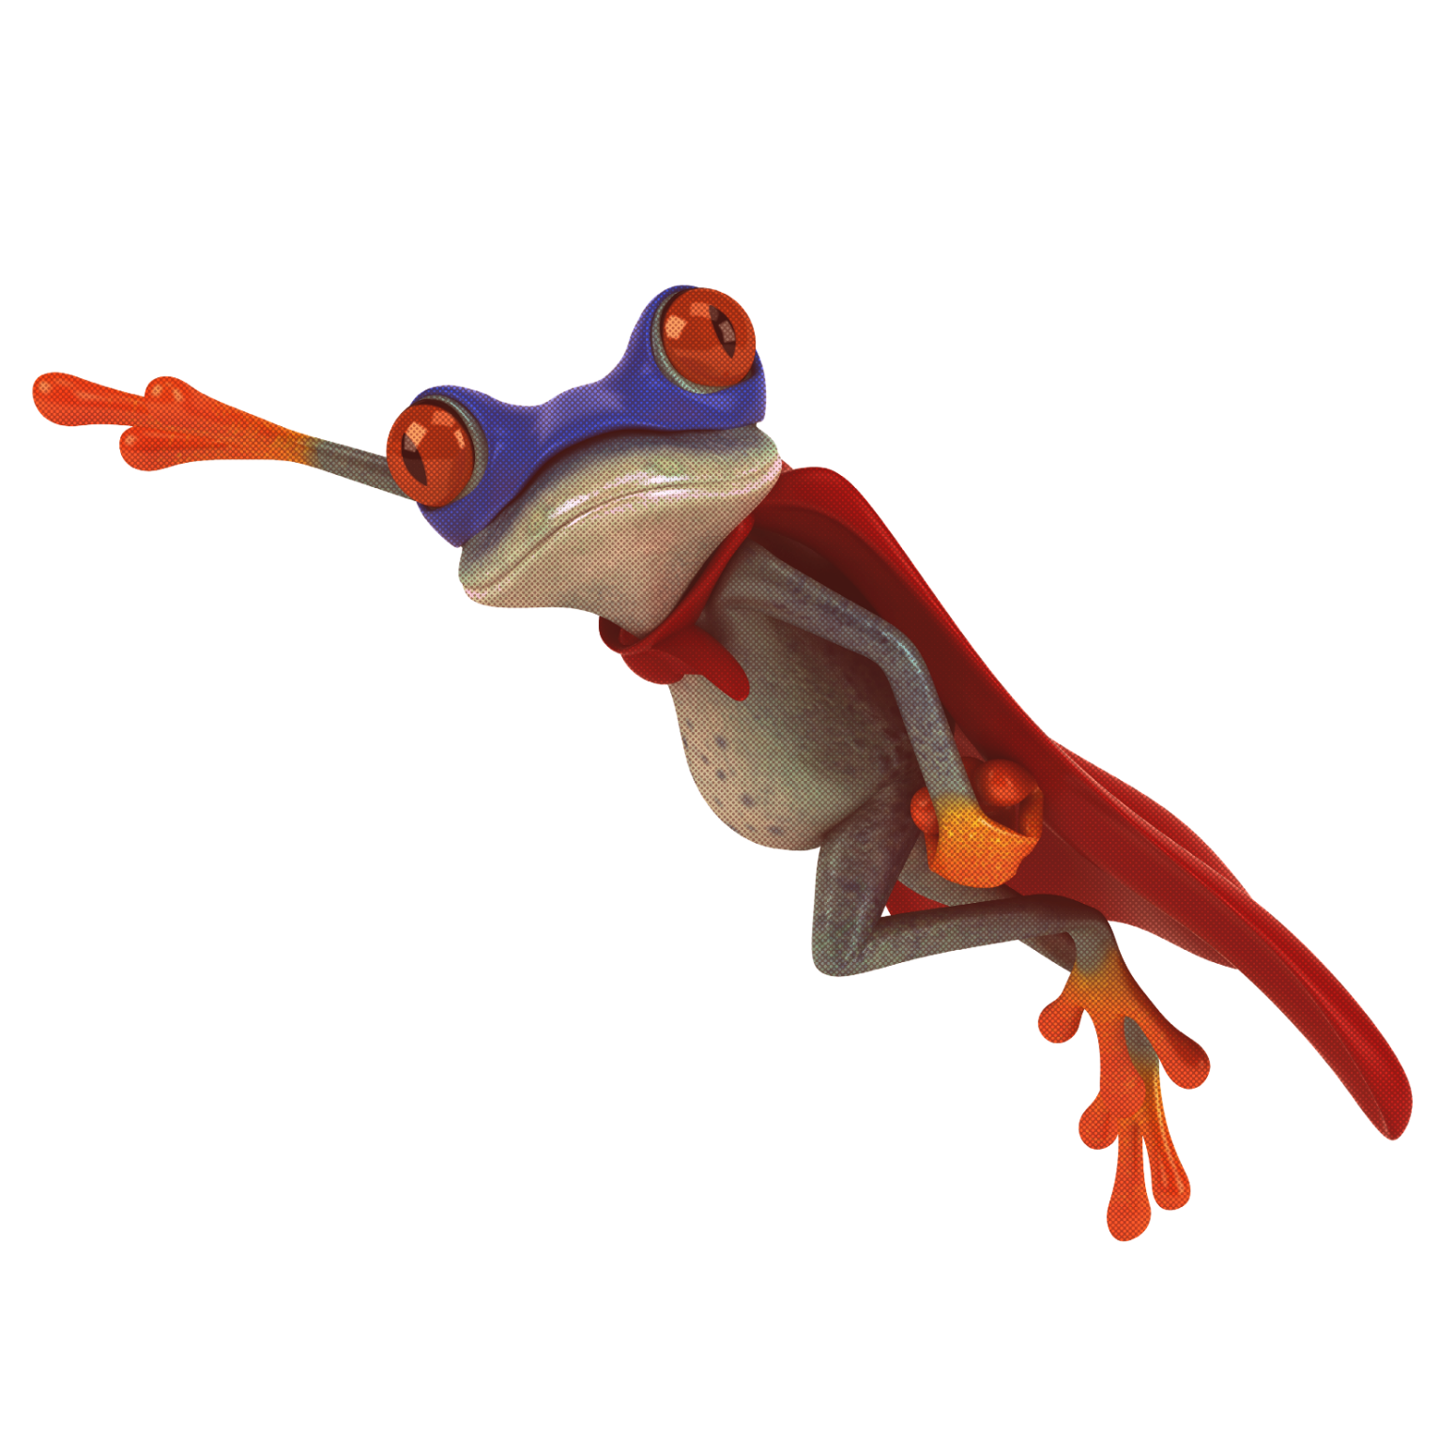
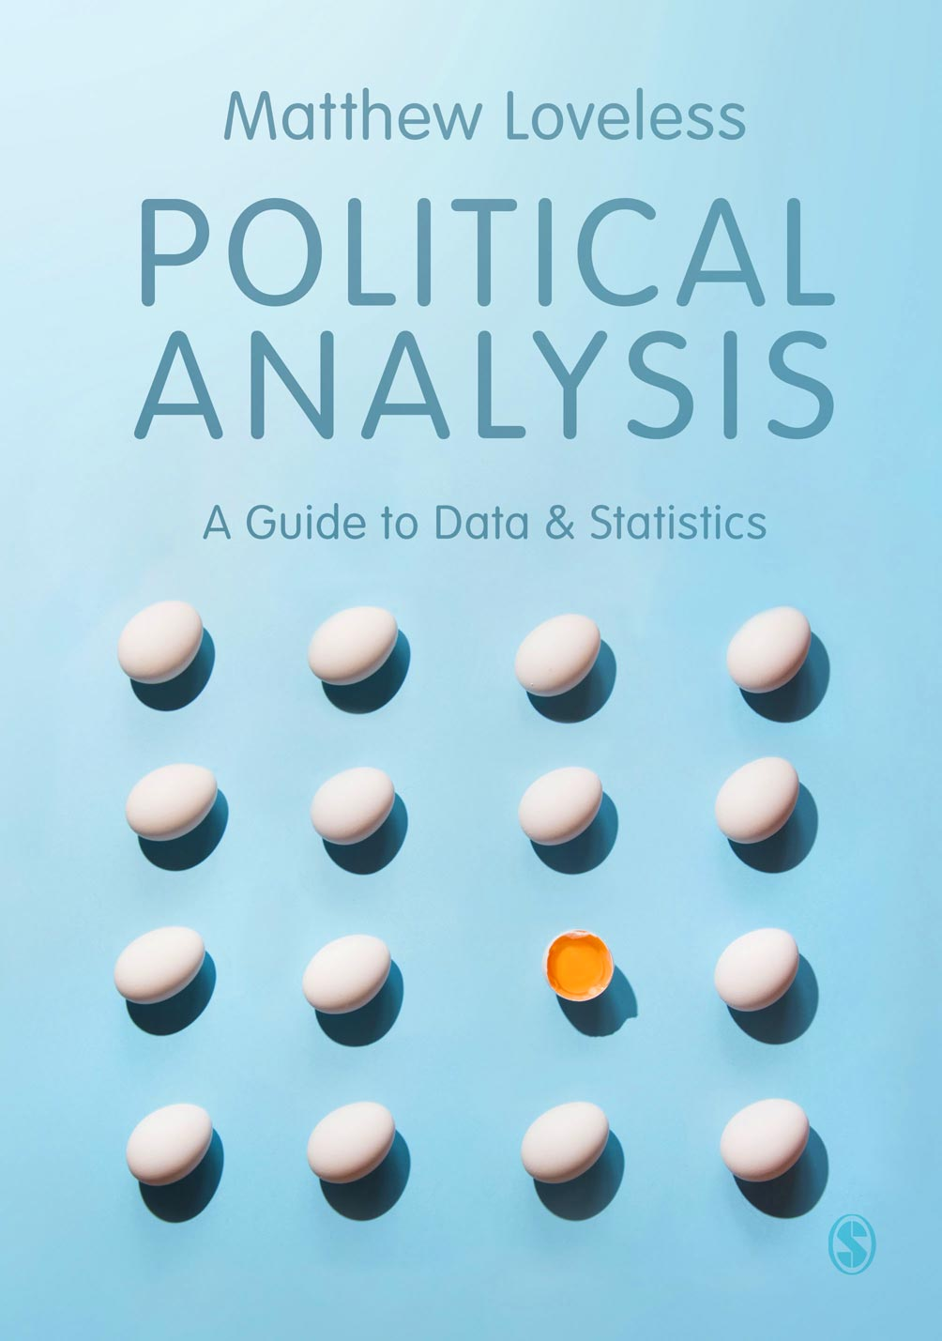
Every hero
needs a trusty
sidekick
We’ve got your back.
Your university adventure is about to begin and we’ve got your back!
Get 30% discount and free P&P on all SAGE and Learning Matters books.
Go to sagepub.co.uk
Find and add your book(s) to the shopping basket
Enter discount code UK23BOLOG at checkout and press ‘Apply’
30% OFF

