Slide 1
Research Methods Prof. Matthew Loveless Descriptive Statistics: Measures of Association I University of Bologna Autumn 2022

Slide 2
Outline
Level of Measurement
Measures of Central Tendency and Dispersion
Cross-tabulation
Measures of Association: Nominal- and Ordinal-level Variables

Slide 3
Descriptive Statistics
Univariate: Summarize variables and tell us how good that summary is.
Bivariate: Summarize the relationship between variables by assessing the existence, strength, and sometimes, the direction of a relationship.
1st part of course
Inferential Statistics
We want to know is whether the observed pattern in the data can be inferred to apply to the population (from which the sample was drawn).
2nd part of course

Slide 4
Data Definitions
Datum: A single piece of data.
Data: A collection of codified observations on a topic we are interested in.
Variable: The choice of indicator that draws data together conceptually and operationally.
Dataset: A collection of variables for the included observations creates a set of data
Unit of Analysis: The subject of your study. What or who you are trying to learn about. e.g.: countries, individuals, parties, parliaments, ethic groups, etc...
Case: An included observations of the unit of analysis.
Level of Analysis: The nature of the data used to examine the units of analysis.
Level of Measurement: The empirical characteristics of specific variables.

Slide 5
Levels of Measurement
Nominal-level variables simply divide data into categories, with no assumption about the order or relationships between groups. Every observation has a category - but the overall order of the categories is unimportant.
Ordinal-level variables categorize observations ‘in order’ but the ‘jump’ from one category to the next is not necessary ‘the same’ mathematically. That is, while orderly, the intervals between the categories are not uniform.
Interval-level variables, the distance between measures – the intervals - have meaning are easily mathematically tractable.

Slide 6
Univariate Descriptive Statistics
Country | Main Religion | FH: Global Freedom Scores | WGI: Voice & Accountability
Bangladesh | Islam | Partly Free | -0.72
Brazil | Christianity | Free | 0.34
China | Unaffiliated Religions | Not Free | -1.61
D.R. of the Congo | Christianity | Not Free | -1.37
Egypt | Islam | Not Free | -1.43
Ethiopia | Christianity | Not Free | -1.30
France | Christianity | Free | 1.14
Germany | Christianity | Free | 1.34
India | Hinduism | Partly Free | 0.29
Indonesia | Islam | Partly Free | 0.16
Iran | Islam | Not Free | -1.37
Italy | Christianity | Free | 0.97
Japan | Unaffiliated Religions | Free | 0.96
Mexico | Christianity | Partly Free | 0.02
Myanmar | Buddhism | Not Free | -0.84
Nigeria | Christianity | Partly Free | -0.41
Philippines | Christianity | Partly Free | 0.03
Russian Federation | Christianity | Not Free | -1.10
South Africa | Christianity | Free | 0.67
Thailand | Buddhism | Not Free | -0.83
Turkey | Islam | Not Free | -0.81
United Kingdom | Christianity | Free | 1.26
Tanzania | Christianity | Partly Free | -0.50
USA | Christianity | Free | 0.97
Viet Nam | Folk Religions | Not Free | -1.38
Nominal: Categories
Ordinal: Categorical but underlying order
Interval: Meaningful intervals

Slide 7
Descriptive Statistics: Levels of Measurement
Nominal: Categories
EXs: Religion, region of birth, gender, membership
Ordinal: Categorical but underlying order
EXs: Education, ideology
Interval (includes ‘Ratio’): Meaningful intervals
EXs: Years between wars, GDP per capita, Income
and…sometimes: Education and Ideology

Slide 8
Measures of Central Tendency and Dispersion
Measures of central tendency give us the most representative value of a variable.
Depends on the Level of Measurement
Measures of dispersion tell us how representative the measure of central tendency is by providing the amount of variation around that value.
Depends on the Level of Measurement

Slide 9
Nominal: Univariate Descriptive Statistics
Born in … | Number of observations
United Kingdom | 22
France | 19
Italy | 9
Spain | 14
Germany | 15
Total | 79
Central Tendency: Mode
Dispersion: Relative Frequencies or Variation Ratio
$VR= \frac{\sum{\left(F_{non−modal}\right)}}{N}$

Slide 10
Nominal: Univariate Descriptive Statistics
Born in … | Number of observations
United Kingdom | 22
France | 19
Italy | 9
Spain | 14
Germany | 15
Total | 79
Central Tendency: Mode: UK
Dispersion: Relative Frequencies or Variation Ratio
$VR= \frac{\sum{\left(F_{non−modal}\right)}}{N}$
0.722

Slide 11
Nominal: Univariate Descriptive Statistics
Born in … | Number of observations
United Kingdom | 38
France | 6
Italy | 14
Spain | 12
Germany | 9
Total | 79
Central Tendency: Mode: UK
Dispersion: Relative Frequencies or Variation Ratio
$VR= \frac{\sum{\left(F_{non−modal}\right)}}{N}$
0.519

Slide 12
Ordinal: Univariate Descriptive Statistics
Would you say that most people in your country can be trusted? | N
Strongly Agree | 42
Agree | 25
Neither Agree nor Disagree | 14
Disagree | 10
Strongly Disagree | 9
Total | 100
Central Tendency: Median
Dispersion: Range

Slide 13
Ordinal: Univariate Descriptive Statistics
Would you say that most people in your country can be trusted? | N
Strongly Agree | 42
Agree | 25
Neither Agree nor Disagree | 14
Disagree | 10
Strongly Disagree | 9
Total | 100
Central Tendency: Agree
Dispersion: Strongly Agree to Strongly Disagree
1-5

Slide 14
Descriptive Statistics: Central Tendency (Ordinal): Median
# of obs
1
4
4
2
1
12
Response # of obs
Strongly Disagree 1
Disagree 3
Neither Disagree/Agree 4
Agree 2
Strongly Agree 1
Total 11
SD D D D N N N N A A SA
SD D D D D N N N N A A SA

Slide 15
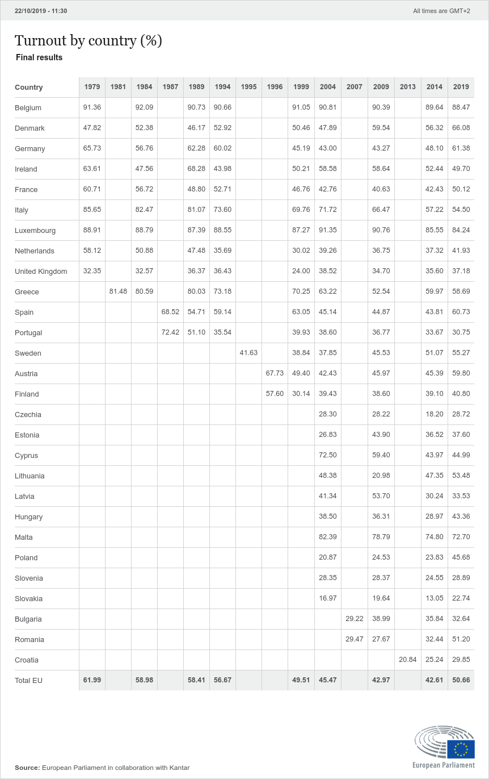
Measures of Central Tendency and Dispersion
Central Tendency: Mean
$\overline{x}= \frac{\sum{x}}{n}$
Dispersion: Standard Deviation
$s_{x}= \sqrt{\frac{\sum{{\left(x−\overline{x}\right)}^{2}}}{n−1}}$

Slide 16
Measures of Central Tendency and Dispersion
 | Measure of Central Tendency | Measure of Dispersion
Nominal | Mode | Relative Frequencies or Variation Ratio
Ordinal | Mode Median | Variation Ratio Range
Interval | Mode Median Mean | Variation Ratio Range Standard Deviation

Slide 17
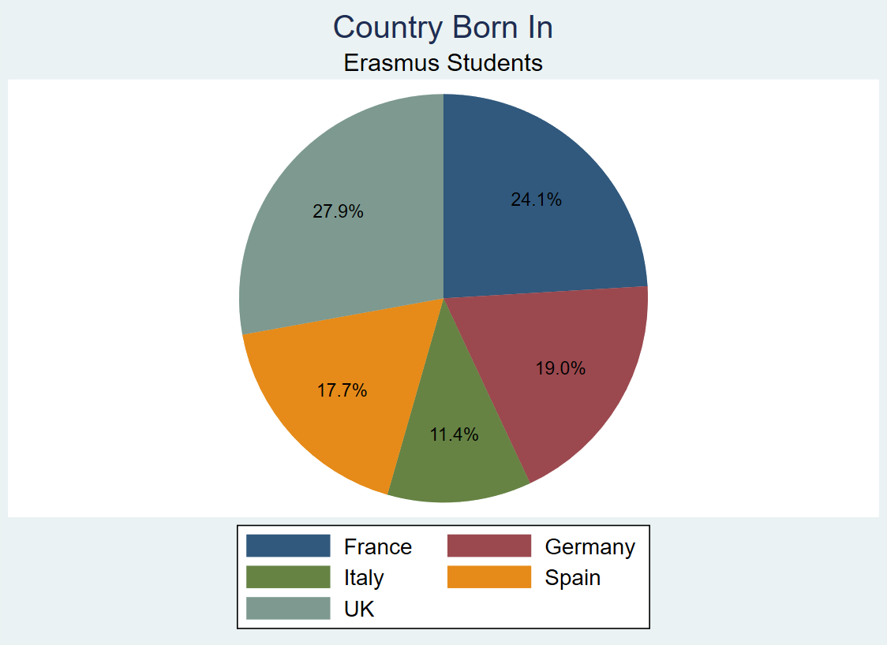
Graphing: Univariate Nominal Graphing

Slide 18
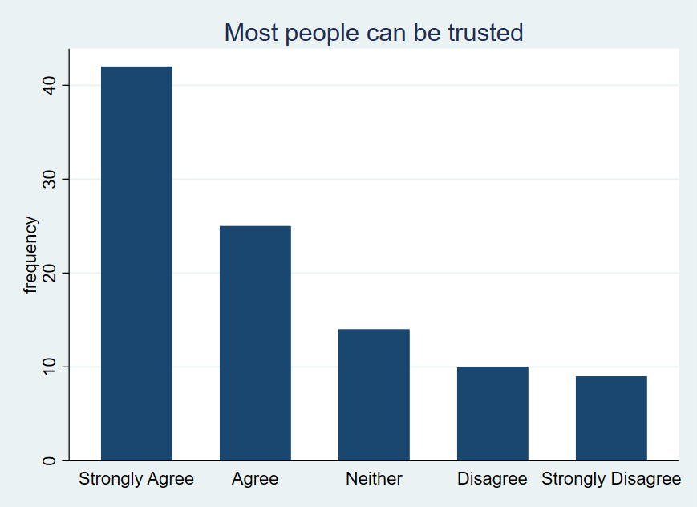
Graphing: Univariate Ordinal Graphing

Slide 19
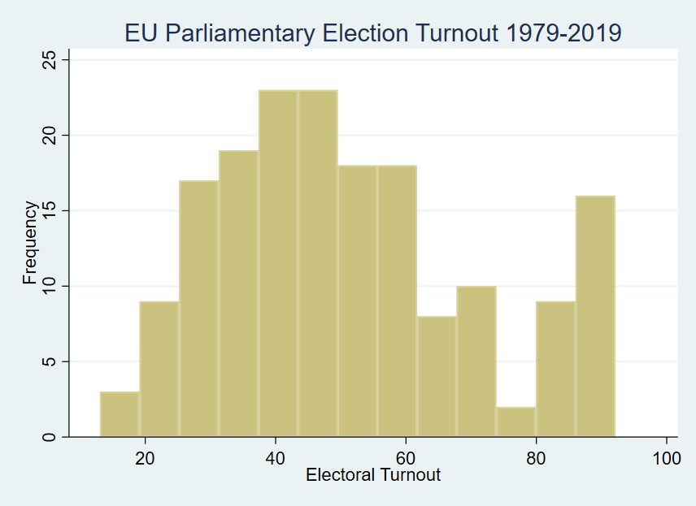
Graphing: Univariate Interval Graphing

Slide 20
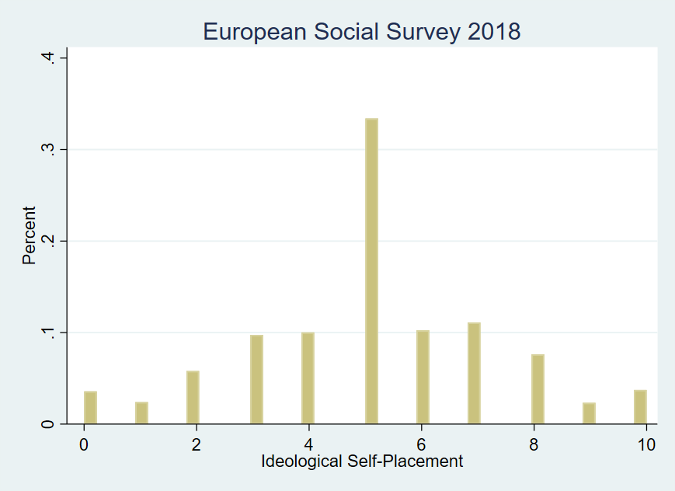
Graphing: Univariate Interval/Ordinal Graphing

Slide 21
Why is graphing important?
 | Variable 1 | Variable 2 | Variable 3
 | 8 | 9 | 7
 | 7 | 8 | 7
 | 8 | 9 | 13
 | 9 | 9 | 7
 | 8 | 9 | 8
 | 10 | 8 | 9
 | 7 | 6 | 6
 | 4 | 3 | 5
 | 11 | 9 | 8
 | 5 | 7 | 6
 | 6 | 5 | 6
Mean | 7.5 | 7.5 | 7.5
std dev | 2.07 | 2.02 | 2.16
Anscombe's quartet.
These three variables have nearly the exact same means and standard deviations.
For simplicity, each variable has 10 observations.

Slide 22
Why is graphing important?
Var 3 |  |  |  | * | *
 |  |  |  | * | * | *
 |  |  | * | * | * | * | * |  |  |  | *
 | 3 | 4 | 5 | 6 | 7 | 8 | 9 | 10 | 11 | 12 | 13
Var 2 |  |  |  |  |  |  | *
 |  |  |  |  |  |  | *
 |  |  |  |  |  |  | *
 |  |  |  |  |  | * | *
 | * |  | * | * | * | * | *
 | 3 | 4 | 5 | 6 | 7 | 8 | 9 | 10 | 11 | 12 | 13
Var 1 |  |  |  |  |  | *
 |  |  |  |  | * | *
 |  | * | * | * | * | * | * | * | *
 | 3 | 4 | 5 | 6 | 7 | 8 | 9 | 10 | 11 | 12 | 13

Slide 23
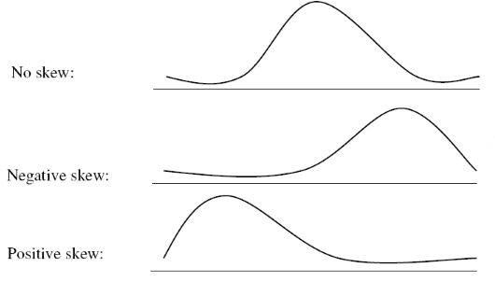
Problems: Descriptive Statistics
Outliers are observations in the data that deviate from the rest of the data.
Skew is the shift of data in one direction or the other away from convergence.

Slide 24
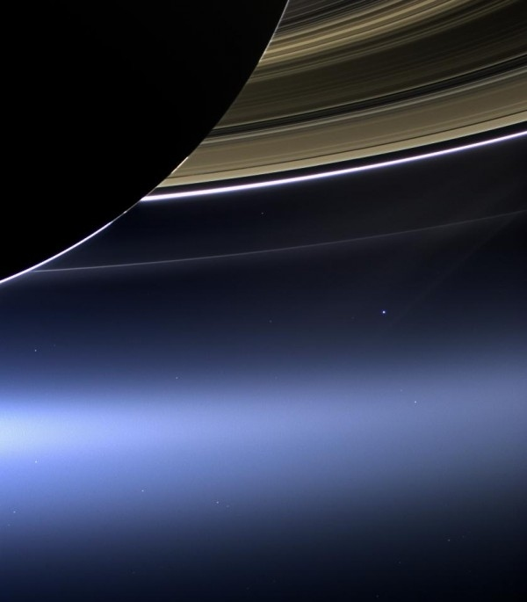

Slide 25
Bivariate Descriptive Statistics: Nominal- and Ordinal-level Variables
How can I best summarize the relationship between nominal- and ordinal-level variables?
Measures of Association assess the existence, strength, and, on occasion, direction of a relationship between variables.

Slide 26
Most Common Means to ‘Look’ at Two Variables: “Joint Distribution”
 | Nominal | Ordinal | Interval
Nominal | Cross-tab
Ordinal | Cross-tab | Cross-tab
Interval
Notes:
Bivariate graphing next week

Slide 27
Cross-Tabulation
 |  | Internet Access
 |  | <50% | >50% | TOTAL
Democracy | Yes | 13 | 20 | 33
 | No | 8 | 22 | 30
 | TOTAL | 21 | 42 | 63
Cross-tabulation – or ‘cross-tab’ - shows the joint distribution of nominal- and ordinal-level variables.
It is sometimes called a ‘contingency table’.

Slide 28
Measures of Association: Nominal- and Ordinal-level Variables
 | Nominal | Ordinal
Nominal | 2 x 2: Yule’s Q [Gamma] N x N: Lambda
Ordinal | Lambda | Gamma

Slide 29
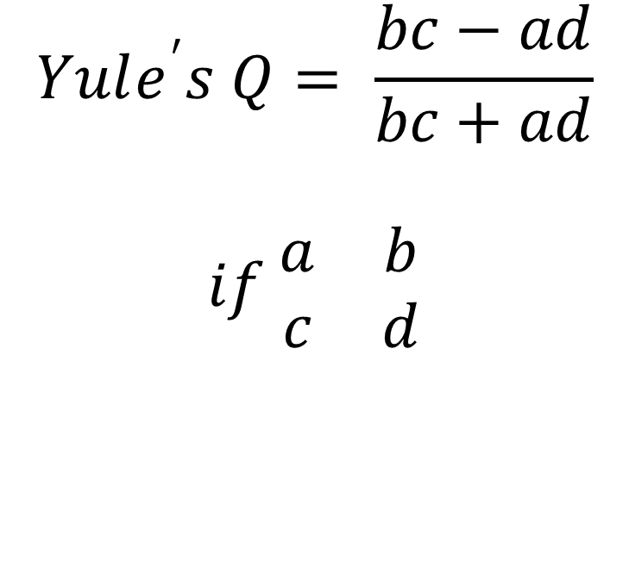
Yule’s Q [Gamma]
Yule’s Q ranges from -1.0 to 1.0. For our interpretation, 0 = no relationship between the variables and 1 (or -1) is a perfect association.
In the case of a 2x2 cross-tab, Yule’s Q estimates the magnitude – but not the direction - of the relationship.
$$Yule^{′}s Q= \frac{bc−ad}{bc+ad}$$
$$if \begin{matrix}a & b \\ c & d\end{matrix}$$

Slide 30

Yule’s Q Example: 2x2 Nominal/Nominal
$Yule^{′}s Q= \frac{bc−ad}{bc+ad}$
$if \begin{matrix}a & b \\ c & d\end{matrix}$
Gamma = 0.134
Interpretation:
“Gender improves our prediction of voting by 13.4%”
 |  | Gender
 |  | Female | Male | TOTAL
Vote | Yes | 300 (a) | 275 (b) | 575
 | No | 250 (c) | 175 (d) | 425
 | TOTAL | 550 | 450 | 1000

Slide 31
Conceptually: Magnitude
Measure of Association: 0
 |  | Gender |  | Total
 |  | Male | Female
Voting | Yes | 25 | 25 | 50
 | No | 25 | 25 | 50
Total |  | 50 | 50 | 100

Slide 32
Conceptually: Magnitude
Measure of Association: 0
 |  | Gender |  | Total
 |  | Male | Female
Voting | Yes | 33 | 33 | 66
 | No | 17 | 17 | 34
Total |  | 50 | 50 | 100

Slide 33
Conceptually: Magnitude
Measure of Association: 1
 |  | Gender |  | Total
 |  | Male | Female
Voting | Yes | 0 | 50 | 50
 | No | 50 | 0 | 50
Total |  | 50 | 50 | 100

Slide 34
Conceptually: Magnitude
Measure of Association: 0.98
 |  | Gender |  | Total
 |  | Male | Female
Voting | Yes | 1 | 49 | 50
 | No | 49 | 1 | 50
Total |  | 50 | 50 | 100

Slide 35
Conceptually: Magnitude
Measure of Association: 0.50
 |  | Gender |  | Total
 |  | Male | Female
Voting | Yes | 17 | 33 | 50
 | No | 33 | 17 | 50
Total |  | 50 | 50 | 100

Slide 36
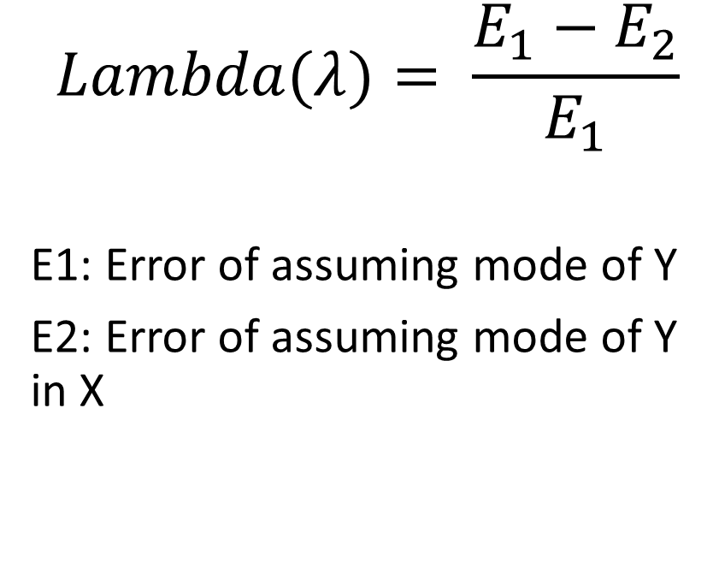
Lambda
Lambda ranges from 0 to 1.0. For our interpretation, 0 = no relationship between the variables and as we approach 1, we get closer to ‘perfect association’.
Lambda estimates the magnitude – but not the direction - of the relationship.
Lambda for non-dichotomous Nom x Nom or Nom x Ord
PRE Statistic
$$Lambda(λ)= \frac{E_{1}−E_{2}}{E_{1}}$$
E1: Error of assuming mode of Y
E2: Error of assuming mode of Y in X

Slide 37
Lambda Example: Nominal/Ordinal
Are there gender differences in the frequency of individuals’ political discussions?
$Lambda(λ)= \frac{E_{1}−E_{2}}{E_{1}}$
 |  | Male | Female | Total
Political Discussion | Frequently
 | Sometimes
 | Never
 | Total
50 | 30 | 80
15 | 40 | 55
5 | 10 | 15
70 | 80 | 150

Slide 38
Lambda Example: Nominal/Ordinal
Lambda Example: Nominal/Ordinal
$Lambda(λ)= \frac{E_{1}−E_{2}}{E_{1}}$
λ = [70] – [15+5+30+10] [70]
λ = 0.1429
Interpretation: “We improve our ability to predict the frequency of political discussions by knowing gender by 14.3%”
OR “We reduce our error in predicting….by 14.3%”
Are there gender differences in the frequency of individuals’ political discussions?
 |  | Male | Female | Total
Political Discussion | Frequently
 | Sometimes
 | Never
 | Total
50 | 30 | 80
15 | 40 | 55
5 | 10 | 15
70 | 80 | 150
 | 30
 | 40
 | 10
 | 80
50
15
5
70
 |  | 80
 |  | 55
 |  | 15
 |  | 150
Title | © Author
Year | SAGE Publishing

Slide 39
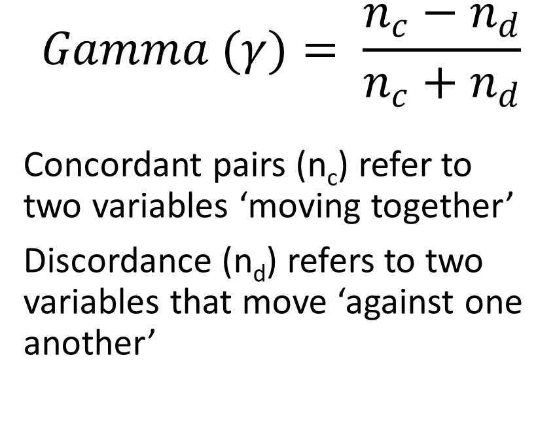
Gamma
Is a PRE statistic
Ranges from -1 to 1
Estimates both magnitude and direction.
Why? Because both variables are ordinal-level.
$$Gamma (γ)= \frac{n_{c}−n_{d}}{n_{c}+n_{d}}$$
Concordant pairs (n_{c}) refer to two variables ‘moving together’
Discordance (n_{d}) refers to two variables that move ‘against one another’

Slide 40

Gamma Example: Ordinal x Ordinal
 | Rare TV Viewing | Med TV Viewing | High TV Viewing | Total
High Interest | 53 | 25 | 19 | 97
Medium Interest | 32 | 49 | 42 | 123
Low Interest | 23 | 31 | 65 | 119
Total | 108 | 105 | 126 | 339
$\text{EX}\text{: }\text{Higher} \text{TV} \text{viewing} \text{produces} \text{lower} \text{political} \text{interest}$
$Gamma (γ)= \frac{n_{c}−n_{d}}{n_{c}+n_{d}}$

Slide 41
Gamma Example: Ordinal x Ordinal
n_{c}=((53)(49+42+31+65))
+((25)(42+65))
+((32)(31+65))
+((49)(65))
n_{d}= ((19)(32+49+23+31)
+((25)(32+23))
+((42)(23+31))
+((49)(23))
Gamma (γ): 0.4396
 | Rare TV Viewing | Med TV Viewing | High TV Viewing | Total
High Interest | 53 | 25 | 19 | 97
Medium Interest | 32 | 49 | 42 | 123
Low Interest | 23 | 31 | 65 | 119
Total | 108 | 105 | 126 | 339
Title | © Author
Year | SAGE Publishing

Slide 42
Measures of Association: EX: Gamma
EX: Higher TV viewing produces lower political interest
 | Rare TV Viewing | Medium TV Viewing | High TV Viewing | Total
High Interest
Medium Interest
Low Interest
Total
 | 49
 |  | 65
53 | 25 | 19 | 97
32 | 49 | 42 | 123
23 | 31 | 65 | 119
108 | 105 | 126 | 339
53 | 25 | 19 | 97
32 | 49 | 42 | 123
23 | 31 | 65 | 119
108 | 105 | 126 | 339
32
 | 31 | 65
 |  | 19
32 | 49
23 | 31
53
 | 49 | 42
 | 31 | 65
 | 25
 |  | 42
 |  | 65
n_{c} = ((53)(49+42+31+65))+((25)(42+65))+((32)(31+65))+((49)(65))
n_{d} = ((19)(32+49+23+31)+((25)(32+23))+((42)(23+31))+((49)(23))
Gamma (γ): 0.4396

Slide 43
Measures of Association: EX: Gamma (continued)
 | Rare TV Viewing | Medium TV Viewing | High TV Viewing | Total
High Interest | 53 | 25 | 19 | 97
Medium Interest | 32 | 49 | 42 | 123
Low Interest | 23 | 31 | 65 | 119
Total | 108 | 105 | 126 | 339
Positive in Gamma (OxO): top left to bottom right positive association
Interpretation: “Knowing a respondent’s level of TV viewing, we reduce our errors in predicting their level of political interest by 44.0%.”
OR “Our prediction of respondents’ level of political interest is 44.0% better by knowing their level of TV consumption.”

Slide 44
Other Measures of Association
 | Nominal | Ordinal
Nominal | 2 x 2: Phi (φ) N x N: Cramer’s V
Ordinal | Cramer’s V | Kendall’s Tau b and Tau c, Somer’s d, Spearman’s rho

Slide 45
Descriptive Statistics: Measures of Association
 | Nominal | Ordinal | Interval
Nominal | N x N (2 x 2): Gamma N x N: Lambda
Ordinal | Lambda | Gamma
Interval | MoA II next week! | MoA II next week! | MoA II next week!

