Slide 1
Research Methods Prof. Matthew Loveless Descriptive Statistics: Measures of Association I Seminar University of Bologna Autumn 2023

Slide 2
Outline
Opening datasets in STATA
Measures of Central Tendency and Dispersion
Measures of Association: Nominal- and Ordinal-level variables

Slide 3
Levels of Measurement
Nominal-level variables simply divide data into categories, with no assumption about the order or relationships between groups. Every observation has a category - but the overall order of the categories is unimportant.
Ordinal-level variables categorize observations ‘in order’ but the ‘jump’ from one category to the next is not necessary ‘the same’ mathematically. That is, while orderly, the intervals between the categories are not uniform.
Interval-level variables, the distance between measures – the intervals - have meaning are easily mathematically tractable.

Slide 4
What is a dataset?
Datasets order observations and variables in the form of rows (observations) and columns (variables).
This is often referred to as the N x K design where ‘N’ refers the number of observations and ‘K’ refers to the number of variables.

Slide 5
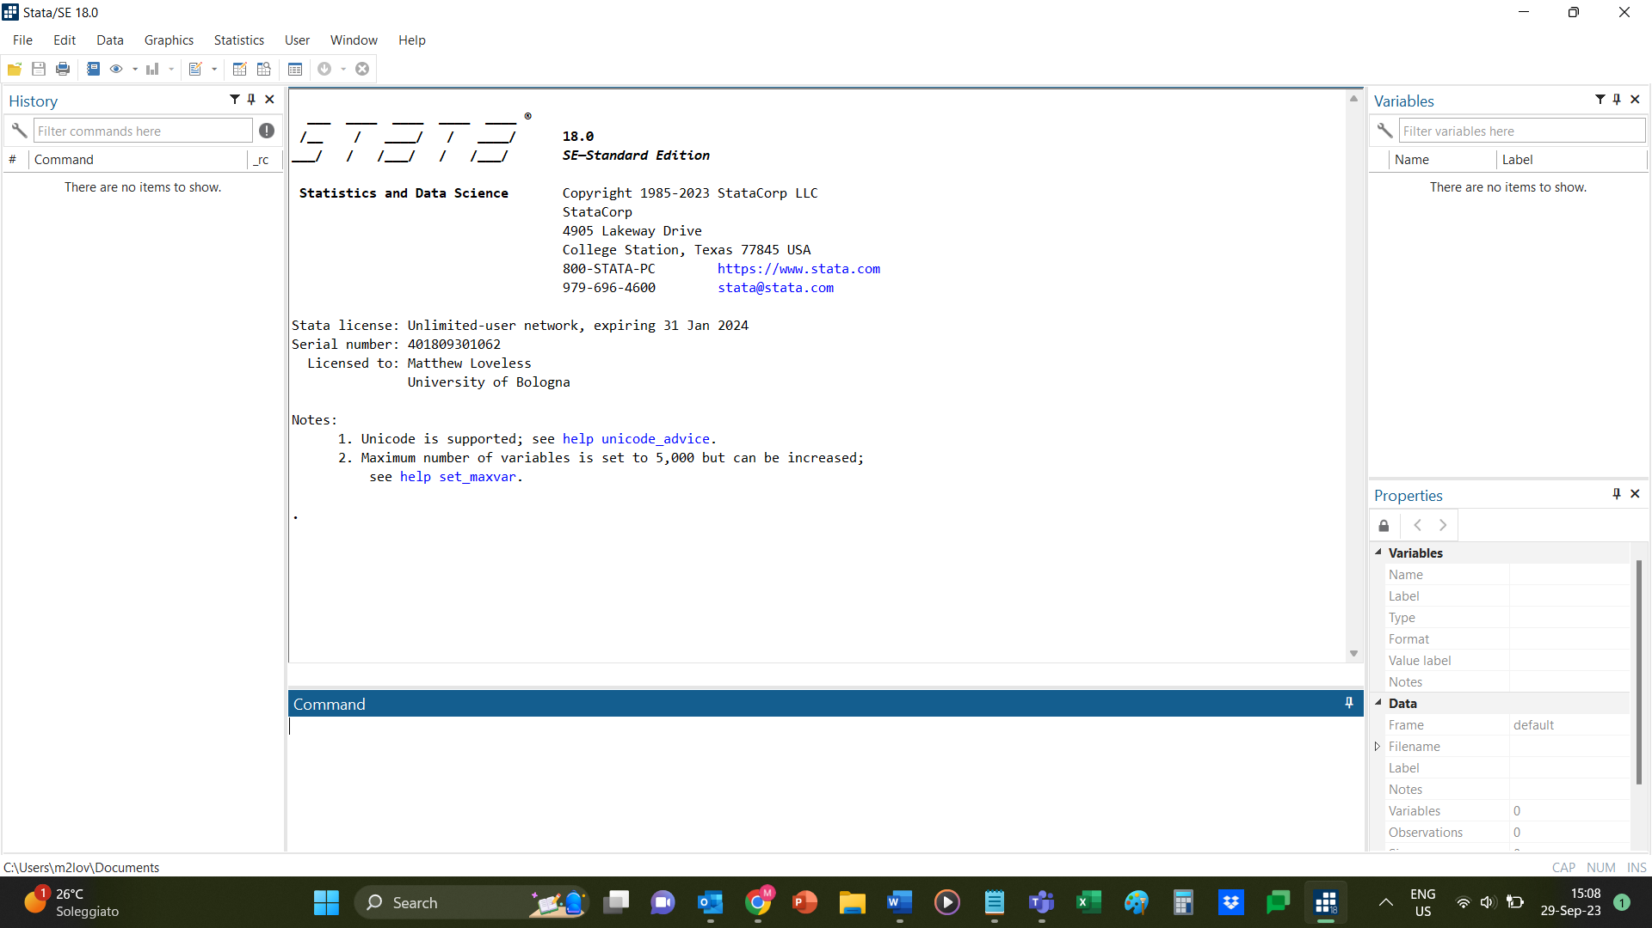
Using STATA

Slide 6
Using STATA: To Open a Dataset

Slide 7
Using STATA: Variables and Commands
Commands
Variables

Slide 8
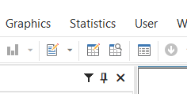
Using STATA: Looking at the Data

Slide 9
Using STATA: Do-file - Saving our Notes

Slide 10
Measures of Central Tendency & Dispersion
use “DS - Levels of Measurement.dta”
Which variables are interval-level, ordinal-level, nominal-level?
Codebook
Kind of messy
codebook, tab(400)
A bit better as this tells STATA to show up to 400 values for each variable. This number can be anything you need.

Slide 11
Measures of Central Tendency & Dispersion: Interval
Interval: GDP Per Capita [gdppc]: mean & standard deviation
summarize gdppc, detail
GDPpc
-------------------------------------------------------------
Percentiles Smallest
1% 556.8 556.8
5% 936.3 936.3
10% 1076.5 1076.5 Obs 25
25% 2097.1 1400.2 Sum of wgt. 25
50% 5090.7 Mean 13691.03
Largest Std. dev. 17930.77
75% 10500.4 40113.1
90% 40284.6 40284.6 Variance 3.22e+08
95% 45723.6 45723.6 Skewness 1.437144
99% 63543.6 63543.6 Kurtosis 3.754848

Slide 12
Measures of Central Tendency & Dispersion: Interval
Interval: GDP Per Capita [gdppc]: mean & standard deviation
tabstat gdppc, stats(mean sd)
Variable | Mean SD
-------------+--------------------
gdppc | 13691.03 17930.77
----------------------------------

Slide 13
Measures of Central Tendency & Dispersion: Ordinal
Ordinal: Global Freedom Scores [fhglobalfreedomscores]: median & range
summarize fhglobalfreedomscores, detail
-------------------------------------------------------------
Percentiles Smallest
1% 1 1
5% 1 1
10% 1 1 Obs 25
25% 1 1 Sum of wgt. 25
50% 2 Mean 1.92
Largest Std. dev. .8621678
75% 3 3
90% 3 3 Variance .7433333
95% 3 3 Skewness .1522463
99% 3 3 Kurtosis 1.417694

Slide 14
Measures of Central Tendency & Dispersion: Ordinal
Ordinal: Global Freedom Scores [fhglobalfreedomscores]: median & range
tabstat fhglobalfreedomscores, stats(median range)
Variable | p50 Range
-------------+--------------------
fhglobalfr~s | 2 2
----------------------------------
???? RANGE: 3-1=2
RENAME: rename fhglobalfreedomscores FH_GS

Slide 15
Measures of Central Tendency & Dispersion: Nominal
Nominal: Main Religion [mainreligion]
tab mainreligion
Identify Mode (most frequent one)
Calculate Variation Ratio: $VR=\frac{\sum{\left(F_{non−modal}\right)}}{no. of obs}$
Here: (2+1+1+5+2)/25
OR 0.44
Also [1-0.56]=0.44
. tab mainreligion
Main Religion | Freq. Percent Cum.
-----------------------+-----------------------------------
Buddhism | 2 8.00 8.00
Christianity | 14 56.00 64.00
Folk Religions | 1 4.00 68.00
Hinduism | 1 4.00 72.00
Islam | 5 20.00 92.00
Unaffiliated Religions | 2 8.00 100.00
-----------------------+-----------------------------------
Total | 25 100.00

Slide 16
Descriptive Statistics: Measures of Association
 | Nominal | Ordinal | Interval
Nominal | 2 x 2: Gamma N x N: Lambda
Ordinal | Lambda | Gamma
Interval

Slide 17
Measures of Association
Identify the Levels of Measurement for all variables
“DS - Gamma Lambda.dta”
codebook, tab(400)
Nominal-level | Ordinal-level | Interval-level
Country | FH_IF | Perc_Internet
DemORnot | FH_GF | CHUNEMPLOY1820
PercInt2 | PercInt3 | VA
UNEMP | Internet_Censor

Slide 18
Measures of Central Tendency and Dispersion
For practice: What are the most appropriate measures of central tendency and dispersion?
% with Internet access: PercInt2
Nominal-level: Mode and Variation Ratio
Freedom House Global Freedom Scores: FH_GF
Ordinal-level: Median and Range
Unemployment rate: UNEMP
Interval-level: Mean and standard deviation

Slide 19
Measures of Association: Yule’s Q
Yule's Q [Gamma]
tab UNEMP DemORnot, gamma
What do we find?
Try:
tab UNEMP PercInt2, gamma col
What do we find?
You can use ‘col' to help see the nature of the relationship

Slide 20
Measures of Association: Lambda
INSTALL
“findit lambda”

Slide 21
Measures of Association: Lambda
*Lambda ["lambda_a"]
lambda DemORnot PercInt3
What do we find?
lambda DemORnot FH_GF
What do we find?

Slide 22
Measures of Association: Gamma
Gamma
tab FH_IF Internet_Censor, gamma
What do we find?
TRY:
tab FH_IF PercInt3, gamma
What do we find?

Slide 24
Using STATA
Using other datasets: “ESS DPC.dta”
You can use ‘recode’ to make variables more intuitive
NOTE: This (below) has already been done in ESS DPC.dta
codebook polintr, tab(40)
recode polintr (4=1) (3=2) (2=3) (1=4), gen(PolInt)
lab def ddd 1 "Not at all Interested" 2 "Hardly Interested" 3 "Quite Interested" 4 "Very Interested"
lab val PolInt ddd
lab var PolInt "Political Interest"

Slide 25
Controlled Comparisons: Example
“ESS DPC.dta”
lambda clsprty PolInt
Compare by gender (Male=1; Female=0)
lambda clsprty PolInt if Gender==0
lambda clsprty PolInt if Gender==1
With gamma, you can use ‘bysort’
bysort Gender: tab netusoft PolInt, gamma

