Slide 1
Research Methods
Prof. Matthew Loveless
Descriptive Statistics:
Measures of Association II
Seminar
University of Bologna
Autumn 2023

Slide 2
Outline
Using datasets and codebooks in STATA
Means Comparisons
Controlled Comparisons
Correlation
(Bivariate) Regression

Slide 3
Means Comparisons
“V-Dem mini.dta“
What is the Liberal Democracy Index by an ordinal-level measure of Freedom of academic and cultural expression
Liberal Democracy Index: v2x_libdem
Freedom of academic and cultural expression: v2clacfree_ord
codebook v2clacfree_ord v2x_libdem, tab(500)
What do you expect to find?

Slide 4
Means Comparisons
tabstat v2x_libdem, stats(mean n) by(v2clacfree_ord)
v2clacfree_ord | Mean N
---------------+--------------------
none | .0648296 3671
weak | .1126246 3090
somewhat | .1838784 3431
mostly | .3876027 4049
fully | .7108208 2018
---------------+--------------------
Total | .2595932 16259
------------------------------------

Slide 5
Means Comparisons
Does the Egalitarian democracy index move with power distributed by gender?
Egalitarian democracy index: v2x_egaldem
  gen EgalDem=v2x_egaldem*10
  lab var EgalDem "Egal Dem Index“
Power distributed by gender (Ordinal): v2pepwrgen_ord
codebook v2pepwrgen_ord EgalDem, tab(500)
What do you expect to find?

Slide 6
Means Comparisons
tabstat EgalDem, stats(mean n) by(v2pepwrgen_ord)
v2pepwrgen_ord | Mean N
-----------------+--------------------
monopoly | .8093719 5726
men dominant, wo | 2.082013 5497
men more, women | 3.910286 3254
men more than wo | 5.794554 1369
equal | 7.411154 413
-----------------+--------------------
Total | 2.447685 16259
--------------------------------------

Slide 7
Controlled Comparisons
Control for Female Head of State
Egalitarian democracy index: v2x_egaldem
Power distributed by gender (ordinal): v2pepwrgen_ord
Female Head of State ‘v2exfemhos’
  Is there something symbolic about a female Head of State?
codebook v2exfemhos
bysort v2exfemhos: tabstat EgalDem, stats(mean n) by(v2pepwrgen_ord)

Slide 8
Controlled Comparisons
-> v2exfemhos = 0
Summary for variables: EgalDem
Group variable: v2pepwrgen_ord (Power distributed by gender)
v2pepwrgen_ord | Mean N
-----------------+--------------------
monopoly | .8412362 4282
men dominant, wo | 2.028906 3928
men more, women | 3.851367 2289
men more than wo | 6.317748 909
equal | 6.727684 249
-----------------+--------------------
Total | 2.385307 11657
--------------------------------------
-> v2exfemhos = 1
Summary for variables: EgalDem
Group variable: v2pepwrgen_ord (Power distributed by gender)
v2pepwrgen_ord | Mean N
-----------------+--------------------
monopoly | 1.516289 49
men dominant, wo | 4.874463 76
men more, women | 5.962227 124
men more than wo | 6.440477 87
equal | 8.701506 103
-----------------+--------------------
Total | 6.015149 439
--------------------------------------
-> v2exfemhos = .
Summary for variables: EgalDem
Group variable: v2pepwrgen_ord (Power distributed by gender)
v2pepwrgen_ord | Mean N
-----------------+--------------------
monopoly | .6871025 1394
men dominant, wo | 2.078672 1492
men more, women | 3.768859 840
men more than wo | 4.375745 372
equal | 8.022269 61
-----------------+--------------------
Total | 2.246256 4159
--------------------------------------

Slide 9
Correlation
Egalitarian democracy index: EgalDem
Power distributed by gender: v2pepwrgen_osp
pwcorr v2pepwrgen_osp EgalDem
scatter v2pepwrgen_osp EgalDem
ALSO: Check our earlier transformation:
pwcorr EgalDem v2x_egaldem
scatter Scatter EgalDem v2x_egaldem

Slide 10
Play with correlation
Electoral democracy index: v2x_polyarchy
Participatory democracy index: v2x_partipdem
Direct popular vote index: v2xdd_dd
Freedom of expression index: v2x_freexp
Harassment of journalists: v2meharjrn
Civil society participation index: v2x_cspart
Women civil liberties index: v2x_gencl
Political corruption: v2x_corr
Election turnout: v2eltrnout
Suffrage level: v2elgvsuflvl
Freedom of foreign movement: v2clfmove
Freedom of domestic movement: v2xcl_dmove

Slide 11
Correlation
codebook v2pepwrgen_osp v2x_egaldem v2x_polyarchy v2x_partipdem v2x_freexp v2x_cspart v2xdd_dd v2x_gencl v2x_corr v2elgvsuflvl v2eltrnout v2clfmove v2xcl_dmove v2meharjrn, tab(25)
pwcorr v2pepwrgen_osp v2x_egaldem v2x_polyarchy v2x_partipdem v2x_freexp v2x_cspart v2xdd_dd v2x_gencl v2x_corr v2elgvsuflvl v2eltrnout v2clfmove v2xcl_dmove v2meharjrn

Slide 12
(Bivariate) Regression: Modelling
Step One: A Research Question
Step Two: Identify Variables
Step Three: Pearson’s Product Moment Correlation Coefficient
Step Four: The Regression Equation
Step Five: Model Fit
Step Six: Interpretation

Slide 13
(Bivariate) Regression: Modelling
Step One: A Research Question
Does the extent of egalitarian dimensions, institutions, and distributions in a democracy create opportunities for (political) power to be as well distributed by gender?

Slide 14
(Bivariate) Regression: Modelling
Step Two: Identify Variables
v2pepwrgen_osp: Power distributed by Gender
Mean: 1.183
Std. dev.: 0.916
Range: 0-4
EgalDem: Egal Dem Index [original index x 10]
Mean: 2.448
Std. dev.: 2.451
Range: 0-10
codebook v2pepwrgen_osp EgalDem

Slide 15
(Bivariate) Regression: Modelling
Step Three: Pearson’s Product Moment Correlation Coefficient
  pwcorr v2pepwrgen_osp EgalDem
  scatter v2pepwrgen_osp EgalDem
| v2pepw~p EgalDem
-------------+------------------
v2pepwrgen~p | 1.0000
EgalDem | 0.7326 1.0000

Slide 16
Scatterplot: (Bivariate) Regression
Scatterplot: (Bivariate) Regression
scatter v2pepwrgen_osp v2x_egaldem || lfit
graph export
TOGETHER:
scatter v2pepwrgen_osp EgalDem || lfit v2pepwrgen_osp EgalDem
$$Gendered Power=0.52+0.275 (EgalDem)+ε$$

Slide 17
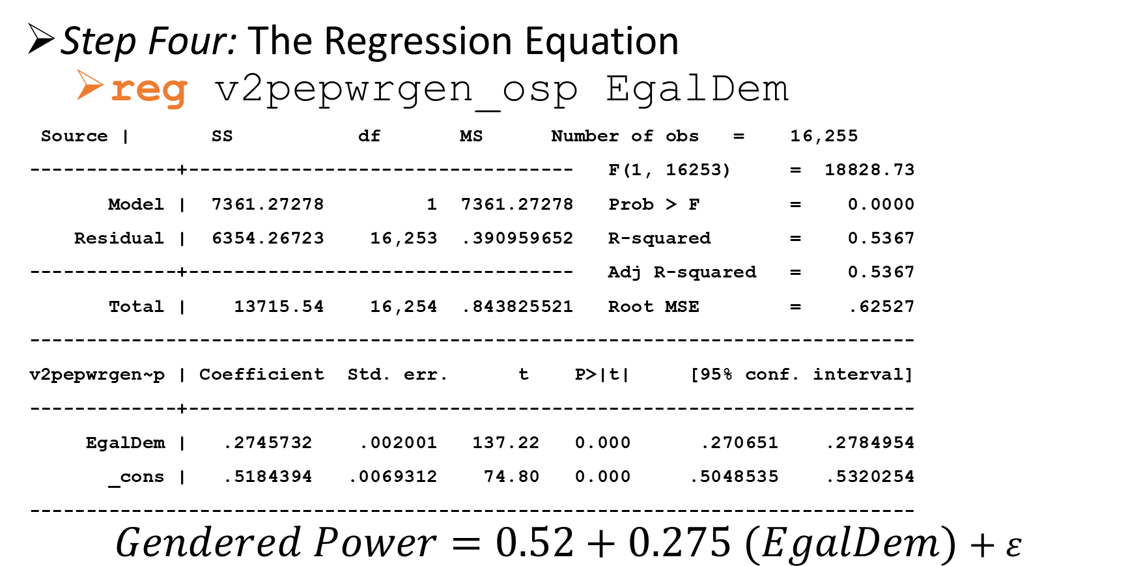
(Bivariate) Regression: Modelling
Step Four: The Regression Equation
  reg v2pepwrgen_osp EgalDem
Source | SS df MS Number of obs = 16,255
-------------+---------------------------------- F(1, 16253) = 18828.73
Model | 7361.27278 1 7361.27278 Prob > F = 0.0000
Residual | 6354.26723 16,253 .390959652 R-squared = 0.5367
-------------+---------------------------------- Adj R-squared = 0.5367
Total | 13715.54 16,254 .843825521 Root MSE = .62527
------------------------------------------------------------------------------
v2pepwrgen~p | Coefficient Std. err. t P>|t| [95% conf. interval]
-------------+----------------------------------------------------------------
EgalDem | .2745732 .002001 137.22 0.000 .270651 .2784954
_cons | .5184394 .0069312 74.80 0.000 .5048535 .5320254
------------------------------------------------------------------------------
$$Gendered Power=0.52+0.275 (EgalDem)+ε$$

Slide 18
Scatterplot: (Bivariate) Regression
Scatterplot: (Bivariate) Regression
scatter v2pepwrgen_osp v2x_egaldem || lfit
graph export
1-unit increase in EgalDem = 0.275 in Gendered power
Intercept: 0.52?
$$Gendered Power=0.52+0.275 (EgalDem)+ε$$

Slide 19
(Bivariate) Regression: Modelling
Step Five: Model Fit
  reg v2pepwrgen_osp EgalDem
Source | SS df MS Number of obs = 16,255
-------------+---------------------------------- F(1, 16253) = 18828.73
Model | 7361.27278 1 7361.27278 Prob > F = 0.0000
Residual | 6354.26723 16,253 .390959652 R-squared = 0.5367
-------------+---------------------------------- Adj R-squared = 0.5367
Total | 13715.54 16,254 .843825521 Root MSE = .62527
------------------------------------------------------------------------------
v2pepwrgen~p | Coefficient Std. err. t P>|t| [95% conf. interval]
-------------+----------------------------------------------------------------
EgalDem | .2745732 .002001 137.22 0.000 .270651 .2784954
_cons | .5184394 .0069312 74.80 0.000 .5048535 .5320254
------------------------------------------------------------------------------

Slide 20
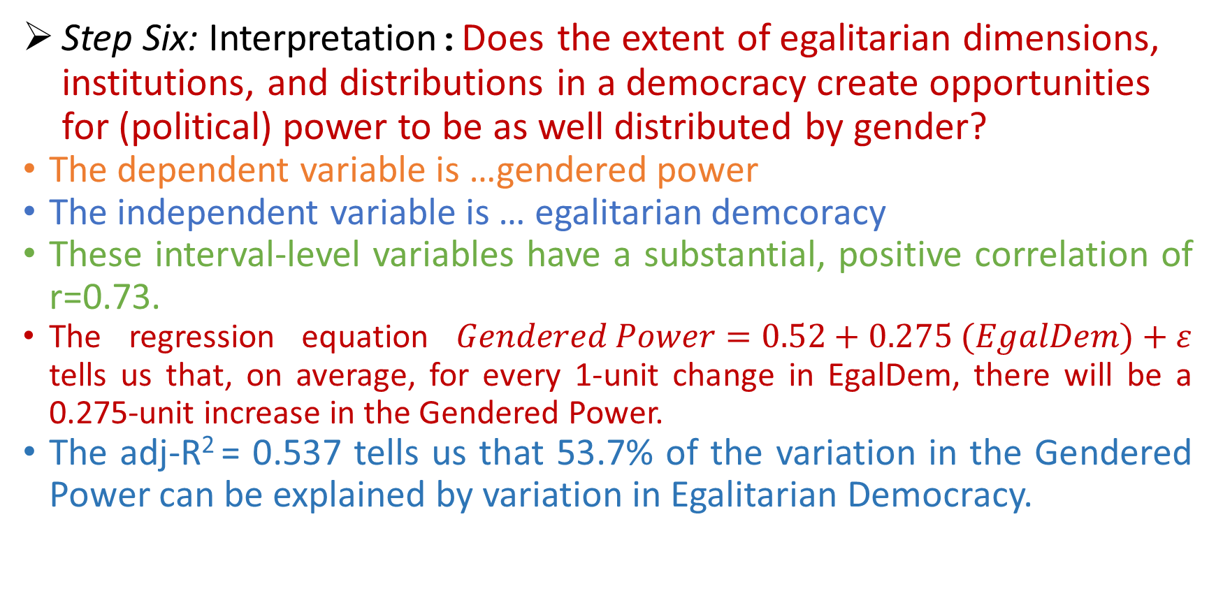
(Bivariate) Regression: Modelling
Step Six: Interpretation:Does the extent of egalitarian dimensions, institutions, and distributions in a democracy create opportunities for (political) power to be as well distributed by gender?
The dependent variable is …gendered power
The independent variable is … egalitarian demcoracy
These interval-level variables have a substantial, positive correlation of r=0.73.
The regression equation $Gendered Power=0.52+0.275 (EgalDem)+ε$ tells us that, on average, for every 1-unit change in EgalDem, there will be a 0.275-unit increase in the Gendered Power.
The adj-R² = 0.537 tells us that 53.7% of the variation in the Gendered Power can be explained by variation in Egalitarian Democracy.

