Slide 1
Research Methods
Prof. Matthew Loveless
Descriptive Statistics:
Measures of Association II
University of Bologna
Autumn 2023

Slide 2
Outline
Means Comparisons
Controlled Comparisons
Correlation
(Bivariate) Regression

Slide 3
Measures of Association
 | Nominal | Ordinal | Interval
Nominal | 2 x 2: Yule’s Q [Gamma] N x N: Lambda
Ordinal | Lambda | Gamma
Interval | Means Comparison | Means Comparison

Slide 4
Means Comparison
 |  | Interval-level variable
Nominal-/Ordinal-level variable | Category A | Mean for Category A
 | Category B | Mean for Category B
 | Category C | Mean for Category C
 | … | …
A means comparison calculates a mean for each category of the nominal- or ordinal-level variable.
This allows us to compare the means of the interval-level variable across the categories of nominal-level and ordinal-level variables.

Slide 5
Descriptive Statistics: Means Comparison
Ideological self-ID | Mean | N
Extremely liberal | 8.29 | 68
Liberal | 8.57 | 221
Slightly liberal | 8.13 | 219
Moderate | 7.75 | 664
Slightly conservative | 7.29 | 262
Conservative | 6.61 | 279
Extremely conservative | 5.21 | 62
Total | 7.58 | 1775
Nominal/Ordinal x Interval:
e.g. Do female roles move with individuals’ ideology?
  Interval: Female Roles: 0 = domestic 12= work/ politics
  Ordinal: 7-point ideological scale (L/R)

Slide 6
Controlled Comparisons
Zero order relationship:
  X → Y : the relationship between 2 variables [nothing else]
Partial relationship:
  X → Y controlling for Z: a controlled comparison
  Simply, X may not explain all the variation in Y

Slide 7
Controlled Comparisons II
There are three ways another variable can contribute to our understanding about a relationship.
  Spurious relationship:
    Instead of X→ Y, we have Z → Y (or even Z → X)
  Additive relationship:
    Instead of only X → Y, you have X → Y and Z → Y
  Interactive relationship:
    Z
    X Y

Slide 8
Controlled Comparisons EX1
Ideological self-ID | Mean | N
Extremely liberal | 8.29 | 68
Liberal | 8.57 | 221
Slightly liberal | 8.13 | 219
Moderate | 7.75 | 664
Slightly conservative | 7.29 | 262
Conservative | 6.61 | 279
Extremely conservative | 5.21 | 62
Total | 7.58 | 1775
Male | N
8.17 | 24
8.02 | 91
8.01 | 104
7.25 | 266
7.04 | 112
6.21 | 133
4.83 | 35
7.15 | 765
Female | N
8.36 | 44
8.96 | 130
8.23 | 115
8.08 | 398
7.47 | 150
6.97 | 146
5.70 | 27
7.91 | 1010

Slide 9
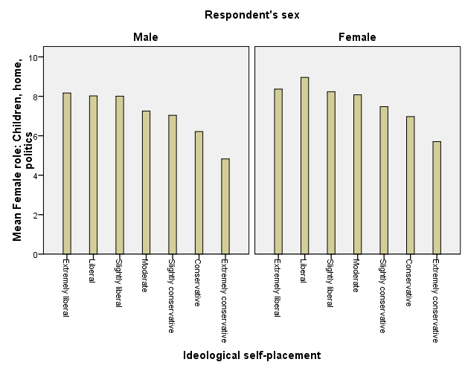
Controlled Comparisons EX2, II

Slide 10
Measures of Association
 | Nominal | Ordinal | Interval
Nominal | 2 x 2: Yule’s Q [Gamma] N x N: Lambda
Ordinal | Lambda | Gamma
Interval | Means Comparison | Means Comparison | Pearson’s Product Moment Correlation Coefficient

Slide 11
Correlation
Pearson’s Product Moment Correlation Coefficient, or ‘r’
Correlation is a direct measure of the strength and direction of the extent to which two interval-level variables are linearly related. It tells us two things.
  The magnitude - or strength - of the relationship.
  The direction of the relationship.
    A positive correlation means that as one variable increases, so does the other.
    Conversely, a negative correlation means that as one variable decreases, the other one increases. And vice versa.

Slide 12
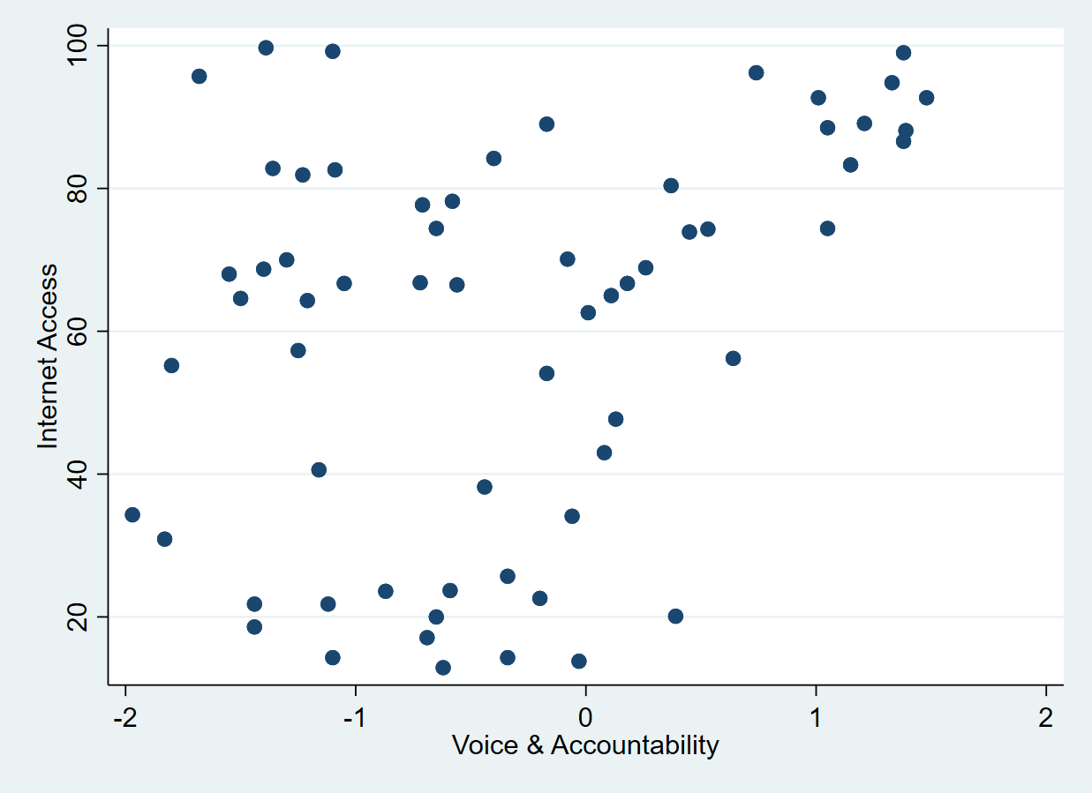
Correlation
A scatterplot is a graph that displays the joint distribution of two interval-level variables as a set of points on a Cartesian coordinate system.
The independent variable on the x-axis
The dependent variable on the y-axis.

Slide 13
Formulas for Correlation

Slide 14
Correlation
Perfect positive/negative correlation | 1.0
Very strong positive/ negative correlation | 0.75 – 0.99
Substantial positive/ negative correlation | 0.50 - 0.74
Moderate positive/ negative correlation | 0.30 - 0.49
Low positive/ negative correlation | 0.10 - 0.29
Negligible | 0.00 - 0.09
Relative Strength reporting

Slide 15
Correlation with Voice & Accountability (WGI)
 | Correlation coefficient
Corruption Perceptions Index | r=0.68
Life expectancy at birth | r=0.43
Renewable energy consumption | r=-0.02
Global Militarization Index | r=-0.40
Press Freedom Index | r=-0.88

Slide 16
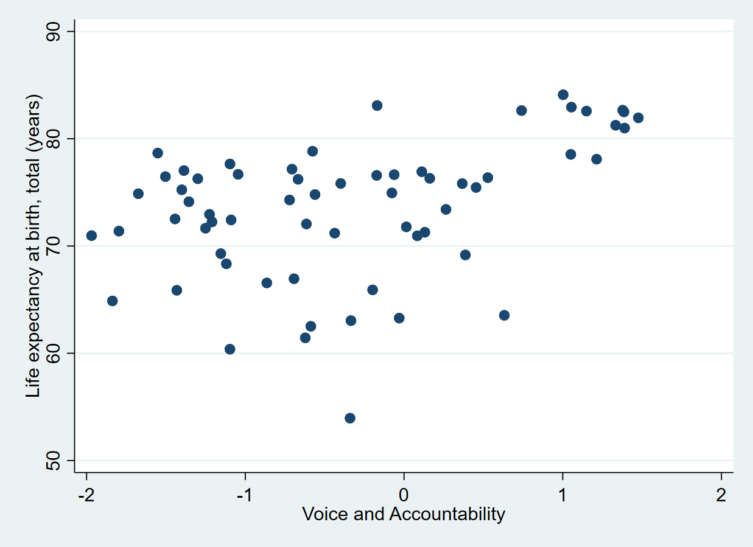
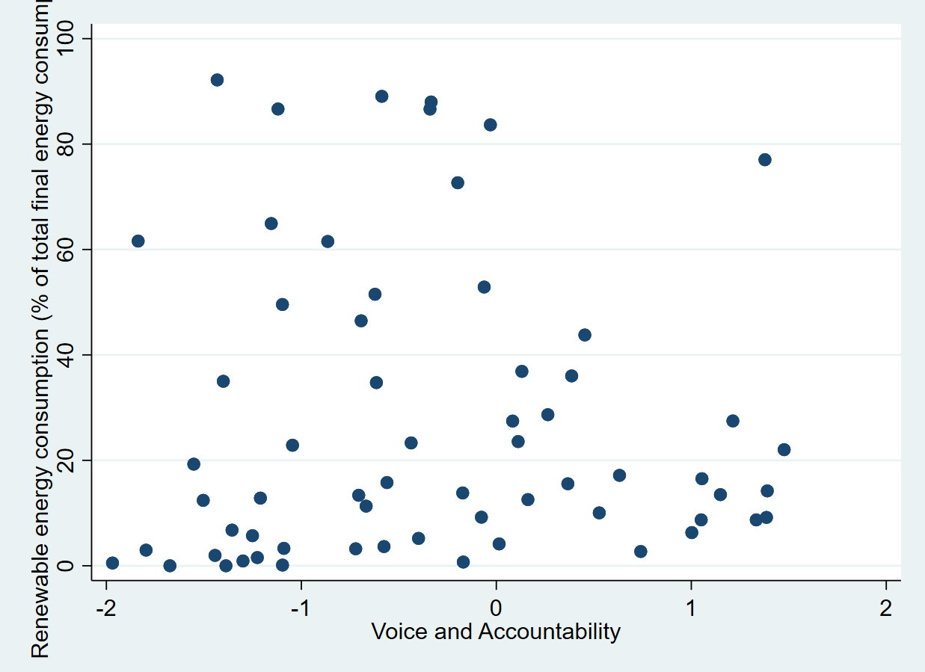
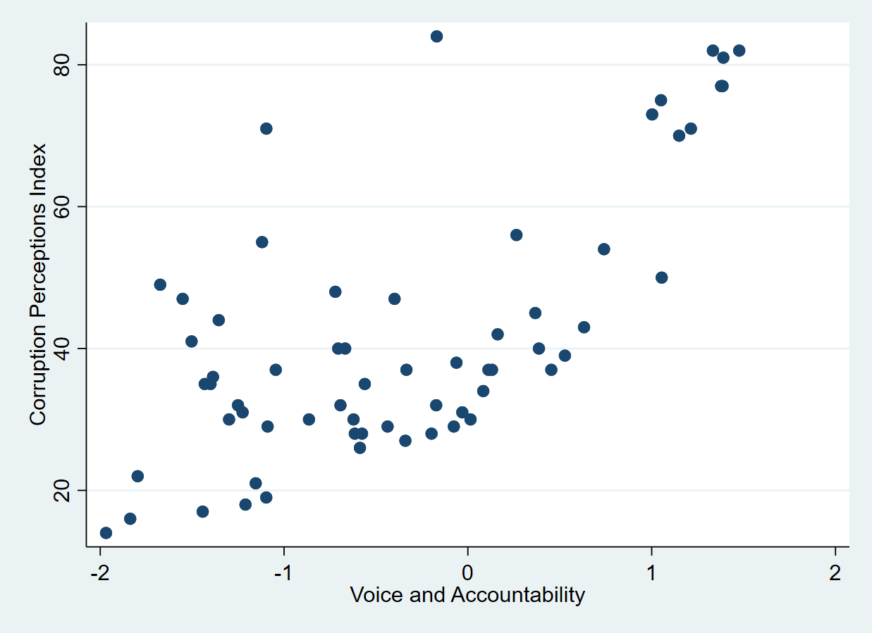
Correlation
r=-0.02
r=0.43
r=0.68
Moderate positive correlation
Negligible
Substantial positive correlation

Slide 17
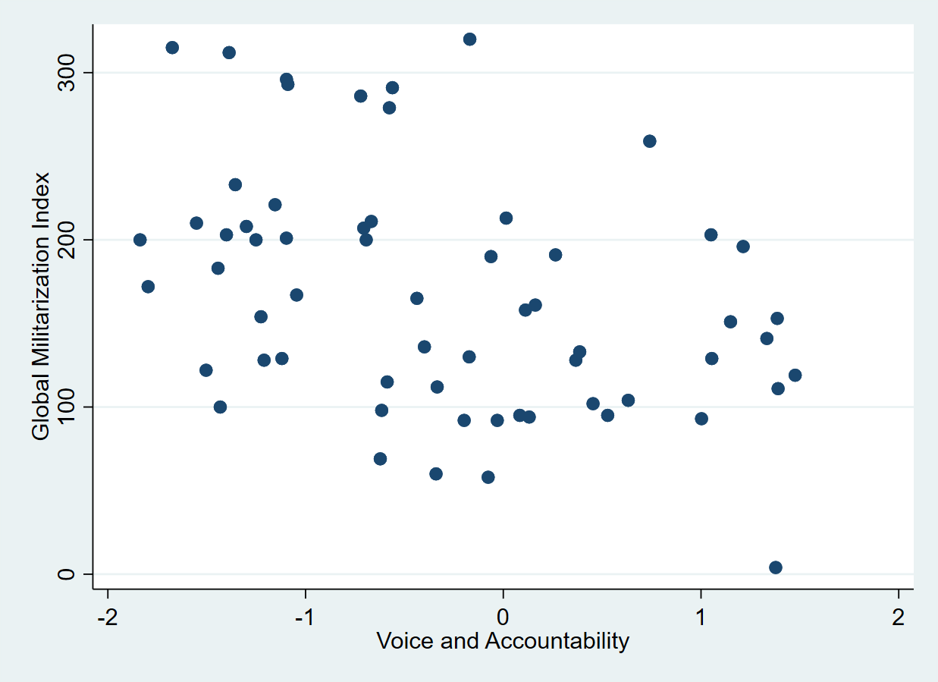
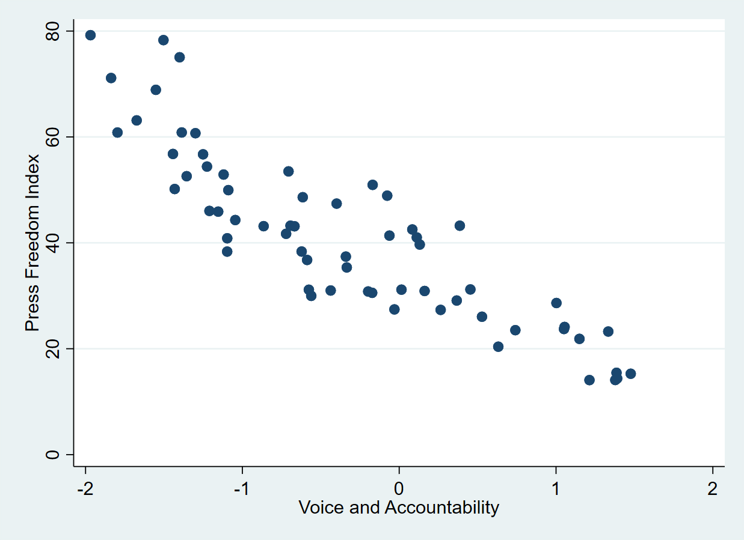
Correlation
r=-0.88
r=-0.40
Moderate negative correlation
Very strong negative correlation

Slide 18
Correlation and Causation
Correlation is not (necessarily) causation
Causation is a theoretical concept while correlation is a statistical concept.
Theory is the how and correlation is the if.
Correlation provides the necessary but not sufficient state for a causal relationship.

Slide 19
Correlation
Correlation is not (necessarily) Causation
Wilkinson, Richard and Kate Pickett. 2010. The Spirit Level. Why Equality is Better for Everyone. London: Penguin.
Apophenia is the tendency to mistakenly perceive connections and meaning between unrelated things.

Slide 20
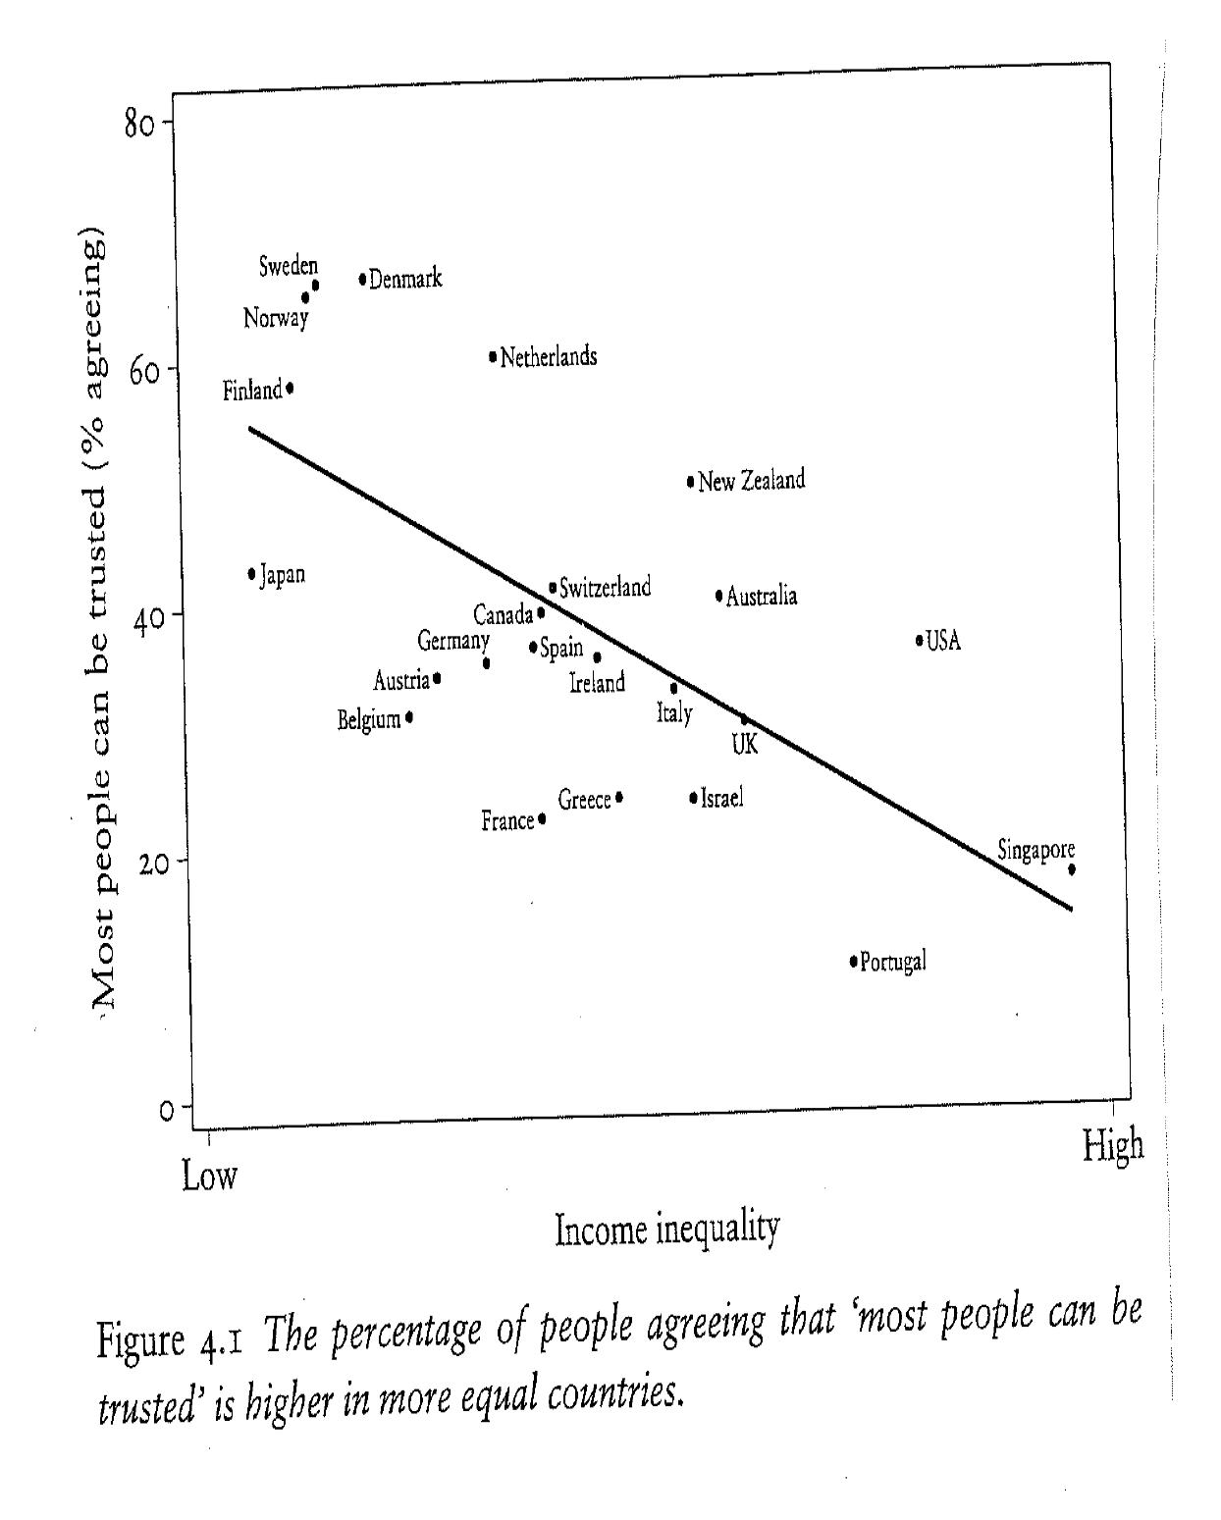

Slide 21
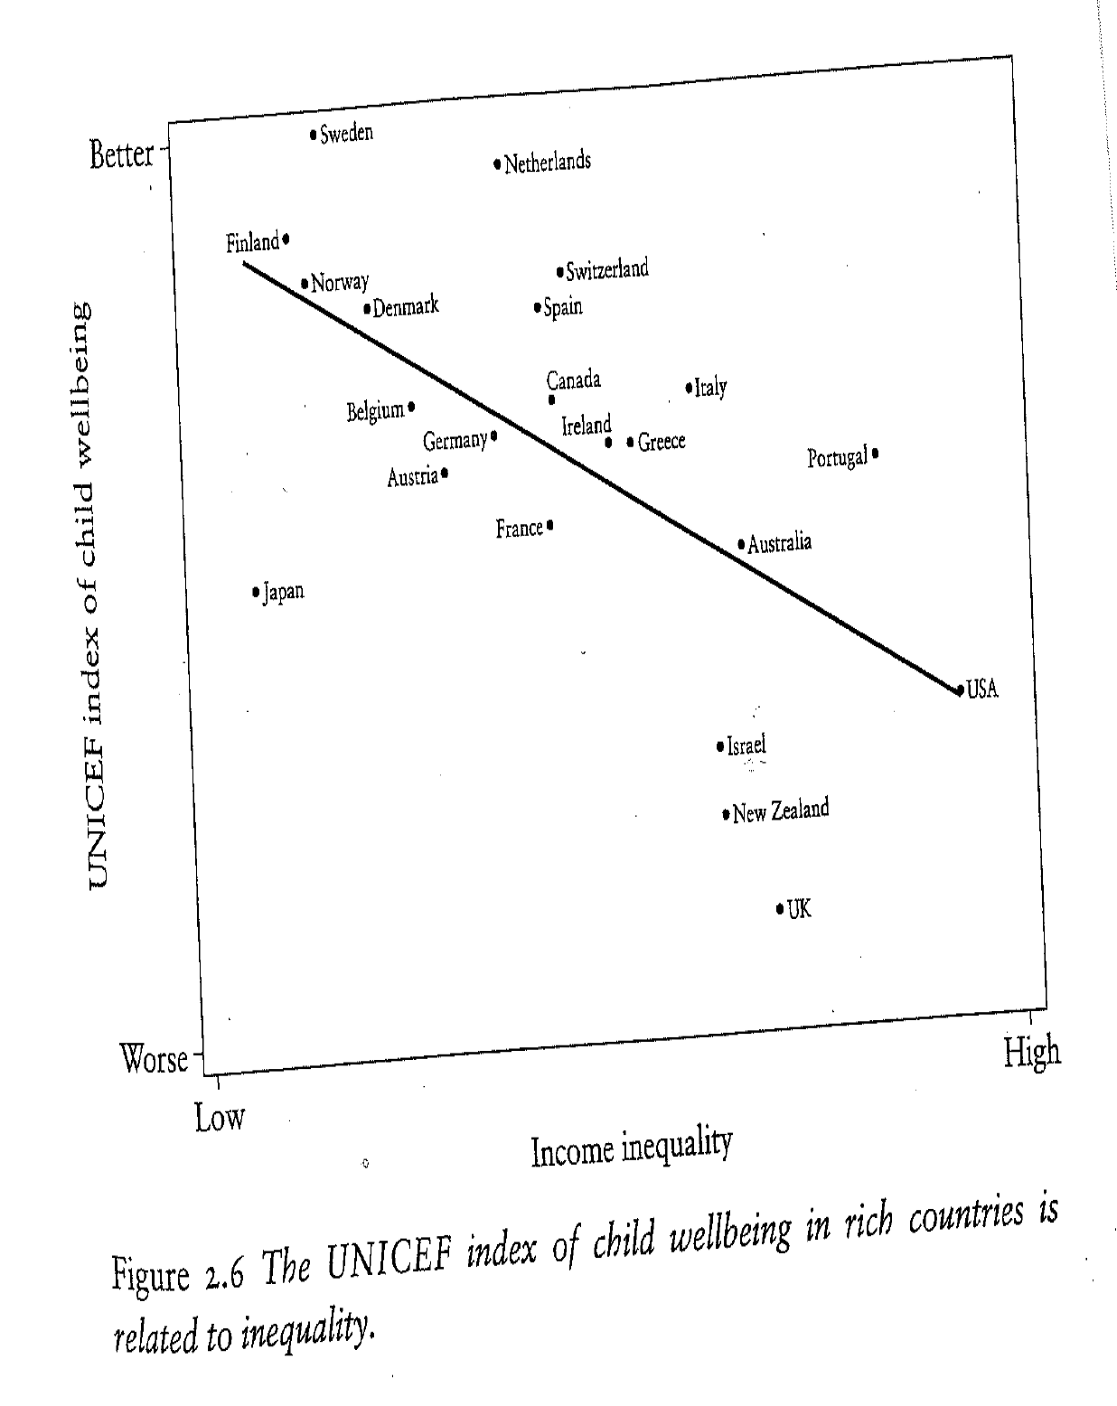

Slide 23
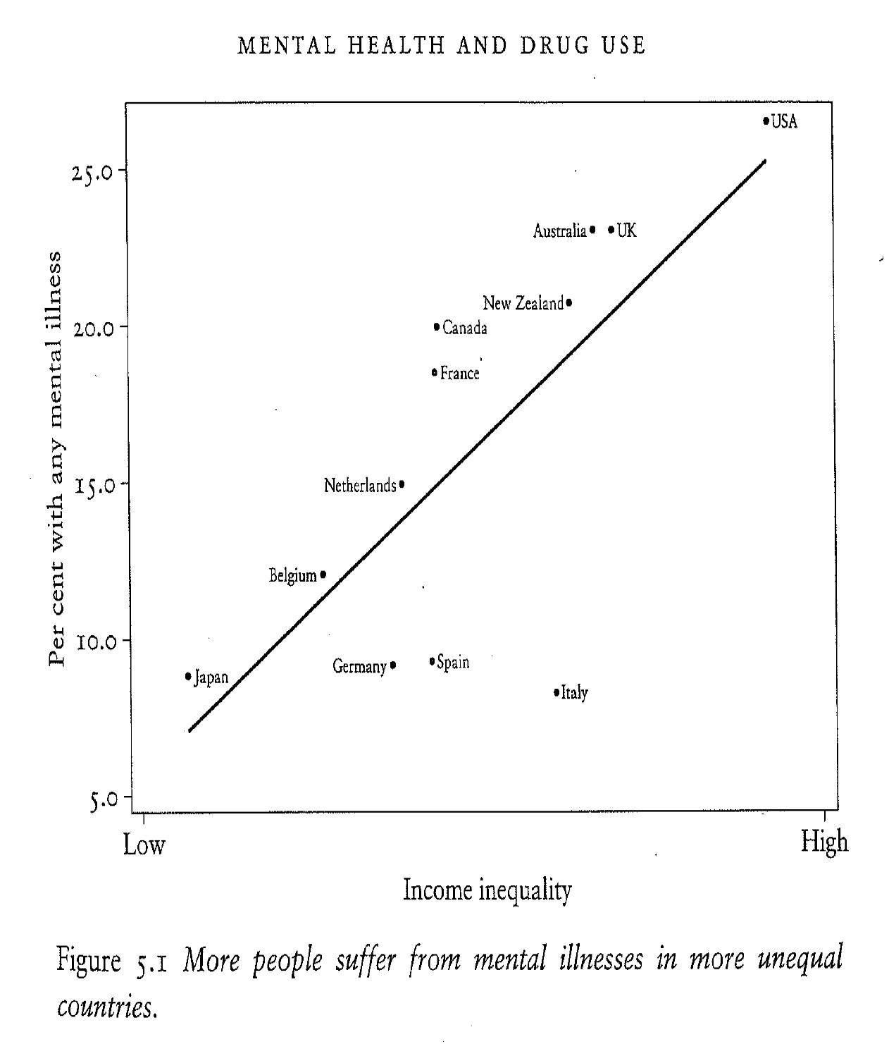

Slide 24
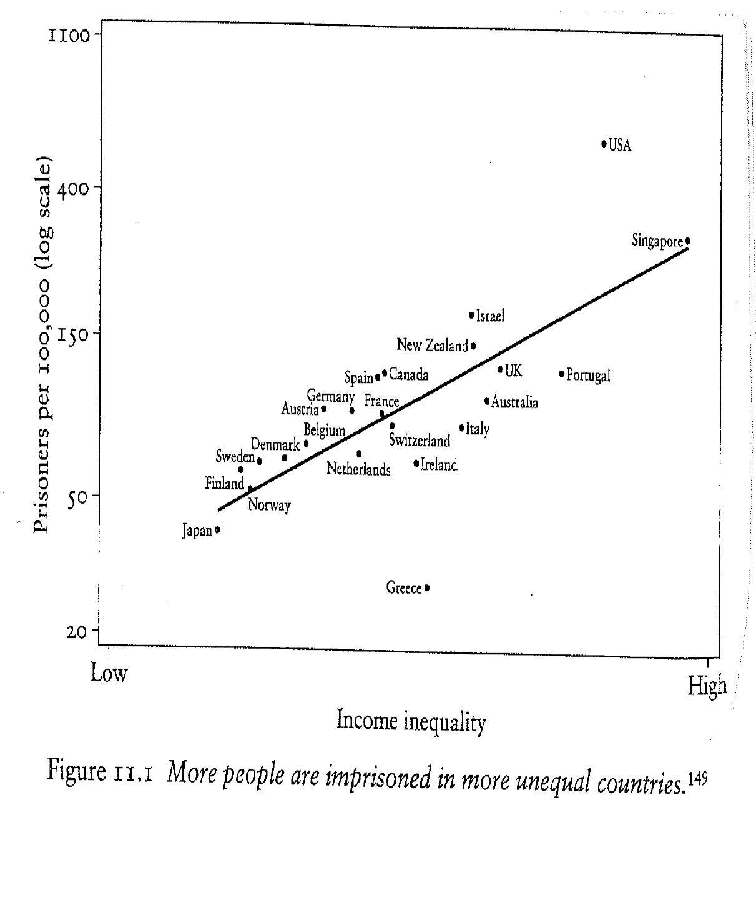

Slide 25
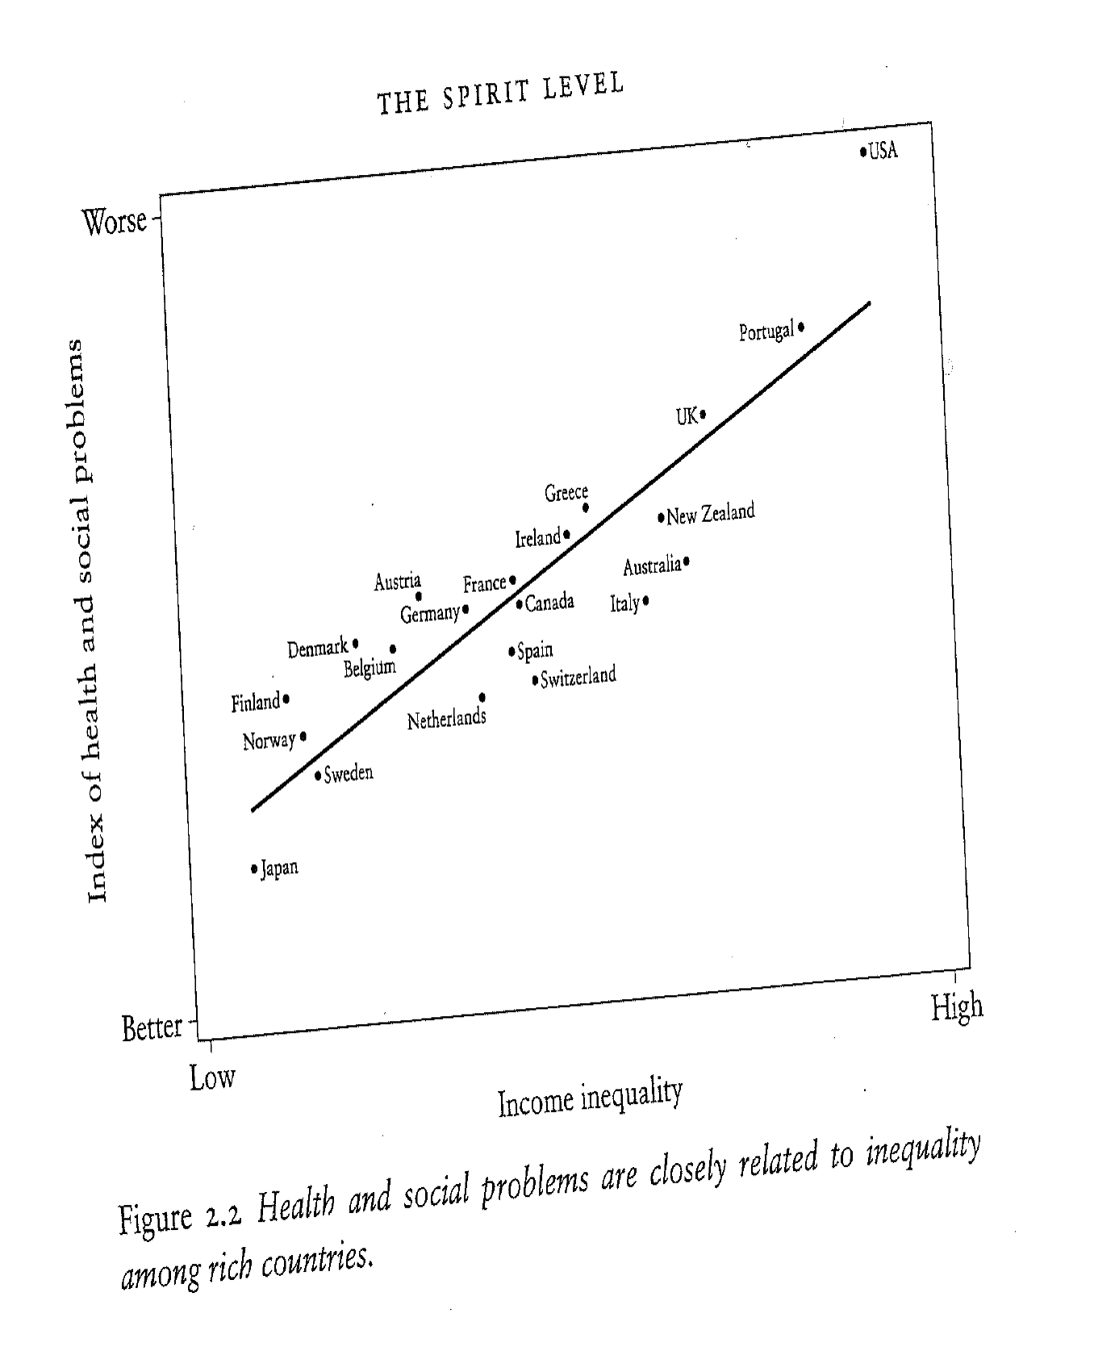

Slide 26
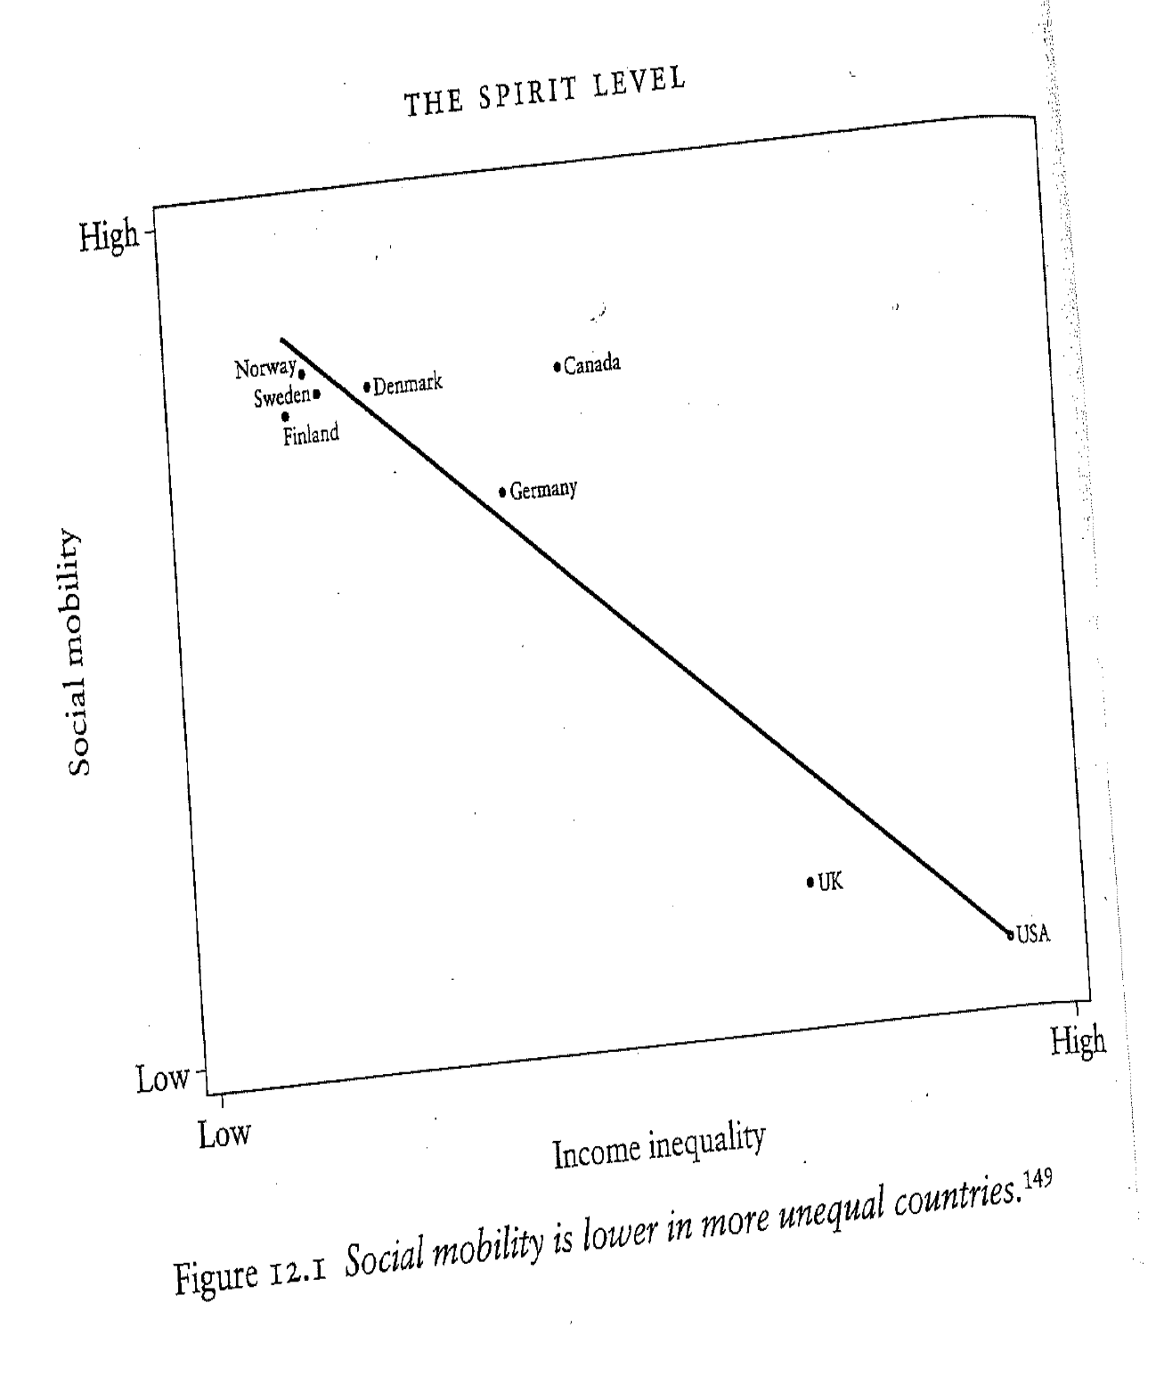

Slide 27
Measures of Association
 | Nominal | Ordinal | Interval
Nominal | 2 x 2: Yule’s Q [Gamma] N x N: Lambda
Ordinal | Lambda | Gamma
Interval | Means Comparison | Means Comparison | Pearson’s Product Moment Correlation Coefficient (Bivariate) Regression

Slide 28
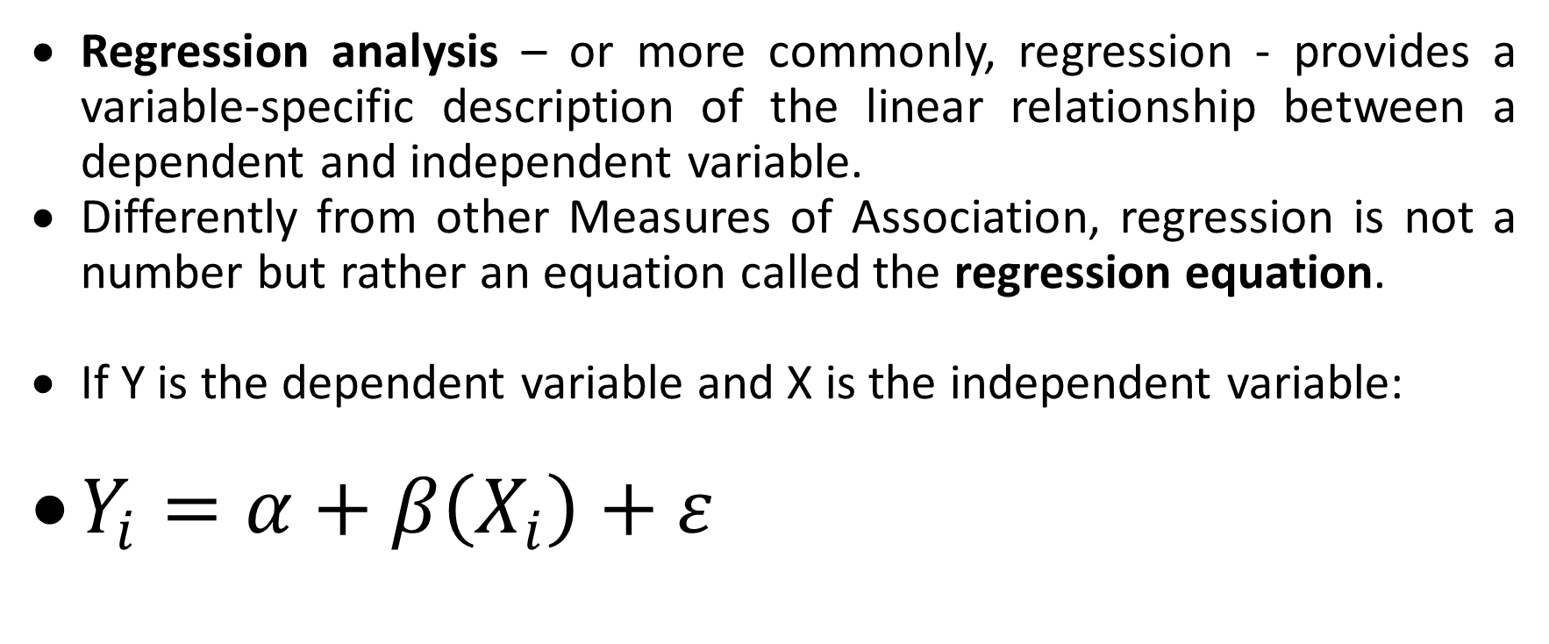
(Bivariate) Regression
Regression analysis – or more commonly, regression - provides a variable-specific description of the linear relationship between a dependent and independent variable.
Differently from other Measures of Association, regression is not a number but rather an equation called the regression equation.
If Y is the dependent variable and X is the independent variable:
$Y_{i}=α+β\left(X_{i}\right)+ε$

Slide 29
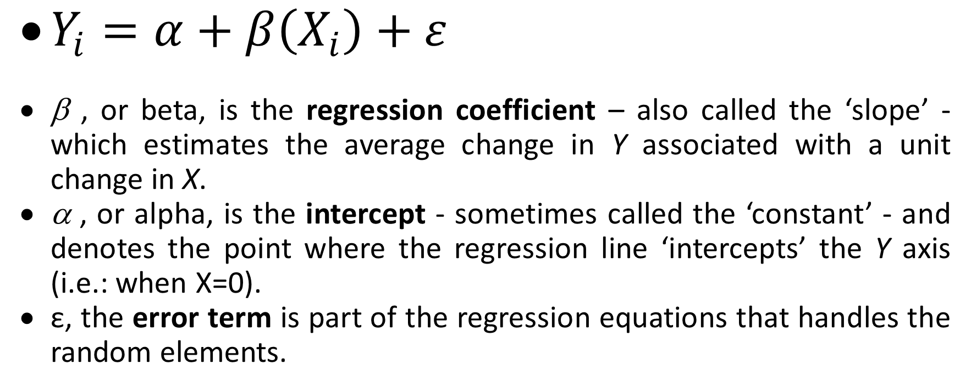
(Bivariate) Regression Equation
$Y_{i}=α+β\left(X_{i}\right)+ε$
β , or beta, is the regression coefficient – also called the ‘slope’ - which estimates the average change in Y associated with a unit change in X.
α , or alpha, is the intercept - sometimes called the ‘constant’ - and denotes the point where the regression line ‘intercepts’ the Y axis (i.e.: when X=0).
ε, the error term is part of the regression equations that handles the random elements.

Slide 30
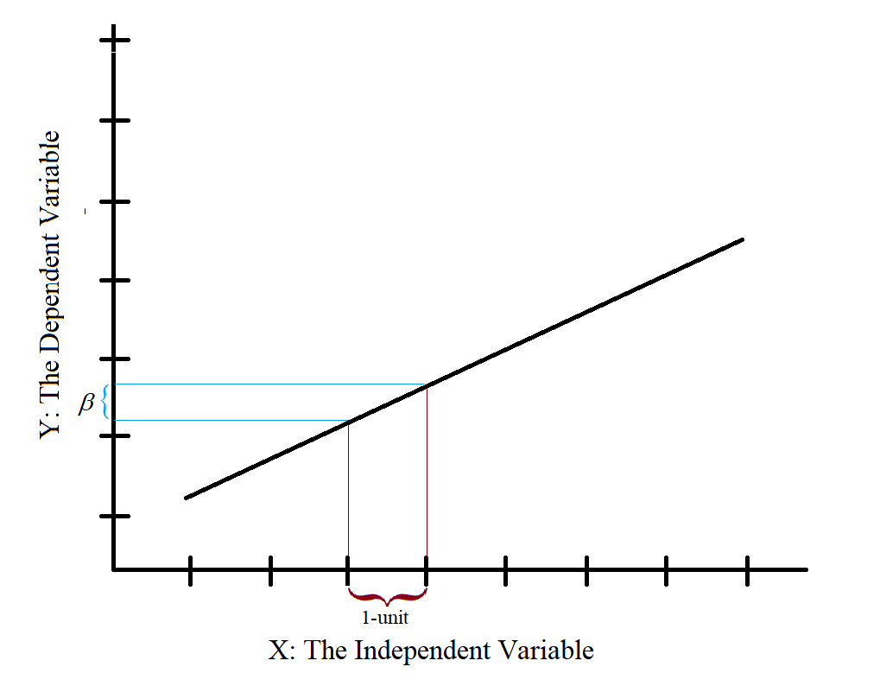
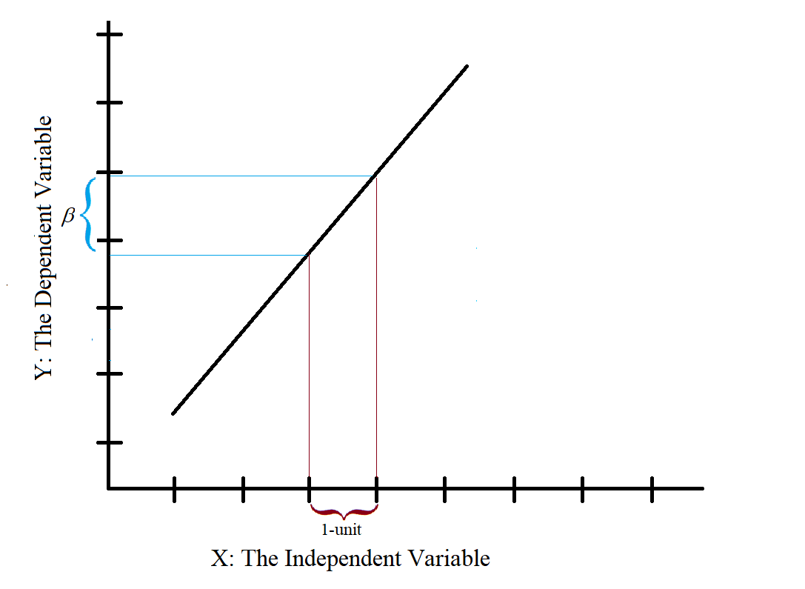
β : The Regression Coefficient
Regression exploits this specificity in the relationship between X - the independent variable (IV) - and Y – the dependent variable (DV).
The regression coefficient simply imposes the change of X to 1-unit.
Thus, the regression coefficient - β - is the change in the value of Y given a 1-unit change in X. In this way, and unlike correlation, the regression coefficient gives us an exact linear relationship between this DV and this IV.

Slide 31

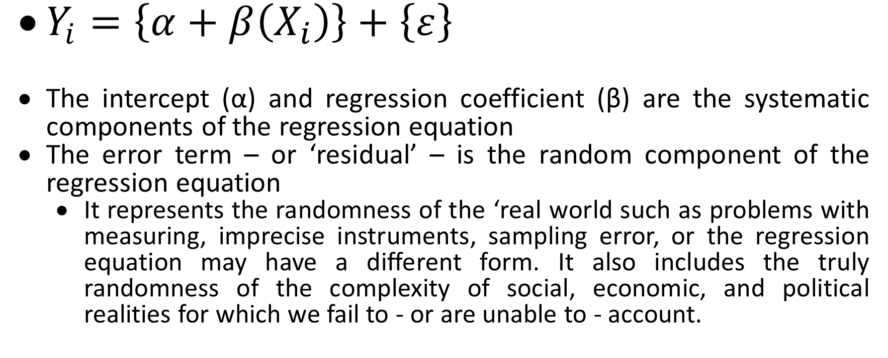
(Bivariate) Regression Equation
$Y_{i}=\left\{α+β\left(X_{i}\right)\right\}+\left\{ε\right\}$
The intercept (α) and regression coefficient (β) are the systematic components of the regression equation
The error term – or ‘residual’ – is the random component of the regression equation
  It represents the randomness of the ‘real world such as problems with measuring, imprecise instruments, sampling error, or the regression equation may have a different form. It also includes the truly randomness of the complexity of social, economic, and political realities for which we fail to - or are unable to - account.

Slide 32
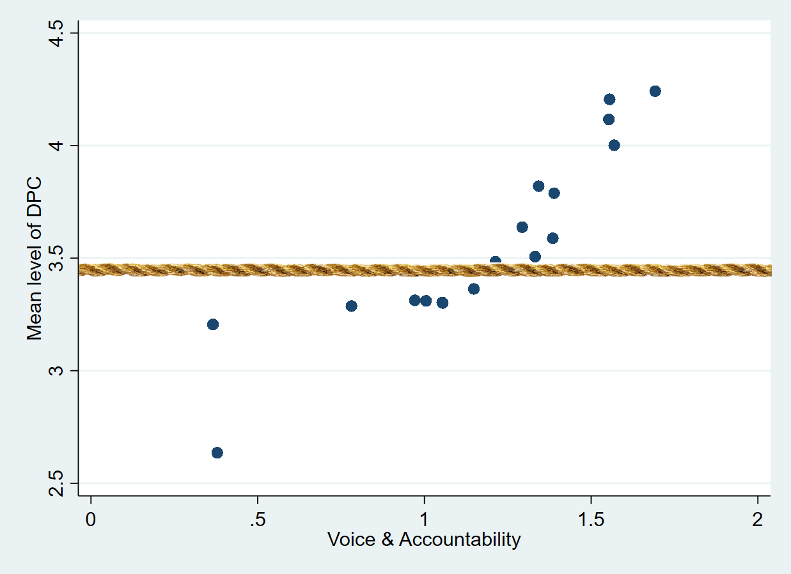
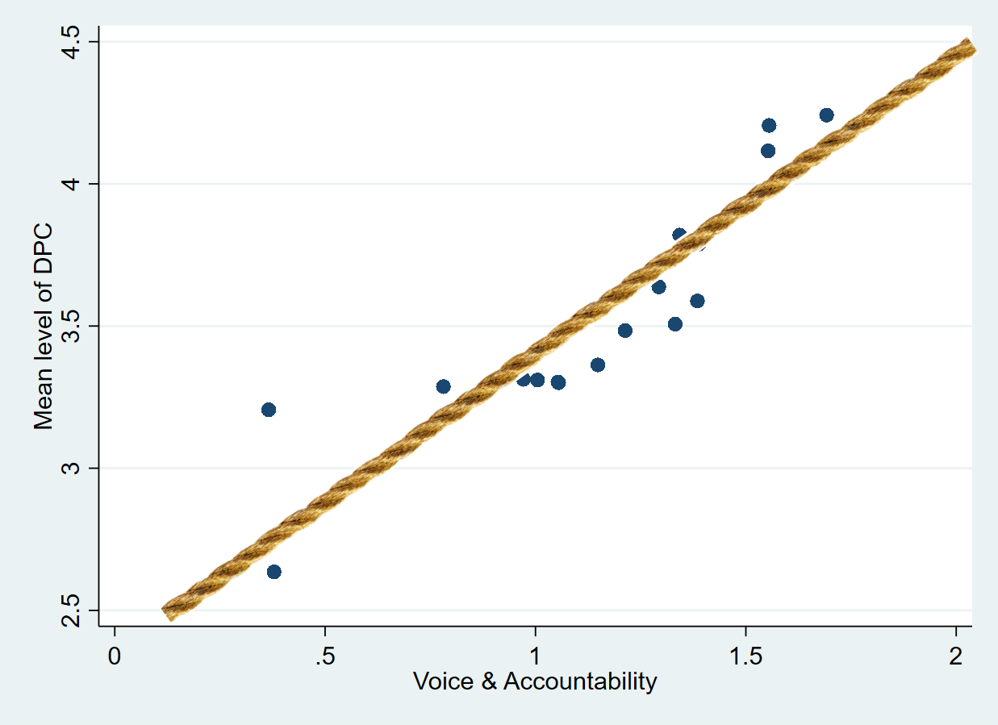
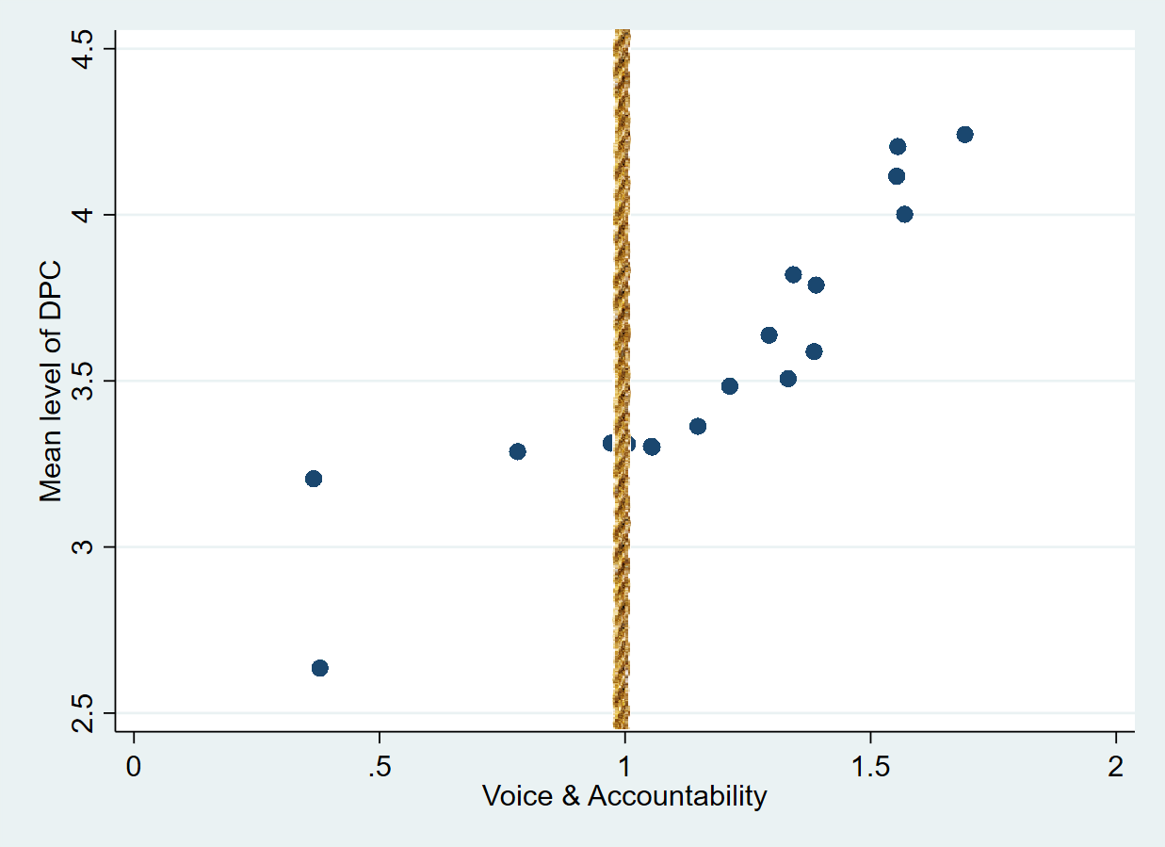
(Bivariate) Regression Equation

Slide 33
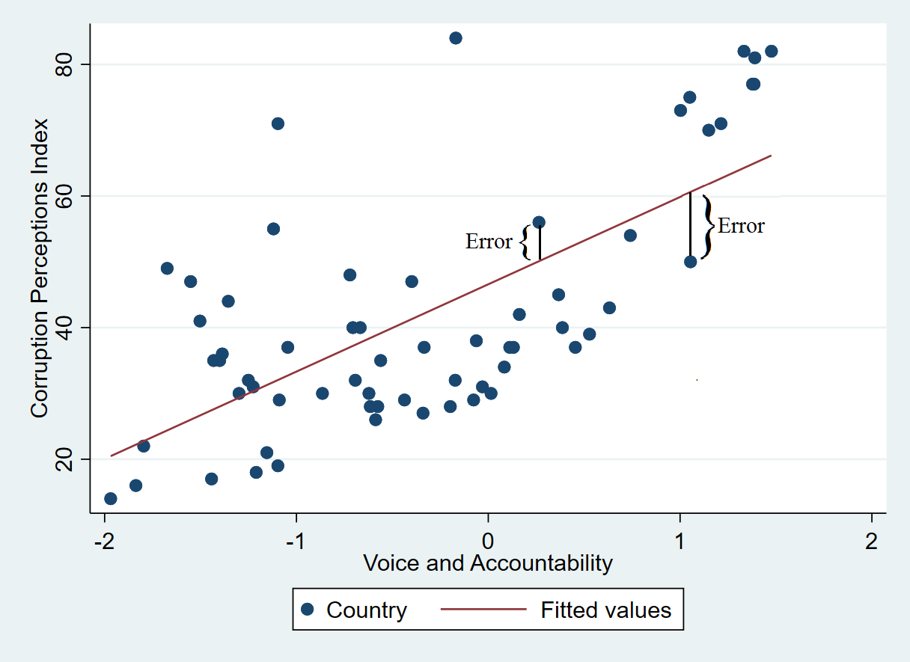
(Bivariate) Regression Equation Estimation
Regression exploits the specific attributes of the relationship between these two specific variables by minimizing the distance between the observations on the dependent variables and the predicted values of the dependent variable (that is, given what we would expect from its relationship to the independent variable).

Slide 34
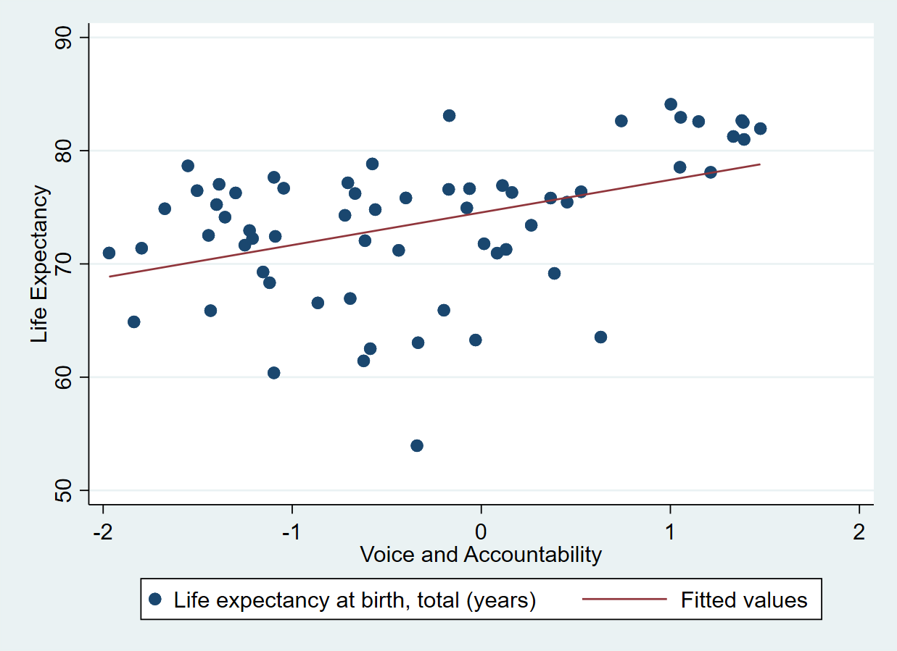
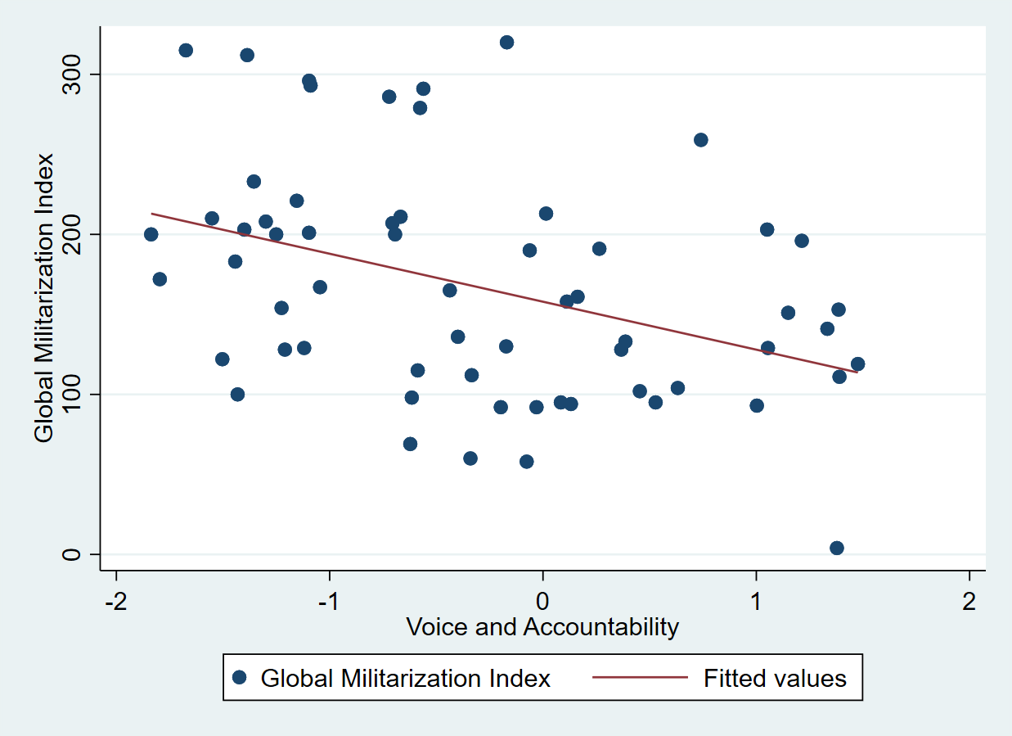
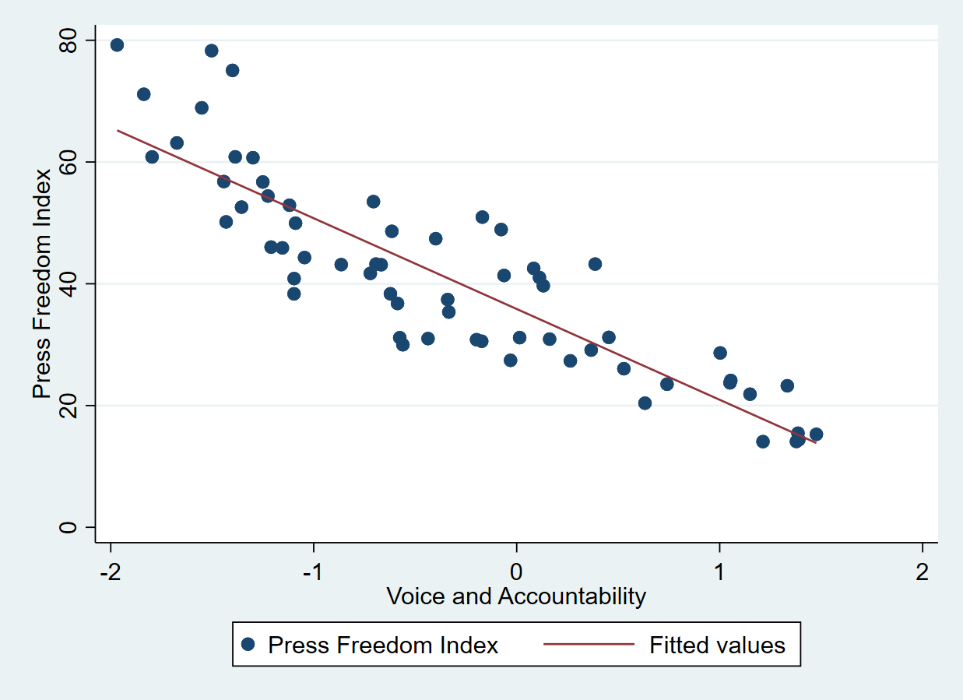
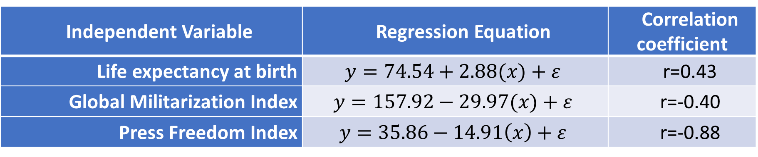
(Bivariate) Regression Examples
Independent Variable | Regression Equation | Correlation coefficient
Life expectancy at birth | $$y=74.54+2.88(x)+ε$$ | r=0.43
Global Militarization Index | $$y=157.92−29.97(x)+ε$$ | r=-0.40
Press Freedom Index | $$y=35.86−14.91\left(x\right)+ε$$ | r=-0.88

Slide 35
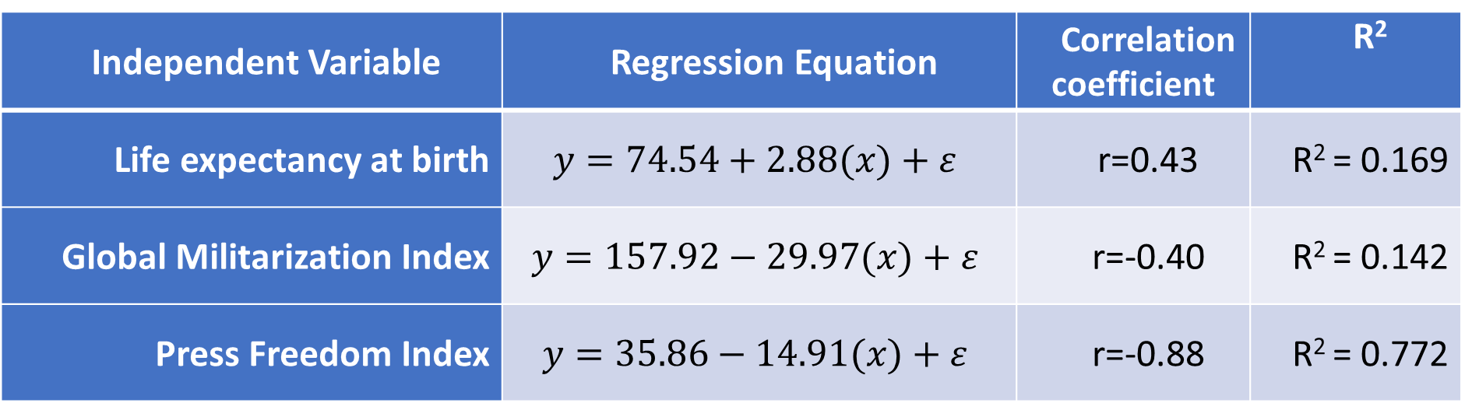
Coefficient of Determination
Independent Variable | Regression Equation | Correlation coefficient | R²
Life expectancy at birth | $$y=74.54+2.88(x)+ε$$ | r=0.43 | R² = 0.169
Global Militarization Index | $$y=157.92−29.97(x)+ε$$ | r=-0.40 | R² = 0.142
Press Freedom Index | $$y=35.86−14.91(x)+ε$$ | r=-0.88 | R² = 0.772
Model Fit
The coefficient of determination or ‘R²‘ represents the proportion of common variation between the two variables.

Slide 36
Modelling
Step One: A Research Question
Step Two: Identify Variables
Step Three: Pearson’s Product Moment Correlation Coefficient
Step Four: The Regression Equation
Step Five: Model Fit
Step Six: Interpretation

Slide 37
Modelling
Step One: A Research Question
  RQ: To what extent does the capacity for citizens to influence and exercise control over their government shape the level of corruption in their country?

Slide 38
Modelling
Step Two: Identify Variables
Dependent Variable (DV): Corruptions Perceptions Index (CPI)
  Aggregated perceptions of business people and country experts of the level on corruption in the public sector.
  Range: 0 [highly corrupt] to 100 [very clean].
  Mean: 42.1; Standard Deviation: 18.5; N=63
  Source: Transparency International
Independent Variable (IV): Voice & Accountability (V&A)
  A measure reflecting the ability of citizens to participate in selecting their government, as well as freedom of expression, freedom of association, and a free media.
  Range: -2 [very low] to 2 [very high].
  Mean: -0.34; Standard Deviation: 0.96; N=63
  Source: World Governance Indicators (World Bank)

Slide 39
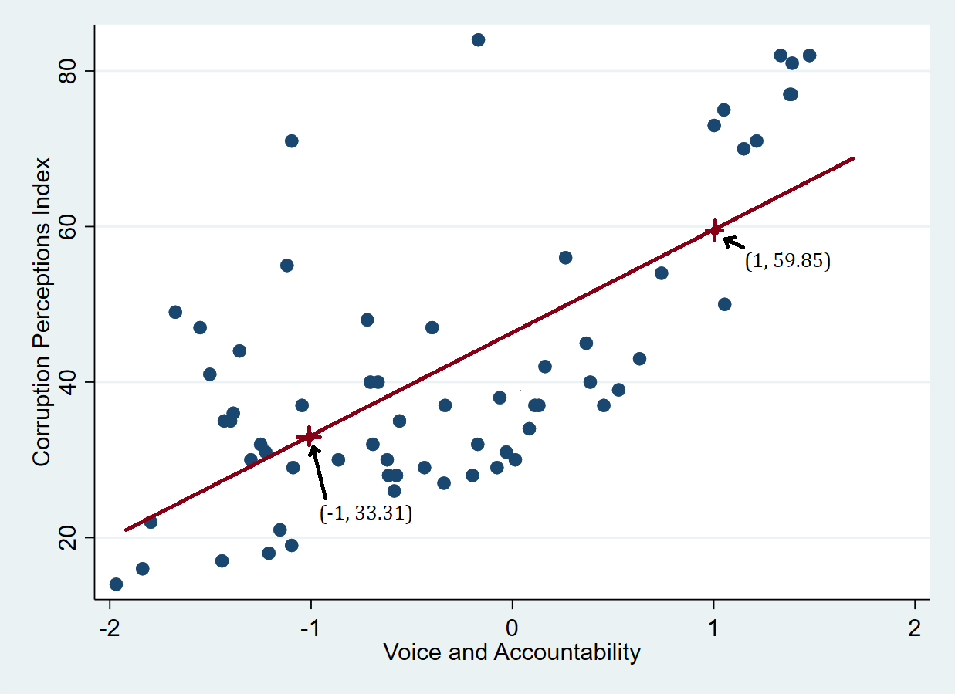

Modelling
Step Three: Pearson’s Product Moment Correlation Coefficient (and a scatter plot)
r=0.68
Step Four: The Regression Equation
$$y=46.58+13.27(x)+ε$$

Slide 40
Modelling
Step Five: Model Fit
  The adjusted R² which accounts for the number of independent variables included in the regression. adj-R² = 0.459.
  Ergo, 45.9% of the variation in the Corruption Perception Index can be explained by variation in Voice and Accountability.

Slide 41
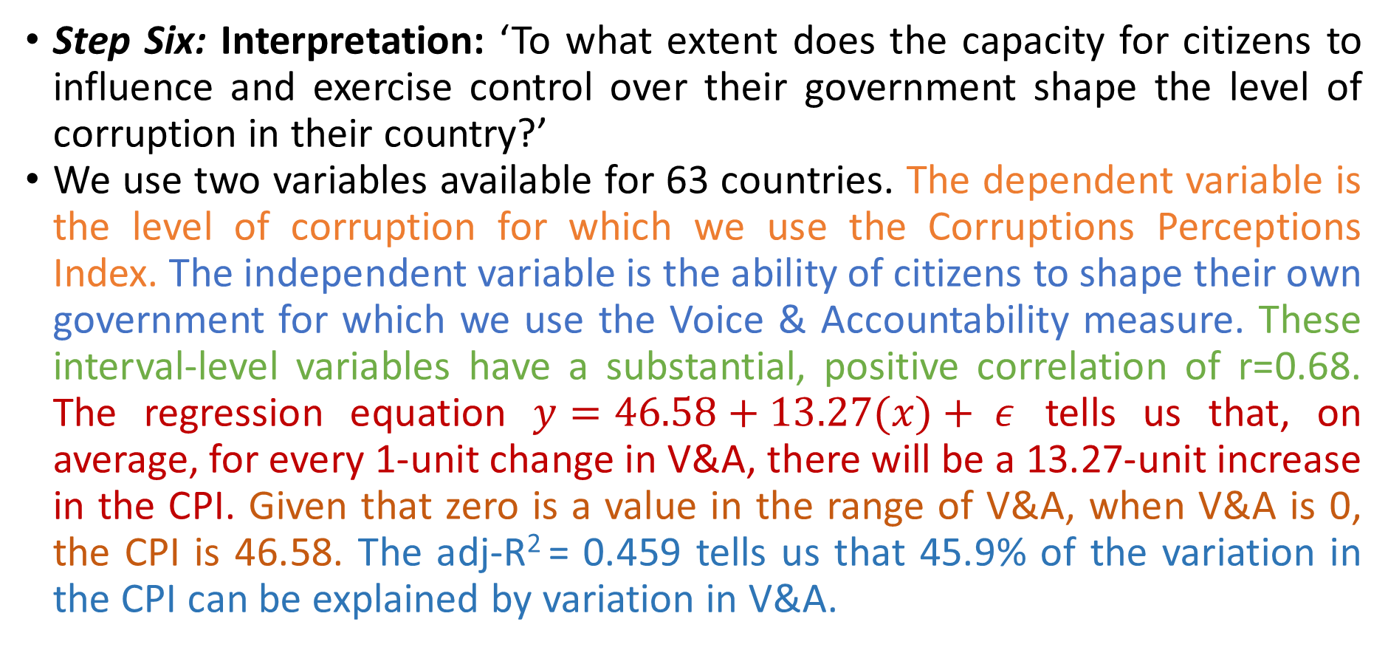
Modelling
Step Six: Interpretation: ‘To what extent does the capacity for citizens to influence and exercise control over their government shape the level of corruption in their country?’
We use two variables available for 63 countries. The dependent variable is the level of corruption for which we use the Corruptions Perceptions Index. The independent variable is the ability of citizens to shape their own government for which we use the Voice & Accountability measure. These interval-level variables have a substantial, positive correlation of r=0.68. The regression equation $y=46.58+13.27(x)+ ε$ tells us that, on average, for every 1-unit change in V&A, there will be a 13.27-unit increase in the CPI. Given that zero is a value in the range of V&A, when V&A is 0, the CPI is 46.58. The adj-R² = 0.459 tells us that 45.9% of the variation in the CPI can be explained by variation in V&A.

Slide 42
(Bivariate) Regression: Troubleshooting
Linearity
Multicollinearity
Multivariate Normality
  Uniform Variance and Autocorrelation
The Exogeneity Assumption
Independence of observations

