Slide 1
Research Methods Prof. Matthew Loveless Inferential Statistics: Nominal- & Ordinal-level Variables
University of Bologna Autumn 2023

Slide 2
Outline
Inferential statistics
Populations and samples
Classical Hypothesis Testing
Inferential statistics for nominal- and ordinal-level variables: χ2: Chi-squared

Slide 3
The Logic of Inference
Inferential Statistics involves making informed guesses about population values – or parameters - from a sample by estimating the probability that the result we observe in the sample could be due to chance.
If the resulting statistic – a description, relationship, or pattern - is unlikely due to chance, we infer that it exists in the population.

Slide 4
The Logic of Inference
Substantive significance is the extent to which that two variables are associated.
Descriptive Statistics
Statistical significance tells us whether this substantiveness can be inferred to the population from which the sample was drawn. That is, whether we can have confidence that the result is ‘real’ and not just chance.
Inferential Statistics

Slide 5
Samples and Population
A population is the entire set of your unit of analysis that you wish to draw conclusions about.
A sample is a subset of units in the population of interest.
A parameter is a descriptive characteristic of a population
A statistic refers to the estimate of a parameter from sample data.

Slide 6
Randomization
Randomization is the selection of units of analysis on the basis of chance and not design.
If we draw observations at random from any population, as number of observations increases, our sample statistics closes in on the population parameter.
No randomization, no inference, no generalization.

Slide 7
Classical Hypothesis Testing
Also known as ‘significance testing’ as it is a process to establish statistical significance.
If we cannot reject the null hypothesis of no relationship, whatever result we have found in the data in the sample is not sufficiently different from chance. And thus, not statistically significant.
If we are able to reject the null hypothesis of no relationship, we are left with the alternative, our research hypothesis. And we have therefore found a statistically significant result in our data in the sample.

Slide 8
Classical Hypothesis Testing
One: the Null Hypothesis
The condition that the expected relationship in your hypothesis does not exist ($H_{0}$).
Two, the Alternative Hypothesis
Your research hypothesis (often written as: $H_{1}$or $H_{a}$).
Three, a Test Statistic
A value of how much our result - calculated from our sample data - deviates from chance.
Four, a Critical or Rejection Region
A value defines the region for rejecting or failing to reject the test statistic. Depends on our level of confidence and the degrees of freedom.
Five, Interpretation
Here we make a final determination of statistical significance.

Slide 9
χ2: Chi-squared: A Test for Independence
The χ² test statistic allows us to make inferential claims about the performance of single variables and relationships among nominal- and ordinal-level data.
$χ^{2}=\sum{\frac{{\left(observed −expected\right)}^{2}}{expected}}$
This creates a χ² sample-specific test statistic for what we observe in the data.

Slide 10
χ2: Chi-squared: A Test for Independence
We compare our χ² sample-specific test statistic to the critical value of a χ² distribution, specified by degrees of freedom and how confident we want to be.
The degrees of freedom - often written ‘df’- refer to the number of columns and rows in the cross-tab.
df = (# of columns - 1)*(# of rows - 1)
Our level of confidence is represented by alpha (α).
Alpha – often called a ‘significance level’ - is used to identify the critical values of sampling distributions.

Slide 11
χ2: Chi-squared: A Test for Independence
Alpha (α): Critical values that define critical region.
Nearly all levels of confidence are 95%; 99%; or 99.9%.
Alphas are the complements to this: 0.05; 0.01; or 0.001.
α=0.05 = 95% confidence
α=0.01 = 99% confidence
α=0.001 = 99.9% confidence

Slide 12
χ2: A Test for Independence: Critical Values
 | Alpha: Significance Level
Degrees of Freedom | 0.10 | 0.05 | 0.025 | 0.01 | 0.001
 | Critical Values of χ²
1 | 2.71 | 3.84 | 5.02 | 6.64 | 10.83
2 | 4.61 | 5.99 | 7.38 | 9.21 | 13.82
3 | 6.25 | 7.82 | 9.35 | 11.35 | 16.27
4 | 7.78 | 9.49 | 11.14 | 13.28 | 18.47
5 | 9.24 | 11.07 | 12.83 | 15.09 | 20.52
6 | 10.65 | 12.59 | 14.45 | 16.81 | 22.46
7 | 12.02 | 14.07 | 16.01 | 18.48 | 24.32
8 | 13.36 | 15.51 | 17.54 | 20.09 | 26.13
9 | 14.68 | 16.92 | 19.02 | 21.67 | 27.88
10 | 15.99 | 18.31 | 20.48 | 23.21 | 29.59
11 | 17.28 | 19.68 | 21.92 | 24.73 | 31.26
12 | 18.55 | 21.03 | 23.34 | 26.22 | 32.91
13 | 19.81 | 22.36 | 24.74 | 27.69 | 34.53
14 | 21.06 | 23.69 | 26.12 | 29.14 | 36.12
15 | 22.31 | 25.00 | 27.49 | 30.58 | 37.70
16 | 23.54 | 26.30 | 28.85 | 32.00 | 39.25
17 | 24.77 | 27.59 | 30.19 | 33.41 | 40.79
18 | 25.99 | 28.87 | 31.53 | 34.81 | 42.31
19 | 27.20 | 30.14 | 32.85 | 36.19 | 43.82
20 | 28.41 | 31.41 | 34.17 | 37.57 | 45.32

Slide 13
χ2: Chi-squared: A Test for Independence

Slide 14
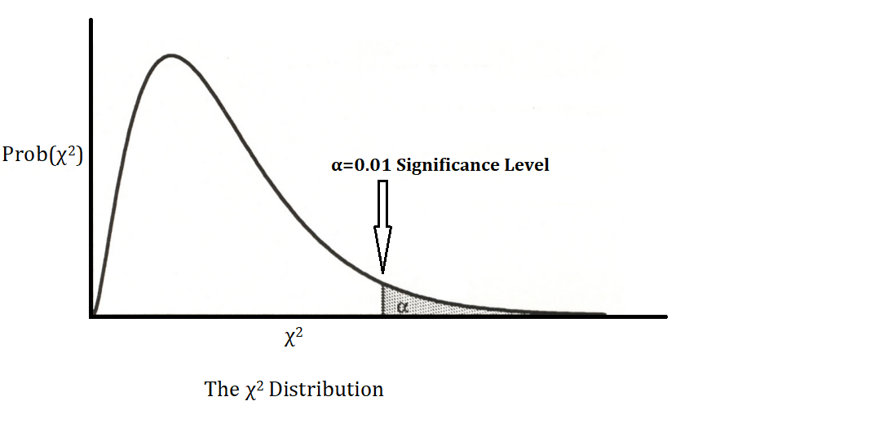
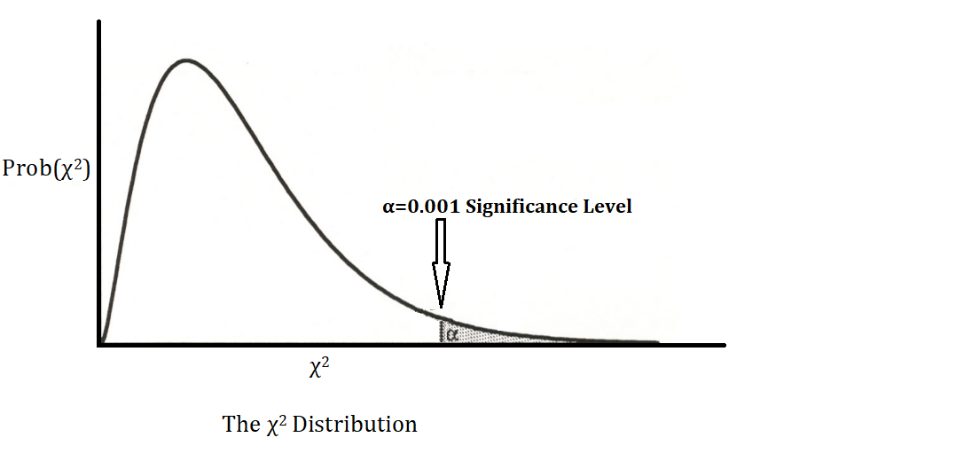
χ2: Chi-squared: A Test for Independence

Slide 15
Classical Hypothesis Testing
Five, Interpretation
Here we make a final determination of statistical significance.
Reject the Null Hypothesis: The relationship in your hypothesis does not exist ($H_{0}$).
Fail to Reject the Null Hypothesis: The relationship in your hypothesis is unlikely to do to chance and therefore we are alpha-level confident it exist in the population from which the sample was drawn.
i.e.: your research hypothesis (often written as: $H_{1}$or $H_{a}$).

Slide 16
χ2: Chi-squared: Example
 |  | Principle of Egalitarian Democracy
 |  | Autocrat | Electoral Auth-ian | Minimally Demo | Demo | TOTAL
Political power distributed by gender | Male monopoly | 1 | 1 | 0 | 0 | 2
 | Men dominant, women marginal | 4 | 11 | 12 | 0 | 27
 | Men more, women some | 0 | 8 | 17 | 5 | 30
 | Men more than women | 0 | 0 | 3 | 9 | 12
 | Gender parity | 0 | 1 | 1 | 3 | 5
 | TOTAL | 5 | 21 | 33 | 17 | 76
We first determine the nature of the relationship
Substantive Significance
$Gamma (γ)=\frac{n_{c}−n_{d}}{n_{c}+n_{d}}$
$Gamma (γ)=0.76$

Slide 17
χ2: Chi-squared: Example
 |  | Principle of Egalitarian Democracy
 |  | Autocrat | Electoral Auth-ian | Minimally Demo | Demo | TOTAL
Political power distributed by gender | Male monopoly | 1 | 1 | 0 | 0 | 2
 | Men dominant, women marginal | 4 | 11 | 12 | 0 | 27
 | Men more, women some | 0 | 8 | 17 | 5 | 30
 | Men more than women | 0 | 0 | 3 | 9 | 12
 | Gender parity | 0 | 1 | 1 | 3 | 5
 | TOTAL | 5 | 21 | 33 | 17 | 76
χ2: Chi-squared: Example
Classical Hypothesis Testing:
The Null Hypothesis (H₀): Variables are independent
‘The greater the extent of democracy has no effect on political gender parity.’
The Alternative Hypothesis (H_{a}): Variables are dependent
‘The greater the extent of democracy, the greater political gender parity.’

Slide 18
χ2: Chi-squared: Example
 |  | Principle of Egalitarian Democracy
 |  | Autocrat | Electoral Auth-ian | Minimally Demo | Demo | TOTAL
Political power distributed by gender | Male monopoly |  |  |  |  | 2
 | Men dominant, women marginal |  |  |  |  | 27
 | Men more, women some |  |  |  |  | 30
 | Men more than women |  |  |  |  | 12
 | Gender parity |  |  |  |  | 5
 | TOTAL | 5 | 21 | 33 | 17 | 76
χ2: Chi-squared: Example
0.1 | 0.6 | 0.9 | 0.4
1.8 | 7.5 | 11.7 | 6.0
2.0 | 8.3 | 13.0 | 6.7
0.8 | 3.3 | 5.2 | 2.7
0.3 | 1.4 | 2.2 | 1.1
Step 3: χ2 Test Statistic
$χ^{2}=\sum{\frac{{\left(observed −expected\right)}^{2}}{expected}}$
Observed in previous table
Generate Expected Values
The χ2 test statistic for our sample is 45.7
EV’s: (2 * 5)/76 = 0.1 (2*21)/76 = 0.6 (33*30)/76 = 13 etc…
Title | © Author
Year | SAGE Publishing

Slide 19
χ2: A Test for Independence
 | Alpha: Significance Level
Degrees of Freedom | 0.10 | 0.05 | 0.025 | 0.01 | 0.001
 | Critical Values of χ²
1 | 2.71 | 3.84 | 5.02 | 6.64 | 10.83
2 | 4.61 | 5.99 | 7.38 | 9.21 | 13.82
3 | 6.25 | 7.82 | 9.35 | 11.35 | 16.27
4 | 7.78 | 9.49 | 11.14 | 13.28 | 18.47
5 | 9.24 | 11.07 | 12.83 | 15.09 | 20.52
6 | 10.65 | 12.59 | 14.45 | 16.81 | 22.46
7 | 12.02 | 14.07 | 16.01 | 18.48 | 24.32
8 | 13.36 | 15.51 | 17.54 | 20.09 | 26.13
9 | 14.68 | 16.92 | 19.02 | 21.67 | 27.88
10 | 15.99 | 18.31 | 20.48 | 23.21 | 29.59
11 | 17.28 | 19.68 | 21.92 | 24.73 | 31.26
12 | 18.55 | 21.03 | 23.34 | 26.22 | 32.91
13 | 19.81 | 22.36 | 24.74 | 27.69 | 34.53
14 | 21.06 | 23.69 | 26.12 | 29.14 | 36.12
15 | 22.31 | 25.00 | 27.49 | 30.58 | 37.70
16 | 23.54 | 26.30 | 28.85 | 32.00 | 39.25
17 | 24.77 | 27.59 | 30.19 | 33.41 | 40.79
18 | 25.99 | 28.87 | 31.53 | 34.81 | 42.31
19 | 27.20 | 30.14 | 32.85 | 36.19 | 43.82
20 | 28.41 | 31.41 | 34.17 | 37.57 | 45.32
χ2: A Test for Independence
Step 4:
χ2 Critical Value [α=0.05; df=12]: 21.03
Title | © Author
Year | SAGE Publishing

Slide 20
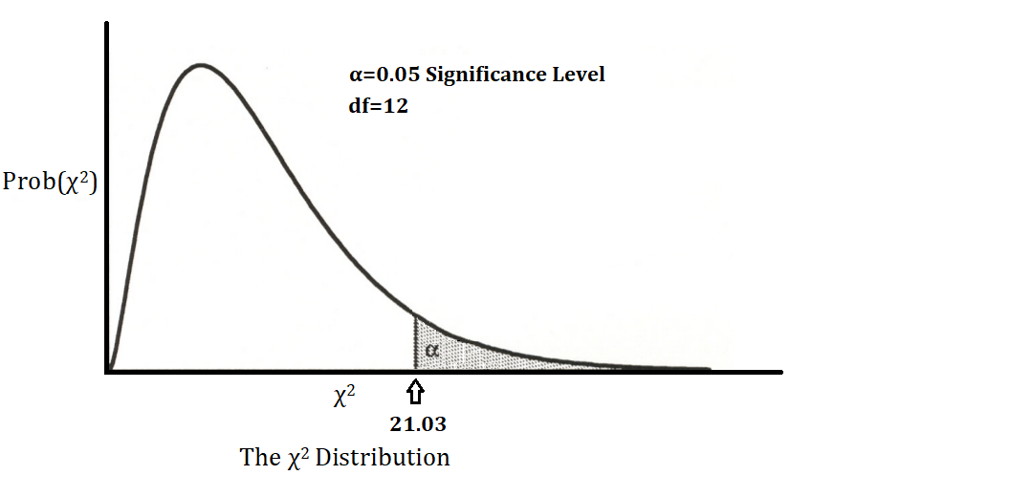
χ2: Chi-squared: Example
χ2 Test Statistic = 45.7
χ2 Critical Value [α=0.05; df=12]: 21.03
Interpretation: We reject the null hypothesis of no relationship.
$Gamma \left(γ\right)=0.76$ is a statistically significant result at 95% confidence.
45.7
Can we be more confident?

Slide 21
χ2: A Test for Independence
 | Alpha: Significance Level
Degrees of Freedom | 0.10 | 0.05 | 0.025 | 0.01 | 0.001
 | Critical Values of χ²
1 | 2.71 | 3.84 | 5.02 | 6.64 | 10.83
2 | 4.61 | 5.99 | 7.38 | 9.21 | 13.82
3 | 6.25 | 7.82 | 9.35 | 11.35 | 16.27
4 | 7.78 | 9.49 | 11.14 | 13.28 | 18.47
5 | 9.24 | 11.07 | 12.83 | 15.09 | 20.52
6 | 10.65 | 12.59 | 14.45 | 16.81 | 22.46
7 | 12.02 | 14.07 | 16.01 | 18.48 | 24.32
8 | 13.36 | 15.51 | 17.54 | 20.09 | 26.13
9 | 14.68 | 16.92 | 19.02 | 21.67 | 27.88
10 | 15.99 | 18.31 | 20.48 | 23.21 | 29.59
11 | 17.28 | 19.68 | 21.92 | 24.73 | 31.26
12 | 18.55 | 21.03 | 23.34 | 26.22 | 32.91
13 | 19.81 | 22.36 | 24.74 | 27.69 | 34.53
14 | 21.06 | 23.69 | 26.12 | 29.14 | 36.12
15 | 22.31 | 25.00 | 27.49 | 30.58 | 37.70
16 | 23.54 | 26.30 | 28.85 | 32.00 | 39.25
17 | 24.77 | 27.59 | 30.19 | 33.41 | 40.79
18 | 25.99 | 28.87 | 31.53 | 34.81 | 42.31
19 | 27.20 | 30.14 | 32.85 | 36.19 | 43.82
20 | 28.41 | 31.41 | 34.17 | 37.57 | 45.32
χ2: A Test for Independence
Step 4:
χ2 Critical Value [α=0.01; df=12]: 26.22
Title | © Author
Year | SAGE Publishing

Slide 22
χ2: A Test for Independence: Example
χ2 Test Statistic = 45.7
χ2 Critical Value [α=0.01; df=12]: 26.22
Interpretation: We reject the null hypothesis of no relationship.
$Gamma \left(γ\right)=0.76$ is a statistically significant result at 99% confidence.

Slide 23
χ2: A Test for Independence
 | Alpha: Significance Level
Degrees of Freedom | 0.10 | 0.05 | 0.025 | 0.01 | 0.001
 | Critical Values of χ²
1 | 2.71 | 3.84 | 5.02 | 6.64 | 10.83
2 | 4.61 | 5.99 | 7.38 | 9.21 | 13.82
3 | 6.25 | 7.82 | 9.35 | 11.35 | 16.27
4 | 7.78 | 9.49 | 11.14 | 13.28 | 18.47
5 | 9.24 | 11.07 | 12.83 | 15.09 | 20.52
6 | 10.65 | 12.59 | 14.45 | 16.81 | 22.46
7 | 12.02 | 14.07 | 16.01 | 18.48 | 24.32
8 | 13.36 | 15.51 | 17.54 | 20.09 | 26.13
9 | 14.68 | 16.92 | 19.02 | 21.67 | 27.88
10 | 15.99 | 18.31 | 20.48 | 23.21 | 29.59
11 | 17.28 | 19.68 | 21.92 | 24.73 | 31.26
12 | 18.55 | 21.03 | 23.34 | 26.22 | 32.91
13 | 19.81 | 22.36 | 24.74 | 27.69 | 34.53
14 | 21.06 | 23.69 | 26.12 | 29.14 | 36.12
15 | 22.31 | 25.00 | 27.49 | 30.58 | 37.70
16 | 23.54 | 26.30 | 28.85 | 32.00 | 39.25
17 | 24.77 | 27.59 | 30.19 | 33.41 | 40.79
18 | 25.99 | 28.87 | 31.53 | 34.81 | 42.31
19 | 27.20 | 30.14 | 32.85 | 36.19 | 43.82
20 | 28.41 | 31.41 | 34.17 | 37.57 | 45.32
χ2: A Test for Independence
Step 4:
χ2 Critical Value [α=0.001; df=12]: 32.91
Title | © Author
Year | SAGE Publishing

Slide 24
χ2: A Test for Independence: Example
χ2 Test Statistic = 45.7
χ2 Critical Value [α=0.001; df=12]: 32.91
Interpretation: We reject the null hypothesis of no relationship.
$Gamma \left(γ\right)=0.76$ is a statistically significant result at 99.9% confidence.

Slide 25
χ2: Chi-squared: Example
To fully interpret these results: “At the 99.9% confidence level, we conclude that there is a positive relationship between the extent of democracy and the level of political gender parity. We reject the null hypothesis which means that the relationship $(γ$ = 0.76) exists in the population from which the sample was drawn.”
Note: although we include the level of confidence, there is no need to report either the test statistic or critical value.

Slide 26
χ2: Chi-squared: Example 2
Let’s use the percentage of internet access as a nominal-level variable: <50% and >50% access and examine how this relates to an ordinal-level variable that measures the level of effort governments make to censor or limit information on the internet.
‘The government successfully blocks Internet access except to sites that are progovernment or devoid of political content’ (1)
‘…but many users are able to circumvent gov’t controls’ (2)
‘The government … blocks selected sites that deal with especially politically sensitive issues’ (3)
‘The government allows Internet access that is unrestricted (4).’

Slide 27
χ2: Chi-squared: Example 2
 |  | Internet Access
 |  | <50% | >50% | TOTAL
Internet Censorship Effort | Successfully Blocked | 1 | 2 | 3
 | Blocked but circumvented | 2 | 4 | 6
 | Allowed with some blocks | 10 | 8 | 18
 | Largely unrestricted | 8 | 25 | 33
 | TOTAL | 21 | 39 | 60
We first determine the nature of the relationship
Substantive Significance:
$Lambda (λ) = \frac{E_{1}− E_{2}}{E_{1}}$
$Lambda (λ) = 0.074$

Slide 28
χ2: Chi-squared: Example 2
 |  | Internet Access
 |  | <50% | >50% | TOTAL
Internet Censorship Effort | Successfully Blocked | 1 | 2 | 3
 | Blocked but circumvented | 2 | 4 | 6
 | Allowed with some blocks | 10 | 8 | 18
 | Largely unrestricted | 8 | 25 | 33
 | TOTAL | 21 | 39 | 60
Classical Hypothesis Testing:
The Null Hypothesis (H₀): Variables are independent
‘The level of internet access is not related to internet censorship efforts.
The Alternative Hypothesis (H_{a}): Variables are dependent
‘The level of internet access is related to internet censorship efforts.’

Slide 29
χ2: Chi-squared: Example 2
 |  | Internet Access
 |  | <50% | >50% | TOTAL
Internet Censorship Effort | Successfully Blocked |  |  | 3
 | Blocked but circumvented |  |  | 6
 | Allowed with some blocks |  |  | 18
 | Largely unrestricted |  |  | 33
 | TOTAL | 21 | 39 | 60
Step 3: χ2 Test Statistic
$χ^{2}=\sum{\frac{{\left(observed −expected\right)}^{2}}{expected}}$
Observed in previous table
Generate Expected Values
The χ2 test statistic for our sample is 5.03
1.1 | 2.0
2.1 | 3.9
6.3 | 11.7
11.6 | 21.5

Slide 30
χ2: A Test for Independence
 | Alpha: Significance Level
Degrees of Freedom | 0.10 | 0.05 | 0.025 | 0.01 | 0.001
 | Critical Values of χ²
1 | 2.71 | 3.84 | 5.02 | 6.64 | 10.83
2 | 4.61 | 5.99 | 7.38 | 9.21 | 13.82
3 | 6.25 | 7.82 | 9.35 | 11.35 | 16.27
4 | 7.78 | 9.49 | 11.14 | 13.28 | 18.47
5 | 9.24 | 11.07 | 12.83 | 15.09 | 20.52
6 | 10.65 | 12.59 | 14.45 | 16.81 | 22.46
7 | 12.02 | 14.07 | 16.01 | 18.48 | 24.32
8 | 13.36 | 15.51 | 17.54 | 20.09 | 26.13
9 | 14.68 | 16.92 | 19.02 | 21.67 | 27.88
10 | 15.99 | 18.31 | 20.48 | 23.21 | 29.59
11 | 17.28 | 19.68 | 21.92 | 24.73 | 31.26
12 | 18.55 | 21.03 | 23.34 | 26.22 | 32.91
13 | 19.81 | 22.36 | 24.74 | 27.69 | 34.53
14 | 21.06 | 23.69 | 26.12 | 29.14 | 36.12
15 | 22.31 | 25.00 | 27.49 | 30.58 | 37.70
16 | 23.54 | 26.30 | 28.85 | 32.00 | 39.25
17 | 24.77 | 27.59 | 30.19 | 33.41 | 40.79
18 | 25.99 | 28.87 | 31.53 | 34.81 | 42.31
19 | 27.20 | 30.14 | 32.85 | 36.19 | 43.82
20 | 28.41 | 31.41 | 34.17 | 37.57 | 45.32
χ2: A Test for Independence
Step 4:
χ2 Critical Value [α=0.05; df=3]: 7.82
Title | © Author
Year | SAGE Publishing

Slide 31
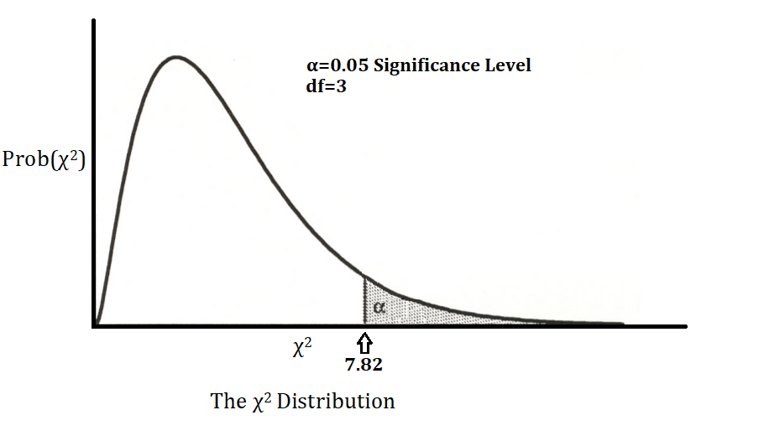
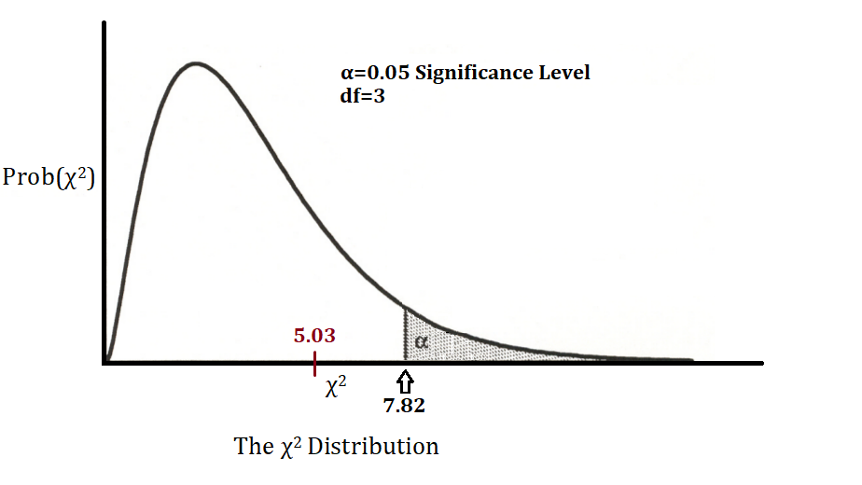
χ2: Chi-squared: Example 2
χ2 Test Statistic = 5.03
χ2 Critical Value [α=0.05; df=3]: 7.82
Interpretation: We fail to reject the null hypothesis of no relationship.
$Lambda \left(λ\right) = 0.074$ does not exist in the population from which this sample was drawn
Can we be more confident?

Slide 32
χ2: Chi-squared: Example 2
To fully interpret these results: “At the 95% confidence level, we conclude that there is no relationship between Aggregate Internet Access and Internet Censorship Efforts. We fail to reject the null hypothesis meaning that the relationship ($λ$=0.074) only exists in the sample and not in the population from which it was drawn.”
Note: although we include the level of confidence, there is no need to report either the test statistic or critical value.

Slide 33
Classical Hypothesis Testing: Statistical significance
One: the Null Hypothesis
The condition that the expected relationship in your hypothesis does not exist ($H_{0}$).
Two, the Alternative Hypothesis
Your research hypothesis (often written as: $H_{1}$or $H_{a}$).
Three, a Test Statistic
A value of how much our result - calculated from our sample data - deviates from chance.
Four, a Critical or Rejection Region
A value defines the region for rejecting or failing to reject the test statistic. Depends on our level of confidence and the degrees of freedom.
Five, Interpretation
Here we make a final determination of statistical significance.

Slide 34
χ2: Chi-squared: Three, a Test Statistic
The χ² test statistic allows us to make inferential claims about the performance of single variables and relationships among nominal- and ordinal-level data.
$χ^{2}=\sum{\frac{{\left(observed −expected\right)}^{2}}{expected}}$
This creates a χ² sample-specific test statistic for what we observe in the data.

Slide 35
χ2: Chi-squared: Four, Critical or Rejection Region
We compare our χ² sample-specific test statistic [above] to the critical value of a χ² distribution, specified by degrees of freedom and how confident we want to be.
The degrees of freedom - often written ‘df’- refer to the number of columns and rows in the cross-tab.
df = (# of columns - 1)*(# of rows - 1)
Our level of confidence is represented by alpha (α).
Alpha – often called a ‘significance level’ - is used to identify the critical values of sampling distributions.

Slide 36
χ2: Chi-squared: Critical or Rejection Region
 | Alpha: Significance Level
Degrees of Freedom | 0.10 | 0.05 | 0.025 | 0.01 | 0.001
 | Critical Values of χ²
1 | 2.71 | 3.84 | 5.02 | 6.64 | 10.83
2 | 4.61 | 5.99 | 7.38 | 9.21 | 13.82
3 | 6.25 | 7.82 | 9.35 | 11.35 | 16.27
4 | 7.78 | 9.49 | 11.14 | 13.28 | 18.47
5 | 9.24 | 11.07 | 12.83 | 15.09 | 20.52
6 | 10.65 | 12.59 | 14.45 | 16.81 | 22.46
7 | 12.02 | 14.07 | 16.01 | 18.48 | 24.32
8 | 13.36 | 15.51 | 17.54 | 20.09 | 26.13
9 | 14.68 | 16.92 | 19.02 | 21.67 | 27.88
10 | 15.99 | 18.31 | 20.48 | 23.21 | 29.59
11 | 17.28 | 19.68 | 21.92 | 24.73 | 31.26
12 | 18.55 | 21.03 | 23.34 | 26.22 | 32.91
13 | 19.81 | 22.36 | 24.74 | 27.69 | 34.53
14 | 21.06 | 23.69 | 26.12 | 29.14 | 36.12
15 | 22.31 | 25.00 | 27.49 | 30.58 | 37.70
16 | 23.54 | 26.30 | 28.85 | 32.00 | 39.25
17 | 24.77 | 27.59 | 30.19 | 33.41 | 40.79
18 | 25.99 | 28.87 | 31.53 | 34.81 | 42.31
19 | 27.20 | 30.14 | 32.85 | 36.19 | 43.82
20 | 28.41 | 31.41 | 34.17 | 37.57 | 45.32

Slide 37
χ2 Example
Measure of Association: Gamma (γ): 0.3584
Why gamma (γ)?
ONE: H₀: Economic development is not related to nation size
TWO: H_{a}: As nation size increases, so does economic development
Cross-tab:
 |  | Size of Country by Population (in millions)
 |  | Small: <1m | Moderate: 1-29m | Large: 30+m | Total
Economic Development | Least |  |  |  | 22
 | Middle |  |  |  | 54
 | Most |  |  |  | 30
 | Total | 8 | 71 | 27 | 106
OBSERVED
 |  | 3 | 18 | 1
 |  | 3 | 35 | 16
 |  | 2 | 18 | 10

Slide 38
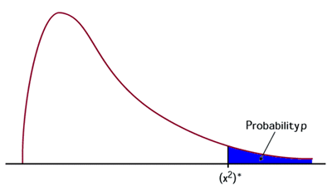
χ2 Example 2 Continued
= 7.216
= [α=0.05; df=4]: 9.488
THREE: Test statistic
FOUR: Critical value: Chi-2
FIVE: “At the 95% confidence level, we conclude that there is no relationship between the size of a country - as measured by population - and economic development.” We fail to reject the null hypothesis of no relationship. The relationship (γ=0.3584) only exists in the sample.
EXPECTED
 |  | 1.7 | 14.7 | 5.6
 |  | 4.1 | 36.2 | 13.8
 |  | 2.3 | 20.1 | 7.6
 |  | Size of Country by Population (in millions)
OBSERVED |  | Small: <1m | Moderate: 1-29m | Large: 30+m | Total
Economic Development | Least | 3 | 18 | 1 | 22
 | Middle | 3 | 35 | 16 | 54
 | Most | 2 | 18 | 10 | 30
 | Total | 8 | 71 | 27 | 106

Slide 39
Descriptive and Inferential Statistics
We now have the ability to ask - and answer - 4 big questions with statistics.
Is there a relationship between the Independent Variable and Dependent Variable?
How strong is the relationship?
What is direction of relationship?
Is the relationship statistically significant?
Please be careful not to confuse Statistical Significance (4) and Substantive Significance (1, 2 , and 3)

