Slide 1
Research Methods Prof. Matthew Loveless Inferential Statistics: Nominal- & Ordinal-level Variables Seminar University of Bologna Autumn 2023

Slide 2
Outline
Classical Hypothesis Testing: χ2: Chi-squared

Slide 3
Feynman Problem Solving Algorithm
Write down the problem
Think very hard
Write down the answer

Slide 4
The Logic of Inference
Substantive significance is the extent to which that two variables are associated.
Descriptive Statistics
Statistical significance tells us whether this substantiveness can be inferred to the population from which the sample was drawn. That is, whether we can have confidence that the result is ‘real’ and not just chance.
Inferential Statistics

Slide 5
Descriptive Statistics: Measures of Association: Substantive significance
 | Nominal | Ordinal
Nominal | N x N (2 x 2): Gamma N x N: Lambda
Ordinal | Lambda | Gamma

Slide 6
χ2: Chi-squared: STATA EXAMPLE
“ESS mini.dta“
Is the level of people’s political interest associated to their level of internet use?
Political Interest: polintr
Internet use: netusoft
codebook netusoft polintr, tab(500)

Slide 7
χ2: EXAMPLE: Substantive Significance
tab netusoft polintr, gamma
Internet use, how | How interested in politics
often | Very inte Quite int Hardly in Not at al | Total
-------------------+--------------------------------------------+----------
Never | 510 1,618 2,207 2,027 | 6,362
Only occasionally | 161 564 891 483 | 2,099
A few times a week | 184 682 897 390 | 2,153
Most days | 278 1,046 1,277 643 | 3,244
Every day | 2,767 7,578 7,874 3,838 | 22,057
-------------------+--------------------------------------------+----------
Total | 3,900 11,488 13,146 7,381 | 35,915
gamma = -0.1819 ASE = 0.007

Slide 8
RECODE in STATA: EXAMPLE
Recode ESS mini.dta
codebook polintr, tab(40)
recode polintr (4=1) (3=2) (2=3) (1=4), gen(PolInt)
lab def ddd 1 "Not at all Interested" 2 "Hardly Interested" 3 "Quite Interested" 4 "Very Interested"
lab val PolInt ddd
lab var PolInt "Political Interest"

Slide 9
χ2: EXAMPLE: Substantive Significance
tab netusoft polintr, gamma
Internet use, how | Political Interest
often | Not at al Hardly In Quite Int Very Inte | Total
-------------------+--------------------------------------------+----------
Never | 2,027 2,207 1,618 510 | 6,362
Only occasionally | 483 891 564 161 | 2,099
A few times a week | 390 897 682 184 | 2,153
Most days | 643 1,277 1,046 278 | 3,244
Every day | 3,838 7,874 7,578 2,767 | 22,057
-------------------+--------------------------------------------+----------
Total | 7,381 13,146 11,488 3,900 | 35,915
gamma = 0.1819 ASE = 0.007

Slide 10
χ2: EXAMPLE: Steps One and Two
One: the Null Hypothesis
The condition that the expected relationship in your hypothesis does not exist ($H_{0}$).
There is no relationship between individuals’ level of political interest and their level of internet use
Two, the Alternative Hypothesis
Your research hypothesis (often written as: $H_{1}$or $H_{a}$).
There is a relationship between individuals’ level of political interest and their level of internet use

Slide 11
χ2: EXAMPLE: Step Three - Test Statistic
$χ^{2}=\sum{\frac{{\left(observed −expected\right)}^{2}}{expected}}$
This creates a χ² sample-specific test statistic for what we observe (here: gamma= -0.18).
tab netusoft polintr, gamma chi2

Slide 12
χ2: EXAMPLE: Step Three - Test Statistic
tab netusoft polintr, gamma chi2
Internet use, how | Political Interest
often | Not at al Hardly In Quite Int Very Inte | Total
-------------------+--------------------------------------------+----------
Never | 2,027 2,207 1,618 510 | 6,362
Only occasionally | 483 891 564 161 | 2,099
A few times a week | 390 897 682 184 | 2,153
Most days | 643 1,277 1,046 278 | 3,244
Every day | 3,838 7,874 7,578 2,767 | 22,057
-------------------+--------------------------------------------+----------
Total | 7,381 13,146 11,488 3,900 | 35,915
Pearson chi2(12) = 860.9397 Pr = 0.000
gamma = 0.1819 ASE = 0.007

Slide 13
χ2: EXAMPLE: CHI2 by hand
NOTE: If you wanted to calculate chi2 by hand:
tab netusoft polintr, expected
$χ^{2}=\sum{\frac{{\left(observed −expected\right)}^{2}}{expected}}$

Slide 14
χ2: EXAMPLE: Step Three - Test Statistic
Pearson chi2(12) = 860.9397 Pr = 0.000
gamma = -0.1819 ASE = 0.007
Pr = 0.001 is 99.9%
Pr = 0.01 is 99%
Pr = 0.05 is 95%
Here, our result (γ = -0.18) is statistically significant at 99.9%
Pr = 0.03
Pr = 0.22
Pr = 0.006
Pr = 0.001
Pr = 0.017
Pr = 0.08
0.05 or 95%
>0.05, not stat sig.
0.01 or 99%
0.001 or 99.9%
0.05 or 95%
>0.05, not stat sig.

Slide 15
Classical Hypothesis Testing
One: the Null Hypothesis
The condition that the expected relationship in your hypothesis does not exist ($H_{0}$).
Two, the Alternative Hypothesis
Your research hypothesis (often written as: $H_{1}$or $H_{a}$).
Three, a Test Statistic
A value of how much our result - calculated from our sample data - deviates from chance.
Four, a Critical or Rejection Region
A value defines the region for rejecting or failing to reject the test statistic. It depends on our level of confidence and the degrees of freedom.
Five, Interpretation
Here we make a final determination of statistical significance.

Slide 16
χ2: A Test for Independence
 | Alpha: Significance Level
Degrees of Freedom | 0.10 | 0.05 | 0.025 | 0.01 | 0.001
 | Critical Values of χ²
1 | 2.71 | 3.84 | 5.02 | 6.64 | 10.83
2 | 4.61 | 5.99 | 7.38 | 9.21 | 13.82
3 | 6.25 | 7.82 | 9.35 | 11.35 | 16.27
4 | 7.78 | 9.49 | 11.14 | 13.28 | 18.47
5 | 9.24 | 11.07 | 12.83 | 15.09 | 20.52
6 | 10.65 | 12.59 | 14.45 | 16.81 | 22.46
7 | 12.02 | 14.07 | 16.01 | 18.48 | 24.32
8 | 13.36 | 15.51 | 17.54 | 20.09 | 26.13
9 | 14.68 | 16.92 | 19.02 | 21.67 | 27.88
10 | 15.99 | 18.31 | 20.48 | 23.21 | 29.59
11 | 17.28 | 19.68 | 21.92 | 24.73 | 31.26
12 | 18.55 | 21.03 | 23.34 | 26.22 | 32.91
13 | 19.81 | 22.36 | 24.74 | 27.69 | 34.53
14 | 21.06 | 23.69 | 26.12 | 29.14 | 36.12
15 | 22.31 | 25.00 | 27.49 | 30.58 | 37.70
16 | 23.54 | 26.30 | 28.85 | 32.00 | 39.25
17 | 24.77 | 27.59 | 30.19 | 33.41 | 40.79
18 | 25.99 | 28.87 | 31.53 | 34.81 | 42.31
19 | 27.20 | 30.14 | 32.85 | 36.19 | 43.82
20 | 28.41 | 31.41 | 34.17 | 37.57 | 45.32
χ2: A Test for Independence
Step 4:
χ2 Critical Value [α=0.05; df=12]: 21.03
χ2: A Test for Independence
χ2: EXAMPLE: Step Four –
Critical Value
[α=0.001; df=12]: 32.91

Slide 17
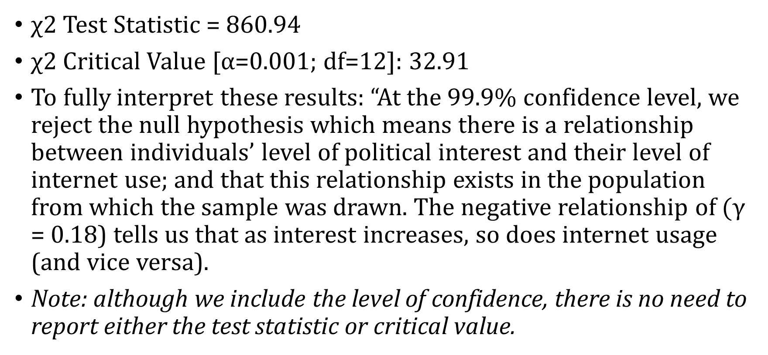
χ2: EXAMPLE: Step Five - Interpret
χ2 Test Statistic = 860.94
χ2 Critical Value [α=0.001; df=12]: 32.91
To fully interpret these results: “At the 99.9% confidence level, we reject the null hypothesis which means there is a relationship between individuals’ level of political interest and their level of internet use; and that this relationship exists in the population from which the sample was drawn. The negative relationship of $(γ$ = 0.18) tells us that as interest increases, so does internet usage (and vice versa).
Note: although we include the level of confidence, there is no need to report either the test statistic or critical value.

Slide 18
χ2: EXAMPLE 2
Are there gendered differences in the level of political interest?
lambda PolInt Gender
| Gender: Male
Political Interest | Female Male | Total
----------------------+----------------------+----------
Not at all Interested | 4,668 2,721 | 7,389
Hardly Interested | 7,436 5,716 | 13,152
Quite Interested | 5,430 6,069 | 11,499
Very Interested | 1,461 2,440 | 3,901
----------------------+----------------------+----------
Total | 18,995 16,946 | 35,941
lambda_a 0.0155

Slide 19
χ2: EXAMPLE 2
Are there gendered differences in the level of political interest?
One: the Null Hypothesis
Gender does not explain any differences in the level of political interest.
Two, the Alternative Hypothesis
Gender does explain some differences in the level of political interest.

Slide 20
χ2: EXAMPLE 2
Three: a Test Statistic
tab PolInt Gender, chi2
| Gender: Male
Political Interest | Female Male | Total
----------------------+----------------------+----------
Not at all Interested | 4,668 2,721 | 7,389
Hardly Interested | 7,436 5,716 | 13,152
Quite Interested | 5,430 6,069 | 11,499
Very Interested | 1,461 2,440 | 3,901
----------------------+----------------------+----------
Total | 18,995 16,946 | 35,941
Pearson chi2(3) = 905.3023 Pr = 0.000

Slide 21
χ2: A Test for Independence
 | Alpha: Significance Level
Degrees of Freedom | 0.10 | 0.05 | 0.025 | 0.01 | 0.001
 | Critical Values of χ²
1 | 2.71 | 3.84 | 5.02 | 6.64 | 10.83
2 | 4.61 | 5.99 | 7.38 | 9.21 | 13.82
3 | 6.25 | 7.82 | 9.35 | 11.35 | 16.27
4 | 7.78 | 9.49 | 11.14 | 13.28 | 18.47
5 | 9.24 | 11.07 | 12.83 | 15.09 | 20.52
6 | 10.65 | 12.59 | 14.45 | 16.81 | 22.46
7 | 12.02 | 14.07 | 16.01 | 18.48 | 24.32
8 | 13.36 | 15.51 | 17.54 | 20.09 | 26.13
9 | 14.68 | 16.92 | 19.02 | 21.67 | 27.88
10 | 15.99 | 18.31 | 20.48 | 23.21 | 29.59
11 | 17.28 | 19.68 | 21.92 | 24.73 | 31.26
12 | 18.55 | 21.03 | 23.34 | 26.22 | 32.91
13 | 19.81 | 22.36 | 24.74 | 27.69 | 34.53
14 | 21.06 | 23.69 | 26.12 | 29.14 | 36.12
15 | 22.31 | 25.00 | 27.49 | 30.58 | 37.70
16 | 23.54 | 26.30 | 28.85 | 32.00 | 39.25
17 | 24.77 | 27.59 | 30.19 | 33.41 | 40.79
18 | 25.99 | 28.87 | 31.53 | 34.81 | 42.31
19 | 27.20 | 30.14 | 32.85 | 36.19 | 43.82
20 | 28.41 | 31.41 | 34.17 | 37.57 | 45.32
χ2: A Test for Independence
Step 4:
χ2 Critical Value [α=0.05; df=12]: 21.03
χ2: A Test for Independence
χ2: EXAMPLE: Step Four –
Critical Value
[α=0.001; df=3]: 16.27

Slide 22
χ2: EXAMPLE: Step Five - Interpret
χ2 Test Statistic = 905.3023
χ2 Critical Value [α=0.001; df=3]: 16.27
To fully interpret these results: “At the 99.9% confidence level, we reject the null hypothesis that there is no relationship between gender and political interest. The observed relationship (λ=0.0155) exists in the population from which the sample was drawn. This tells us that we reduce our errors in predicting political interest by 1.5% by knowing the gender.
Note: although we include the level of confidence, there is no need to report either the test statistic or critical value.

