Slide 1
Research Methods Prof. Matthew Loveless Inferential Statistics: Interval-level Variables
University of Bologna Autumn 2023

Slide 2
Outline
Inferential statistics
Standard Normal Distribution: Z-Distribution
The Central Limit Theorem
Inferential statistics for interval-level variables: Student’s t
Classical Hypothesis Testing
Confidence Intervals
Point Estimates
Difference of Means test

Slide 3
Inferential Statistics
Inferential Statistics involves making informed guesses about population values – or parameters - from a sample by estimating the probability that the result we observe in the sample could be due to chance.
If the resulting statistic – i.e.: substantive significance - is unlikely due to chance, we infer that it exists in the population (i.e.: statistical significance).
Why?

Slide 4
Sampling Distributions
A sampling distribution is a summary of the probabilities of outcomes, also called, a probability density function or probability density curve. As the nature of the outcomes change, so does the shape of distribution of probabilities.
For interval-level variables, the resultant curve has characteristics that enable us to connect what we know – sample statistics – to what we want to know - population parameters.

Slide 5
Central Limit Theorem
The Central Limit Theorem (CLT) states that as sample size increases, the sampling distribution of sample means approaches Normal with a mean the same as the mean of the population and a standard deviation equal to the standard deviation of the population divided by the square root of n (the sample size). This is true even if the population distribution is not distributed normally.

Slide 6
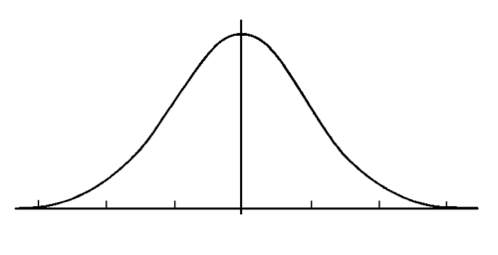
The Normal Distribution
A family of distributions that have the same general shape.
Most observations are concentrated in the middle and fewer in its tails.
A Normal distribution refers to the probabilities associated with interval-level variables. As such, the shape is specified by a mean and standard deviation

Slide 7
The Normal Distribution

Slide 8
The Normal Distribution
Three extremely useful properties
They are symmetric. The mean is the median is the mode. The curve is the same on both sides of the centre line.
The total area under the curve is 1. As a probability distribution, it represents all the probabilities added together.
The areas under the curve have fixed proportions.

Slide 9
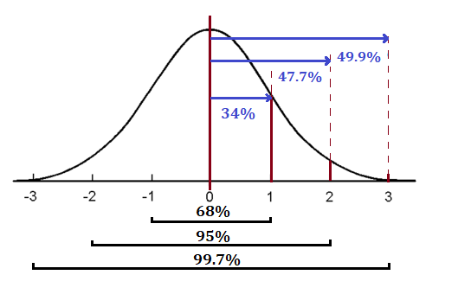
The 68-95-99.7% Rule (of thumb)
Approximately 68% of the observations fall within 1 standard deviation of the mean
Approximately 95% of the observations fall within 2 standard deviations of the mean
Approximately 99.7% of the observations fall within 3 standard deviations of the mean
Remember that the rule applies to ALL normal distributions …and ONLY to normal distributions

Slide 10
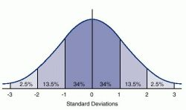
So what?
EX: The distribution of heights of women aged 18 to 24 in Italy is approximately normally distributed with mean 165 cm and standard deviation of 6 cm.
From the 68-95-99.7% rule, it follows that…
68% of these women are between 165-6 and 165+6 cms: 171 and 159 cms.
95% of these women are between 165-2(6) and 165+2(6) cms: 153 and 177 cms.
That is, there are likely to be only 2.5% taller than 177 and 2.5% shorter than 153.
And almost all young Italian women (99.7%) are between 147 and 183 cms.
165-3(6) and 165+3(6) cms
Why is this important?
Practically, easy to work with.
Theoretically, most classical statistical tests are based assumptions of normal distribution (~χ²).
Again, three properties that make it wonderful:
Symmetric: Mean = Median = Mode
Total area under the curve is 1
Fixed Proportions

Slide 11
Standard Normal: Z-Distribution
$$z=\frac{\left(x_{i}−\overline{x}\right)}{s}$$
A special case of the Normal distribution is the Standard Normal (Z-Distribution):
The mean is set at zero
The "standard unit" is 1, called a z-score.
Z-scores convert observations into standard units which represent the distance from the mean in standard deviations.
The characteristics of Normal Distributions:
They are symmetric: the mean is the median is the mode.
The total area under the curve is 1.
The areas under the curve have fixed proportions.

Slide 12
Z-Distribution
$$z=\frac{\left(x_{i}−\overline{x}\right)}{s}$$
EX: The distribution of heights of women aged 18 to 24 in Italy is approx. normally distributed with mean 165 cm and standard deviation of 6 cm.
Recall: 68% of these women are b/t 165-6 and 165+6 cms: 171 &159 cms.
Z= (171-165)/6 = 1 That is, 1 z = 1 standard deviation above mean
Same for (159-165)/6 = -1 1 z below mean
Recall: 95% of these women are b/t 165-2(6) and 165+2(6) cms: 153 &177 cms.
Z= (177-165)/6 = 2 That is, 2z, or 2 standard deviations above mean
Same for (153-165)/6 = -2, 2z below mean
…
IOW: instead of solving the 68-95-99.7% rule for every variable, we can simply standardize ALL INTERVAL-LEVEL variables to the Z-distribution.

Slide 13
Z-Distribution
$$z=\frac{\left(x_{i}−\overline{x}\right)}{s}$$
We can convert any Normal distribution to Standard Normal by converting the observed scores to z-scores (these are the “standard units”, hence, “z-scores”)
Thus, z-scores simply represent distances from the mean in standard deviations.
We can then compare across all interval level variables because they are standardized to this curve.

Slide 14
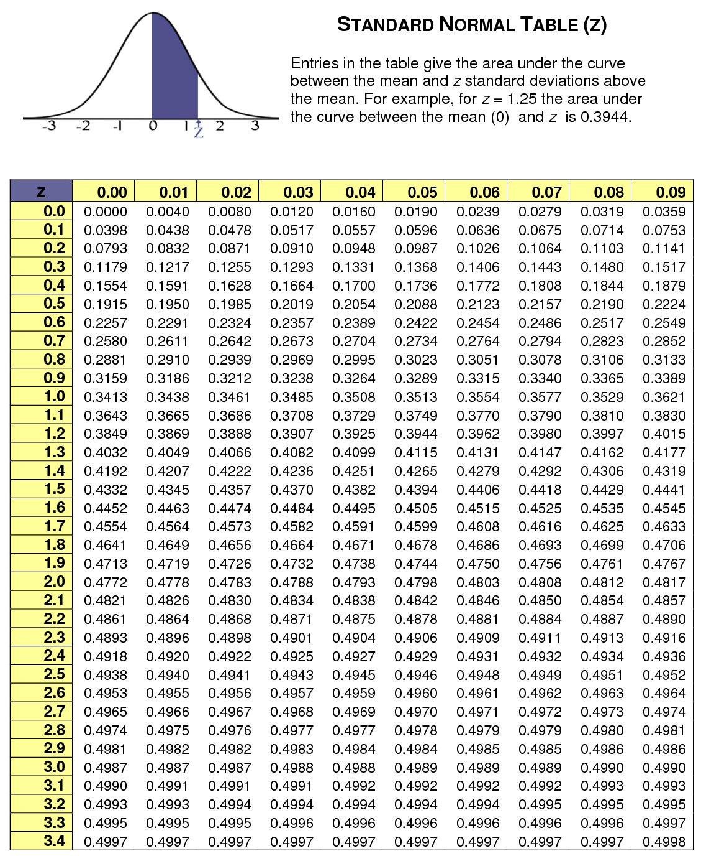
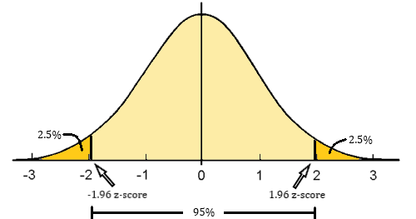
Utility of the Z-Distribution
The 1.96 z-score creates a critical value for 95% confidence

Slide 15
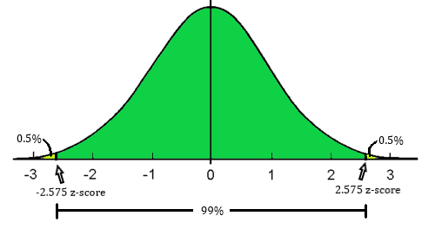
Utility of the Z-Distribution
The 2.575 z-score creates a critical value for 99% confidence

Slide 16
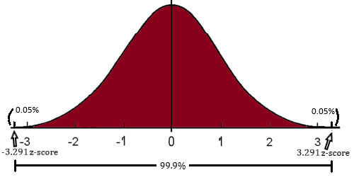
Utility of the Z-Distribution
The 3.291 z-score creates a critical value for 99.9% confidence

Slide 17
Utility of Z-Distribution: Inference
If we want to be 95% confident (α=0.05) in our results, a z-score of 1.96 is associated with 95% of expected outcomes, outside of which would be equal to or above 95% confidence.
i.e.: 1.96 is a critical value defining the 95% rejection region
If we want to be 99% confident (α=0.01) in our results, a z-score of 2.575 is associated with 99% of expected outcomes, outside of which would be equal to or above 99% confidence.
i.e.: 2.575 is a critical value defining the 99% rejection region
And, of course, if we want to be 99.9% confident (α=0.001) in our results, a z-score of 3.291 is associated with 99.9% of expected outcomes, outside of which would be equal to or above 99.9% confidence.
i.e.: 3.291 is a critical value defining the 99.9% rejection region

Slide 18
Utility of Z-Distribution
Determine the expected probability of different outcomes.
We can determine the percentage of observations that fall to the right of the mean, or outside 2 standard deviations, or between the mean and one standard deviation.
Similarly, using the area under the curve as the expected probability, we can also determine the probability of various outcomes – or even the likelihood of the occurrence of a single event.

Slide 19
Utility of the Z-Distribution
All z-scores correspond to probabilities of outcomes
Z-score: 0.45
Z-score: 1.6
Z-score: 2.17
…

Slide 20
Central Limit Theorem
The Central Limit Theorem (CLT) states that as sample size increases, the sampling distribution of sample means approaches Normal with a mean the same as the mean of the population and a standard deviation equal to the standard deviation of the population divided by the square root of n (the sample size). This is true even if the population distribution is not distributed normally.
IOW: No matter what the distribution of the population looks like, the sampling distribution will be distributed normally, as long as your sample size is big enough.

Slide 21
Univariate Inferential Statistics: Confidence Intervals
We use the CLT to make point estimates and to construct confidence intervals for population parameters from sample data.
A Confidence Interval is a range of values around a point estimate that expresses the probability that the interval contains the population parameter between the upper and lower limits of the interval.
It has 2 parts: the sample statistic and the margin of error (associated with a level of confidence)
There is a 95% or 99% or 99.9% chance that the confidence interval contains the true population mean.

Slide 22
Confidence Intervals: Example
‘Ethnic Fractionalization’ has 61 observations with a (sample) mean of 0.46 and a (sample) standard deviation of 0.25.
$${C.I.}_{95\%}=0.46±\left(1.96\right)\left(\frac{0.25}{\sqrt{61}}\right)$$
$${C.I.}_{95\%}=0.46±\left(1.96\right)\left(0.032\right)$$
$${C.I.}_{95\%}=0.46±\left(0.063\right)$$
$${C.I.}_{95\%}=0.397 and 0.523$$
We interpret the result as, ‘there is a 95% chance that the confidence interval 0.397 and 0.523 contains the true population mean.’

Slide 23
Confidence Intervals: Example
If we have a larger sample, the CI will become smaller.
And vice versa.
If the standard deviation is larger, the CI will become larger.
And vice versa.
If we increase our level of confidence, the CI will get larger.
And vice versa.

Slide 25
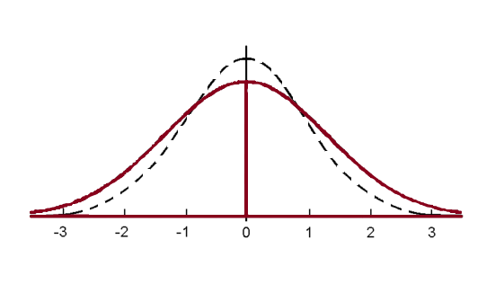
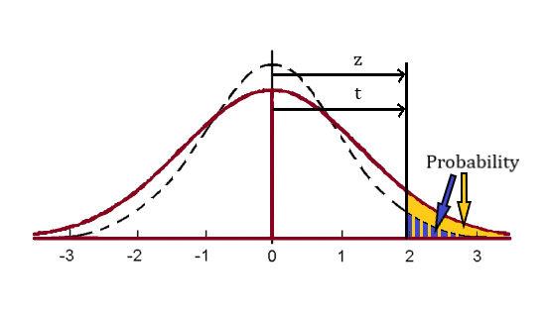
Student’s t
A t-distribution is essentially a z-distribution that adjusts to the number of observations in the sample.
For small samples, the t-distribution ‘flattens out’ making the critical values farther and farther out.
As sample size increases, the t-distribution is indistinguishable from the Standard Normal z-distribution.

Slide 26
Student’s t
A t-value essentially adjusts z-scores for smaller samples and takes into account the use of the use of the sample standard deviation.
It is specified by degrees of freedom and a confidence level and define the critical or rejection region.
Remember, z-scores only needed level of confidence as the shape is standardized (i.e.: without regard for df)

Slide 27
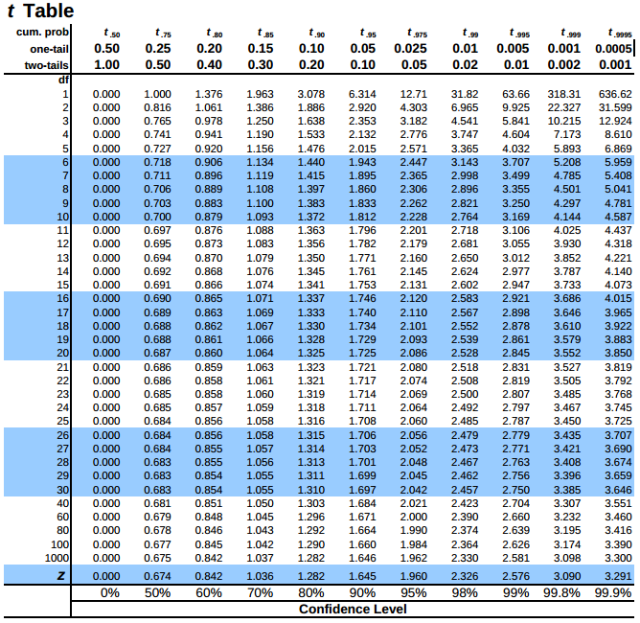
Student’s t: Critical Values α=0.05 for 95% confidence α=0.01 for 99% confidence α=0.001 for 99.9% confidence

Slide 28
Student’s t
Inferential statistics for interval-level variables
Updating Confidence Intervals
Classical Hypothesis Testing
Point Estimates
Difference of Means test

Slide 29
Student’s t: Confidence Interval Example
$$C.I.=Sample Statistic±\left({t−value }_{confidence level}\right)\left(s.e.\right)$$
$$in which s.e. = \frac{s_{x}}{\sqrt{n}}$$
Recall: ‘Ethnic Fractionalization’. ‘Ethnic Fractionalization’ has 61 observations with a (sample) mean of 0.46 and a (sample) standard deviation of 0.25.
RECALL: ‘There is a 95% chance that the confidence interval 0.397 and 0.523 contains the true population mean.’

Slide 30
Student’s t: Critical Values df and confidence

Slide 31
Student’s t: Confidence Interval Example
$${C.I.}_{95\%}=0.46±\left(2.000\right)\left(\frac{0.25}{\sqrt{61}}\right)$$
$${C.I.}_{95\%}=0.46±\left(2.000\right)\left(0.032\right)$$
$${C.I.}_{95\%}=0.46± 0.064$$
${C.I.}_{95\%}=0.396 and 0.524$
There is a 95% chance that the confidence interval 0.396 and 0.524 contains the true population mean.’
Changes bc of smaller sample?
$${C.I.}_{95\%}=0.46±\left(2.064\right)\left(\frac{0.25}{\sqrt{25}}\right)$$

Slide 32
Student’s t: Critical Values

Slide 33
Student’s t: Confidence Interval Example
$${C.I.}_{95\%}=0.46±\left(2.000\right)\left(\frac{0.25}{\sqrt{61}}\right)$$
$${C.I.}_{95\%}=0.46±\left(2.000\right)\left(0.032\right)$$
$${C.I.}_{95\%}=0.46± 0.064$$
${C.I.}_{95\%}=0.396 and 0.524$
There is a 95% chance that the confidence interval 0.396 and 0.524 contains the true population mean.’
Changes bc of smaller sample?
$${C.I.}_{95\%}=0.46±\left(2.064\right)\left(\frac{0.25}{\sqrt{25}}\right)$$
$${C.I.}_{95\%}=0.46±\left(2.064\right)\left(0.05\right)$$
$${C.I.}_{95\%}=0.46± 0.103$$
$${C.I.}_{95\%}=0.357 and 0.563$$
There is a 95% chance that the confidence interval 0.357 and 0.563 contains the true population mean

Slide 34
Student’s t: Point Estimation
Sometimes we can use Student’s t to evaluate whether a number is another number.
That is, we can determine how likely two different numbers are different only because of chance (e.g.: different sampling methods, mismeasurement, error) or if they really represent different numbers.
We use Student’s t and Classical Hypothesis Testing

Slide 35
Classical Hypothesis Testing
One: the Null Hypothesis
The condition that the expected relationship in your hypothesis does not exist ($H_{0}$).
Two, the Alternative Hypothesis
Your research hypothesis (often written as: $H_{1}$or $H_{a}$).
Three, a Test Statistic
A value of how much our result - calculated from our sample data - deviates from chance.
Four, a Critical or Rejection Region
A value defines the region for rejecting or failing to reject the test statistic. Depends on our level of confidence and the degrees of freedom.
Five, Interpretation
Here we make a final determination of statistical significance.

Slide 36
Student’s t: Classical Hypothesis Testing
Is the global average of the level of e-governance’ ‘about half’ or 50%?
A sample of 63 observations tells us that the mean is 0.617 with a standard deviation of 0.188.
ONE: Null Hypothesis: H₀: μ = 0.500
TWO: Alternative Hypothesis H_{a}: μ ≠ 0.500
THREE: Test statistic: The test statistic for Students’ t is called the t-test statistic or simply t-statistic:
$$t−statistic = \frac{\overline{x} − x}{\left(\frac{s}{\sqrt{n}}\right)}$$

Slide 37
Student’s t: Classical Hypothesis Testing
Therefore, for our E-Governance example:
$$t−statistic = \frac{0.617 − 0.500}{\left(\frac{0.188}{\sqrt{63}}\right)}$$
FOUR: Critical Value: [α= 0.05; df=62]: 2.000.
FIVE: Interpretation and conclusion: Is 4.222 larger than 2.000?
With 95% confidence [α= 0.05; df=62], we reject the null hypothesis that μ = 0.500.
With 99% confidence [α= 0.01; df=62]: 2.66, we reject the null hypothesis that μ = 0.500.
With 99.9% confidence [α= 0.001; df=62]: 3.66, we reject the null hypothesis that μ = 0.500.
$$t−statistic = \frac{0.117}{\left(0.024\right)}$$
$$t−statistic =4.222$$

Slide 38
Student’s t: Difference of Means Test
The difference of means t-test determines whether the difference between two means is zero (or not).
We can show whether two different groups have a different mean of the same variable - or whether a single variable, separated by another variable, produces significantly different means.
$${t−statistic}_{Diff of Means}= \frac{\left({\overline{x}}_{1}− {\overline{x}}_{2}\right)}{{s.e.}_{Diff}}$$
$${s.e.}_{Diff}= \sqrt{{\left(\frac{s_{1}}{\sqrt{n_{1}}}\right)}^{2}+{\left(\frac{s_{2}}{\sqrt{n_{2}}}\right)}^{2}}$$
$$df = n_{1}+ n_{2} − 2$$

Slide 39
Student’s t: Difference of Means Test Example
Do democracies have different levels of GDP than non-democracies?
ONE: H₀: The difference between the means is zero (µ1 - µ2 = 0)
TWO: H_{a}: The difference is not zero (µ1 - µ2 ≠ 0)
 | n | Mean (gdp_1000) | Standard Deviation
Democracy | 56 | 7.56 | 5.37
Non-democracy | 56 | 5.05 | 2.04

Slide 40
Student’s t: Difference of Means Test Example
THREE: To calculate the test statistic we need:
The observed difference between the sub-sample means: 7.56-6.05 = 2.51
Standard Error of the Difference: √((5.37/√(56))² + (2.04/√(56))²) = 0.768
T-test statistic: of the difference 2.51/0.768 = 3.27
FOUR: Critical value: df: (n₁ + n₂ – 2) = 56+56-2= 110; 95% conf. (α= 0.05)
Critical Value: [α= 0.05; df=110]: 1.984
FIVE: Interpretation: At 95% confidence, we reject the null.
99% confidence [α= 0.01; df=110]: 2.61
99.9% confidence [α= 0.001; df=110]: 3.39

Slide 41
Point Estimates: Using Student’s t
Is the global average of the level of e-governance’ ‘about half’ or 50%?
The Quality of Governance dataset actually has a sample of 193 observations which tell us that the mean is 0.549 with a standard deviation of 0.213.
ONE: Null Hypothesis: H₀: μ = 0.500
TWO: Alternative Hypothesis H_{a}: μ ≠ 0.500
THREE: Test statistic: t-test statistic or simply t-statistic: $t−statistic = \frac{\overline{x} − x}{\left(\frac{s}{\sqrt{n}}\right)}$
$t−statistic = \frac{0.549 − 0.500}{\left(\frac{0.213}{\sqrt{193}}\right)}=3.21$
FOUR: Critical Value: [α= 0.05; df=192]: …

Slide 42
Student’s t: Critical Values df and confidence

Slide 43
Point Estimates: Using Student’s t
Is the global average of the level of e-governance’ ‘about half’ or 50%?
The Quality of Governance dataset actually has a sample of 193 observations which tell us that the mean is 0.549 with a standard deviation of 0.213.
ONE: Null Hypothesis: H₀: μ = 0.500
TWO: Alternative Hypothesis H_{a}: μ ≠ 0.500
THREE: Test statistic: t-test statistic or simply t-statistic: $t−statistic = \frac{\overline{x} − x}{\left(\frac{s}{\sqrt{n}}\right)}$
$t−statistic = \frac{0.549 − 0.500}{\left(\frac{0.213}{\sqrt{193}}\right)}=3.21$
FOUR: Critical Value: [α= 0.05; df=192]: 1.984
FIVE: Interpretation and conclusion.
With 95% confidence [α= 0.05; df=192]: 1.98, we reject the null hypothesis that μ = 0.500.
With 99% confidence [α= 0.01; df=192]: 2.63, we reject the null hypothesis that μ = 0.500.
With 99.9% confidence [α= 0.001; df=192]: 3.39, we fail to reject the null hypothesis μ = 0.500.

Slide 44
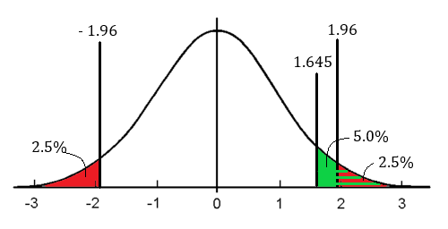
Student’s t: One and Two Tailed Tests
A two-tailed test is based on the idea of a confidence interval. That is, the test is designed so that the t-statistic can be either positive or negative but must still reach the critical value to be statistically significant.
A one-tailed test is for directional hypothesis testing in which the direction of the difference is known or anticipated. That is, one group is expected to have a higher or lower level of something before the testing.

