Slide 1
Epigenetic regulatory enzymes

Slide 2
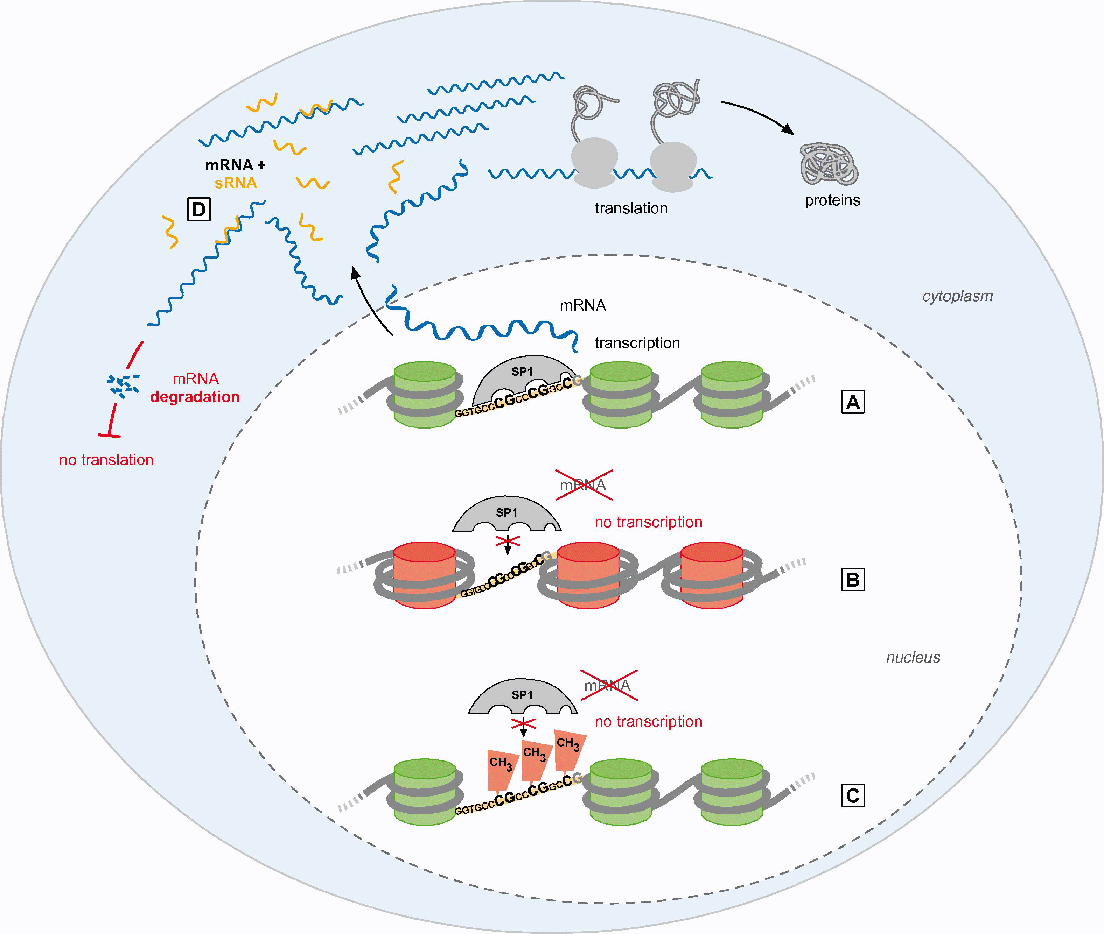
EPIGENETIC MECHANISMS
A. Doehring et al. , European Journal of Pain 15 (2011)
Epigenetic mechanisms which induce changes in gene expression without changing the DNA sequence include modifications of genomic DNA or histones and the action of small regulatory non-coding RNAs.
Notes:
Fig. 1. Epigenetic mechanisms which induce changes in gene expression without changing the DNA sequence include modifications of genomic DNA or histones and the action of small regulatory non-coding RNAs. (A) In transcriptional active euchromatin, the nucleosomes composed of histones around which the DNA is wrapped are loosely packed and available for transcription factors, e.g., SP1, that binds to the promoter region of the human l-opioid receptor gene at the DNA sequence motif ‘‘ggtgcccgcccggcc”. (B) Most of each histone complex is inaccessible, but the histone tails protrude from the nucleosomes and are subject to various modifications (e.g., deacetylation or methylation). These modifications affect the second structure of the histones and, therefore, the compaction of the nucleosomes. Densely packed nucleosomes are generally inaccessible to the transcription machinery because the binding motif is rendered unreadable. Therefore, no mRNA will be produced. (C) Promoter regions of many human genes have unmethylated CpG dinucleotide-rich regions. The methylation of these CpG islands prevents the binding of transcription factors such as SP1 and represses the transcription mechanism. (D) Post-transcriptionally, small regulatory non-coding RNA molecules can bind to mRNA molecules and induce their degradation and therefore the repression of the translation process.

Slide 3
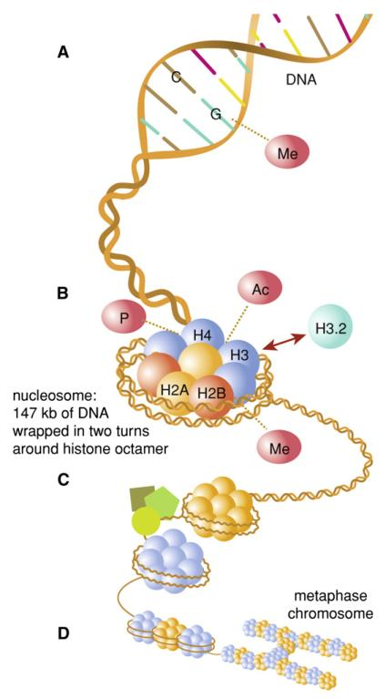
(A) DNA methylation was traditionally considered mainly in the context of CpG islands and is known to have silencing functions (e.g., silencing of the inactive X chromosome).
(B) Histone variants and modifications: DNA is wrapped around a histone octamer consistent of a histone H3, H4 tetramer and two histone H2A, H2B dimers. The lysine residues of histones can be modified, e.g., by phosphorylation (P), acetylation (Ac) and methylation (Me), and this changes chromatin conformation. Different histone variants exist (e.g., H3.2) that have distinct posttranslational modification patterns, occur at different stages of neuronal development, and hence affect chromatin function.
(C) Chromatin remodeling complexes: chromatin conformation can also be changed through protein complexes whose actions are fuelled by ATP hydrolysis.
(D) Nucleosomes are further condensed into chromatin fibers and packaged into chromosomes to fit inside the nucleus. The structure of chromatin and chromosomes is highly dynamic and varies with cell cycle.

Slide 4
EPIGENETIC ENZYMES
Epigenetic modifications are catalyzed by epigenetic regulatory enzymes:
DNA methyltransferases (DNMTs)
DNA demethylases
Histone acetyltransferases (HATs)
Histone deacetylases (HDACs)
Histone methyltransferases (HMTs):
  Histone lysine methyltransferases (HKMTs)
  Histone arginine methyltransferases (HRMTs)
Histone demethylase (HDMs):
  Lysine demethylase 1 (KDM1 or LSD1)
  JmjC domain-containing histone demethylases (JHDMs)

Slide 5
DNA METHYLATION
In mammals, DNA methylation occurs in the cytosine residues at their C5 positions, primarily in the CG dinucleotides and only occasionally at non-CG sites. However, only certain CG sites are methylated, resulting in the generation of a tissue- and cell-type-specific pattern of methylation.
There are 56 million CG sites in the human genome, about 60–80 % of which are methylated, which corresponds to 4–6% of all cytosines.
DNA methylation is mediated by a family of conserved DNA methyltransferases (DNMTs).

Slide 6
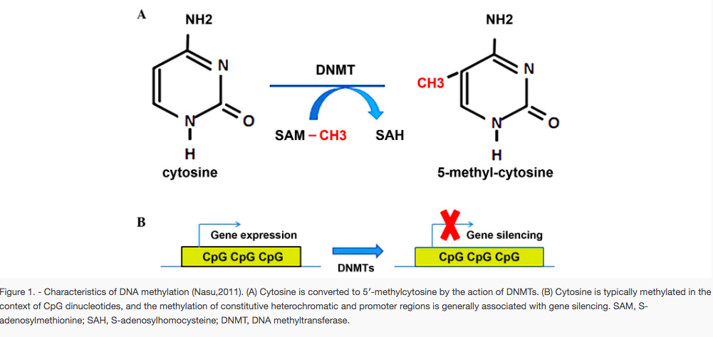

Slide 7
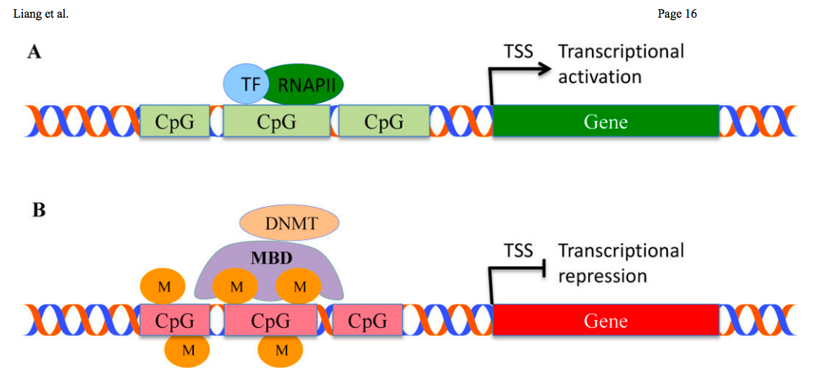
DNA methylation represses gene transcriptional processes
Without methylation at the CpG sites of the gene promoter, the transcription factor (TF) and RNA polymerase II (RNAPII) bind to the promoter region of the gene, thereby gene transcription is activated.
When methyl groups are added at the CpG islands by methyl-CpG-binding domain protein (MBD)-mediated DNA methyltransferases (DNMTs), the transcription factor (TF) and RNA polymerase II (RNAPII) cannot bind the promoter region of the gene, resulting in the repression of gene transcription. TSS: Transcription start site.

Slide 8
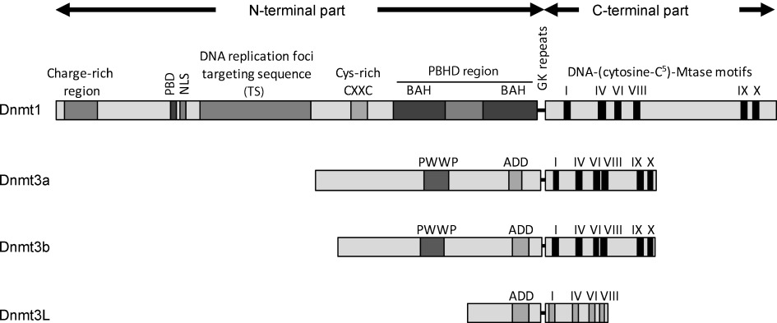
In mammals there are four isoforms of DNMTs:
  three active DNA methyltransferases: DNMT1, DNMT3a, DNMT3b
  one related protein lacking catalytic activity: DNMT3L
Jurkowska et al., ChemBioChem (2011)
Mammalian DNMTs comprise two parts: a large multidomain N-terminal part of variable size, which has regulatory functions, and a C- terminal catalytic part. The N-terminal part guides the nuclear localisation of the enzymes and mediates their interactions with other proteins, DNA and chromatin. The smaller C-terminal part harbours the active centre of the enzyme.

Slide 9
DNMT1
DNMT1 was the first mammalian DNA methyltransferase enzyme to be cloned and biochemically characterised.
DNMT1 shows a preference for hemimethylated DNA over un-methylated DNA and it is localised at DNA replication foci during the S phase.
It plays a role as a maintenance methyltransferase, responsible for the preservation of the methylation patterns during cell divisions by methylation of hemimethylated CG dinucleotides produced by DNA replication.
It has an essential function in early development: disruption of the Dnmt1 gene in mice results in extensive demethylation of the genome and embryonic lethality shortly after gastrulation; knockdown of Dnmt1 in human germ line cells leads to their immediate apoptosis.

Slide 10
DNMT3
The mammalian DNMT3 family of DNA methyltransferases comprises three members: DNMT3a, DNMT3b and DNMT3L.
DNMT3a and DNMT3b are active MTases that are responsible for the establishment of DNA methylation patterns early in mammalian development and in germ cells.
DNMT3L is catalytically inactive and functions as a regulatory factor in germ cells.
DNMT3a and DNMT3b have traditionally been designated as de novo DNMTs, because they do not display any significant preference between hemimethylated and unmethylated DNA. Although they function primarily as de novo MTases, they also play a role in the maintenance of DNA methylation at hetero-chromatic regions.

Slide 11
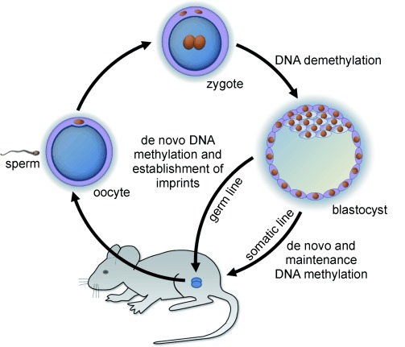
Similarly to Dnmt1, both Dnmt3a and Dnmt3b are indispensable for embryonic development in mice. Mouse Dnmt3b knockout embryos die in utero (at embryonic day E9.5) and show multiple developmental defects, whereas the Dnmt3a knockout animals develop to term, but become runts and die shortly after birth.
Figure 4
Dynamics of DNA methylation during mammalian development. After fertilisation the zygote undergoes global DNA demethylation to establish totipotency in the embryo. The patterns of DNA methylation are set de novo in the somatic line around the time of implantation and are maintained though the lifespan of the organism. During the development of the germ cells another round of de novo methylation occurs and the methylation imprints are established in a gender‐specific manner.

Slide 12
Regolazione epigenetica durante lo sviluppo

Slide 13
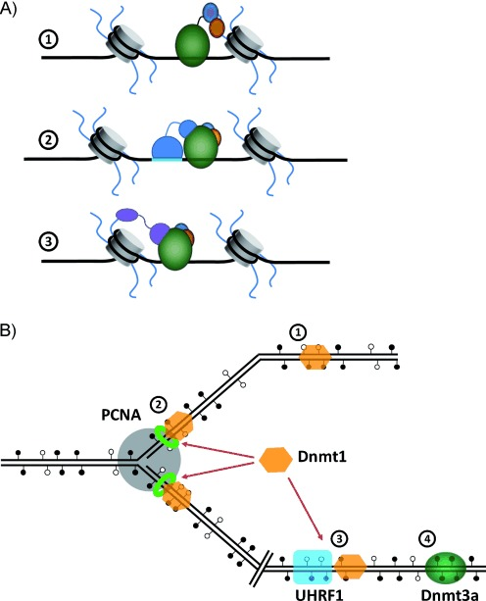
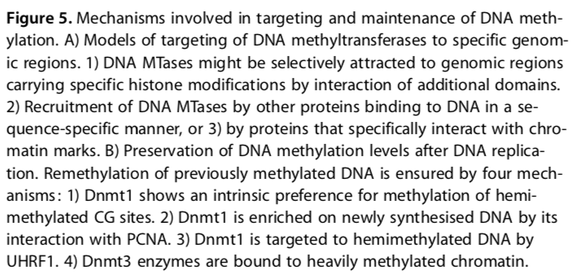
Jurkowska et al., ChemBioChem (2011)

Slide 14
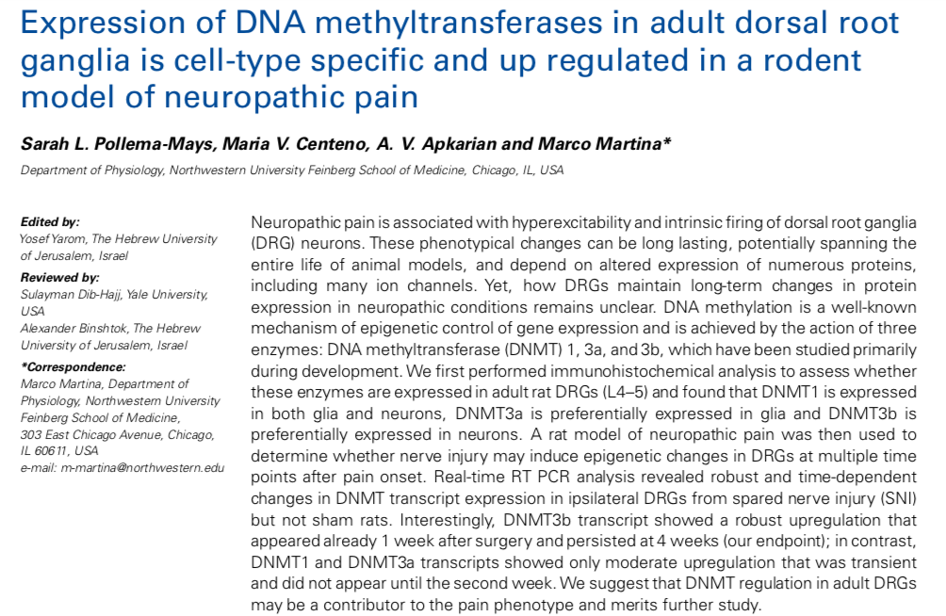

Slide 16
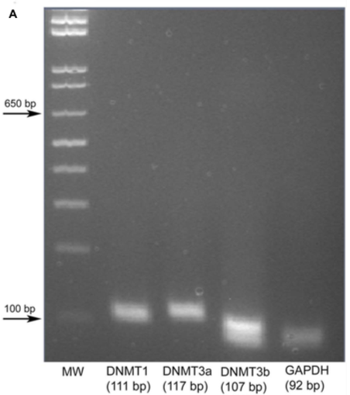
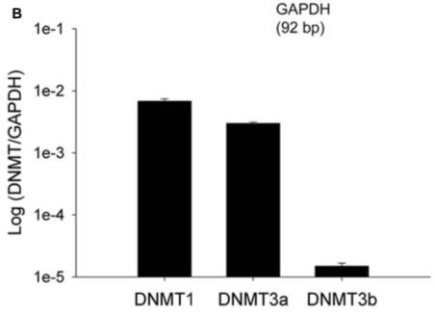
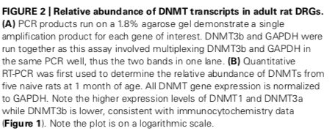

Slide 17
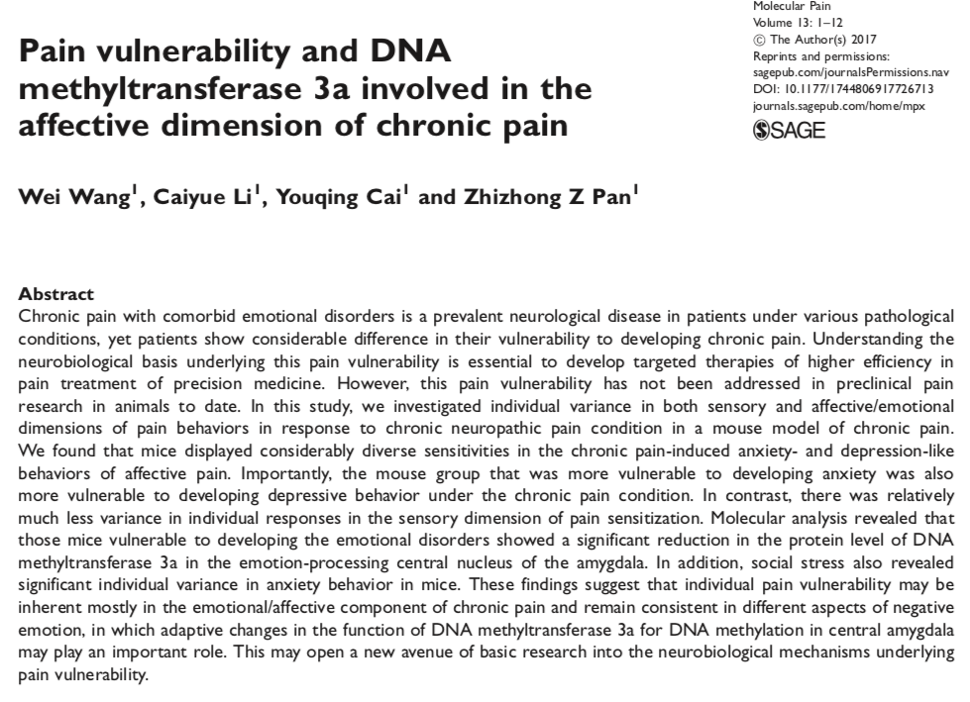

Slide 18
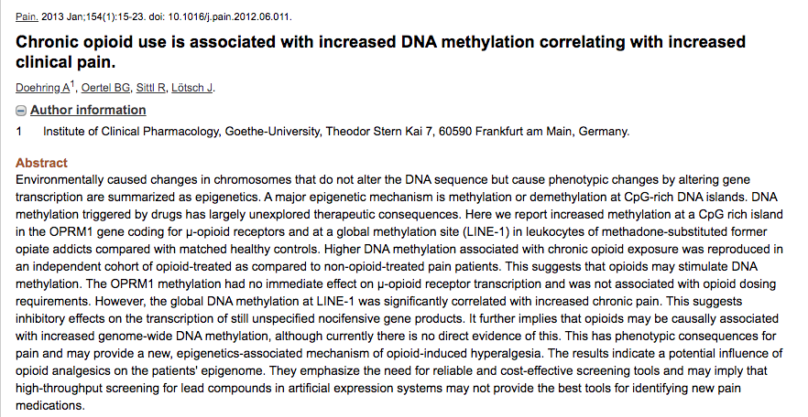

Slide 19
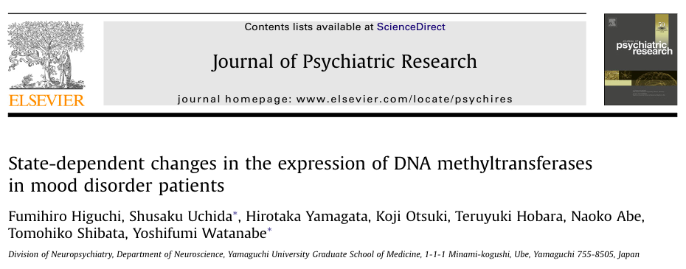
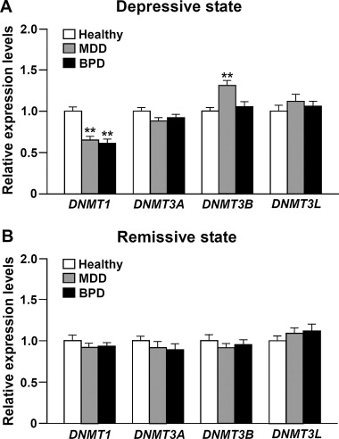
These results indicate that the decreased levels of DNMT1 in MDD (major depressive disorder) and BPD (bipolar disorder), and the increased levels of DNMT3B in MDD are state-dependent.
State-dependent changes in the expression of mRNA for DNMTs in the peripheral blood cells are useful biological markers for mood disorders.
Notes:
In this study, we found altered mRNA expression of DNMT1 and DNMT3B in peripheral blood cells of MDD and BPD patients in a current depressive state (Fig. 1A). In contrast, these alterations were not observed in a remissive state (Fig. 1B). Importantly, a similar significant difference was found in the expression levels of these mRNA in the same patients with MDD and BPD before and after remission. These results thus indicate that the decreased levels of DNMT1 in MDD and BPD, and the increased levels of DNMT3B in MDD are state dependent.

Slide 20
…studi clinici…

Slide 21
DNA DEMETHYLATION
The knowledge about DNA demethylation and the player involved in this process has been poor for quite some time.
Generally it can be distinguished between global, genome wide and locus-specific demethylation events.
A typical example for global demethylation is implemented in zygote formation; locus-specific DNA demethylation occurs for instance in genomic imprinting during plant reproduction.
DNA demethylation is necessary for the epigenetic reprogramming of genes and is also directly involved in many important disease mechanisms such as tumor progression.
There are two mechanisms of DNA demethylation: passive and active demethylation.

Slide 22
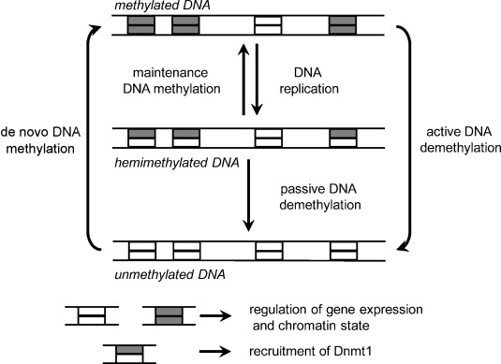
The initial methylation pattern is set by so-called de novo mtases (DNMT3 enzymes in mammals). After each round of DNA replication, hemimethylated DNA is created, with the parental strand carrying the methylation marks and newly synthesised daughter strand being devoid of methylation. The daughter strand is remethylated by a maintenance DNA methyltransferase, which is specific for hemimethylated DNA (DNMT1 in mammals).
When the maintenance MTase activity is suppressed, passive demethylation of the DNA takes place, resulting in the generation of unmethylated DNA after another round of replication equivalent to the loss of 50% of the methylation per replication cycle. Active demethylation, in contrast, occurs independently of DNA replication and requires enzymatic activity, either to remove the methyl group from the methylated base directly or to exchange the whole base by an unmethylated one. Furthermore, a previously unmethylated region (such as a CG island) might become methylated through the action of a DNA methyltransferase targeted to that locus.
Figure. Dynamics and roles of DNA methylation in mammals (Jurkowska et al., ChemBioChem (2011)

Slide 23
Passive DNA demethylation
The passive process takes place in the absence of methylation of newly synthesised DNA strands by DNMT1 during several replication rounds (for example, upon 5-Azacytidine treatment), leading to dilution of the methylation signal.
The hyper-methylation state is maintained through the inhibition of DNA demethylases.

Slide 24
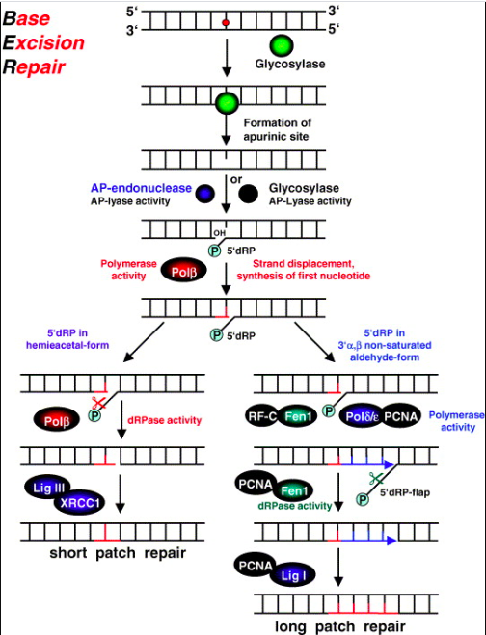
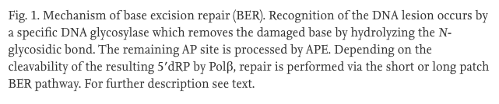
Active demethylation
The active demethylation pathway has long been elusive, until a recent suggestion was made for the involvement of cytosine hydroxymethylation, which is followed with the Base Excision Repair (BER) pathway, to achieve the demethylation on DNA.

Slide 25
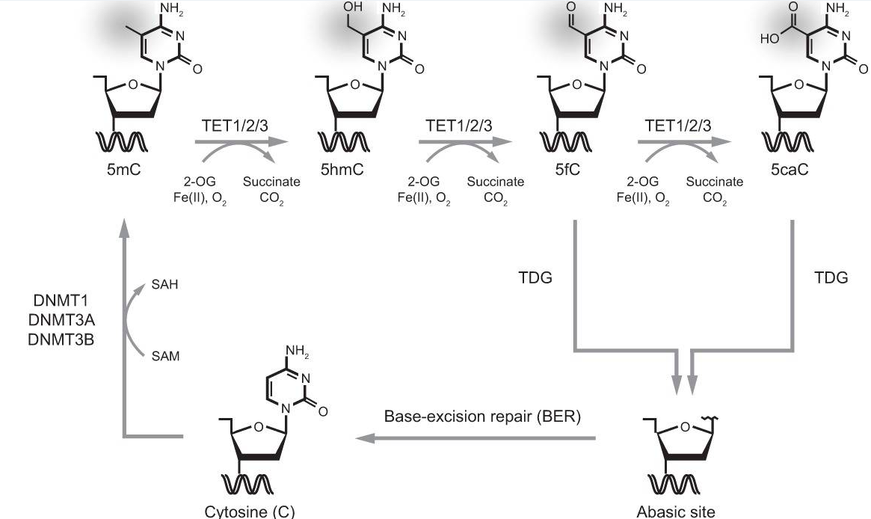
Ten Eleven Translocation (TET) enzymes hydroxylate 5-methylcytosine to 5-hydroxymethylcytosine. The enzymes utilize α-ketoglutarate and Fe2+ion to oxidize 5-methylcytosine into 5-hydroxylmethylcytosine.
Kasper Dindler Rasmussen and Kristian Helin; Genes Dev 2016
Model of active DNA demethylation by a TET/TDG (thymine–DNA–glycosylase)/BER (base excision repair)-dependent pathway. A cytosine base can be methylated by the DNA methylation machinery (DNMT1 or DNMT3A/B) to form 5mC, which in turn can be iteratively oxidized by TET enzymes to produce 5hmC, 5fC, and 5caC. TDG then recognizes 5fC and 5caC, and the oxidized cytosine base is excised. This yields an abasic site that is repaired by BER and results in restoration of the unmodified cytosine state.

Slide 26
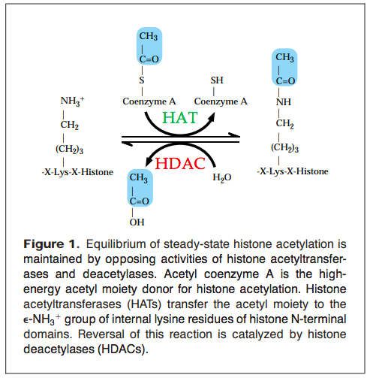
HISTONE ACETYLATION
Histone acetylation, a well-studied post translational histone modification, is controlled by the opposing activities of histone acetyltransferases (HATs) and histone deacetylases (HDACs).
Acetylation of histones is closely linked to transcriptional activation.
Acetylation of internal lysines may affect several aspects of the nucleosome function.
→ Hyperacetylated histones are associated with certain transcriptionally active domains.
→ Underacetylated histones are enriched in the loci that are repressed or silenced in transcription.
Min-Hao Kuo and C. David Allis, BioEssays (1998)

Slide 27
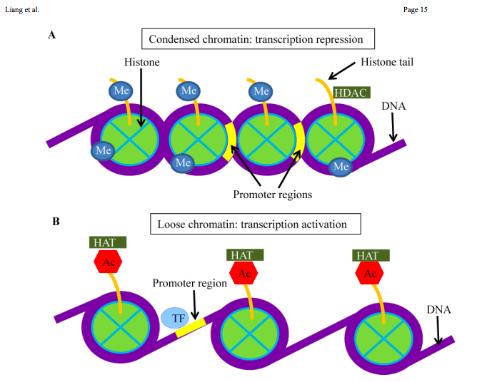
Histone modification regulates gene expression
Methylation (Me) of histones and deacetylation of histones with HDAC results in a condensed chromatin. Under this condition, transcription factors (TF) cannot bind to the promoter region of the gene, thereby gene transcription is repressed.
Histone acetylation (Ac) with HAT results in loose chromatin that allows the transcription factor (TF) to bind to the promoter region of the gene. Consequently, gene transcription is activated.

Slide 28
Histone acetyltransferases (HATs)
HATs can be grouped into at least two classes:
type A HATs are localized in nuclei and most likely acetylate nucleosomal histones in reactions closely tied to transcriptional activation.
type B HATs can be purified from cytoplasmic fractions, and it is commonly held that these activities are responsible for acetylating newly synthesized histones before chromatin assembly during DNA replication.
several known transcriptional regulators have been found to possess intrinsic HAT activity: Gcn5p and homologs, PCAF, p300/CBP, TAFII250 and homologs, SRC-1, ACTR, etc.

Slide 29
Histone deacetylases (HDACs)
Removal of the acetyl group from the ε-amino group of acetylated lysine residues by HDACs restores the positive charge on the lysine residue and allows the electrostatic interaction with the negatively charged DNA backbone causing a condensed/inactive chromatin structure.
Until today, 18 different members of HDACs have been identified and grouped into four classes:
  Class I, II, and IV HDACs, or the so-called classical histone deacetylases, remove the acetyl moiety on lysine residues in the presence of a Zn2+ ion via a charge-relay system. They are zinc-dependent amidohydrolases.
  Class III HDACs, also called sirtuins, are dependent on nicotinamide adenine dinucleotide (NAD+) as a cofactor to catalyze the deacetylation reaction.

Slide 30
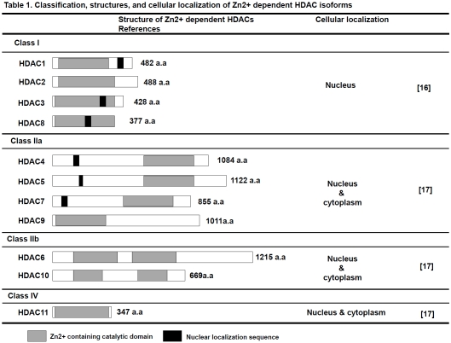

Slide 31
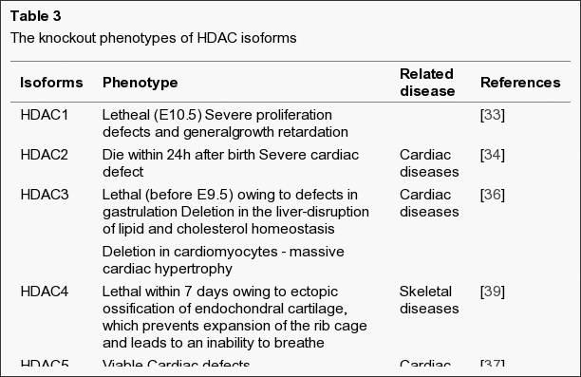
HDACs are both directly and indirectly involved in many biological processes, including development, proliferation, differentiation, and cell death.
HDAC knockout mice enable study of their biological functions and provide valuable insights into the development and side effects of selective inhibitors.
Kim HJ, Bae SC. Am J Transl Res. 2011;3(2):166–179.

Slide 32
Aggiungere lavori nostri su hdac

Slide 35
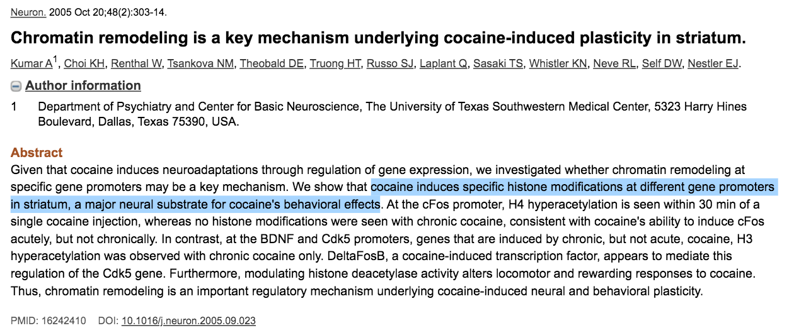

Slide 36
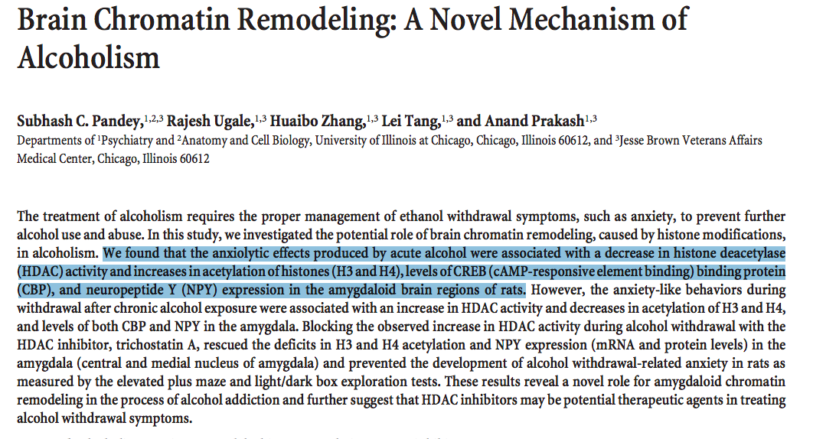
The Journal of Neuroscience, April 2, 2008 ; 28(14):3729 –3737

Slide 37
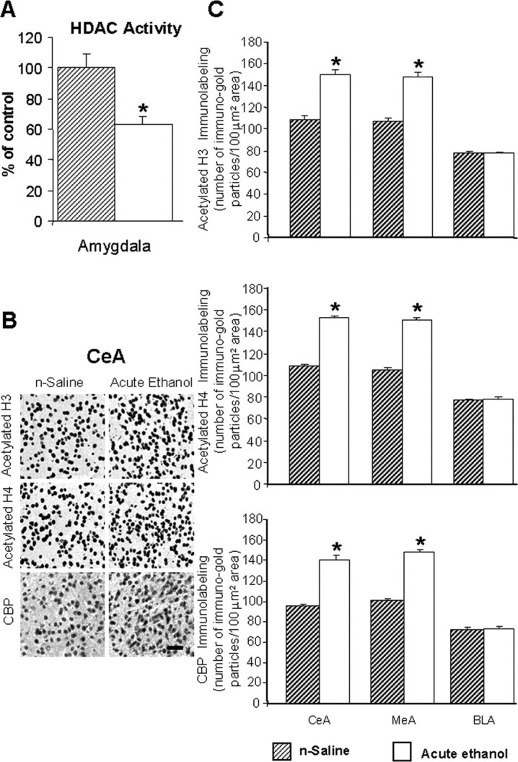
A, Acute ethanol exposure inhibited HDAC activity in the amygdala of rats.
B, Low-magnification photomicrographs of acetylated histones H3 (Lys 9) and H4 (Lys 8) and CBP gold-immunolabeling (protein levels) in central amygdaloid (CeA) structures of n-saline or acute-ethanol-treated rats.
C, Effect of acute ethanol treatment on protein levels of acetylated H3 and H4, and of CBP in various amygdaloid (CeA, MeA, and BLA) structures of rats
Pandey et al., The Journal of Neuroscience (2008)
Notes:
A, Acute ethanol exposure inhibited HDAC activity in the amygdala of rats [injected with ethanol (1 h after 1 g/kg, i.p.) or n-saline]. The HDAC activity was determined in the cell lysates of amygdala by measuring the deacetylation of acetylated lysine side chains. The values are the mean ± SEM of seven rats per group. *Significantly different from n-saline-treated rats (p < 0.01; Student's t test). B, Low-magnification photomicrographs of acetylated histones H3 (Lys 9) and H4 (Lys 8) and CBP gold-immunolabeling (protein levels) in central amygdaloid (CeA) structures of n-saline or acute-ethanol-treated rats. Scale bar, 40 μm. C, Effect of acute ethanol treatment on protein levels of acetylated H3 and H4, and of CBP in various amygdaloid (CeA, MeA, and BLA) structures of rats. Values are the mean ± SEM of seven to nine rats per group. *Significantly different from the n-saline-treated rats (p < 0.001; Student's t test).

Slide 38
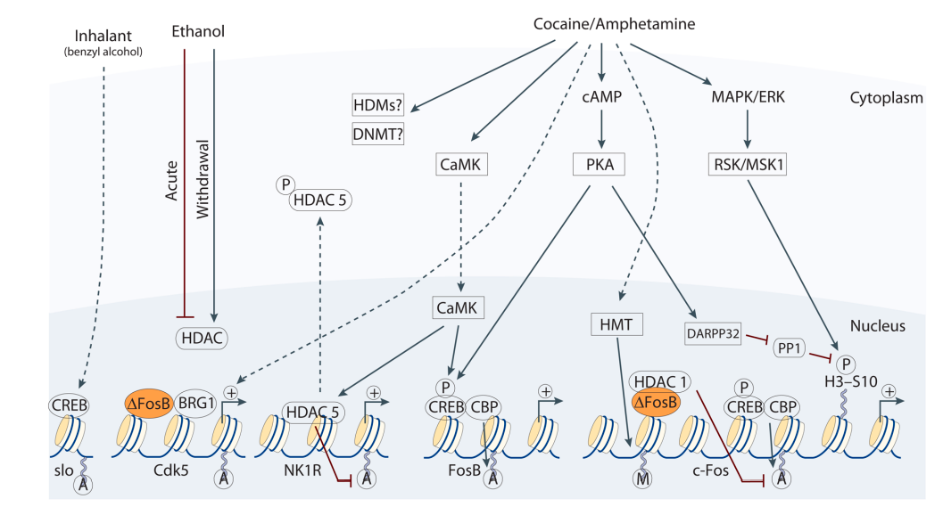
REGULATION OF CHROMATIN STRUCTURE BY DRUGS OF ABUSE
Notes:
Figure 2. Regulation of chromatin structure by drugs of abuse Drug-induced signaling events are depicted for cocaine/amphetamine, ethanol, and an inhalant, benzyl alcohol. Cocaine and amphetamine can increase cAMP levels in striatum, which activates protein kinase A (PKA) and leads to phosphorylation of its targets. This includes the cAMP response element binding protein (CREB), the phosphorylation of which induces its association with the histone acetyltransferase, CREB binding protein (CBP) to acetylate histones and facilitate gene activation. This is known to occur on many genes including fosB and c-fos in response to psychostimulant exposure. ΔFosB is also upregulated by chronic psychostimulant treatments, and is known to activate certain genes (e.g., cdk5) where it recruits the SWI-SNF chromatin remodeling enzyme, BRG1, and represses others (e.g., c-fos) where it recruits HDAC1. This repression of c-fos also involves increased repressive histone methylation, which is thought to occur via the induction of specific histone methyltransferases. It is not yet known how cocaine regulates histone demethylases (HDM) or DNA methyltransferases (DNMTs). Cocaine also activates the mitogen activated protein kinase (MAPK) cascade, which through MSK1 can phosphorylate CREB and histone H3 at serine 10. Cocaine promotes H3 phosphorylation via a distinct pathway, whereby PKA activates protein phosphatase 2A, leading to the dephosphorylation of serine 97 of DARPP32. This causes DARPP32 to accumulate in the nucleus and inhibit protein phosphatase 1 (PP1) which normally dephosphorylates H3. Chronic exposure to psychostimulants is also known to increase glutamatergic stignaling from the prefrontal cortex to the NAc. Glutamatergic signaling elevates Ca2+ levels in NAc synapses and activates CaMK (calcium/calmodulin protein kinases) signaling, which, in addition to phosphorylating CREB, also phosphorylates HDAC5. This results in nuclear export of HDAC5 and increased histone acetylation on its target genes (e.g., NK1R [NK1 or substance P receptor). Acute ethanol has been shown to reduce histone acetylation by increasing HDAC activity, while withdrawal from chronic ethanol increases histone acetylation by reducing HDAC activity. The organic solvent, benzyl alcohol, which is used to study the tolerance effects of inhalants, rapidly induces histone acetylation on the Ca2+-activated K+ channel, slo, to facilitate CREB-dependent transcription.

Slide 39
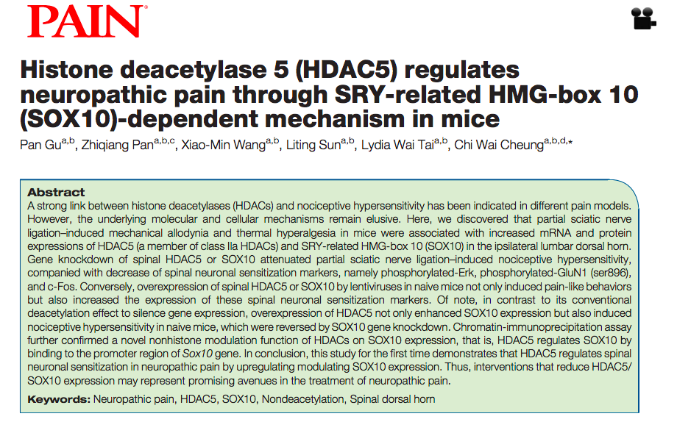

Slide 40
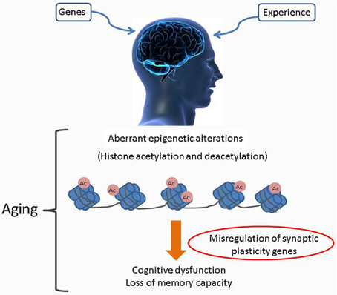
TARGETING SPECIFIC HATS FOR NEURODEGENERATIVE DISEASE TREATMENT
Figure 1. Age associated alterations to the brain epigenome. Age associated cognitive decline as caused by accumulated alterations of histone acetylation patterns in the brain. Misregulation of specific HAT production and/or their targeting to chromatin leads to complex changes in the chromatin landscape with subsequent altered transcription profiles. Such negative changes exacerbate an individual's vulnerability to age related cognitive decline (typical of many Age-related neurodegenerative disorders such as Huntington's disease (HD), Alzheimer's disease (AD), Parkinson disease (PD), amyotrophic lateral sclerosis (ALS), and others are multifactorial illnesses).
Pirooznia and Elefant; Front. Cell. Neurosci. (2013)

Slide 41
HISTONE METHYLATION
Recent studies demonstrated that histone methylation is not static but is dynamically regulated by histone methyltransferases and the most recently discovered histone demethylases.
Histone methylation is now recognized as an important modification linked to both transcriptional activation and repression.
Histones contain numerous lysine and arginine residues, of which many are methylated in vivo.
Lysine can be mono-, di-, and trimethylated while arginine can be both monomethylated and symmetrically or asymmetrically dimethylated.

Slide 42
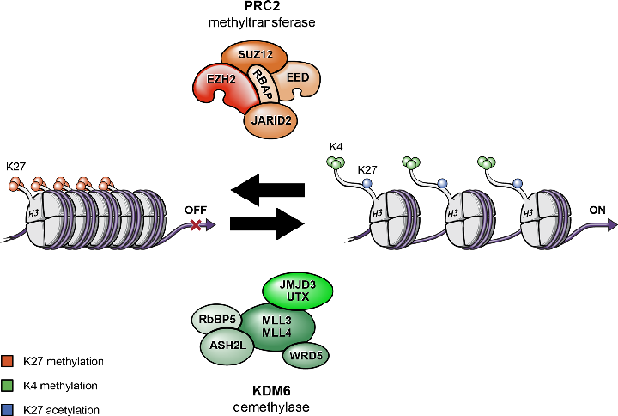
Histone methyltransferases & demethylase
Histone modifications by PRC2 methyltransferase and KDM demethylase activities, and associations with transcriptionally active vs inactive states. Histone proteins are modified by the PRC2 and by KDM. PRC2 increases methylation of Lys 27, which promotes a more compact and transcriptionally repressed chromatin state. In contrast, KDM complex removes methyl groups from Lys 27 and increases methylation of Lys 4 that, in combination, promote an open and transcriptionally active chromatin state.

Slide 43
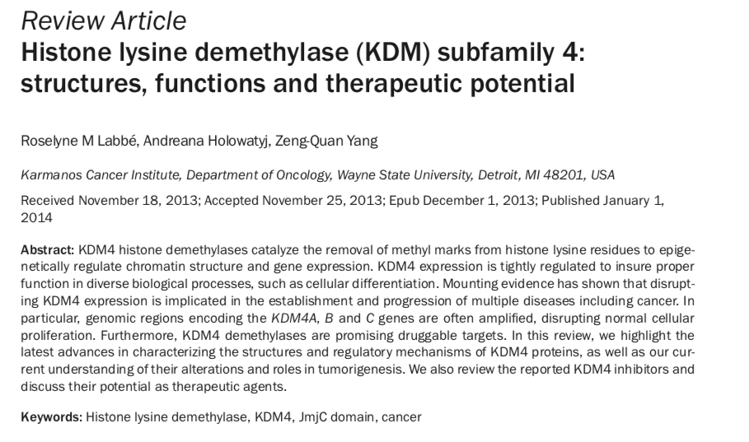

Slide 44
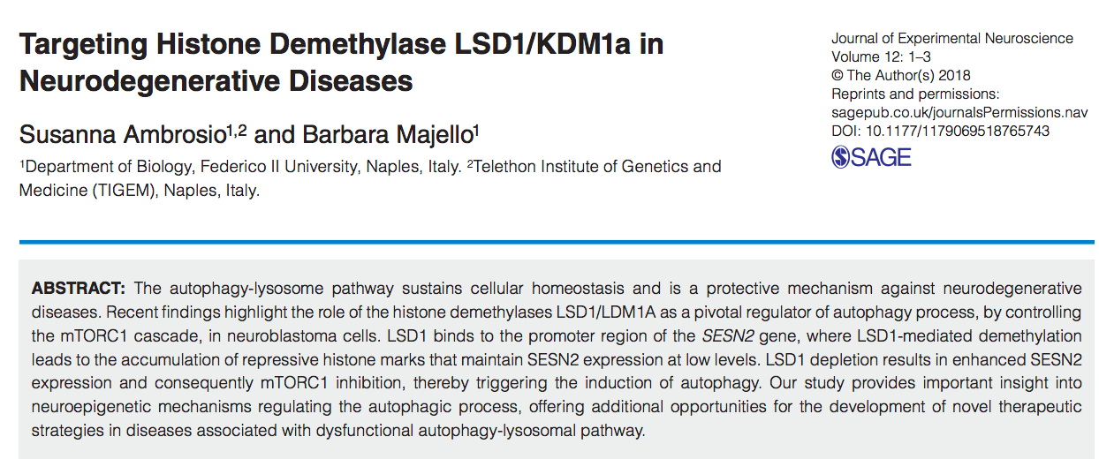
* Our ongoing work….

Slide 45
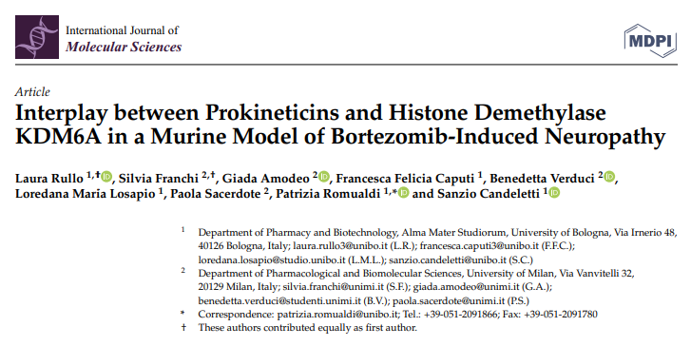
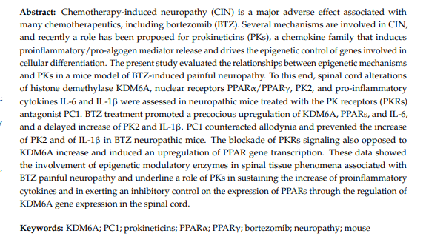

Slide 46
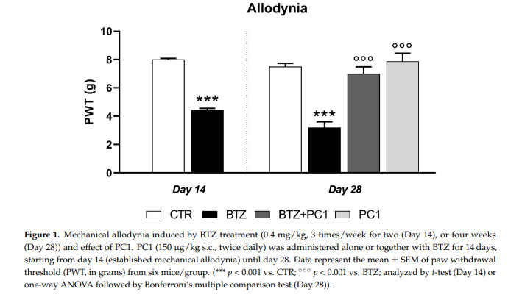

Slide 47
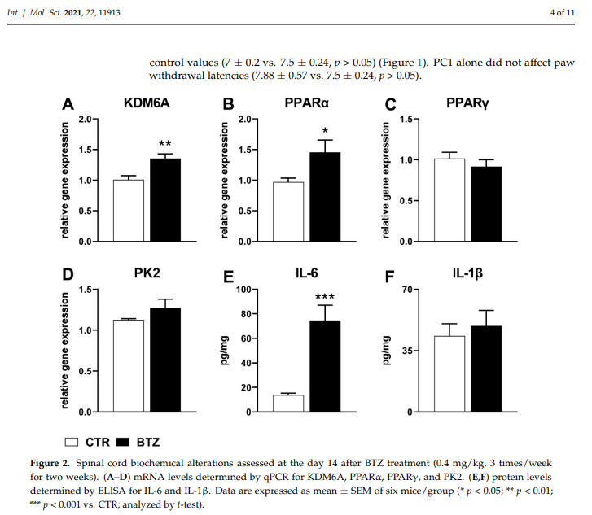

Slide 48
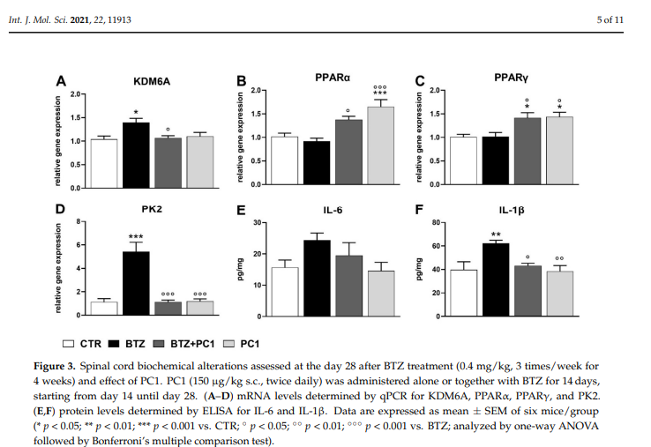

Slide 49
EPIGENETIC DRUGS
DNA methyltransferase inhibitors
Histone deacetylase inhibitors
Histone acetyltransferase modulators
Histone methyltransferase inhibitors
Histone demethylase inhibitors
Non-coding RNAs (miRNAs)

Slide 50
DNA methyltransferase inhibitors
Currently, two DNMT inhibitors (azanucleosides) have been approved by FDA:
azacytidine (Vidaza; Celgene)
decitabine (5 aza 2’ deoxycytidine) (Dacogen; SuperGen)
These two types of drugs are the first molecules that have been characterized as the archetypal DNMT inhibitors and the only epidrugs that have been approved for the treatment of patients with acute myeloid leukemia (AML) and myelodyplastic syndrome (MDS). Azacytidine has also been approved by the FDA and the European Medicines Agency (EMA) for use against chronic myelomonocytic leukemia (CMML).
3. The third novel member of the nucleoside DNMT inhibitor family is zebularine, a cytidine analog, which has been characterized as a potent and promising agent because of good results achieved in in vitro experiments, encouraging zebularine use for future clinical trials.

Slide 51
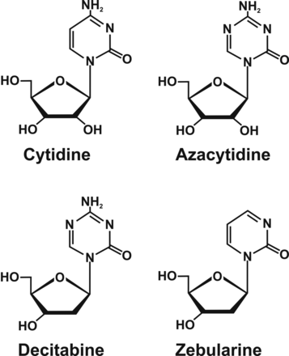
Nucleoside analog inhibitors of DNA methyltranferases
Azacytidine and decitabine are cytidine analogs modified in position 5 of the pyrimidine ring.
Both compounds were synthesized by Sorm and co-workers in 1964.
Azacytidine, being a ribonucleoside, is incorporated into RNA and, to a lesser extent, into DNA, whereas decitabine, as a deoxyribose analog, is incorporated only into DNA strands.
The enzymes remain covalently bound to DNA and its DNMT and the function is blocked. In addition, the covalent protein adduction also compromises the functionality of DNA and triggers DNA damage signaling, resulting in the degradation of the trapped DNMTs.
Further methylation of cytosine residues is inhibited, causing the passive loss of cytosine methylation in the daughter cells after replication.

Slide 52
Another demethylating agent in the family of nucleoside analogs is zebularine, which is characterized by chemical stability, apparent bioavailability and low cytotoxicity.
It acts, however, primarily as a DNMT inhibitor by trapping the DNMT protein and forming tight covalent complexes between the DNMT protein and zebularine-substituted DNA
Zebularine is also activated after incorporation into DNA and metabolized presumably in a similar way to azacytidine.
Notes:
Another demethylating agent in the family of nucleoside analogs is zebularine, which is characterized by chemical stability, apparent bioavailability and low cytotoxicity (22). Such properties distinguish zebularine among nucleoside inhibitors (Figure 2). Zebularine was originally synthesized and evaluated as an inhibitor of CDA to prevent de-amination of nucleoside analogs. It acts, however, primarily as a DNMT inhibitor by trapping the DNMT protein and forming tight covalent complexes between the DNMT protein and zebularine-substituted DNA (23). Zebularine is also activated after incorporation into DNA and metabolized presumably in a similar way to azacytidine. The initial phosphorylation is most likely mediated by uridine-cytidine kinase, followed by conversion to the 2’-deoxyzebularine-5’-diphosphate by ribonucleotide reductase. Furthermore, 2’ deoxyzebularine-5’-diphosphate is converted to 2’-deoxyzebularine-5’ triphosphate, which appears to be crucial for its incorporation into DNA, but this step of metabolic activation still needs to be clarified. In brief, inactivation of the DNMT by zebularine may be related to the absence of the 4-amino group in the 6-position of its pyrimidine ring (Figure 3B). In this way, zebularine does not allow the activation of cytosine C5 position and methyl group transfer. The lack of methylation, even if it is reversible, can clarify the stabilization of the zebularine containing DNA binding complex and slowing its dissociation

Slide 53
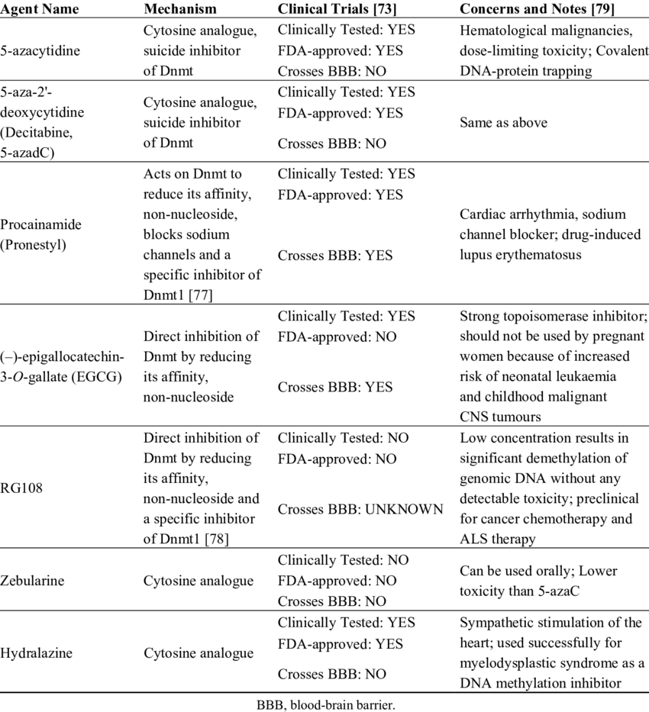

Slide 54
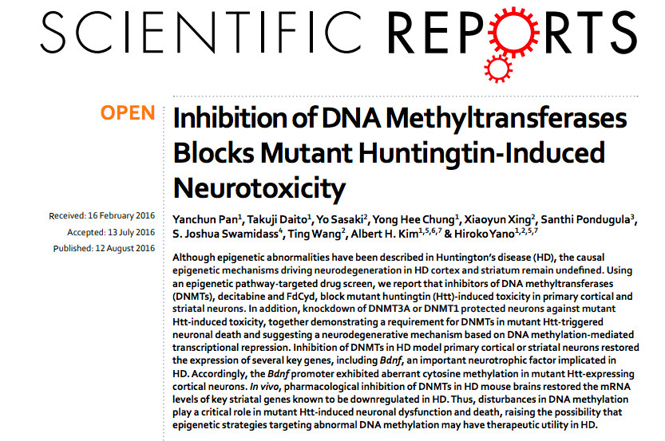

Slide 55
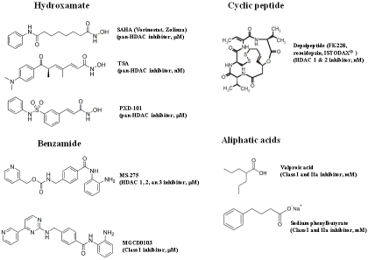
HISTONE DEACETYLASE INHIBITOR (HDI)
HDAC inhibitors can be structurally grouped into at least four classes:
Hydroxamates:
  Vorinostat (SAHA) → pan-HDAC inhibitor
  Trichostatin A (TSA) → pan-HDAC inhibitor
  Balinostat (PDX-101) → pan-HDAC inhibitor
Cyclic peptides:
  Depsipeptide (HDAC 1,2 inhibitor)
Aliphatic acids:
  Valproid acid (Class I, IIa inhibitor)
  Sodium butyrate (Class I, IIa inhibitor)
Benzamides:
  Entinostat (MS-275) → HDAC 1,2,3 inhibitor
  Mocetinostat (MGCD0103) → Class I inhibitor
Notes:
Structures of major classes of HDAC inhibitors. Suberoylanilide hydroxamic acid (SAHA/Vorinostat/Zolinza), Trichostatin A (TSA), and PXD-101 are hydroxamic acid-based pan-HDAC inhibitors. Depsipeptide (FK228/ romidepsin/ISTODAX®) is a natural cyclic peptide product of prodrug type, which inhibits HDAC1 and 2 selectively. Both MS-275 and MGCD0103 are synthetic benzamide derivatives. MS-275 is selective to HDAC 1, 2, and 3, and MGCD0103 is a class I selective HDAC inhibitor. Aliphatic acids include valproic acid and Sodium phenylbutyrate which have relatively low HDAC inhibitory potency.

Slide 56
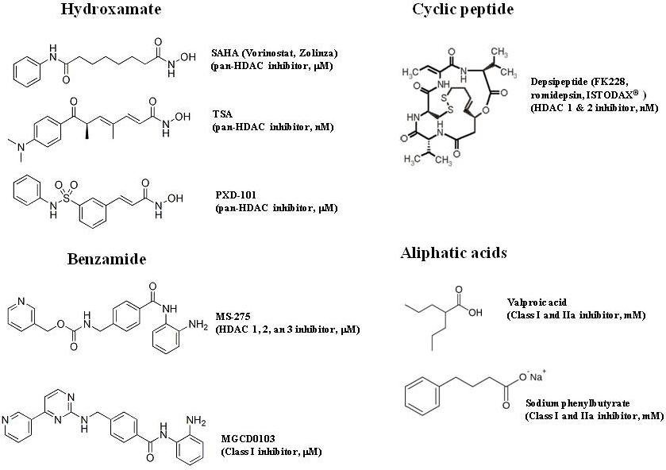

Slide 57
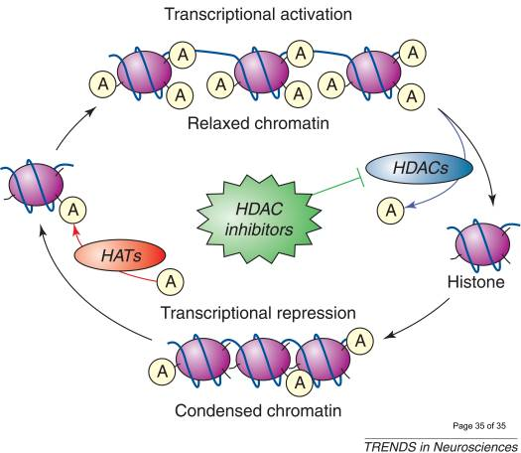
The effects of HDAC inhibitors on chromatin remodeling
Levels of histone acetylation at Lys residues on histone tails are determined by interplays of acetylation and deacetylation catalyzed by HATs and HDACs. Inhibition of HDACs by HDAC inhibitors results in a net increase in histone acetylation levels and a more open, relaxed chromatin conformation which favors transcriptional activation.

Slide 58
Clinical Applications of HDAC Inhibitors
As therapeutic targets, HDACs have elicited growing interest in the treatment of various diseases.
Although mainly evaluated in the antitumor setting, a substantial body of preclinical work demonstrates the promise of HDAC inhibitors for the treatment of noncancer disorders:
    Neuromuscular diseases
    Cardiovascular and hematological disordes
    Pulmonary, infectious, and inflammatory diseases.
    Human immunodeficiency virus (HIV). HDI regulate latency, directly and indirectly by inducing histone deacetylation at HIV integrated sites and by causing nonhistone protein modification.
    Neurodegenerative diseases

Slide 59
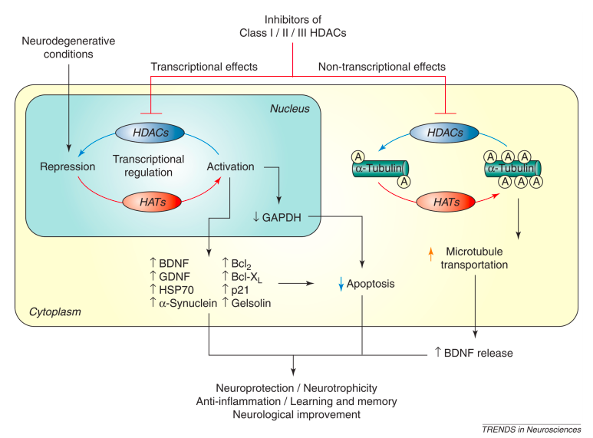
The actions of HDAC inhibitors in neurodegenerative conditions
Chuang et al., Trends Neurosci. 2009
Notes:
A large number of neurodegenerative conditions in vivo and in vitro involve functional imbalance in HATs and HDACs, resulting in histone hypoacetylation and transcriptional dysfunction.
Treatment with Class I, II and, more recently, III HDAC inhibitors restores these deficiencies. These effects appear to be mediated by multiple HDAC-regulated gene products including BDNF, GDNF, HSP70, α-synuclein, Bcl-2, Bcl-X_{L}, p21, and gelsolin, among others.
Non-transcriptional effects of HDAC inhibitors, such as hyperacetylation and stabilization of microtubule proteins, have also been shown in many neurodegenerative disease models. Studies suggest that HDAC inhibitors have neuroprotective, neurotrophic, and anti-inflammatory effects, as well as improve neurological performance and learning/memory in various neurodegenerative conditions. Bcl-2: B-cell lymphoma 2; BDNF: brain-derived neurotrophic factor; GAPDH: glyceraldehyde-3-phosphate dehydrogenase; GDNF: glial cell line-derived neurotrophic factor; HAT: histone acetyltransferase; HDAC: histone deacetylase; HSP70: heat shock protein 70.

Slide 60
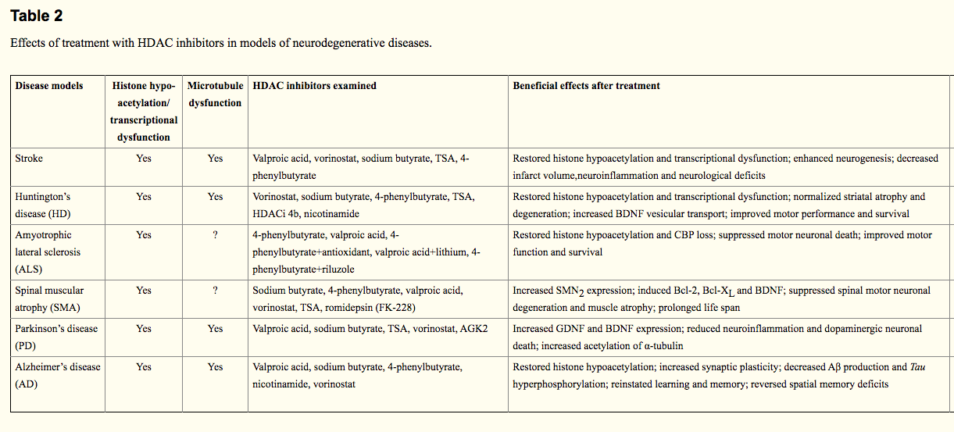
Chuang et al., Trends Neurosci. 2009

Slide 61
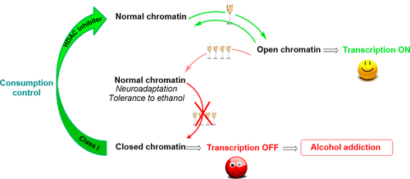
Class I HDAC Inhibitors: Potential New Epigenetic Therapeutics for Alcohol Use Disorder (AUD)
Alcohol use disorder (AUD) represents a serious public health issue, and discovery of new therapies is a pressing necessity. Alcohol exposure has been widely demonstrated to modulate epigenetic mechanisms, such as histone acetylation/deacetylation balance, in part via histone deacetylase (HDAC) inhibition. Epigenetic factors have been suggested to play a key role in AUD. Recent studies have suggested that both epigenetic mechanisms underlying AUD and the efficacy of HDAC inhibitors (HDACIs) in different animal models of AUD may involve class I HDACs. More effort is required to improve the selectivity, pharmacokinetics, and toxicity profiles of HDACIs to achieve a better understanding of their efficacy in reducing addictive behavior.
Bourguet et al., J. Med. Chem. 2018

Slide 62
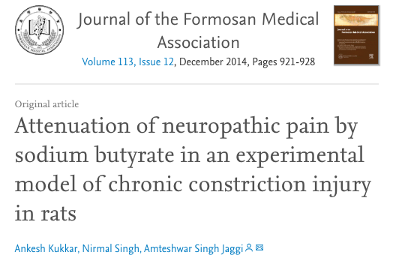
Effects of HAT inhibitors and HDAC inhibitors on neuropathic pain
Several groups reported that the HDAC inhibitors had an antinociceptive effect in neuropathic pain. Oral administration of Sodium butyrate, a HDAC inhibitor, not only attenuated chronic constriction injury (CCI)-induced pain hypersensitivity but also reduced the CCI-induced increase in TNFα in the sciatic nerve.

Slide 63
EPIGENETIC REGULATION OF CHRONIC PAIN
Histone modification in chronic pain
HDAC inhibitors reduce inflammatory pain and visceral pain.
Both HAT inhibitors and HDAC inhibitors show antinociceptive effects in neuropathic pain.
Peripheral nerve injury or inflammation alters histone methylation in the promoter regions of some pain-related genes.
DNA methylation and chronic pain
DNMT inhibitors blocks inflammatory pain.
DNMT inhibitors attenuates neuropathic pain
Alterations of DNA methylation have been found in patients with some painful diseases.
Liang L et al., Epigenomics. 2015;7(2):235–245.

Slide 64
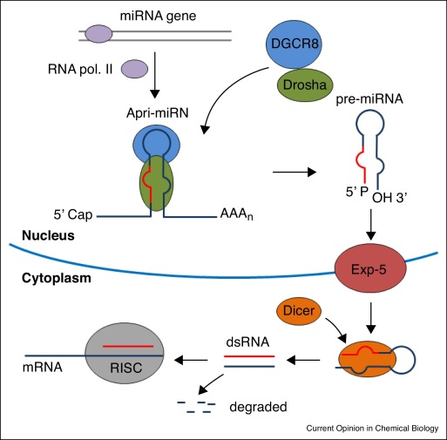
miRNAs
MicroRNAs (miRNAs) are small noncoding RNAs, approximately 18-25 nucleotides in length, recognized as one of the major regulatory gene families in eukaryotes.
They generally bind to the 3'-UTR of their target mRNAs and repress protein production.
miRNAs can act as epigenetic modulators by targeting key enzymes responsible for epigenetic reactions (DNMTs, HDACs and HMTs).
miRNAs can also be regulated by epigenetic modifications. The dysregulation of the miRNA-epigenetic feedback loop interferes with the physiological and pathological processes and contributes to variety of diseases.

Slide 65
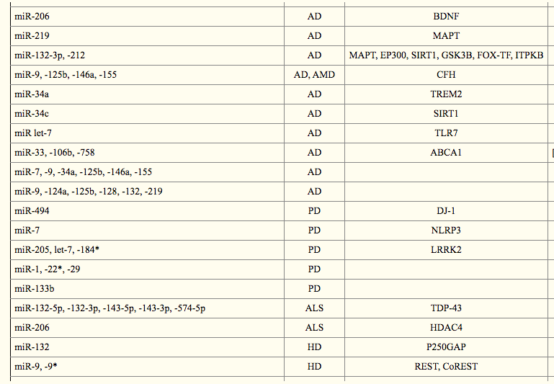
microRNAs in neurodegeneration
AD: Alzheimer’s Disease; PD: Parkinson’s Disease; ALS: Amyotrophic Lateral Sclerosis; HD: Huntington’s Disease

Slide 66



