Slide 1

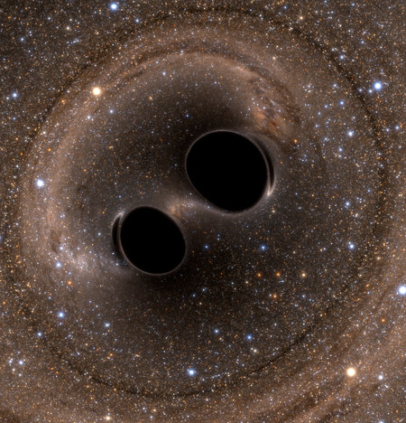



Astroparticle physics a.a. 2024/25
e ⁻
CR
γ
GW
p
n
e⁺
n
p
Maurizio Spurio
Università di Bologna e INFN
maurizio.spurio@unibo.it

Slide 2
Content and didactic material
This series of lectures (started in the a.a. 1996/97) originated the book below.
The content of these lectures strictly follows the book; for some technical details, I refer to the specific section in the book
Index of contents
An Overview of Multimessenger Astrophysics
Charged Cosmic Rays in Our Galaxy
Direct Cosmic Ray Detection
Indirect Cosmic Ray Detection
Diffusion of Cosmic Rays in the Galaxy
Galactic Accelerators and Acceleration Mechanisms
The Extragalactic Sources and UHECRs
The Sky Seen in γ-rays
The TeV Sky and Multiwavelength Astrophysics
High-Energy Neutrino Astrophysics
Atmospheric Muons and Neutrinos
Low-Energy Neutrino Physics and Astrophysics
Basics on the Observations of Gravitational Waves
Microcosm and Macrocosm

Slide 3
Readings/Bibliography (from web pages
87966 - Astroparticle Physics
Maurizio Spurio: PROBES OF MULTIMESSENGER ASTROPHYSICS : Charged cosmic rays, neutrinos, γ-rays and gravitational waves [ https://www.springer.com/la/book/9783319968537 ]-
Students not from the "Nuclear and Subnuclear Physics" curriculum MUST necessarily have pre-requisites of introductory knowledge of particle physics, particle detection and particle detectors. The introductory chapters of the book:
Braibant, S., Giacomelli, G., Spurio, M. (2012): Particles and Fundamental Interactions [https://www.springer.com/la/book/9789400724631]
(A free PDF version of the book pre-print is available on the VIRTUALE area availablefor UNIBO students)

Slide 4
I.
An Overview of Multimessenger Astrophysics
Astroparticle Physics a.a. 2024/25
Maurizio Spurio
Università di Bologna e INFN
maurizio.spurio@unibo.it

Slide 5
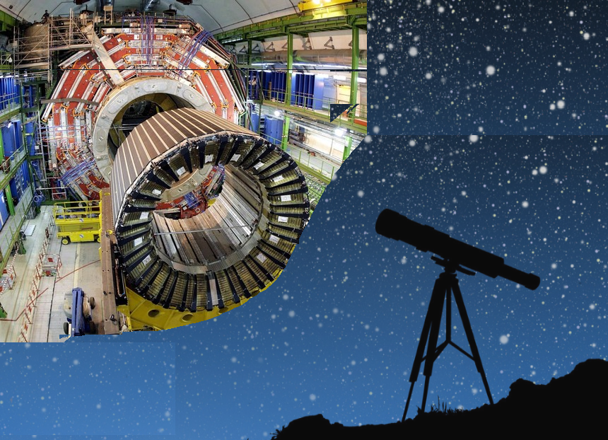

Multimessenger astrophysics
The study of the Universe with probes different from the EM radiation, with experimental techniques mainly developed in particle physics
Charged cosmic rays
Neutrinos
γ−rays
Gravitational waves
CR
γ
GW

Slide 6
«Traditional» Astronomy: not covered in this course

Slide 7
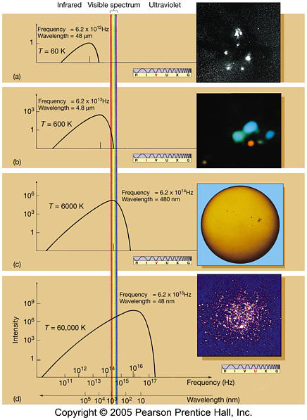
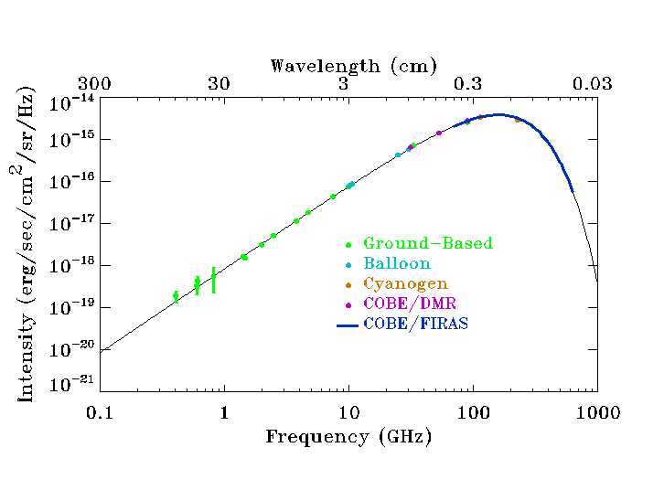
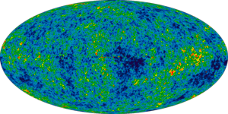
The thermal universe: the black-body spectrum
A Galactic gas cloud: 60 K
CMBR: 2.7 K
Star in the
Orion Nebula:
600 K
The Sun surface:
6000 K
Cluster of very bright stars, Omega Centauri:
60,000 K

Slide 8
Opacity of the Earth atmosphere

Slide 9



The multimessenger physics
Starting in the 1980s, new kinds of detectors were developed, using cosmic probes different from the electromagnetic radiation: individual photons with energy above the GeV (γ-rays), charged, cosmic rays (including antiparticles), neutrinos and, finally, gravitational waves
Multimessenger astrophysics connects different kinds of observations of the same astrophysical event or system.
e ⁻
e⁺
CR
p
n
n
p
GW
γ

Slide 10
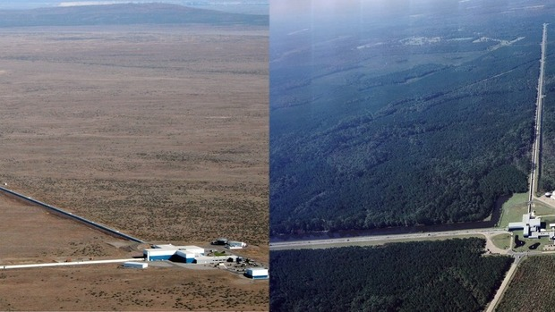
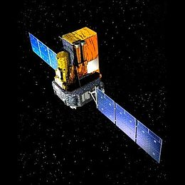
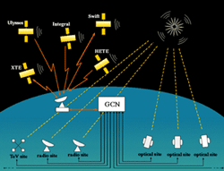
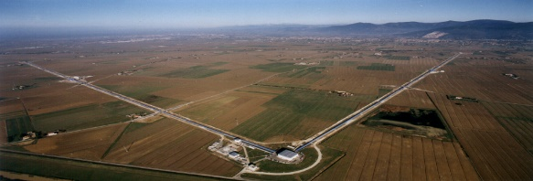
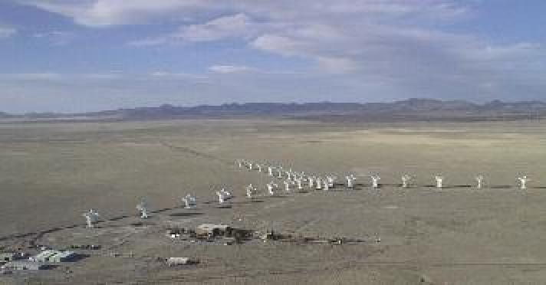
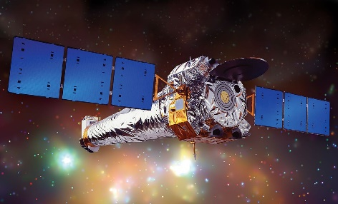
The key ingredients for discoveries
GW Interferometers
γ-ray satellites
Fast info dissemination
+
+
Optical observations
Other EM observations
Neutrino observatories
+
+
+

Slide 11
General informations
LEARNING OUTCOMES: After completing this course, the student knows the bases of experimental and theoretical aspects of nature, origin and propagation of charged CRs, neutrinos, γ-rays and GWs. In particular, the student discusses the connections between astrophysics and particle physics.
Assessment method: Oral examination, about 30-35 minutes. The first 10-12 minutes is on a subject on your choice. Always remember to put in evidence also the experimental aspects
Sessions: 6 exam session/year fixed on ALMAESAMI. Additional sessions can be introduced in ALMAESAMI along the year in any moment under the condition that at least 3 students are present at the day of the exam.
TEACHING TOOLS: The course is primarily aimed for students of the Nuclear and Subnuclear Physics address. For students of other addresses of the LM in Physics, or for students who have no knowledge of Nuclear and Subnuclear Physics, it is strongly recommended as a pre-requisite the self-study of Chapters 1 to 5 and Chap. 14 of the book "Particles and Fundamental Interactions”.

