Slide 1
III.
Direct CR Detection:
Protons, Nuclei, Electrons and Antimatter
Astroparticle Physics a.a. 2024/25
Maurizio Spurio
Università di Bologna e INFN
maurizio.spurio@unibo.it

Slide 2
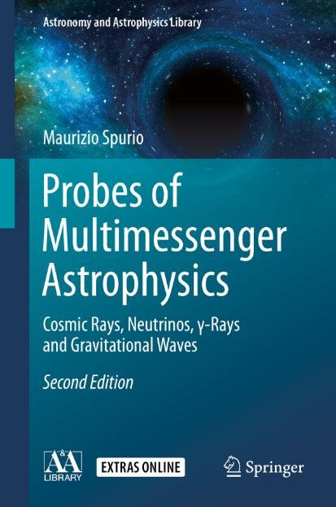
Content

Slide 3
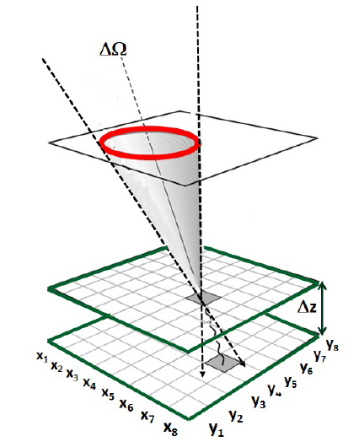
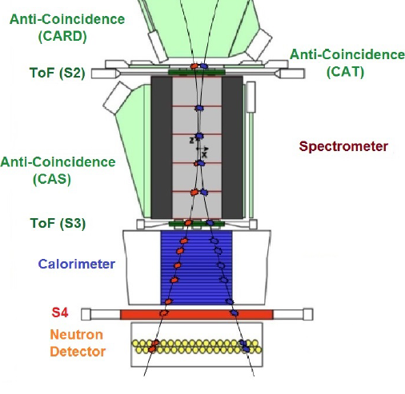
Generalities on Direct Measurements
Any experimental apparatus for primary CR detection must identify the particle by measure its energy-momentum and its electric charge;
A real detector needs devices to measure momentum (e.g., a spectrometer) and energy (e.g, a calorimeter or TRDs)
An excellent repository to retrieve information of (almost) all the published material is the database of charged cosmic-ray measurements, available at http://lpsc.in2p3.fr/crdb
The database contains information on experimental setups (type, flight dates, techniques) from which the data originate, along with the references to all relevant publications.

Slide 4
The goal of «direct CR» experiments
Measure the differential intensity of primary CRs (protons, nuclei and electrons)
Measure the fraction of antimatter
(At low energy, isotopic fraction)
The figure shows a summary of direct measurement of primary CRs by different experiments on the top (or outside) the Earth atmosphere

Slide 5
The Structure of the Atmosphere
The amount of matter above any atmospheric layer, in which the primary CR has is the vertical atmospheric depth , X_{v}:
Units of X_{v}: g/cm².
Under the isothermal approximation of the atmosphere, it is found that:
The atmospheric scale height h₀ is:

Slide 6
Why in space or upper atmosphere?
nuclear (or hadronic) interaction length λ:
the number density depends on the matter density ρ (g cm⁻³), usually, the nuclear interaction length for a nucleus with mass number A is expressed in units [g cm⁻²] as
Typically, the cross-section for a proton in a medium with mass number A is; for the atmosphere A ∼ 14-15
The mean free path for CR protons in the atmosphere is:

Slide 8
Balloons
Today, scientific balloons (NASA flights) are made can be as large as a football stadium, with a diameter of about 140m and a volume larger than 10⁶ m³ filled with helium (see the CREAM experiment in Figure, whit trajectory of a 37-day flight in Antartica)
Baloon can carry experiments (payloads) up to 3,600 kg and fly at altitudes up to 42 km. The payloads are attached to a parachute. The flights are terminated by remotely firing an explosive squib that separates the payload from the balloon.
The experiment descends slowly, suspended by the parachute, and it is recovered and refurbished for future flights

Slide 9
The BESS experiment
Joint project of Japanese and USA Institutions to search for antimatter https://asd.gsfc.nasa.gov/bess/
Last flight: 8 days from McMurdo (Antarctica) in Dec 2004
Top and bottom Tof scintillators that also measure the particle energy loss
Aerogel Cherenkov counter mounted under the top ToF
2 inner drift chambers (IDC) inside the magnetic field space
Central tracking device in magnetic field region made of JET type drift chambers

Slide 10
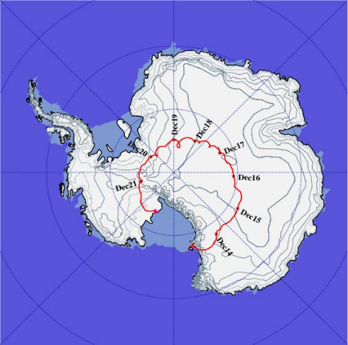
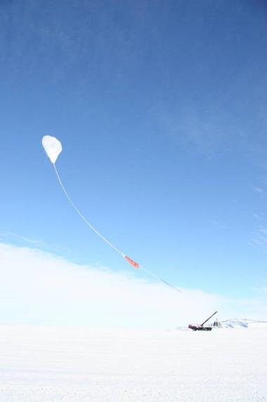
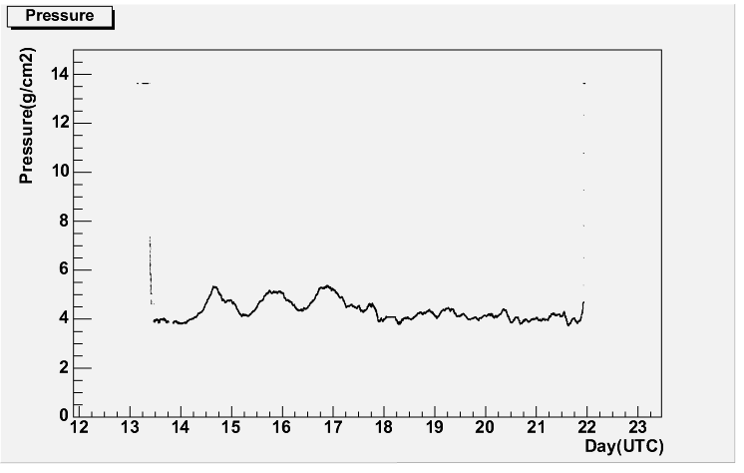
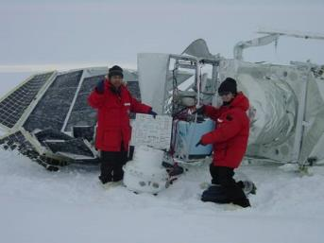
The BESS-polar (2004) flight
  8.5 day flight
  35-37 km in altitude
  900 million events recorded
Altitude～38000m
Residual air～4g/cm²
Floating

Slide 11
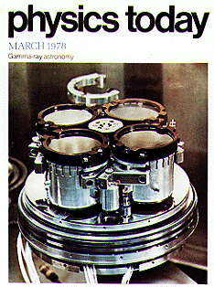
Old satellite experiment
Skip this
Primary CR data from early space experiments (1970s-1980s) refer mostly to energies <1 GeV.
Of particular importance, the first measurement of isotopic Li, Be, and B fluxes. In particular IMP-7(in 1972), IMP-8 (in 1973) detected the ¹⁰Be
The IMP was a series of 10 scientific satellites launched by NASA between 1963 and 1973
This was the first measurement of this isotope important for evaluate the “age” of CRs (see Sect. 5) which was repeated on successive satellite missions (Voyager, Ulysses, CRIS)
Other space experiments were on board the High-Energy Astrophysics Observatory (HEAO-3) satellite (1979-81, in the figure ) and the Cosmic Ray Nuclei (CRN) experiment, which flew for nine days on the Space Shuttle

Slide 12
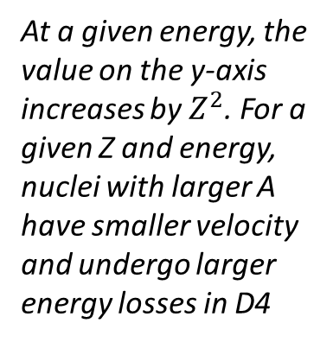
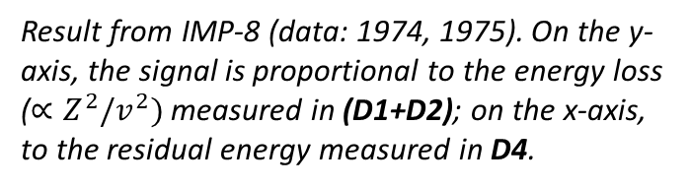
The isotopic measurements of Li, Be, B
Figure: Layout of the telescope on board IMP–7, –8. The silicon detectors (D1, D2, D3) measure the particle energy loss. D4 is a CsI (Tl) scintillator viewed by four photodiodes. D5 and D6 are two additional scintillators.
Result from IMP-8 (data: 1974, 1975). On the y-axis, the signal is proportional to the energy loss ($∝Z^{2}/v^{2})$measured in (D1+D2); on the x-axis, to the residual energy measured in D4.
Skip this
At a given energy, the value on the y-axis increases by $Z^{2}$. For a given Z and energy, nuclei with larger A have smaller velocity and undergo larger energy losses in D4

Slide 13
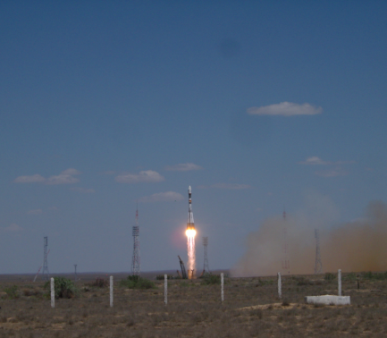
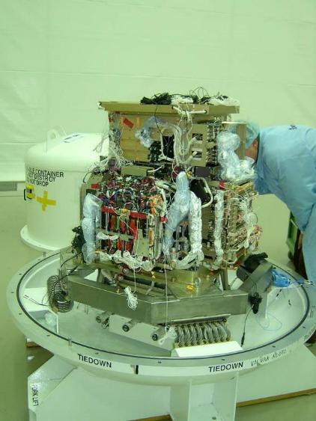
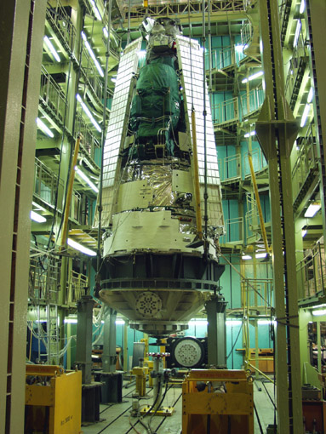
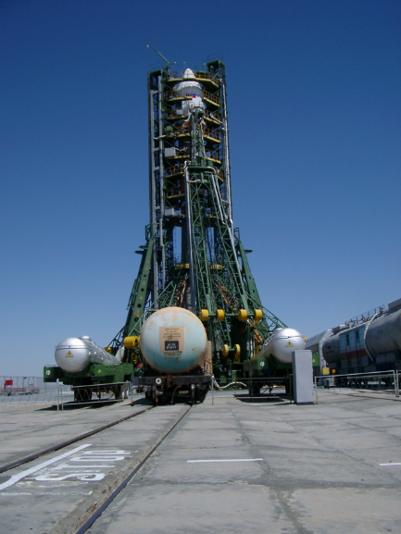
A satellite experiment: PAMELA
The Payload for Antimatter Matter Exploration and Light-nuclei Astrophysics (PAMELA) was mainly devoted to antimatter studies up to ~100 GeV.
Launched on board of a Russian Resurs-DK1 satellite from the Baikonur cosmodrome in Kazakhstan in June 2006. The operations of Resurs-DK1 terminated in 2016.

Slide 14
A satellite experiment: PAMELA
The apparatus was composed of different subdetectors (Figure)
a time of flight system, ToF (S1, S2, S3);
an anticoincidence system (denoted in the figure as CARD, CAT, CAS);
a magnetic spectrometer;
an EM calorimeter;
a shower tail catcher scintillator (S4);
a neutron detector.
~1.3m
Notes:
Calorimetro non dice energia al meglio di 2-3% ma dice pid perche’ vedi se em/h
Si misura momento e carica con spettrometro e poi si determina se interazione h o em nel calorimetro e si discrimina 10^4-5 tra h e leptone
Problemidi discriminazione pioni prodotti nel rivelatore con p

Slide 15
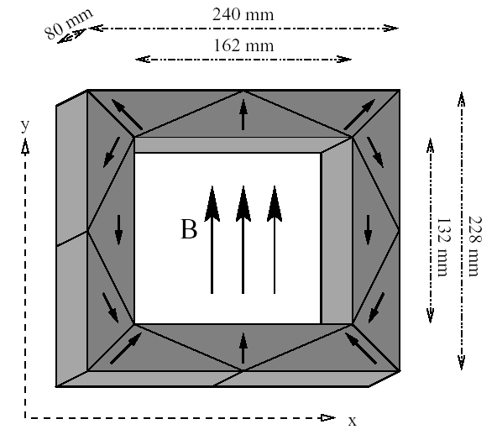
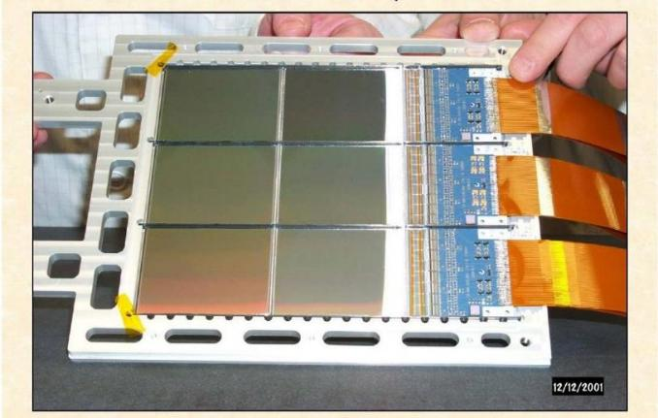
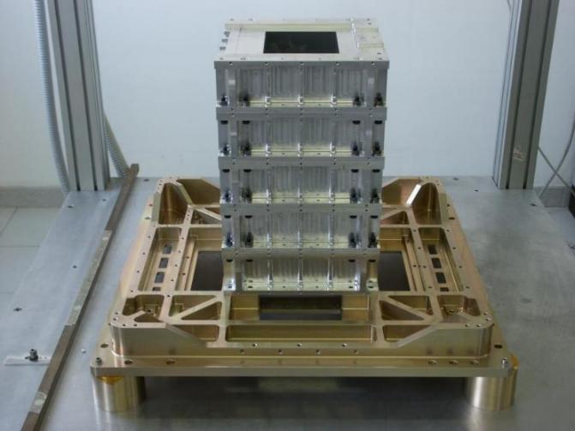
The magnetic spectrometer
Permanent Magnet
  5 blocks of Nb-B-Fe
  0.48 T in the cavity center
  Magnetic Tower= (13.2 x 16.2 cm²) x 44.5 cm h ⇒ accettance: 20.5 cm² sr
Double-sided silicon
  microstrips (300 μm thick)
  Readout pitch 50 μm

Slide 16
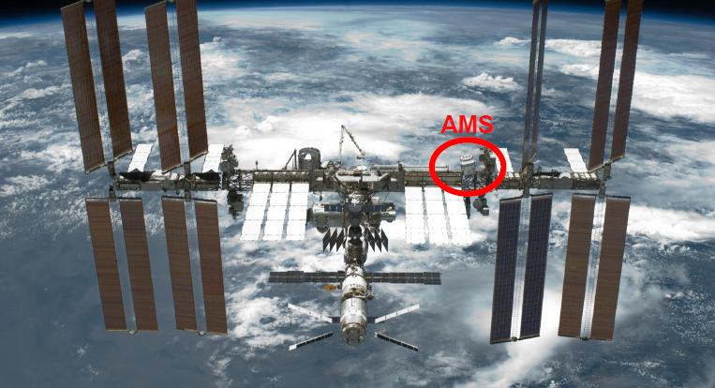
The AMS-02 Experiment on the ISS
The ISS is a space station, corresponding to a habitable artificial satellite in a low Earth orbit.
The ISS is the largest artificial body in orbit, and it can often be seen at the appropriate time with the naked eye.
It is a modular structure, whose first component was launched in 1998.
The AMS-02 is the largest particle physics detector ever carried outside the Earth.
About 500 collaborators
It was designed to operate as an external module on ISS
It was launched on May 16th, 2011, on board the NASA shuttle Endeavour.

Slide 17
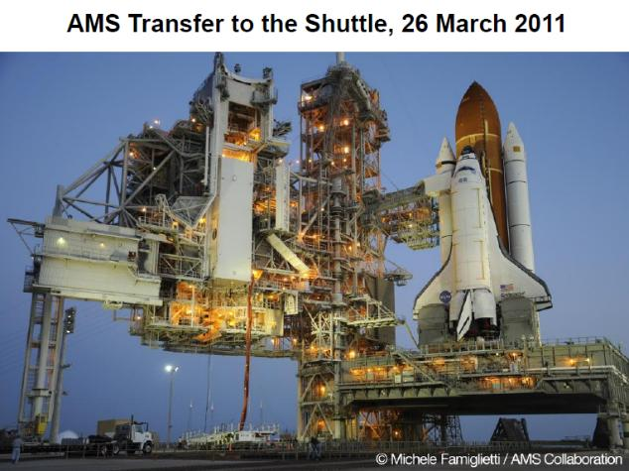
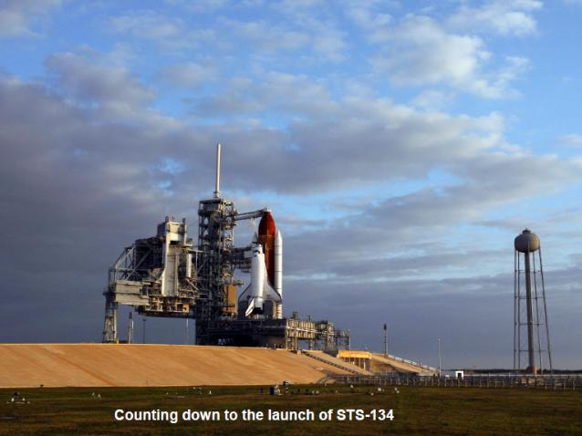
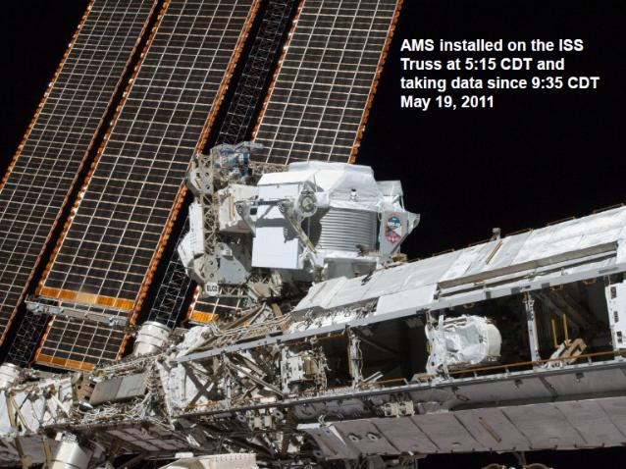
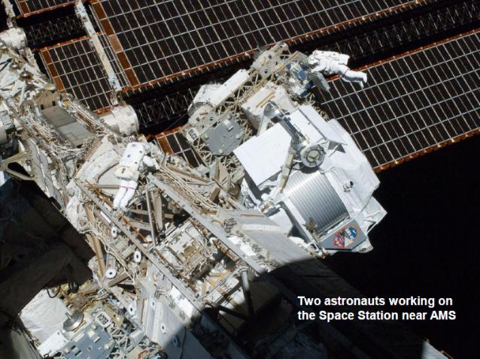
The AMS-02 Experiment

Slide 18

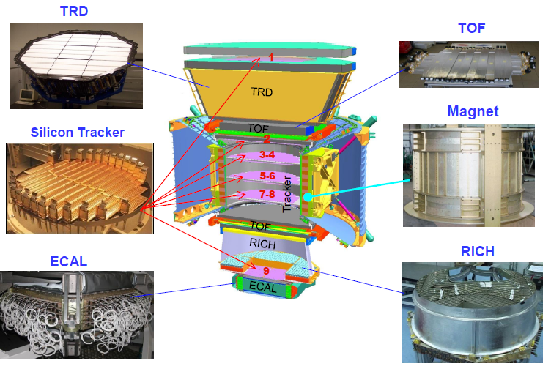
AMS-02 features
≈3m
Notes:
Strong gradients perche’ esterno mentre pamela e’ in un bussolotto (container)

Slide 19
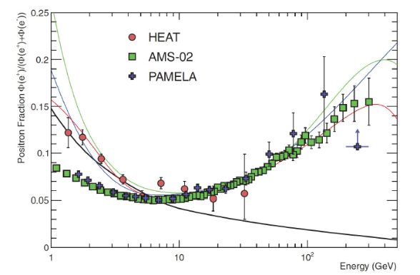
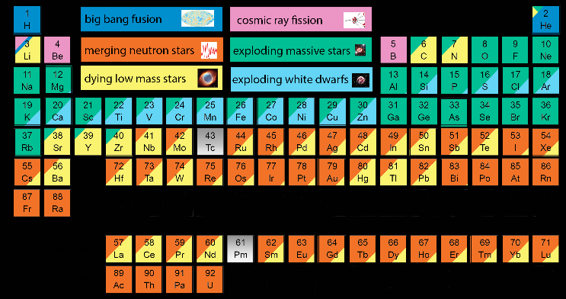
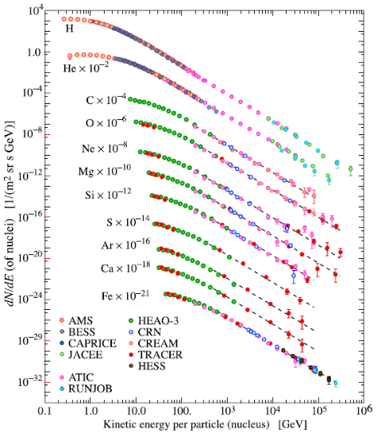
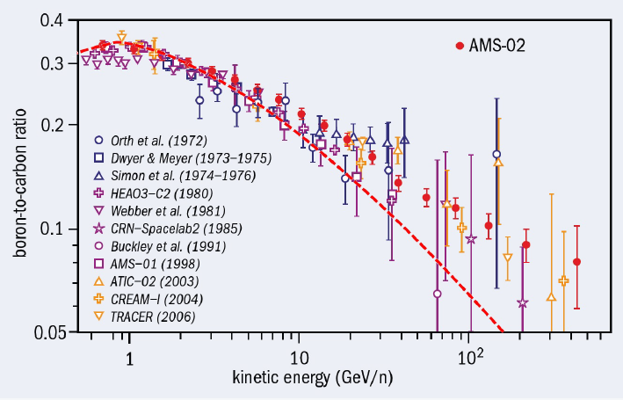
Results of experiments in space
Cap. 5
Cap. 5

Slide 20
Abundances of Elements in Solar System and CRs
A remarkable resemblance between the measured CR abundances of nuclear species and the abundances found in the solar system (SS) can be noticed, see Figure. Essential piece of information for understanding the origin and history of accelerated particles, Chapter 5.
Hydrogen (p) is ~90% of the total, He ~9%. Nuclei heavier than He only contribute about a few percent of the total flux on Earth.
Nuclei with Z>26 are largely suppressed w.r.t. Fe (both in CRs and SS)

Slide 21

Energy Spectrum of CR Protons and Helium
Fig 3.9: the p and He spectra (flux multiplied by E^{2.7}) with E> 1 GeV/n measured by balloon and space experiments.
Fluxes of CR nuclei follow a power law
For all nuclear species, the dependence on energy is of the type (E = 1 GeV)
The energy dependence of the p and He fluxes (about 98% of the total CRs) are important for understanding their origin, acceleration, and propagation.
$$R=\frac{E}{Z}$$

Slide 22
Energy Spectrum of CR Nuclei
Figure shows the major nuclear components in CRs as a function of the energy-per-nucleus.
The exponent α_{i} is almost the same for all nuclear species, apart p.
This has consequances in the CR acceleration models
Data obtained mainly through balloon-borne experiments (CREAM, ATIC and TRACER) with a good relative agreement
At the highest energies, measurements are limited by statistics.

Slide 23
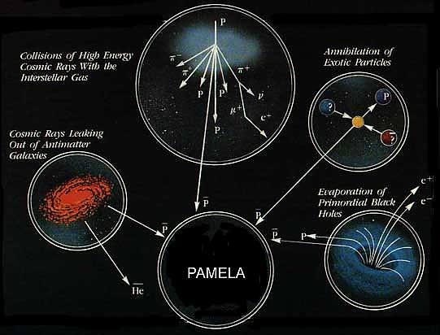
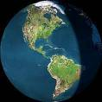
Antimatter in Our Galaxy and in the Universe
?
Propagation
?
?
Earth
23

Slide 24
Chapter 6
Chapter 5

Slide 25
Antiprotons in Our Galaxy
Equal amounts of matter and antimatter should have been produced at Big Bang.
Why only matter seems to surround us is one of the major unknowns in cosmology and particle physics.
The possible presence of cosmological antimatter is a fundamental issue of experimental physics
Antiprotons, as well as positrons, are a component of the cosmic radiation being produced in the interaction between CRs and interstellar matter.
Secondary ‾p are mainly produced by CR protons (E> 7 GeV: relativistic exercise) interacting with ISM protons
The ratio pbar/p~10⁻⁴ .
Measurements of the‾p/p flux ratio by PAMELA, AMS-02 and BESS-Polar
The antiproton spectrum agrees with detailed theoretical simulations that assume pure secondary production of ‾p during the propagation of primary CRs in the Galaxy interacting with the ISM (see Chap. 5)

Slide 26
Electrons and Positrons
Electrons and positrons constitute about 1% of the CRs flux
High-energy electrons are already subject to a huge EM energy loss processes in the sources, where the matter density and the magnetic fields are large.
The accelerated electrons are the source of most of the non-thermal EM radiation measured by astronomers from radio to X-rays (Chap. 8)
These processes distort their energy spectra as they propagate through the ISM; they provide information on the acceleration, propagation and confinement.
Protons x 0.01
Electrons directly produced at accelerator sites are called primary electrons.
Figure: The e⁻ + e⁺ energy spectrum from different space-based, balloon, and ground-based experiments. The flux is multiplied by E³. The solid black line shows 0.01 x p-flux

Slide 27
Electrons and Positrons
Electrons and positrons constitute about 1% of the CRs flux
High-energy electrons are already subject to a huge EM energy loss processes in the sources, where the matter density and the magnetic fields are large. They are the source of most of the EM radiation from radio to X-rays (Chap. 8)
These processes distort their energy spectra as they propagate through the ISM; they provide information on the acceleration, propagation and confinement.
Electrons directly produced at accelerator sites are called primary electrons.
Protons x 0.01
e⁻+e⁻
e⁻
Figure: Intensities (multiplied by E³) of electrons (squares), positrons (diamonds) and their sum (dots) vs. E. Data from AMS-02, CALET, DAMPE, Fermi-LAT, PAMELA + H.E.S.S. experiment.
e⁺

Slide 28
The positron Component
Experiments using magnetic spectrometers can distinguish the electric charge.
This allows for the measurement of the positron fraction in the e- component;
The dominant background is represented by misidentified CR protons.
Unlike electrons, which are present as a primary component in CR sources, the vast majority of positrons arise as secondary products of CR interactions in our Galaxy.
Figure shows the e+ energy spectrum vs. E. The dashed line shows the prediction from a computer codes of primary propagation in the ISM (Chap. 5.4).
Above a few GeV, a significant excess with respect to the secondary production by CR propagation is observed (PAMELA first, Fermi-LAT (Chap. 8) and finally AMS-02)
Exercise: do it yourself the plot using
http://lpsc.in2p3.fr/crdb

Slide 29
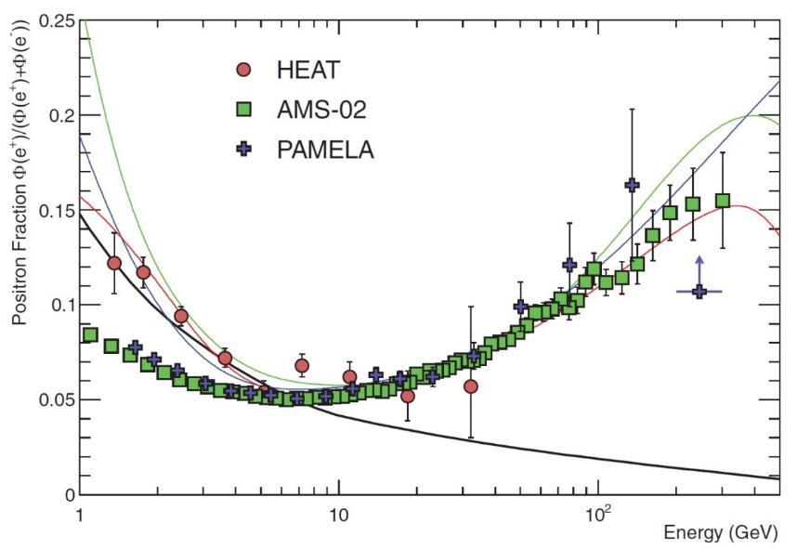

The positron fraction: an open question
The positron-fraction (on average, 10% of e-) spectrum does not exhibit fine structures and steadily increases in the region between 10 and 250 GeV (AMS-02 data)
Since positrons are always created in pair with an electron, about 90% of the observed electrons must be of primary origin.
This increase of e+ fraction is well above that expected from “propagation models” (red); some changes will be requested under astrophysical assumptions (green), for instance the presence of near pulsars (Chap. 6)
More exotic models have been carried out (dark matter)
Further data on higher energies can be disentangle between hypotheses

