Slide 1
IV.
Indirect CR Detection:
Showers in the Atmosphere
Astroparticle Physics a.a. 2024/25
Maurizio Spurio
Università di Bologna e INFN
maurizio.spurio@unibo.it

Slide 2
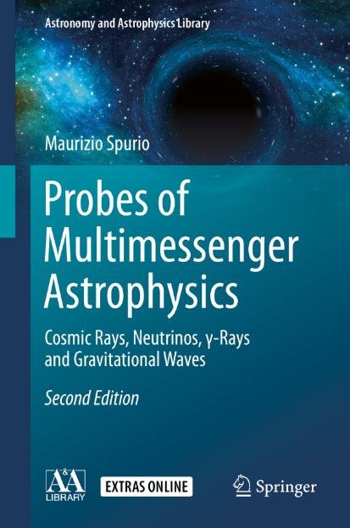
Content

Slide 3
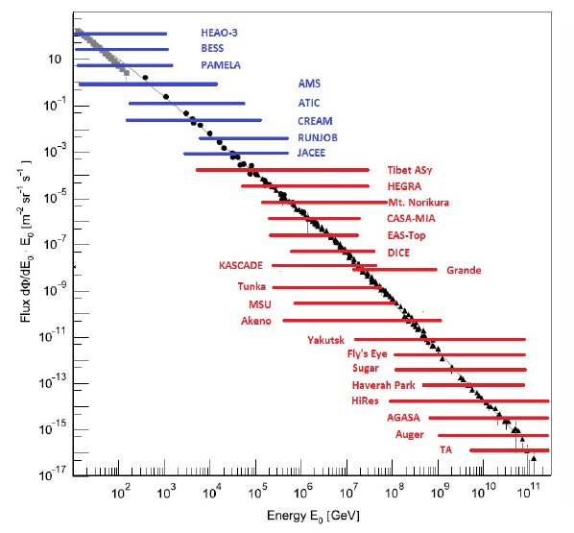
Introductory remarks (Chap. 2)
Above 10¹⁵ eV, the CR flux drops below a few tens of particles per m²-year.
It is no longer possible to detect CRs above the atmosphere
Completely different approach to CR measurements, starting with the pioneering experiments conducted soon after World War II by Auger, Kohlhorster and Rossi
Direct experiments must be replaced with ground-based sampling instruments covering up to several thousands of km², the extensive air shower (EAS) arrays.
The main drawback of EAS experiments is that the interpretation of the observations depends on the model used to describe the hadronic interactions of CRs with air nuclei
Notes:
Descrizione dello spettro
Lo avete visto innumerevoli volte
Si distinguono tre regioni...
Ci concentreremo sulla terza, altissime energie, sopra i 10¹⁹ eV, dove non è chiaro:
COME siano accelerati
DOVE siano le sorgenti
Addirittura PERCHè riusciamo a vederli

Slide 4
The Structure of the Atmosphere (Chap. 3)
The amount of matter above any atmospheric layer, in which the primary CR has is the vertical atmospheric depth , X_{v}:
Units of X_{v}: g/cm².
Under the isothermal approximation of the atmosphere, it is found that:
The atmospheric scale height h₀ is:

Slide 5
The cascade components
The basic mechanism of air shower production of a CR is the reaction
Interaction between hadrons (particle made by quarks)
Energy is transferred to rest mass of new hadrons (mainly light mesons)
Meson decays produce gamma and leptons (see also Chap. 11)
The simple model of a proton made only by valence quarks
A more realistic proton model with also sea quarks and gluons

Slide 6
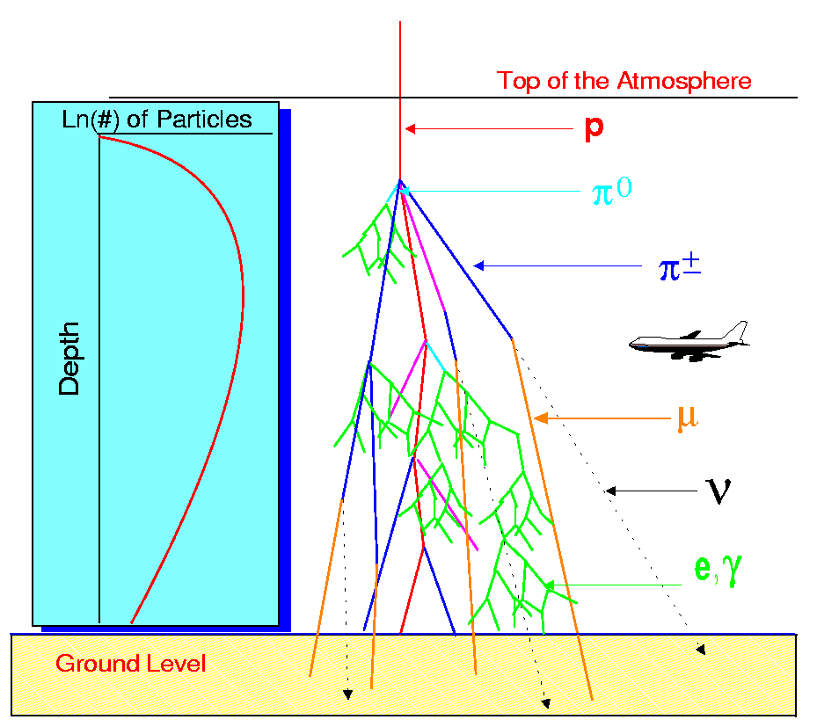
The shower components in atmosphere
CR
Secondary particles
Decay products
Electron-photon cascades

Slide 7
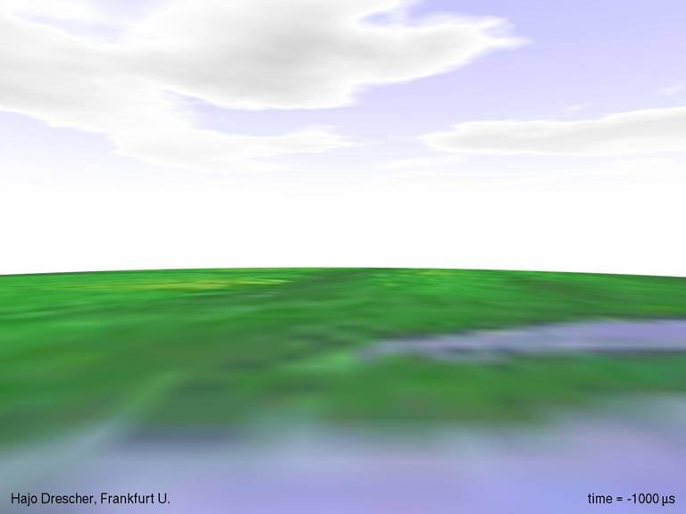





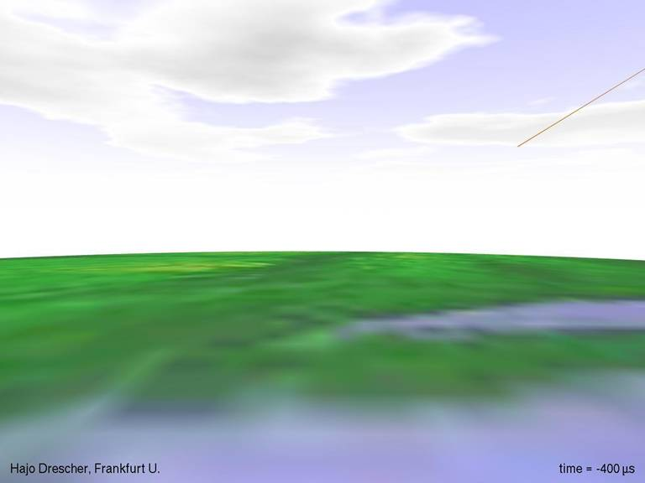
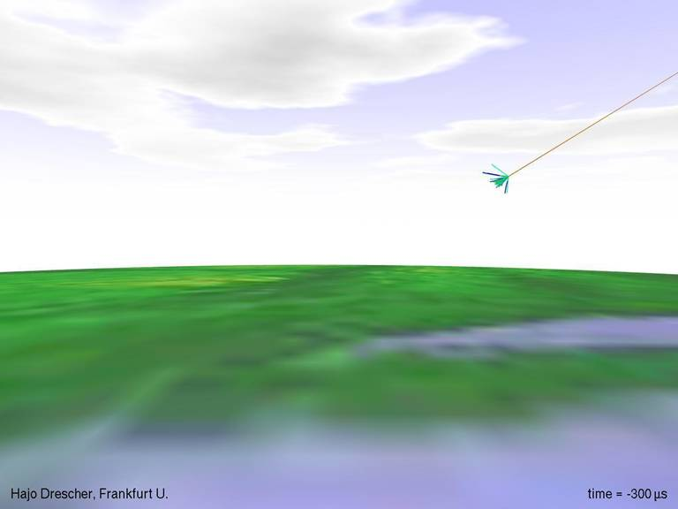
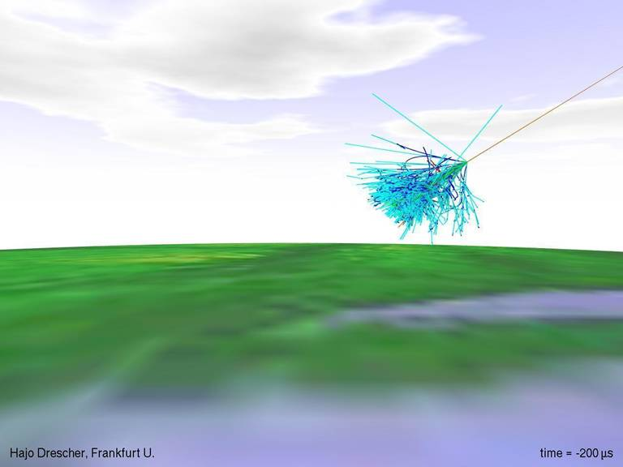
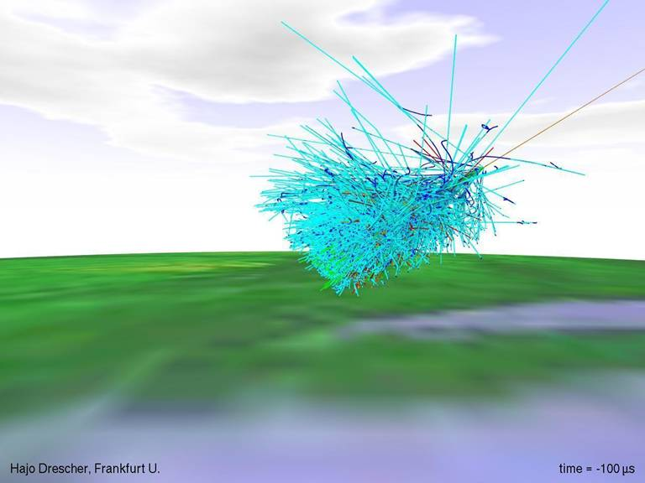
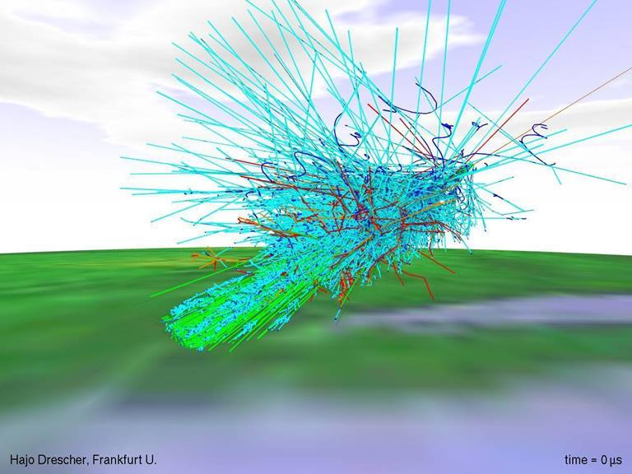
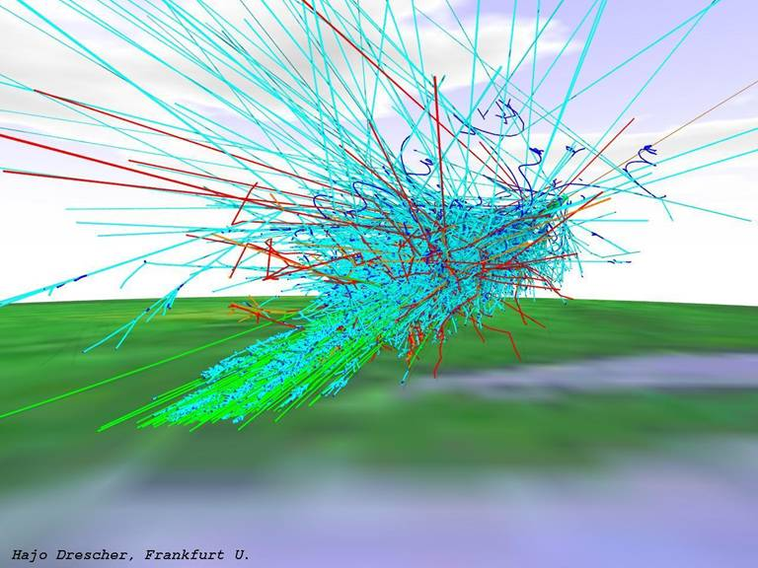
Example of a Monte Carlo shower development

Slide 8
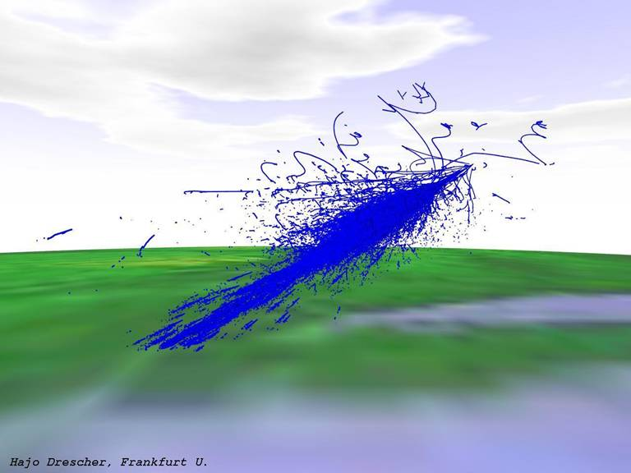
The electron-positron component

Slide 9
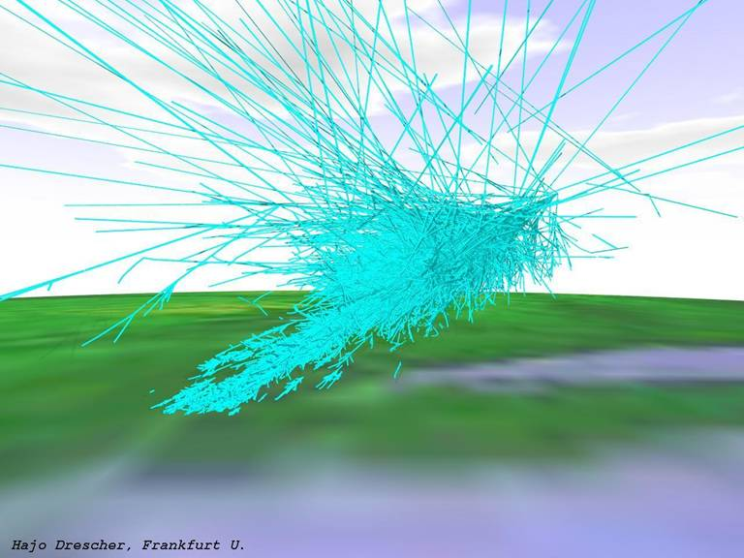
The component of gamma-rays

Slide 10
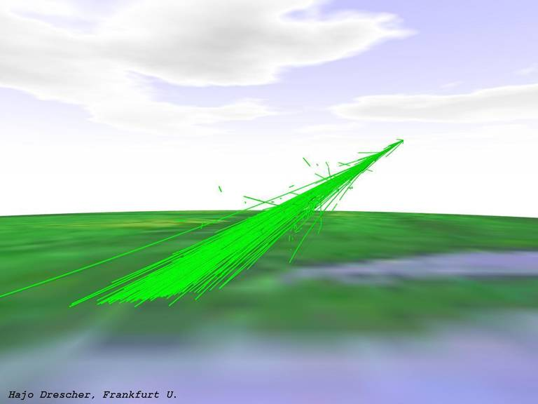
The muon component

Slide 11
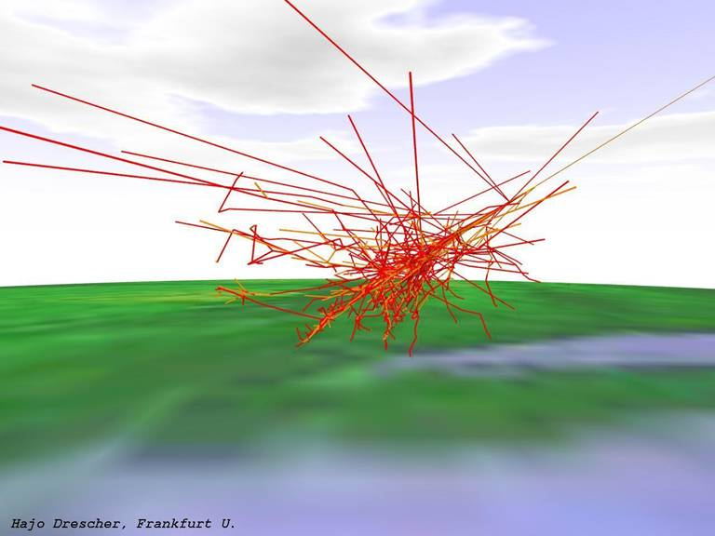
The hadron component

Slide 12
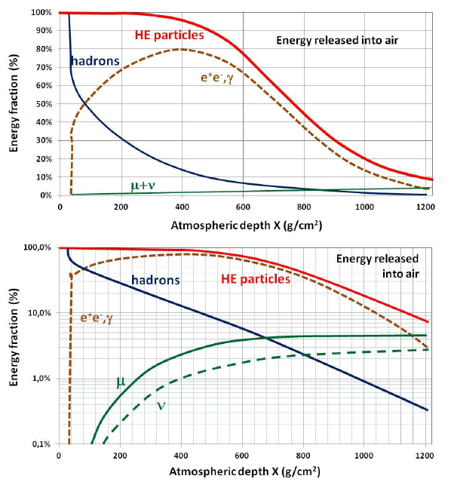
The shower components vs. depth
Hadrons interact in the upper atmosphere and get exponentially attenuated
The EM cascade (e+,e-,γ) develops in a exponential way up to a maximum. The maximum depends on E₀.
On ground (and underground), the muons represent the dominant component
Fig. 4.5 Fraction of energy transferred to the different components of the cascade induced by 10¹⁹ eV proton.
Part of the energy is “lost”, as released into air by excitation/ ionization processes.
Top: linear scale; bottom: log scale for a better visualization of the “older” part of the shower

Slide 13
The shower components vs. depth
Average number of (e⁺ + e⁻),(μ⁺ + μ⁻), and hadrons (lines), and their ±1 deviation (bands), as a function of matter (in g cm⁻²) crossed in the atmosphere along the shower axis. The profiles are obtained with MC of proton, iron and photon-induced EAS of E = 1 EeV = 10¹⁸ eV and zenith angle = 45 w.r.t. the vertical to ground (at depth 870 g cm⁻²).
Lateral development (perpendicular to shower axis) at ground level of the same components as in the left panel as a function of distance to shower axis

Slide 14
The Electromagnetic (EM) component
The fraction of e⁺e⁻, and γ-rays is called the EM component of the showers;
It is present in all cascades, but is the only component if the cascade is initiated by photons or electrons ;
In hadron-initiated showers, the EM component is initiated by the π⁰ decay.
The EM component is mathematically described using differential transport equations, which include the particle energy losses and particle production.
EM showers are governed mainly by
  (i) bremsstrahlung of electrons/positrons
  (ii) pair production by γ-rays
In addition to bremsstrahlung, electrons are subject to excitation/ionization energy loss.
The radiation length, X₀, is defined as:
  (a) the mean free path of a HE e
  (b) 7/9 of the mean free path for pair production by a HE photon.
k *d

Slide 15
The Heitler’s Model of EM Showers
The radiation length, X₀, and the critical energy E_{c} (the energy such that radiation energy losses = excitation/ ionization) depend on the material.
From Table, for electrons in air
(3.6)
These are the key ingredients for the Heitler’s Model of EM Showers (see figure.)
An incoming electron interacts in the atmosphere after traveling a certain “step” and produces o bremsstrahlung photon (final state = 2 particles with ½ energy)
Similarly, a photon converts into an electron-positron pair if its energy >2m_{e}.
The “step” depends on X = x·ρ (g/cm²) of the distance x (cm) traversed and the medium density ρ (g/cm³).
The energy loss of bremsstrahlung corresponds to the second term of (3.6). When excitation/ionization processes can be neglected (α = 0), the solution to (3.6) is

Slide 16
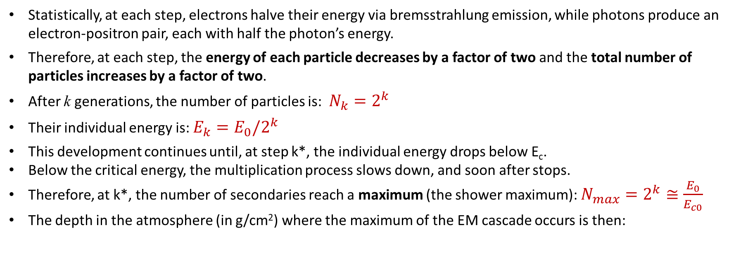
The Heitler’s Model of EM Showers
The “step” d is defined as
By inserting (4.11) into (4.10), we have
Statistically, at each step, electrons halve their energy via bremsstrahlung emission, while photons produce an electron-positron pair, each with half the photon’s energy.
Therefore, at each step, the energy of each particle decreases by a factor of two and the total number of particles increases by a factor of two.
After k generations, the number of particles is: $N_{k}=2^{k}$
Their individual energy is: ${E_{k}=E}_{0}/2^{k}$
This development continues until, at step k*, the individual energy drops below E_{c}.
Below the critical energy, the multiplication process slows down, and soon after stops.
Therefore, at k*, the number of secondaries reach a maximum (the shower maximum): $N_{max}=2^{k}≅\frac{E_{0}}{E_{c0}}$
The depth in the atmosphere (in g/cm²) where the maximum of the EM cascade occurs is then:

Slide 17

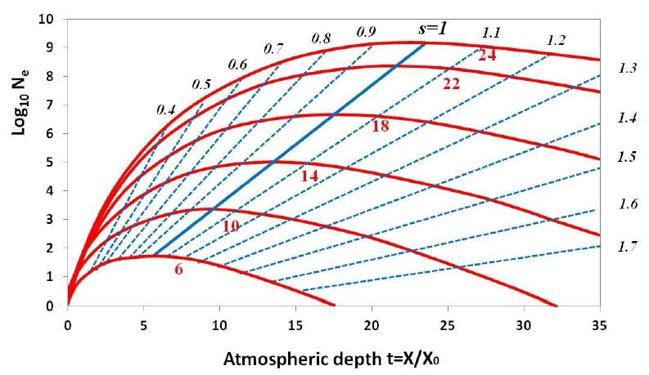
Analytic Solutions
Skip this
Purely EM showers were historically studied by coupled differential equations, which describe the evolution of the number of photons and electrons vs. depth, X.
These solutions are combinations of exponential functions and contain the important parameter “s”, the shower age.
Figure 4.3 shows the electron size N_{e} as a function of t=X/X₀ obtained from (4.16) and for different energies E₀ of the incoming particle.
The shapes look very similar for every energy E₀.
Showers have age s = 1 at maximum.
“Young” showers have age s < 1 (before the maximum).
“Old” showers have s > 1.

Slide 18
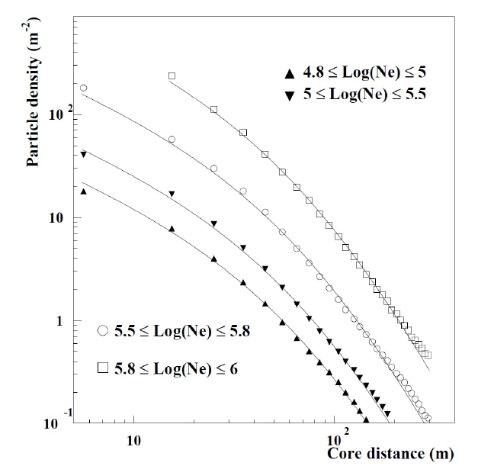

The lateral particle distribution
Skip this
The particle density vs. the distance r to the shower core (lateral particle distribution) is used in most air shower experiments to determine the primary CR energy;
The lateral distribution is determined by electrons multiple Coulomb scattering
Results of detailed calculations: the Nishimura Kamata and Greisen
(4.21)
The quantity r₁ is the Molière unit:
Figure 4.16: Experimental lateral distributions in different intervals of measured shower size, Ne. The average particle density vs. r is fitted with the NKG function (4.21) (solid lines), with r₁ = 100m and a fixed age parameter s = 1.21.

Slide 19
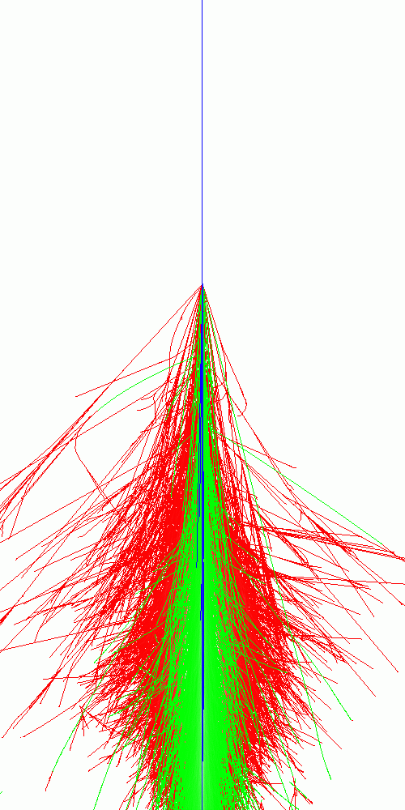
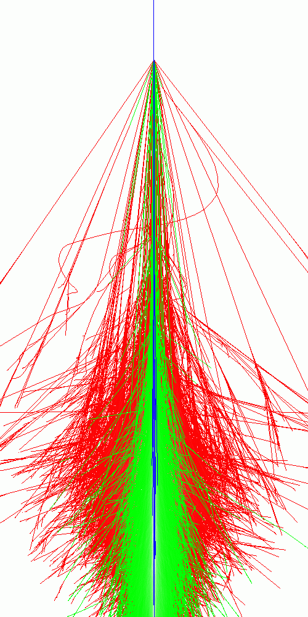
50 km
CORSIKA Simulation [QGSJET/EGS4]
proton
E₀=10¹⁴ eV
iron nucleus
40 km
e/γ
μ
h
30 km
20 km
10 km
10 km

Slide 20
General features of the EM cascade
Detailed Monte Carlo (MC) simulations of the cascades confirm that the EM component of the showers exhibits a number of universal features.
EM cascades induced by primary photons, electrons, protons and nuclei have properties that are independent of the primary type and rather insensitive to the primary energy
SF1) The number of particles at shower maximum is approximately proportional to the primary energy.
SF2) The depth in the atmosphere of the shower maximum increases logarithmically with energy.
SF3) In γ-ray induced showers very few muons are expected, and to a first approximation, N^{γ}_{μ}=0.
SF4) The longitudinal development of EM cascades depends on two parameters: the energy E₀ of the primary nucleus and the shower age “s”.
SF5) Near the shower core, the electron energy distribution is a universal function of the age parameter (not shown).
SF6) The lateral distribution of the EM cascade, at a given age s is a universal function if the lateral distance is measured in Molière units r₁.

Slide 21
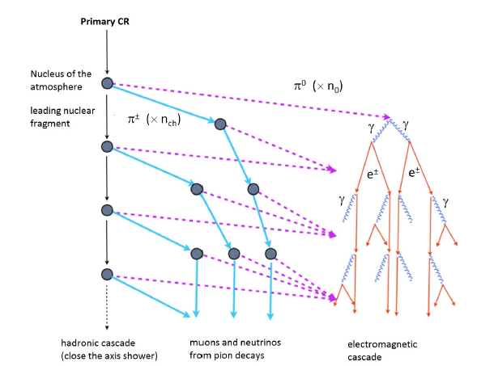
Showers Initiated by Protons and Nuclei
CRs (protons and nuclei) initiate a hadronic shower by interacting with atmospheric nuclei after traversing, on average, one interaction length λ_{I} .
The multiplicity of charged particles produced in the interaction increases with the center of mass energy
Neutral pions (π⁰) decay immediately (10⁻¹⁶ s) in two gamma-rays.
Charged pions decay through weak interactions into
SF7) The number of muons produced in an air shower increases almost linearly with the proton energy E₀;
SF8) The energy E₀ of a primary can be estimated, greatly reducing the relative fluctuation of the EM/muonic size, by measuring both N_{e} and N_{μ} components

Slide 22

p and Nuclei: the “Superposition” model
The superposition model assumes that a nucleus with atomic mass number A and energy E₀ is equivalent to A individual single nucleons, each with energy E₀/A, each acting independently
Number of particles (EM component) at the maximum:
$N_{max}\left(p\right)=\frac{E_{0}}{E_{C}} →N_{max}\left(A\right)=A×\frac{E_{0}/A}{E_{C}}=\frac{E_{0}}{E_{C}}$= $N_{max}\left(p\right)$
The EM component (at maximum) depends only on E₀!
The depth of the shower maximum: $X_{max}\left(A\right)=X_{f}+X_{0}ln\frac{E_{0}}{AE_{C}}=$
${=X}_{max}\left(p\right)−X_{0}ln$A
Figure: Depth of maximum vs. primary energy for the EM component of air showers. An air shower initiated by Fe nuclei of the same E₀ of a proton reaches max ∼150 g/cm² (evaluated from formula above) earlier. Dashed lines= full MC simulation. Green: photon-initiated

Slide 23
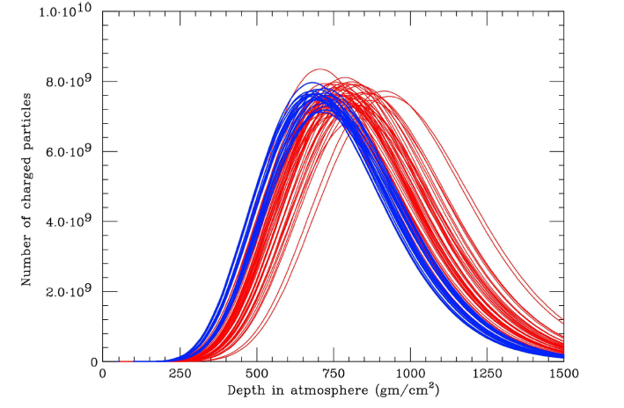
Detailed simulations of p and Fe showers
Simulation of the longitudinal profile obtained with the CORSIKA code for 50 proton-induced (red) and 50 iron-induced (blue) showers.
The same total energy of 10¹⁹ eV is assumed.
Shower by shower fluctuations on N_{max} and X_{max} are evident.

Slide 24
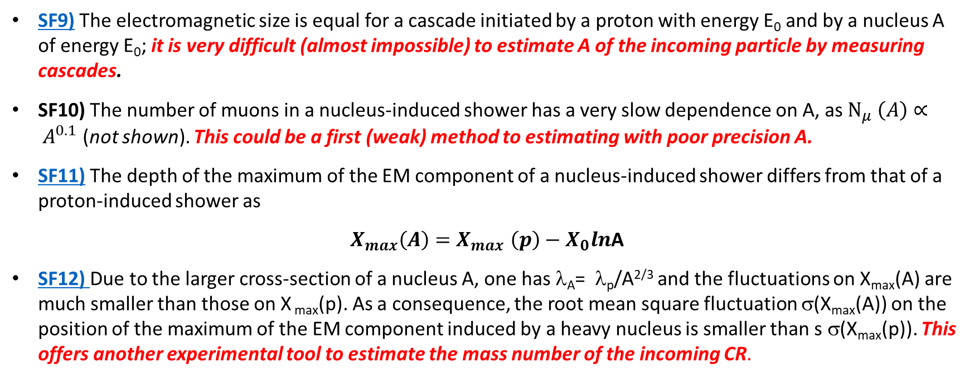
Features of hadron-induced showers
The main qualitative results and properties of our first-order estimate for nucleus-induced showers are below. They are confirmed by detailed MC simulations.
SF9) The electromagnetic size is equal for a cascade initiated by a proton with energy E₀ and by a nucleus A of energy E₀; it is very difficult (almost impossible) to estimate A of the incoming particle by measuring cascades.
SF10) The number of muons in a nucleus-induced shower has a very slow dependence on A, as $N_{μ} \left(A\right)∝ A^{0.1}$ (not shown). This could be a first (weak) method to estimating with poor precision A.
SF11) The depth of the maximum of the EM component of a nucleus-induced shower differs from that of a proton-induced shower as
$X_{max}\left(A\right){=X}_{max}\left(p\right)−X_{0}ln$A
SF12) Due to the larger cross-section of a nucleus A, one has λ_{A}= λ_{p}/A^{2/3} and the fluctuations on X_{max}(A) are much smaller than those on X _{max}(p). As a consequence, the root mean square fluctuation σ(X_{max}(A)) on the position of the maximum of the EM component induced by a heavy nucleus is smaller than s σ(X_{max}(p)). This offers another experimental tool to estimate the mass number of the incoming CR.

Slide 25
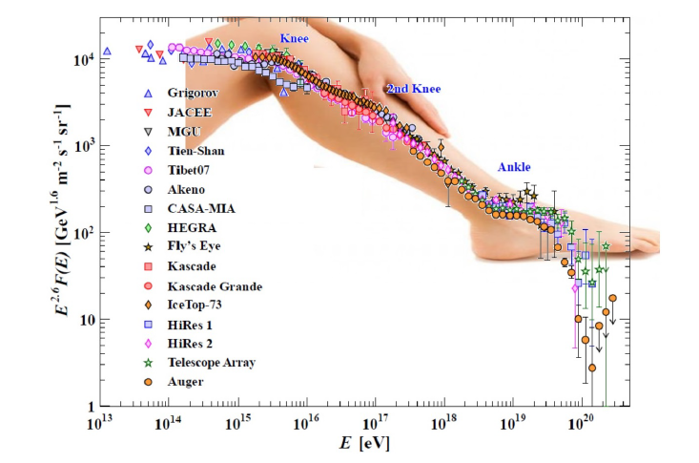
Detectors of EAS at the Energy of the Knee

Slide 26
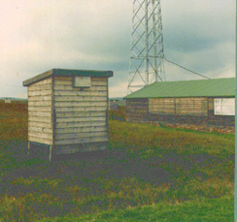
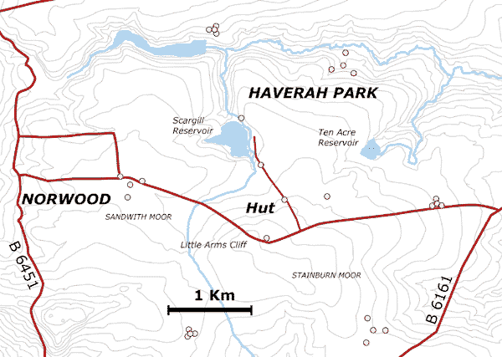
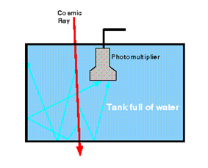
EAS detectors
Extensive air showers induced by CRs with energies above ∼10¹⁴ eV can be detected with arrays of sensors (scintillators, water Cherenkov tanks, muon detectors, Cherenkov telescopes, etc.) spread over a large area.
When a CR falls within the array boundary, the subsample of detectors placed near enough to the shower core will observe the radiation reaching the detection level.
Haverah Park array, operating in England from 1964 to 1987
Water Cherenkov
detectors

Slide 27
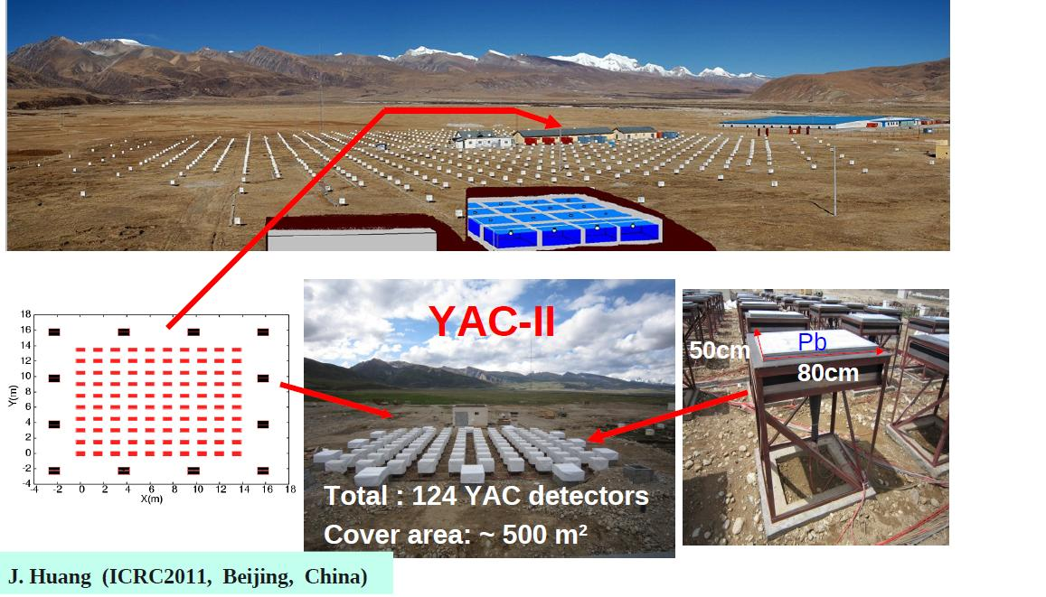
Detectors in Tibet

Slide 28
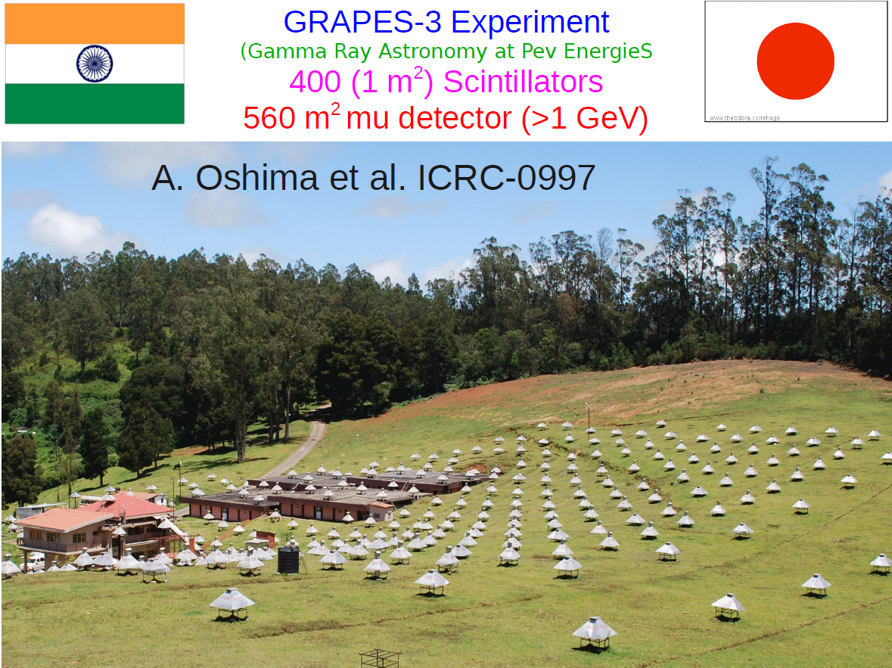
Tamilnadu, India

Slide 29
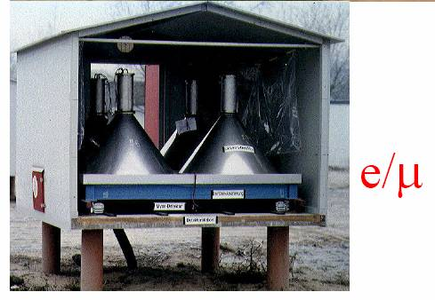
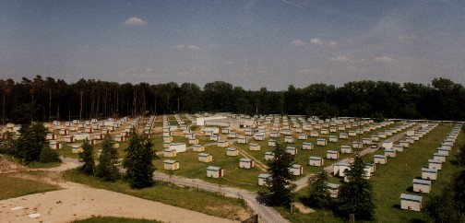
KASCADE in Germany
KASCADE experiment started collecting data in 1996 (KASCADE+Grande in 2003): End in 2013.
It studied CRs within the range from 10¹⁴ to 10¹⁷ eV. It detected a combination of observables: electrons, muons at four energy thresholds, energy and number of hadrons

Slide 30
A Toy Example of an EAS Array
Left: Footprint of a vertical shower generated by a primary iron nucleus with E₀ = 4x10¹⁵ eV on an ideal detector (like KASCADE) with 196 counters (area 1 m²) on a 15m grid and total instrumented surface A=4x10⁸ cm². The lateral distribution was sampled from the NKG distribution with Poisson fluctuations. At the position of each counter, we show the number of detected particles. Circles represent the regions within which the n. of particles per counter exceeds 10, 20, 50 and 100/m². Right: The particle density as a function of the distance from the shower axis for the event shown on the left. The line represents the average particle lateral distribution.
[Exercise: Assuming that the detector is at 2000 m above sea level, shows that the shower size is Ne=8×10⁵ particles. Use Figure].

Slide 31
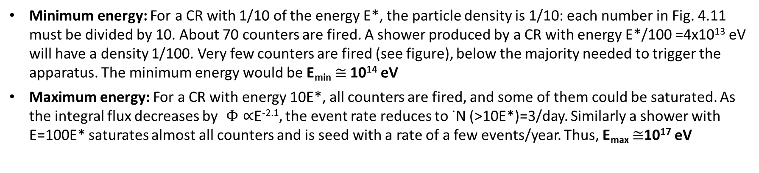
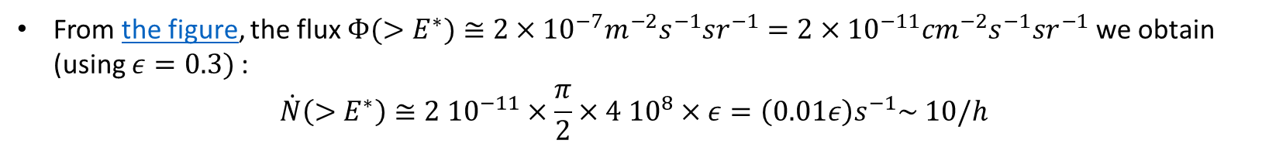
A Toy Example: estimate of the E range
The expected rate of CRs with E> E*=4x10¹⁵ eV producing events similar to that shown in Fig. 4.11 is obtained from (2.17b):
From the figure, the flux $Φ(>E^{∗})≅2×{10}^{−7}m^{−2}s^{−1}{sr}^{−1}=2×{10}^{−11}{cm}^{−2}s^{−1}{sr}^{−1}$ we obtain (using $ε=0.3)$:
$$\dot{N}\left(>E^{∗}\right)≅2 {10}^{−11}×\frac{π}{2}×4 {10}^{8}×ε=\left(0.01ε\right)s^{−1}\sim 10/h$$
Minimum energy: For a CR with 1/10 of the energy E*, the particle density is 1/10: each number in Fig. 4.11 must be divided by 10. About 70 counters are fired. A shower produced by a CR with energy E*/100 =4x10¹³ eV will have a density 1/100. Very few counters are fired (see figure), below the majority needed to trigger the apparatus. The minimum energy would be E_{min} $≅$10¹⁴ eV
Maximum energy: For a CR with energy 10E*, all counters are fired, and some of them could be saturated. As the integral flux decreases by $Φ∝$E^{-2.1}, the event rate reduces to ˙N (>10E*)=3/day. Similarly a shower with E=100E* saturates almost all counters and is seed with a rate of a few events/year. Thus, E_{max} $≅$10¹⁷ eV

Slide 32
Our toy detector
Toy

Slide 33
Measurement of the CR direction
T₄
T₃
θ
T₂
T₁
T₅

Slide 34
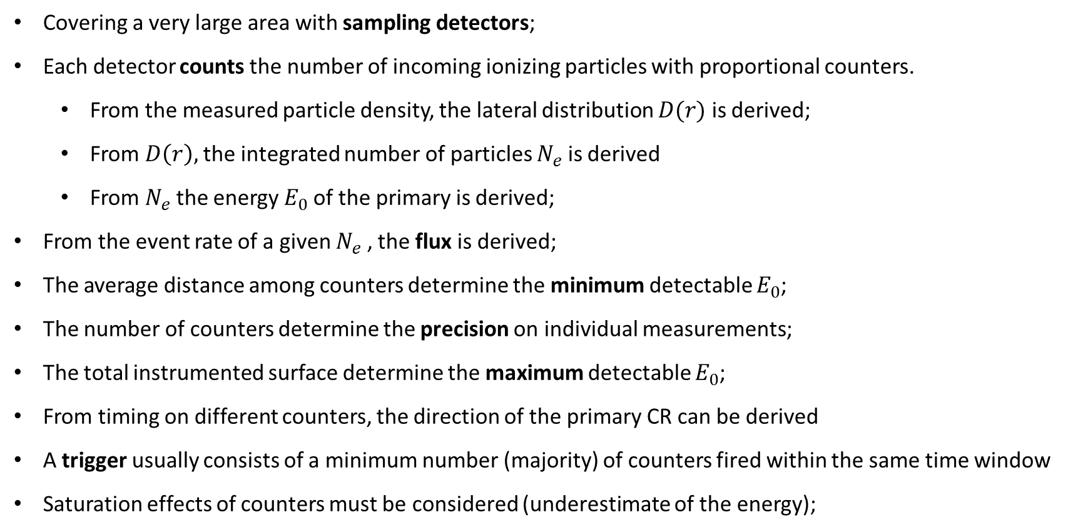
General Features of Detectors of EAS
Covering a very large area with sampling detectors;
Each detector counts the number of incoming ionizing particles with proportional counters.
  From the measured particle density, the lateral distribution $D(r)$ is derived;
  From $D\left(r\right),$the integrated number of particles $N_{e}$ is derived
  From $N_{e}$ the energy $E_{0}$of the primary is derived;
From the event rate of a given $N_{e}$ , the flux is derived;
The average distance among counters determine the minimum detectable $E_{0}$;
The number of counters determine the precision on individual measurements;
The total instrumented surface determine the maximum detectable $E_{0}$;
From timing on different counters, the direction of the primary CR can be derived
A trigger usually consists of a minimum number (majority) of counters fired within the same time window
Saturation effects of counters must be considered (underestimate of the energy);

Slide 35
The CR Flux Measured with EAS Arrays
The CR flux in the region up to 10¹⁸ eV is still dominated by p and nuclei originating in our Galaxy.
Many experiments provided measurements of the all-particle spectrum, i.e., the sum over all nuclear species present in cosmic rays, without any separation.
The energy E₀ is derived through the measurement of the shower size.
Typical Ne→E₀ conversion systematics are of the 15-30%
The arrival direction distribution is still isotropic up to 10¹⁹ eV;
Figure 4.17: Flux of CRs with zenith θ < 17º vs. shower size, Ne, measured at depth of 820 g/cm² by the EAS-Top experiment. The relation among Ne and E₀ is from MC; data on the x-axis, when converted into energy, range between ∼0.9x10¹⁵ and ∼1.0x10¹⁶ eV, covering the knee region. The flux has been multiplied
by Ne^{2.5} to make evident the change of slope occurring at logNe = 6.1 (the knee).

Slide 36
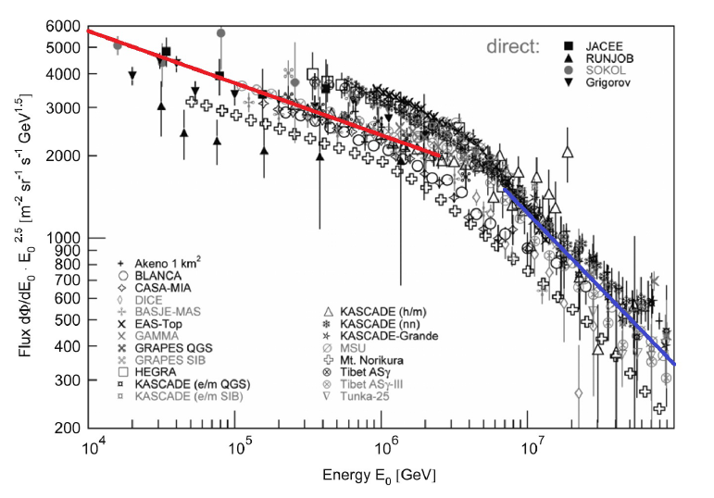
The all-particle spectrum
A change in the slope of the CR flux (the knee) is evident at 4x10¹⁵ eV.
The differential spectrum between 10¹⁶-10¹⁸ eV can be expressed as
The integral spectrum above the knee corresponding to (4.52) is (energy in PeV):
E^{-2.7}
E^{-3.1}
Figure 4.18 All-particle energy spectra in the knee region from EAS experiments and a few direct experiments. The line below the knee refers to the power-law spectrum (2.20a), while the line above the knee to (4.52).

Slide 37
Mass Composition of CRs Around the Knee
As discussed, it is particularly difficult to determine the mass number, A
At least two independent quantities have to be measured to estimate energy and mass of the primary CR that initiated the EAS.
In addition to the shower size Ne, the position X_{max} of the maximum or the muon size Nμ are usually observed.
The measurement is difficult on a shower-to-shower basis, due to the intrinsic fluctuation (at a fixed Ne) of X_{max} and Nμ.
Unfolding methods are usually employed

Slide 38
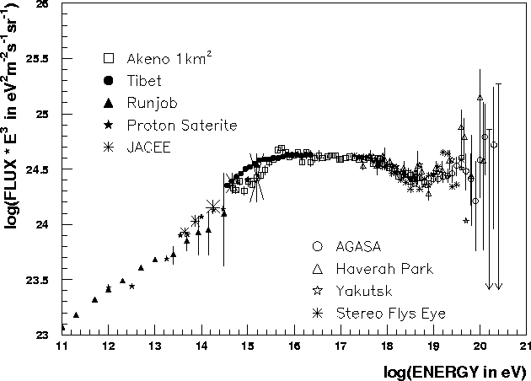
Data and sources
SNRs
Pulsars, compact systems
AGN, GRB ?
Notes:
All’anca (10¹⁷-10¹⁸ eV)
La composizione cambia (nuclei pesanti→protoni)
Le sorgenti cambiano (galattiche→extragalattiche)
Sopra ~6·10¹⁹ eV
GZK cutoff? (CMBR) rilevante per sorgenti oltre ~30 Mpc

