Slide 1
V.
Diffusion of Cosmic Rays in the Galaxy
Astroparticle Physics a.a. 2024/25
Maurizio Spurio
Università di Bologna e INFN
maurizio.spurio@unibo.it

Slide 2
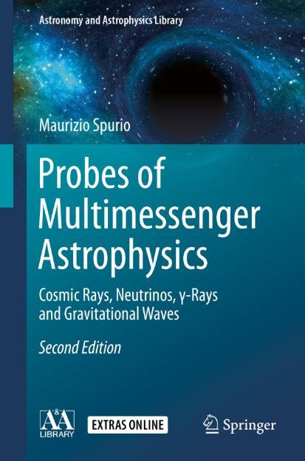
Content

Slide 3
Importance of the CR diffusion in the Galaxy
The observed spectra of CRs depend on two basic processes: acceleration in the astrophysical sources and the propagation in the interstellar medium (ISM)
Upon leaving the source regions, high-energy charged particles diffuse in the random galactic magnetic field that accounts for their high isotropy and relatively long confinement time.
Galactic diffusion models explain the observations on energy spectra, composition, and anisotropy of CRs.
They also provide a basis for the interpretation of radio-astronomical, X-ray, and γ-ray measurements (Chapter 8), since non-thermal radiation is produced during propagation by the energetic e-, p and nuclei.

Slide 4
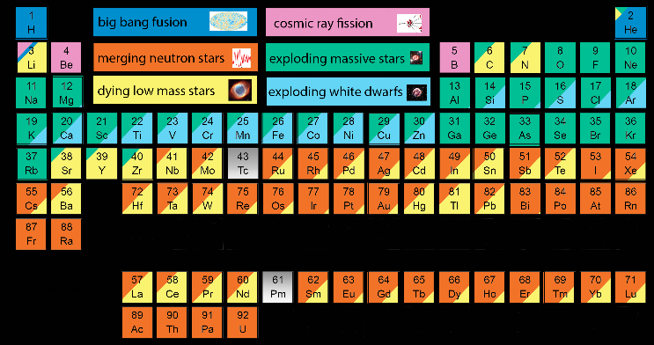
Origin of the elements
Most information on CR propagation arise from the measurements of the abundances of “light elements”: Li, Be, and B, w.r.t. the more abundant C, N, and O elements (“medium elements”).
Light elements are mainly of secondary origin, as explained by stellar nucleosynthesis processes (low cosmic abundance of Li, Be, and B).
The material formed in the early Universe (primordial nucleosynthesis) was, in mass, ¾ protons and ¼ He.
Stellar nucleosynthesis (the process of nuclear fusions inside stars producing energy to support their gravitational contraction, Chap. 12) form the elements up the Iron
Once Fe becomes the primary element in the core of a star, further compression no longer ignites nuclear fusion; the star is unable to thermodynamically support its outer envelope (supernova, Chapter 12)

Slide 5
Abundances of Elements in Solar System and CRs (Chap. 3)
A remarkable resemblance between the measured CR abundances of nuclear species and the abundances found in the solar system (SS) can be noticed, see Figure. Essential piece of information for understanding the origin and history of accelerated particles, Chapter 5.
Hydrogen (p) is ~90% of the total, He ~9%. Nuclei heavier than He only contribute about a few percent of the total flux on Earth.
Nuclei with Z>26 are largely suppressed w.r.t. Fe (both in CRs and SS)

Slide 6
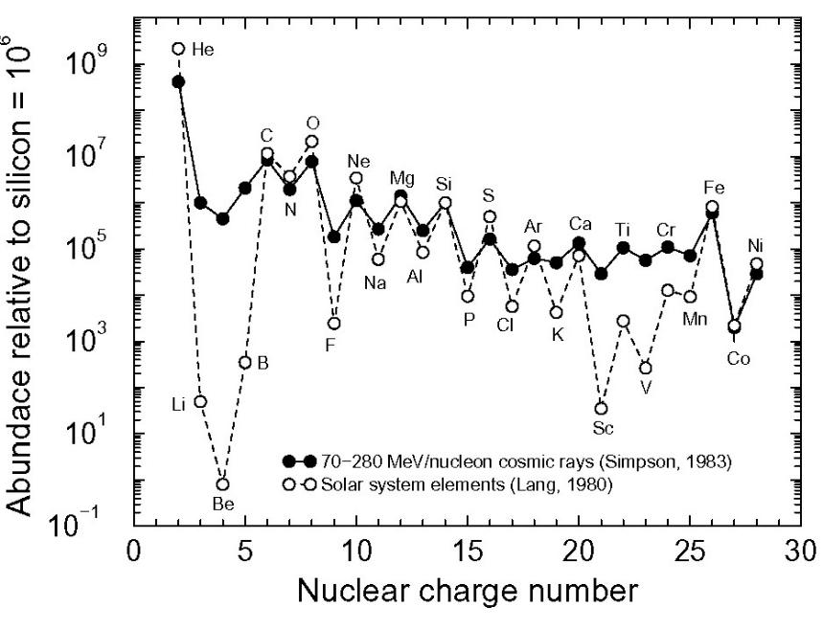
Elements below Iron in Solar System and CRs
Figure: relative abundances of elements in CRs as a function of the nuclear charge Z for all elements, compared with the solar system abundances
The saw tooth pattern expected from the energy levels of adjacent nuclei in the nuclear binding energy curve
The two samples (CRs and solar system abundances) exhibit a striking similarity, differences being within 20% in most cases.
A first conclusion: the CR matter arriving on Earth is sampled from a region whose surrounding material has the same chemical composition as our Solar System.
This material is plausibly originated by the same mechanism that originated the Sun and the planets.
J.A. Simpson, Ann. Rev. Nucl. Part. Sci. 33 (1983) 323

Slide 7
The nuclear binding energy
{ }
Note: you must know this plot and the concept of nuclear binding energy. If not, please refer to chap. 14 of «Particles and Fundamental interactions».

Slide 8
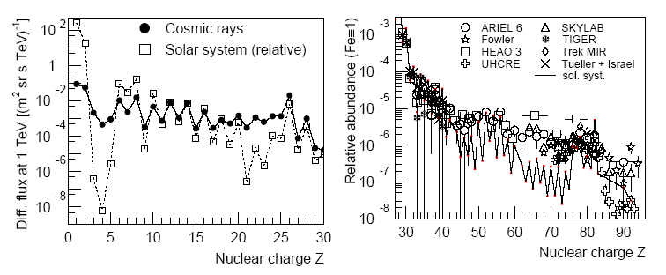
Elements in Solar System and CRs
Trans-iron elements are also present in the cosmic radiation
Their production mechanism is one ot the hottest topics in nuclear astrophysics
A possible production mechanism has been observed during the gravitational event observed in August 2017, with the merging of two neutron stars
C,N,O
Li,Be,B
Formed in stellar
Nucleosyntesis
79, Au
Formed by s- and r- nuclear processes
Fe

Slide 9
The Overabundance of Li, Be, and B in CRs
Li, Be, and B act as catalysts of thermonuclear reactions in stars, and a low abundance after a stellar collapse is expected, as the collapse occurs when material for fusion is no longer available (→ Chap. 12)
For this reason, the Li, Be, and B abundances in the solar system (and in the Universe) are generally very small.
The bulk of CRs is believed to be accelerated by galactic SN remnants;
A similarity between the chemical composition of the solar system and that of nuclei present in CRs is thus expected.
A clear difference between the relative abundances “R” of Li, Be, and B elements in CRs with respect to those in the solar system (SS) is evident (Fig. 3.7 and Table 3.3).
The discrepancy between the ratios is explained as being due to the CR propagation in the Galaxy before reaching the Earth.
The interstellar medium is filled with matter (mainly hydrogen), and Li, Be, and B elements are produced during the propagation as an effect of interactions of heavier nuclei (C,N,O) with protons of the ISM.

Slide 10
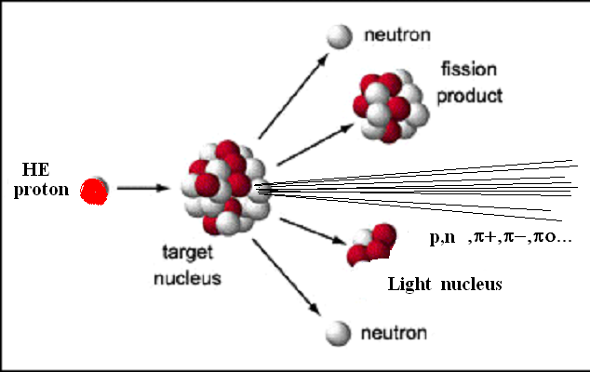
Production of Li, Be, and B during Propagation
A simplified analytic model for the production of Li, Be, and B
Let us globally identify the Li, Be, and B secondary with the symbol L (which stands for light elements) and the C, N, and O primary elements with M (medium)
The (relatively) abundant M-type CR nuclei propagate in the Galaxy, constantly deflected by galactic magnetic fields until, they reach the galactic border and exit
Along the way, M nuclei can interact with p of the ISM
This gives rise to the so-called spallation process (or fragmentation process); the result is the ejection of some nucleons from the hit nucleus;
The production of secondaries by CRs distributed over the whole galactic volume depends on the nuclear cross-section, the average density of the interstellar material, ρ, and the distance x (cm) traveled between the production and the exit from Galaxy.
The relevant quantity for the production of secondaries is thus the grammage:

Slide 11
The average path of CRs in Galaxy
The problem consists in finding the value of ξ =ξ_{esc} that reproduces the observed ratio R_{CR} between the L and M abundances.
This value corresponds to the mean amount of ISM traversed by CRs before escaping from the confinement volume.
In this simple model, ξ_{esc} =constant and independent of the energy (to be improved)
The spallation of M nuclei by protons produces L nuclei and can be quantitatively studied with accelerator data using the reaction
Table: Fragmentation cross-sections of C, N and O nuclei hit by protons. The considered fragments are the isotopes of Li, Be and B. It is assumed that the fragmentation cross-section does not depend on the energy

Slide 12
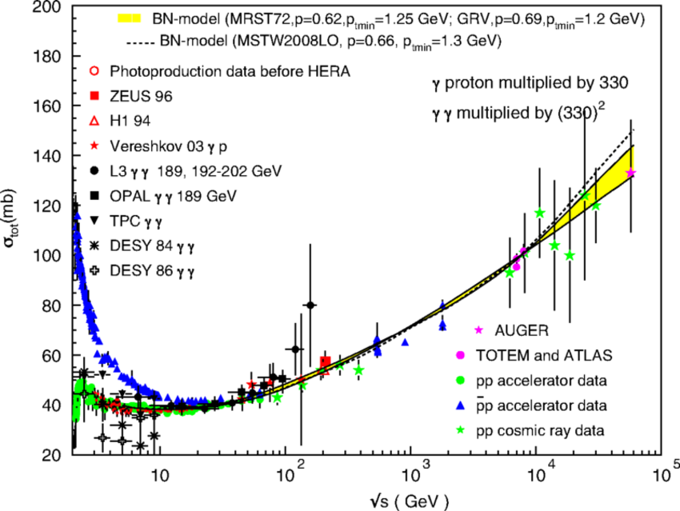
p-p cross section
1 mb= 10⁻²⁷ cm²
60 mb=πR²
R= 1 fm
Question: do you know the behavior of the e-e cross section? (electro-magnetic cross-section)
And that of ν -p (or ν-e) cross-section? (WI cross-section)

Slide 13

(Remember) The nuclear cross-section and λ
In the simplest model, the nuclear cross-sections are assumed energy-independent and proportional to the geometrical area of the interacting nuclei:
where R_{P} and R_{T} are the projectile (P) and target (T) radii.
From nuclear models, the radius of a nucleus with mass A (r_{o}= 0.85x10⁻¹³ cm).
Typically, the cross-section for a p in a medium with mass number A is
The particle mean path length in a medium with number density n [cm⁻³] is
As the number density depends on the density ρ (g cm⁻³), the nuclear interaction length for a nucleus with mass number A in a medium made of protons (A_{medium}=1) is also expressed in units [g cm⁻²] as
$$λ_{I}=\frac{ρ}{nσ}=\frac{A_{medium} m_{p}}{σ}=\frac{ m_{p}}{σ} [g {cm}^{−2}]$$

Slide 14
The simplified propagation model
To determine the escape length ξ =ξ_{esc} that reproduces the observed ratio between L=(Li, B, and Bo) and M=(C, N, and O), we need to set out a system of differential equations for the number of M and L nuclei as a function of ξ .
Boundary conditions: No L nucleus present at sources.
and
From Table, the average probability P_{ML} = 0.28 that a M element fragments into a lighter L element. Thus, during propagation
Using the cross-sections for p to L and M nuclei, their mean free path are
The reduction of the number of M nuclei during their journey is
The equation that describes the number of L nuclei vs ξ contains a positive source term and a negative attenuation term:

Slide 15
Solution of the differential equation system (I)
Equations (5.7) and (5.8) are coupled, since the number of L nuclei depends on N_{M}(ξ) Equation (5.7) can be immediately solved (5.9)
to solve (5.8), replace the N_{M}(ξ ) in it with the value (5.9); then multiply both sides by the exponential term; the two terms containing N_{L} can be considered as the derivative of the product of two functions. As a result, (5.8) takes the form:
                (5.10)
The ansatz is of the form
Placing the test solution in (5.10), we obtain an identity if
The solution to (5.8) is:

Slide 16
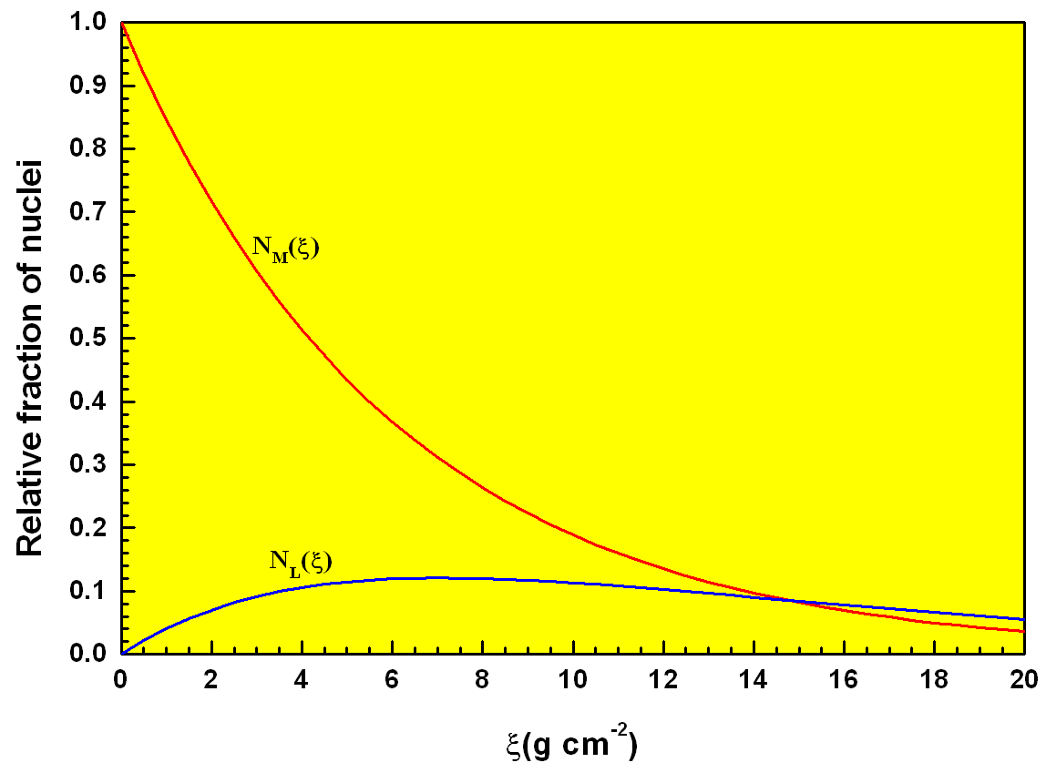
Solution of the differential equation system (II)
The figure shows the two functions (5.9) and (5.11), arbitrarily assuming N⁰_{M} = 1.
The measured quantity is the ratio of R_{CR} = N_{L} /N_{M} = 0.25, which does not depend on N⁰_{M} .
The value of ξ = ξ_{esc}, which gives the measured value of R_{CR}, is determined using the ratio between (5.9) and (5.11), or through inspection of the figure
P_{ML} = 0.28
λ_{M} = 6.0 g cm⁻²
λ_{N} = 8.4 g cm⁻²
R = N_{L}/N_{M} = 0.25
This is the average escape length of CRs from our Galaxy.
Using the density of the ISM, the escape path x_{esc} corresponds to

Slide 17

CR average escepe time from the Galaxy
The escape path x_{esc} is much larger than the Galaxy (radius of 15 kpc and a thickness of 300 pc).
This result can be explained only if the propagation of CRs resembles that of a random walk (see figure). Moreover, it suggests that the propagation and acceleration processes can be treated separately.
A characteristic escape time, τ, can be defined starting from ξ = ξ_{esc}.
The escape time represents the average time of permanence of CRs inside the confinement volume before escaping our Galaxy:
It depends only on the ratio between the abundances of L and M nuclei, and not on the observer’s position: in any other position in the Galaxysimilar to that of our Sun, a hypothetical observer would measure the same Light/Medium ratio obtaining the same value of the escape time τ .
B
300 pc

Slide 18
The Diffusion-Loss Equation (§5.3)
Skip this
CRs undergo a diffusion process through the interstellar medium from their sources until they exit the Galaxy.
The CRs’ journey through the Galaxy modifies the CRs’ energy spectrum from the sources to the observer. Solar modulations, affect CRs with E< few GeV.
The galactic magnetic field is the main factor that affect the CRs’ motion, as the Larmor radius for particles below the knee (E < 10¹⁵ eV) is much smaller than the typical spatial dimension over which the magnetic fields are coherent.
A random component in the motion is induced by the presence of irregularities, associated either with fluctuations in the fields or with the induction of instabilities due to the streaming motions of the CRs themselves.
During their diffusion, CRs are subject to energy-loss mechanisms and absorption by dense media; nuclei may suffer spallation processes. Occasionally, CRs can gain energy by scattering with magnetized clouds.
A diffusion-loss equation can be set to describe these processes through simulation MC codes

Slide 19
Energy Dependence of the escape time τ_{esc}
The framework in which CRs propagate freely in a containment volume is called the leaky box model; it provides CR transport in the Galaxy at energies below 10¹⁷ eV.
The model is based on particles injected by sources, Q(E), distributed uniformly over the galactic volume, uniformly filled with matter and radiation fields.
Particles get away from this volume with a time-dependent escape time, τ_{esc}(E), independent of their position in the box;
The energy dependence of the CR escape time can be deduced from the measurement of the secondary-to-primary ratios of stable nuclei.
The reference ratio is that between boron and carbon (B/C), because B is entirely secondary, i.e., produced by heavier primary CR nuclei. C, N, and O are the major progenitors of B, with cross-section better known than those of Be and Li.
A large number of different measurements exists up to ~1 TeV.

Slide 20
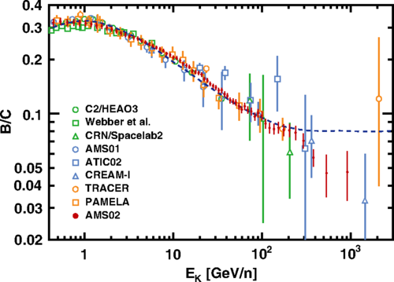
The (B/C) ratio and τ_{esc}
Fig. presents the measurement of the B/C ratio vs. kinetic energy
The increase below ~1 GeV/n is due to the dependence, at low energies, of the cross-section vs E_{K}
At high energies, the fragmentation cross-section is almost constant.
Above 1 GeV/n, therefore, the decrease in the B/C ratio is only a consequence of propagation effects for nuclei with different energies.
Empirically, we assume a dependence of the path length on the particle rigidity R, defined as
The measured B/C ratio and the prediction from a theoretical model [ApJ. 827, 119 (2016)] (blue dash line), which explains the AMS positron fraction [PRL 113, 121101 (2014)] and antiproton results [PRL. 117, 091103 (2016)] by secondary production in CR propagation.

Slide 21
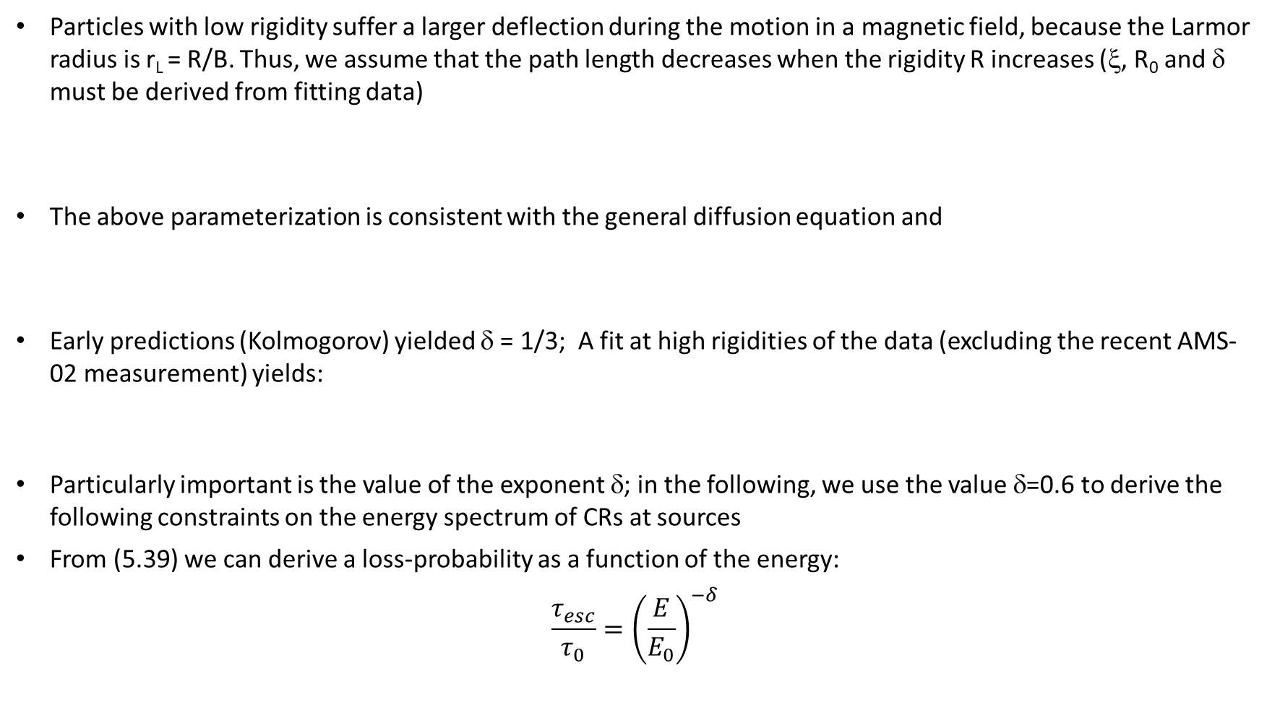
The (B/C) ratio and τ_{esc}
Particles with low rigidity suffer a larger deflection during the motion in a magnetic field, because the Larmor radius is r_{L} = R/B. Thus, we assume that the path length decreases when the rigidity R increases (ξ, R₀ and δ must be derived from fitting data)
The above parameterization is consistent with the general diffusion equation and
Early predictions (Kolmogorov) yielded δ = 1/3; A fit at high rigidities of the data (excluding the recent AMS-02 measurement) yields:
Particularly important is the value of the exponent δ; in the following, we use the value δ=0.6 to derive the following constraints on the energy spectrum of CRs at sources
From (5.39) we can derive a loss-probability as a function of the energy:
$$\frac{τ_{esc}}{τ_{0}}={\left(\frac{E}{E_{0}}\right)}^{−δ}$$

Slide 22
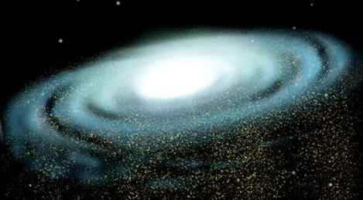
Energy Considerations on CR Sources – I (Chap. 2)
Primary CRs arrive on Earth in a completely isotropic way, due to the presence of the galactic magnetic field
Present observations: total kinetic energy of CRs corresponds to:
If CRs are confined inside the galactic volume, this energy would increase over time in the presence of new galactic sources;
However, there is a loss of CRs due to their escape from the Galactic disk, loss occurring with a characteristic time (τ_{esc}). Anticipating the results we derive in Sect. 5.2, the confinement time is τ_{esc}~10⁷ y.
Thus, the rate of energy loss is

Slide 23
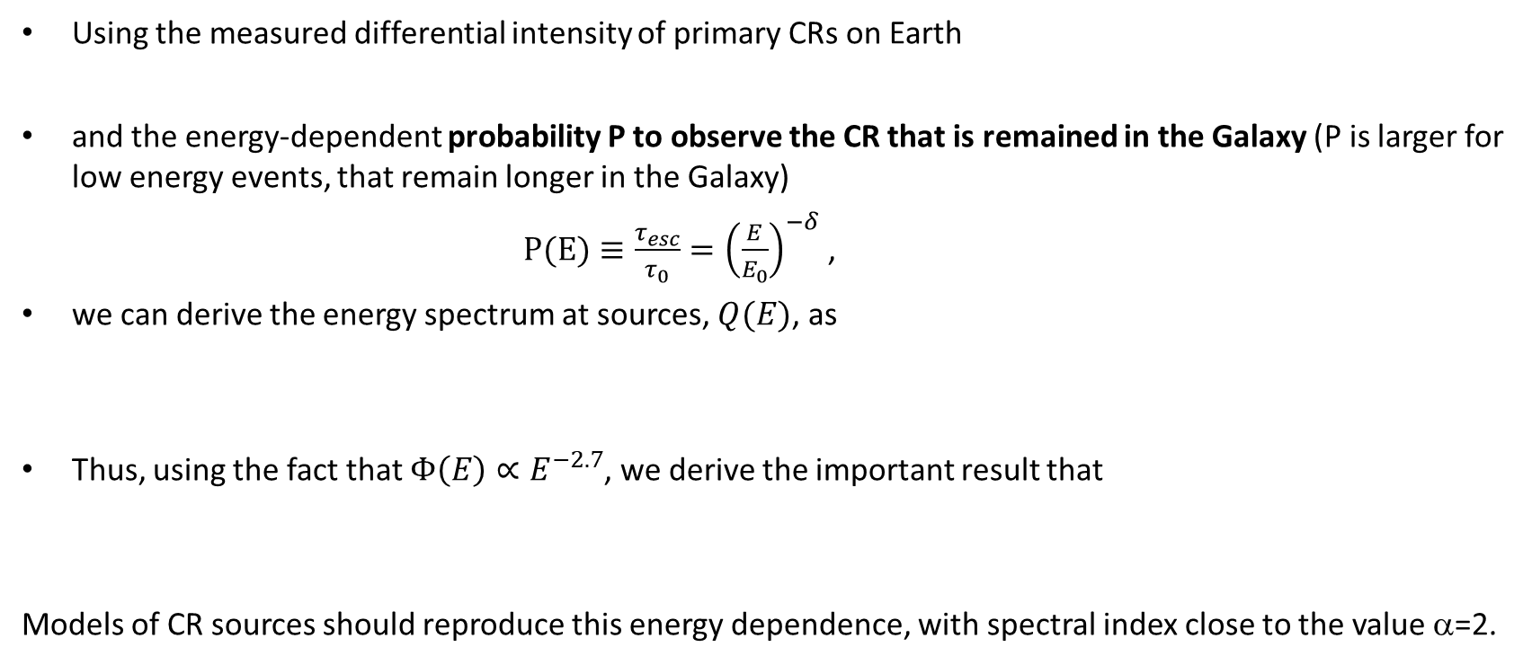


Energy Spectrum of Cosmic Rays at the Sources
Using the measured differential intensity of primary CRs on Earth
and the energy-dependent probability P to observe the CR that is remained in the Galaxy (P is larger for low energy events, that remain longer in the Galaxy)
$P(E)≡\frac{τ_{esc}}{τ_{0}}={\left(\frac{E}{E_{0}}\right)}^{−δ}$ ,
we can derive the energy spectrum at sources, $Q(E)$, as
Thus, using the fact that $Φ\left(E\right)∝E^{−2.7}$, we derive the important result that
Models of CR sources should reproduce this energy dependence, with spectral index close to the value α=2.
$Φ\left(E\right)=Q\left(E\right)∙P\left(E\right)$=$Q\left(E\right)∙E^{−δ}$
$$Q\left(E\right)∝E^{−2.1}$$

