Slide 1
VI.
Galactic Accelerators and Acceleration
Mechanisms
Astroparticle Physics a.a. 2024/25
Maurizio Spurio
Università di Bologna e INFN
maurizio.spurio@unibo.it

Slide 2
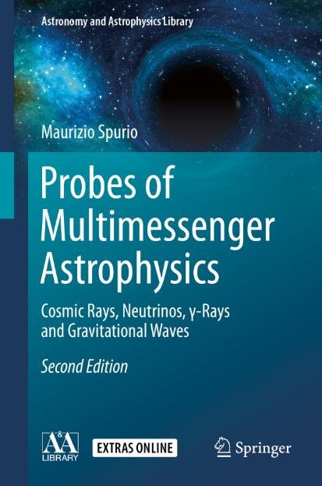
Content

Slide 3
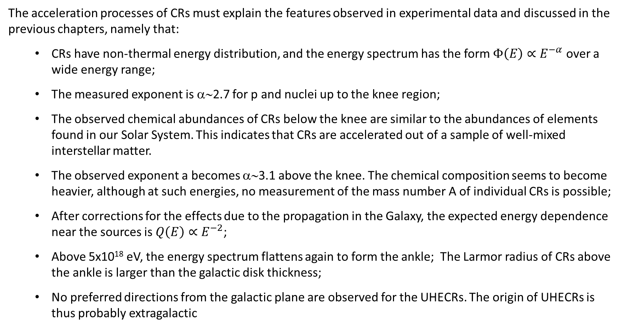
The summary of experimental facts
The acceleration processes of CRs must explain the features observed in experimental data and discussed in the previous chapters, namely that:
  CRs have non-thermal energy distribution, and the energy spectrum has the form $Φ\left(E\right)∝E^{−α}$ over a wide energy range;
  The measured exponent is α∼2.7 for p and nuclei up to the knee region;
  The observed chemical abundances of CRs below the knee are similar to the abundances of elements found in our Solar System. This indicates that CRs are accelerated out of a sample of well-mixed interstellar matter.
  The observed exponent a becomes α∼3.1 above the knee. The chemical composition seems to become heavier, although at such energies, no measurement of the mass number A of individual CRs is possible;
  After corrections for the effects due to the propagation in the Galaxy, the expected energy dependence near the sources is $Q\left(E\right)∝E^{−2}$;
  Above 5x10¹⁸ eV, the energy spectrum flattens again to form the ankle; The Larmor radius of CRs above the ankle is larger than the galactic disk thickness;
  No preferred directions from the galactic plane are observed for the UHECRs. The origin of UHECRs is thus probably extragalactic

Slide 4
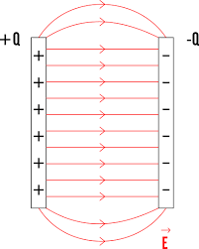
The possible acceleration mechanism(s)
In astrophysical environments, static electric fields cannot be maintained, because matter is in the state of a plasma. Ionized gases have a high electrical conductivity, and any static electric field is rapidly short-circuited by the motion of free charges.
This is the metod in Earth accelerators. A different mechanism must be in place
CRs below the knee are thought to be accelerated by violent processes that produce shock waves and turbulences (SN explosions) .
The bulk of CRs is believed to be accelerated in recursive stochastic mechanisms in which low-energy particles, after many interactions with a shock wave, reach high energies, up to 10¹⁵–10¹⁶ eV, with a spectral index α∼ 2.
This “standard model” of galactic CR acceleration has some limitations: in particular, it fails to describe the flux above the knee.
Additional models have been put forward, such as the particle acceleration through EM mechanisms associated with time-varying magnetic fields (Faraday’s law).
Some peculiar galactic objects can be involved in these processes, but at present, no firm experimental proof is evident for any point-like source of CRs.
Because galactic magnetic field is not able to confine CRs with E>10¹⁸ eV, they are believed to be of extragalactic origin (Chap. 7)

Slide 5
Magnetic Mirrors
Acceleration of CRs can occur in regions where very strong inhomogeneous magnetic fields exist. The process can be seen as the scattering of the particle by magnetic field irregularities (magnetic mirrors, see figure).
In literature, this situation is sometimes called a collisionless shock. A collisionless shock is defined as a shock wave in which the scattering occurs on a length scale much smaller than the mean free path λ (Eq. 3.1), necessary for a particle collision.
In such a structure, particles interact with each other not through collisions, but by the emission and absorption of collective excitations of the plasma (plasma waves).
In astrophysical situations, the magnetic field necessary for the existence of such plasma waves, is provided by a “frozen” cloud of interstellar matter, with a density much higher than that of the surrounding material.
Motion of a charged particle in a nonuniform magnetic field
Picture of a mirror reflection of an electron beam in a magnetic field

Slide 6
Importance of the CR diffusion in the Galaxy (Chap. 5)
The observed spectra of CRs depend on two basic processes: acceleration in the astrophysical sources and the propagation in the interstellar medium (ISM)
Upon leaving the source regions, high-energy charged particles diffuse in the random galactic magnetic field that accounts for their high isotropy and relatively long confinement time.
Galactic diffusion models explain the observations on energy spectra, composition, and anisotropy of CRs.
They also provide a basis for the interpretation of radio-astronomical, X-ray, and γ-ray measurements (Chapter 8), since non-thermal radiation is produced during propagation by the energetic e-, p and nuclei.

Slide 7
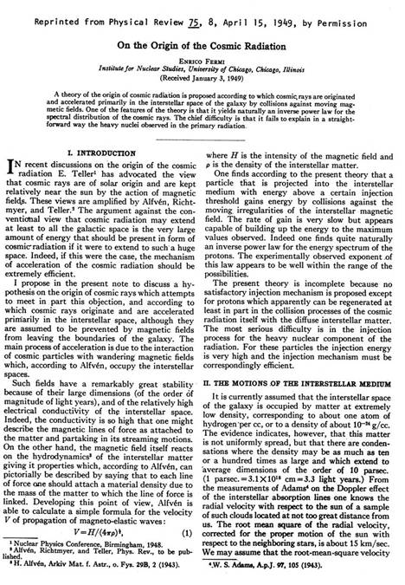
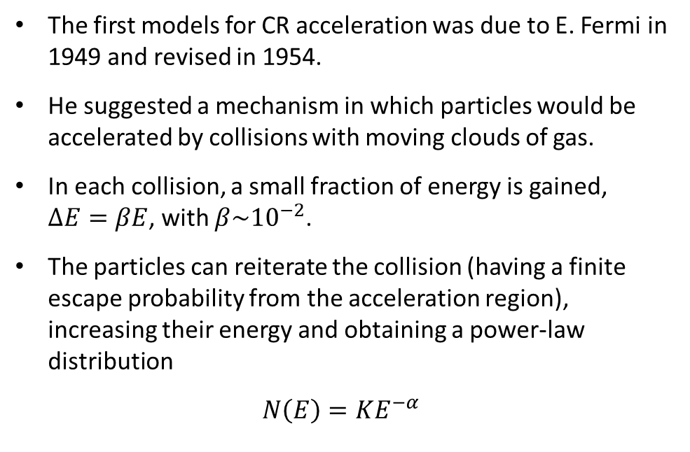
The Fermi acceleration model
The first models for CR acceleration was due to E. Fermi in 1949 and revised in 1954.
He suggested a mechanism in which particles would be accelerated by collisions with moving clouds of gas.
In each collision, a small fraction of energy is gained, $∆E=βE$, with $β\sim {10}^{−2}$.
The particles can reiterate the collision (having a finite escape probability from the acceleration region), increasing their energy and obtaining a power-law distribution
$$N\left(E\right)=KE^{−α}$$

Slide 8
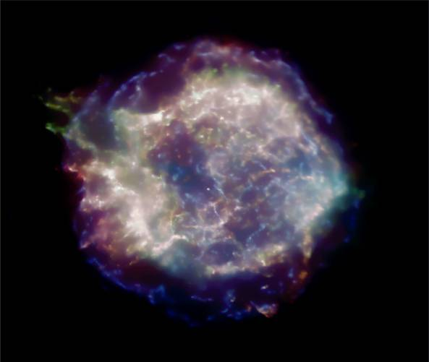
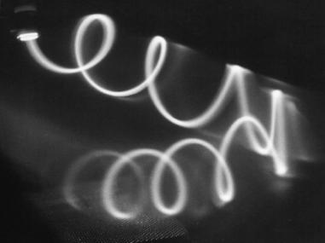
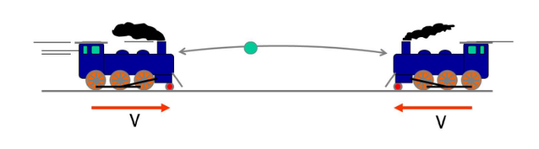
The Fermi acceleration model: ingredients
Shock wave +
Magnetic fields +
Iterative processes
CasA Supernova Remnant in X-rays
Shock fronts

Slide 9

Kinematics of the scattering process
S = reference frame of the observer, with the cloud speed U directed along the x-axis;
S’ = the frame in which the cloud is at rest.
Only the p_{x} component is relevant, as the y; z components are conserved in the interaction. The four-momentum describing the particle is (E; p_{x}) in the frame S, and (E’; p_{x}’) in S’. Thus
U
The collision is elastic in the S’ frame.
θ
v

Slide 10
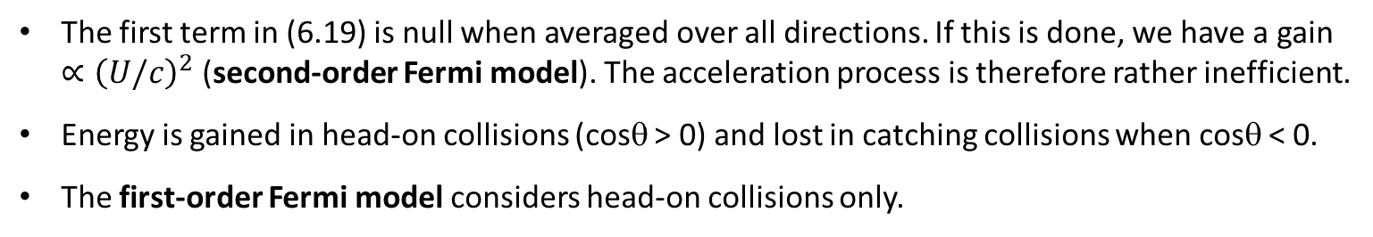
Kinematics of the scattering process
Thus, the energy E* (6.15) after the collision becomes
And, at the second order of U/c:
The energy gained by the particle in the observer reference frame is:
U
θ
v
The first term in (6.19) is null when averaged over all directions. If this is done, we have a gain ${∝\left(U/c\right)}^{2}$ (second-order Fermi model). The acceleration process is therefore rather inefficient.
Energy is gained in head-on collisions (cosθ > 0) and lost in catching collisions when cosθ < 0.
The first-order Fermi model considers head-on collisions only.

Slide 11
Head-on in first-order Fermi model
At Ist order for a relativistic particle, (6.19) becomes
Averaging over all head-on direction (cosθ>0)
v cosθ
U
Elastic scattering
Magnetic Fields
vcl
A situation in which accelerated particles suffer only head-on collisions is assumed in diffusive shock acceleration model, which uses the strong shock waves produced by SNRs.

Slide 12
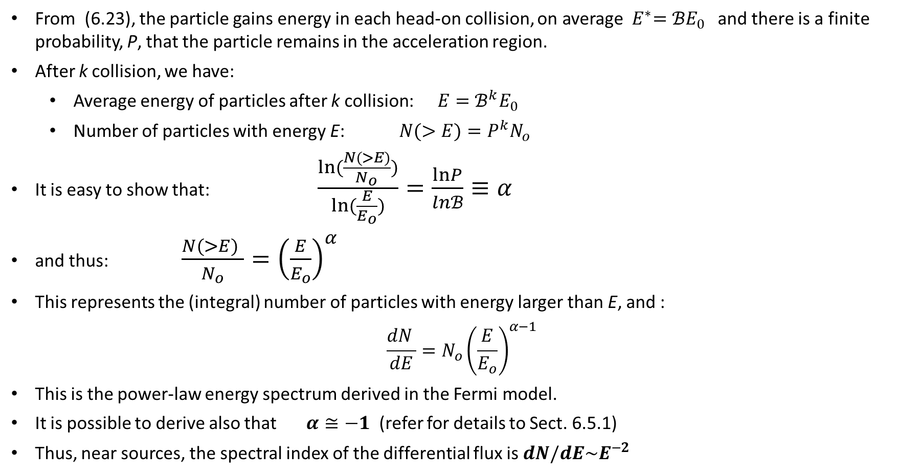
The Power-Law Spectrum from Fermi Model
From (6.23), the particle gains energy in each head-on collision, on average${ E}^{∗}=ℬE_{0}$ and there is a finite probability, P, that the particle remains in the acceleration region.
After k collision, we have:
  Average energy of particles after k collision: $E=ℬ^{k}E_{0}$
  Number of particles with energy E: $N(>E)=P^{k}N_{o}$
It is easy to show that: $\frac{ln(\frac{N(>E)}{N_{o}})}{ln(\frac{E}{E_{o}})}=\frac{lnP}{lnℬ}≡α$
and thus: $\frac{N(>E) }{N_{o}}={\left(\frac{E}{E_{o}}\right)}^{α}$
This represents the (integral) number of particles with energy larger than E, and :
$$\frac{dN }{dE}={N_{o}\left(\frac{E}{E_{o}}\right)}^{α−1}$$
This is the power-law energy spectrum derived in the Fermi model.
It is possible to derive also that $α≅−1$ (refer for details to Sect. 6.5.1)
Thus, near sources, the spectral index of the differential flux is $dN/dE\sim E^{−2}$

Slide 13
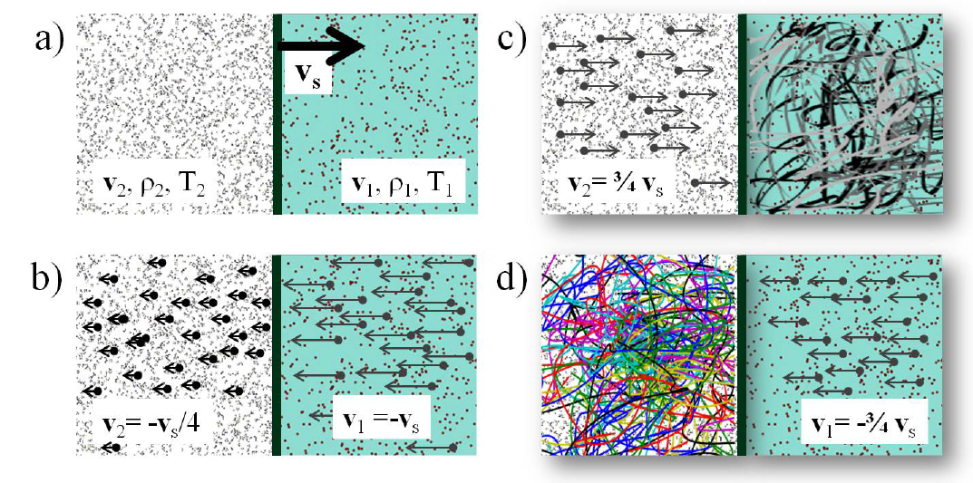
The spectral index (α-1)=-2 (§6.5.1, 6.5.2)
Skip this

Slide 14
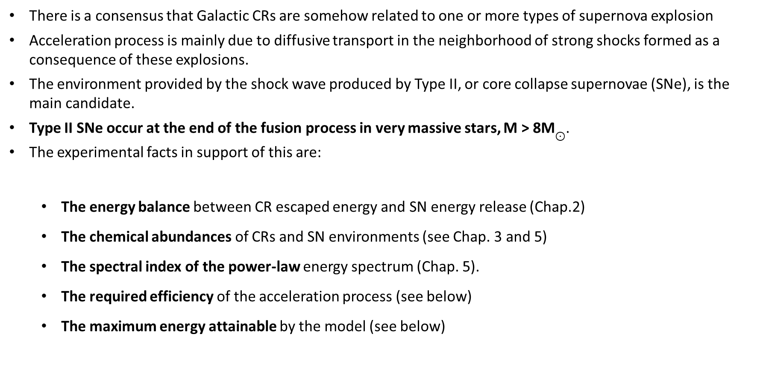
SNRs and Standard Model of CRs Acceleration
There is a consensus that Galactic CRs are somehow related to one or more types of supernova explosion
Acceleration process is mainly due to diffusive transport in the neighborhood of strong shocks formed as a consequence of these explosions.
The environment provided by the shock wave produced by Type II, or core collapse supernovae (SNe), is the main candidate.
Type II SNe occur at the end of the fusion process in very massive stars, M > 8M$⊙$.
The experimental facts in support of this are:
  The energy balance between CR escaped energy and SN energy release (Chap.2)
  The chemical abundances of CRs and SN environments (see Chap. 3 and 5)
  The spectral index of the power-law energy spectrum (Chap. 5).
  The required efficiency of the acceleration process (see below)
  The maximum energy attainable by the model (see below)

Slide 15
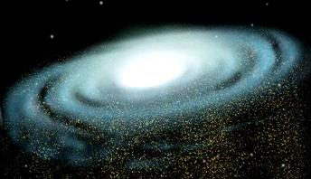
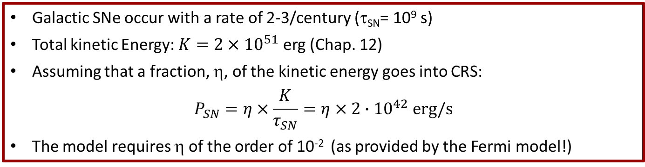
Energy Considerations on CR Sources – I (Chap. 2)
Primary CRs arrive on Earth in a completely isotropic way, due to the presence of the galactic magnetic field
Present observations: total kinetic energy of CRs corresponds to:
If CRs are confined inside the galactic volume, this energy would increase over time in the presence of new galactic sources;
However, there is a loss of CRs due to their escape from the Galactic disk, loss occurring with a characteristic time (τ_{esc}). Anticipating the results we derive in Sect. 5.2, the confinement time is τ_{esc}~10⁷ y.
Thus, the rate of energy loss is
Galactic SNe occur with a rate of 2-3/century (τ_{SN}= 10⁹ s)
Total kinetic Energy: $K=2×{10}^{51}$ erg (Chap. 12)
Assuming that a fraction, η, of the kinetic energy goes into CRS:
$$P_{SN}=η×\frac{K}{τ_{SN}}=η×2∙{10}^{42} erg/s$$
The model requires η of the order of 10⁻² (as provided by the Fermi model!)

Slide 16
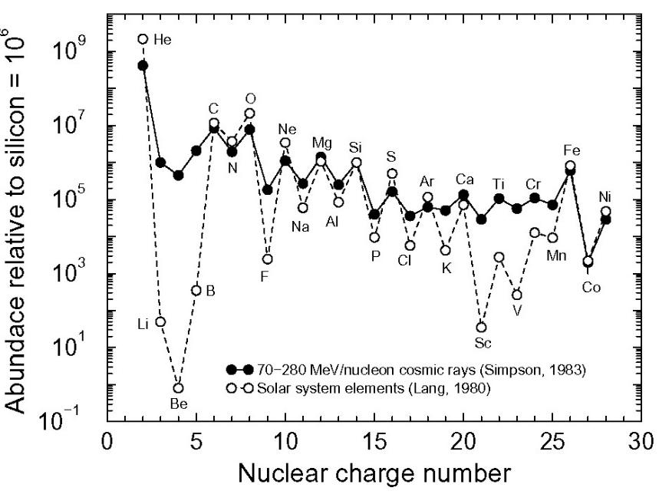
Elements in Solar System and CRs (Chap. 5)
Figure: elative abundances of elements in CRs as a function of the nuclear charge Z for all elements, compared with the solar system abundances
The saw tooth pattern expected from the energy levels of adjacent nuclei in the nuclear binding energy curve
The two samples (CRs and solar system abundances) exhibit a striking similarity, differences being within 20% in most cases.
A first conclusion: the CR matter arriving on Earth is sampled from a region whose surrounding material has the same chemical composition as our Solar System.
This material is plausibly originated by the same mechanism that originated the Sun and the planets.
J.A. Simpson, Ann. Rev. Nucl. Part. Sci. 33 (1983) 323

Slide 17
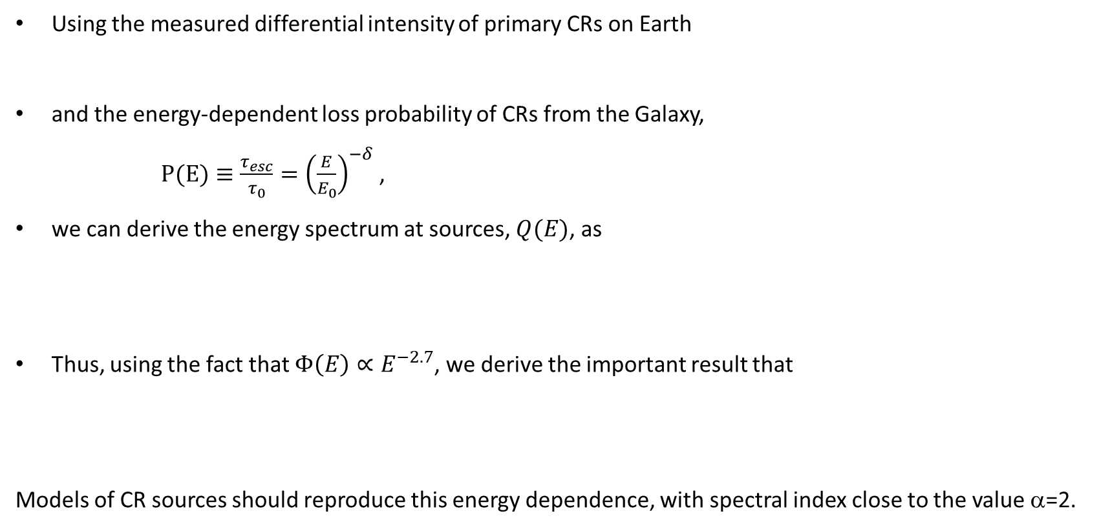


Energy Spectrum of CRs at Sources (chap 5)
Using the measured differential intensity of primary CRs on Earth
and the energy-dependent loss probability of CRs from the Galaxy,
$P(E)≡\frac{τ_{esc}}{τ_{0}}={\left(\frac{E}{E_{0}}\right)}^{−δ}$ ,
we can derive the energy spectrum at sources, $Q(E)$, as
Thus, using the fact that $Φ\left(E\right)∝E^{−2.7}$, we derive the important result that
Models of CR sources should reproduce this energy dependence, with spectral index close to the value α=2.
$Φ\left(E\right)=Q\left(E\right)∙P\left(E\right)$=$Q\left(E\right)∙E^{−δ}$
$$Q\left(E\right)∝E^{−2.1}$$

Slide 18
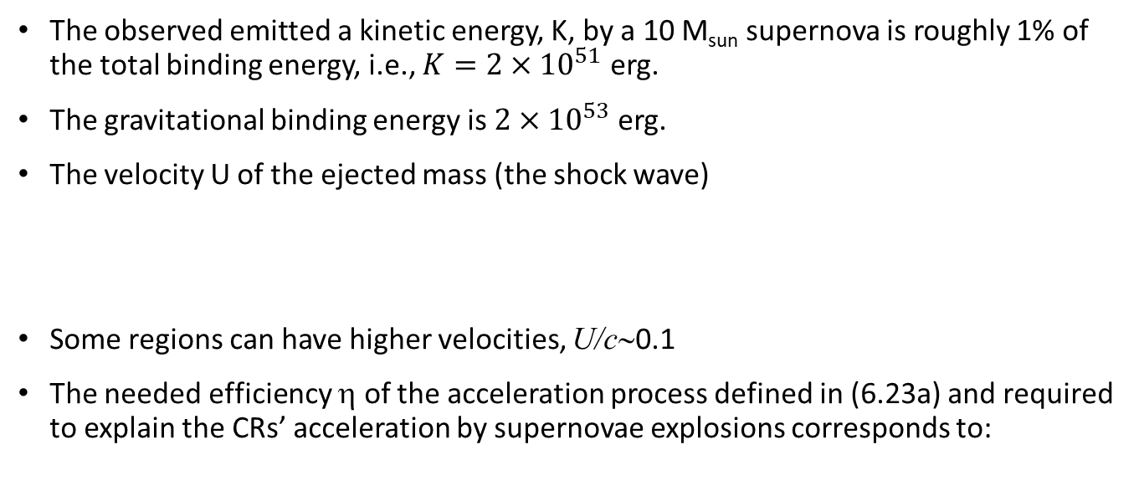
Relevant Quantities in SNRs
The observed emitted a kinetic energy, K, by a 10 M_{sun} supernova is roughly 1% of the total binding energy, i.e., $K=2×{10}^{51}$ erg.
The gravitational binding energy is $2×{10}^{53}$ erg.
The velocity U of the ejected mass (the shock wave)
Some regions can have higher velocities, U/c∼0.1
The needed efficiency η of the acceleration process defined in (6.23a) and required to explain the CRs’ acceleration by supernovae explosions corresponds to:
The shock front expands across the ISM. During the expansion, the shock collects interstellar matter.
When the mass of the swallowed material becomes comparable to the mass of the ejected shells of the SN, the velocity of the shock decreases remarkably.
As the radius R_{SN} of the shock increases, the matter density ρ_{SN} decreases.
The shock becomes inefficient for acceleration when the ρ_{SN} = ρ_{ISM}.

Slide 19
Relevant Quantities in SNRs
The radius within which the shock wave is able to accelerate particles can be derived using the condition
Exercise: Figure shows the SN 1572 (or Tycho’s Supernova) as seen in different wavelengths by modern astronomers. It occurred in the Cassiopeia constellation, about D = 3 kpc from Earth. SN 1572 is one of about eight SN visible to the naked eye in historical records. Its angular radius is 4 arcmin. Using the information in bold:
Derive the linear radius of the object visible from the figure
Derive the speed of the ejected material

Slide 20
Maximum Energy in the Supernova Model
With simple arguments, it is possible to derive the maximum energy that CR can reach in the acceleration process due to the diffusive shock mechanism.
Eq. (6.23a) gives the energy gain for each iterative acceleration process.
The energy increase at a rate given by the ratio between (6.23a) and the characteristic period T_{cycle} :
The typical extension of the confinement region is given by the Larmor radius in the magnetic field B:
and thus the typical period T_{cycle} of the process:
Consequently, the rate of energy gain is independent of the initial energy:
The maximum energy that a charged particle could achieve is then simply the rate of energy gain, times the duration T_{SN} of the shock:

Slide 21
Maximum Energy in the Supernova Model
Inserting the numerical values for the velocity U of the shock (6.33), the proton electric charge, the maximum radius of the expansion R_{SN} (6.36a), and the typical value of the galactic magnetic field B, we obtain
This mechanism explains the spectrum of CR protons up to a few hundred TeV;
This corresponds to the knee energy
A consequence of (6.43) is that E_{max} depends on the particle charge Z.
A heavy nucleus Z could achieve much higher total energy with respect protons.
The knee is explained as a structure resulting from the different maximum energy reached by nuclei with different charge Z (see fig)

Slide 22
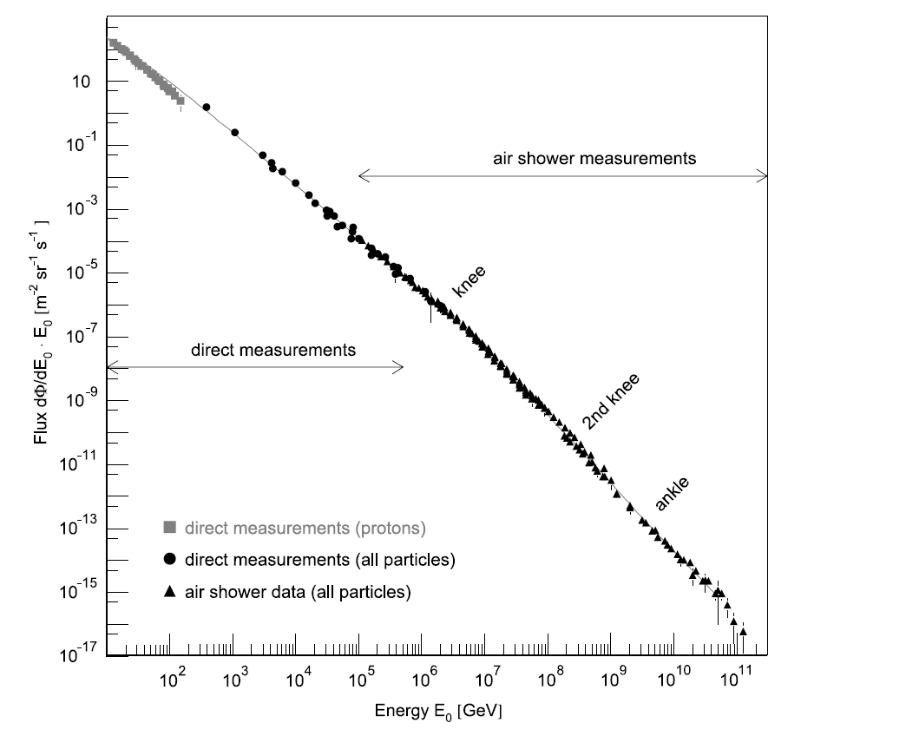
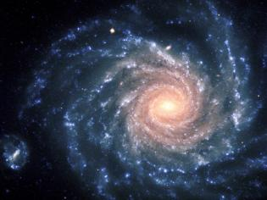
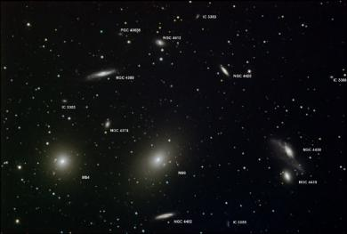
The sources of CRs (Chap. 2)
Galactic (SuperNova
Remnants- SNRs)
Power law E^{-2.7}
?
ExtraGalactic
(AGN, GRBs)
The CR “knee”
CR
Power law E^{-3.1}

Slide 23
Higher energy accelerators
To overcome the rigidity-dependent limit (6.43), the possibility has been proposed that, under particular conditions, cosmic rays suffer additional acceleration by variable magnetic fields in the acceleration region.
Candidate that can accelerate CRs up to a maximum energy of 10¹⁹ eV are galactic compact objects, as
  neutron stars (the remnant of the final stages of a massive star) or
  a binary system (a neutron star or a black hole and a complaining star)
A neutron star (NS) is a stellar remnant that can result from the gravitational collapse of a massive star (M> 8 M_{sun}).
As the core of a massive star is compressed during a supernova event, increases in the electron energy allow the reaction:
Neutrinos escape, the matter cools down, the density increases and nuclei in the center of the star become neutron-enriched.

Slide 24
{NS and BH

Slide 25
Neutron Stars (in one page)

Slide 27
Neutron Stars (in one page)
The mass of the system is given in terms of a dimensionless quantity
and the proton mass, m_{p}:
NB: The value of this value (the “Chandrasekhar mass” is 1.4 M_{sun}

Slide 28
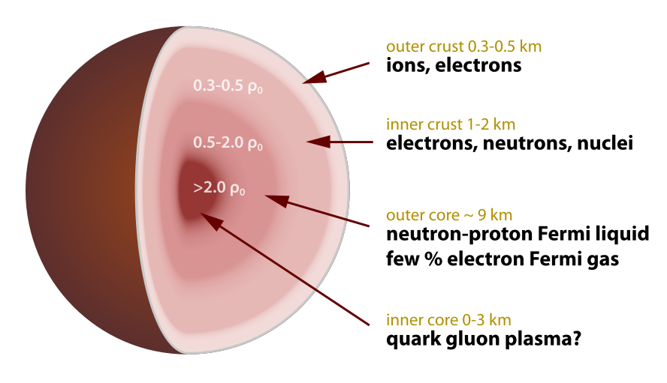
A neutron star
A Neutron Star is an object with a defined mass, M_{NS} ∼1.4M_{sun}, the Chandrasekhar mass
Its density corresponds to the density of a nucleus, 10¹⁴ g/cm³
The radius of a neutron star is thus a few km (exercise)
If the remnant star has a mass greater than the Chandrasekhar limit, it continues collapsing to form a black hole, Sect. 6.8.
The details of their structure is unknown (it depends on the Equation of state, EoS)
The maximum observed mass of neutron stars is ∼2.0M_{sun}
“Old” NS do not emit EM radiation and are very small. They are extremely difficult to observe, and the number density of NS in the Galaxy (Universe) is largely unknown
“Young” NS can have an additional characteristic…

Slide 29
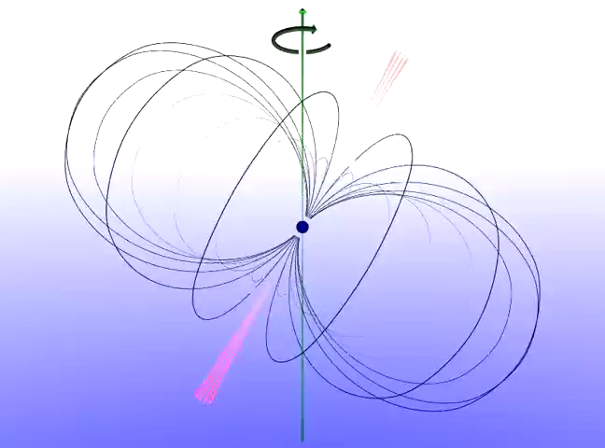
Young NS: the Pulsars
A pulsar is a rotating neutron star that emits a beam of electromagnetic radiation, typically along its magnetic axis.
They were discovered in the radio band by Hewish and Bell in 1967, and soon identified with isolated, rotating, magnetized NSs.
The key observations were the very stable, short periods of the pulses and the observation of polarized radio emission.
The radiation can only be observed when the axis is pointing towards the Earth.
More than 2,600 pulsars are known and present in the catalogue. http://www.atnf.csiro.au/people/pulsar/psrcat/
The rotation period, and thus the interval between observed pulses, is very regular, and the periods of their pulses range from 1.4 ms to 8.7 s.
This rotation slows down over time as electromagnetic radiation is emitted

Slide 30
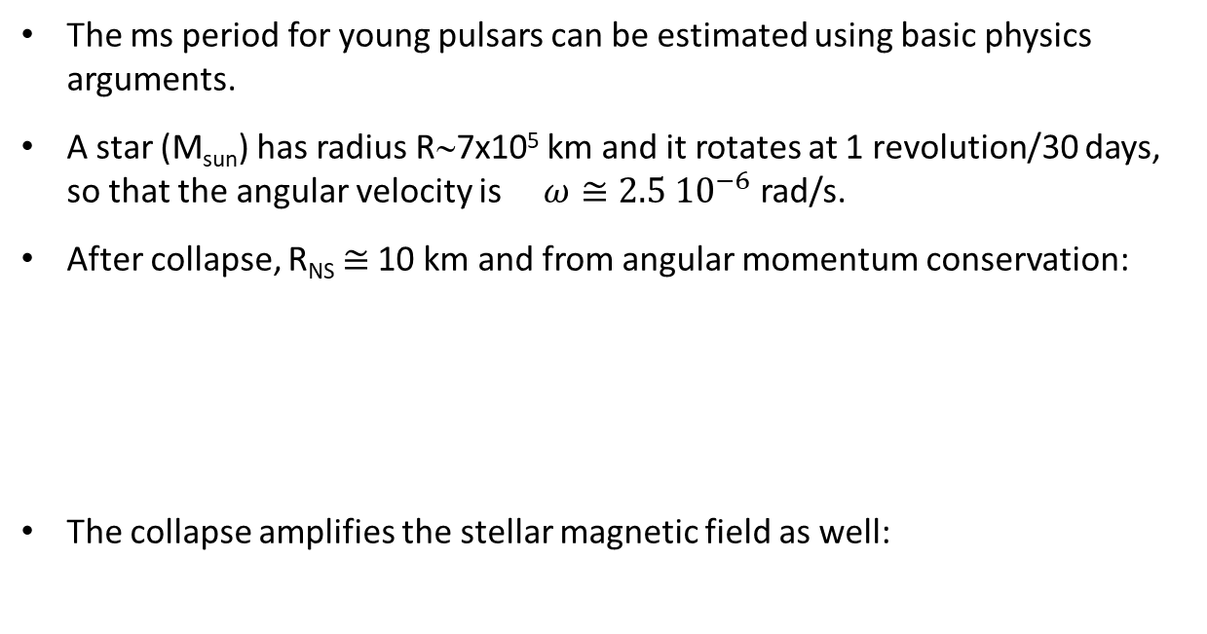
Pulsar properties
The ms period for young pulsars can be estimated using basic physics arguments.
A star (M_{sun}) has radius R∼7x10⁵ km and it rotates at 1 revolution/30 days, so that the angular velocity is $ω≅2.5{ 10}^{−6}$ rad/s.
After collapse, R_{NS} $≅$10 km and from angular momentum conservation:
The collapse amplifies the stellar magnetic field as well:
For typical values B_{star} =10³ G, the magnetic fields on the NS surface become on the order of B_{NS} = 10¹¹-10¹² Gauss.

Slide 31
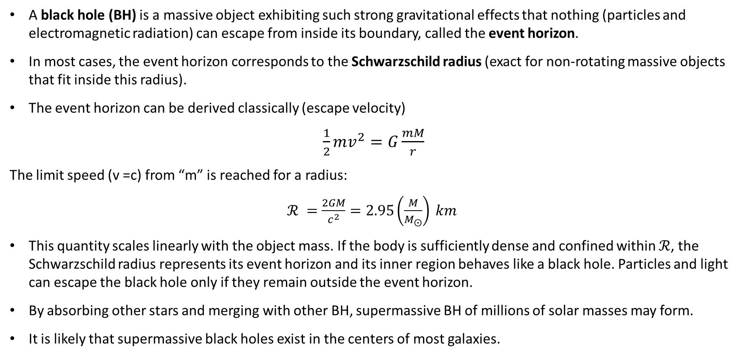
Stellar Mass Black Holes
A black hole (BH) is a massive object exhibiting such strong gravitational effects that nothing (particles and electromagnetic radiation) can escape from inside its boundary, called the event horizon.
In most cases, the event horizon corresponds to the Schwarzschild radius (exact for non-rotating massive objects that fit inside this radius).
The event horizon can be derived classically (escape velocity)
$\frac{1}{2}mv^{2}=G\frac{mM}{r}$
The limit speed (v =c) from “m” is reached for a radius:
$ℛ =\frac{2GM}{c^{2}}=2.95\left(\frac{M}{M_{⨀}}\right) km$
This quantity scales linearly with the object mass. If the body is sufficiently dense and confined within $ℛ$, the Schwarzschild radius represents its event horizon and its inner region behaves like a black hole. Particles and light can escape the black hole only if they remain outside the event horizon.
By absorbing other stars and merging with other BH, supermassive BH of millions of solar masses may form.
It is likely that supermassive black holes exist in the centers of most galaxies.

Slide 32
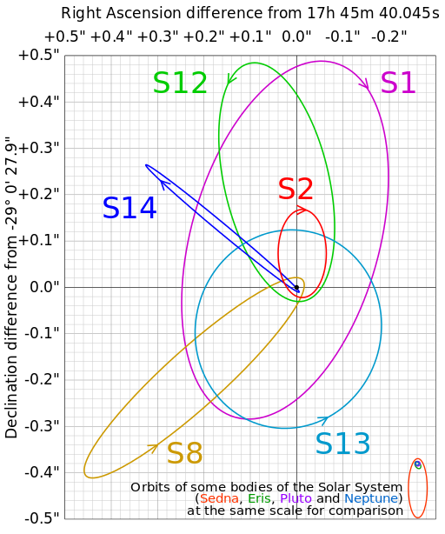
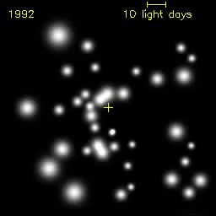
Did you ever see a SMBH? (Cap. 2)
Exercise: evaluate the BH mass

Slide 33
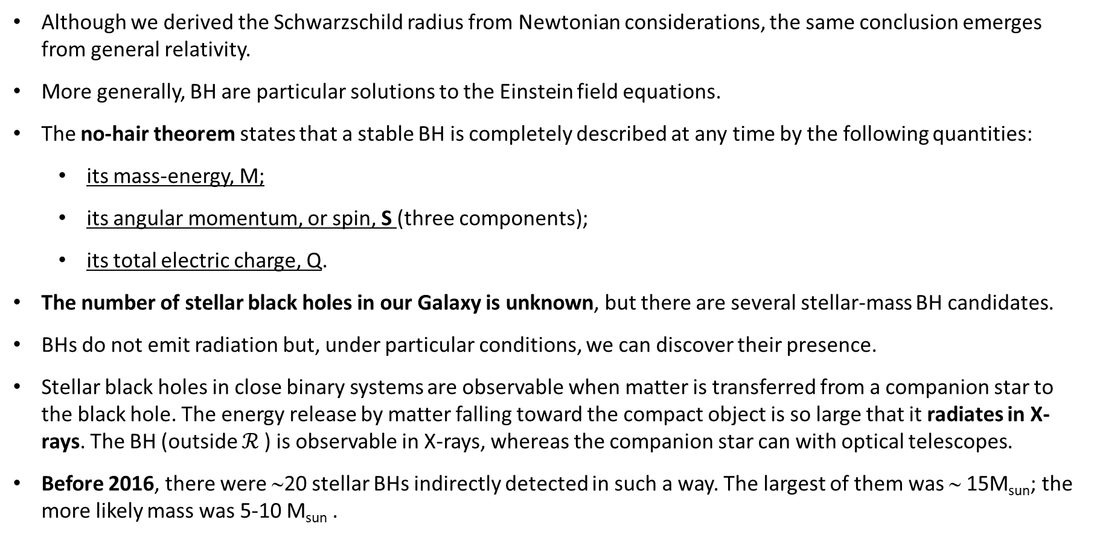
Stellar BH: observations
Although we derived the Schwarzschild radius from Newtonian considerations, the same conclusion emerges from general relativity.
More generally, BH are particular solutions to the Einstein field equations.
The no-hair theorem states that a stable BH is completely described at any time by the following quantities:
  its mass-energy, M;
  its angular momentum, or spin, S (three components);
  its total electric charge, Q.
The number of stellar black holes in our Galaxy is unknown, but there are several stellar-mass BH candidates.
BHs do not emit radiation but, under particular conditions, we can discover their presence.
Stellar black holes in close binary systems are observable when matter is transferred from a companion star to the black hole. The energy release by matter falling toward the compact object is so large that it radiates in X-rays. The BH (outside $ℛ$) is observable in X-rays, whereas the companion star can with optical telescopes.
Before 2016, there were ∼20 stellar BHs indirectly detected in such a way. The largest of them was ∼ 15M_{sun}; the more likely mass was 5-10 M_{sun} .

Slide 34
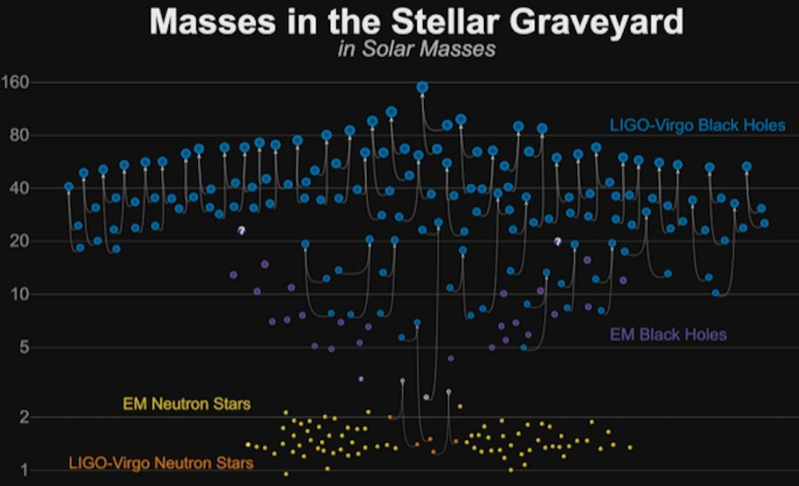
Stellar BH: observations after September 2015
On September 14th, 2015, the LIGO gravitational wave observatory made the first-ever successful observation of gravitational waves.
Starting from this observation (GW150914) , the astrophysical models of stellar evolution probably should be revised
(we return on that in Chapter 13)
https://www.youtube.com/watch?v=nawiIfudYuA

Slide 35
}

Slide 36
Possible Galactic CR Sources above the Knee
Dimensional arguments to obtain the maximum attainable energy of a charged particle near an astrophysical object with a strong, rotating magnetic field.
Remember: for the whole CR spectrum, we need order of 10⁴⁰-10⁴¹ erg/s
The power needed to accelerate CRs above the knee is three orders of magnitude smaller than that required for the whole CR spectrum (not shown. We need the diffusion equation, skipped in Chap. 5. See also Sect. 6.9)
Thus, even few powerful galactic point sources could be important
Question: does an energy flux of 10³⁸ erg/sec be a small or large quantity on the astrophysical point of view?
(Remark: this is the fundamental question for any new physical phenomena we meet, i.e., consider the energy of the system and compare with similar quantities/objects)

Slide 37
Exercise: the CRAB and Tycho SNR
Distance of the CRAB=2000 pc
Put on the right y-axis the corresponding emitted energy by the source in units of erg/s. Put in evidence the position of 10³⁷ erg/s
Do the same exercise for the Tycho SNR (2.5 kpc) in Fig. 9.14 of the book
Solution for the CRAB (displace the figure)
Answer: The factor 4πr² for 2000 pc correspond to 5 10⁴⁴ cm², and the energy flux must be multiplied by this factor. Thus 2x10⁻⁸ erg/(s cm²) corresponds to 10³⁷ erg/s
Exercise: found the error in the previous answer
Multiwavelength observations of the Crab nebula. Refer to Chap. 8 for details

Slide 38
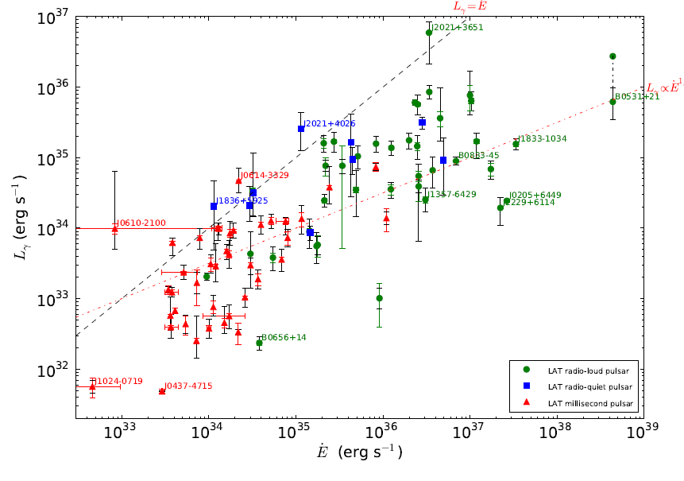
Luminosity in the gamma-ray band
Observed luminosity of binary system and pulsars in gamma-rays from the Fermi-LAT vs. energy loss
Exercise: estimate the pulsar’s lifetime
Fig. 9 from “The Second Fermi Large Area Telescope Catalog of Gamma-ray Pulsars.” https://arxiv.org/abs/1305.4385
Astrophysical Journal Supplement 208, 17 (2013)

Slide 39
A Simple Model Involving Pulsars
High magnetic fields spinning around the nonaligned axis of rotation will produce strong electric fields E through Faraday’s law (6.1), i.e., order of:
the maximum energy E_{max} gained from a particle passing close to a pulsar rotating with angular velocity ω_{NS} over the length L∼R_{NS} is
Using the derived value of the magnetic field and with (ω_{NS}R_{NS}/c) ∼ 0.1
Thus, some galactic accelerators could explain the presence of CRs with energies up to ∼ 10¹⁸ - 10¹⁹ eV.
A similar model holds for microquasars (binary systems, see § 6.9.2)

Slide 40
Which model for 10¹⁵<E_{CR}<10¹⁹ eV is the correct one?
?

