Slide 1
VII.
The Extragalactic Sources and Ultra High
Energy Cosmic Rays
Astroparticle Physics a.a. 2024/25
Maurizio Spurio
Università di Bologna e INFN
maurizio.spurio@unibo.it

Slide 2
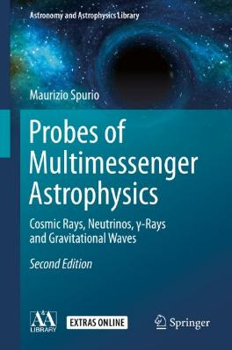
Content

Slide 3
Anisotropy of UHECRs: Extragalactic Magnetic Fields
CR with energies above 10¹⁹ eV are usually referred as Ultra High Energy CRs (UHECRs)
Magnetic fields affect the propagation of UHECRs: charged particles are deflected, emitting synchrotron radiation.
For protons, synchrotron losses are negligible, except close to sources.
Above 10¹⁹ eV, the galactic magnetic field would not even trap iron nuclei very effectively. This motivated the idea of extragalactic sources of CRs.
Extragalactic magnetic fields are very little known (only upper limits known)
Simulated trajectory of CRs in the galactic magnetic field. Low-energy charged particles are bent by magnetic fields, but those above 10²⁰ eV travel along almost straight trajectories

Slide 4
{
Observational cosmology

Slide 5
The Large-Scale Structure of the Universe
Slices through the 3-dimensional map of the distribution of galaxies from the Sloan Digital Sky Survey (SDSS).
The Earth is at the center; each point represents a galaxy (∼ 10¹¹ stars each).
The position of that point indicates its location in the sky, and the distance from the center of the image indicates its distance from the Earth.
Galaxies are colored according to the ages of their stars, the redder are older.
The outer circle is at a distance of about 2x10⁹ light years.
The region not mapped is because dust in our own Galaxy. The lower part of the figure is thinner than the upper, thus it contains fewer galaxies.
Another group completed a similar survey of the galaxies in the Universe called the 2 dF Redshift Survey.
Credit: M. Blanton and the SDSS
https://www.sdss3.org/science/gallery_sdss_pie2.php

Slide 6
Hubble’s Law (I)
Observational cosmology consists of the study of the structure, the evolution and the origin of the Universe through experimental measurements.
The Hubble’s observations correlate the luminosity distance D_{L} to galaxies and their velocities, measured through the Doppler shift (z) of the emission wavelengths.
This shift can be measured because the emission/absorption spectra for atoms and molecules are distinctive and well known.
(7.1)
The discovery of a linear relation between the z and D_{L} of a Galaxy, coupled with the assumption of a linear relation between v (in km/s) and z, yields the expression for the Hubble’s Law:
The Hubble constant, H₀, has physical dimensions of [time⁻¹]. Its value is H₀ ∼70 [km/s]/Mpc
The Hubble “constant” is a constant only in space, not in time (“0” indicates “today”)
The reciprocal of H₀ is called the Hubble time and corresponds to τ_{H0} = 1/H₀ =13.7 Gy.
A plot of the luminosity distance DL vs. redshift z is usually referred to as the Hubble diagram. The right plot shows the deviation from the linear relation (7.2) at high z.

Slide 7
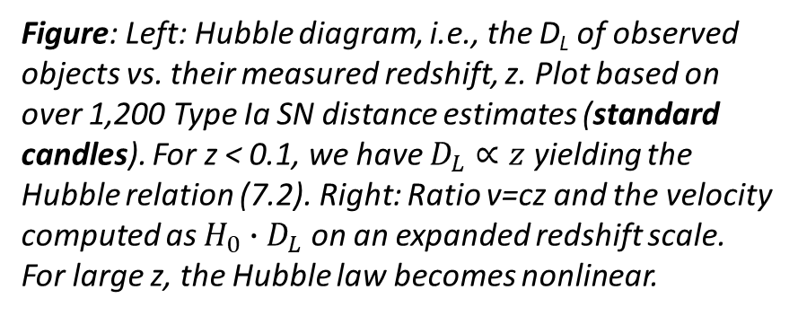
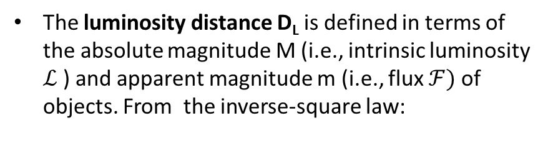
Hubble’s Law (II)
The luminosity distance D_{L} is defined in terms of the absolute magnitude M (i.e., intrinsic luminosity $ℒ$) and apparent magnitude m (i.e., flux $ℱ)$ of objects. From the inverse-square law:
Figure: Left: Hubble diagram, i.e., the D_{L} of observed objects vs. their measured redshift, z. Plot based on over 1,200 Type Ia SN distance estimates (standard candles). For z < 0.1, we have $D_{L}∝z$ yielding the Hubble relation (7.2). Right: Ratio v=cz and the velocity computed as ${H_{0}∙D}_{L}$ on an expanded redshift scale. For large z, the Hubble law becomes nonlinear.
For cosmological distances, particular care must be taken, because the D_{L} is affected by relativistic effects such as spacetime curvature, redshift and time dilation.

Slide 8
The Cosmic Microwave Background Radiation (CMBR)
A second fundamental step in modern cosmology was the discovery of the CMBR, predicted in 1948 by G. Gamow and R. Alpher, as a consequence of a hot origin of the Universe.
In 1965, A. Penzias and R. W. Wilson (Nobel Prize in 1978), discovered in a radiometer an excess of signal equivalent to a 3.5K antenna temperature.
The COBE satellite found that the CMB has a thermal black body spectrum with
The average number density of CMB photons is given by the Planck spectrum;
The WMAP and Planck space mission improved measurements
The most-precisely measured black body spectrum in nature: CMBR spectrum measured by the FIRAS on the COBE (blue points) as a function of ν and λ.

Slide 9
The Planck Map of CMB temperature (2018)

Slide 10
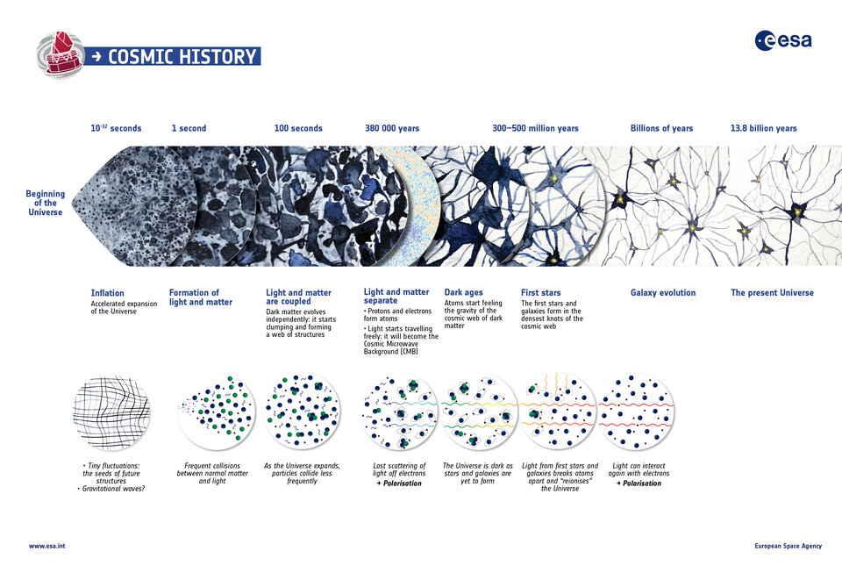

Slide 11
https://arxiv.org/pdf/1807.06209.pd
Baryon density
Cold dark matter density
Hubble's constant (km Mpc⁻¹ s⁻¹)
Dark energy density
Matter density
Redshift of reionization
Age of the Universe (Gy)
Redshift at decoupling

Slide 12
}

Slide 13
A Simple Model Involving Pulsars (Chap. 6)
High magnetic fields spinning around the nonaligned axis of rotation will produce strong electric fields E through Faraday’s law (6.1), i.e., order of:
the maximum energy E_{max} gained from a particle passing close to a pulsar rotating with angular velocity ω_{NS} over the length L∼R_{NS} is
Using the derived value of the magnetic field and with (ω_{NS}R_{NS}/c) ∼ 0.1
Thus, some galactic accelerators could explain the presence of CRs with energies up to ∼ 10¹⁸ - 10¹⁹ eV.
A similar model holds for microquasars (binary systems, see § 6.9.2)

Slide 14
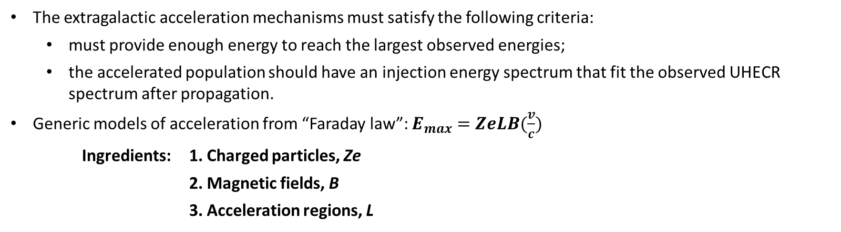
The Quest for Extragalactic Sources of UHECRs
The extragalactic acceleration mechanisms must satisfy the following criteria:
  must provide enough energy to reach the largest observed energies;
  the accelerated population should have an injection energy spectrum that fit the observed UHECR spectrum after propagation.
Generic models of acceleration from “Faraday law”: $E_{max}=ZeLB(\frac{v}{c})$
Ingredients: 1. Charged particles, Ze
2. Magnetic fields, B
3. Acceleration regions, L
Electric fields through the Faraday law that can supply a consequent amount of energy: the E^{max} of a CR of charge Ze, accelerated in a region where the magnetic field B changes in a spatial region of size L is (see previous page):
Using the conversion from erg to eV:

Slide 15
The Hillas Plot
Eq. (7.10) defines the Hillas criterion for CR sources
In the figure, several possible galactic and extragalactic acceleration sources are considered. Among them:
  AGN
  Gamma Ray Bursts (GRBs)
  Magnetars
Example of the Hillas plot. Acceleration of CRs up to a given energy requires magnetic fields and sizes above the respective line. The full (dashed) line corresponds to the condition for B,L to accelerate protons (iron) at 10²⁰ eV. Some source candidates are still controversial

Slide 16
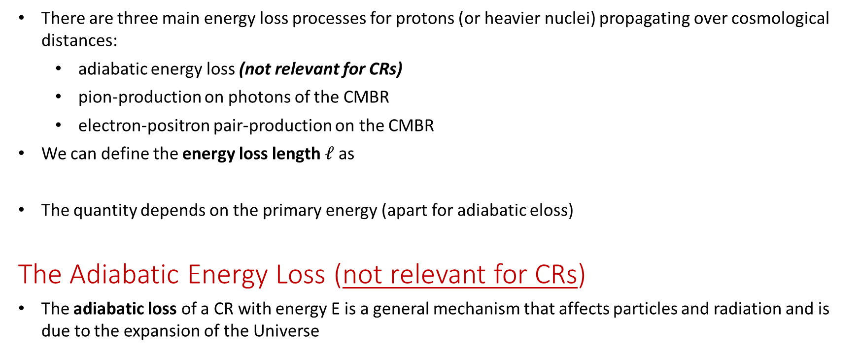
Energy loss of UHECRs in propagation
There are three main energy loss processes for protons (or heavier nuclei) propagating over cosmological distances:
  adiabatic energy loss (not relevant for CRs)
  pion-production on photons of the CMBR
  electron-positron pair-production on the CMBR
We can define the energy loss length $ℓ$as
The quantity depends on the primary energy (apart for adiabatic eloss)
The Adiabatic Energy Loss (not relevant for CRs)
The adiabatic loss of a CR with energy E is a general mechanism that affects particles and radiation and is due to the expansion of the Universe
and thus

Slide 17
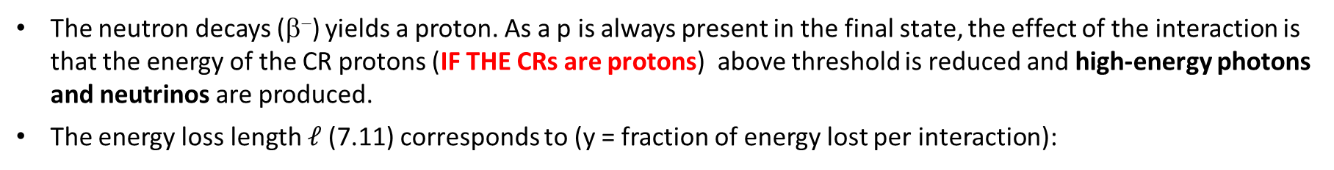
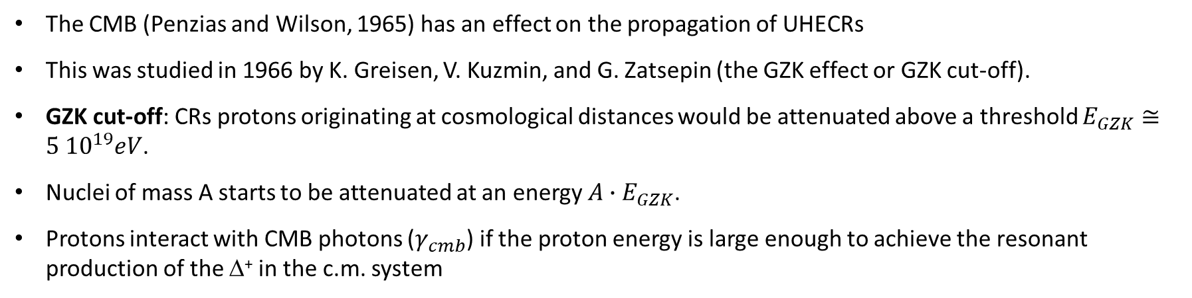
The Propagation in the CMB: The possible GZK Cut-Off
The CMB (Penzias and Wilson, 1965) has an effect on the propagation of UHECRs
This was studied in 1966 by K. Greisen, V. Kuzmin, and G. Zatsepin (the GZK effect or GZK cut-off).
GZK cut-off: CRs protons originating at cosmological distances would be attenuated above a threshold $E_{GZK}≅5 {10}^{19}eV$.
Nuclei of mass A starts to be attenuated at an energy ${A∙E}_{GZK}$.
Protons interact with CMB photons ($γ_{cmb}$) if the proton energy is large enough to achieve the resonant production of the Δ⁺ in the c.m. system
The Δ⁺ immediately decays; the π⁰ decay in two photons, while the π⁺ decays into μ+ν_{μ}.
The neutron decays (β⁻) yields a proton. As a p is always present in the final state, the effect of the interaction is that the energy of the CR protons (IF THE CRs are protons) above threshold is reduced and high-energy photons and neutrinos are produced.
The energy loss length $ℓ$(7.11) corresponds to (y = fraction of energy lost per interaction):

Slide 18
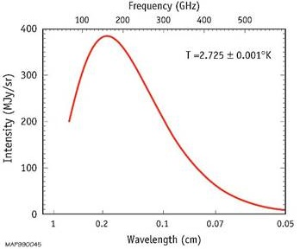
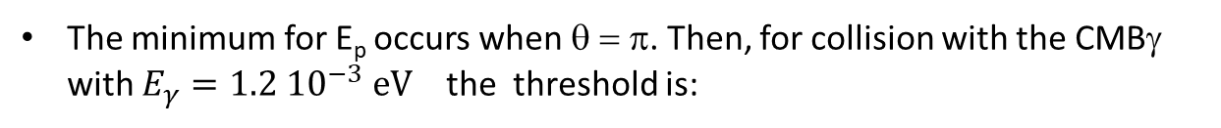
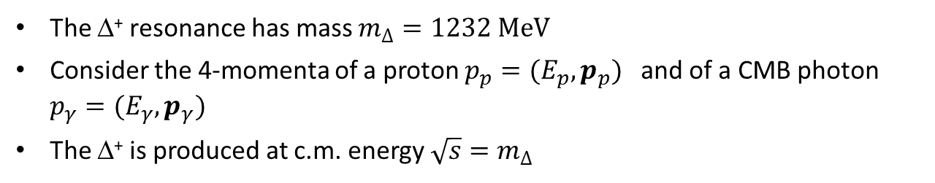
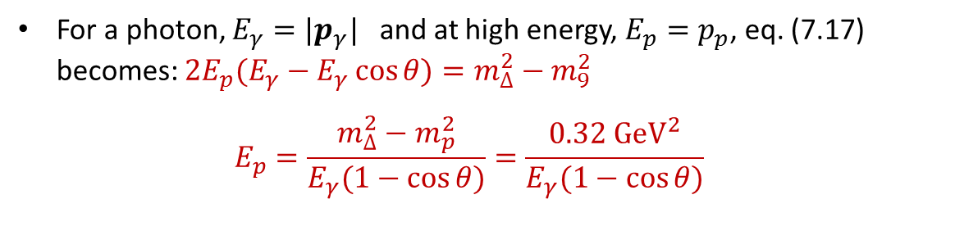
Exercise: kinematics of the GZK Cut-Off
We derive now the threshold energy for protons to induce this reaction and their mean free path.
The Δ⁺ resonance has mass $m_{∆}=1232 MeV$
Consider the 4-momenta of a proton $p_{p}=(E_{p},p_{p})$ and of a CMB photon $p_{γ}=(E_{γ},p_{γ})$
The Δ⁺ is produced at c.m. energy $\sqrt{s}=m_{∆}$
CMBR
For a photon, $E_{γ}=|p_{γ}|$ and at high energy, $E_{p}=p_{p}$, eq. (7.17) becomes: $2E_{p}(E_{γ}−E_{γ}\cos{θ)=m_{∆}^{2}−m_{9}^{2}}$
$$E_{p}={\frac{m_{∆}^{2}−m_{p}^{2}}{E_{γ}(1−\cos{θ)}}=\frac{0.32 {GeV}^{2}}{E_{γ}(1−\cos{θ)}}}_{}$$
The minimum for E_{p} occurs when θ = π. Then, for collision with the CMBγ with $E_{γ}=1.2 {10}^{−3} eV$ the threshold is:
The threshold E_{p} decreases when the interaction occurs with higher energy CMBγ. The effect starts to become significant for protons with E_{p} = 5x10¹⁹ eV.

Slide 19
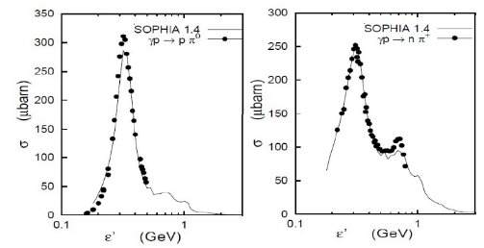
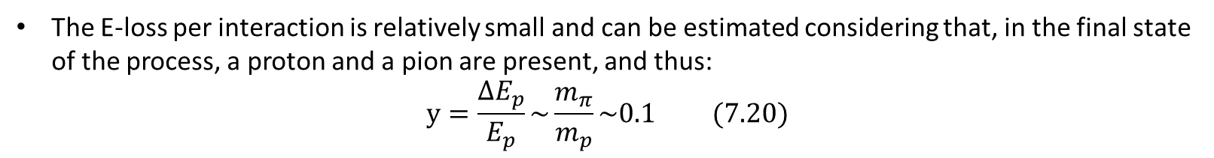
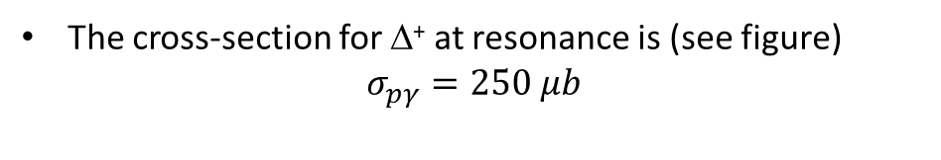
Exercise: the energy loss length
The cross-section for Δ⁺ at resonance is (see figure)
$$σ_{pγ}=250 μb$$
The E-loss per interaction is relatively small and can be estimated considering that, in the final state of the process, a proton and a pion are present, and thus:
$$y=\frac{∆E_{p}}{E_{p}}\sim \frac{m_{π}}{m_{p}}\sim 0.1 (7.20)$$
Within a few interactions, the p energy decreases to a value below the threshold for the reaction.
The energy loss length (7.16) corresponds to
All protons originating at D>30 Mpc arrive on Earth with energy below 10²⁰ eV.
This horizon is small in terms of the dimensions of the Universe.

Slide 20
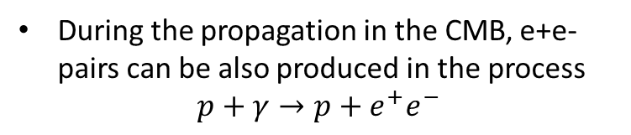
Proton energy losses vs. E
During the propagation in the CMB, e+e- pairs can be also produced in the process
$$p+γ→p+e^{+}e^{−}$$
The energy loss lengths for this process can be computed similarly to that of the GZK.
The Figure compares the relative contributes of the three considered processes
The energy loss lengths (7.16) for a high-energy proton propagating through the CMB radiation field. Pair creation, photo-pion production, and energy loss through cosmological expansion (7.13) are shown

Slide 21
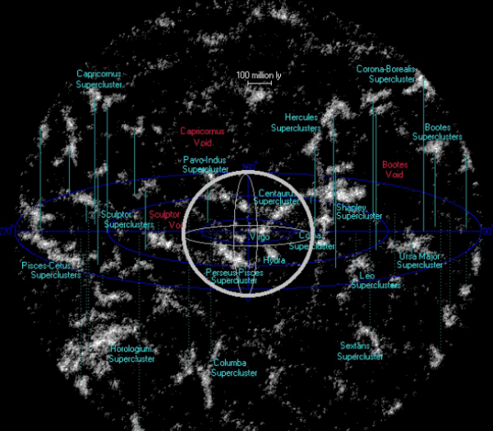
The CR protons horizon
The neighboring superclusters of galaxies (<300 Mpc)
There are about 100 superclusters and about 3 10⁶ large galaxies.
The central sphere corresponds to 100 Mpc (>GZK limit)
Are UHECR protons?
A beautiful web site designed to give an idea of what our universe looks like at different scales, created by R. Powell:
http://www.atlasoftheuniverse.com/

Slide 22
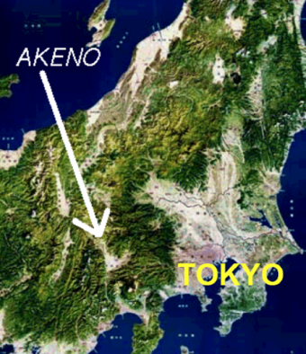
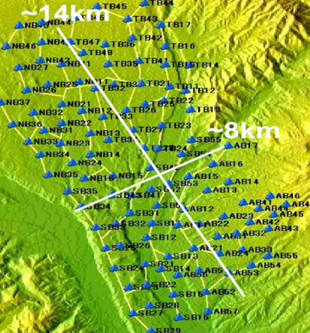
UHECRs detection methods: I) EAS
Two techniques are employed to detect UHECRs.
The first extends the use of EAS arrays (Chapter 4) to energies above 10¹⁸ eV. The pioneering experiment AGASA (Japan) took data between 1984 and 2003.
AGASA consisted of 111 scintillation counters, each of 2.2m², placed at a distance of 1 km from each other and covering an effective surface of 100 km².
The layout of the Akeno Giant Air Shower Array (AGASA)

Slide 23
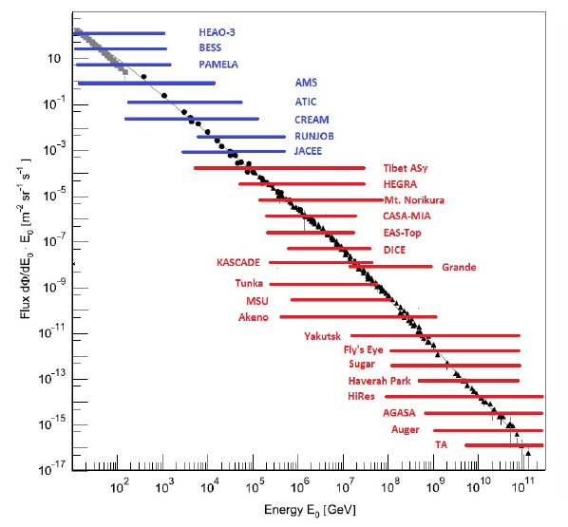
Our toy detector (Chap. 4)
Toy

Slide 24
UHECRs detection methods: II) Fluorescence
The second exploits the excitation of nitrogen molecules by charged particles in the shower and the associated fluorescence emission of light.
The light is detected by photomultipliers and the profile of the shower in the atmosphere can be inferred rather directly by ground detectors.
The limitation of this type of detectors is that they may only operate in clear, moonless nights. Any spurious source of light would be a problem.

Slide 25
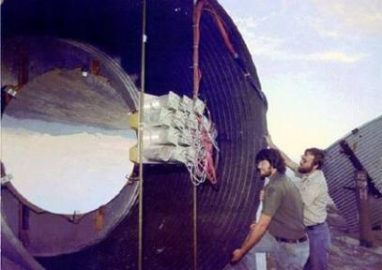
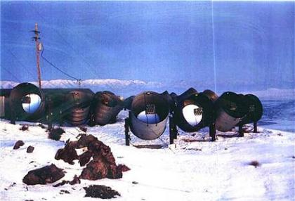
Fluorescent Light and Fluorescence Detectors
Fluorescent emission is isotropic: the air showers can be observed from all directions
The observations allow us to follow the development of the shower and to evaluate the position of maximum in the atmosphere, X_{max}.
To record the longitudinal development, many PMTs, closely packed together, pointing towards different but adjacent regions are used.
One of the 67 PMTs in the Fly’s Eye experiment and the layout

Slide 26
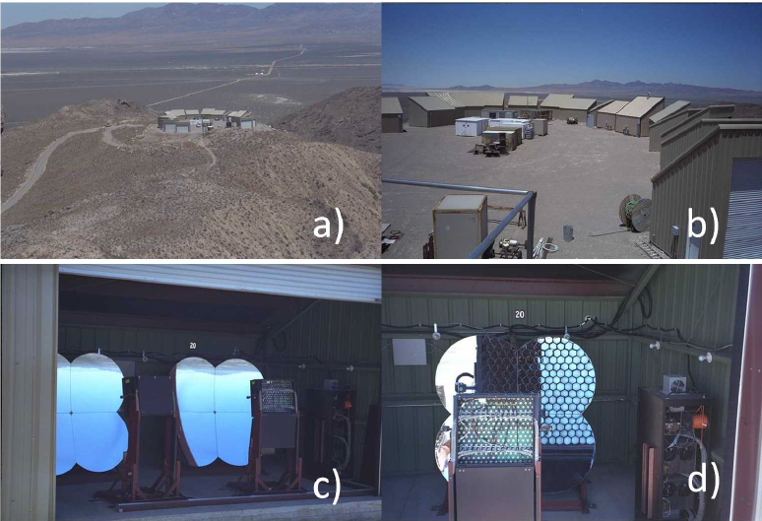

High Resolution Fly’s Eye detector (HiRes), (Utah)

Slide 27
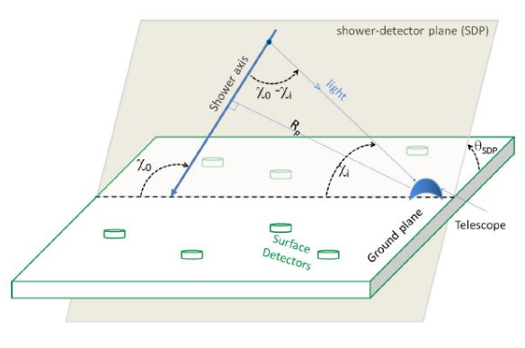
Detection principles of a fluorescence detector
Fluorescence detectors use large spherical mirrors to improve light collection.
The light is then focused on an array of small PMTs.
Whit only one array, ambiguous solutions can be found. If more than one telescope is available, each telescope provides its own shower-detector plane, and the geometry of the shower axis is constrained to within a fraction of a degree.
This technique, first used by HiRes, is known as stereo reconstruction.
Another possibility is to complement the fluorescence detector with a surface shower detector. This independently provides the position of the impact point of the shower on the ground.
This, known as the hybrid technique, used in both the Pierre Auger (PAO) and Telescope Array (TA) experiments.

Slide 28
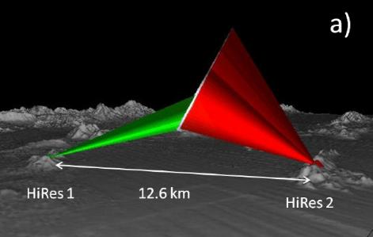
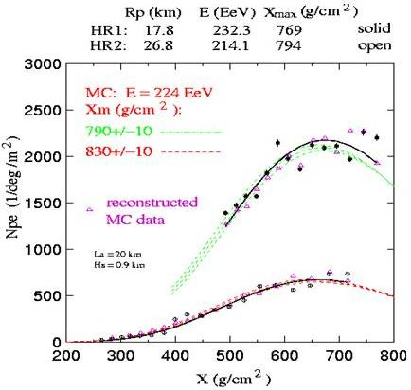
The highest energy HiRes stereo event
∼ 10²⁰ eV
Note: this event has a reconstructed energy >10²⁰ eV.
After calibration, the total energy is slightly reduced below 10²⁰ eV (see figure next page)

Slide 29
Experimental status before 2007
HiRes results were compatible with no events > 10²⁰ eV, in agreement with the GZK
AGASA has observed 11 events above 10²⁰ eV with zenith<45º.
NOTE: This plot contains OLD data
Differently from HiRes, AGASA results seemed to indicate that the energy spectrum continues without discontinuity beyond 5x10²⁰ eV, in violation of the GZK effect
One possible explanation for the discrepancy between the two experiments is a possible bias regarding the energy assignment of the parent CR from one (or both) of the two methods.
The use of hybrid detectors was mandatory → PAO and TA
AGASA
HIRES

Slide 30
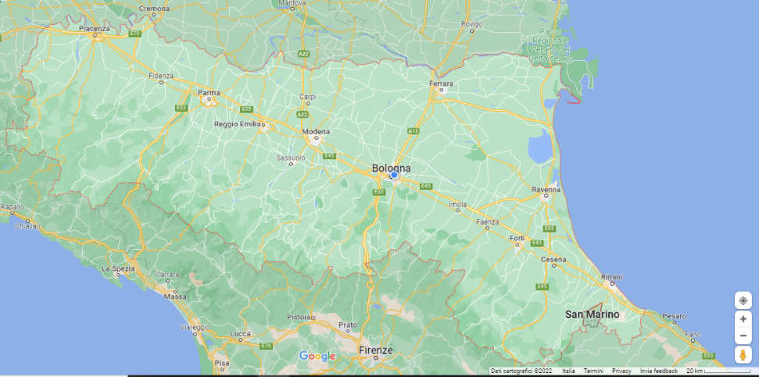
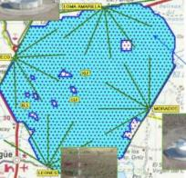
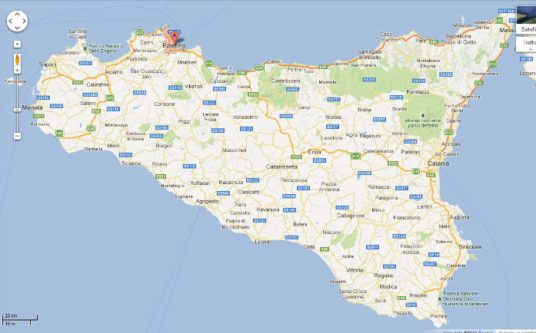

The Pierre Auger Observatory (PAO)- 2008→
70 km
For Italian students.
The AUGER experiment is in Argentina !
Just for the dimension of the detector. PAO is not in Emilia Romagna

Slide 31

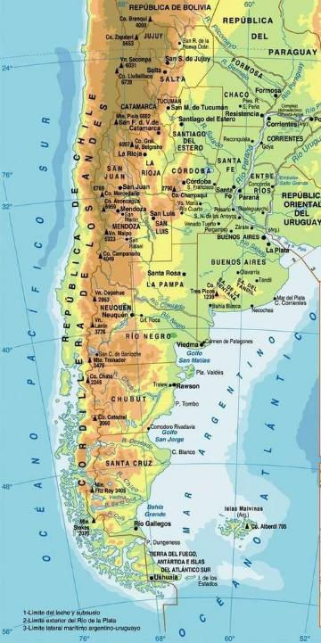
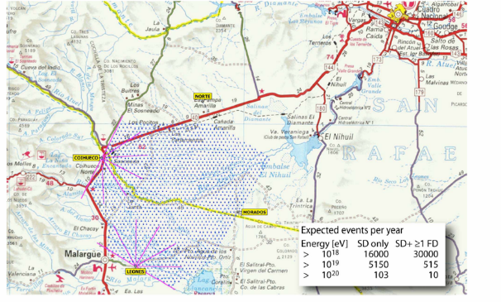
PAO

Slide 32
The Pierre Auger Observatory (PAO)
The Pierre Auger Observatory (PAO) was completed in 2008. Still in data taking, with some improvements
The layout of the PAO consists of a surface detector (SD) array, with 1,600 water Cherenkov detectors spaced by 1.5 km on a grid covering an area of 3,000 km².
Each tank of the SD array has a 10m² surface and 1.2m depth of purified water. Each station is equipped with three PMTs to measure the Cherenkov light and:
Flash Analog-Digital Converters
electronic cards (control/trigger)
a solar panel and two batteries
a GPS receiver, time tagging
a custom radio emitter and receiver for data transfer.

Slide 33
The Surface Detector (SD) Array (particular)

Slide 34
The Surface Detector (SD) Array of PAO
The SD has a 100% duty cycle and the height of the individual SD tanks allows to detect muons with also excellent sensitivity to horizontal showers.
Left: zoomed view of the PAO SD interested by a cascade. The quantity is expressed in terms of a vertical equivalent muon (VEM) crossing a tank. The concentric lines represent the distance from the axis shower with an equal number of particles, obtained after reconstruction.
Right: fit of the event using the Auger Lateral Distribution Function. On the y-axis, the signal in units of VEM is proportional to the signal density ρ = particles/cm² vs. the distance from the axis shower.

Slide 35
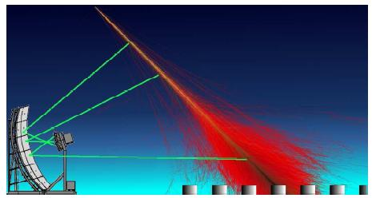
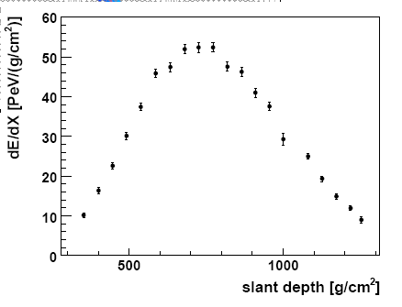
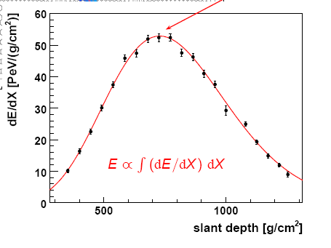
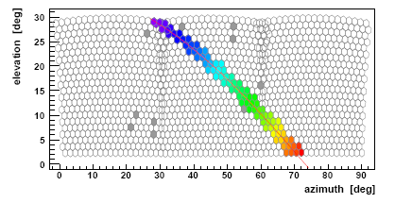
The Fluorescence Detector (FD) of the PAO
The PAO uses four sites, “eyes”.
Their geometrical arrangement ensures full detection efficiency for showers from primaries with E > 10¹⁹ eV over the entire surface of the array.
The primary CR energy is determined by the FD in a calorimetric way using the reconstructed energy deposited along the shower’s profile

Slide 36
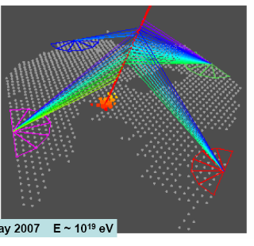
Hybrid Events
Energy scales. The sub-sample of EAS recorded by both the FD and the SD is used to relate the energy reconstructed with the FD, to that used by the SD. The energy scale inferred from this data sample is applied to all showers detected by the SD array.

Slide 37
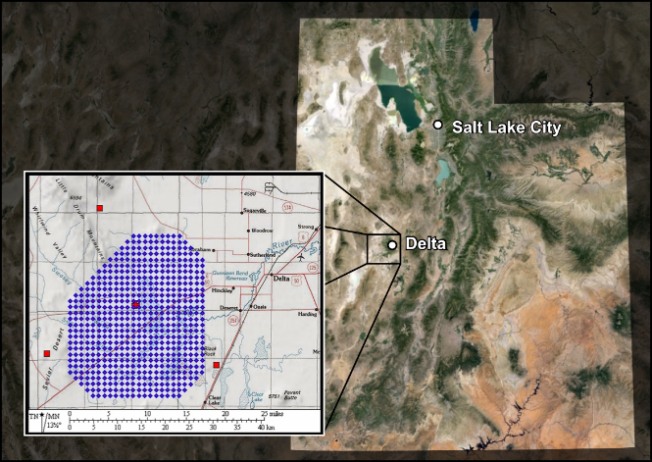
The Telescope Array (Utah)
http://www.telescopearray.org/

Slide 38
UHECRs spectrum from AUGER

Slide 39
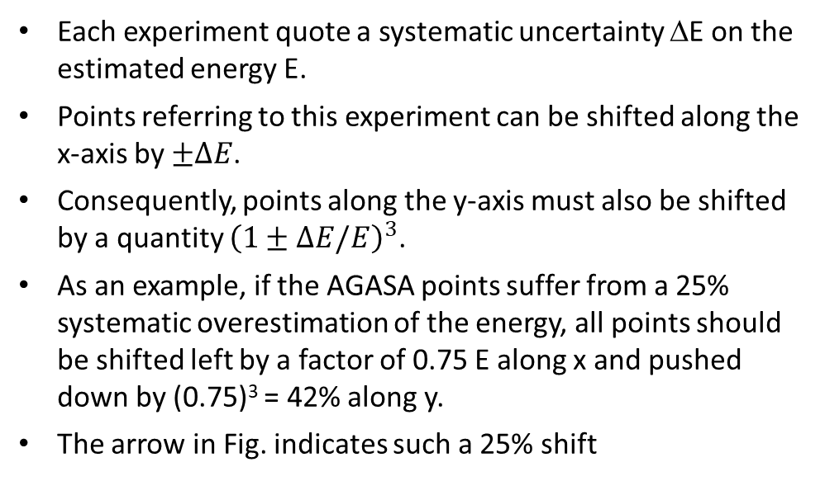

Summary of the results (and a warning!)
Beware of the plots. It is common to present the CR flux (power law) multiplied by E^{k} .
In this representation, features such as the ankle at 10^{18.5} eV are more evident.
Scaling the flux with energy to some power could induce a bias regarding the interpretation of the results from the visual inspection of the figure. Let consider the case k=3, as in this figure.
Each experiment quote a systematic uncertainty ΔE on the estimated energy E.
Points referring to this experiment can be shifted along the x-axis by $±ΔE$.
Consequently, points along the y-axis must also be shifted by a quantity ${\left(1±ΔE/E\right)}^{3}$.
As an example, if the AGASA points suffer from a 25% systematic overestimation of the energy, all points should be shifted left by a factor of 0.75 E along x and pushed down by (0.75)³ = 42% along y.
The arrow in Fig. indicates such a 25% shift
$$2ΔE$$

Slide 40
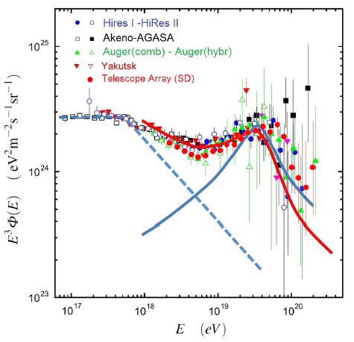
Data and Possible source models (one example!)
The same data, after rescaling the energy of the experiments to obtain a common position of “dip” at 5x10¹⁸ eV.
The nominal energy scales multiplied by 1.2 (Auger), 1.0 (HiRes), 0.75 (AGASA), 0.95 (TA) and 0.625 (Yakutsk)
Predictions
Red: “dip model”, due to extragalactic p.
Blue line: “superposition model” with a galactic (dashed) + extra-galactic component (full line)
The softening of the spectrum at E> 5x10¹⁹ eV observed by HiRes, PAO and TA is consistent with the GZK effect,
BUT, It does not necessarily represent a proof that the cut-off has been discovered. The GZK cut-off at ∼10²⁰ eV implies that UHECRs are protons, and not heavier nuclei
Before
propagation

Slide 41
The Chemical Composition of UHECRs
The determination of charge (or mass) of the incoming primary UHECRs is difficult.
Shower-to-shower fluctuations prevent the individual measurement of mass number, A.
The general features of a heavy nuclei cascade are (Sect. 4.4.4):
  (i) the showers reach their maximum development, X_{max}, higher in atmosphere,
  (ii) they generate more muons than showers induced by a proton primary of equivalent energy.
The discrimination between the arrival of a proton or that of a heavier nucleus relies thus on the observation of either the longitudinal development of a shower or by the simultaneous determination of the EM and muonic components of EAS at ground level.
Unfortunately, the fluorescence technique can be used only on clear, moonless nights and suffers from the lack of statistics at the highest energies.
The first analysis of the X_{max} vs. energy with fluorescence detector data was done with the Fly’s Eye, then by HiRes and followed by PAO and TA

Slide 42
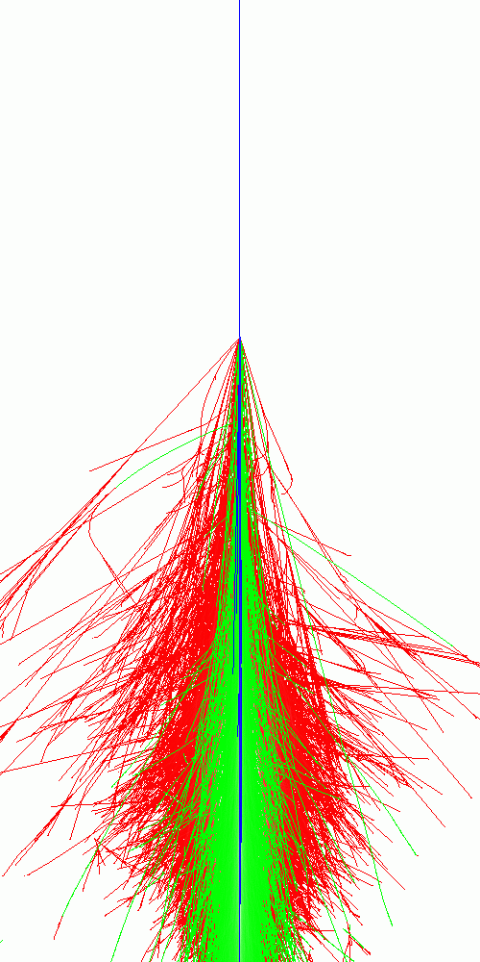
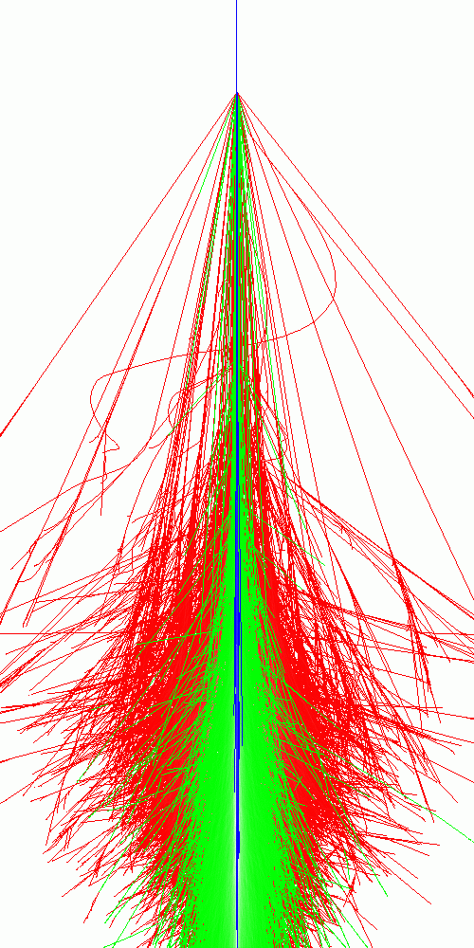
50 km
CORSIKA Simulation [QGSJET/EGS4]
proton
E₀=10¹⁴ eV
iron nucleus
40 km
30 km
20 km
10 km
e/γ
μ
h
10 km

Slide 43
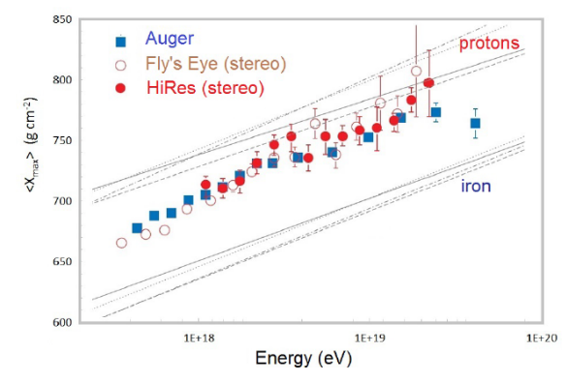
The X_{max} measurement for UHECRs (2018)
The HiRes result suggested a quick transition from heavy to light cosmic ray composition above a few 10¹⁸ eV.
The Telescope Array measurement (not shown) is consistent with that of HiRes.
The PAO results are somewhat in disagreement with those of HiRes and TA. In their data, the CR composition becomes lighter up to 2x10¹⁸ eV and then consistently heavier up to the highest energy measured.
The chemical composition of UHECRs is unknown, although PAO suggests a significant fraction of heavy nuclei.
Work for future generations of physicists
PoS(UHECR2024)041

Slide 44
Mass Composition of CRs Around the Knee (Chap. 4)
As discussed, it is particularly difficult to determine the mass number, A
At least two independent quantities have to be measured to estimate energy and mass of the primary CR that initiated the EAS.
In addition to the shower size Ne, the position X_{max} of the maximum or the muon size Nμ are usually observed.
The measurement is difficult on a shower-to-shower basis, due to the intrinsic fluctuation (at a fixed Ne) of X_{max} and Nμ.
Unfolding methods are usually employed

Slide 45
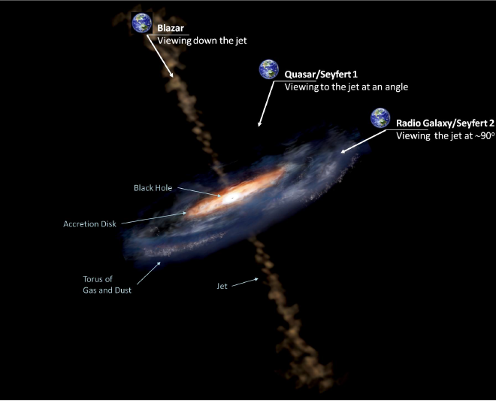
Sources?

