Slide 1
IX.
The TeV Sky and
Multiwavelength Astrophysics
Astroparticle Physics a.a. 2023/24
Maurizio Spurio
Università di Bologna e INFN
maurizio.spurio@unibo.it

Slide 2
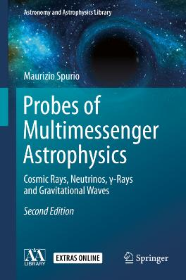
Content

Slide 3
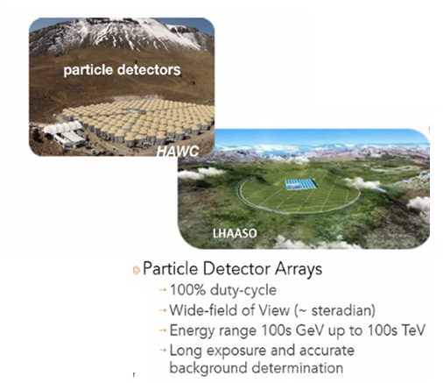
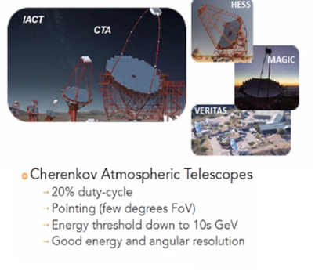
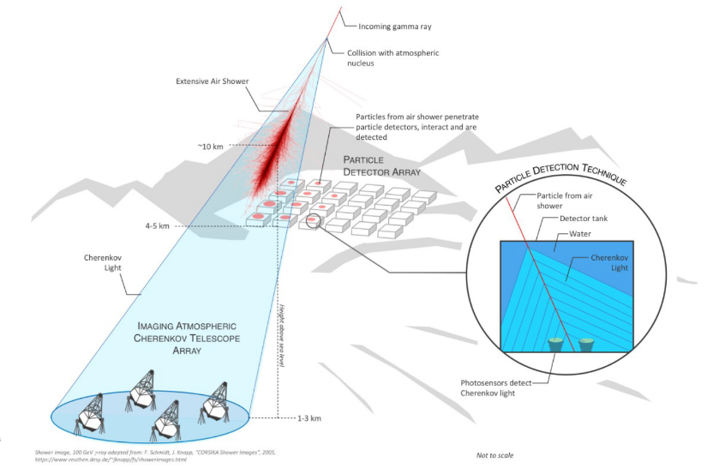
γ-rays on ground: two methods

Slide 4
Detecting γ-rays on ground: the Cherenkov technique
The Earth’s atmosphere is opaque to high-energy γ-rays (X₀ ∼40 gcm⁻²) → e⁺e⁻
Charged particles at ground can be measured with detectors; the main task is the discrimination between CR-induced and γ-ray induced showers.
Secondary charged particle in the shower produces Cherenkov light at the Cherenkov angle θ, with cosθ = 1/βn, if its velocity exceeds the threshold β=v/c > n (Chap. 11)
Thus, γ-ray induced showers can be detected also with Cherenkov telescopes.
As n∼1 in air, the Cherenkov angle is small (from 0.66º to 0.74º): this results in a focusing of light onto the ground into a ring-like region with typically R∼ 120 m.
Atmospheric Cherenkov detectors are of 2 types: sampling and imaging telescopes. The latter relies on the detection on the ground of the images of the Cherenkov light.
From the measurement, it is determined the longitudinal and lateral development of the EM showers → the arrival direction and energy of the primary γ-rays.
Imaging Cherenkov are essentially wide-field optical telescopes consisting of a large reflector of about 10m radius, reflecting the light (the image) into a high-speed multi-PMT camera in the focal plane.
Short exposures (less than 30 ns) are required to detect the faint flashes of Cherenkov light against the Poisson fluctuation in the night-sky background.

Slide 5
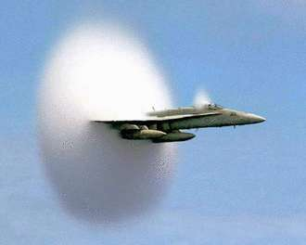
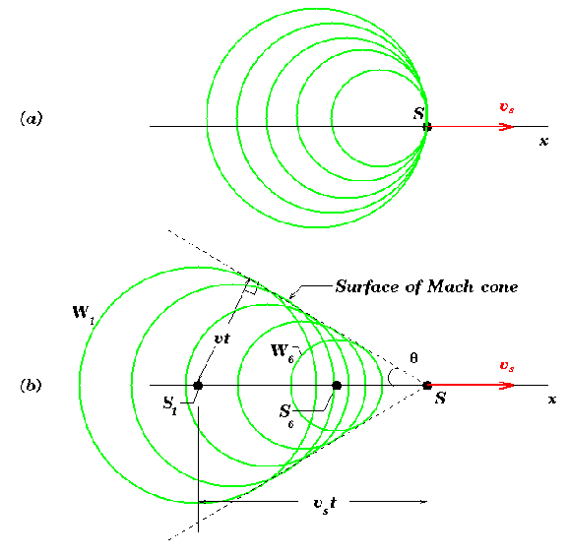
Cherenkov Radiation
As a charged particle travels, it disrupts the local electromagnetic field (EM) in a medium.
Electrons in the atoms of the medium will be displaced and polarized by the passing EM field of a charged particle.
Photons are emitted as an insulator's electrons restore themselves to equilibrium after the disruption has passed.
In a conductor, the EM disruption can be restored without emitting a photon.
In normal circumstances, these photons destructively interfere with each other and no radiation is detected.
However, when the disruption travels faster than light is propagating through the medium, the photons constructively interfere and intensify the observed Cerenkov radiation.

Slide 6
Cherenkov Radiation
Threshold velocity β_{T} = 1/n → θ_{T} ~ 0
Angle of emission (β=1): θ_{max}= arcos(1/n)
Distribution of emitted photons:
Question: Evaluate the number of Cherenkov photons in water (n=1.33) in the λ=300-600 nm interval for a relativistic single charged particle

Slide 7
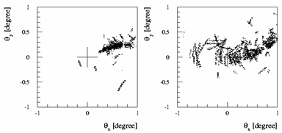
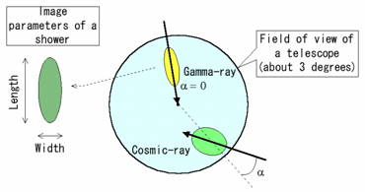
Charged CR rejection
Comparison of a pure EM shower (from a 300 GeV γ-ray) and a shower initiated by a 1 TeV proton.
The plot shows the projection of secondary particle trajectories onto a plane in which the ordinate corresponds to the elevation

Slide 8
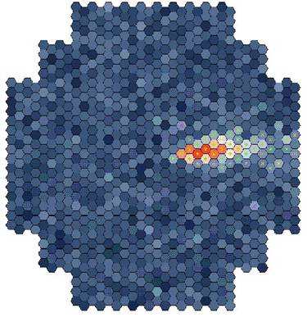



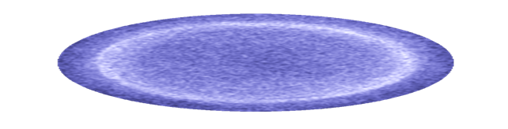
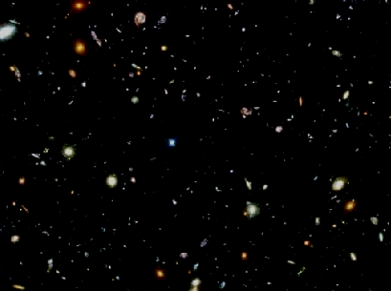
Astronomia Gamma (al TeV)
Focal Plane
~ 10 km
Particle
Shower
At 100 GeV
~ 10 Photons/m²
(300 – 600 nm)
5 nsec
1. Intensity →
Shower Energy
2. Imagine shape→
Background rejection
3. Image orientation → shower direction

Slide 9

Stereo Approach
IACTs operate in almost total darkness, far from human environments.
Thy have limited duty cycle, ∼ 10–15 %.
The FoV of is ∼ 4º.
Notes:
Add sentence about using a 3-D view of a shower
Use angular resolution as transition

Slide 10
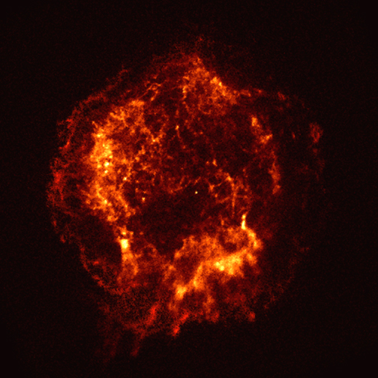
CRs and Secondary neutral particles@sources
radiation fields and matter
p
ν
π±
p
γ
π⁰
protons/nuclei
electrons/positrons
e±
γ
Inverse Compton
(+Bremsstr.)

Slide 11
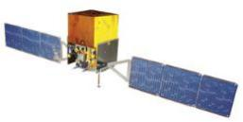
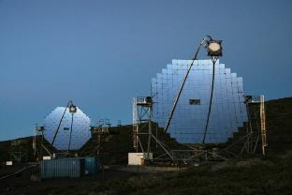
Non-thermal Universe: leptonic model
leptonic processes
e⁻ (TeV)
Synchrotron
γ (eV-keV)
B
γ (eV)
γ (TeV)
Inverse Compton(IC)
IC
π⁰
E² dN/dE
ν F(ν)
SED [Energy/cm² s]
energy E
Radio Optical X-ray GeV TeV

Slide 12
Non-thermal Universe: hadronic model
1) Astrophysical beam dump mechanism.
hadronic process
p⁺ (≫TeV)
2) Photoproduction through the Δ+ resonance:
π⁰
γγ (TeV)
matter
π⁻
π⁺
IC
To distinguish between hadronic/leptonic origin the Spectral Energy Distribution (SED) must be studied with different experimental techniques.
π⁰
E² dN/dE
ν F(ν)
SED [Energy/cm² s]
energy E
Radio Optical X-ray GeV TeV

Slide 13
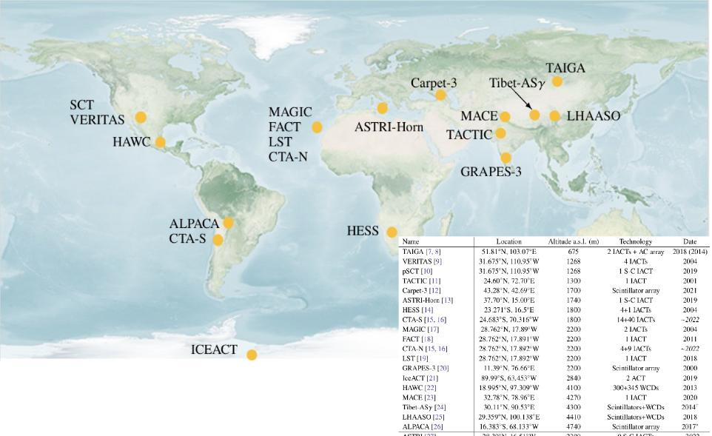
Distribution of γ-ray telescopes on Earth

Slide 14
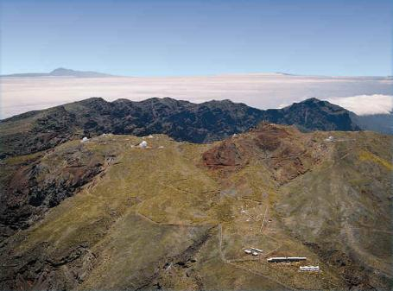
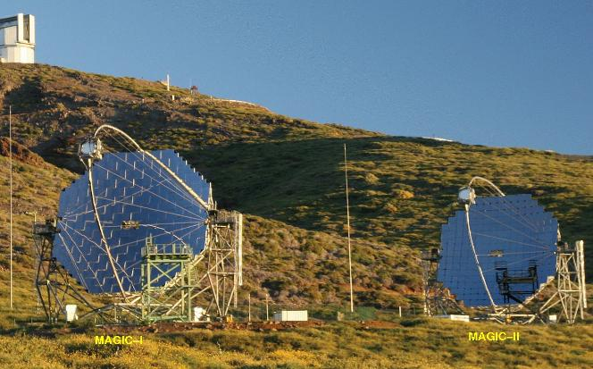
MAGIC at La Palma
The largest reflector in the world (2 x 17 meters diameter telescopes)
International collaboration of 160 scientists from Germany, Italy, Spain, Japan, Croatia, Switzerland, Finland, Poland, Bulgaria

Slide 15
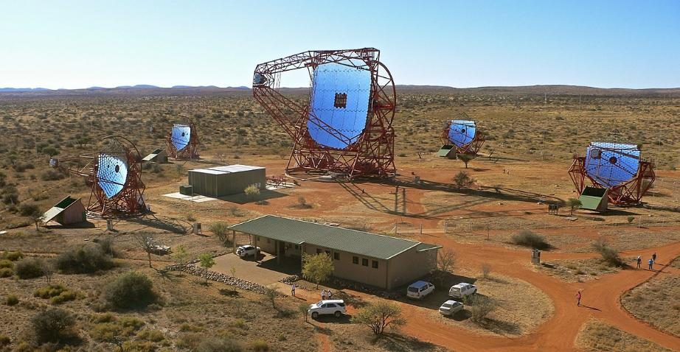
The HESS telescope (Nanibia)

Slide 16
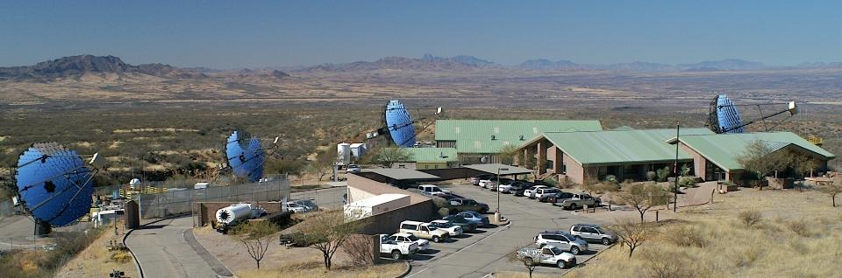
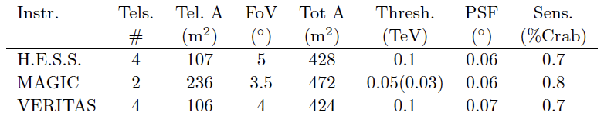
VERITAS in Utah
Comparison among IACTs

Slide 17
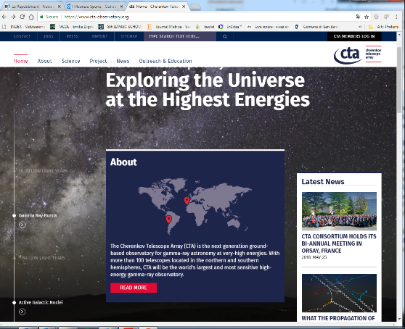
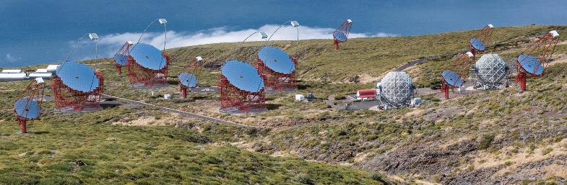
The future: CTA
https://www.cta-observatory.org/
CTA will be the largest ground-based γ-ray detection observatory in the world, with more than 100 telescopes in the Northern (Canarias’ IAC’s) and Southern (Paranal Observatory in the Atacama Desert, Chile) hemispheres

Slide 18
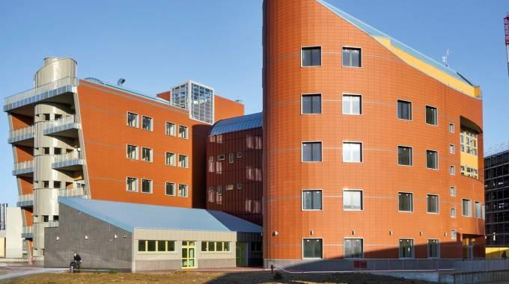

Bologna as the host site of the CTA Headquarters
Munich, Germany – On 13 June 2016, the governing body of the Cherenkov Telescope Array Observatory gGmbH (CTAO gGmbH), the CTA Council, selected Bologna as the host site of the CTA Headquarters and Berlin - Zeuthen for the Science Data Management Centre (SDMC) from five site candidates.
https://www.cta-observatory.org/headquarters-science-data-management-centre-sites-selected/

Slide 19
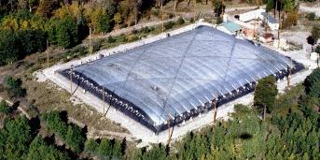
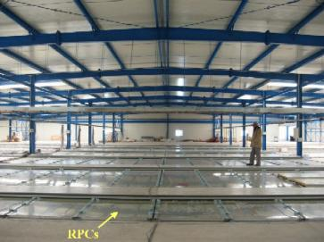
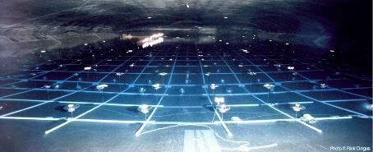
EAS Arrays for γ-astronomy
The EAS technique, designed for the detection of CRs at PeV -EeV energies, can also be adopted for γ-ray astronomy.
The mandatory requirement is that the energy threshold be reduced to the >TeV scale using dense particle arrays located at very high altitudes.
The feasibility of the measurement at ground level of showers initiated by a γ-ray has been successfully demonstrated by the Milagro (2000 to 2008 in New Mexico) and ARGO (Tibet, 2001-2013) Collaborations
Milagro
ARGO

Slide 20
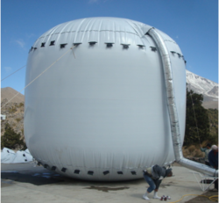
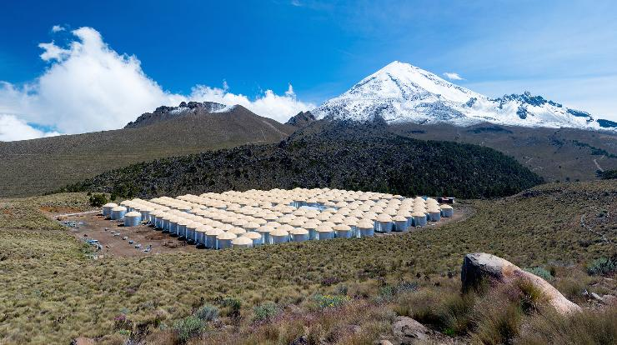
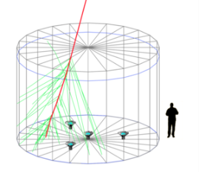
HAWC in Mexico
HAWC was completed in 2015, located at 4,100m close to Sierra Negra, Mexico.
it consists of an array of 300 water Cherenkov detectors.

Slide 21

LHAASO in China (started in 2020)

Slide 22
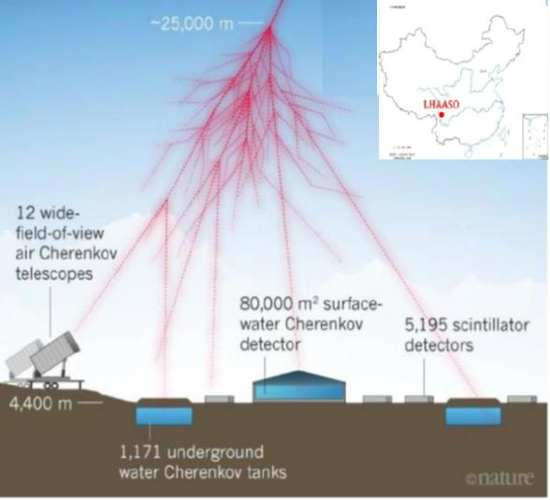
LHAASO in China
Three different kind of instruments
1171 WCDA (water Cherenkov for muon detection, 36m², 30m spacing)
5195 surface scintillator detectors (1m², 15 m spacing)
12 air Cherenkov telescopes

Slide 23
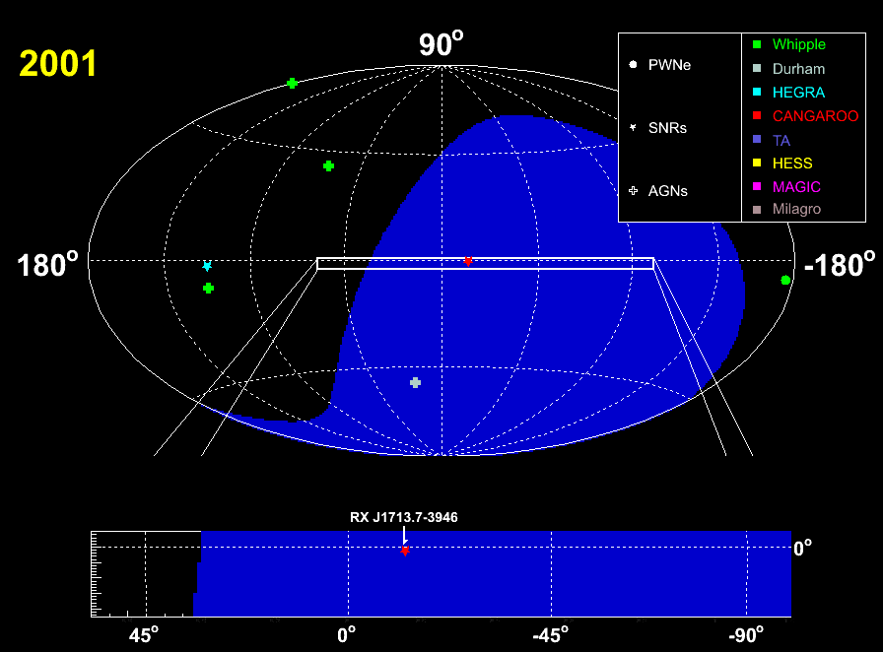
List of TeV sources in 2001
Jim Hinton
ICRC 2007

Slide 24
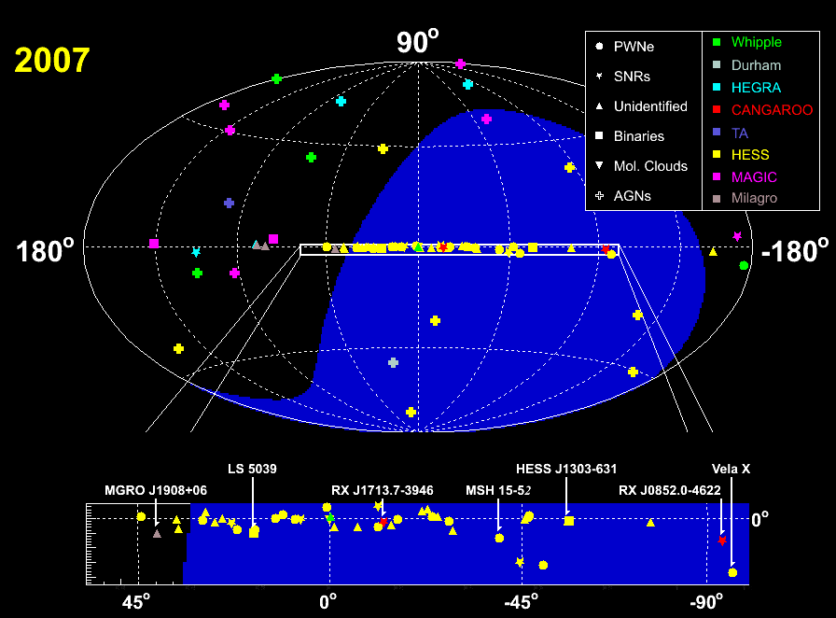
List of TeV sources in 2007
Jim Hinton
ICRC 2007

Slide 25
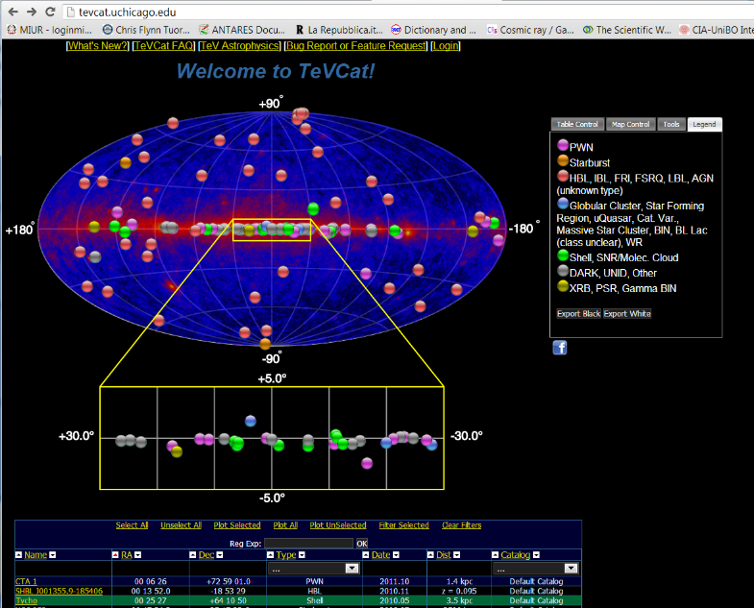
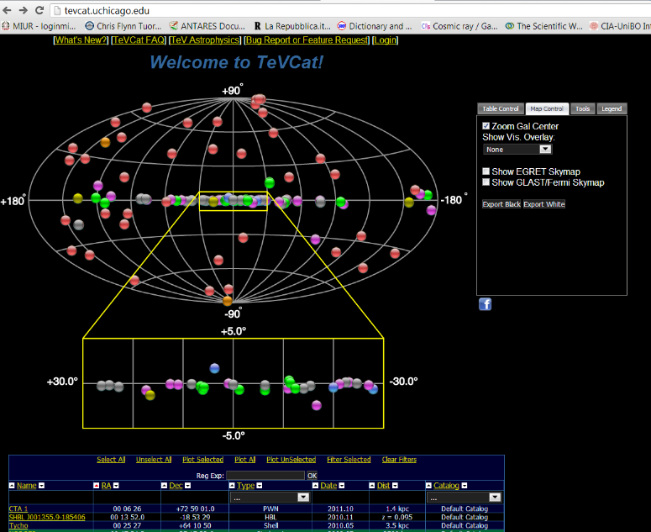
TeV sky today (2025) → 336 sources
Today: 336 objets
94 Galactic (<15 kpc)
Out of the Galactic Plane: AGN
  8 AGN with 0.5<z<1
  18 AGN with 0.2<z<0.5
  28 AGN with 0.1<z<0.2
  23 AGN with 0.001<z<0.1
  7 GRBs (transient)

Slide 26
Type of TeV sources
The wide FoV and the survey mode operation of LAT yield a roughly (within a factor two) uniform exposure to the entire sky.
The IACTs have very narrow effective FoV and small duty cycle (10-15%): this means that each source must be individually studied by IACTs
The galactic plane is the only large fraction of the sky that has been studied by HESS in detail with a dedicated survey of 2,800 (-85º <l<60º; -3.5º <b<3.5º): the survey has revealed more than fifty VHE γ-ray sources
Today: 336 objets
94 Galactic (<15 kpc)
Out of the Galactic Plane: AGN
  8 AGN with 0.5<z<1
  18 AGN with 0.2<z<0.5
  28 AGN with 0.1<z<0.2
  23 AGN with 0.001<z<0.1
  7 GRBs (transient)
A large fraction (78%) of TeVCat Galactic sources corresponds to PWNe, located in close vicinity to young and energetic pulsars.
Extragalactic sky is dominated by different AGN types

Slide 27
The HESS survey of the galactic plane

Slide 28
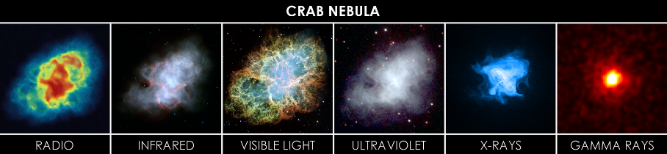
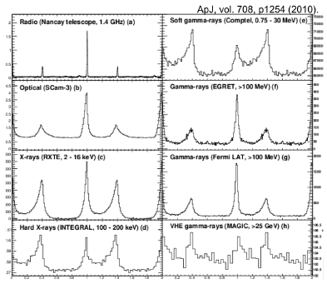
The reference source: the CRAB pulsar and nebula
Pulsar
Distance= (2.0±0.2) kpc; Diameter=3.4 pc, apparent diameter of 7’∼0.1º ; expanding at a rate of about 1,500 km/s, v/c= 0.5%
The Crab Pulsar and Nebula are a remnant of supernova SN1054, which was widely observed on Earth in the year 1054.
The Pulsar was discovered in 1968, and it was the first to be connected with a SNR.
The Crab is the strongest TeV γ-ray source, and it is used as a gauge for other sources
CRAB pulsar

Slide 29
The crab (D=2.0±0.5) kpc

Slide 30
The Spectral Energy Distribution (SED)
Matter Density
B↑
E_{e}↓
Stars
E² dN/dE
Dust
Cosmic
Electron
Accelerators
Cosmic
Proton
Accelerators
CMB
B↑
E_{e}↓
Inverse Compton
Synchrotron Radiation
π⁰→γγ
Synchrotron Radiation of Secondary Electrons
ln(E)

Slide 31
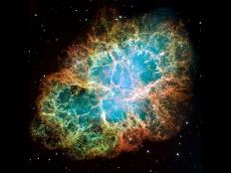
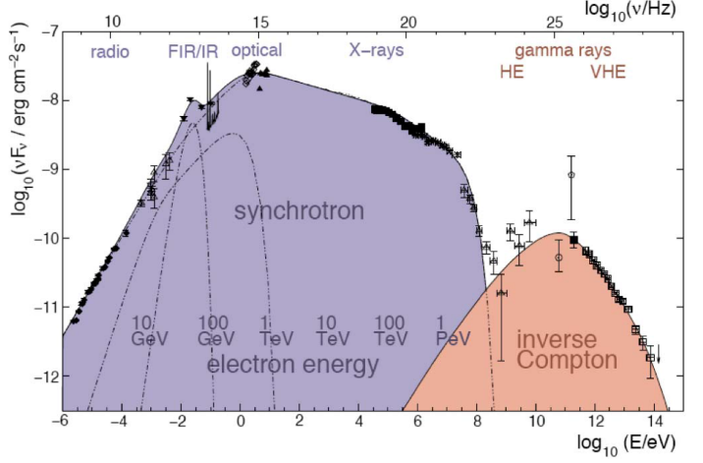
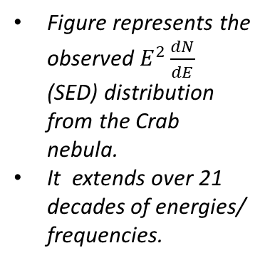
CRAB: a galactic source with leptonic emission
A simple MHD model for the interaction of a HE electron-positron wind with the interstellar medium satisfactorily describes the main features of the non-thermal emission
Figure represents the observed $E^{2}\frac{dN}{dE}$ (SED) distribution from the Crab nebula.
It extends over 21 decades of energies/ frequencies.

Slide 32
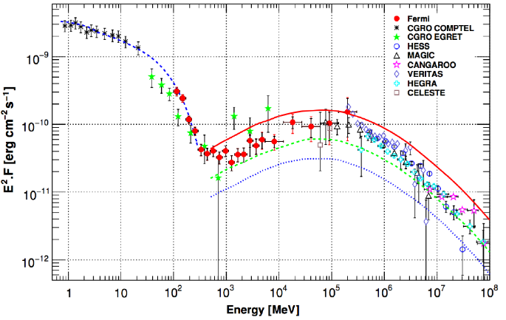
CRAB: a galactic source with leptonic emission
Figure represents the observed $E^{2}\frac{dN}{dE}$ (SED) distribution from the Crab nebula.
It extends over 21 decades of energies/ frequencies.

Slide 33
CRAB: a galactic source with leptonic emission
Crab spectrum up to 1.1 PeV: electrons PeVatron
2.2 PeV electrons, challenging acceleration model

Slide 34
About the Identification of Galactic CR Sources
The diffusive shock acceleration (DSA) model predicts the production CRs in SNRs;
The amount of relativistic particles present in the acceleration region increases with time as the SNR passes through its free expansion phase, and reaches a maximum in early stages of the so-called Sedov phase (Sect. 6.3.2).
Correspondingly, the peak in γ-ray luminosity typically appears some 10³–10⁴ years after the supernova explosion.
Thanks to the HESS survey of the galactic plane, we know that acceleration sites up to ∼ 100 TeV are spatially superimposed with regions of non-thermal X-ray emission.
This has strengthened the hypothesis that galactic CRs up to the knee are accelerated in SNRs.
Figure shows the morphological structure of the RX J1713.7-3946 SNR. This shows a correlation of TeV emission with non-thermal X-rays.
Even if radio and X-ray data suggest that SNRs are indeed the sources of CR electrons, no compelling evidence for the acceleration of protons in SNRs up to the PeV energies has been found.

Slide 35
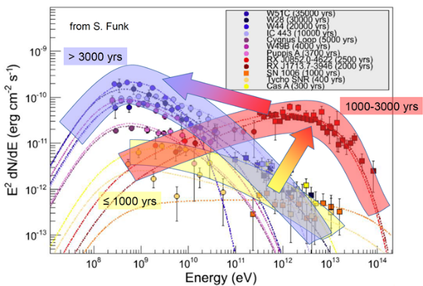
About the Identification of Galactic CR Sources
A straightforward test of the acceleration of CRs in SNRs up to PeV energies would be the detection of γ-rays produced through the hadronic mechanism directly from young remnants and/or from dense clouds overtaken by the expanding shells.
Multiwavelength observations are fundamental (and still not sufficient in most cases) to disentangle leptonic or hadronic mechanisms.
Only the presence of HE neutrinos will be the proof of hadronic acceleration
The figure presents the SED of γ-rays from different SNRs at different ages. The largest energies are for SNe about 1-3 ky old.
The Green catalog on radio observations contains 295 SNRs. Only 11 SNR have been firmly detected at TeV energies

Slide 36
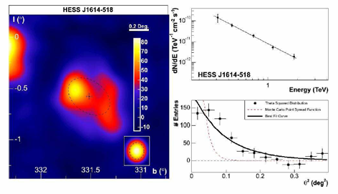
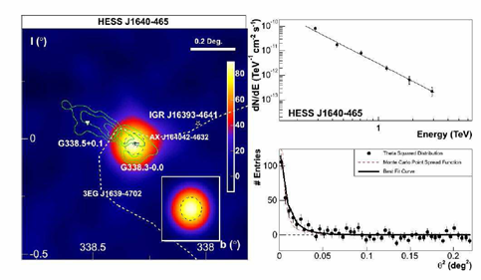
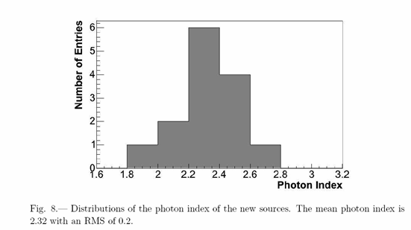
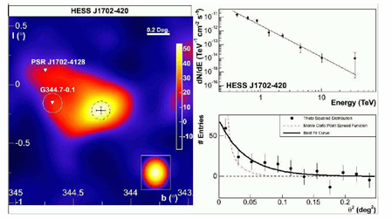
Example of spectral indexes: Γ∼2

Slide 37
(2021) LHAASO first PeVatrons

Slide 38
Hadronic PeVatrons ?
Not yet demonstrated...but challenging for electrons
To prove hadronic process:spectral signature:
  neutral Pion bump vs IC/SSC
  association with dense Molecular Clouds
  smoking gun: neutrinos association

Slide 39
The extragalactic sky: AGN
Active Galaxies are observed at different wavelength.
Three main criteria are used to classify them:
  radio wavelengths yields a division into radio loud and radio weak objects;
  The optical luminosity:
    Radio weak sources are subdivided into optically strong and optically weak;
    radio loud are subdivided in low luminosity and high luminosity;
  The orientation of the AGN toward the observer.
The radiation emitted is attributed to one of the two following processes:
  Thermal radiation, from in-falling matter strongly heated in the accretion disk close to the central BH (Seyferts galaxies, QSO);
  Nonthermal emission, by HE particles accelerated in a jet of material ejected from the nucleus at relativistic speed (jet dominated AGN: Blazars, FSRQs, BL Lacs)

Slide 40
The Spectral Energy Distributions of Blazars
The study/classification of AGN and their acceleration mechanisms require observations from different instruments.
The spectral energy distributions (SEDs) of blazars can span almost 20 orders of magnitude in energy, making simultaneous multiwavelength
Usually, SEDs of different objects were obtained using data not collected at the same time. Only very recently strictly contemporaneous (or at least as contemporaneous as possible) and broadband sampling of SEDs been strengthened.
This effort is particularly relevant for time-varying sources in which changes in overall brightness are often accompanied by changes in the energy spectra.
One of the closer blazar is Mrk 421. The extensive multi-instrument (radio to TeV) data set provides an unprecedented, complete look of SED for this source.
IC
π⁰
E² dN/dE
ν F(ν)
SED [Energy/cm² s]
energy E
Radio Optical X-ray GeV TeV

Slide 41
SED for a normal/starbust galaxy
NGC 7714 (a nearby starburst)
NGC 6090 (normal galaxy)

Slide 42

The SED of Mrk 421
Multiwavelength SED measurements (2009) of Markarian 421. The legend reports the correspondence between the instruments and the measured fluxes. The dashed line is a fit of the data with a leptonic model.
See previous slide

Slide 43
The central BH in M87
Skip

Slide 44
Testing the jet formation
Skip

Slide 45
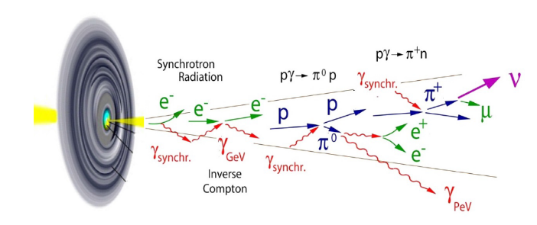
Jets in astrophysics
Powerful relativistic outflows and jets, have been observed in different sources, as AGN and galactic objects such as pulsars and microquasars.
If these outflows point toward us, as in blazars, relativistic effects can significantly change their appearance.
The dynamics of nonthermal processes in these jets are important fields of research.
The jet compositions and their production mechanisms are not completely understood.
In AGN, models predict that the matter in the disk falls into the BH, converting a large fraction of the gravitational potential into kinetic energy.
In some cases, particles in jet moves with relativistic bulk velocity (measured in the radio) up to Lorentz factors Γ=50 and with an extension that goes from fractions of kilo-parsecs up to hundreds of kpc.

Slide 46
The maximum EM luminosity
Electromagnetic radiation can be produced from different emission mechanisms.
In microquasars (§6.7.2), AGN (§9.9) and GRBs (§8.9), the energy production occurs by conversion of gravitational potential energy through accretion mechanisms.
In the case a limit, referred to as the Eddington luminosity (or limit), exists.
The Eddington limit gives the maximum luminosity that an astrophysical object can achieve. It is not possible to generate arbitrarily large luminosities by allowing matter to fall at a sufficiently great rate onto a black hole.
If the luminosity is too large, radiation pressure would blow away the infalling matter.
The limiting luminosity can be determined using hydrostatic equilibrium between the inward gravity force and the outward radiation pressure force.
EXERCIZE: Derive the expression for the Eddington luminosity
Solution: see “Extras” material of the book
The above holds for spherically symmetric phenomena. For a 10⁹ M black hole, the corresponding Eddington limit is 2x10⁴⁷ erg/s. It is possible to slightly exceed that limit by adopting different geometries for the source region.
Skip

Slide 47
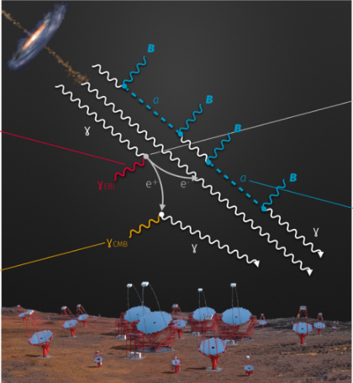
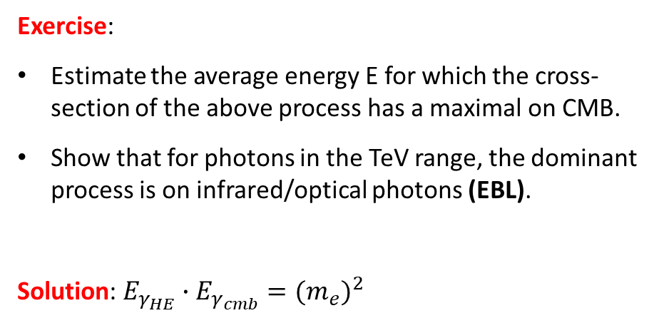
The Extragalactic Background Light
The detection of γ-ray emitting blazars has started providing information for observational cosmology
The Universe is opaque to γ-rays because of pair-creation processes
Exercise:
Estimate the average energy E for which the cross-section of the above process has a maximal on CMB.
Show that for photons in the TeV range, the dominant process is on infrared/optical photons (EBL).
Solution: $E_{γ_{HE}}∙E_{γ_{cmb}}=(m_{e})^{2}$

Slide 48
The γ-ray attenuation of the Universe
The EBL is the totality of light emitted by stars, galaxies, and AGN over the lifetime of the Universe, modified by the redshift due to the expansion of the Universe.
Therefore, in principle, the EBL contains information about the evolution of the baryonic components of galaxies and the structure of the Universe.
Models for EBL are very poorly constrained.
Once the energy density of the EBL has been assumed from a particular model, the optical depth τ(E; z) for a photon of observed energy E produced in a source at redshift z can be calculated.
The attenuation of the γ-ray of energy E from the source at redshift z is
Figure shows the mean free path (in Mpc) of photons vs energy. Galactic sources start to be attenuated at >100 TeV by the presence of CMB. Photons from the nearby Universe (below some tens of Mpc) start to be attenuated above 10 TeV.

Slide 49
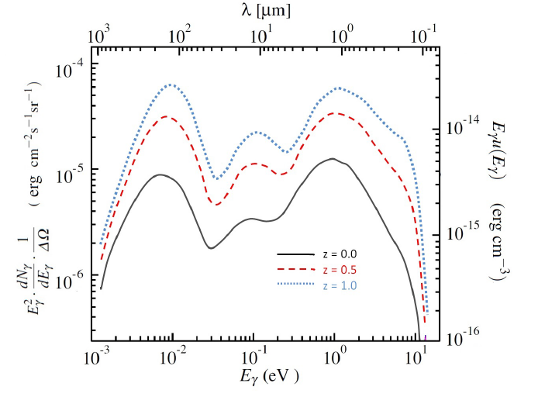
Extragalactic Background Light
Finke, Razzaque, & Dermer, 2010, ApJ, 712, 238 .
Left scale: SED per unit of solid angle for the extragalactic background light (EBL) energy density vs. E_{γ} (bottom scale) or λ (upper scale) for three values of redshifts. Right scale the energy density of the EBL

