Slide 1
X.
High Energy neutrino Astrophysics
Astroparticle Physics a.a. 2024/25
Maurizio Spurio
Università di Bologna e INFN
maurizio.spurio@unibo.it

Slide 2
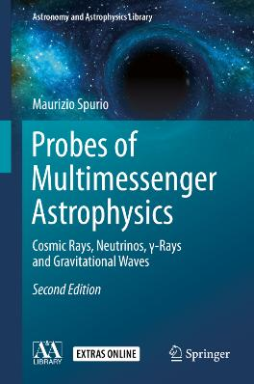
Content

Slide 3
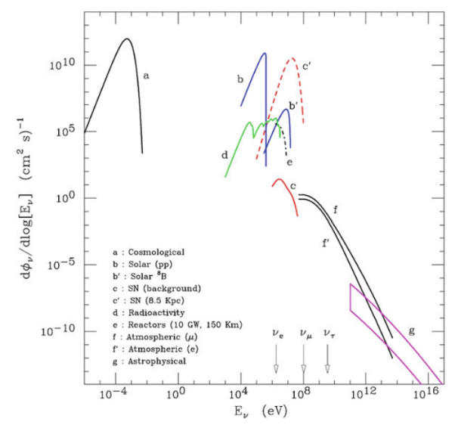
Prologo: Neutrinos from the Cosmos
Flux of neutrinos at the surface of the Earth.
Arrow indicate the energy threshold for CC production of the charged lepton
Big Bang neutrinos
Neutrinos from the Sun
Neutrinos from SNe
Atmospheric neutrinos
High-energy cosmic neutrinos

Slide 4
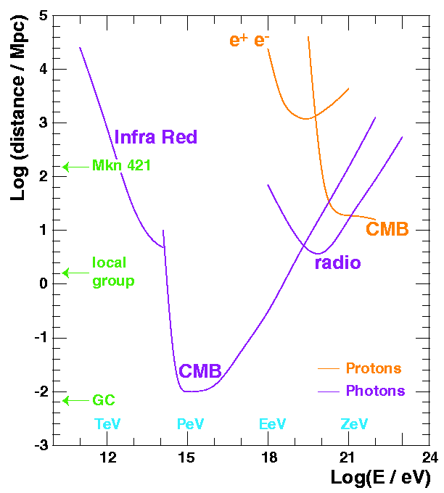
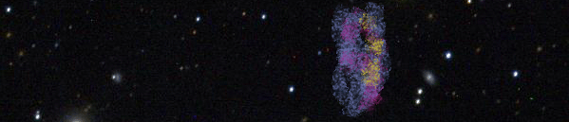
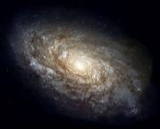

Why HE Neutrino Astronomy?
Photon and proton mean free range path
Astronomy with neutrinos is a quite recent and very promising experimental field.
Advantages:
  Photons: interact with CMB (r~10 kpc @100 TeV) and other radiation fields and matter
  Protons: interact with CMB (r~10 Mpc@10¹¹ GeV) and deflected by magnetic fields (Δθ>3º, E<5·10¹⁰ GeV)
  Neutrons: are not stable
Drawback: large detectors (~GTon) are needed.
γ
n
ν
p
Notes:
OK, so Neutrino Astronomy is a very recent and very promising experimental field in Astrophysics, in particular in the high energy region.
The main advantages of neutrinos with respect to other astrophysical probes are summarized here:
The range of high energy photons is limited by their interaction with the cosmic microwave background, as shown here. We can see that, for energies around 100 TeV, the range is not more that the distance to the Galactic Center.
The range of protons is also limited by the interaction with the cosmic microwave background. Moreover, since they are charged particles, the Galactic and extra-Galactic fields spoils the angular information.
And neutrons, which are neutral, are not either useful, since they are not stable. Even at very high energies, their range is very limited.
So we must look for a particle which is stable, neutral and weakly interacting, and this particle is the neutrino. However, the drawback of neutrinos is that since they only interact weakly, very large detectors are needed.

Slide 5
Discussion about…
Attenuation of 100 TeV gamma-rays
In the previous slide, it is mentioned that the mean free path of a ~100 TeV photon is about 10 kpc.
  Determine which is the process that attenuates the 100 TeV photon
  Estimate the resonant energy
  Draw the Feynman diagram of the process
  Verify that the mean free path corresponds to ∼10 kpc
Answer
Neutron decay
Evaluate the path length needed (on average) for the decay of a 10⁹ GeV neutron.
Express the distance in pc
Answer

Slide 6
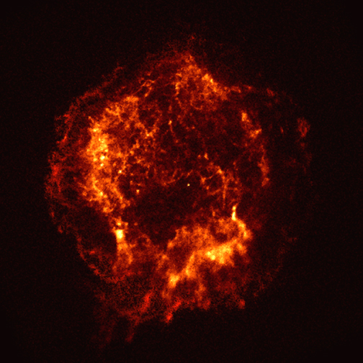
Cosmic sources: cosmic rays, ɣ-rays and ν’s
radiation fields and matter
p
ν
π±
p
γ
π⁰
e±
γ
Inverse Compton
(+Bremsstr.)
protons/nuclei
electrons/positrons

Slide 7
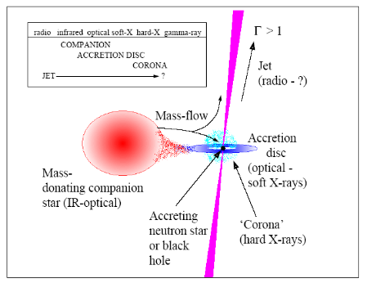
Candidate Astrophysical Sources
Galactic sources: these are near objects (few kpc) so the luminosity requirements are much lower.
  Micro-quasars
Micro-quasars: a compact object (BH or NS) towards which a companion star is accreting matter.
Neutrino beams could be produced in the Micro-quasar jets.
Notes:
We are going now to review some of the most relevant candidates to emit detectable neutrino rates in ANTARES.
Among the Galactic sources, one of the most promising sources are MQs. The name of these objects is due to the fact that they seem a reduced version of a Quasar. They consist It consists of a compact object towards which a companion star is accreting matter. Neutrino beams could be produced in the MQ jets, with rates which could be of the order of 10 in ANTARES for best candidates.
Another interesting kind of sources is the SNRs. The most interesting scenarios for neutrino astronomy are shown here: plerions (which are center-filled SNRs, like the Crab, shown here), shell-type remnants and SNRs containing an energetic pulsar. As shown here, the predicted rates range from 1 to 100 events per year in a km² detector.
Another good Galactic candidate is magnetars, which are isolated neutrons stars with very large magnetic fields. Seismic activity in the surface could induce particle acceleration in the magnetosphere, giving several neutrino events per year and km₂. These predictions depends strongly on the beaming angle.
Concerning the extra-Galactic sources, we are interested in the most powerful objects in the Universe. On the one hand, the AGNs. This classification includes several kinds of objects: Seyferts I and II, quasars, radio galaxies and blazars. The standard model of AGNs assumes that are the same kind of object viewed from different angles. According to this model, AGNs consist in a super-massive (10⁶-10⁸ M_{o}) black hole towards which large amounts of matter are accreted. If there is hadronic acceleration in the jets, detectable neutrino rates could be expected.
Finally, Gamma Ray Busters are also interesting for neutrino astronomy. According to the fireball model, ejecta of matter moving at relativistic velocities collides with the surrounding material. These collisions produce high energy gamma ray and probably also high energy neutrinos. In this case we can use the time information of the event, which allows us to reduce reject almost all the background.

Slide 8
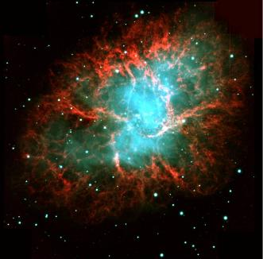
Candidate Astrophysical Sources
Galactic sources: these are near objects (few kpc) so the luminosity requirements are much lower.
  Micro-quasars
  Supernova remnants
Several different objects (with different neutrino production scenarios):
Plerions (center-filled SNRs)
Shell-type SNRs:
SNRs with energetic pulsars
Notes:
We are going now to review some of the most relevant candidates to emit detectable neutrino rates in ANTARES.
Among the Galactic sources, one of the most promising sources are MQs. The name of these objects is due to the fact that they seem a reduced version of a Quasar. They consist It consists of a compact object towards which a companion star is accreting matter. Neutrino beams could be produced in the MQ jets, with rates which could be of the order of 10 in ANTARES for best candidates.
Another interesting kind of sources is the SNRs. The most interesting scenarios for neutrino astronomy are shown here: plerions (which are center-filled SNRs, like the Crab, shown here), shell-type remnants and SNRs containing an energetic pulsar. As shown here, the predicted rates range from 1 to 100 events per year in a km² detector.
Another good Galactic candidate is magnetars, which are isolated neutrons stars with very large magnetic fields. Seismic activity in the surface could induce particle acceleration in the magnetosphere, giving several neutrino events per year and km₂. These predictions depends strongly on the beaming angle.
Concerning the extra-Galactic sources, we are interested in the most powerful objects in the Universe. On the one hand, the AGNs. This classification includes several kinds of objects: Seyferts I and II, quasars, radio galaxies and blazars. The standard model of AGNs assumes that are the same kind of object viewed from different angles. According to this model, AGNs consist in a super-massive (10⁶-10⁸ M_{o}) black hole towards which large amounts of matter are accreted. If there is hadronic acceleration in the jets, detectable neutrino rates could be expected.
Finally, Gamma Ray Busters are also interesting for neutrino astronomy. According to the fireball model, ejecta of matter moving at relativistic velocities collides with the surrounding material. These collisions produce high energy gamma ray and probably also high energy neutrinos. In this case we can use the time information of the event, which allows us to reduce reject almost all the background.

Slide 9
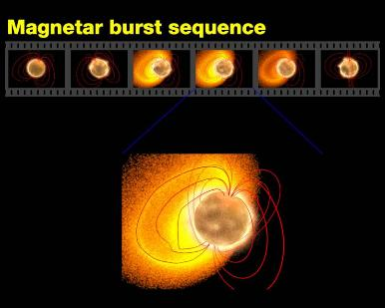
Candidate Astrophysical Sources
Galactic sources: these are near objects (few kpc) so the luminosity requirements are much lower.
  Micro-quasars
  Supernova remnants
  Magnetars
  …
Isolated neutron stars with surface dipole magnetic fields ~10¹⁵ G, much larger than ordinary pulsars.
Seismic activity in the surface could induce particle acceleration in the magnetosphere.
Notes:
We are going now to review some of the most relevant candidates to emit detectable neutrino rates in ANTARES.
Among the Galactic sources, one of the most promising sources are MQs. The name of these objects is due to the fact that they seem a reduced version of a Quasar. They consist It consists of a compact object towards which a companion star is accreting matter. Neutrino beams could be produced in the MQ jets, with rates which could be of the order of 10 in ANTARES for best candidates.
Another interesting kind of sources is the SNRs. The most interesting scenarios for neutrino astronomy are shown here: plerions (which are center-filled SNRs, like the Crab, shown here), shell-type remnants and SNRs containing an energetic pulsar. As shown here, the predicted rates range from 1 to 100 events per year in a km² detector.
Another good Galactic candidate is magnetars, which are isolated neutrons stars with very large magnetic fields. Seismic activity in the surface could induce particle acceleration in the magnetosphere, giving several neutrino events per year and km₂. These predictions depends strongly on the beaming angle.
Concerning the extra-Galactic sources, we are interested in the most powerful objects in the Universe. On the one hand, the AGNs. This classification includes several kinds of objects: Seyferts I and II, quasars, radio galaxies and blazars. The standard model of AGNs assumes that are the same kind of object viewed from different angles. According to this model, AGNs consist in a super-massive (10⁶-10⁸ M_{o}) black hole towards which large amounts of matter are accreted. If there is hadronic acceleration in the jets, detectable neutrino rates could be expected.
Finally, Gamma Ray Busters are also interesting for neutrino astronomy. According to the fireball model, ejecta of matter moving at relativistic velocities collides with the surrounding material. These collisions produce high energy gamma ray and probably also high energy neutrinos. In this case we can use the time information of the event, which allows us to reduce reject almost all the background.

Slide 10
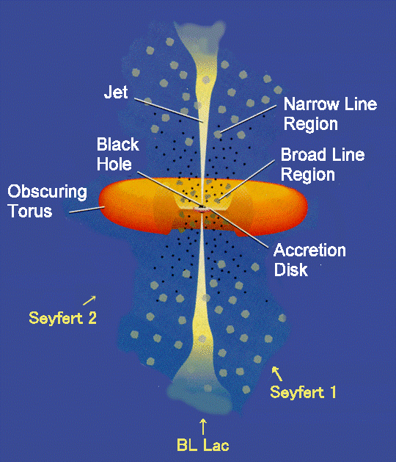
Candidate Astrophysical Sources
Galactic sources: these are near objects (few kpc) so the luminosity requirements are much lower.
  Micro-quasars
  Supernova remnants
  Magnetars
  …
Extra-galactic sources: most powerful accelerators in the Universe
  AGNs
Active Galactic Nuclei includes Seyferts, quasars, radio galaxies and blazars.
Standard model: a super-massive (10⁶-10⁸ M_{o}) black hole towards which large amounts of matter are accreted.
Notes:
We are going now to review some of the most relevant candidates to emit detectable neutrino rates in ANTARES.
Among the Galactic sources, one of the most promising sources are MQs. The name of these objects is due to the fact that they seem a reduced version of a Quasar. They consist It consists of a compact object towards which a companion star is accreting matter. Neutrino beams could be produced in the MQ jets, with rates which could be of the order of 10 in ANTARES for best candidates.
Another interesting kind of sources is the SNRs. The most interesting scenarios for neutrino astronomy are shown here: plerions (which are center-filled SNRs, like the Crab, shown here), shell-type remnants and SNRs containing an energetic pulsar. As shown here, the predicted rates range from 1 to 100 events per year in a km² detector.
Another good Galactic candidate is magnetars, which are isolated neutrons stars with very large magnetic fields. Seismic activity in the surface could induce particle acceleration in the magnetosphere, giving several neutrino events per year and km₂. These predictions depends strongly on the beaming angle.
Concerning the extra-Galactic sources, we are interested in the most powerful objects in the Universe. On the one hand, the AGNs. This classification includes several kinds of objects: Seyferts I and II, quasars, radio galaxies and blazars. The standard model of AGNs assumes that are the same kind of object viewed from different angles. According to this model, AGNs consist in a super-massive (10⁶-10⁸ M_{o}) black hole towards which large amounts of matter are accreted. If there is hadronic acceleration in the jets, detectable neutrino rates could be expected.
Finally, Gamma Ray Busters are also interesting for neutrino astronomy. According to the fireball model, ejecta of matter moving at relativistic velocities collides with the surrounding material. These collisions produce high energy gamma ray and probably also high energy neutrinos. In this case we can use the time information of the event, which allows us to reduce reject almost all the background.

Slide 11
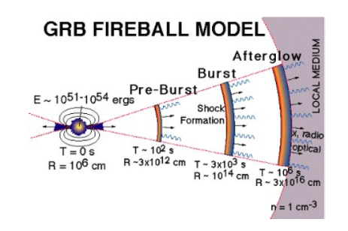
Candidate Astrophysical Sources
Galactic sources: these are near objects (few kpc) so the luminosity requirements are much lower.
  Micro-quasars
  Supernova remnants
  Magnetars
  …
Extra-galactic sources: most powerful accelerators in the Universe
  AGNs
  GRBs
GRBs are brief explosions of γ rays
(often + X-ray, optical and radio).
In the fireball model, matter moving at relativistic velocities collides with the surrounding material. The progenitor could be a collapsing super-massive star.
Time correlation enhances the neutrino detection efficiency.
Notes:
We are going now to review some of the most relevant candidates to emit detectable neutrino rates in ANTARES.
Among the Galactic sources, one of the most promising sources are MQs. The name of these objects is due to the fact that they seem a reduced version of a Quasar. They consist It consists of a compact object towards which a companion star is accreting matter. Neutrino beams could be produced in the MQ jets, with rates which could be of the order of 10 in ANTARES for best candidates.
Another interesting kind of sources is the SNRs. The most interesting scenarios for neutrino astronomy are shown here: plerions (which are center-filled SNRs, like the Crab, shown here), shell-type remnants and SNRs containing an energetic pulsar. As shown here, the predicted rates range from 1 to 100 events per year in a km² detector.
Another good Galactic candidate is magnetars, which are isolated neutrons stars with very large magnetic fields. Seismic activity in the surface could induce particle acceleration in the magnetosphere, giving several neutrino events per year and km₂. These predictions depends strongly on the beaming angle.
Concerning the extra-Galactic sources, we are interested in the most powerful objects in the Universe. On the one hand, the AGNs. This classification includes several kinds of objects: Seyferts I and II, quasars, radio galaxies and blazars. The standard model of AGNs assumes that are the same kind of object viewed from different angles. According to this model, AGNs consist in a super-massive (10⁶-10⁸ M_{o}) black hole towards which large amounts of matter are accreted. If there is hadronic acceleration in the jets, detectable neutrino rates could be expected.
Finally, Gamma Ray Busters are also interesting for neutrino astronomy. According to the fireball model, ejecta of matter moving at relativistic velocities collides with the surrounding material. These collisions produce high energy gamma ray and probably also high energy neutrinos. In this case we can use the time information of the event, which allows us to reduce reject almost all the background.

Slide 12
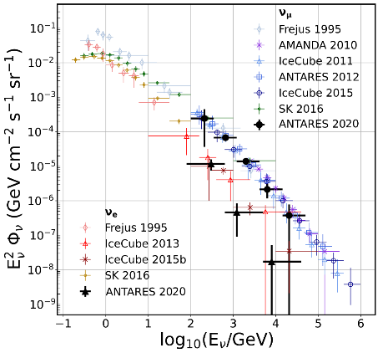
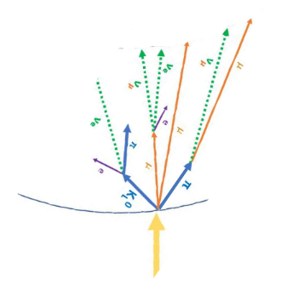



Background: atmospheric muons and neutrinos
arXiv:2101.12170
$$μ$$
$$ν_{μ}$$
In a ∼1 km³ detector
Atmospheric muons: ∼10¹⁰⁻¹¹/y, i.e., 1 kHz
Atmospheric ν◊ μ: ∼10⁵/y, i.e., 1 in 5 min (upgoing)
Cosmic ν◊ μ , e, τ: ∼100/y, mostly hidden in the background
$$ν_{e}$$
Cosmic signal

Slide 13
Recipes for a Neutrino Telescope
M.A. Markov and B.M. Pontecorvoat the International conference on neutrino physics and astrophysics. Baksancanyon, Cheget, the Caucasus, 1977
Telescope= Cosmic flux⊗detector response
An example of cosmic ν production
Deep in water/ice
Neutrino cross-section
Muons and electrons ⇔ tracks and showers
Neutrino absorption from the Earth
“Effective area” for HE neutrinos
Cherenkov radiation
Medium properties
«Optical modules» containing PMTs
Existing telescopes
M. Markov: 1960, Rochester Conference
“We propose to install detectors deep in a lake or in the sea and to determine the direction of the charged particles with the help of Cherenkov radiation”
Part II: NT and multimessenger astrophysics

Slide 14
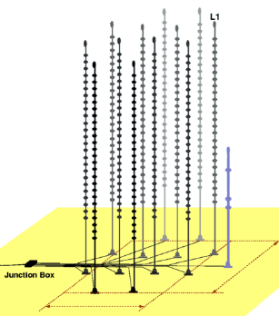
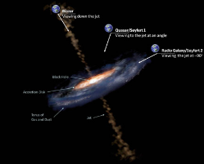
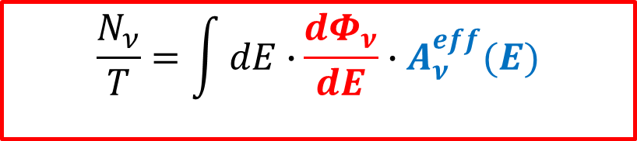
Telescope= Cosmic flux⊗detector response
Event rate (s⁻¹) in the detector in a time interval T: neutrino detection through CC interaction with production of a charged lepton
Neutrino spectrum from the source (ν/cm² s GeV)
  astrophysical models
  Neutrino physics (oscillations)
Detector response= Neutrino- effective area (cm²).
  neutrino cross section
  energy losses of secondary leptons (e/muon)
  Neutrino propagation in the Earth
  Properties of the medium
Instrumented detector D<R_{μ}
$$\frac{N_{ν}}{T}=\int{dE∙}\frac{dΦ_{ν}}{dE}∙A_{ν}^{eff}(E)$$

Slide 15
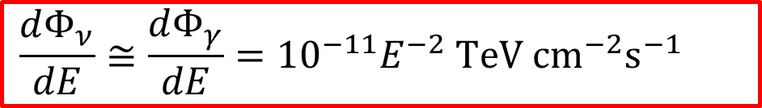
1. Neutrinos from a Galactic source (example)
TeV γ-rays and ν’s can be produced from photoproduction hadronic processes:
p + γ → Δ⁺→ πº+ p p + γ → Δ⁺→ π⁺+ n
The same occurs in beam-dump collisions of CRs with matter
  p + p → many hadrons (mostly π⁺,π⁻,π^{ο})
Figure: RX J1713.7-3946 as seen by HESS (γ−rays)
Then, neutral mesons decay in photons: πº→ γγ
Charged mesons decay in neutrinos:
  π⁺→ ν_{µ} + µ⁺ µ⁺ → ν_{µ} + ν_{e} + e⁺
  π⁻ → ν_{µ} + µ⁻ µ⁻ → ν_{µ} + ν_{e} + e⁻
In all cases, at first order:
$$\frac{dΦ_{ν}}{dE}≅\frac{dΦ_{γ}}{dE}={{10}^{−11}E}^{−2} TeV {cm}^{−2}s^{−1}$$

Slide 16
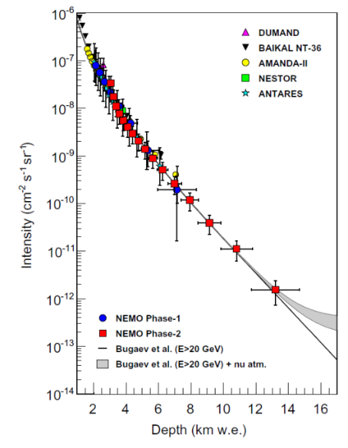
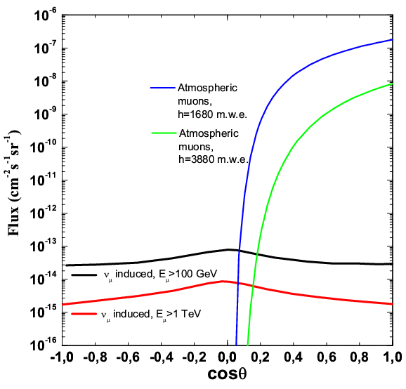
2. “Deep in a transparent medium”: water/ice
Large mass (and inexpensive) target for ν interaction
transparent radiators for Cherenkov light;
large deep: protection against the cosmic-ray muon background
S. Aiello et al.,Astropart.Phys. 66 (2015) 1-7
μ
Muon flux
μ
ν
Zenith angle

Slide 17
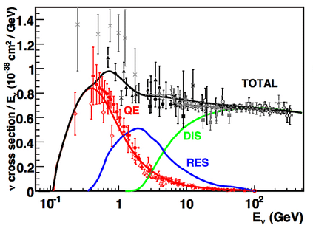
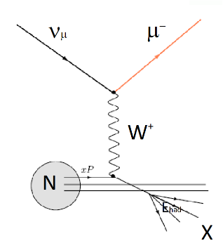
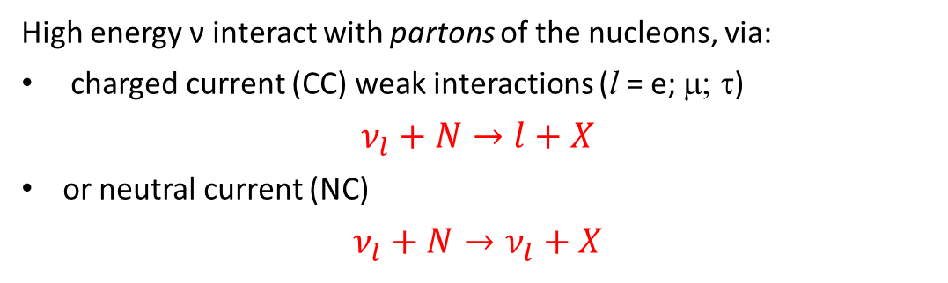
3. Neutrino cross section
Top: Different processes for the ν interaction on nucleons
At > few tens GeV, ν interactions occur via the so-called “deep inelastic scattering (DIS)”
The DIS cross-section increases as σ∼E_{ν} up to 10⁴ GeV;
At higher energies, the linear rise starts flattening out.
High energy ν interact with partons of the nucleons, via:
charged current (CC) weak interactions (l = e; μ; τ)
$$ν_{l}+N→l+X$$
or neutral current (NC)
$$ν_{l}+N→ν_{l}+X$$

Slide 18
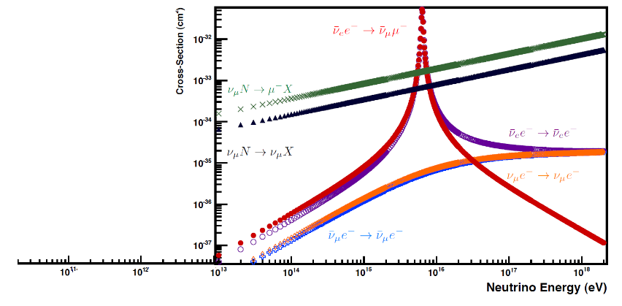


3. Neutrino cross section
The DIS cross-section increases as σ∼E_{ν} up to 10⁴ GeV;
At higher energies, the linear rise starts flattening out.
PDG
arXiv:1305.7513: J.A. Formaggio,
G.P. Zeller
From eV to EeV: Neutrino Cross-Sections Across Energy Scales.
(Really suggested reading!)
$$ν_{μ}N→μ^{−}X$$
$$ν_{μ}N→ν_{μ}X$$

Slide 19
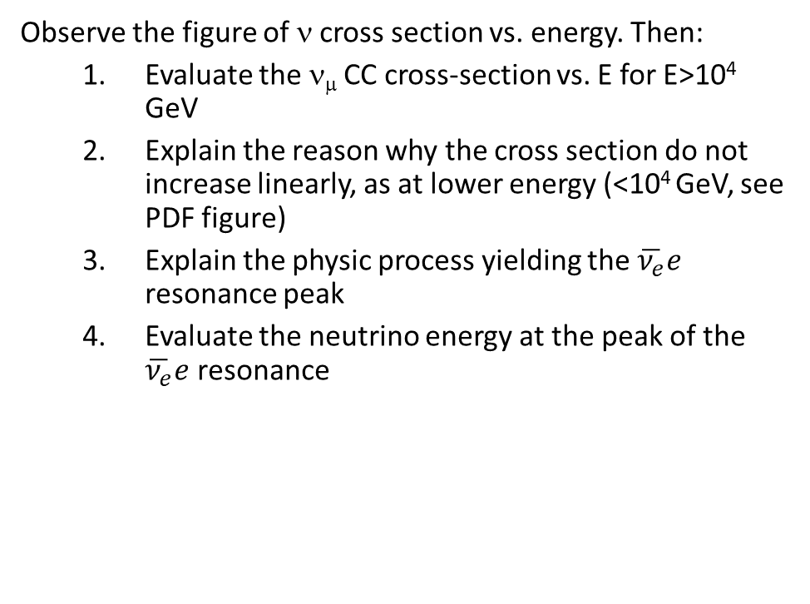
Discussion about…
ν cross section
Observe the figure of ν cross section vs. energy. Then:
  Evaluate the ν_{μ} CC cross-section vs. E for E>10⁴ GeV
  Explain the reason why the cross section do not increase linearly, as at lower energy (<10⁴ GeV, see PDF figure)
  Explain the physic process yielding the $\overline{ν_{e}}e$ resonance peak
  Evaluate the neutrino energy at the peak of the $\overline{ν_{e}}e$ resonance
Answer

Slide 20
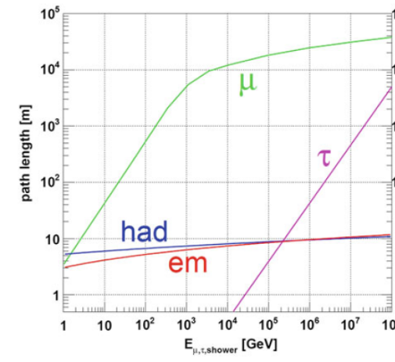
4. e, μ, τ : shower- and track-like events
ν_{e},ν_{τ}, CC and all flavor NC: showers in the detector
  Better energy measurement (energy dissipated in the detector)
ν_{μ} CC: tracks in the detector
  Better direction estimate (the muon collinear with the neutrino)
Figure: Path length (m) of particles produced by different neutrino flavors and interactions in water versus their respective energy.
Track-like
ν_{μ} CC interactions
μ
ν_{μ}
Shower-like
ν_{e} , ν_{τ} CC interactions
ν_{X} NC interactions
ν_{e}

Slide 21
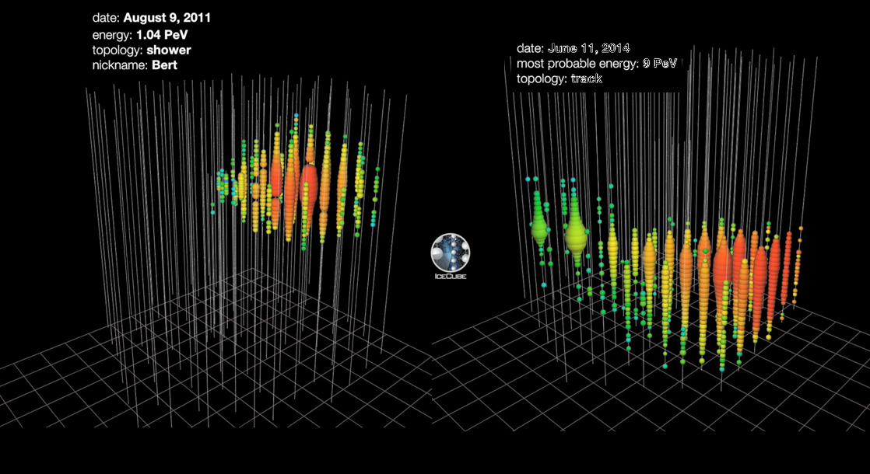

Two real events (shower/track) in IceCube
Total energy measured
All ν flavors
All sky (Ω=4π)

Slide 22
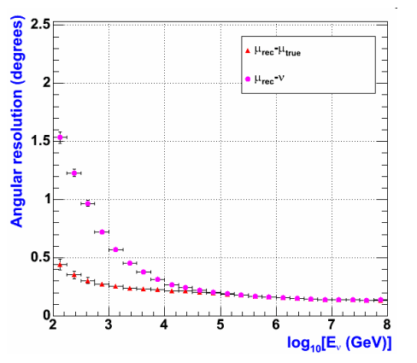
4. Angular precision in the ν_{μ} channel (tracks)
The μ reconstruction allows the measurement of the ν direction
For E_{ν} >TeV, μ and ν are almost collinear.
For shower-like events, the angular resolution is worse (3º-15º, depending on the neutrino energy)
ν_{μ}
μ
N
θ
X
Figure: Average differences between the true and reconstructed muon directions (red Δ) and the difference with respect to the neutrino direction (pink o), evaluated with a Monte Carlo vs. event energy in the ANTARES detector. This value represents the angular resolution of the detector at a given energy

Slide 23
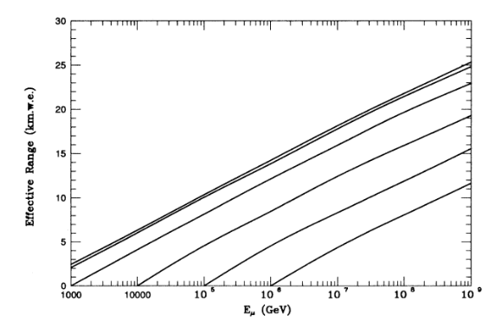

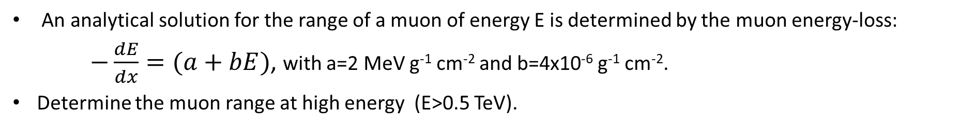
4. Muon range
An analytical solution for the range of a muon of energy E is determined by the muon energy-loss:
$−\frac{dE}{dx}=(a+bE)$, with a=2 MeV g⁻¹ cm⁻² and b=4x10⁻⁶ g⁻¹ cm⁻².
Determine the muon range at high energy (E>0.5 TeV).
Muon range (km.w.e.) vs. initial energy E_{μ} for E^{μ}_{thr} =1 TeV

Slide 24
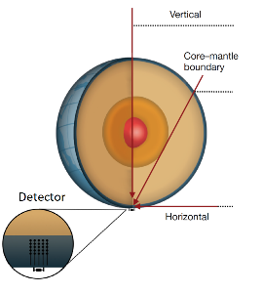
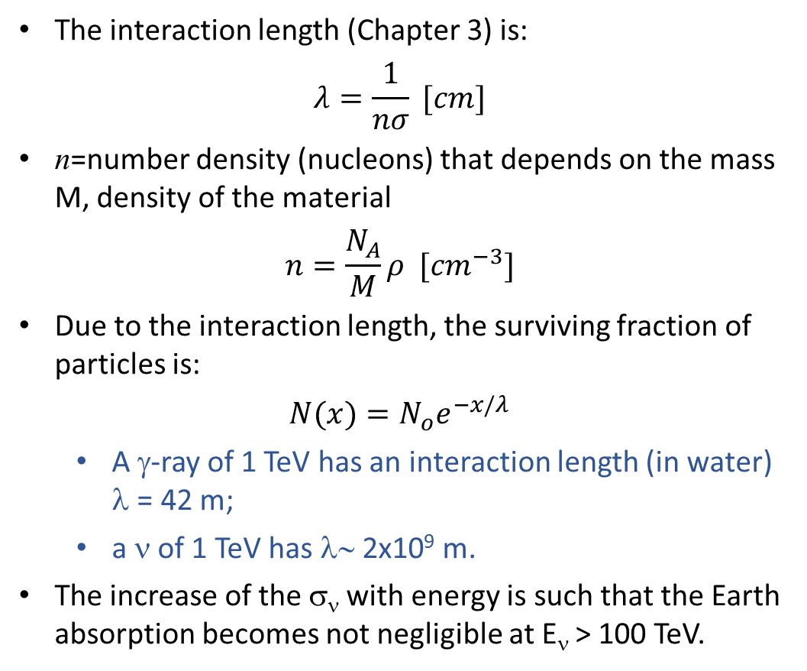
5. ν absorption in the Earth
The interaction length (Chapter 3) is:
$$λ=\frac{1}{nσ} [cm]$$
n=number density (nucleons) that depends on the mass M, density of the material
$$n=\frac{N_{A}}{M}ρ [{cm}^{−3}]$$
Due to the interaction length, the surviving fraction of particles is:
$$N(x)=N_{o}e^{−x/λ}$$
  A γ-ray of 1 TeV has an interaction length (in water) λ = 42 m;
  a ν of 1 TeV has λ∼ 2x10⁹ m.
The increase of the σ_{ν} with energy is such that the Earth absorption becomes not negligible at E_{ν} > 100 TeV.

Slide 25

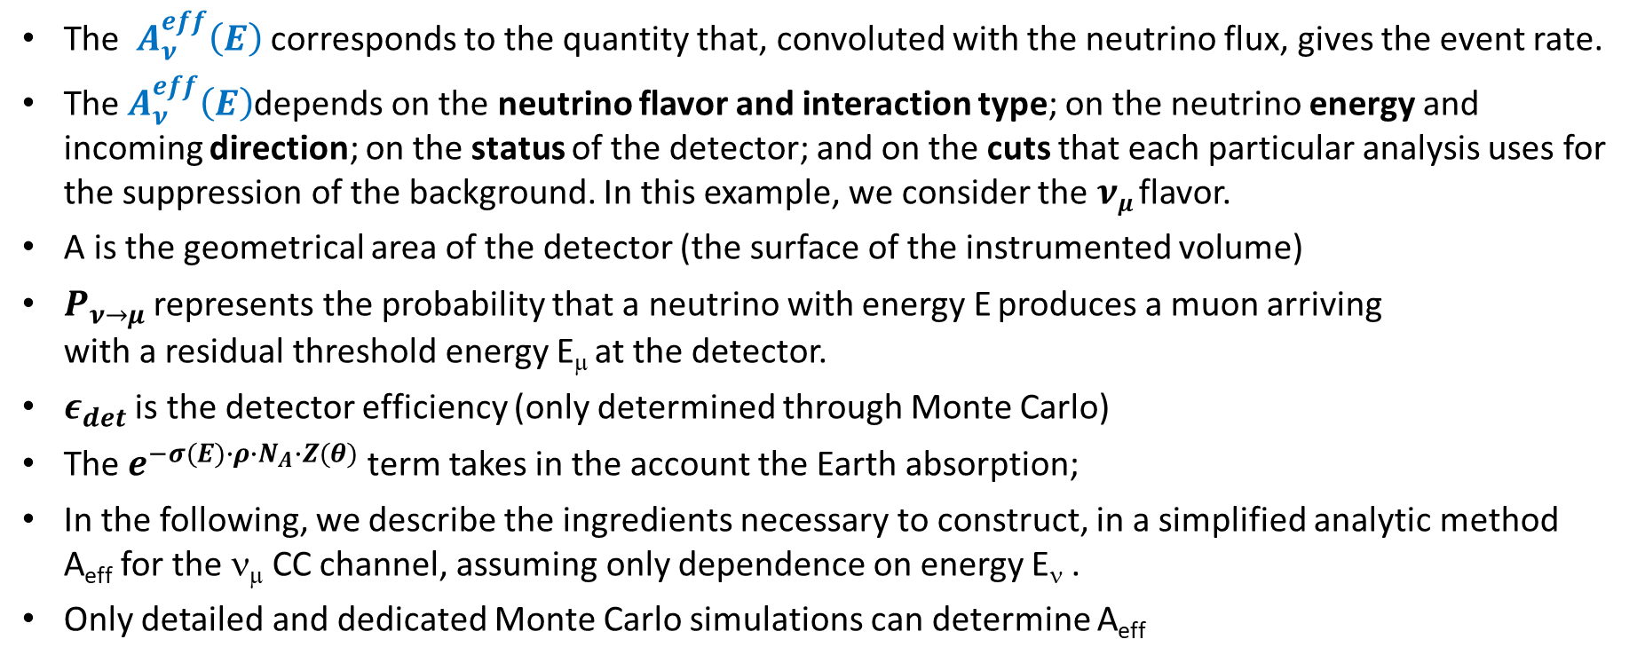




6. Detector effective area, $A_{ν}^{eff}(E)$
$$A_{ν}^{eff}(E)=$$
$$A∙$$
$$P_{ν→μ}(E,E_{μ})∙$$
$$ε_{det}∙$$
$$e^{−σ(E)∙ρ∙N_{A}∙Z(θ)}$$
The $A_{ν}^{eff}\left(E\right)$corresponds to the quantity that, convoluted with the neutrino flux, gives the event rate.
The $A_{ν}^{eff}\left(E\right)$depends on the neutrino flavor and interaction type; on the neutrino energy and incoming direction; on the status of the detector; and on the cuts that each particular analysis uses for the suppression of the background. In this example, we consider the $νμ$ flavor.
A is the geometrical area of the detector (the surface of the instrumented volume)
$P_{ν→μ}$ represents the probability that a neutrino with energy E produces a muon arriving with a residual threshold energy E_{μ} at the detector.
$ε_{det}$ is the detector efficiency (only determined through Monte Carlo)
The $e^{−σ(E)∙ρ∙N_{A}∙Z(θ)}$ term takes in the account the Earth absorption;
In the following, we describe the ingredients necessary to construct, in a simplified analytic method A_{eff} for the ν_{μ} CC channel, assuming only dependence on energy E_{ν} .
Only detailed and dedicated Monte Carlo simulations can determine A_{eff}

Slide 26
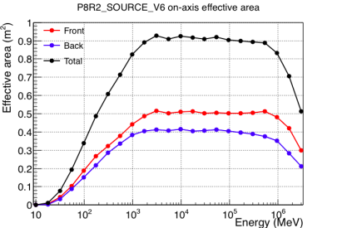
Discussion about…
Comparison with Fermi-LAT γ-ray detector effective area
Compare the neutrino effective area with the effective area of the Fermi-LAT satellite for γ-rays detection.
Discuss the relevant differences w.r.t. neutrino telescopes
Answer

Slide 27
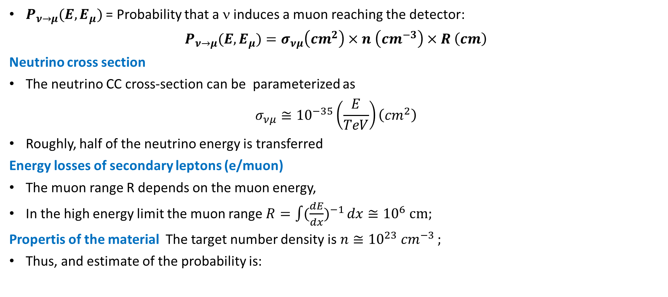
6. The 𝑷_{𝝂→𝝁} term in the detector effective area
$P_{ν→μ}(E,E_{μ})$ = Probability that a ν induces a muon reaching the detector:
$$P_{ν→μ}(E,E_{μ})=σ_{νμ}\left({cm}^{2}\right)×n \left({cm}^{−3}\right)×R \left(cm\right)$$
Neutrino cross section
The neutrino CC cross-section can be parameterized as
$${σ_{νμ}≅10}^{−35}\left(\frac{E}{TeV}\right)\left({cm}^{2}\right)$$
Roughly, half of the neutrino energy is transferred
Energy losses of secondary leptons (e/muon)
The muon range R depends on the muon energy,
In the high energy limit the muon range $R=\int{(\frac{dE}{dx})^{−1}}dx≅{10}^{6} cm;$
Propertis of the material The target number density is $n≅{10}^{23} {cm}^{−3 };$
Thus, and estimate of the probability is:
$P_{ν→μ}(E,E_{μ})={10}^{−35}\left(\frac{E}{TeV}\right)×{10}^{23}\left({cm}^{−3}\right)×{10}^{6}\left(cm\right)$=${10}^{−6}\left(\frac{E}{TeV}\right)$

Slide 28
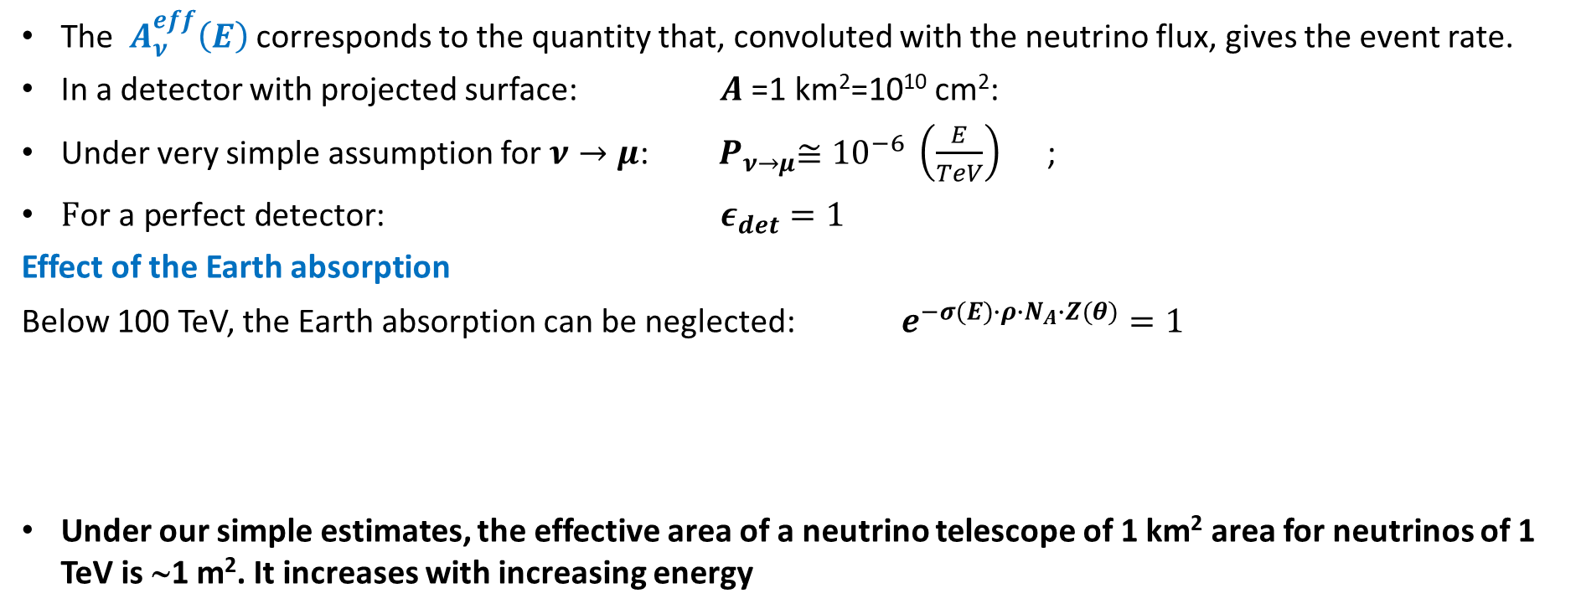
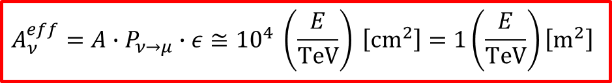
6. Detector effective area, $A_{ν}^{eff}(E)$
$$A_{ν}^{eff}(E)=$$
$$A∙$$
$$P_{ν→μ}(E,E_{μ})∙$$
$$ε_{det}∙$$
$$e^{−σ(E)∙ρ∙N_{A}∙Z(θ)}$$
The $A_{ν}^{eff}\left(E\right)$corresponds to the quantity that, convoluted with the neutrino flux, gives the event rate.
In a detector with projected surface: $A$=1 km²=10¹⁰ cm²:
Under very simple assumption for $ν→μ$: ${ P}_{ν→μ}≅{10}^{−6} \left(\frac{E}{TeV}\right)$ ;
$\text{F}\text{or} \text{a} \text{perfect} \text{detector}$: $ε_{det}=1$
Effect of the Earth absorption
Below 100 TeV, the Earth absorption can be neglected: $e^{−σ(E)∙ρ∙N_{A}∙Z(θ)}=1$
Under our simple estimates, the effective area of a neutrino telescope of 1 km² area for neutrinos of 1 TeV is ∼1 m². It increases with increasing energy
$${A_{ν}^{eff}=A∙P}_{ν→μ}∙ε≅{10}^{4} \left(\frac{E}{TeV}\right) \left[{cm}^{2}\right]=1\left(\frac{E}{TeV}\right)\left[m^{2}\right]$$

Slide 29
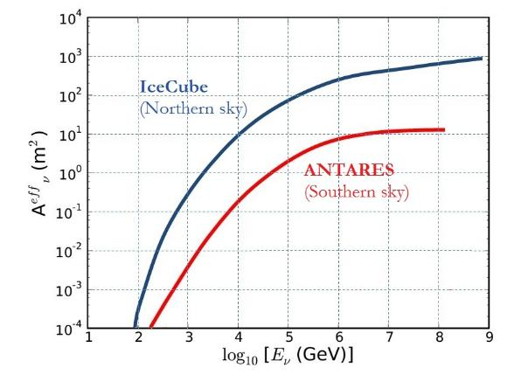
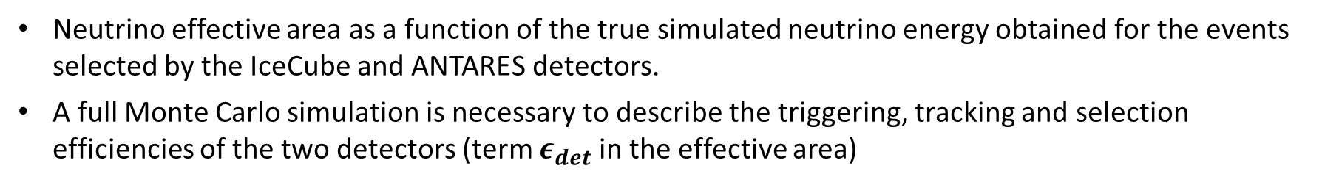
6. Effective areas from «real» detectors
Neutrino effective area as a function of the true simulated neutrino energy obtained for the events selected by the IceCube and ANTARES detectors.
A full Monte Carlo simulation is necessary to describe the triggering, tracking and selection efficiencies of the two detectors (term $ε_{det}$ in the effective area)
The plots refer to the ν_{μ} channel for upgoing particles, selected in order to have angular resolution <1º and small contamination of atmospheric muons

Slide 30
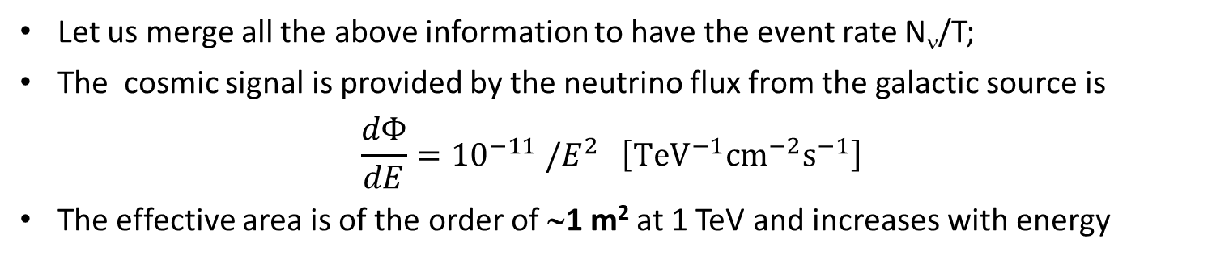

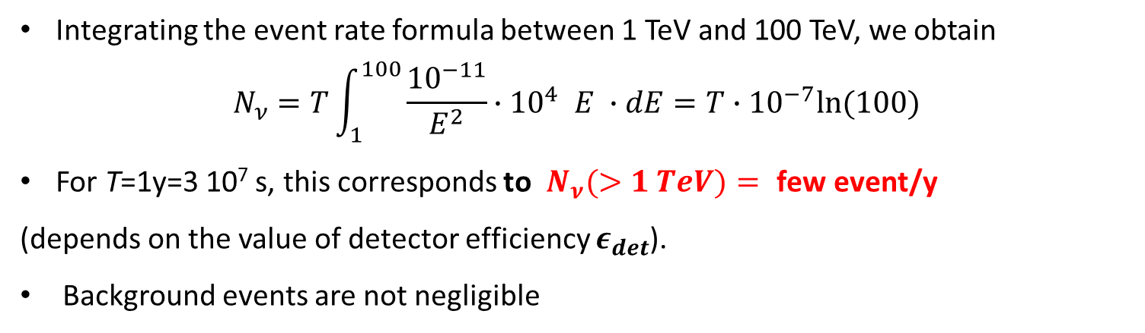
6. Number of expected events in a ν telescope
$$\frac{N_{ν}}{T}=\int{dE∙}\frac{dΦ_{ν}}{dE}∙A_{ν}^{eff}(E)$$
Let us merge all the above information to have the event rate N_{ν}/T;
The cosmic signal is provided by the neutrino flux from the galactic source is
$$\frac{dΦ}{dE}={10}^{−11} /E^{2} \left[{TeV}^{−1}{cm}^{−2}s^{−1}\right]$$
The effective area is of the order of ∼1 m² at 1 TeV and increases with energy
Integrating the event rate formula between 1 TeV and 100 TeV, we obtain
$$N_{ν}=T\int_{1}^{100}{\frac{{10}^{−11}}{E^{2}}}{∙10}^{4} E ∙dE={T∙10}^{−7}ln(100)$$
For T=1y=3 10⁷ s, this corresponds to $N_{ν}(>1 TeV)= \text{few} \text{event}\text{/}\text{y}$
(depends on the value of detector efficiency $ε_{det}$).
Background events are not negligible

Slide 31
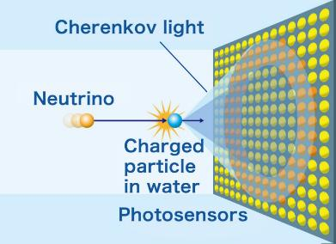
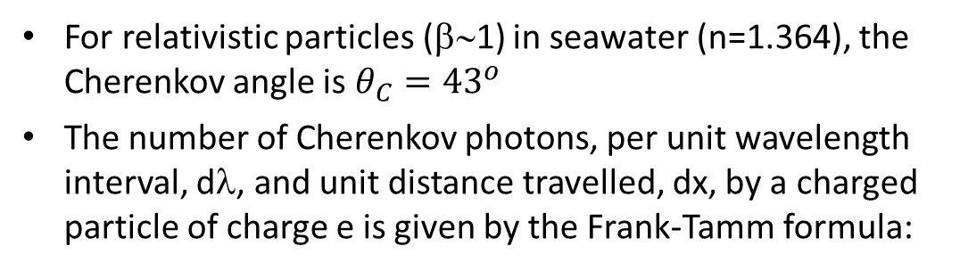
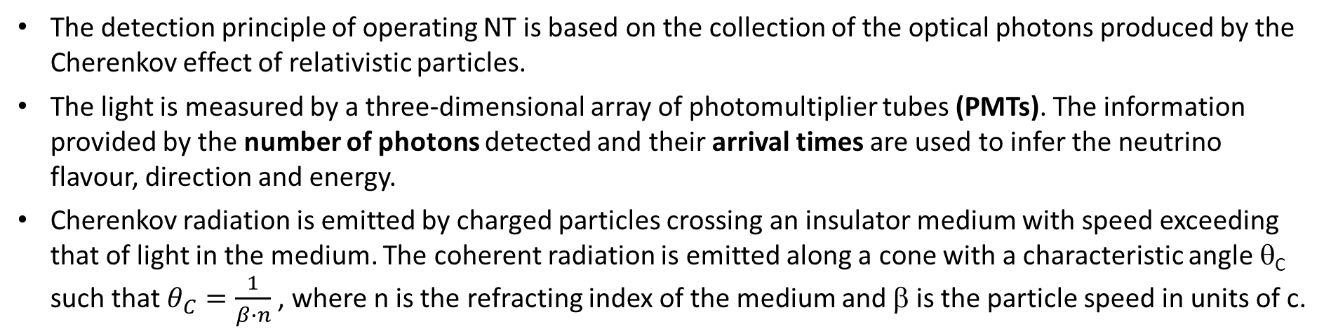
7. Cherenkov light emission
The detection principle of operating NT is based on the collection of the optical photons produced by the Cherenkov effect of relativistic particles.
The light is measured by a three-dimensional array of photomultiplier tubes (PMTs). The information provided by the number of photons detected and their arrival times are used to infer the neutrino flavour, direction and energy.
Cherenkov radiation is emitted by charged particles crossing an insulator medium with speed exceeding that of light in the medium. The coherent radiation is emitted along a cone with a characteristic angle θ_{C} such that $θ_{C}=\frac{1}{β∙n}$, where n is the refracting index of the medium and β is the particle speed in units of c.
For relativistic particles (β∼1) in seawater (n=1.364), the Cherenkov angle is $θ_{C}={43}^{o}$
The number of Cherenkov photons, per unit wavelength interval, dλ, and unit distance travelled, dx, by a charged particle of charge e is given by the Frank-Tamm formula:

Slide 32

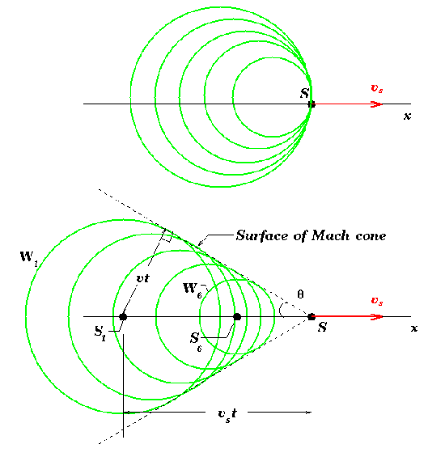
Discussion about…
Cherenkov light emission
The number of Cherenkov photons, per unit wavelength interval, dλ, and unit distance travelled, dx, by a charged particle of charge e is given by the Frank-Tamm formula:
Compute the Cherenkov angle and the number N_{C} of Cherenkov photons in water (n=1.364) in the range 300-600 nm for a β=1, Z=1 particle.
Answer: θ=42° ; N_{C} = 300/ cm

Slide 33
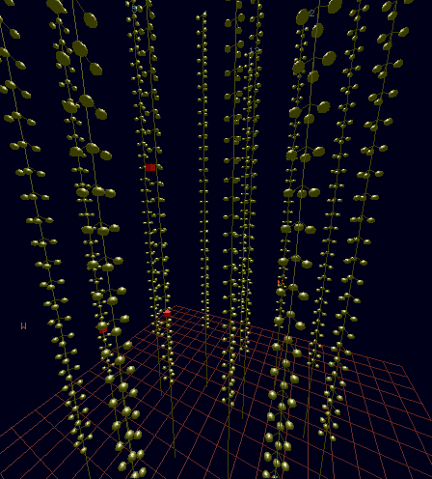
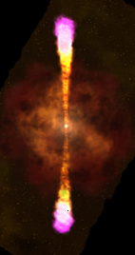

8. Properties of the medium
Event Reconstruction based on time-space correlations of fired PMTs (hits) in the PMTs
Water/ice are transparent only for 300 nm<λ< 600 nm.
The effects of the medium (water or ice) on propagation are absorption and scattering of photons. These affect the reconstruction capabilities of the telescope.
The absorption length is ∼100 m for deep polar ice in the blue-UV region; it is ∼ 70m for seawater.
Scattering is large in polar ice (due to impurities)
Tracks (CC ν_{μ}): Long pattern in the detector
Showers (CC ν_{e}+ NC): Short pattern (point like)
Direction reconstructed from time-space correlation between hits produced by Cherenkov photons
Energy reconstructed from hits amplitudes

Slide 34
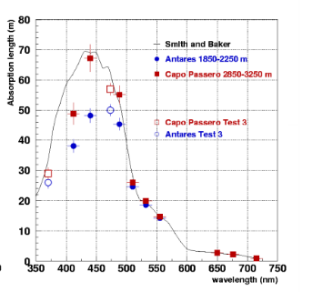
8. Water/Ice properties
Scattering changes the direction of the Cherenkov photons, and consequently delays their arrival time on the PMTs; this degrades the measurement of the direction of the incoming neutrino.
Some characteristic of water:
the position of strings must be monitored due to sea currents
there is bioluminescence and (in seawater) ⁴⁰K.
has a smaller value of the absorption length w.r.t. ice, which is more transparent. The same instrumented volume of ice corresponds to a larger effective volume with respect to seawater.
Some characteristic of ice:
No positioning, no bioluminescence and (almost) no radioacitity
smaller scattering length: this is a cause of a larger degradation of the angular resolution of detected events in ice w.r.t. water.
there are air/dust bubbles that scatter light, degrading the angular resolution of the direction

Slide 35
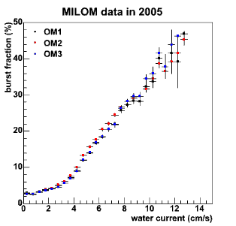
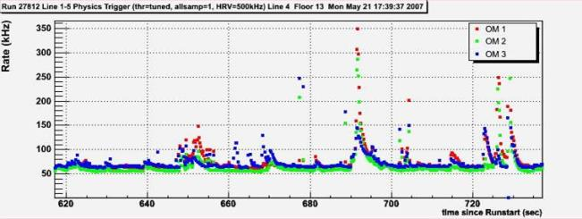

8. Water properties
The water is an homogeneous medium
The medium properties changes with location (+ seasonal, depth )
bursts
baseline
Baseline:
G. Riccobene et al. Astroparticle Physics 27 (2007) 1–9
⁴⁰K decays + bacteria luminescence
Bioluminescence bursts:
Animal species which emit light by flashes, spontaneous or stimulated around the detector.
Periodical
Correlated with water speed

Slide 36
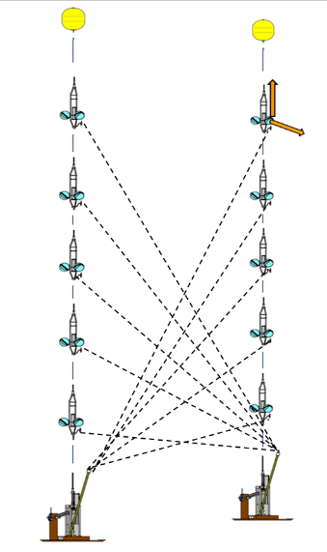


8. Detector positioning in water
Δr<10 cm accuracy on individual OM position
Acoustic system monitoring the OM position vs. time
Additional devices provide independent sound velocity measurements
Figures: ANTARES Data
Exercise: guess why the request of Δr<10 cm
36

Slide 37

8. Ice properties
South Pole Ice= sedimentation of the snow in the last 10⁵ y
Absorption/scattering depend on depth
Only region below 1500 m can be used
M. Ackermann (IceCube Coll.) JOURNAL OF GEOPHYSICAL RESEARCH, VOL. 111, D13203, doi:10.1029/2005JD006687, 2006

Slide 38


9. «Optical modules» containing PMT(s)
ANTARES/IC/Baikal option: 1 PMT/OM
Typical OM efficiency γ→ p.e. : 20%
The KM3NeT (IC-Gen 2?) option: multi-(small) PMTs
31 x 3” PMTs in one OM
  Uniform angular coverage
  Directional information
  Digital photon counting
  Reduced ageing

Slide 39
Discussion about…
How many light sensors?
The scale-dimension for a HE neutrino detector must be >1 km³ (1 Gton mass).
However, after the neutrino interaction, you must detect the Cherenkov photons through optical sensors (PMTs) inside pressure-resistant optical modules (OMs).
The number of OMs is the major impact factor on the cost of the detector.
Assuming:
  the passage of a muon with track L_{μ}=1 km
  to have a 10ʺ PMTs in one OM (as IceCube/ANTARES)
  that N_{p.e.}∼100 p.e. are necessary for track reconstruction
Evaluate how many OMs are needed in 1 km³ detector volume in order to detect N_{pe}~100 p.e.
Discuss the KM3NeT case (small PMTs)
The 100p.e. will be collected by (order) of 10-20 OMs
Answer

Slide 40







10. Neutrino telescopes. Where …
ANTARES
KM3NeT/ORCA
KM3NeT/ARCA
GVD
IceCube

Slide 41




Difference between ice…

Slide 42






… and Mediterranean water

Slide 43

IceCube @South Pole

Slide 44



ANTARES
Details: see arXiv 1409.4552
2500m
Running from 2007 to 2022
885 10” PMTs
12 lines
25 storeys/line
3 PMTs / storey
ANTARES
Km3NeT
40 km to
shore
40 km to
shore
450 m
Junction
Box
70 m
Interlink cables

Slide 45




2500m
450 m
Junction
Box
70 m
Interlink cables

Slide 46

KM3NeT: ARCA/ORCA

Slide 47





KM3NeT technology
~ 700 or 200 m
Rapid deployment
Multiple strings/sea campaign
Autonomous/ROV unfurling
Reusable
Digital Optical Module (DOM)
Multi-PMT : 31 x 3” PMTs
Gbit/s on optical fiber
Positioning & timing
Detection Unit (DU)
18 DOMs
Low-drag design
https://www.youtube.com/watch?v=tzxHlLgAahE
https://www.youtube.com/watch?v=omlFkdCkbYk&t=3s

Slide 48


Part II: NT and multimessenger astrophysics

Slide 49
Excess of events over the atmospheric ν flux
arXiv:2101.12170
$$μ$$
$$ν_{μ}$$
$$ν_{e}$$
In a ∼1 km³ detector
Atmospheric muons: ∼10¹⁰⁻¹¹/y, i.e., 1 kHz
Atmospheric ν◊ μ: ∼10⁵/y, i.e., 1 in 5 min (upgoing)
Cosmic ν◊ μ , e, τ: ∼100/y, mostly hidden in the background
Cosmic signal

Slide 50

I-IceCube High Energy Starting Events
 IceCube PRD 104 (2021), 022002
Mostly cascades with poor angular resolution (>10° )
Selection criteria favor events from Southern sky
Excess of events (>60 TeV) w.r.t. atmospheric background.
Single Power Law (SPL)
$${ Φ}_{ν}=Φ_{astro}{\left(\frac{E}{E_{0}}\right)}^{−γ}$$
The astrophysical origin deduced mainly from their high energies
A Single Power Law assumed to fit the entire energy range, due to the limited statistics.

Slide 51


II-Upward throughgoing tracks
 IceCube ApJ 928 50 (2022)
Upgoing tracks by ν_{μ} interactions, 9.5 y of data→ Northern sky
Relatively poor (good) energy (direction) estimate
Excess (E>100 TeV) over the expected distribution for background events using an unfolding method

Slide 52


III-Cascades: ν_{e} ν_{τ} CC+NC interactions
 IceCube PRL. 125, 121104 (2020)
Showers produced by ν_{e} and ν_{τ} interactions, 6.0 y of data
Relatively poor (good) direction (energy) estimate
Energy range from 16 TeV to 2.6 PeV, all-sky
Boosted Decision Tree based rejection of muons

Slide 53

IV-Enhanced Starting Track Events (ESTES)
 IceCube: arXiv:2402.18026
Selection of starting tracks (ν_{μ} CC) based on a BDT,.
Energy range from 3 to 500 TeV
SPL slightly different from North and South sky
ESTES (4π)
ESTES (South sky)
ESTES (North sky)

Slide 54
Baikal-GVD cascades
 GVD: PRD 107 (2023) 042005
Selection of cascades, events from all sky
To remove the background of atmospheric muons, upgoing events selected (mostly South sky)
Excess w.r.t. atmospheric ν’s > 15 TeV
GVD cascades, 3y
ESTES (4π)
ESTES (South sky)
ESTES (North sky)

Slide 55
Diffuse flux: no a Single Power Law
IceCube: PoS(ICRC23)1064
IceCube: arXiv:2402.18026
No clear agreement with SPL from different samples, in particular below few tens of TeV.
This could be attributed to:
  different energy range of samples
  the different flavor in the samples;
  (most) of Galactic Plane in South Sky.
A segmented fit of the IceCube data (tracks+ cascades) seems represent data better: spectral features visible (between 20-30 TeV)
The starting tracks sample (new) agrees with segmented fit above the 30 TeV feature
ANTARES data also are more compatible with some change of slope at 20-30 TeV. See:
ANTARES JCAP 08 (2024) 038 • arXiv:2407.00328

Slide 56

Point Sources: catalog of TeV γ-rays
http://tevcat.uchicago.edu/
Plot to fill with ν sources
Today: 336 objets
94 Galactic (<15 kpc)
Out of the Galactic Plane: AGN
  8 AGN with 0.5<z<1
  18 AGN with 0.2<z<0.5
  28 AGN with 0.1<z<0.2
  23 AGN with 0.001<z<0.1
  7 GRBs (transient)
North sky
South sky
Mediterraneo
Blazars are powerful AGN with relativistic jets directed at the Earth.
Not all blazars are γ-ray sources, but they constitute the dominant population
Seyfert are visible galaxies with active nuclei (unusually bright core regions).

Slide 57
ν_{μ} from the blazar TXS 0506+056 (I)
 IceCube:Science 361 (2018)eaat1378
 IceCube:Science 361 (2018)eaat2890
An electromagnetic follow-up campaign followed the IC ν_{μ} event (angular resolution < 1º)
FERMI-LAT and MAGIC observations indicate that this event correlate with the blazar (BL Lac object or FSRQ?) TXS 0506+056 at redshift z=0.3365
After the coincident event, a ν-flare but without associated γ−rays found in archival IceCube data.
A further analysis of archival IceCube data revealed a precedent ν burst with excess of (13±5) events.
No significant EM flaring activity during the ν burst
Two potential ν flares of very different nature
Not simple theoretical interpretation

Slide 58

IceCube 2π sr sky survey
 IceCube:DOI 10.1126/science.abg3395 (2022)
NGC-1068
Neutrino candidates vs. (angular distance)² from source.
79±22 events in excess
110 selected sources. Found 3 sources with > 3σ pre-trial.
Use of up-going muon tracks
The astrophysical origin of the ν excess deduced mainly from directional clustering, not from their high energies
NGC 1068 (M77), close AGN (10 Mpc), not TeV γ-rays
TXS 0506+056, z=0.336 (1.8 Gpc), γ-rays from 80 to 400 GeV
PKS 1424+240, z=?

Slide 59


Results of neutrino sky map
 IceCube:DOI 10.1126/science.abg3395 (2022)
NGC 1068: neutrino energies in a range not well measured with the diffuse flux.
Best-fit spectral index of γ = 3.2±0.2, softer than the diffuse flux
TXS 0506+056 is >100 times farther away than the near NGC 1068: there are at least two populations of neutrino sources that differ in luminosity by orders of magnitude.
The TXS 0506+056 time-integrated emission in 10 y has pre-trial of 3.5 σ (i.e. n_{s}=5).
The Science 2018 result provided evidence for transient emission with n_{s} = 13±5 in 6 months.
If the TXS 0506+056 findings are both corrects, the population of HE (100 TeV range) ν’s could be significantly influenced by transients
My estimation, assuming the flux of transient flare
Spectral Energy Distribution of IC diffuse flux and of NGC and TXS sources.

Slide 60
Origin of the (diffuse) extragalactic ν’s
For a recent review: see the 377 refs in
 Fiorillo, Universe 2024, 10, 149
To identify ν sources, different strategies are adopted in IceCube, ANTARES, Baikal-GVD and KM3NeT:
  searches for multiplets of events from close directions in the sky
  searches for temporal and spatial correlations with transients
  cross-correlation of ν angular distribution with catalogs
  the analysis of the neutrino angular power spectrum
 Becker Tjus, Merten, Phys. Rep. 872 (2020) 1
Sources candidates
AGNs jets: about 1-10% of the AGNs. Blazars=jets towards the Earth. TXS 0506+056
AGNs cores (Seyfert,…): ν produced in an optically thick region that absorbs γ−rays. NGC 1068
GRBs (or choked/low-luminosity GRBs)
Starburst galaxies
Tidal Disruption Events (TDEs)
Clusters of galaxies
Galaxy & Galaxy Cluster mergers
Beyond the Standard Model (BSM)
…

Slide 61

Open problems with the identification of sources
Public catalogues have also been used by many authors in >>377 refs
Positive correlations (also >3σ) between ν and selected catalogues have disappeared or significantly reduced after a new release of ν candidates appears.
The ν catalogs released by Collaborations are “work in progress” as they can be improved in the future
The accuracy of reconstruction of the ν properties is limited by systematics: new refined statistical analysis, improved reconstruction/ calibration can lead to a significant improvements in ν direction/energy.
The reduction of “>3σ” is true also for the TXS 0506+056 burst (arXiv:2307.14559)
Analysis of data of independent experiments, with uncorrelated systematic errors, could be recommended to reduce incorrect associations
Warning for young researchers: the machine learning involves a training dataset with characteristics based on MC simulations can be affected by the medium properties (water is more homogeneous that ice, but it needs calibrations)

Slide 62
Neutrinos from the Galaxy

Slide 63
IceCube: Neutrinos from the Galaxy
DOI: 10.1126/science.adc9818
Use cascade events (“showers”), making use of “veto” capabilities of the detector
Angular precision of showers intrinsically worse than the track-channel
Model-dependent, due to the impossibility to evaluate the background using data
Tested on 3 models based on neutrino production from γ-ray observations
Three “results” priduced

Slide 64

The ANTARES method
Physics Letters B841 (2023) 137951
Model-independent measurement
Use track-like events (more precise direction)
On-Off method (i.e., ratio of events from the signal region to off-zone regions)
Observed a 2.2σ excess from signal region
Possible due to the Earth rotation and detector location not at the Pole

Slide 65
Galactic and extragalactic neutrinos (I)
 IceCube: PoS(ICRC2023)017
Normalized for unit solid angle
IceCube diffuse flux

Slide 66

Galactic and extragalactic neutrinos (II)
 IceCube: PoS(ICRC2023)017
 IceCube: science.adc9818
Galactic ν’s
Averaged over the whole 4p with the same weigh (my incorrect approx.)

Slide 67
Galactic and extragalactic neutrinos (III)
 IceCube: PoS(ICRC2023)017
 Fang, Halzen-arXiv:2404.15944
ARGO-YBJ
LHAASO-KM2A
Tibet A
Tibet
Tibet A region:
|b|<5º , 25º <|l|<100º =0.23 sr
Points: γ-ray experiments.
Blu line: ν (3 flavors) and
Red line : γ-ray prediction as in arXiv:2404.15944

Slide 68

Galactic and extragalactic neutrinos (I)
 IceCube: PoS(ICRC2023)017
IceCube diffuse flux

Slide 69



KM3-230213A
69
 Nature 638 (2025) 8050, 376-382

Slide 70

An exceptionally-high-energy event (21 strings)
Horizontal event (1° above horizon) as expected since earth opaque to neutrinos at PeV scale
Side view
Top view

Slide 71

KM3-230213A: incoming direction
71
 Nature 638 (2025) 8050, 376-382
Event almost horizontal (1º above horizon), as expected for UHE neutrinos
Exceedingly unlikely for atmospheric muon to travel through that much water/column depth
atmospheric muons
140 km
neutrino
muon

Slide 72


Uncharted Territory
KM3-230213A: An exceptionally high-energy event
Proxy for the event energy: the number of fired PMTs and the number of photoelectrons (p.e.)
Search for events with large amount of p.e. One with huge amount of light
3672 PMTs (i.e. 35% of the whole detector) were triggered
Muons simulated at 10 PeV almost never generate this much light, likely multiple 10’s of PeV
~1 evt/y in IceCube
μ
1 in 110 million data events
~1 evt/10 y in IceCube
ν
Cos(Zenith angle)

Slide 73


KM3-230213A: Energy estimate
73
 Nature 638 (2025) 8050, 376-382
Muon energy from the amount of light:
$$E_{μ}={120}_{−60}^{+110} PeV$$
The neutrino energy (assuming an E⁻² source spectrum) is higher
$$E_{ν}={220}_{−100}^{+570} PeV$$
Notes:
On estime l’energie sur les hits triggés, pour eviter les afterpulses.
D’autres estimatimeurs donnent plus ou moins les memes resultatS.

Slide 74










KM3-230213A: Energy estimate
74
Position of light emission along track consistent with hit time assuming direct light
Light profile consistent with at least 3 large energy depositions along the muon track
Characteristic of stochastic losses from very high energy muons
t_{hit}
v = c/n
t₀
v = c
x
74
Notes:
Gauche : Résidus sur modules optiques d’une ligne. On utilize les informations de la somme de chaque PMTs.
Droite : les modules optiques à une certaines distances : peu d'

Slide 75
Unexplored energy regime
75
 Nature 638 (2025) 8050, 376-382
 e-Print: 2502.08173
LHC@CERN
Previous highest
Energy neutrino
This observation
Factor ~30
Intensity of neutrinos

Slide 76


Extragalactic sources ?
76
 e-Print: 2502.08484
Candidate blazars selected through multi-wavelength properties.
→ Correlation non conclusive.
Notes:
17 candidats blazars – 12 du papiers Natures + observations radios
Reprendre les figures 1 et 2 du papier compagnons

Slide 77

Multimessenger: the GCN/AMON networks
The GCN is a system that distributes information (notices) about GRBs and other transients detected by various ground and space experiments and receives and distributes messages (circulars) about follow-up observations to interested individuals and institutions.
AMON searches for multimessenger transients using the messenger particles of all four fundamental interactions. Follow-up Observatories receive and respond to AMON alerts
  Triggering: IceCube, ANTARES, Pierre Auger, HAWC, VERITAS, FACT, Swift BAT, Fermi LAT & GBM, LIGO-Virgo*
  Follow-up: Swift XRT & UVOT, VERITAS, FACT, HESS, MAGIC, MASTER, LCOGT

Slide 78
The multi-messenger approaches
Receiving alerts
Sending alerts

Slide 79







KM3NeT online alert system
Tasks running in parallel: output within few sec
ANTARES/IceCube
Sending alert within 15s-60s from the event
Angular resolution, depending on event type (track ∼ 1º, showers 10º)
“signalness”
Online Calibration
(charge, time, positioning)
Time and charge of all PMTs over threshold to the computer farm (100 km away)
Track reco
1
Alert sending
Shower reco
Data filter
SN identification
2
Online searches
Data monitoring
“L0” buffering

Slide 80








Multimessenger: Info dissemination from NT
GW
LIGO, VIRGO
Optical Telescopes
(MASTER, Tarot,
ZADKO,…
ν !
X-ray satellites
Swift…
Radio Telescopes
WMA, …
Cherenkov Telescopes
MAGIC, HESS, Veritas,…

Slide 81

Multimessenger: external alert to NT
ν ?
GRB
GW
Supernova
FRB

Slide 82
Conclusions
ν fundamental probe to identify the production sites of high energy cosmic particles and test the neutrino sector of the SM and BSM
Cosmic neutrinos exist, but the sources still largely unknown
Few sources have compelling evidence of neutrino emission
ν are key ingredient of multi-messenger astronomy for the quest of hadron accelerators
A ν telescope in the Mediterranean Sea is fundamental to complement the of IceCube at South Pole
Galactic “TeV-PeVatrons”: necessary a ν telescope in the Northern hemisphere
ν telescopes: opportunities for precision measurements in ν physics
Today, astroparticle physics with multi-messenger probes is paving the way for the future of particle physics, after the next generation of collider.
Only knowing the beams (=accelerators and space medium) you can study the underlying properties of particles and interactions

Slide 83
Spares

Slide 84





Neutrinos from Galactic sources

Slide 85



Physics: effect of neutrino oscillations
Neutrino flavour ratio at sources$Φ^{0}\left(ν_{e}\right):Φ^{0}\left(ν_{μ}\right):Φ^{0}\left(ν_{τ}\right)=1 :2 :0$
Propagation: $P_{αβ}≡P\left(ν_{α}→ν_{β}\right)=\sum_{j}{|U_{αj}|^{2}|U_{βj}|^{2}}$
Flavour ratio at Earth (see §12.6 of [1]): $Φ^{T}\left(ν_{e}\right):Φ^{T}\left(ν_{μ}\right):Φ^{T}\left(ν_{τ}\right)=1 :1 :1$
Thus, at Earth:
2γ = 2 ν_{μ}
$$Φ_{γ}\left(E\right)=Φ_{ν_{μ}}\left(E\right)$$
*
* NOTE: This is not completely correct, at a fixed energy, when decay kinematics are taken into account. See: Villante, Vissani Phys.Rev. D78 (2008) 103007

Slide 86
Answers to discussion arguments

Slide 87

Attenuation of 100 TeV gamma-rays
The process is the γ−γ interaction of the HE photon (E_{γ} ) against the CMB (E_{CMB}∼1 meV) with (n_{CMB}=400/cm³) and the creation of an e⁺e⁻ pair
The kinematics is identical to that of the GZK effect (see §7.5.2 of [1]). The energy of the photons must be almost equal to the energy necessary for the creation of 2m_{e}, i.e.
$$E_{γ}=\frac{(2m_{e})^{2}}{2E_{CMB}(1−cosθ)}≅\frac{{4m}_{e}^{2}}{{4E}_{CMB}}≅\frac{1 {MeV}^{2}}{{4×(1.2 10}^{−3}eV)}≅{10}^{14} eV$$
The Feynman diagram:
The e⁺e⁻ cross section for the EM annihilation at low energies is
$σ≅\frac{2πα^{2}}{s}(ℏc)^{2}=\frac{2π(1/137)^{2}}{(2m_{e})^{2}}\left(0.4 GeV^{2}mb\right)=$ 0.13 barn
Thus, the mean free path $ℓ=(σn_{CMB})^{−1}$is:
$ℓ=(0.13∙{10}^{−24}×400)^{−1}=2 {10}^{22}cm=6000 pc$.

Slide 88

Neutron decay
The Lorentz factor is $γ=\frac{E}{m}=\frac{{10}^{9}}{1}$ thus
$L=γcτ={10}^{9}×3 {10}^{10}×1000=3 {10}^{22}$cm
1 pc = 3 x 10¹⁸ cm, thus $L={10}^{4} pc$
O(10 kpc) is the typical radius of a spiral Galaxy

Slide 89


Neutrino cross section
The cross section $σ=1.5×{10}^{−34}{\left(\frac{E}{10 TeV}\right)}^{0.4}$ (see red dashed line)
The $Q^{2}=2m_{N}E_{ν}$ term in the propagator cannot be neglected w.r.t. the ${\left(m_{W}\right)}^{2}$
The $\overline{{ ν}_{e}}e$ scattering occurs through the “t” channel. But at the energy of the formation of a formation of a W- in the “s” channel, there is a resonant enhancement of the cross section.
This occurs at energy $2m_{e}E_{ν}=m_{W}^{2}$ or
${ E}_{ν}={\frac{m_{W}^{2}}{2m_{e}}}_{}^{}$= 6.3 PeV

Slide 90

Comparision with LAT effective area
Fermi-LAT effective area vs. E for normal γ-ray incidence
Fermi-LAT = pair-conversion telescope
The A^{eff} is a fundamental quantity: The number of observed events is the integral over energy of the neutrino flux [cm² s GeV]⁻¹ with A^{eff} [cm²]
LAT: Almost 90% of incoming γ-rays are detected (=converted into observable particles), if the g-ray is within the correct energy range. Below, the tracks are too short to be observed; at higher energies, the containment of the calorimeter is insufficient.

Slide 91
How many sensors in a 1km³ NT
1) In the ANTARES/IC OMs
N_{γ}= L_{μ} ×300 Čγ/cm= 3x10⁷ Čγ
N_{pe}= (OMs× V_{OM} × N_{γ} × ε_{QE} )/1 km³
=100
10” PMT =0.05 m²
OMs=5000
This is the order of OMs buried in IceCube. ANTARES has 900 OMs
For KM3NeT the area of 31 PMTs of 3’’ is equivalent to that of 3PMTs of 10’’. Thus, 1/3 of OMs are needed
L_{ass}~60 m
V_{OM}= 3 m³

