Slide 1
XI.
Atmospheric Muons and Neutrinos
Astroparticle Physics a.a. 2023/24
Maurizio Spurio
Università di Bologna e INFN
maurizio.spurio@unibo.it

Slide 2
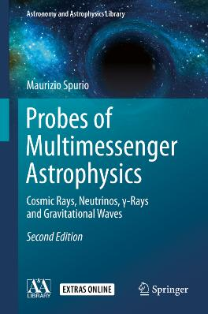
Content

Slide 3
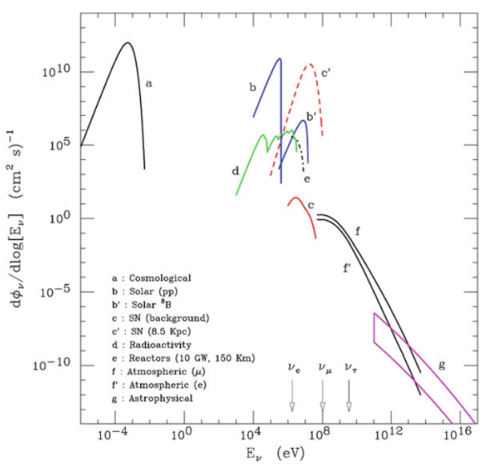
Neutrinos from the Cosmos
Flux of neutrinos at the surface of the Earth.
Arrow indicate the energy threshold for CC production of the charged lepton
Big Bang neutrinos (no)
Neutrinos from the Sun (Chap. 12)
Neutrinos from SNe (Chap. 12)
Atmospheric neutrinos (Here)
High-energy cosmic neutrinos (Chap. 10)

Slide 4
Once upon a time… GUT
In the ‘80 Grand Unified Theories (GUT) predicted the proton decay with measurable livetime of the order of τ=10³⁰ y (20 orders of magnitude 1/H_{o})
QUESTION: Which is 1/H_{o}?
The proton was thought to decay in (for instance) p→e⁺π⁰
Detector size: 10³ m³, and mass 1kt (=10³¹ p)
The background for the detection of proton decay were atmospheric neutrinos interacting inside the apparatus
QUESTION: How many p decays in 1 kt for τ= 10³⁰ y, assuming 100% efficiency?
Water Cerenkov Experiments (IMB, Kamiokande)
Tracking calorimeters (NUSEX, Frejus, KGF)
Result: NO p decay ! But some anomalies on the neutrino measurement!
γγ
Neutrino Interaction
e
Proton decay

Slide 5
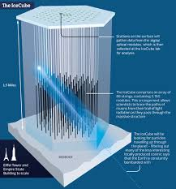
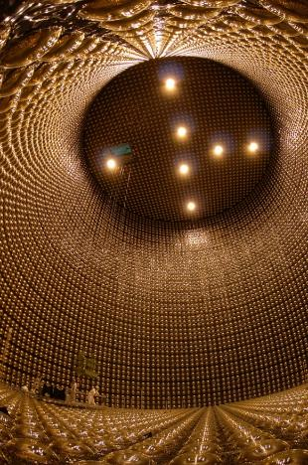
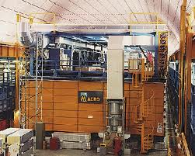
General problems for ν detectors
Low cross section→ Large detector volume/mass
Particle identification
Energy/momentum measurement
Direction measurement
No magnetic field (ν =‾ν)
Backgrounds

Slide 6
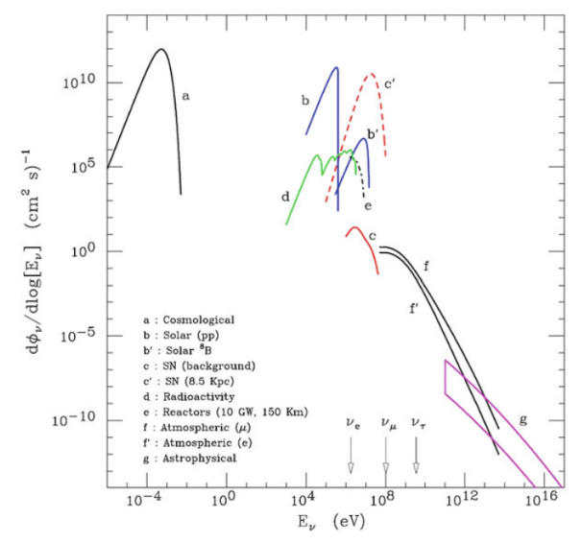
Atmospheric neutrinos
Flux of neutrinos at the surface of the Earth.
Arrow indicate the energy threshold for CC production of the charged lepton
Big Bang neutrinos
Neutrinos from the Sun
Neutrinos from SNe
Atmospheric neutrinos
High-energy cosmic neutrinos

Slide 7
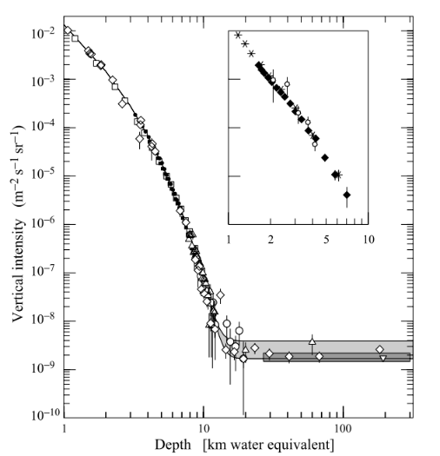
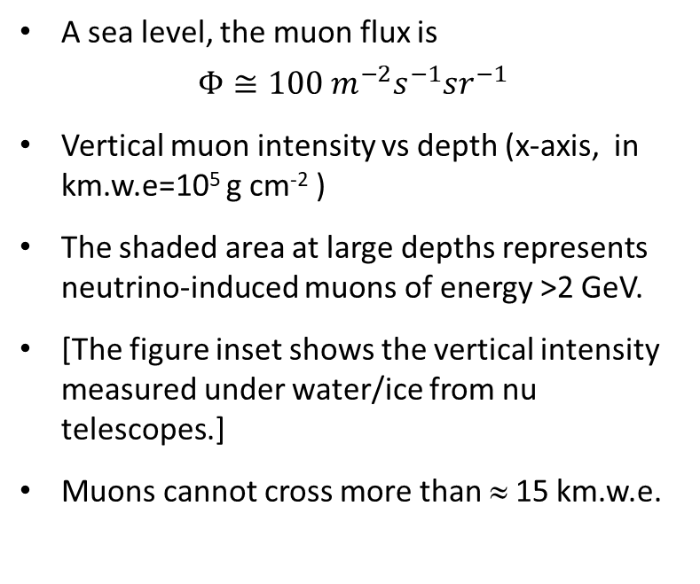
The flux of atmospheric muons vs depth
A sea level, the muon flux is
$$Φ≅100 m^{−2}s^{−1}{sr}^{−1}$$
Vertical muon intensity vs depth (x-axis, in km.w.e=10⁵ g cm⁻² )
The shaded area at large depths represents neutrino-induced muons of energy >2 GeV.
[The figure inset shows the vertical intensity measured under water/ice from nu telescopes.]
Muons cannot cross more than ≈ 15 km.w.e.

Slide 8
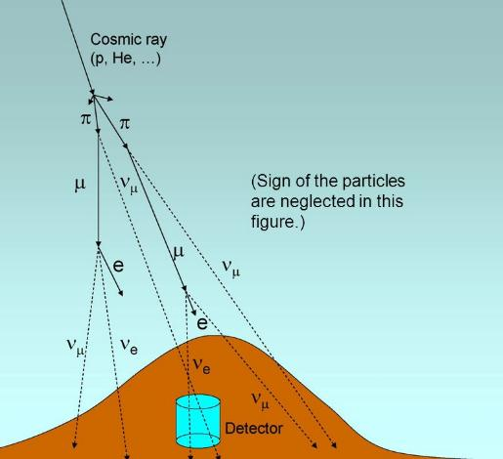
Recipes for the evaluation of the atmospheric flux
Independently from the details of the computation of Φν_{μ} (E), Φν_{e}(E), one can obtain two very robust properties:
At energies below few GeV, the flux of ν_{μ} is approximately twice as large as the νe, i.e.:
Φ(ν_{μ})= 2Φ(ν_{e})
The ν_{μ}, ν_{e} fluxes are up-down symmetric in zenith θ, i.e.:
Φ _{ν} (E_{ν}, θ) = Φ _{ν} (E_{ν}, π − θ)
Question 1: why Φ(ν_{μ})= 2Φ(ν_{e}) not hold at higher (>> GeV) energies?

Slide 9
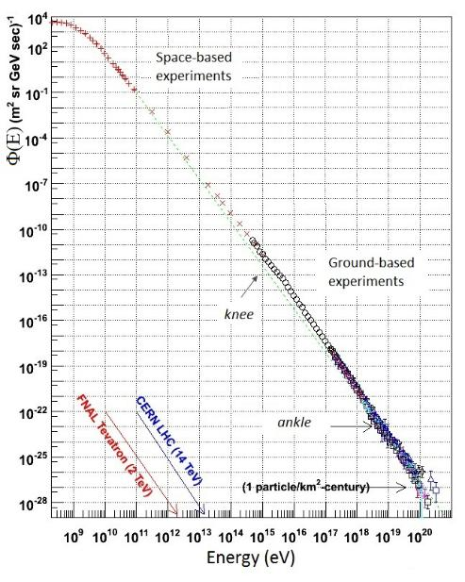
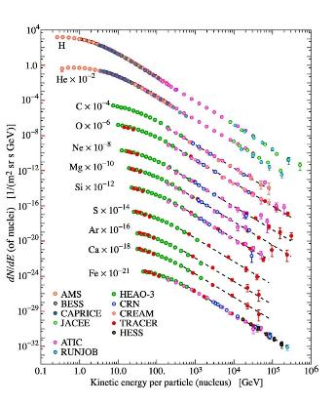
Ingredient 1) The primary CR spectrum
Skyp
Direct measurements
Indirect measurements

Slide 10




Ingredient 1) Cascade initiated by primary CRs
Primary CR attenuation as function of X (g cm⁻²) and E
Boundary condition:
From Feyman scaling:
The dependence on X depends on an effective attenuation length Λ_{N}:
Skyp

Slide 11
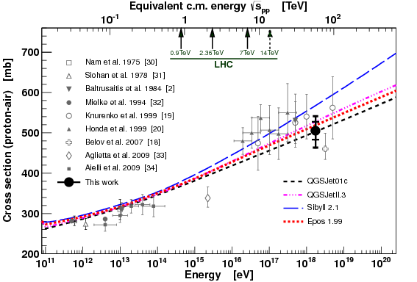
Ingredient 2) p-air cross section
Skyp
AUGER Coll. PRL 109 (2012) 062002

Slide 12
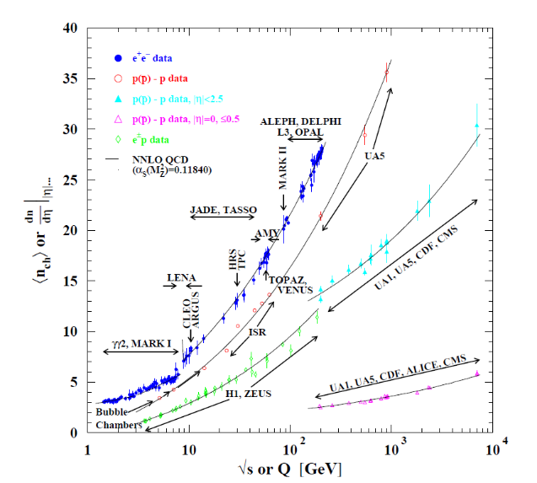
Ingredient 3) Secondary charged multiplicity
Skyp
Average number of charged hadrons produced in pp (and‾pp), e+e-, ep collisions versus center of mass energy

Slide 13
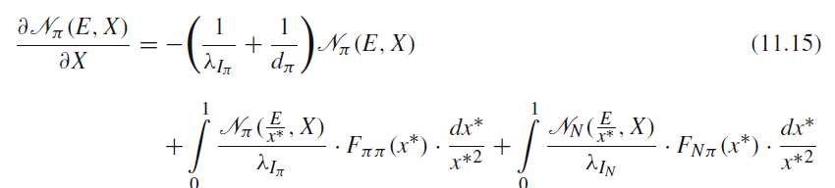

Ingredient 2), 3) → meson production
Skyp
The pion propagation in atmosphere is described by:
Competition between interaction and decay . The decay length:
The pion decay constant ε_{π}=115 GeV.
Pions start to increase with increasing depth X, reach a maximum and then decrease

Slide 14
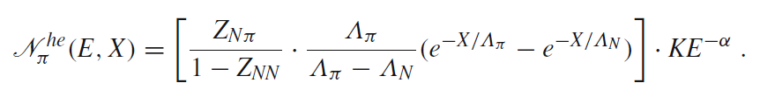


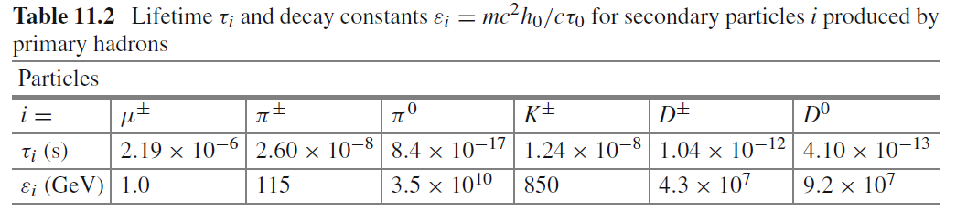
Ingredient 2), 3) → meson production
High-energy limit (E>> ε_{π} ): the decay term d_{π} can be neglected:
(the Z are the the spectrum weighted moments)
Low-energy limit (E cosθ << ε_{π} ): we neglect the term λ_{Iπ}.
Similar equations hold for other particles with different decay constants:
Skyp

Slide 15
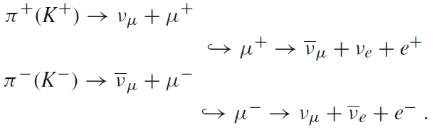



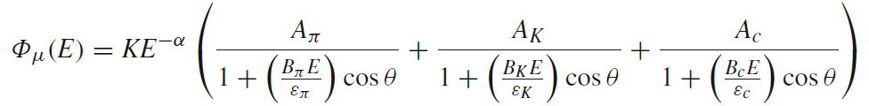
Ingredient 2), 3) → neutrino production
Skyp
Conventional muons are produced by π and K decays:
}
Prompt muons by the decay of charmed mesons.
The muon flux is thus described by the equation:
The muon neutrino flux follows similarly.

Slide 16
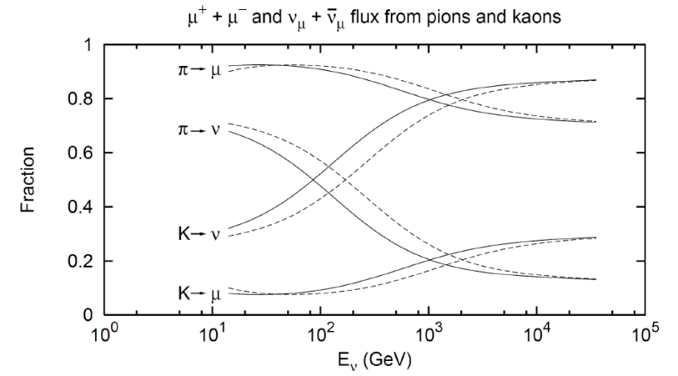
The conventional ν flux: π and K
Solid lines: vertical, dashed lines: zenith 60º
Skyp

Slide 17
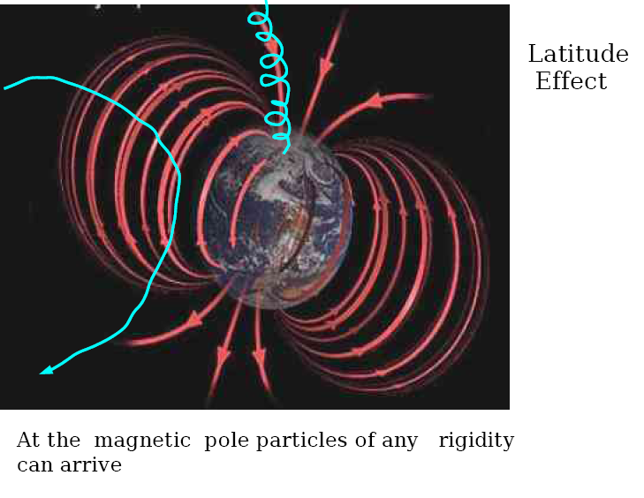
Ingredient 4) Solar effects+geomagnetic field
high precision 3D calculations,
refined geomagnetic cut-off treatment (also geomagnetic field in atmosphere)
elevation models of the Earth
different atmospheric profiles
geometry of detector effects
Skyp

Slide 18
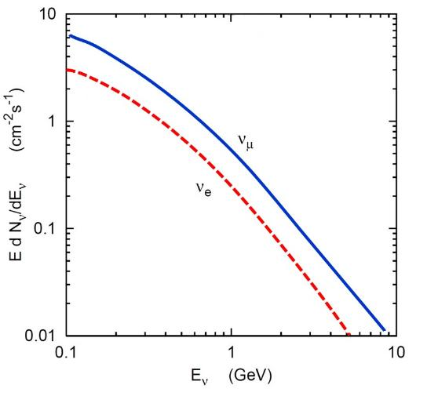
The conventional ν flux (Honda)
M. Honda, et al. Phys. Rev. D 92, 023004 (2015)
The result of one of such calculations: the ν flux prediction (Honda) from MC simulations;
Different models exist;
Question 2: Compute the number of ν interaction/y for E_{ν}>1 GeV in 1 kton detector (ε=1)
Question 3: Explain qualitatively the (ν_{μ}/ν_{e}) ratio
Question 4: Explain qualitatively why the (ν_{μ}/‾ν_{μ}) ratio increases with energy

Slide 19
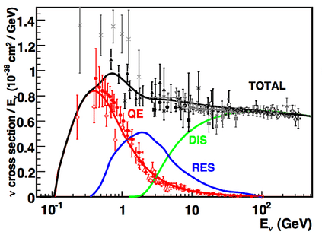
Neutrino interactions and cross section
Energy threshold
ν_{e} > 0.5 MeV
ν_{μ}>105 MeV
ν_{τ}>1700 MeV
Different processes for the neutrino interaction on nucleons
QE: warning to the conservation laws!
Question: why we do not mention the neutrino cross-section on electrons?
Which is the expected behavior for ν+e?

Slide 20
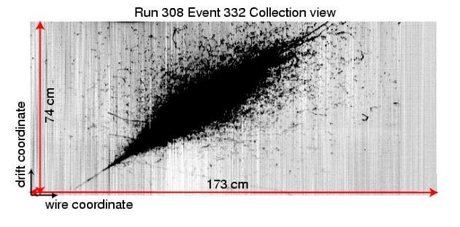
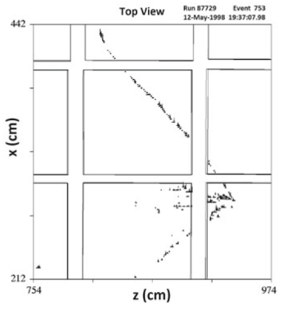
Measurement of atmospheric ν‘s
Example: Soudan II@ USA
ν_{e}= cascade
Example: Icarus@ Gran Sasso
ν_{μ}=track

Slide 21
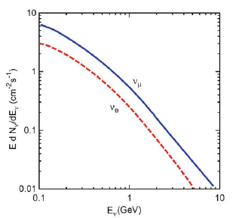
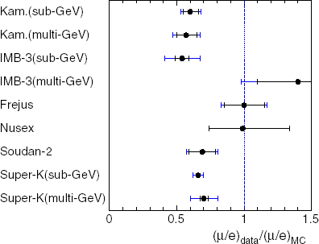
Early measurement of atmospheric ν‘s (<1990)
Tracking calorimeter: Frejus, Nusex, Soudan (hard to find pictures on the web!)
Water Cherenkov: IMB, Kamiokande
Measured the number of neutrino interaction in the detector, separating tracks (=ν_{μ}) from showers (=ν_{e})
Intergral flux of atmo ν’s vs energy
T. Kajita, New J. Phys. 6 (2004) 194.

Slide 22
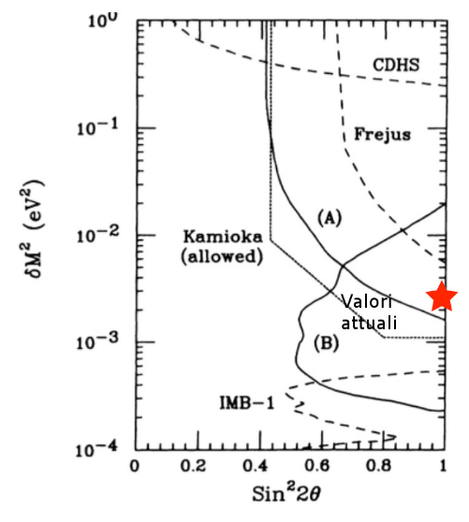
(Early) measurement of atmospheric ν‘s
Tracking calorimeter: Frejus, Nusex, Soudan.
Water Cherenkov: IMB, Kamiokande
Measured the number of neutrino interaction in the detector, separating tracks (=ν_{μ}) from showers (=ν_{e})

Slide 23
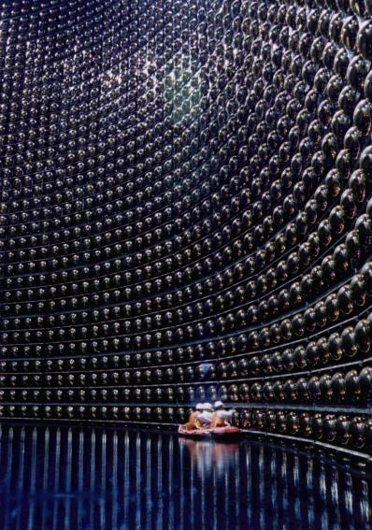
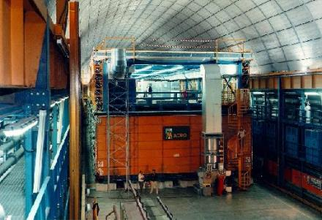
The golden age (1995-2002): SK and MACRO
SuperKamiokande (SK) is located in Japan, 1000 m Underground (1996 →
MACRO was located at LNGS in Italy (1990-2000)

Slide 24
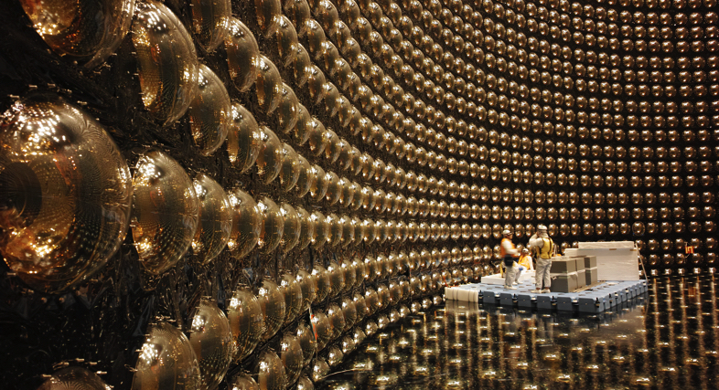
Super-Kamiokande
SuperKamiokande (SK) is located in Japan, 1000 m Underground
Active since 1996
Filled 50.000 ton water
11000 large PMTs +2000 PMTs

Slide 25
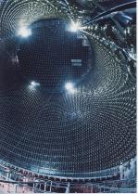
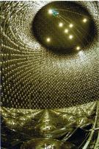
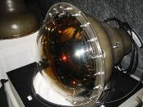
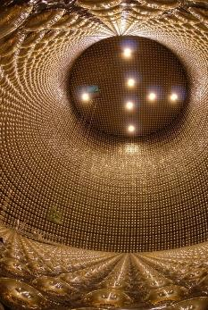
25 years of Super-Kamiokande
1996.4 Start data taking
1998 Evidence of atmospheric ν oscillation (SK)
1999.6 K2K started
SK-I
2001 Evidence of solar ν oscillation (SNO+SK)
2001.7 data taking was stopped
for detector upgrade
2001.11 Accident
2002.10 data taking was resumed
SK-II
2005 Confirm ν oscillation by accelerator ν (K2K)
SK-III
2006.7 data taking was resumed
2005.10 data taking stopped for full reconstruction
SK-IV
2009 data taking
2018.5 Stop SK-IV
2019.1 Start
SK-V

Slide 26
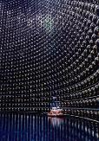
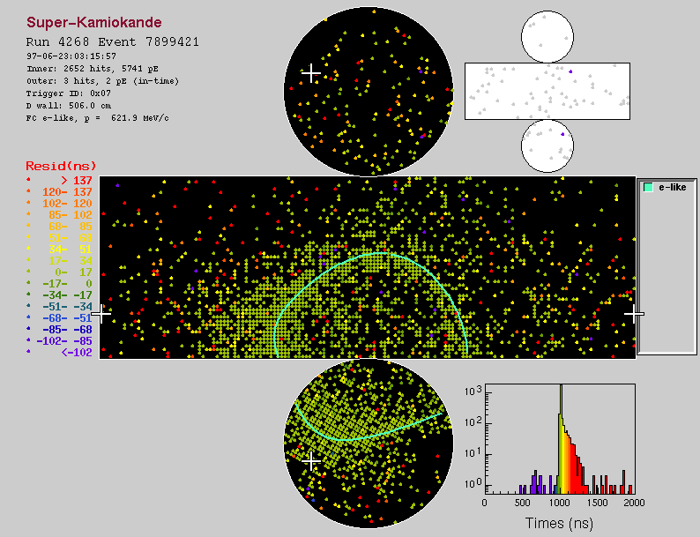
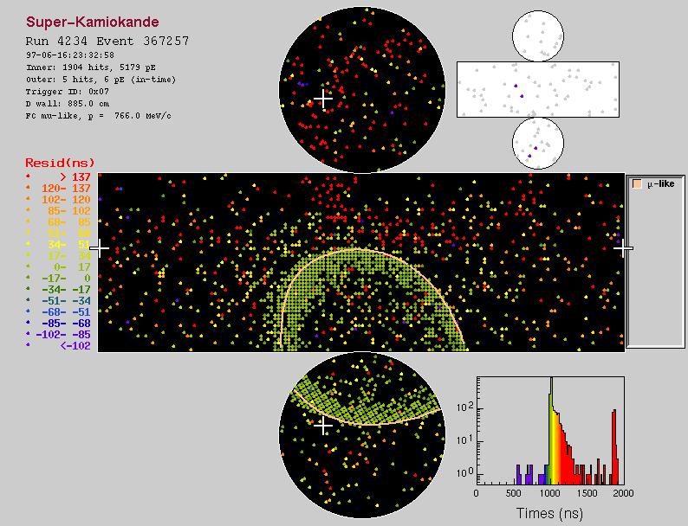
SuperKamiokande: ν_{e}

Slide 27
SuperKamiokande: ν_{μ}

Slide 28
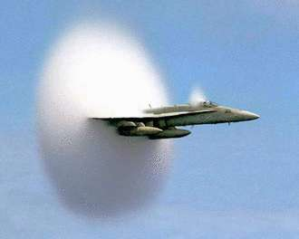
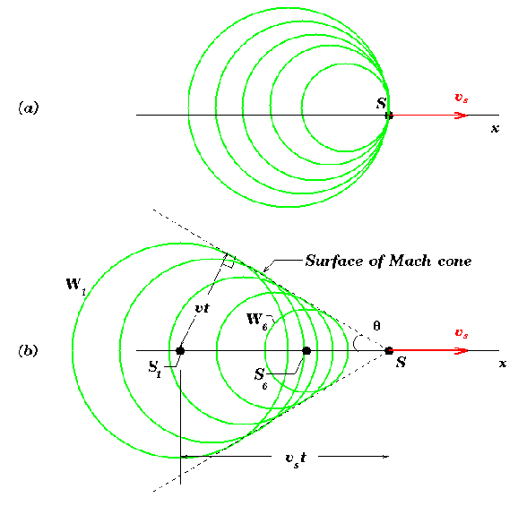
Cherenkov Radiation
As a charged particle travels, it disrupts the local electromagnetic field (EM) in a medium.
Electrons in the atoms of the medium will be displaced and polarized by the passing EM field of a charged particle.
Photons are emitted as an insulator's electrons restore themselves to equilibrium after the disruption has passed.
In a conductor, the EM disruption can be restored without emitting a photon.
In normal circumstances, these photons destructively interfere with each other and no radiation is detected.
However, when the disruption travels faster than light is propagating through the medium, the photons constructively interfere and intensify the observed Cerenkov radiation.

Slide 29
Cherenkov Radiation
Threshold velocity β_{T} = 1/n → θ_{T} ~ 0
Angle of emission (β=1): θ_{max}= arcos(1/n)
Distribution of emitted photons:
Question 5: Evaluate the number of Cherenkov photons in water in the λ=300-600 nm interval for a relativistic single charged particle

Slide 30
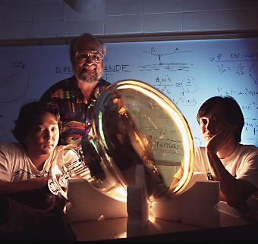
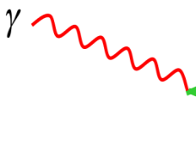
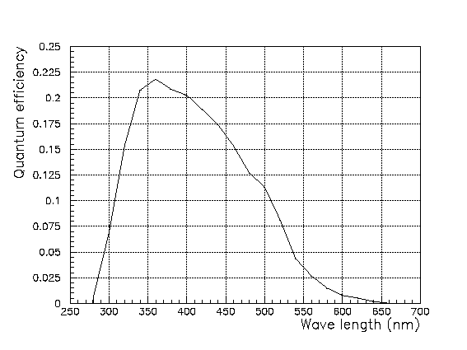
The PMTs
Quantum efficiency (Q.e.)= probability that an incoming photon of a given wavelength produces a signal

Slide 31
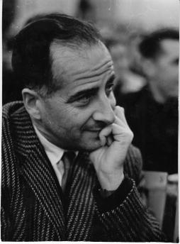

The discovery of neutrino masses
Neutrino are massless in the Standard Model
Lepton flavour is strictly conserved in SM
Idea of neutrinos being massive was first suggested by B. Pontecorvo, from proposal of neutrino oscillations
|ν_{e}> , |ν_{μ}> , |ν_{τ}> =Weak Interactions (WI) eigenstats
|ν¹> , |ν²> , |ν³> =Mass (Hamiltonian) eigenstats

Slide 32
The Pontecorvo-Maki-Nakagawa-Sakata matrix
We are here

Slide 33
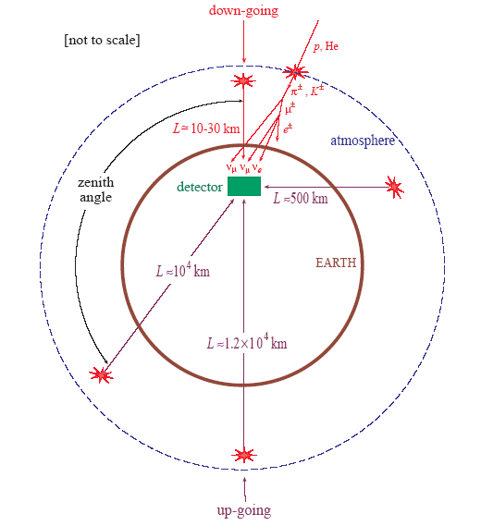
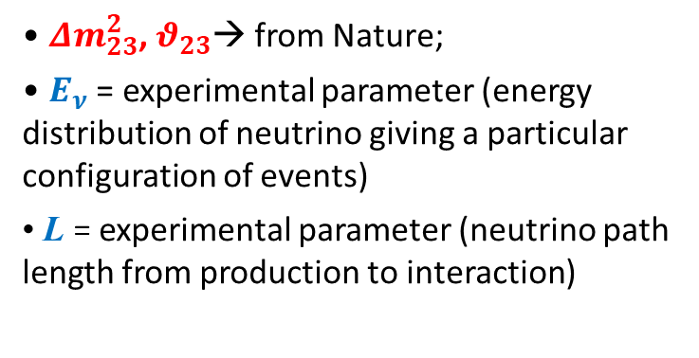
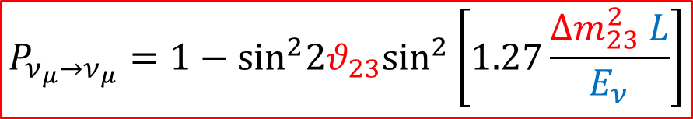
…with atmospheric neutrinos
$$P_{ν_{μ}→ν_{μ}}=1−{\text{sin}}^{2}{2θ}_{23}{\text{sin}}^{2}\left[1.27\frac{Δm_{23}^{2} L}{E_{ν}}\right]$$
$Δm_{23}^{2}$, $θ_{23}$→ from Nature;
$E_{ν}$ = experimental parameter (energy distribution of neutrino giving a particular configuration of events)
L = experimental parameter (neutrino path length from production to interaction)

Slide 34
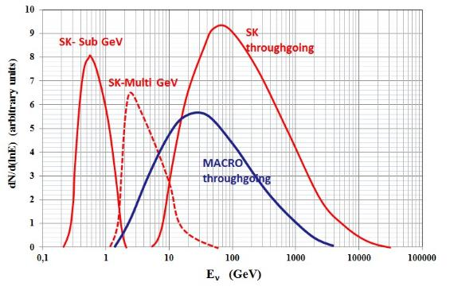
ν energy/direction: event topology
ν
Fully
Contained
ν
Partially Contained
Through going μ
Stopping μ
μ
μ
μ
ν
ν
Energy spectrum (Monte Carlo) of atmospheric ν seen with different event topologies (Super-Kamiokande, MACRO)

Slide 35
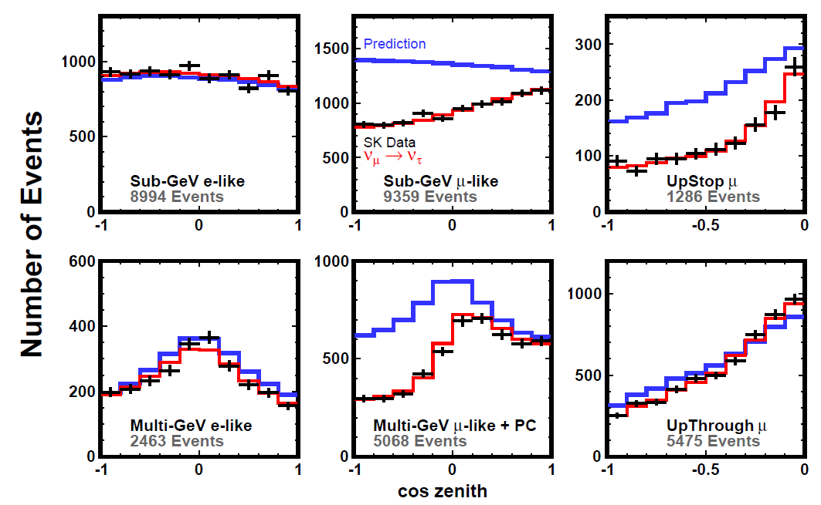

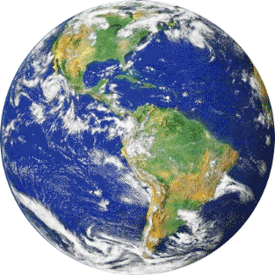
SuperKamiokande I-IV: results
ν_{e} like
ν_{μ} like
cosΘ>0
cosΘ<0

Slide 36
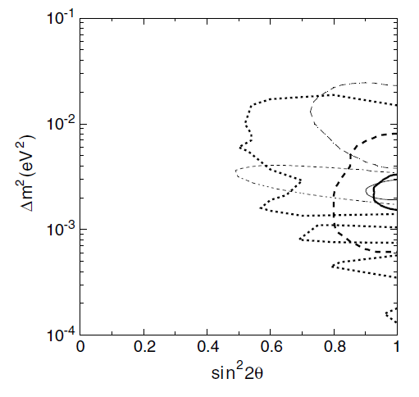
Discovery of neutrino oscillations
SuperKamiokande
Kamiokande
MACRO
Soudan 2

Slide 37


MACRO@ LNGS
Liquid scintillator counters, (3 planes) for the measurement of time and dE/dx.
Streamer tubes (14 planes), for the measurement of the track position (<1º);
Detector mass: 5.3 kton
1 Up going muons ~ 10⁶ downgoing muons
Different neutrino topologies

Slide 38


ToF measurement
T₂
+1 μ
Streamer tube track
-1 μ
T₁
μ from ν: upgoing
Atmospheric μ: downgoing

Slide 39



The MACRO neutrino deficits
Completely different topology w.r.t. SK
Different experimental technique
Deformation of the angular distribution w.r.t. expectation
Missing events from the vertical direction
Interpretation: oscillations
The same oscillation parameters!

Slide 40


The Soudan II neutrino deficit
μ-like
Iron tracking calorimeter
770 t fiducial mass
Active from 1989 to 2001 in the Soudan Mine (USA)
(P)contained events
μ-like deficit from below
e-like

Slide 41



Why not ν_{μ}→ν_{e} ?
i.e., through the $θ_{13}$ angle of the PMNS matrix
Apollonio et al., CHOOZ Coll., Phys.Lett.B466 (1999) 415
PDG value:
0.095±0.010

Slide 42

The 2015 Nobel Prize

Slide 43



Slide 44



Slide 45
Now and next… [From E. Lisi (INFN-Bari)]

Slide 46
Now and next… [From E. Lisi (INFN-Bari)]

Slide 47
Terra incognita

Slide 48





Atmospheric neutrinos: background for cosmic ν
arXiv:2101.12170
$$μ$$
$$ν_{μ}$$
$$ν_{e}$$
In a ∼1 km³ detector
Atmospheric muons: ∼10¹⁰⁻¹¹/y, i.e., 1 kHz
Atmospheric ν◊ μ: ∼10⁵/y, i.e., 1 in 5 min
Cosmic ν◊ μ , e, τ: ∼100/y, mostly hidden in the background
Cosmic signal

Slide 49
Solution of question 2)
The event rate of atmospheric neutrinos can be obtained from Fig. 11.9.
With a threshold of about 1 GeV, the Φνμ (>1 GeV)=0.65 cm⁻² s⁻¹, and that of Φνe(>1 GeV) a factor of two lower. The neutrino must interact inside the detector to produce a visible event.
The event rate for T =1 y and for the flavor i= μ;e is given by
σ_{ν} =σ_{o}E is the neutrino cross-section. After averaging over neutrinos and aninu’s, we have σ_{o} ≈ 0.5 10⁻³⁸ cm²/GeV
NT = 6×10³² nucleons/ton is the number of target nucleons in 1 tonl,
T = 3:15 107 s is the number of seconds in 1 year.
Thus, inserting the numerical values, we obtain

Slide 50
Solution of question 3)
At low energy, neutrinos exceed antineutrinos due to the fact that CR protons are more aboundant than neutrons
Above few hundreds GeV, neutrinos from K decay are more abundant than from pions. Thus, conservation of the strangeness (S) and baryon (B) quantum numbers are responsible for the difference
Consider the production of charged kaons from pp interactions:
  Κ⁺ (B=0, S=1) is produced in association with Λ (B=1, S=-1);
  Κ⁻ (B=0, S=-1) requires at least one associated baryon (B=1) and an additional strange meson (S=1).
Κ⁺ are generated much more frequently than Κ⁻ because of the associated production with the Λ.

Slide 51
Solution of question 5)
In water (n=1.33) for z=1 and β=1 the number of photons for energy interval and unit path length is:
With:
The Δλ=(600-300) nm corresponds to ΔE=2 eV, thus

