Slide 1
XII.
Low-Energy Neutrino Physics
and Astrophysics
Astroparticle Physics a.a. 2024/25
Maurizio Spurio
Università di Bologna e INFN
maurizio.spurio@unibo.it

Slide 2
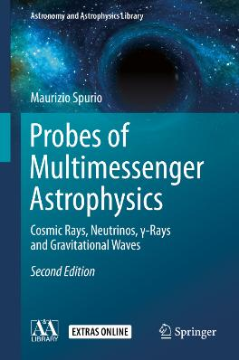
Content

Slide 3
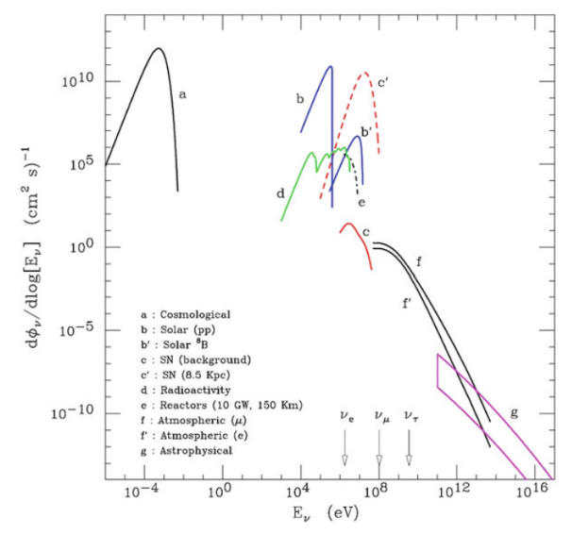
Neutrinos from the Cosmos
Flux of neutrinos at the surface of the Earth.
The three arrows near the x-axis indicate the energy thresholds for CC production of the charged lepton

Slide 4
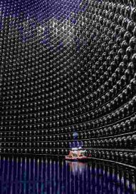
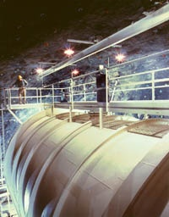
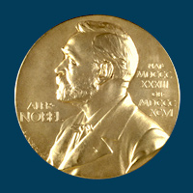
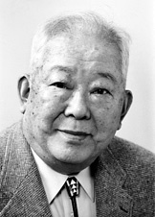

The 2002 Nobel Prize for the Solar Neutrinos
Masatoshi Koshiba
http://nobelprize.org/nobel_prizes/physics/laureates/2002/koshiba-lecture.pdf
Raymond Davis Jr.
http://nobelprize.org/nobel_prizes/physics/laureates/2002/davis-lecture.pdf

Slide 5
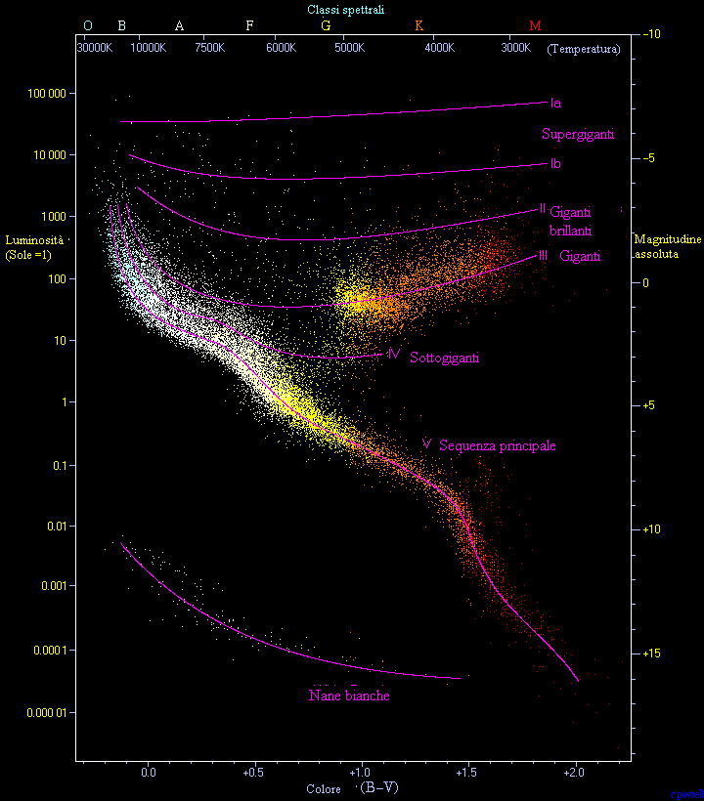
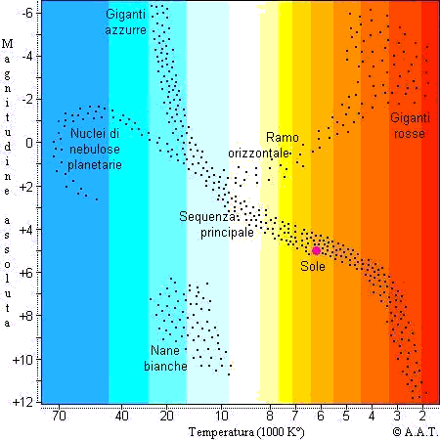
The HR diagram

Slide 6
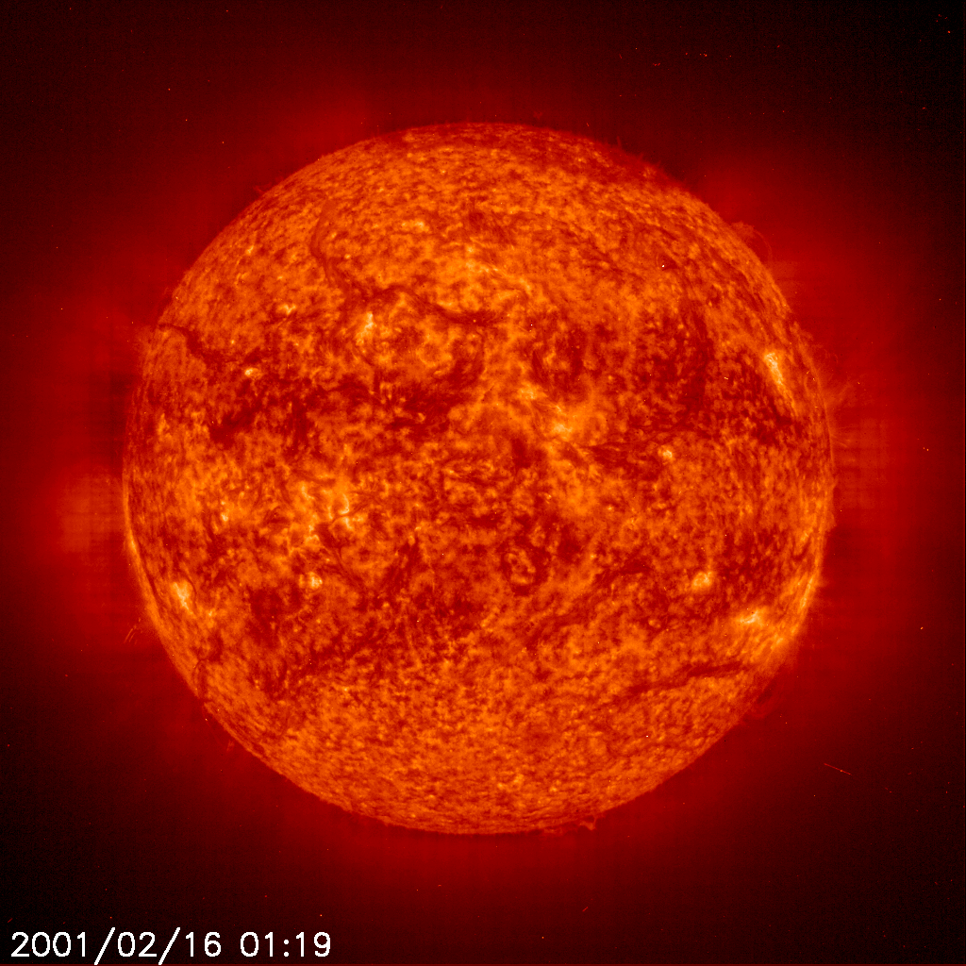
The Sun
Composition :
73% hydrogen (H)
25% helium (He)
2% heavier elements (= “metals”)
Central temperature: 15 10⁶ K
Convective
zone
Radiative
zone
Question 1: Compute the Sun age assuming electromagnetic burning
Question 2.2: Compute the Sun age assuming the Lord Kelvin model (gravitational energy source of radiation)
nucleus
p + p → d + e⁺ + ν_{e}
Solar constant: ε=0.136 W/cm²
→ Luminosity: L_{sun}= 3,84 10²⁶ W

Slide 7
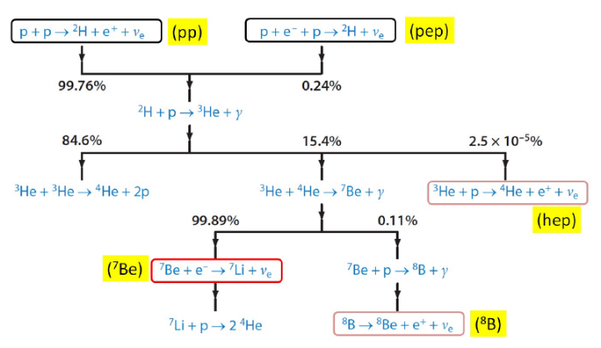



ν from the Sun: the pp chain
≅0.53

Slide 8
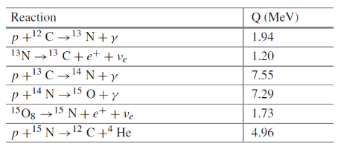
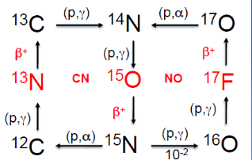
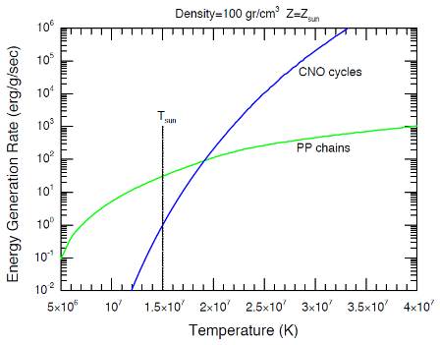
ν from the Sun: the CNO chain
Solar ν’s are a unique probe for understanding the interior of the Sun and its energy source
The Sun can be used to calibrate stellar models
Probing ν propagation (physics) in a high density medium (~100 g/cm³)

Slide 9
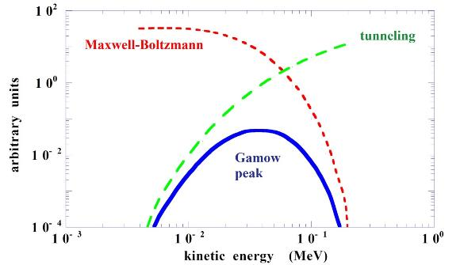
A key ingredient: the nuclear physics
Interaction rates depends on nuclear physics parameter, as <σv>
v= relative velocity between colliding nuclei
σ= cross section
<…>= average over the Maxwell-Boltzmann distribution
E_{G}= energy for which the reaction reaches a maximum (Gamow peak)
Recent experimental effort for the measurement of the E_{G} for different reactions

Slide 10
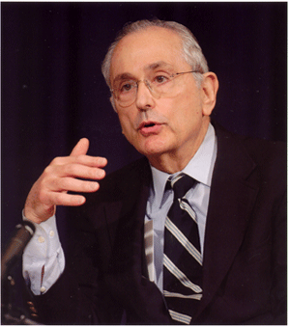
The Standard Solar Model (SSM)
J. Bahcall: The initial author of the SSM
Derived from the conservation laws and energy transport equations of physics, applied to a spherically symmetric gas (plasma) sphere
_{John Bahcall}
_{1934–2005}
Input of the SSM:
  Mass, Age, Luminosity, Radius
Assumptions of the SSM
  Hydrostatic equilibrium
  Spherical symmetry, no rotation, no magnetic field
  Energy generation by H burning
Free parameters:
  initial relative mass abundances:
X_{in} (H), Y_{in}(He), Z_{in}(metals)=1-X_{in} – Y_{in}
Tested by helioseismology
_{http://www.sns.ias.edu/~jnb/}
Note: Read the paper (anche in italiano)
http://www.sns.ias.edu/~jnb/Papers/Popular/Nobelmuseum/italianmystery.pdf

Slide 11
Output: differential ν_{e} flux
Chlore
SuperK, SNO
< 2006
Gallium
Indium
TPC
10¹⁰
pp
¹³N
Flux
Spectres continus : cm⁻²s⁻¹MeV⁻¹
Raies monoénergétiques : cm⁻²s⁻¹
¹⁵O
pep
10⁶
⁷Be
⁸B
hep
10²
0,1
1
10
neutrino energy (MeV)

Slide 12
Differential ν_{e} flux
Chlore
SuperK, SNO
Borexino
> 2010
Gallium
Indium
TPC
10¹⁰
pp
¹³N
Flux
Spectres continus : cm⁻²s⁻¹MeV⁻¹
Raies monoénergétiques : cm⁻²s⁻¹
¹⁵O
pep
10⁶
⁷Be
⁸B
hep
10²
0,1
1
10
neutrino energy (MeV)

Slide 13
The predictions of the SSM
Most of the Sun ν’s from the first step of the pp chain.
These ν’s have energy very low (<0.425 MeV) → very difficult to detect.
A rare side branch produces the “⁸B” ν’s with a maximum energy of ∼15 MeV
⁸B are the easiest ν’s to observe, because the cross section increases with energy.
A very rare interaction in the pp chain produces the "hep" neutrinos.
All of the interactions described above produce ν’s with a spectrum of energies. The inverse beta decay of ⁷Be produces mono-energetic ν’s at either ∼ 0.9 or ∼ 0.4 MeV.

Slide 14
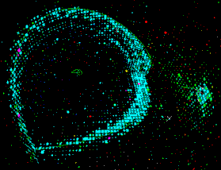
Experimental Methods
Detection methods for detecting solar neutrinos:
1- elastic scattering (*)
ν_{x} +e → ν_{x} +e
SK
(* ν_{e} channel dominant due to W exchange)
2- Neutron capture on nuclei
ν_{e} +n → e +p
No free neutrons in nature:
(Z,A) + ν_{e} → e +(Z+1,A)
Examples:
³⁷Cl + ν_{e} → ³⁷Ar + e⁻
⁷¹Ga + ν_{e} → ⁷¹Ge + e
3- The SNO way:
  ν_{e} +d → e +p+p
  ν_{x} +d → ν_{x} +n+p

Slide 15
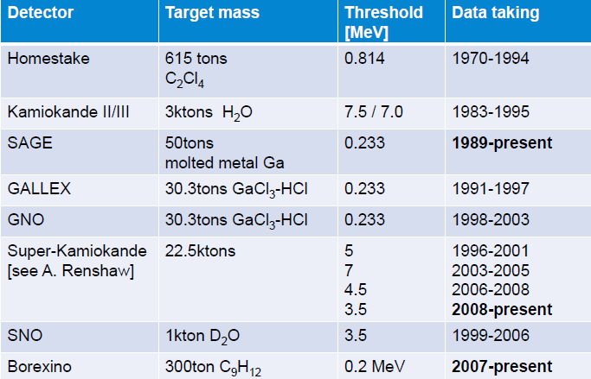
Solar ν_{e} experiments
2019 ?
2022

Slide 16
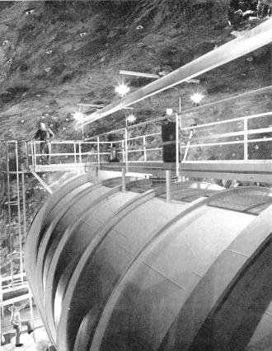
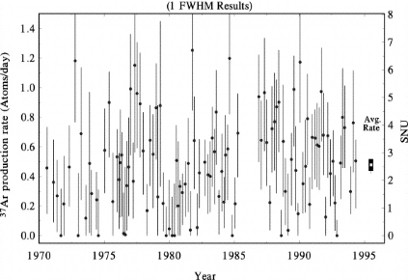
Clorine (Davis) pioneering experiment (1970-94)
1970 : the detector
Pioneering experiment by Ray Davis at Homestake mine (S. Dakota)
Threshold: 0.8 MeV, began in 1967
Consisted of a 600 ton chlorine tank
Measured rate: 0.48 counts/d (bck:0.09/d)
Experiment was carried out over 20 year
The Ar returns to Cl (electron capture). The new Cl atom has one electron missing → X-ray cascade
ν_{e} + ³⁷Cl → ³⁷Ar + e⁻
Expected
Measured: 1/3 of expected from
Sun models (7.6 ± 1.2 SNU)
Measured
B.T.Cleveland et al., Ap. J. 496 (1998) 505
SNU= 10⁻³⁶ (interactions/s · nucleus)

Slide 17
The Solar Neutrino Problem, after Clorine (1980)
How can this deficit be explained?
The Sun’s reaction mechanisms are not fully understood
  NO! new measurements (~1998) of the sun resonant cavity frequencies
The experiment is wrong –
NO! All the forthcoming new experiments confirmed the deficit!
Something happens to the neutrino as it travels from the Sun to the Earth
  YES! Oscillations of electron neutrinos!

Slide 18
GALLEX/GNO (1991- 2003) and SAGE (1989-2019)
The main solar neutrino source is from the p-p reaction:
p + p → d + e⁺ + ν_{e} + 0.42MeV
Experiments based on the reaction:
⁷¹Ga + ν_{e} → ⁷¹Ge + e⁻
Radiochemical experiments, like Homestake
Energy threshold: (233.2 ± 0.5) keV, below the p-p neutrino (420 keV)
SAGE: Located at the Baksan Neutrino Observatory in the Caucasus mountains of Russia (1990-2000); Used 50 t of Ga (molten metal at 30º)
GALLEX/GNO: Located at the Gran Sasso; 30 t of Ga in the form of GaCl₃
The produced ⁷¹Ge has half-life of 11.4 d; in GALLEX the GeCl₄ molecule was recovered by bubbling Ni through the solution and scrubbing the gas

Slide 19
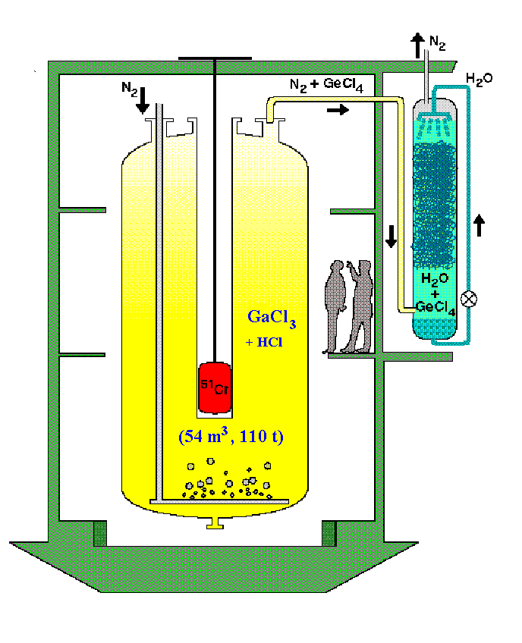
GALLEX/GNO @ LNGS (1991- 2003)
30.3 tons of gallium in form of a concentrated GaCl₃-HCl solution
Neutrino induced ⁷¹Ge forms the volatile compound GeCl₄
Nitrogen gas stream sweeps GeCl₄ out of solution
GeCl₄ is absorbed in water GeCl₄ → GeH₄ and introduced into a proportional counter
Calibration
Important improvement w.r.t. Homestake:
Number of ⁷¹Ge atoms evaluated by their radioactive decay

Slide 20
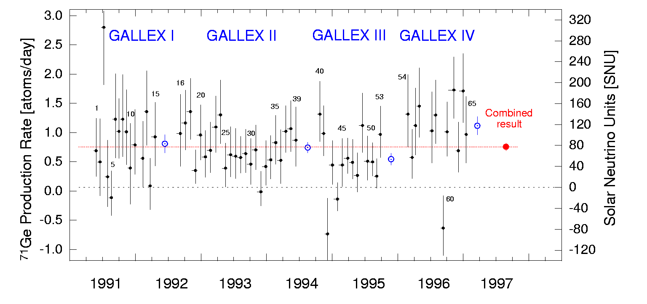
GALLEX-SAGE results
 | GALLEX+GNO (SNU) | SAGE (SNU)
Measured | 71 ± 5 | 66 ± 5
Expected | 128 ± 8 | 128 ± 8
SNU= 10⁻³⁶ (interactions/s · nucleus)

Slide 21

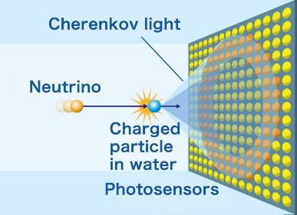
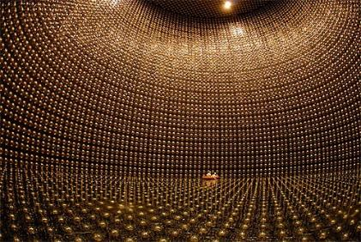
SuperKamiokande (1996→): ES 𝜈_{𝑥} 𝑒 →𝜈_{𝑥} 𝑒
Question 3: Explain why in the Elastic Scattering (ES) reaction the contribution of the ν_{μ}+ν_{τ} flux on the event rate is only 1/6 of that of the ν_{e}.
(Note: the same is valid for SNO)
ν_{e}
e

Slide 22
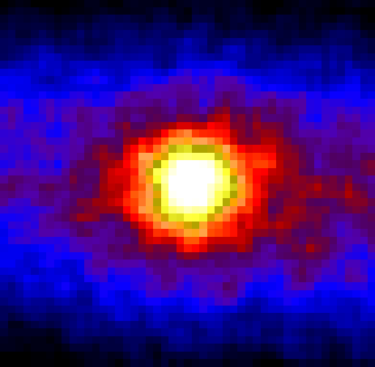
Neutrino Picture of the Sun
SuperKamiokande: ES 𝜈_{𝑥} 𝑒 →𝜈_{𝑥} 𝑒
Sun direction
Radioactivity Background
SK measured a flux of solar neutrinos with energy > 5 MeV (from B⁸) about 40% of that predicted by the SSM
The reduction is almost constant up to 18 MeV

Slide 23
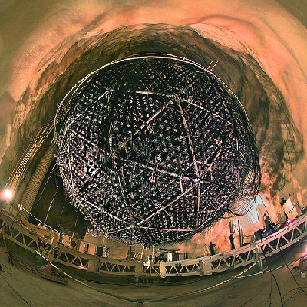
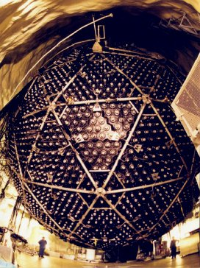
The decisive observation: SNO (1999 –2006)
18 m sphere underground (~2.5km), in Ontario - Canada
Heavy water (D₂O) inside a transparent acrylic sphere (12m diameter)
10,000 photomultiplier tubes (PMTs)
PMTs collect Cherenkov light photons
Pure salt is added to increase sensitivity of NC reactions (≥2002)
SNO measure the flux of all flavors ‘Φ(ν_{x})’ from NC and electron neutrinos ‘Φ(ν_{e})’ with CC
The flux of non-electron neutrinos is
Φ(ν_{μ}, ν_{τ}) = Φ(ν_{x}) - Φ(ν_{e})

Slide 24
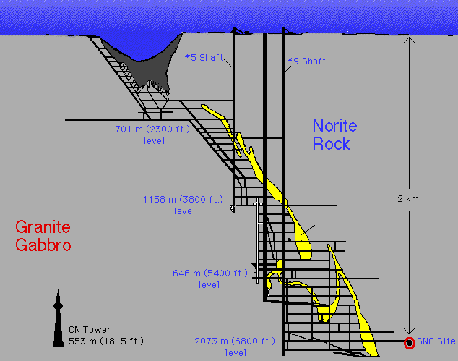
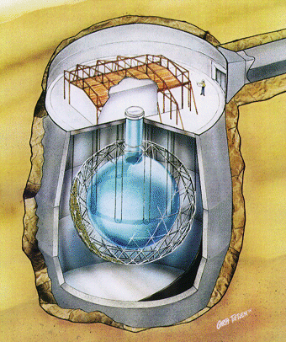
Sudbury Neutrino Observatory (SNO)
1000 tons D₂O
Support Structure for 9500 PMTs, 60% coverage
12 m Diameter Acrylic Vessel
1700 tonnes Inner
Shielding H₂O
5300 tonnes Outer
Shield H₂O
Urylon Liner and
Radon Seal

Slide 25
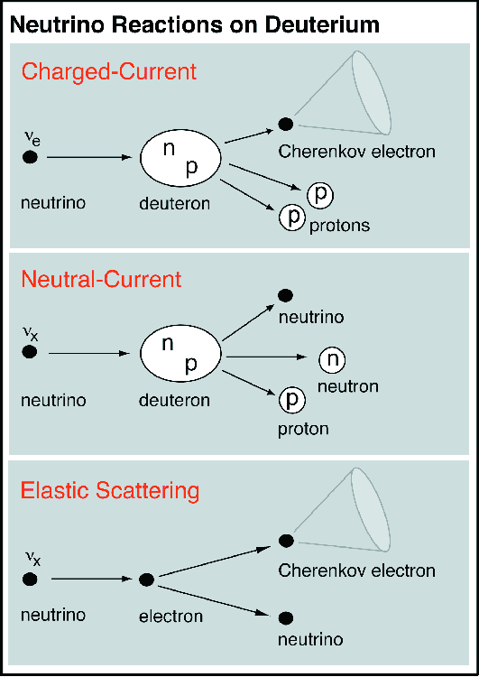
Reactions in SNO
CC
ν
+
d
⇒
p
+
p
+
-
e
e
  Gives ν_{e} energy spectrum well
  Weak direction sensitivity ∝ 1-1/3cos(θ)
  ν_{e} only.
  SSM: 30 CC events day⁻¹
NC
ν
+
d
⇒
p
+
n
+
ν
x
x
  - Measure total ⁸B ν flux from the sun.
  Equal cross section for all ν types
  SSM: 30/day
ES
ν
+
e
-
⇒
ν
+
e
-
x
x
  Low Statistics (3/day)
  Mainly sensitive to ν_{e,}, some
    sensitivity to ν_{μ} and ν_{τ}
  Strong direction sensitivity

Slide 26
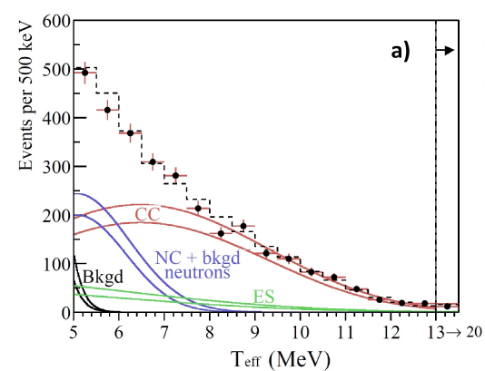
2001- Total spectrum (NC + CC + ES)
Pure D₂O
Nov 99 – May 01
n + d → t + γ
(E_{γ} = 6.25 MeV)
PRL 87, 071301 (2001)
PRL 89, 011301 (2002)
PRL 89, 011302 (2002)
PRC 75, 045502 (2007)
Kinetic energy spectrum (points) for events with measured energy T_{e f f} > 5MeV occurring inside the fiducial region (R < 550 cm) in the SNO-I.
Monte Carlo predictions for charged-current (CC = red lines), elastic scattering (ES = green lines), and neutral current (NC) and background (bkgd) neutron events (blue lines).
The simulations are scaled to fit the results. The dashed line represents the summed components, and the bands show the statistical uncertainties from the signal-extraction fit.

Slide 27
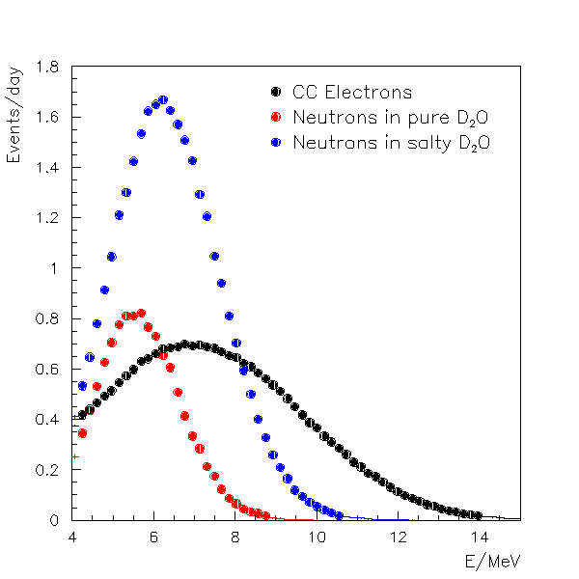
2002 (Salt): increased neutron capture
Higher capture cross section of ν on Cl
Higher energy release
Many gammas
γ
n
³⁶Cl*
³⁵Cl
³⁶Cl
σ = 44 b
³⁵Cl+n
σ = 0.0005 b
8.6 MeV
²H+n
6.0 MeV
³H
³⁶Cl

Slide 28
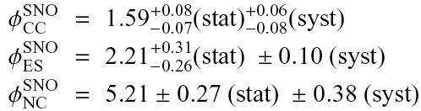
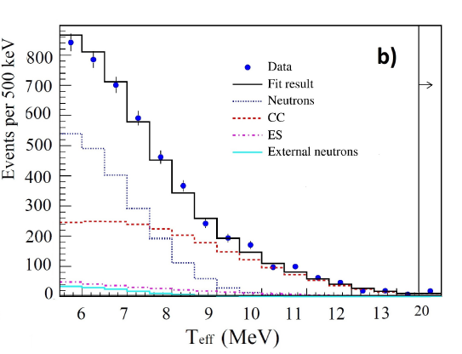
2003: SNO Energy spectra (Salt data)
UNITS:
x 10⁶ cm⁻² s⁻¹
Predictions:
Bahcall et al. – SSM= 5.05±0.8
Electron kinetic energy

Slide 29
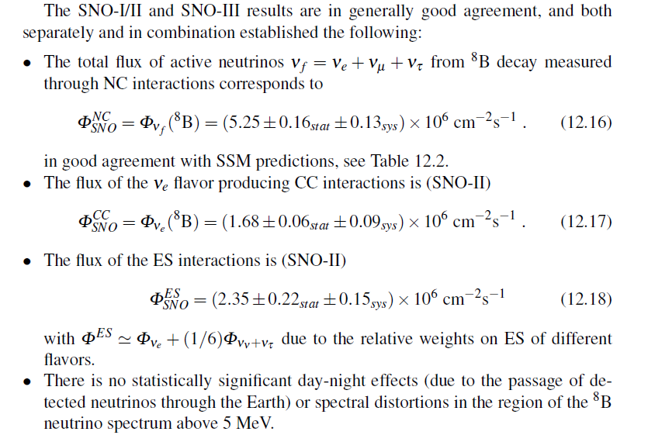
Final SNO Solar ν Results

Slide 30
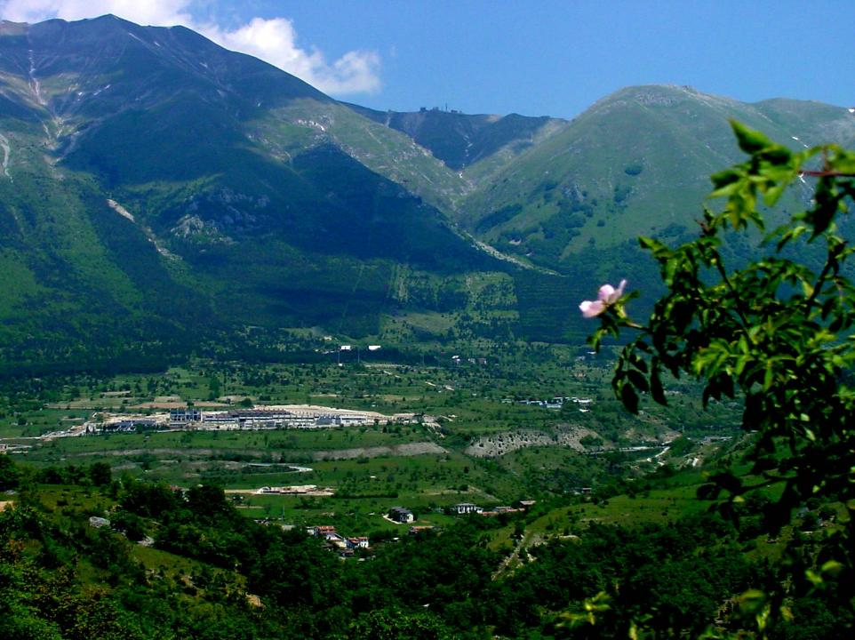
Laboratori Nazionali del Gran Sasso
1000 m
rock
1.2 μ/m²/h

Slide 31
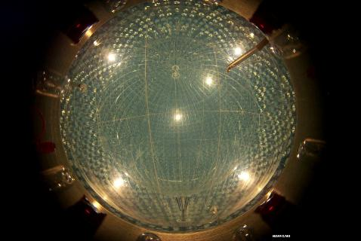
Borexino filled with scintillator (2007-2022)
Borexino has a layout similar to SNO, but it measures the ν_{e}e elastic scattering (ES) using a liquid scintillator as the active target.
It is located at the Laboratori Nazionali del Gran Sasso, and started its data-taking in 2007.
The suppression of the radioactivity of the scintillator itself has been achieved using several radio-purification techniques.
This allows Borexino to test the SSM using neutrinos of lower energy than the 8B.
The detector consists of 278 tons of a high-purity liquid scintillator. The scintillation light yield is a measure of the energy imparted to the electron of the ES, but has no sensitivity to direction.
The scintillation photons are detected with an array of 2,200 PMTs mounted on the inside surface of the stainless-steel sphere (light-yield ∼500 photons/MeV, energy resolution is ∼ 5% at 1MeV, and the position resolution is ∼10–15 cm.

Slide 32
Borexino@LNGS (ES)
Elastic scattering
ν e → ν e
Goal n° 1 : ⁷Be neutrinos
Proposal :
60 event/ day (without oscillation)
10-40 (if oscillation)
5 10⁻⁹ Bq/kg
1 water glass : 10 Bq
Background suppression (10
Orders of magnitude)
x 50 times light w.r.t. Cherenkov
No direction
No distinction e⁻ Sun from e⁻ radioactivity

Slide 33
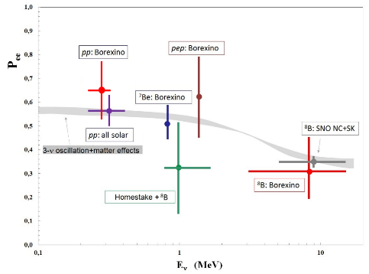
Neutrino oscillations and the Sun
CNO || 7.2^{+3.0}_{-1.7} | || 7.0^{+3.0}_{-2.0} | Nature 587 (2020) 577
Table: Interaction rates of different ν measured by Borexino and the ratios w.r.t. SSM (column 3)
Figure:
Survival probability as a function of E_{ν} produced by the different reactions.
The gray band represents the ratio between the expected flux on Earth and the SSM prediction when neutrino oscillations in the Sun matter are considered.
Points with error bars represent measurements from different experiments..

Slide 34
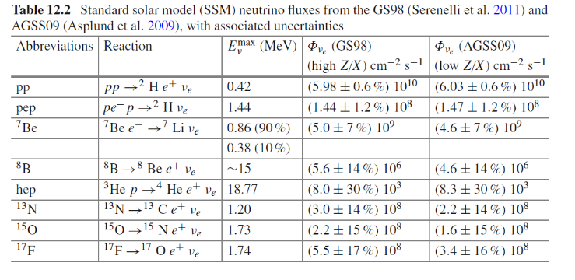
The solar abundance problem
-27%
-30%
-38%
The GS98 abundances (old, from a 1D model) are thought to be wrong
The new AGSS09 derived metal (Z_{in}) abundances with a Sun 3D model; they are smaller by about a factor of two wrt previous calculations
Significant differences in the prediction of the ν_{e} flux for the CNO cycle
However, helioseismology (the study of Solar oscillations) agree better with the old GS98 value of metalliticity Zin than those from the new AGSS09

Slide 35
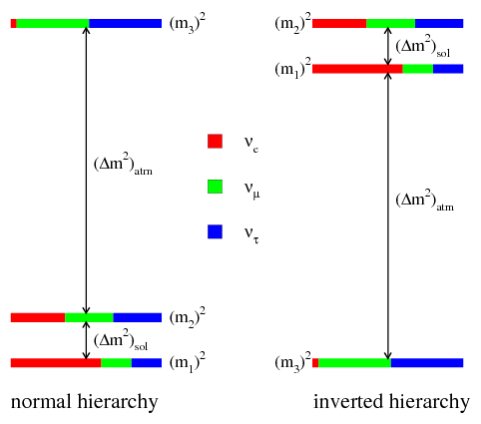
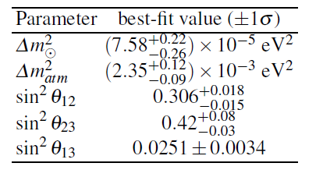
Neutrino oscillation parameters

Slide 36
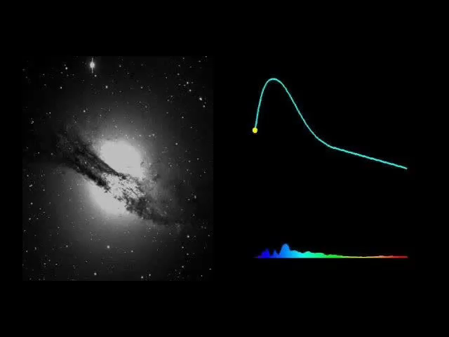
Neutrinos from a Stellar Gravitational Collapse
Three representations of a SN occurred in the Centaurus A galaxy.
The clip was prepared by the Supernova Cosmology Project (P. Nugent: spectral sequence; A. Conley: image sequence) with the help of Lawrence Berkeley National Laboratory's Computer Visualization Laboratory (N. Johnston: animation) at the National Energy Research Scientific Computing Center.
For a review: Supernova neutrinos: Production, oscillations and detection
Mirizzi, et al. Rivista del Nuovo Cimento 39, N1-2: https://arxiv.org/pdf/1508.00785.pdf

Slide 37
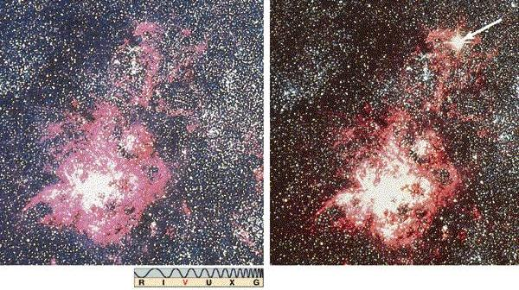
Recorded explosions visible to naked eye
SN1987A
Year (A.D.) Where observed Brightness
185 Chinese Brighter than Venus
369 Chinese Brighter than Mars or Jupiter
1006 China, Japan, Korea, Europe, Arabia Brighter than Venus
1054 China, SW India, Arabia Brighter than Venus
1572 Tycho Nearly as bright as Venus
1604 Kepler Brighter than Jupiter
1987 Ian Shelton (Chile)

Slide 38
The nuclear binding energy
H and He (produced after the Big Bang) are the most abundant elements
The remaining elements, making up only about 2% of the Universe, have been produced as the result of stellar activities.
Nuclear fusion in stars synthetize elements with mass number A up to 56.
⁵⁶Fe is one of the highest binding energies of all of the isotopes, and is the last element that releases energy by fusion.

Slide 39
Heavy elements in massive stars
The onion-like structure in the final stage of a massive (25 M_{s}) star.
The outermost envelope is composed of H and He, and progressively heavier nuclei (up to Fe) are layered, due to successive fusion reactions.
Typical values of the mass, density ρ (in g/cm³) and temperature T (in K) of the different shells are indicated along the axes
Once the star’s inner region is made primarily of Fe, further compression of the core no longer ignites nuclear fusion;
the star is unable to thermo-dynamically support its outer envelope of concentric shells.
The rest of the star, without the support of the radiation, collapses, compressing the nucleus, producing a core-collapse supernova.

Slide 40
Core-Collapse Supernovae (Type II)
Stars with masses above eight solar masses undergo gravitational collapse (see the details on the figures in the following slides)
Once the star’s core becomes constituted primarily of iron, further compression does not ignite nuclear fusion and the star is unable to support its outer envelope.
As the surrounding matter falls inward under gravity, the temperature of the core rises and iron dissociates into α particles and nucleons.
Electron capture on protons becomes heavily favored and electron neutrinos are produced as the core gets neutronized (a process known as neutronization).
When the core reaches densities above 10¹² g/cm³, neutrinos become trapped (in the so-called neutrinosphere).
The collapse continues until 3 − 4 times nuclear density is reached, after which the inner core rebounds, sending a shock-wave across the outer core and into the mantle.
This shock-wave loses energy as it heats the matter it traverses and incites further electron-capture on the free protons left in the wake of the shock.
During the few milliseconds in which the shock-wave travels from the inner core to the neutrinosphere, electron neutrinos are released in a pulse. This neutronization burst carries away approximately 10⁵¹ ergs of energy.

Slide 41
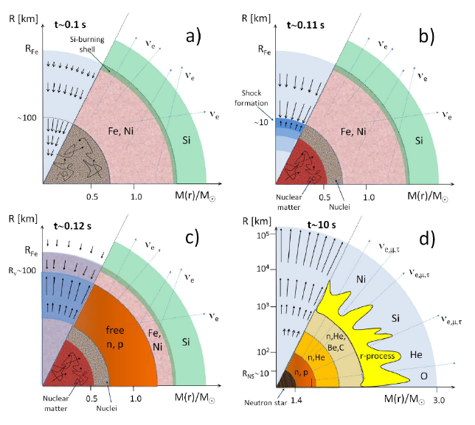
Schematic illustration of a SN explosion. The dense Fe core collapses in a fraction of a second and gets neutronized. The inner core rebounds and gives rise to a shock-wave (lower-right). The protoneutron star cools by the emission of neutrinos.

Slide 42
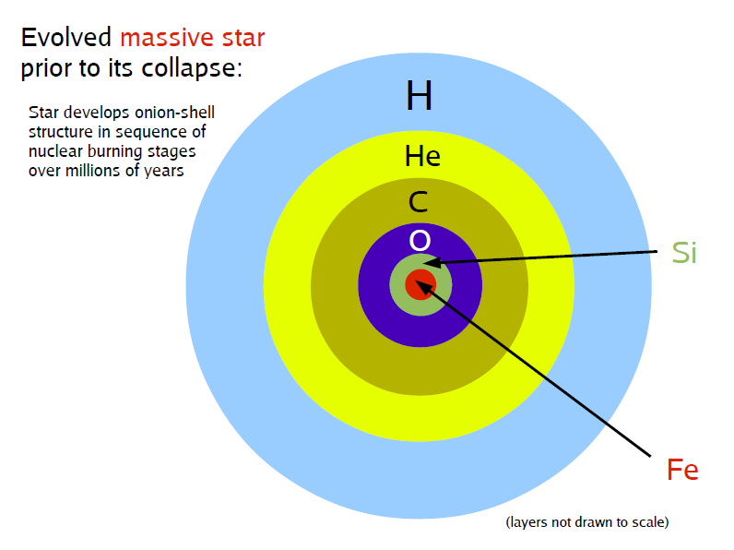
Description for a Type II Supernovae (I)
From: Hans-Thomas Janka, TAUP 2013

Slide 43
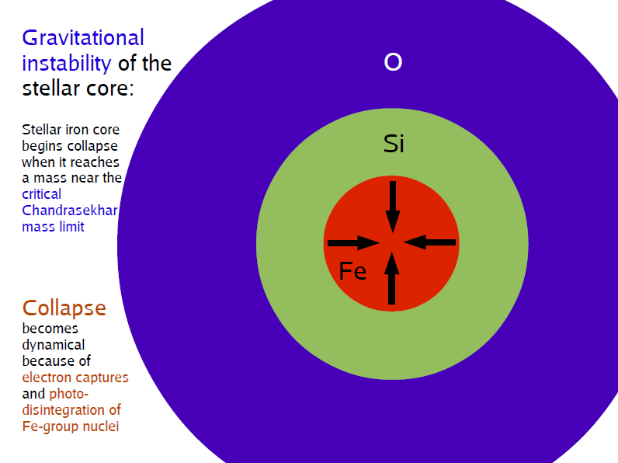
Description for a Type II Supernovae (II)
From: Hans-Thomas Janka, TAUP 2013

Slide 44
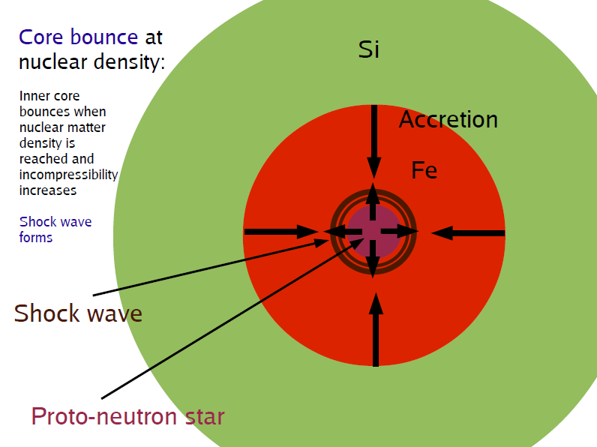
Description for a Type II Supernovae (III)
From: Hans-Thomas Janka, TAUP 2013

Slide 45
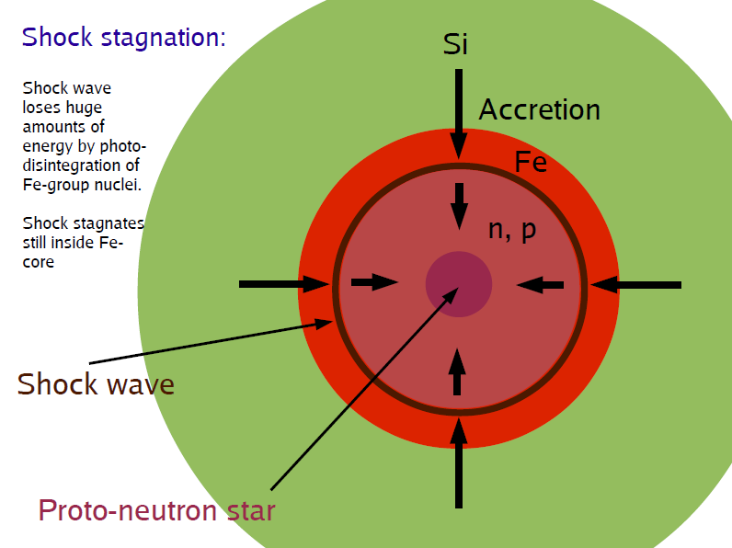
Description for a Type II Supernovae (IV)
From: Hans-Thomas Janka, TAUP 2013

Slide 46
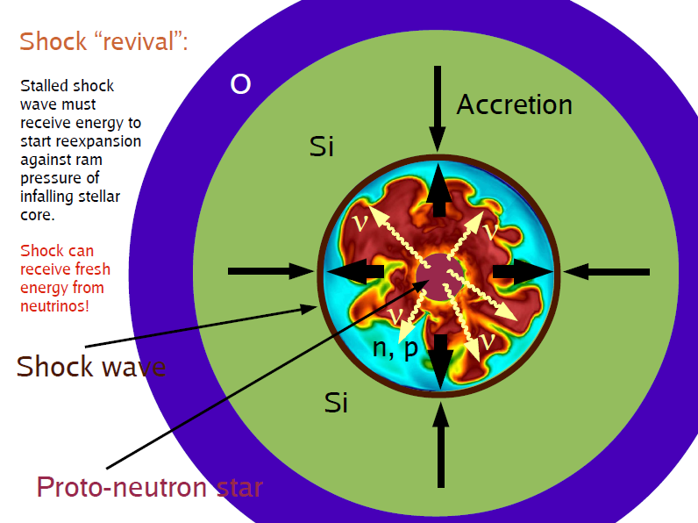
Description for a Type II Supernovae (V)
From: Hans-Thomas Janka, TAUP 2013

Slide 47

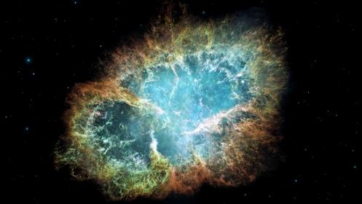
Core-Collapse Supernovae (Type II)
The work U done by gravity in compressing a star of mass M and radius R in the core (neutron star) of radius R_{NS} and mass M_{NS} is given by
This shows up as
99% Neutrinos
1% Kinetic energy of the explosion (few % of this into Cosmic Rays)
0.01% Photons (outshine host galaxy)
The Crab Nebula (derived from SN1054)
Neutrino luminosity (while it lasts) outshines the photon luminosity of the entire Universe
    L_{ν}= 3x10⁵³ erg/3 sec = 3x10¹⁹ L_{Sun}

Slide 48
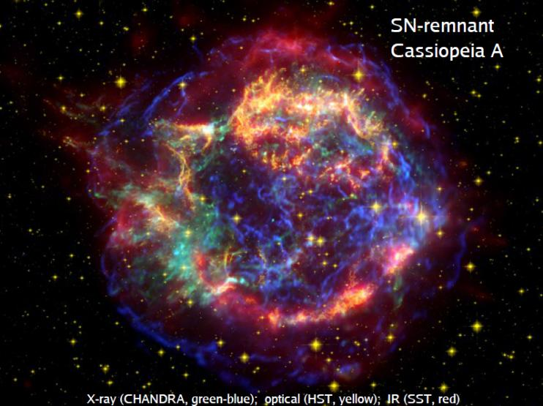
SN1572 (Tycho)

Slide 49

Predictions from SN Core

Slide 50

The SN neutrino fluence
Neutronization (burst), ~10 ms 10⁵¹ erg, ν_{e} only
t=0
Thermalization (cooling): ~10 s
3×10⁵³ erg
L_{νe}(t) ≈ L_{‾νe}(t) ≈ L_{νx}(t)
Δt=3-10 s
Exercize: evaluate the ${\overline{ν}}_{e}^{}$fluence [cm⁻²] on Earth for a SN burst occurred at the Galactic Center (GC, 8.5 kpc) using the above information
astro-ph/0211194

Slide 51


The SN neutrino signal on detectors
Electron scattering (ES). Sensitive to all flavors, with pointing capabilities
The‾ν_{e} CC (inverse beta decay). Dominant cross section; threshold at 1.8 MeV. Easy to detect (delayed coincidence)
Neutral current on p. Smaller σ than CC, but sensitive to all flavors. Difficult to detect.
CC ν_{e} ,‾ν_{e} with nuclei (as in solar experiments). Only in dedicated experiments
Exercize: evaluate the number of ${\overline{ν}}_{e}^{}$interaction in 1 kton of material (=water) using the fluence and the cross-section reported in figure for a SN burst in the GC.
Answer: about 250 positrons/kton are expected (see solution in Question 4)

Slide 52

The SN1987A
SN1987A was the first SN since 1604 visible with the naked eye
The progenitor was a main-sequence star of mass M = (16−22)M_{sun}
Located in the Large Magellanic Cloud at a distance of about 50 ± 5 kpc
Two water Cherenkov detectors, Kamiokande-II (2.2 kton) and IMB (5 kton in USA), observed 12 and 8 neutrino interactions respectively, over a 13 s interval
The signals of the two experiments were simultaneous (for the technology of 1987)
Two smaller scintillator detectors, LSD and Baksan also reported observations
  Baksan reported five counts
  The LSD is controversial because the events were recorded several hours early
Question 4: Evaluate the expected signal in Kamiokande for the SN1987A
Question 5: Why IMB (larger) detected fewer events than Kamiokande?

Slide 53





The detectors

Slide 54



The KamiokaNDE events
http://www-sk.icrr.u-tokyo.ac.jp/sk/news/2017/02/SN1987A-en.html
The printout of the data. Horizontal axis shows time (from right to left and one line as 10 seconds) and the vertical axis shows the number of hit (proportional to the energy of the event). The peak is the signal of neutrinos from SN1987A. The blank period due to the detector maintenance was recorded a few minutes before the signal.

Slide 55

Neutrino signal from SN1987A

Slide 56

Neutrino signal from SN1987A
Although Kamiokande, IMB and Baksan collected a small sample of ν’s, they were sufficient to give an exact time for the start of the explosion to which the light curve can be normalized and to confirm the baseline model of core-collapse. In particular:
Relative time and energy of SN1987A neutrinos
observed by Kamiokande, IMB and Baksan.
The time of the first event was arbitrarily set = 0
  the time distribution of the observed events is in agreement with predictions of a ∼10 s burst;
  their energy distribution gives a measure T ∼ 4.2MeV of the ν-sphere and an average energies of detected neutrinos of∼15MeV;
  the number of the observed events is in agreement with ∼ 3 × 10⁵³ erg luminosity of a core-collapse burst
Question 6: Estimate an upper limit on the neutrino mass from SB1987A

Slide 57

Present and future detectors
Current and proposed SN neutrino detectors. Not included are smaller detectors and detectors sensitive primarily to coherent elastic neutrino-nucleus scattering.
An * indicates a surface detector, which may not be self-triggering due to background.
Numbers in parentheses indicate that individual events will not be reconstructed.

Slide 58


LVD @LNGS

Slide 59

The Origin of Trans-Fe Elements
Elements of higher mass number become progressively rarer: they increasingly absorb energy in being produced.
The abundance of elements in the Solar System is thought to be similar (Chap. 3)
Supernova nucleosynthesis is the theory of the releasing in the Universe of elements up to iron (Z = 26) and nickel (Z = 28) in supernova explosions (F. Hoyle, 1954).
Core-collapse supernovae are the main contributors of the heavy elements (A≥12) Elements heavier that iron are produced by neutron capture in neutron-rich

Slide 60

Slow (s) and Rapid (r) processes
Elements heavier that iron are produced by neutron capture in neutron-rich astrophysical environments, followed by β decay of the forming nuclei.
The so-called s-process is believed to occur mostly in asymptotic giant.
The s-process is believed to occur over time scales of thousands of years, passing decades between successive neutron captures.
The r-process also involves neutron capture, as in (12.49) but the neutron capture time is much smaller than the nucleus decay time, due to the high neutron density.
The newly formed nucleus does not decay immediately; after subsequent captures, the isotopes move away from the stability valley: ${}_{Z}^{A}{X→{}_{Z}^{A+1}{X→}{}_{Z}^{A+2}{X→}}…$
The r-process occurs in astrophysical locations where there is a high density of free neutrons (astrophysical regions matter of ongoing researches).
Until the observation of GW170817, the environment around core-collapse SN was the most plausible candidate.
GW170817 showed that the most suited ambient for r-processes is probably the neutron-rich matter in a binary neutron star merger (the so-called kilonova).

Slide 62

Question 1)
Potere calorifico carbone (lignite)= 24 MJ/kg, senza produzione di cenere
Potere calorifico del Sole, immaginato come palla di carbone di massa 2x10³⁰ kg → Q= 4 10³⁷ J = 4 10⁴⁴ erg
(significa che la potenza per 1 ora di funzionamento equivale a 24 MJ/3600 s= 6600 W)
Costante solare ε= 1.4 10⁶ erg/cm² s; Distanza Terra-Sole D= 1.5 10¹³ cm
Potenza erogata dal sole dE/dt= ε ×(4π D²) = 4 10³³ erg/s
Tempo necessario a bruciare il Sole:
T₁= Q/(dE/dt) =4 10⁴⁴ erg /(4 10³³ erg/s) = 10¹¹ s= 3300 y
Total gravitational potential energy of a sphere of mass M_{sun} of radius R is
T₂≅ U/(dE/dt)= 10⁶ year
Question 2)
$U=\frac{3GM^{2}}{5R}≅{10}^{48} erg$

Slide 63
Question 4) The SN1987A: how many events?
1- Energy released 2.5 10⁵³ erg
2- Average ‾ν_{e} energy ≈ 16 MeV = 2.5 10⁻⁵ erg
3- N_{source}= (1/6) × 2.5 10⁵³/ (2.5 10⁻⁵)= 1.7 10⁵⁷ ‾ν_{e}
4- LMC Distance : D=52 kpc = 1.6 10²³ cm
5- Fluency at Earth: F = N_{Source}/4pD² = 0.5 10¹⁰ cm⁻²
6- Targets in 1 Kt water: N_{t} = 0.7 10³² protons
7- cross section: σ(‾ν_{e}+p) ~ 2x10⁻⁴¹ cm²
8- Ne+ = F (cm⁻²)× σ (cm²)× N_{t} (kt⁻¹)= 0.5 10¹⁰ × 2x10⁻⁴¹× 0.7 10³²
= 7 positrons/kt
9 – M(Kam II) = 2.1 kt, efficiency ε~ 80%
10 – Events in Kam II = 7 x 2.1 x e ~ 12 events
For a SN @ Galactic Center (8.5 kpc) :
N _{events}= 7x(52/8.5)² = 260 e⁺/kt
Question 5)
IMB had smaller PMTs that Kamiokende, less covered area, thus an higher energy threshold (20 MeV) and a much smaller detection efficiency

Slide 64



Question 6) Neutrino mass from SN
The observation of SN ν’s brings a better understanding of the core collapse mechanism from the feature of the time and energy spectra;
Moreover, an estimation of the neutrino masses could be done in the following manner. The velocity of a particle of energy E and mass m, with E >> m, is given by (with c = 1):
$$v_{i}=\frac{p_{i}c}{E_{i}}=\frac{\sqrt{E_{i}^{2}−m_{}^{2}c^{4}}}{E_{i}^{2}}\sim 1−\frac{m^{2}c^{4}}{2E_{1}^{2}}$$
Thus, for a SN at distance d, the delay of a ν from the highest/lowest energy neutrino, ΔE, due to its mass is (in proper units)
$$∆t_{[s]}\sim 0.05 \frac{m_{[{eV}^{2}]}^{2}}{∆E_{[MeV]}}d_{[kpc]}$$
Therefore, neutrinos of different energies released at the same instant should show a spread in their arrival time. For SN1987A, assuming Kam data and Δt=13 s, ΔE=30 MeV and d=50 kpc, we get:
$$mc^{2}<12 eV$$

