Slide 1
92869 - ROAD INFRASTRUCTURE SUSTAINABLE AND SAFE MANAGEMENT (6 CFU)
Lesson 1 / 2 –
INTRODUCTION –
Imola, - 19/09/2025

Slide 2
Prof. ANDREA SIMONE
DICAM – Department
andrea.simone@unibo.it
http://www.unibo.it/docenti/andrea.simone
Notes:
2

Slide 3
TIMETABLE
Day Hour ROOM
Friday 9 -11 1.1
Friday 11-13 1.1
Palazzo Vespignani
Via Giuseppe Garibaldi 24 - Imola

Slide 4
INTRODUCTION – General Objectives
This course includes 26 meetings of 2 hours each:
The objectives of the course are:
- why road safety engineering is important, how we can achieve improvements and who is doing the work;
- the multidisciplinary nature of road safety and why we need to use a combination of engineering, education and enforcement to be successful;
- the behaviour of road users and ways in which the road environment can be designed/improved to cater for their needs;
- the complexity of the human/vehicle/road system and how the interrelationships work to influence the level of safety;
Notes:
4

Slide 5
INTRODUCTION – General Objectives
This course includes 26 meetings of 2 hours each:
The objectives of the course are:
- what are the legal responsibilities of road authorities and decision makers (engineers) and how they can fulfil them;
- how to collect accident data and what to look for in quality data;
- how to analyse accident data, turn it into information and develop cost effective, practical counter measures;
- what needs to be done after treating a site and how to do it;
- how to be proactive in preventing accidents before they occur.
Notes:
5

Slide 6
INTRODUCTION – General Objectives
This course includes 26 meetings of 2 hours each:
The objectives of the course are:
what are the more common procedures for the management of the road pavements in urban networks (Pavement management system);
which are the more common procedures for road pavement maintenance.
Evaluation of the most common sustainable materials, technologies and test for subgrade and soil stabilization
Evaluation of the most common sustainable materials, technologies and test for bituminous mixtures;
Performance evaluation of new and existing pavement
Notes:
6

Slide 7
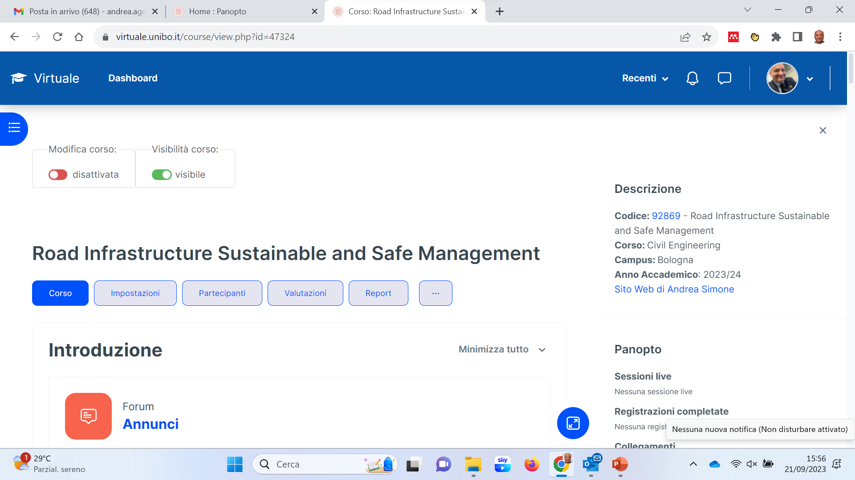
CLASS NOTES – LECTURE NOTES - EXERCISES Andrea Simone 33145 Civil Engineering 8211 92869 - ROAD INFRASTRUCTURE SUSTAINABLE AND SAFE MANAGEMENT - 6 cfu
https://virtuale.unibo.it/my/

Slide 8
COURSE OUTLINE
Notes:
8

Slide 9
ROAD SAFETY FACTORS
Road safety problems need to be addressed through the implementation of integrated actions that take into account each of
3 the main components of the road safety system
human-environment-vehicle
In order to propose efficient actions, it is first necessary to understand why accident occur.
In this first lesson we make a brief description of the road safety system and then we describe, in more detail, various analytical methods that have been proposed over the years to better understand the mechanisms leading to accident occurrence

Slide 10
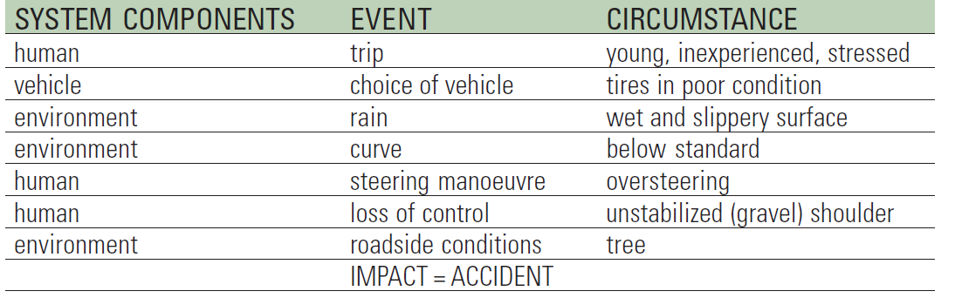
HUMAN-ENVIRONMENT-VEHICLE SYSTEM
Representation of events and circumstances
Example: a 20-year old man with little driving experience, is taking an unfamiliar road on his way to an important appointment. The rain makes the road slippery and his tires are not in good condition. During the trip, he enters a curve with a radius of curvature below minimum standards, loses control and run off the road into a tree at the roadside.

Slide 11
HUMAN-ENVIRONMENT-VEHICLE SYSTEM
This example illustrates the following principles:
Each accident is the result of a succession of events occurring under precise circumstances;
Each event can be related to one of the components of road safety system;
An adverse conjunction of events is the explanatory cause of the malfunction;
Each separate event is largely determined by preceding events and their circumstances.
THE HUMAN-ENVIRONMENT-VEHICLE (HEV) SYSTEM
THUS PROVIDES A CONCEPTUAL FRAMEWORK FOR
ANALYZING THE ACCIDENT IN ORDER TO IDENTIFY THE FACTORS ON WHICH TAKE ACTION

Slide 12
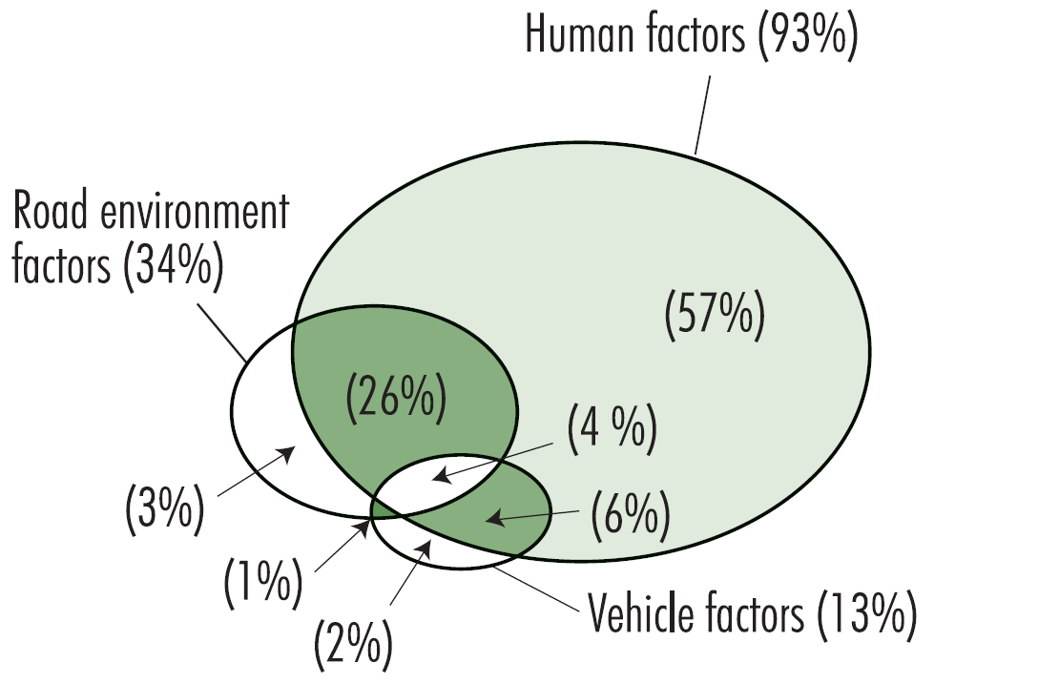
HUMAN-ENVIRONMENT-VEHICLE SYSTEM
Several research papers have shown the predominant role of the “human” component in accidents. However, the fact that human factors are involved in most accidents does not mean that only this component of the system must be treated.
Behavioral changes are very low slow and progressive.
In comparison, road environments can be quickly modified with immediate results
The Venn diagram shows that significant safety benefits can be induced by working at the human-road environment interface.
Accident contributing factors (Treat et al. 1979)

Slide 13
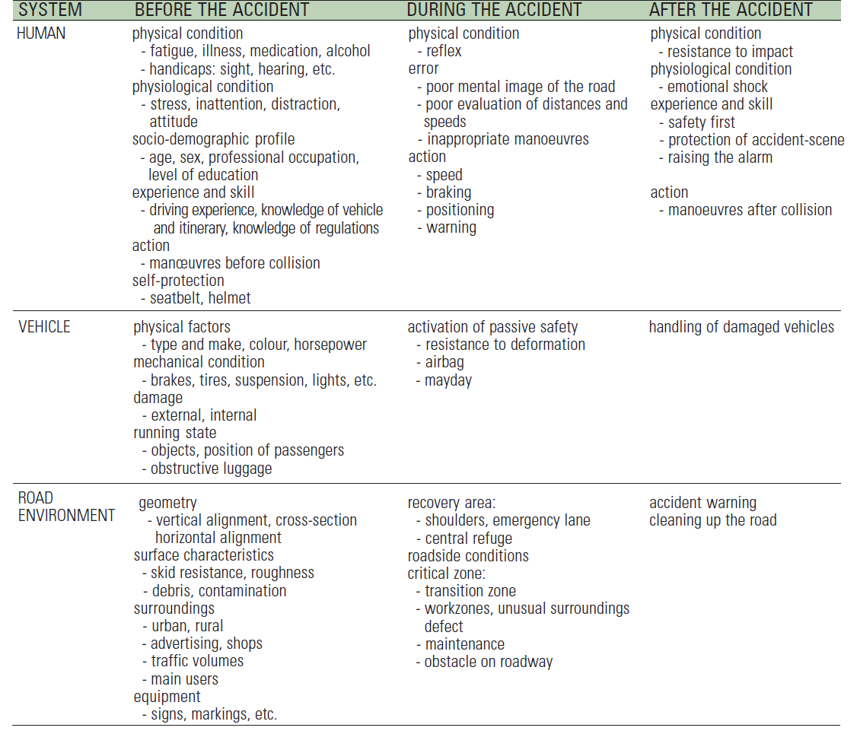
(HEV SYSTEM) - HADDON MATRIX LIST OF ACCIDENT CONTRIBUITING FACTORS
Human
Vehicle
Road
Environment

Slide 14
FOR FURTHER DETAILS
AIPCR – PIARC World Road Association
http://www.piarc.org/en/

Slide 15

Prof. ANDREA SIMONE
DICAM Department
andrea.simone@unibo.it
http://www.unibo.it/docenti/andrea.simone
www.unibo.it

