Slide 1


Advances in Seasonal Sea Ice Forecasting: Dynamical Models, Machine Learning, and Applications
Yiguo Wang
1. Nansen Environmental and Remote Sensing Center, Norway
2. Bjerknes Centre for Climate Research, Norway
BCPU

Slide 2
Outline
Introduction
Case Studies (NorCPM)
Arctic sea ice
Antarctic sea ice
Conclusions
Questions and Discussion

Slide 3
Seasonal forecasting
Seasonal forecasting (also called seasonal prediction) is a type of climate prediction that aims to estimate the average climate conditions (temperature, rainfall, sea surface temperature, etc.) over a period of one to several months into the future.
It differs from a weather forecast in that:
Weather forecasts predict day-to-day atmospheric conditions up to ~10–14 days.
Seasonal predictions give probabilities of anomalies (e.g., wetter/drier, warmer/colder than normal) for entire months or seasons.
Seasonal forecasts rely on:
Slowly evolving climate drivers such as: Sea surface temperature patterns (e.g., El Niño–Southern Oscillation, ENSO), Soil moisture, Snow cover, Ocean heat content
Coupled climate models or statistical/ML models

Slide 4
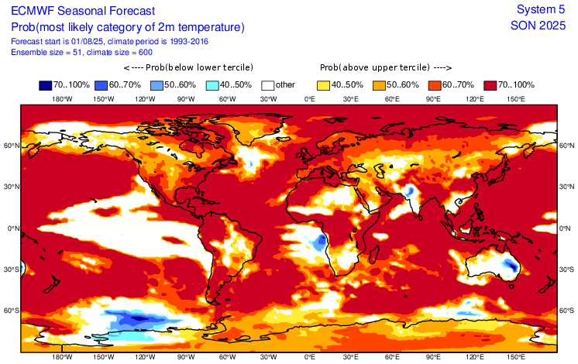
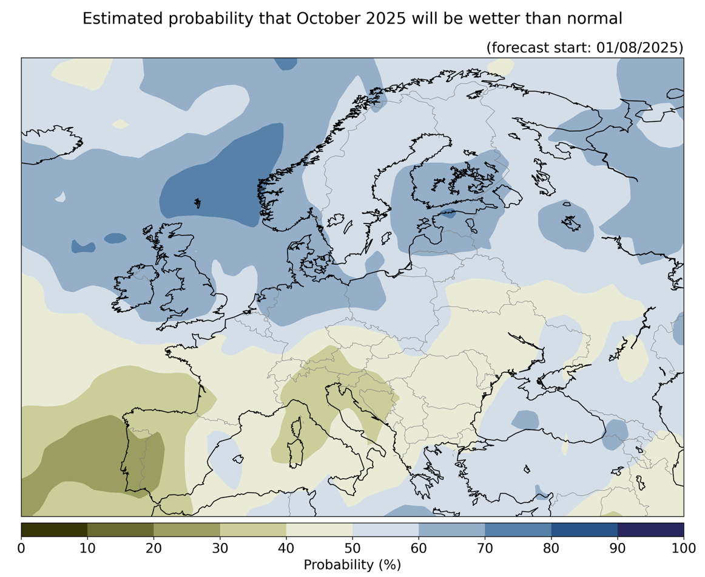
Seasonal forecasting
https://bcpu.w.uib.no/seasonal-forecast/

Slide 5

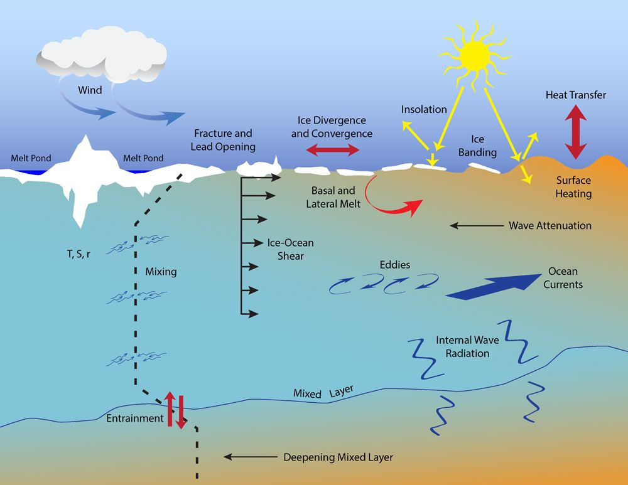

Sea ice basics and Factors Interacting with Sea Ice
Photo: Espen Storheim/NERSC
Photo: Espen Storheim/NERSC

Slide 6
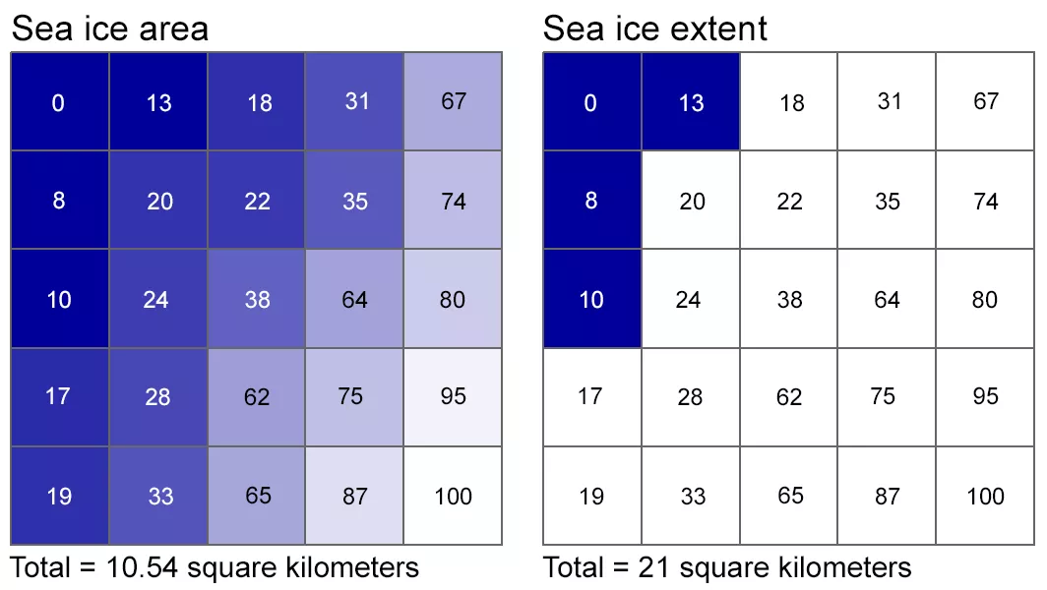
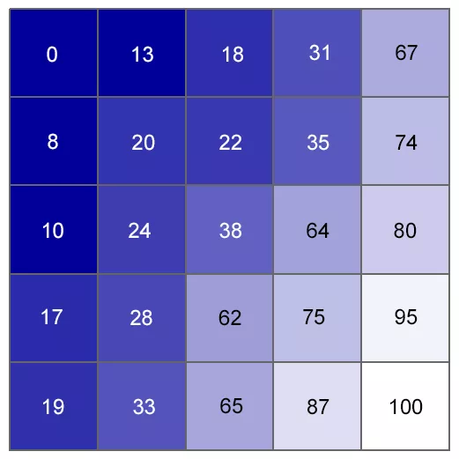
Sea Ice Properties
Sea ice concentration, sea ice thickness, sea ice edge, sea ice area, sea ice extent, sea ice volume, sea ice age, sea ice drift …
Sea ice concentration

Slide 7
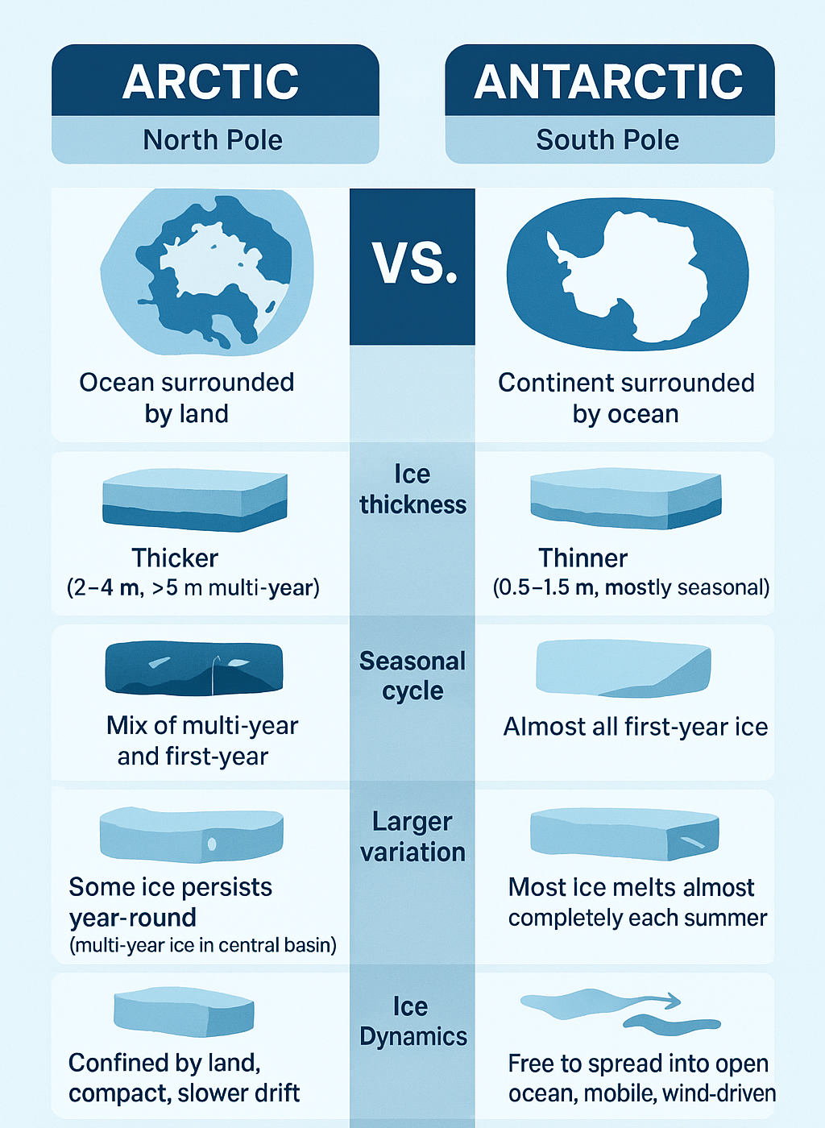
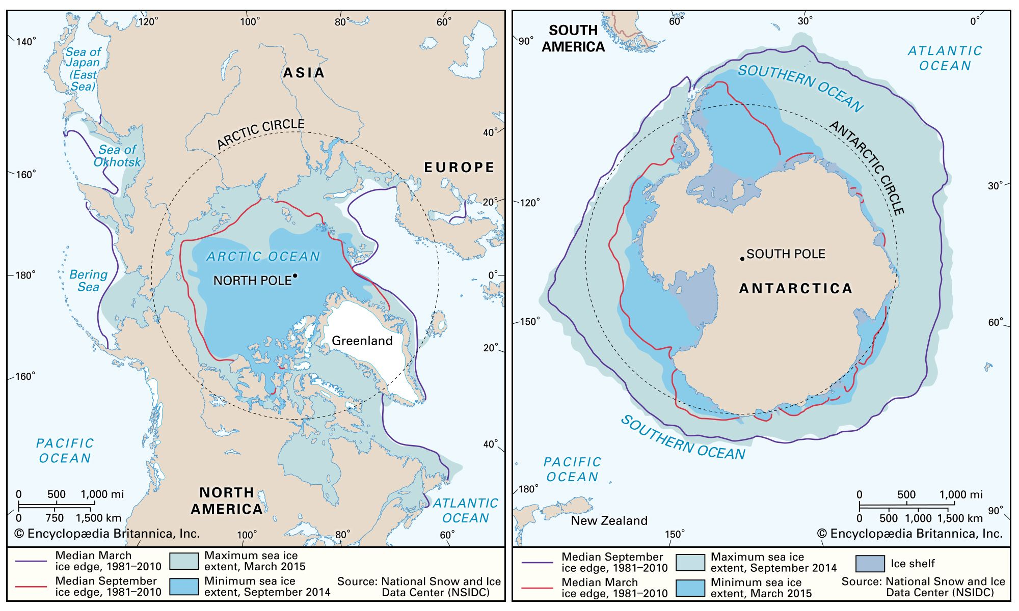
Sea ice in the Arctic and Antarctic

Slide 8
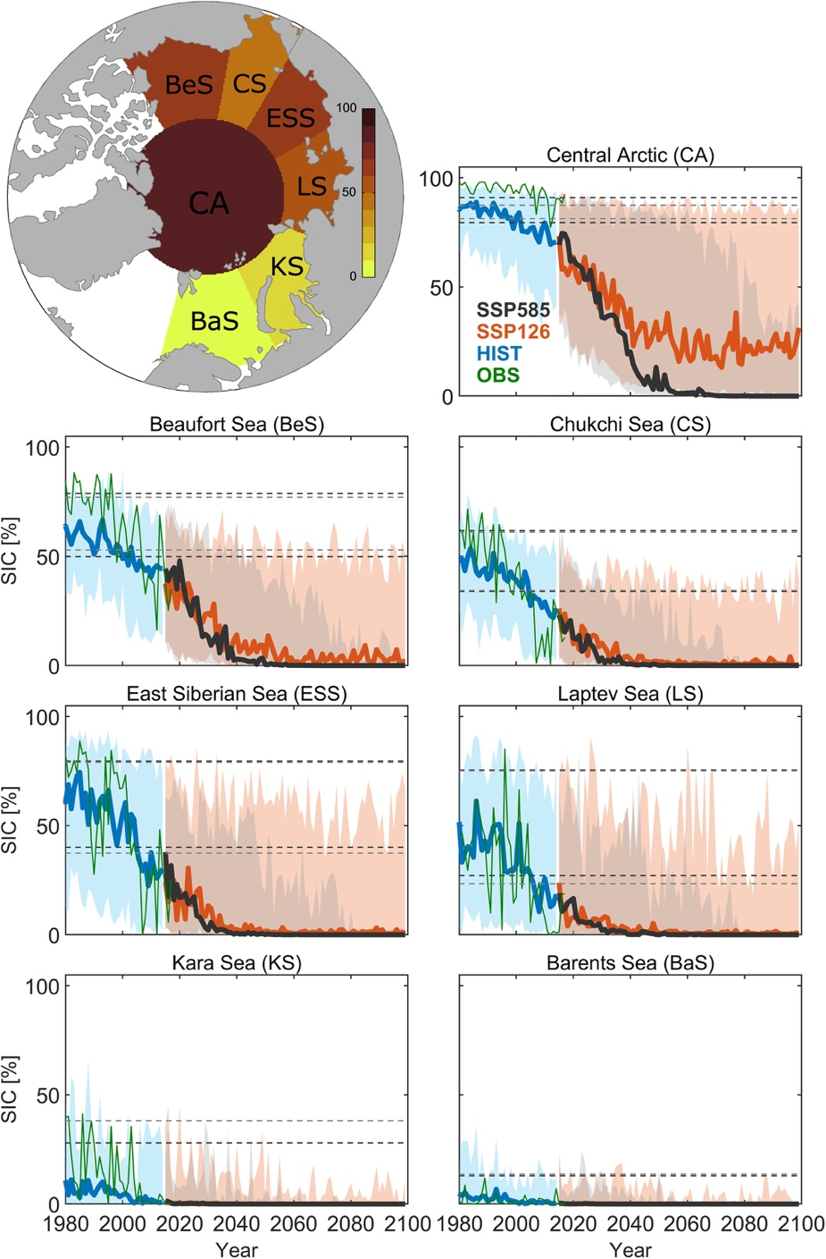
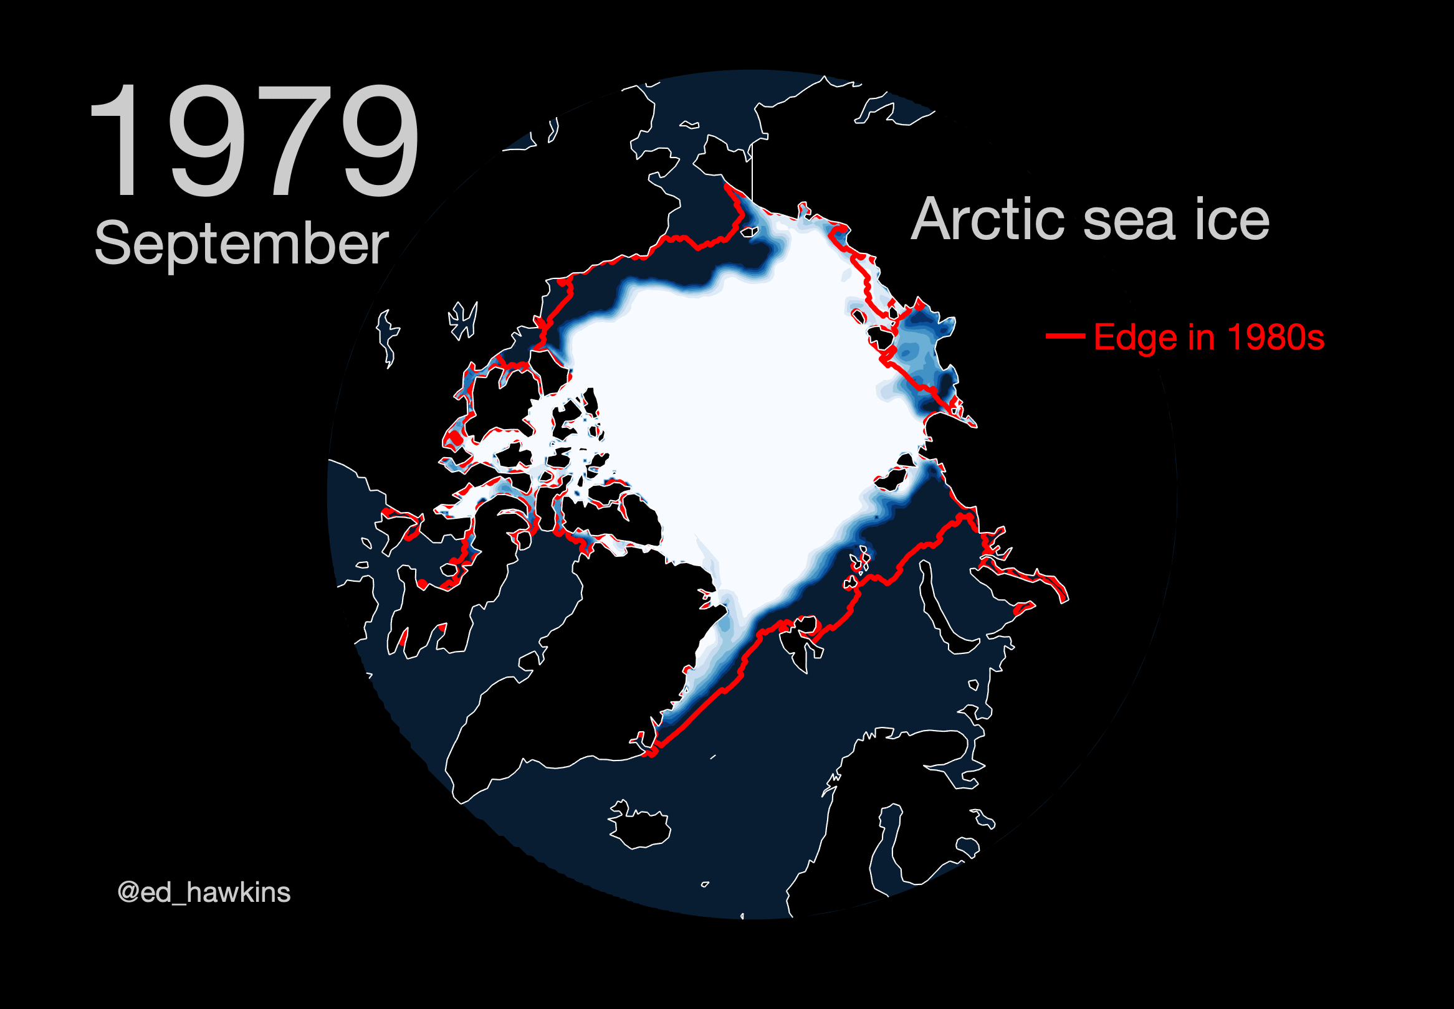
Sea Ice Changes under Global Warming
(Årthun et al., 2020)

Slide 9
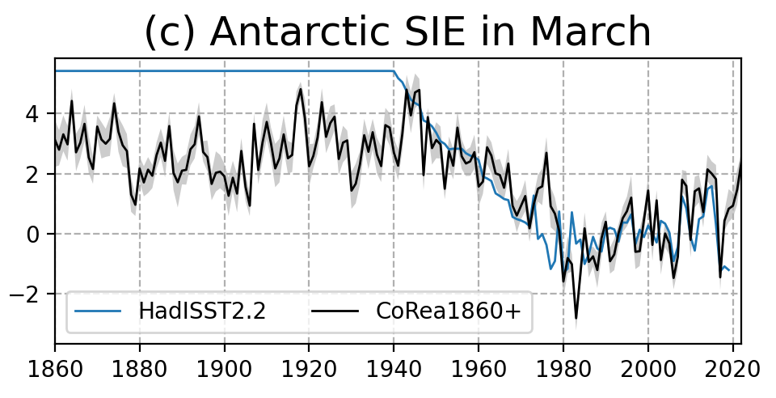
Sea Ice Changes under Global Warming
Since the satellite era, the Antarctic increases slightly until 2014 and then decline rapidly.
(Wang et al., ESSD, 2025)
Decline from 1940 to 1980 is consistent with previous studies (e.g., Fogt et al., 2022; Dalaiden et al., 2023; Goosse et al., 2024; Divine et al., 2024).

Slide 10
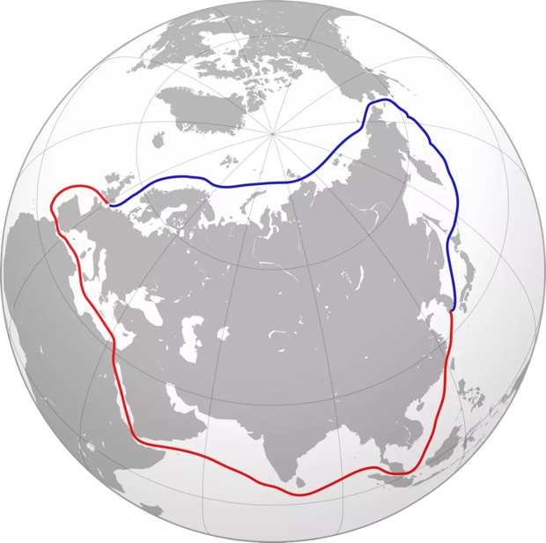
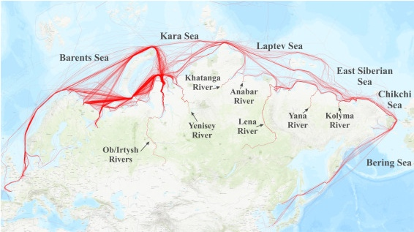
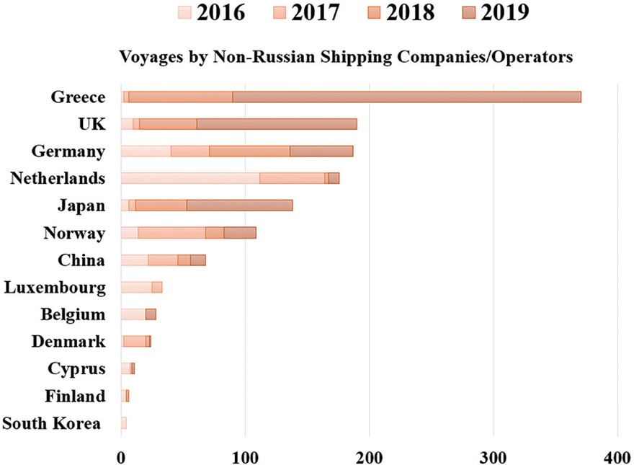
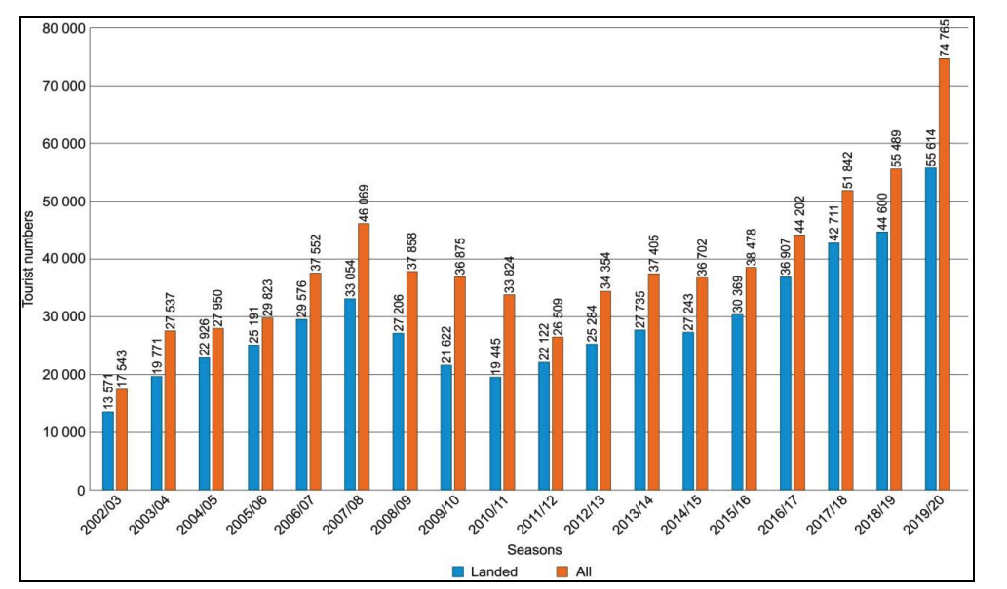

Importance of Sea Ice Forecasting
Northern Sea Route in 2018
Northeast Passage：
13700 km / 22 days
Suez Canal Route：
20900 km / 37 days
(Gunnarsson, 2021)
Bekkers et al., 2018
(Gunnarsson, 2021)
Tourisms
(Eicken et al., Nature, 2013)
(Palmowski et al., 2020)
Notes:
-Sailing tracks of vessels operating on the NSR in 2018
-Nationality of foreign (non-Russian) shipping companies/operators working on the NSR, 2016–2019, and total number of their voyages during those years
-Fast-changing sea ice brings hazards

Slide 11
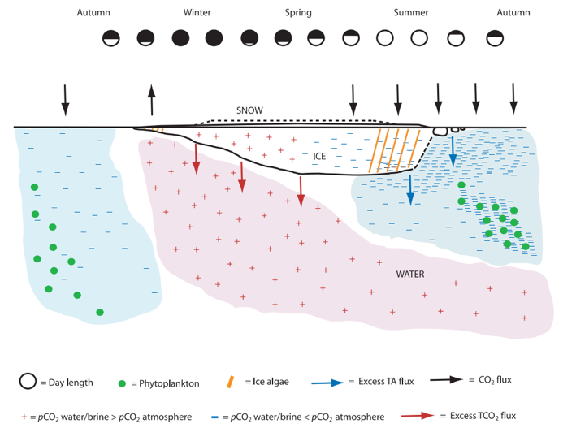
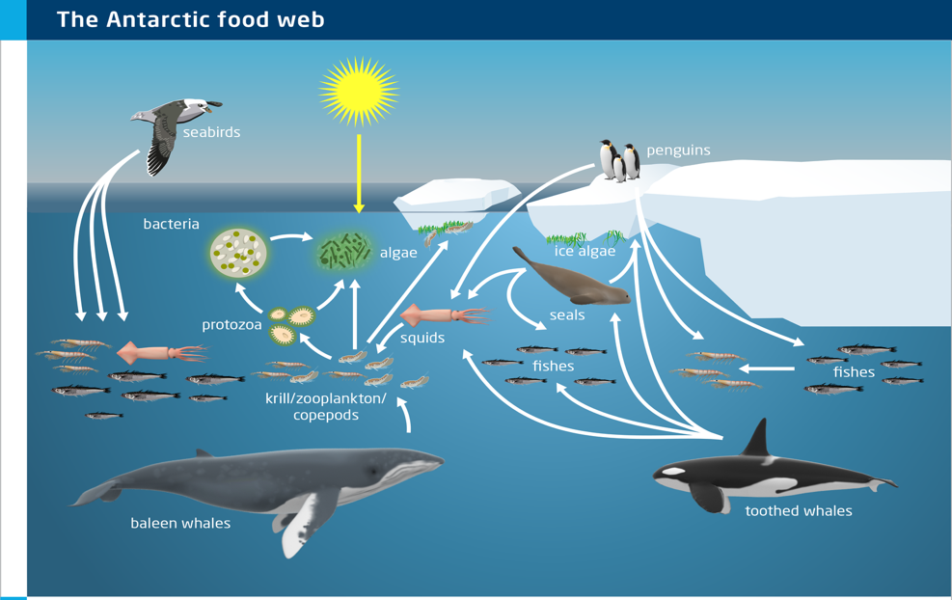
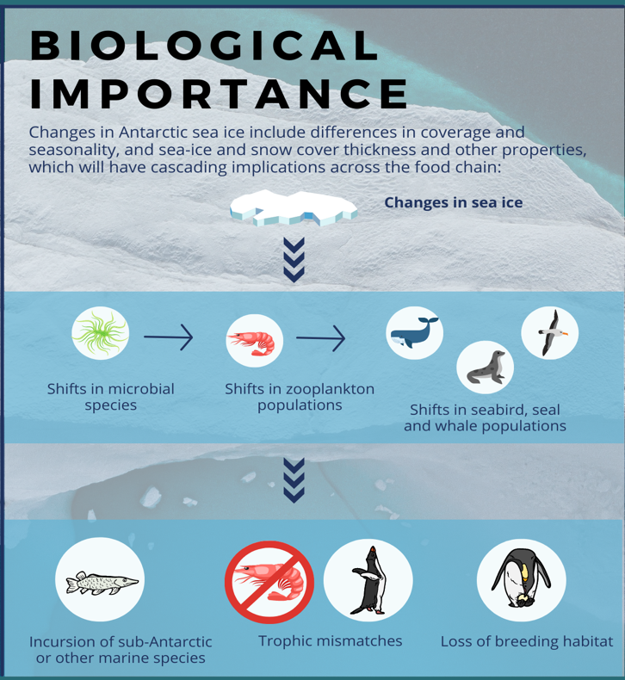
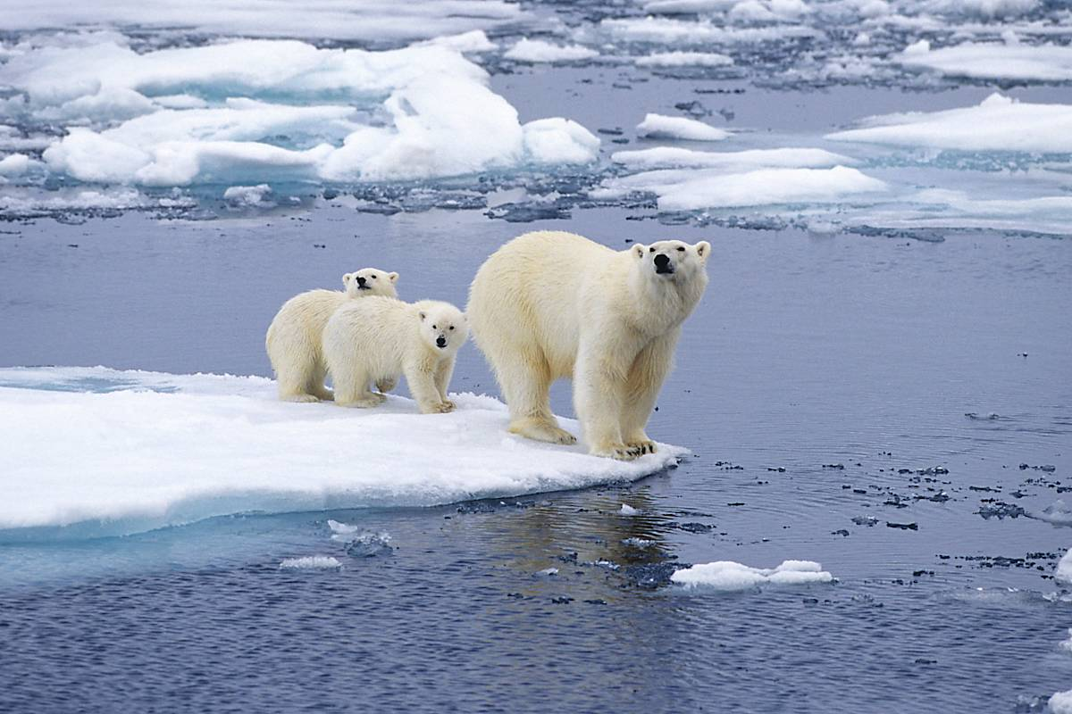
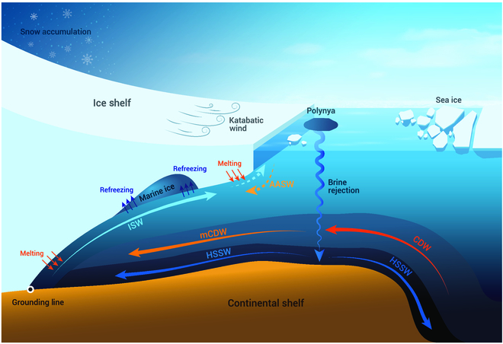
Importance of Sea Ice Forecasting
Air-sea carbon flux
Local ecosystem
Food Chain
Søren et al., 2011
Ocean circulation
Clem et al., 2022

Slide 12
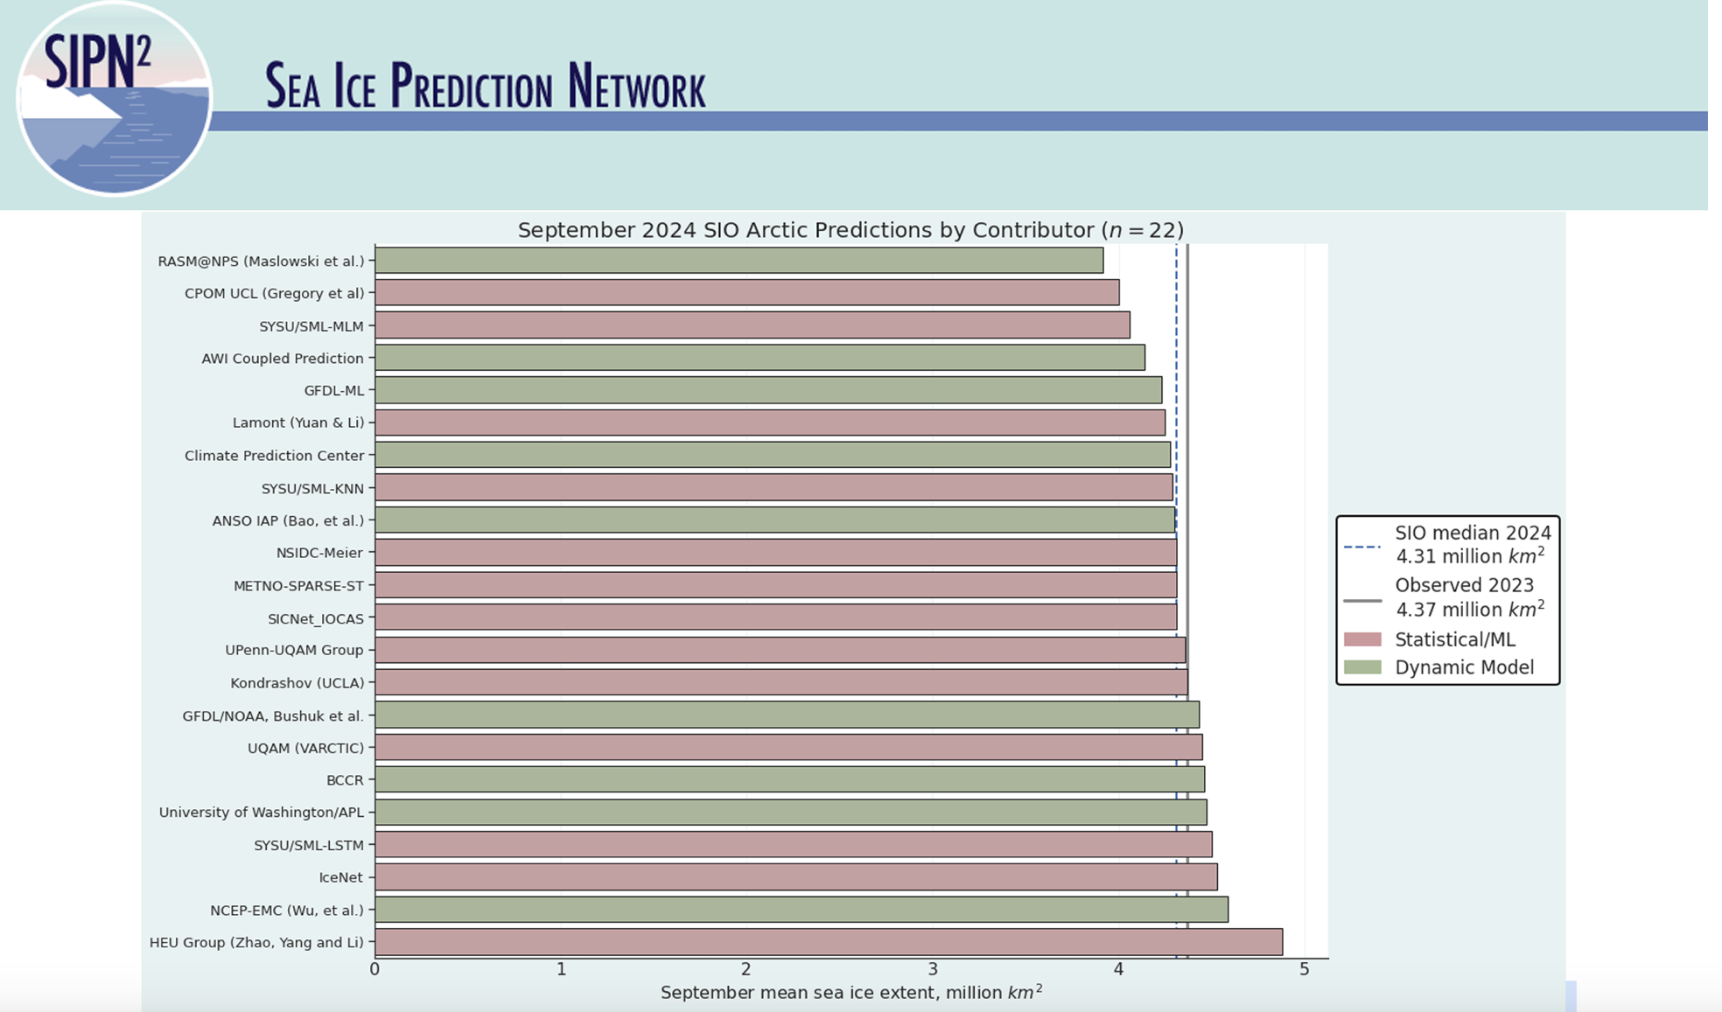
Importance of Sea Ice Forecasting
Sea ice predictions are needed by shipping industries, local communities, fisheries, wildlife conservation, tourism, oil and gas industries, scientific logistics, etc
International sea ice prediction communities: Sea Ice Prediction Network (SIPN) and SIPN-South
Notes:
-Sailing tracks of vessels operating on the NSR in 2018
-Nationality of foreign (non-Russian) shipping companies/operators working on the NSR, 2016–2019, and total number of their voyages during those years
-Fast-changing sea ice brings hazards

Slide 13
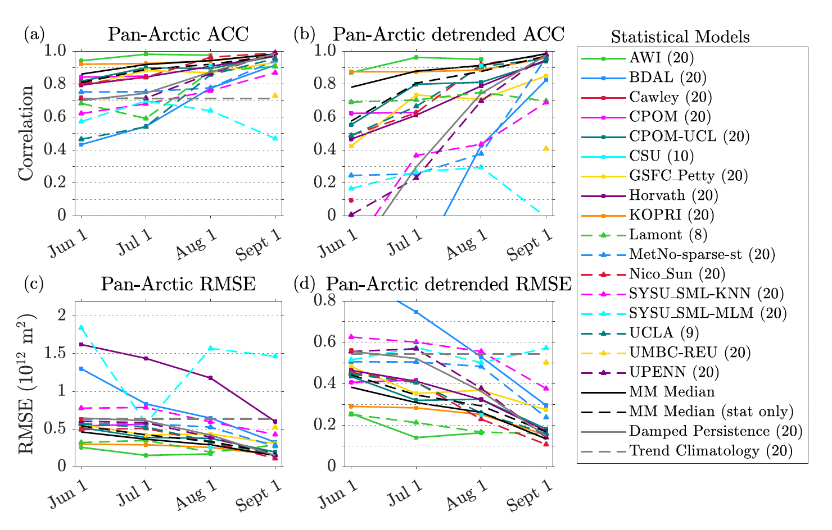
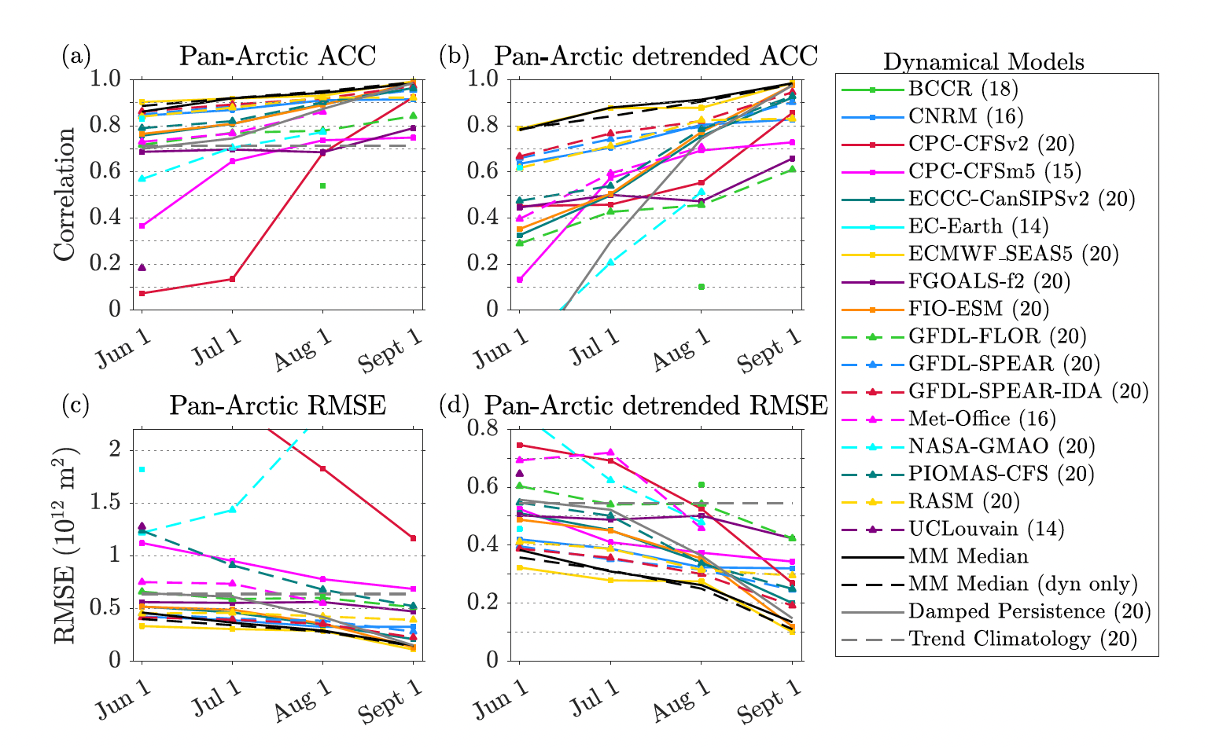
Methods of Seasonal Forecasting
Statistical models
Dynamical models
(Bushuk et al., BAMS, 2024)

Slide 14
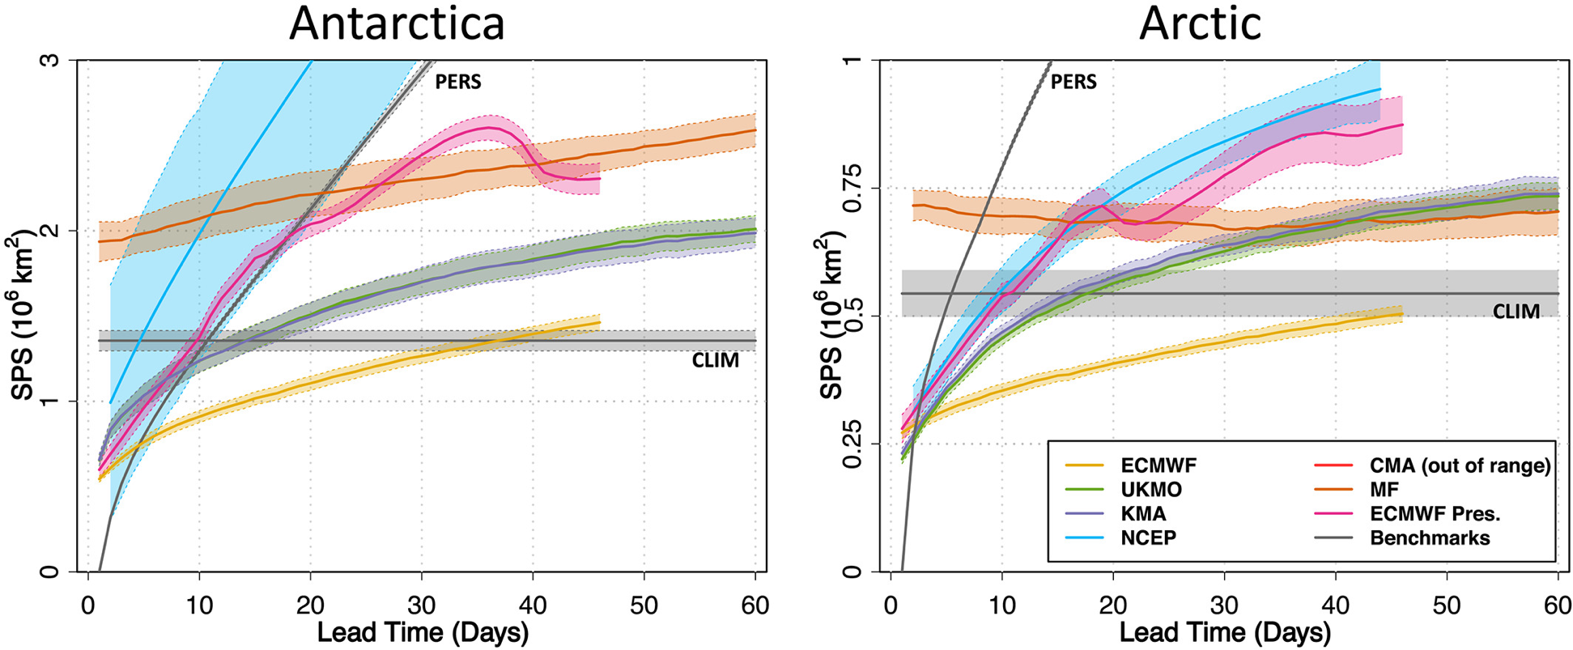
Sea ice edge prediction with dynamical models
(Zampieri et al., 2019)
ECMWF = European Centre for Medium-Range Weather Forecasts
UKMO = UK Met Office
KMA = Korea Meteorological Administration
NCEP = National Centers for Environmental Prediction
CMA = China Meteorological Administration
MF = Météo-France
Key factors: imperfect model physics and uncertainty in the initial conditions

Slide 15
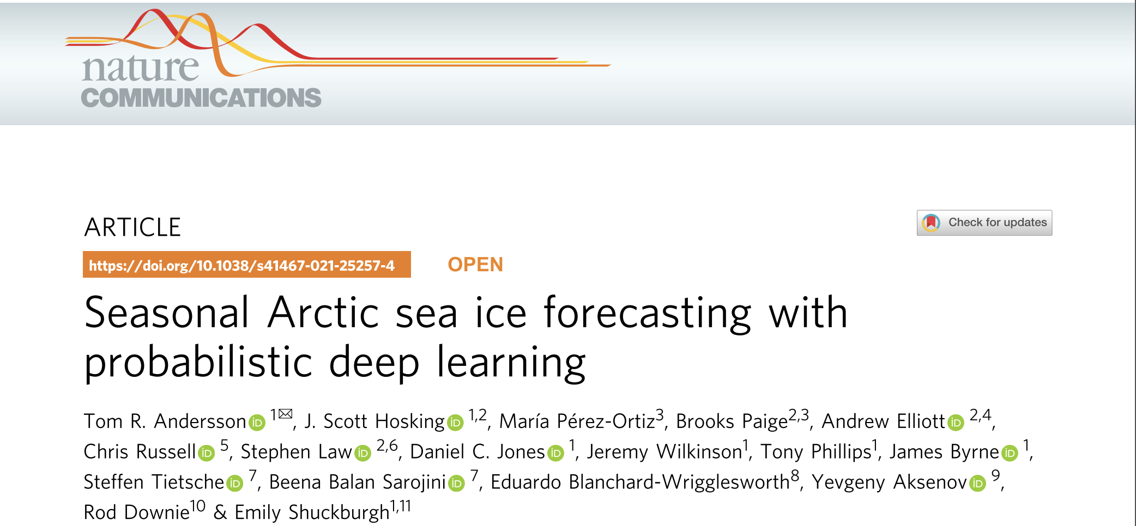
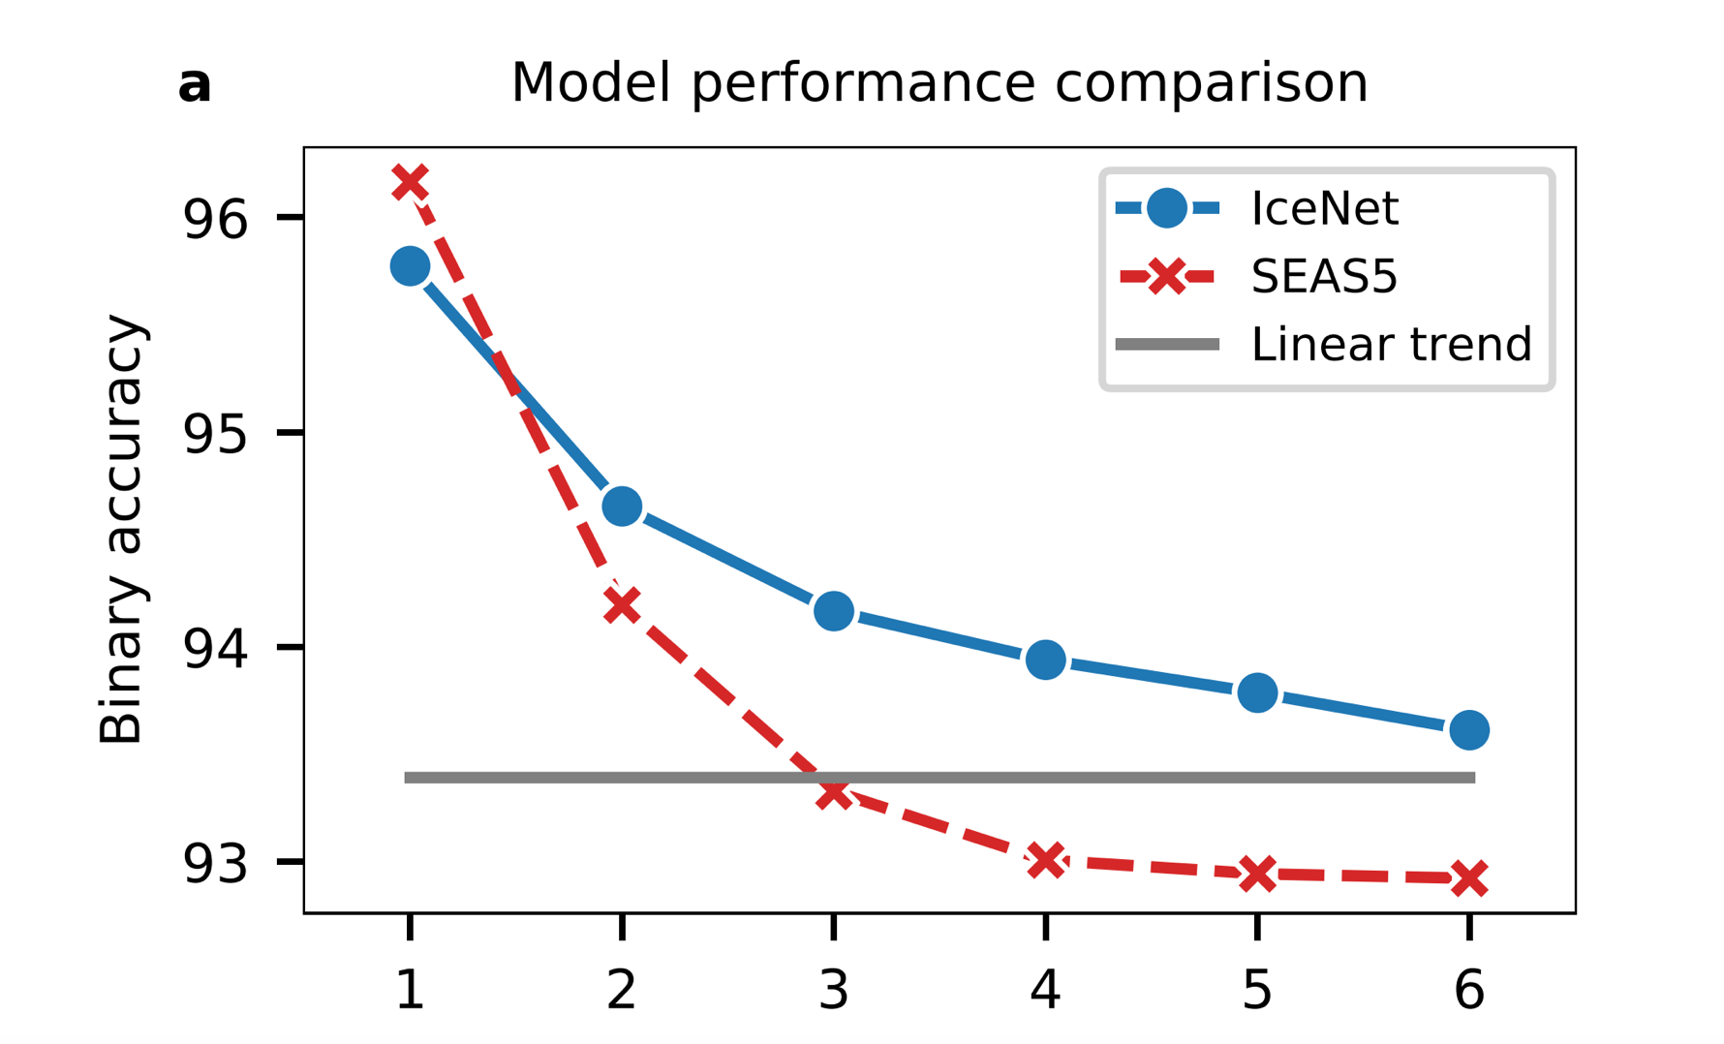
Machine learning may beat dynamical model
Lead month

Slide 16
Outline
Introduction
Case Studies (NorCPM)
Arctic sea ice
Antarctic sea ice
Conclusions
Questions and Discussion

Slide 17
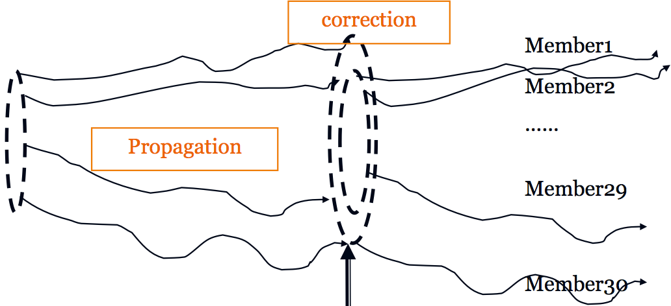
Norwegian Climate Prediction Model (NorCPM)
Norwegian Earth System model
Data assimilation (EnKF)
chemistry/aerosols
Atmosphere
Ensemble
Ice
Land
ice
land
Ocean
river
Ocean biochemistry
Objectives:
Long climate reanalysis
Instrumental (from 1850, CoRea)
Paleoproxy (last millennium, PARCIM)
Climate prediction
Seasonal time scale (Climate Services, SFI Climate Futures)
Annual-to-decadal time scale (CMIP6 DCPP, WMO-ADCP)
Observations
SST (HADISST2, NOAA)
T-S profiles (EN4)
SIC (HADISST2, NOAA)
SIT (ESA CCI; C2SMOS)
(Counillon et al. 2016; Bethke et al. 2021)
Notes:
-Atmospheric nudging
17

Slide 18






Recent team members on sea ice prediction
Permanent
Francois Counillon (NERSC)
Group leader
Yiguo Wang
(NERSC)
Senior researcher
Mariko Koseki (UiB)
Engineer
Temporal
Nicholas Williams (NERSC)
Post-doc
Yongwu Xiu
(SYSU)
PhD student
Zikang He
(HoU)
PhD student
Yongcheng Lin
(SYSU)
PhD student

Slide 19
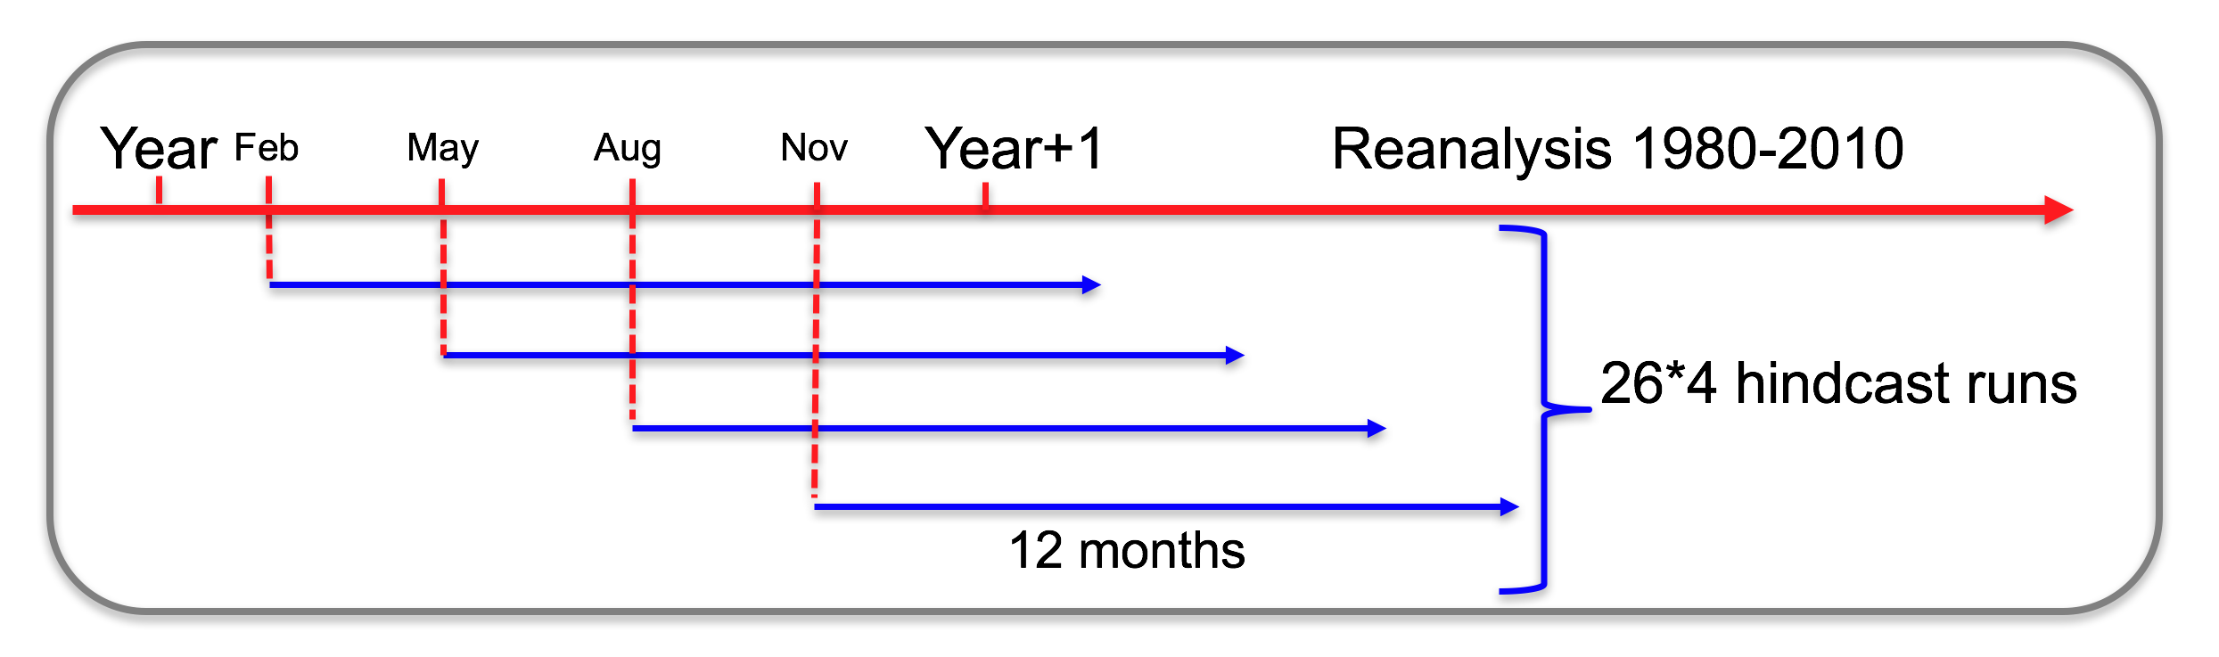
Seasonal hindcast experiments
(Wang et al. 2019)
Notes:
Weakly coupled
1985-2010
Determination coefficients (R2) in our reanalysis

Slide 20
Arctic sea ice prediction

Slide 21
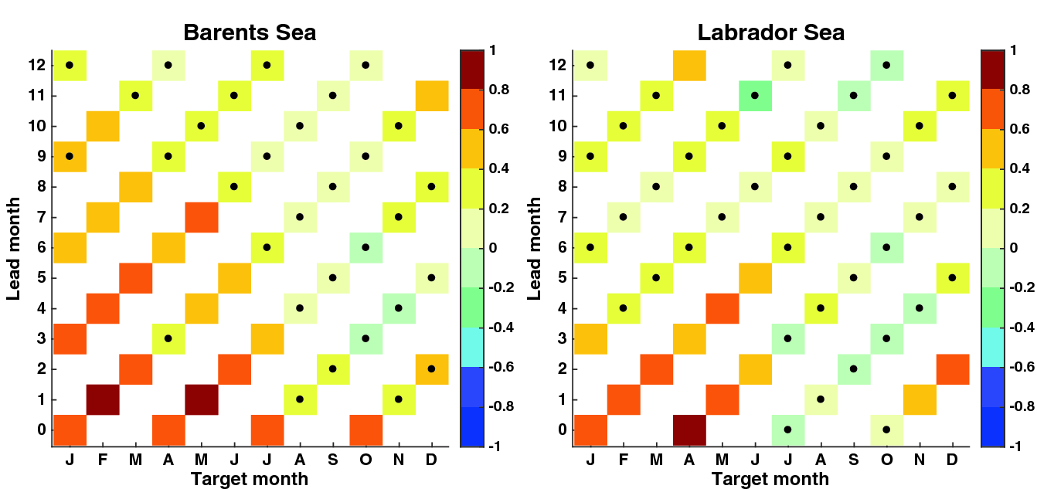
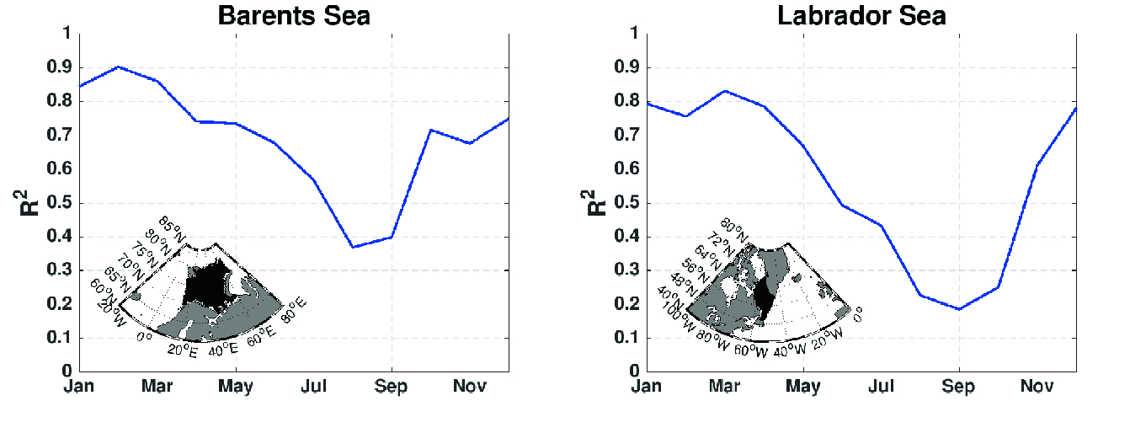
Sea ice extent seasonal prediction with assimilation of oceanic data
(Wang et al. 2019)
Notes:
Weakly coupled
1985-2010
Determination coefficients (R2) in our reanalysis

Slide 22
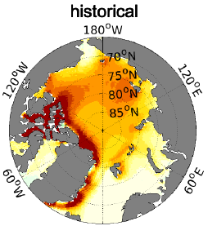
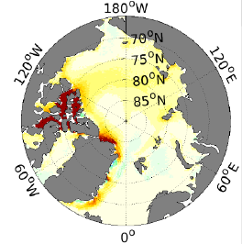

Can we further constrain sea ice with ocean obs.?
Assim
Strongly coupled assimilation of ocean data reduces both the bias and bias-free RMSE
[m]
(Bethke et al. 2021)
Notes:
Strongly coupled data assimilation

Slide 23
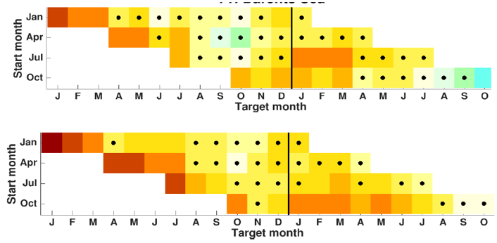
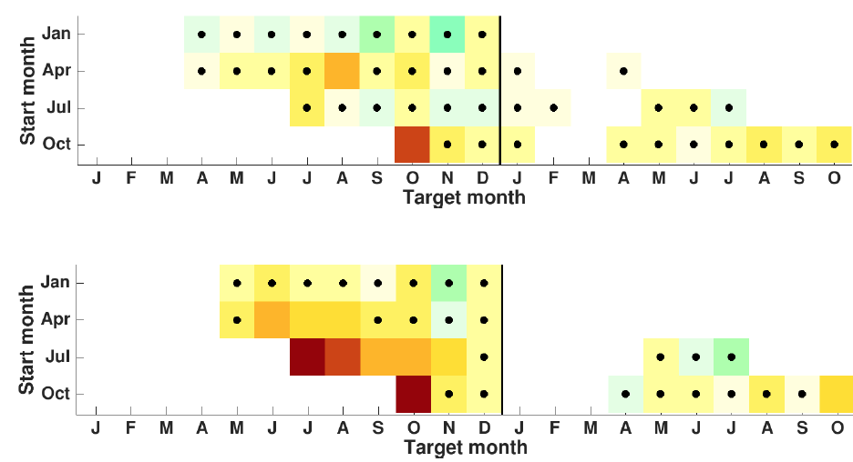
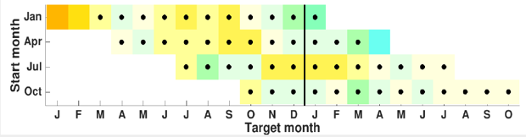
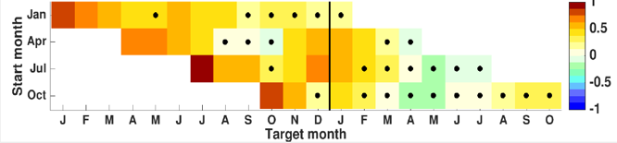
Enhancing seasonal prediction in the Arctic?
Detrended correlation skill of sea ice extent in the real framework
1985:2010
Black dot means not significant
Barents Sea
Chukchi Sea
Greenland Iceland Sea
ocean obs
ocean +icec
Initialisation of heat content
Initialisation of SIT in May
Improved sea ice export
Complementing our system with sea ice concentration data greatly improved prediction skill of sea ice extent
(Kimmritz et al. 2019)

Slide 24
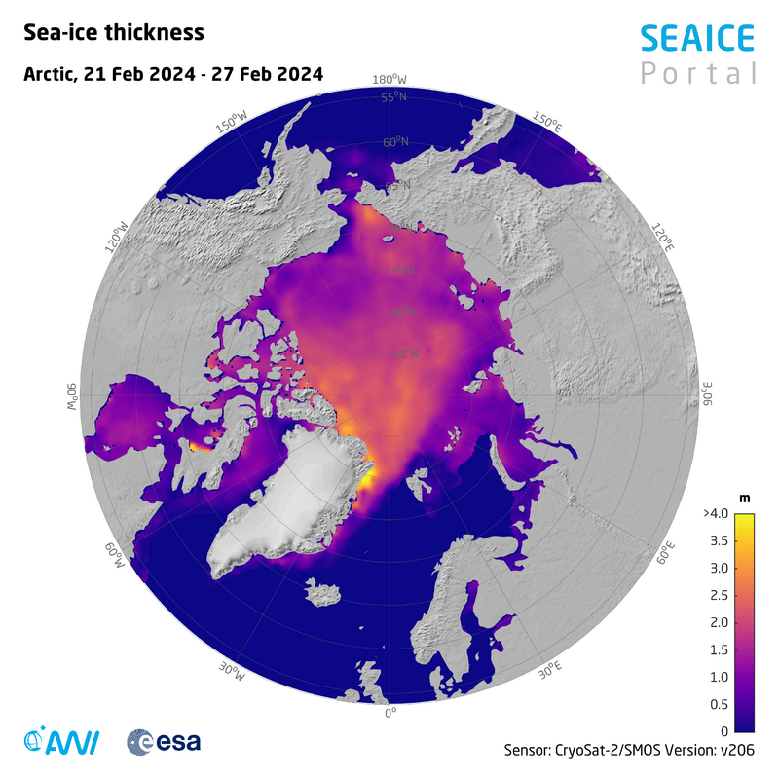
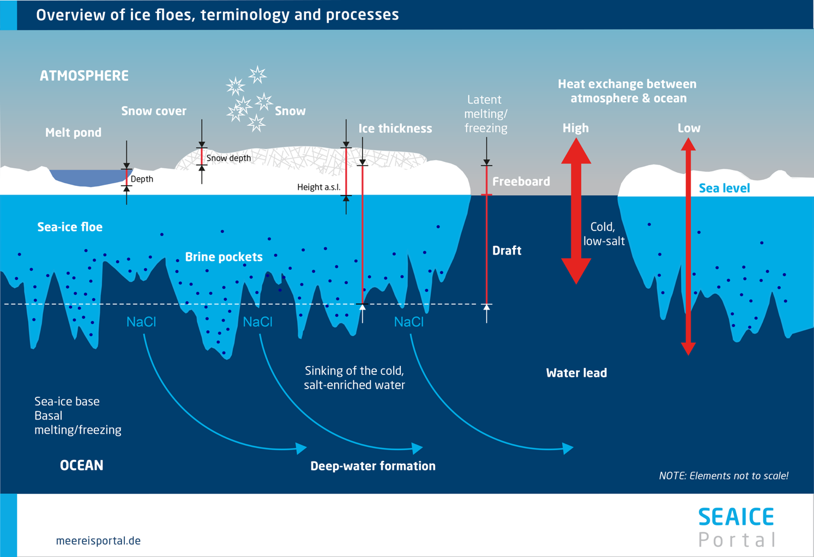
Impact of sea ice thickness assimilation
Notes:
ESA CCI
Nov, Dec, Jan, Feb, Mar

Slide 25
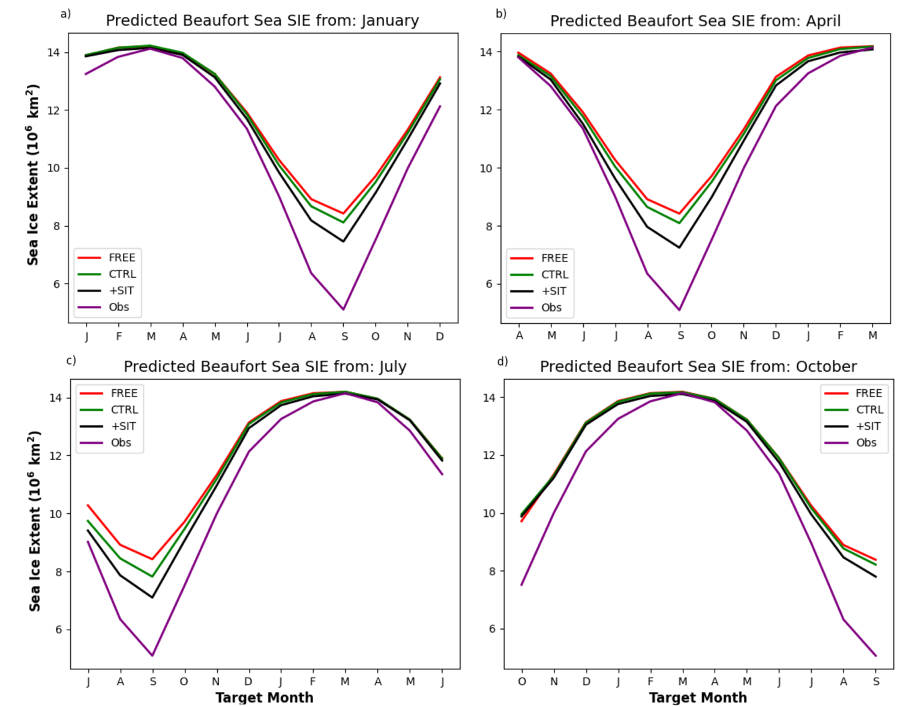
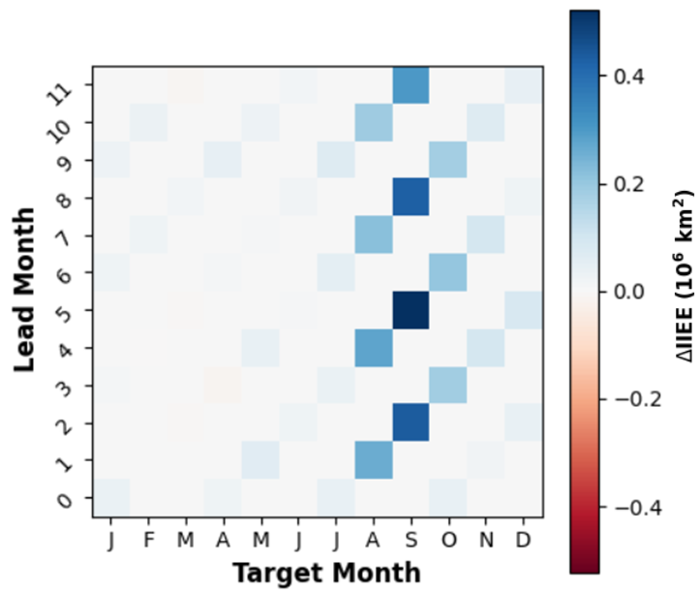
Impact of sea ice thickness assimilation
Assimilate ENVISAT from 2002-2010 (winter) and C2SMOS afterwards (winter)
Improves SIE prediction in summer
(Williams et al., TC, under review)
Notes:
ESA CCI
Nov, Dec, Jan, Feb, Mar

Slide 26
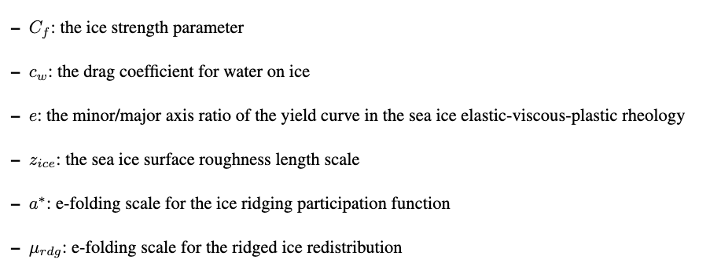
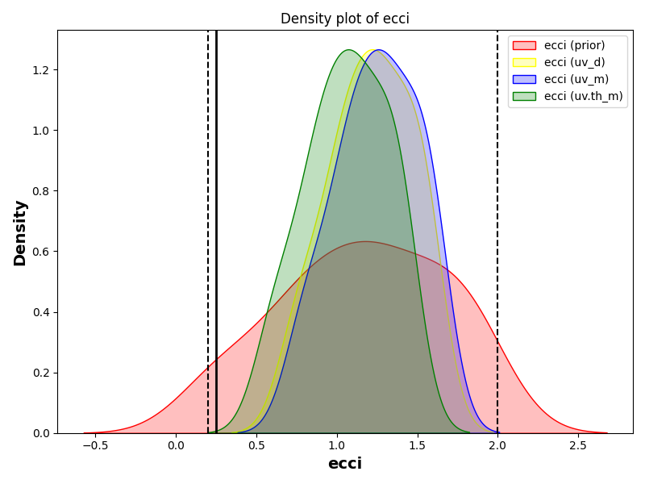
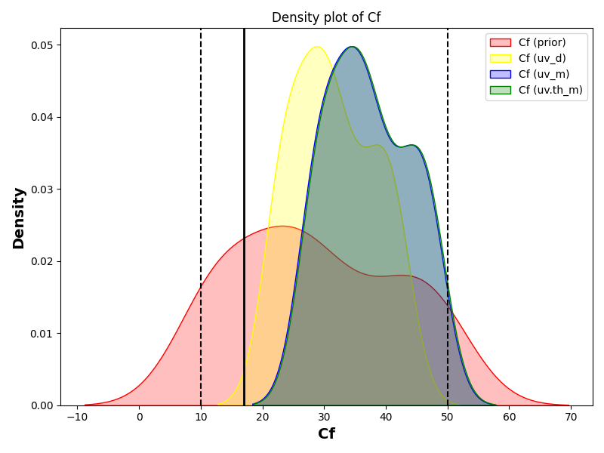
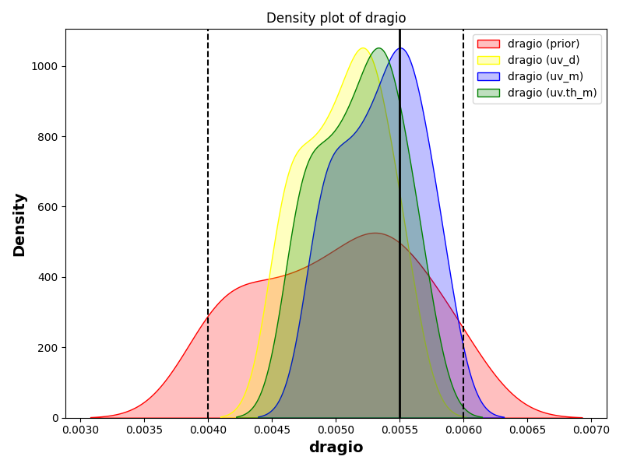
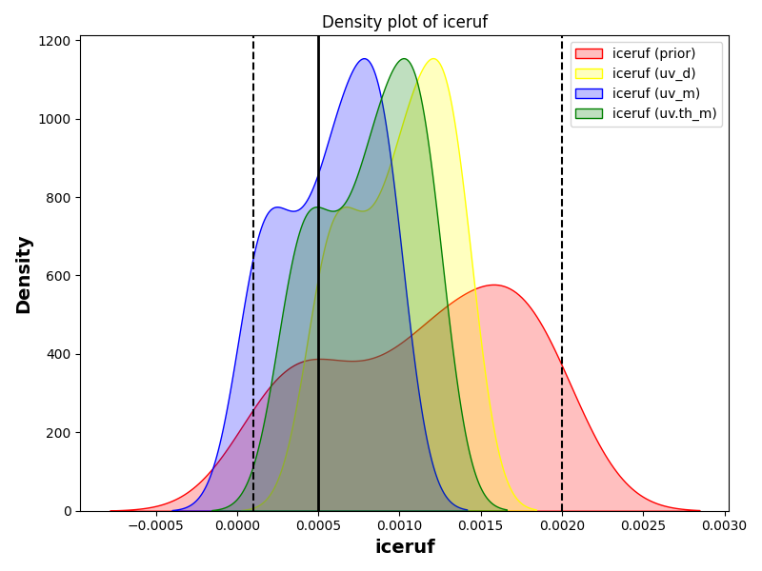
Estimation of sea ice dynamic parameters
(Williams et al., in prep)
Notes:
ESA CCI
Nov, Dec, Jan, Feb, Mar

Slide 27

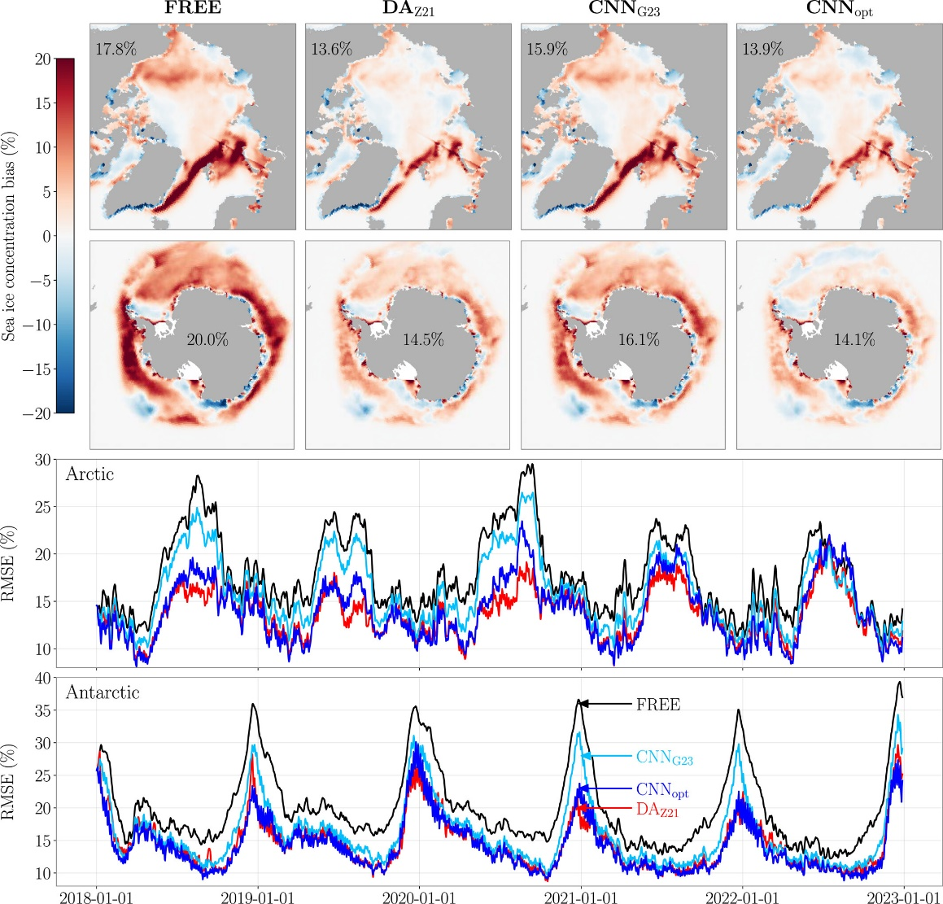
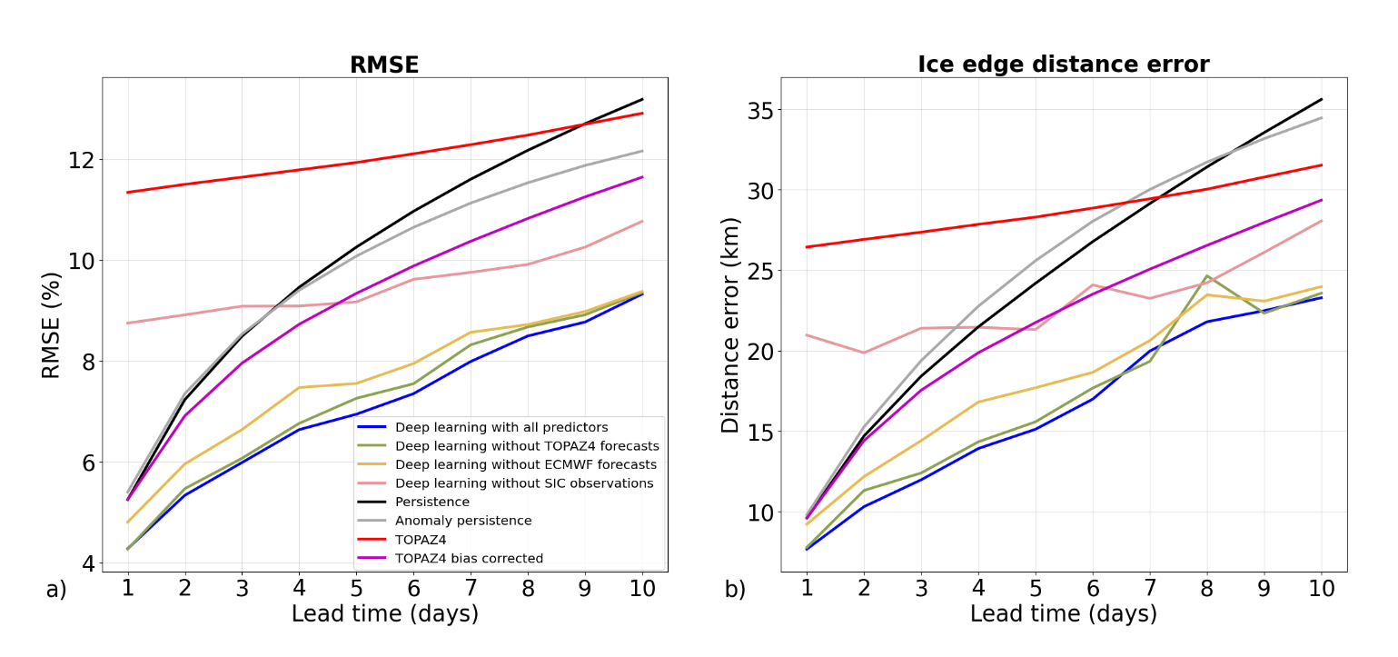
Error correction approaches
Online error correction
Offline error correction
(Palerme et al., 2024)
(Gregory et al., 2024)
Notes:
ML have been apply widely in a lot fields also in bias correction.

Slide 28
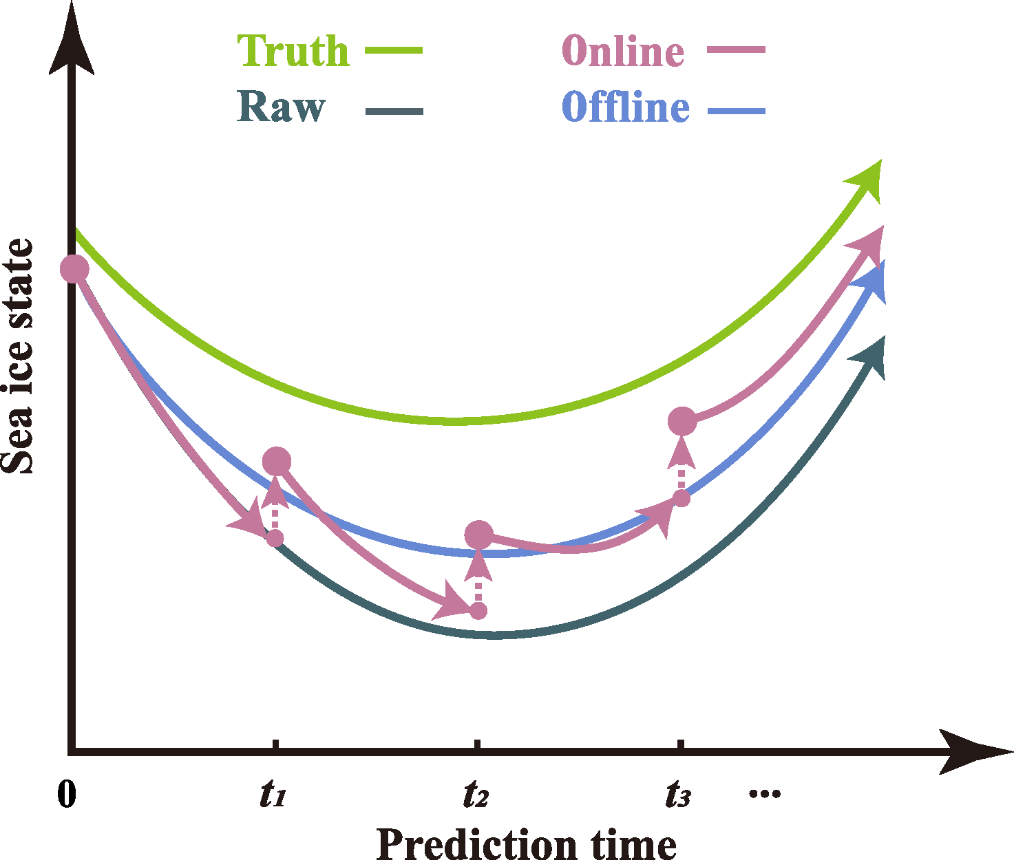
What we want to do?
Research questions
The previous work has not investigated how the performance of apply ML into seasonal prediction of Arctic sea ice?
Which method performs the best?
(He et al., TC, 2025)
Notes:
ML have been apply widely in a lot fields also in bias correction.

Slide 29
ANN model
Input layer
SST
Hidden layer
SSS
b₁
a₁
Ice concentration
output layer
Observed ice concentration at different lead time
Ice
thickness
a₂
b₂
y
Stand deviation
a₁₀₀
b₅₀
Latitude
(He et al., TC, 2025)

Slide 30
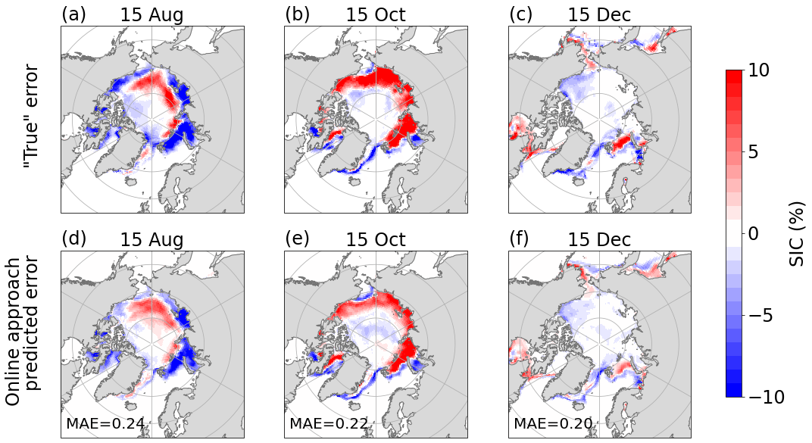
ML performance
Time average of model error during 2003-2021
(He et al., TC, 2025)

Slide 31
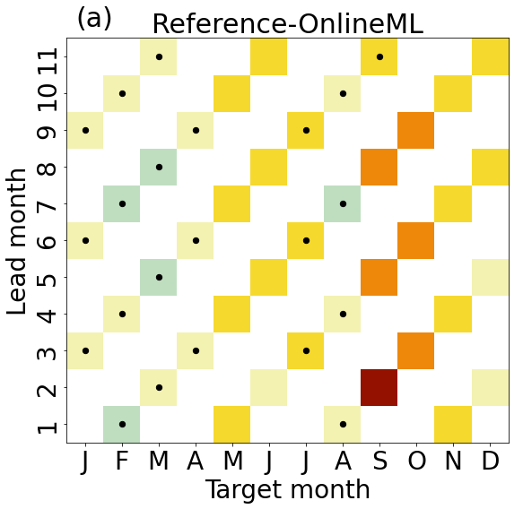
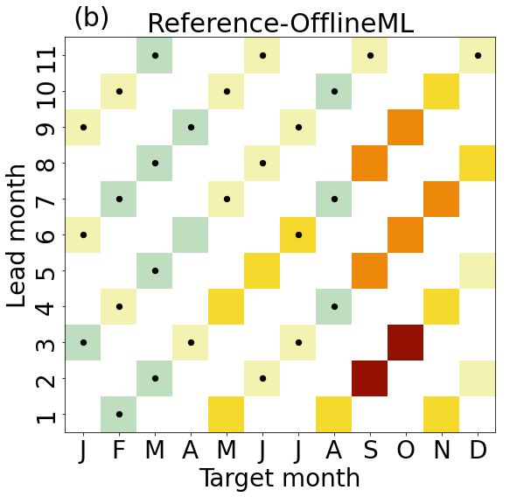

Pan Arctic skill
Error-corrected better
Reference better
Significant improvement happens during September to December
OfflineML performs better than OnlineML
(He et al., TC, 2025)

Slide 32

Prediction skill for sea ice concentration
OfflineML performs better
Reference performs better
Improvements vary by target month and regions
The improvement mainly in margin region
(He et al., TC, 2025)

Slide 33
Antarctic sea ice prediction
Notes:
Ongoing work from Yongwu Xiu

Slide 34


1. Seasonal prediction of Antarctic sea ice in NorCPM
Our goal: Investigate the effect of initialization of different components on the seasonal prediction of Antarctic sea ice
Experimental design:
Ocean + Sea Ice : EnKF
Name | Initialization | periods
OCN | SST+T/S profile | 1985-2010
OCNICE | SST+T/S profile+SIC | 1985-2010
ATM | UVT | 1985-2010
Atmosphere: Nudging
(Garcia-Oliva et al., 2024)
(Xiu et al., JAMES, 2025)
Name | Initialization | periods
OCN | SST+T/S profile | 1985-2010
OCNICE | SST+T/S profile+SIC | 1985-2010
ATM | UVT | 1985-2010
Notes:
Due to the issue I mentioned above, our study aims to understand the effect of initialization of different components on the seasonal prediction of the Antarctic sea ice.
To achieve this goal, we have conducted several experiments, which we only initialize one or two components of the climate model.
For example, in the OCN experiment, we only use the oceanic data for initialization.
While in the OCNICE experiment, we only use the oceanic data and sea ice concentration data.
And in the ATM experiment, we only use the wind and temperature for initialization.
Every experiment is based on NorCPM which has 30 members. For the ocean and sea ice assimilation, we use the EnKF while for the atmosphere we use the nudging. The period is from 1985 to 2010. We make the prediction every February, May, August, and November, and each hindcast lasts for one year.

Slide 35
1. Seasonal prediction of Antarctic sea ice in NorCPM
Prediction skill of SIE in the Weddell Sea：
Weddell Sea
ACC
95% significant
Once ocean is initialized, SIC initialization provides limited benefit for prediction.
Atmosphere initialization performs best.
(Xiu et al., JAMES, 2025)
Notes:
I use the prediction for the Weddell sea to demonstrate the effect of initialization of different components. In this figure, we have three heatmap, from left to right, is the prediction skill of the OCN hindcast, the OCNICE hindcast, and the ATM hindcast.
We can summarize two key points from this figure.
The first one, the prediction skill of the OCN and OCNICE is quite similar, which means that if the ocean is initialized, the assimilation of the sea ice concentration will not provide benefit for the prediction. This is because the memory of the Antarctic sea ice extent is too short, which can not persist for long time.
The second one, compared to the OCN and OCNICE hindcast, the ATM hindcast is better, in particular for the prediction initialized in July and October. I will explain the reason for this point.

Slide 36


1. Seasonal prediction of Antarctic sea ice in NorCPM
Reasons for the better performances of atmosphere initialization #1
Better atmospheric prediction
stratosphere-troposphere coupling
SLP Prediction from July
Geopotential height prediction from July
ACC
ACC
coupling
Similar as Wang et al. (2021)
ATM initialization
Better ATM prediction
Better ICE prediction
(Xiu et al., JAMES, 2025)
Notes:
The first reason, the initialization of the atmosphere leads to improved prediction of the atmosphere. For example, this figure shows the prediction skill for mean sea level pressure. The prediction is initialized in July and validated in August, September, October, and November. For the OCN and OCNICE hindcast, the model don’t have prediction skill for the mean sea level pressure, however, for the ATM hindcast , the prediction skill for in the October and November is quite high. This could improve the sea ice extent prediction.
The second one, the initialization of the atmosphere leads to improved prediction of the sea ice thickness. This figure shows the prediction skill of the SIT which are validated by the GIOMAS reanalysis. For example, the OCN and OCNICE don't have prediction skill in July and October, however, the ATM initialization have the prediction. This prediction skill for the SIT could benefit for the sea ice extent prediction.

Slide 37

1. Seasonal prediction of Antarctic sea ice in NorCPM
Reasons for the better performances of atmosphere initialization #2
Better sea ice thickness prediction
The memory of sea ice thickness
Weddell Sea
SIT prediction validated by GIOMAS reanalysis
ATM initialization
Large SIT anomaly
Longer persistence
memory
(Xiu et al., JAMES, 2025)
Notes:
The second one, the initialization of the atmosphere leads to improved prediction of the sea ice thickness. This figure shows the prediction skill of the SIT which are validated by the GIOMAS reanalysis. For example, the OCN and OCNICE don't have prediction skill in July and October, however, the ATM initialization have the prediction. This prediction skill for the SIT could benefit for the sea ice extent prediction.
The reason can be explained by the memory of sea ice thickness. We found the atmosphere initialization lead to a thicker ice, and this figure shows that the thicker ice in this area, can persist longer than the thinner ice. This memory can contribute to the SIE prediction.

Slide 38
Take-home messages
Sea ice holds significant importance and provides valuable benefits to society.
Ocean, sea ice and atmosphere observations are useful for sea ice prediction.
Combining dynamical model and machine learning improves sea ice forecast.
Perspectives:
Fine-tune sea ice dynamic parameters, such as ice strength, ocean-sea ice drag and atmosphere-sea ice drag)

