Slide 1

Lost (and found)
in latent land:
A journey through latent space in climate science
Pierre Gentine
Columbia university

Slide 2







Many incredibly talented and kind scientists aka the Dream Team
Sophie Abramian
Sara Shamekh
Hang Fan
Jianing Fang
Carla Roesch
Juan Nathaniel
Yongquan Qu

Slide 3
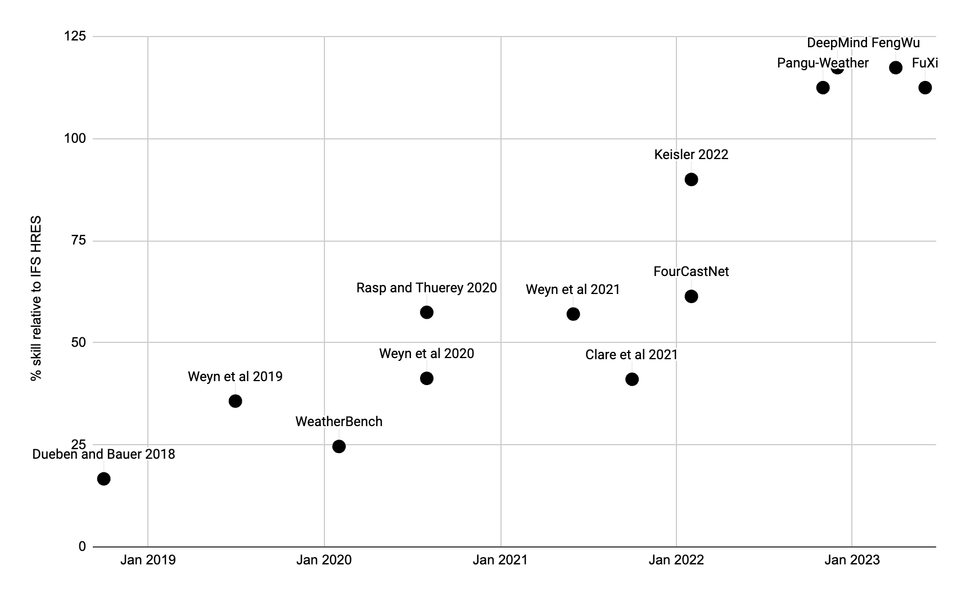
Machine learning and AI have had a profound impact on weather and climate applications…
Weather forecasting
% skill relative to ECMWF IFS
Chart by Stephan Rasp @DeepMind
Jan 2019
Jan 2020
Jan 2021
Jan 2022
Jan 2023

Slide 4
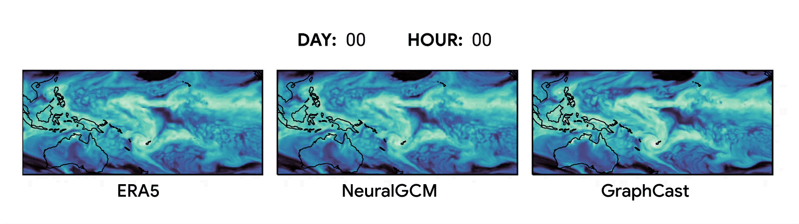
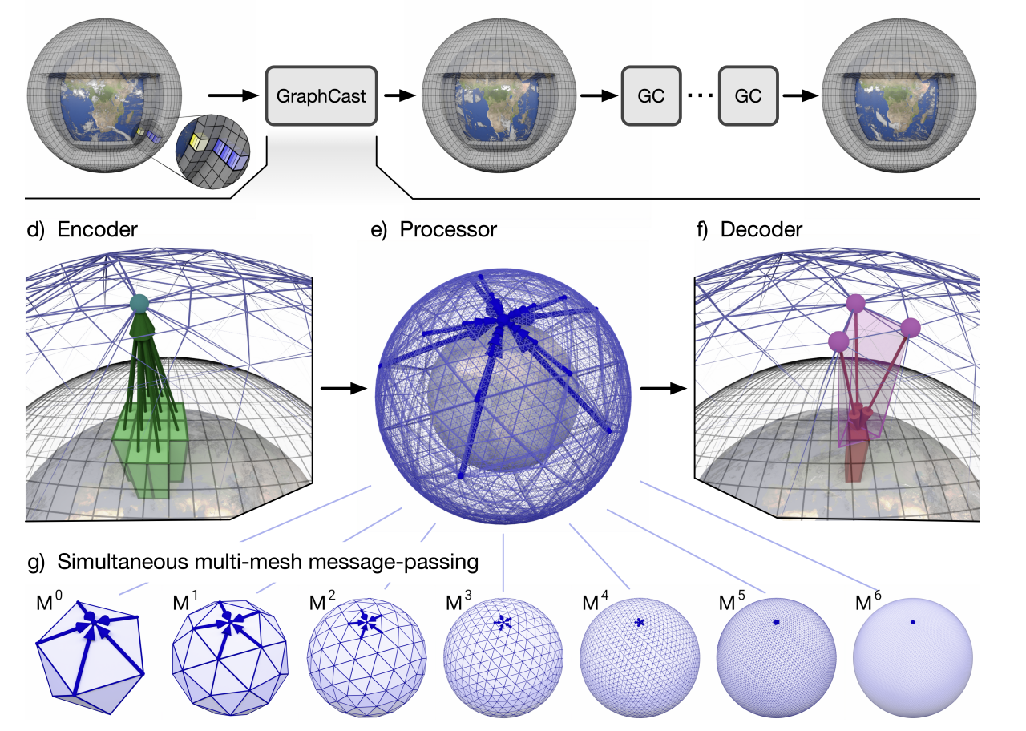
Machine learning and AI have had a profound impact on weather and climate applications…
Weather forecasting
Skillful (but blurry)
Slide from Stephan Hoyer @Google

Slide 5
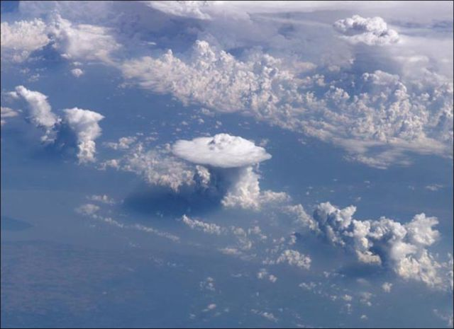
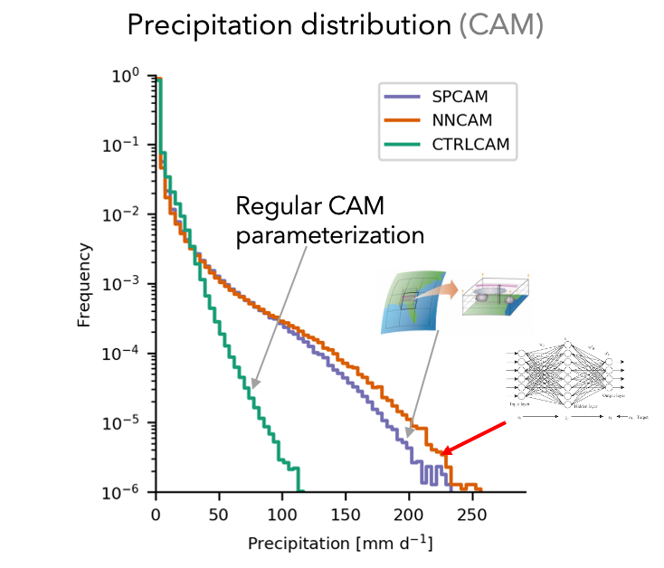
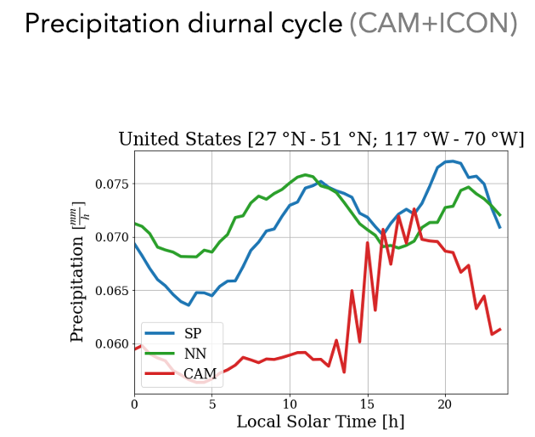
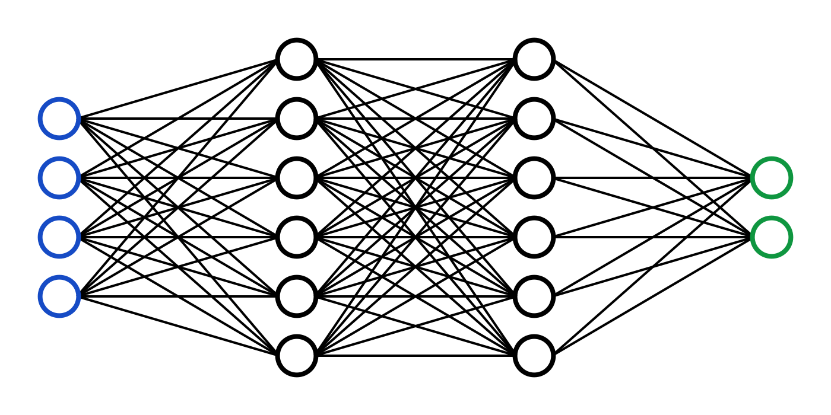
Machine learning and AI have had a profound impact on weather and climate applications…
Climate modeling
Climate Model Grid ~100km
Rasp, Pritchard, Gentine., 2018 PNAS; Behrens, Eyring, Gentine JAMES, 2024

Slide 6
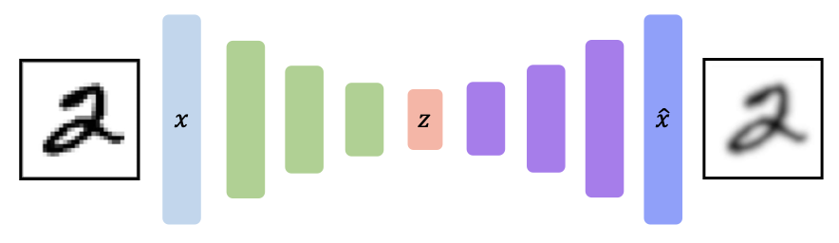
… but what new understanding did we gain?
Can we open up the black box?
Can “data compression” teach us something?
Example of autoencoder

Slide 7
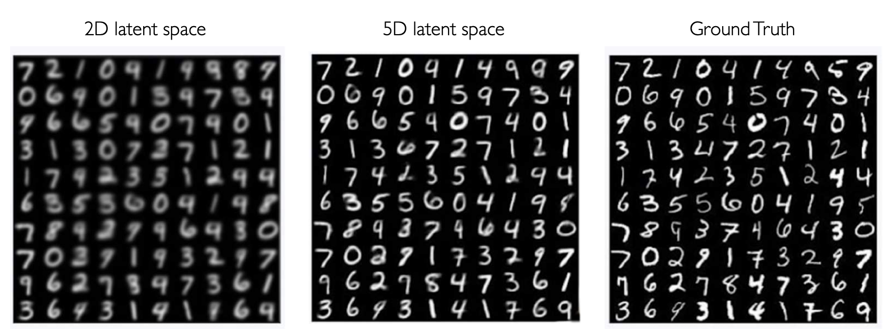
… but what new understanding did we gain?
Example of (variational) autoencoder
in computer vision

Slide 8
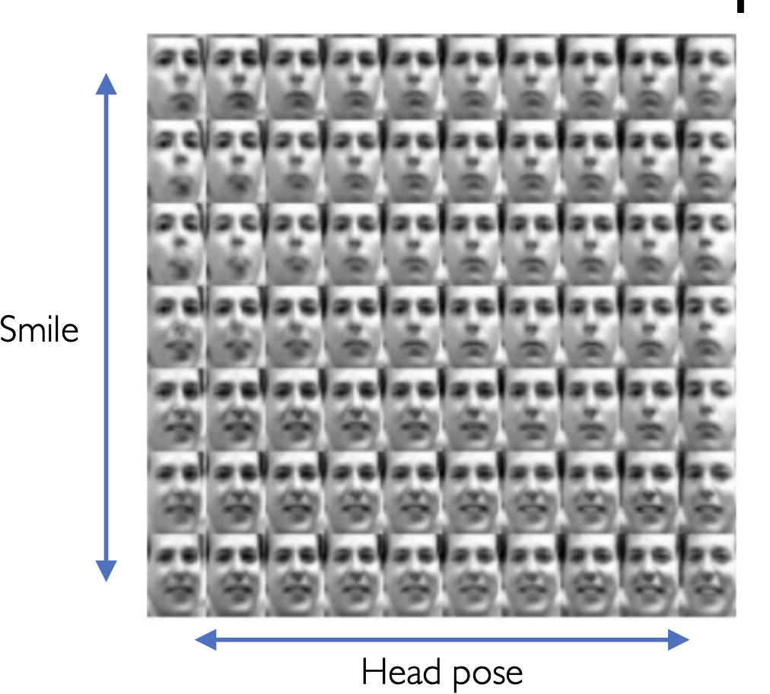
… but what new understanding did we gain?
Example of (variational) autoencoder in computer vision
Are there equivalent dimensional reductions in climate?

Slide 9
Examples of latent spaces in climate
1. Turbulence - Prediction
2. Latent space and data assimilation - Model-data fusion
3. (Deep) convection - Understanding

Slide 10
Latent spaces in climate for prediction, data assimilation and understanding
1. Turbulence - Prediction
2. Latent space and data assimilation - Model-data fusion
3. (Deep) convection - Understanding

Slide 11
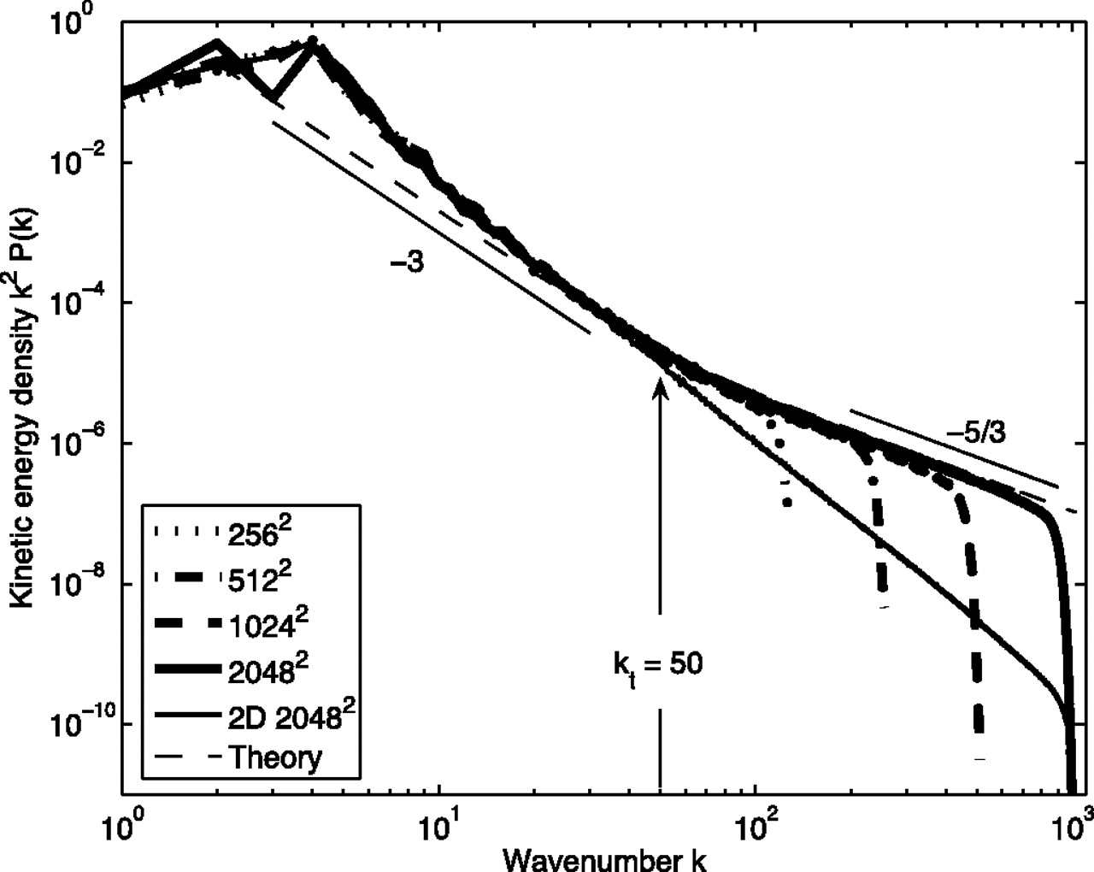
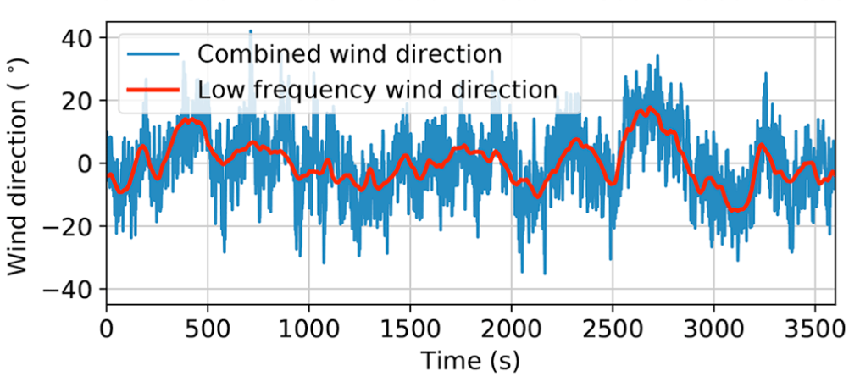
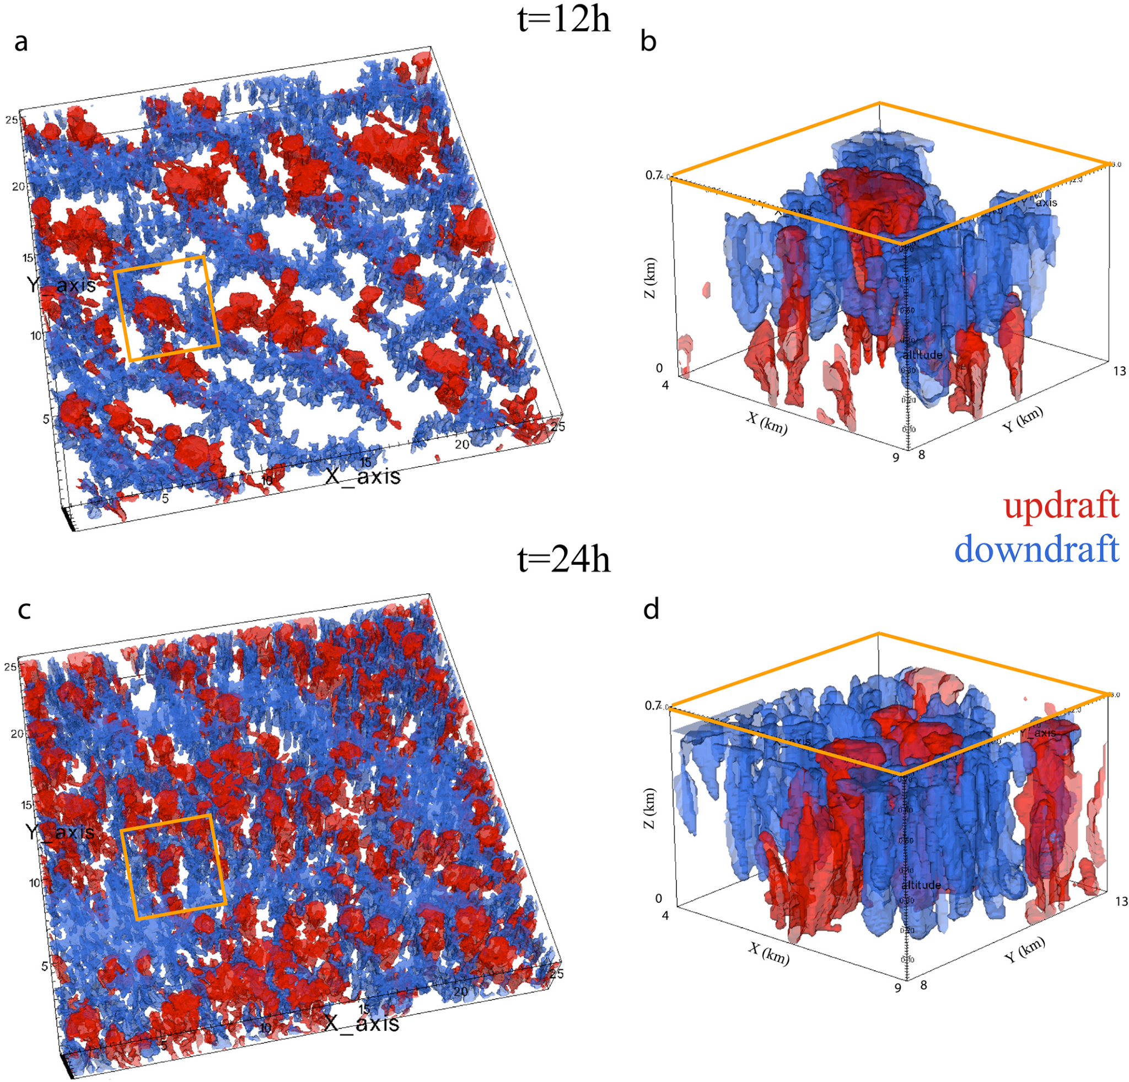
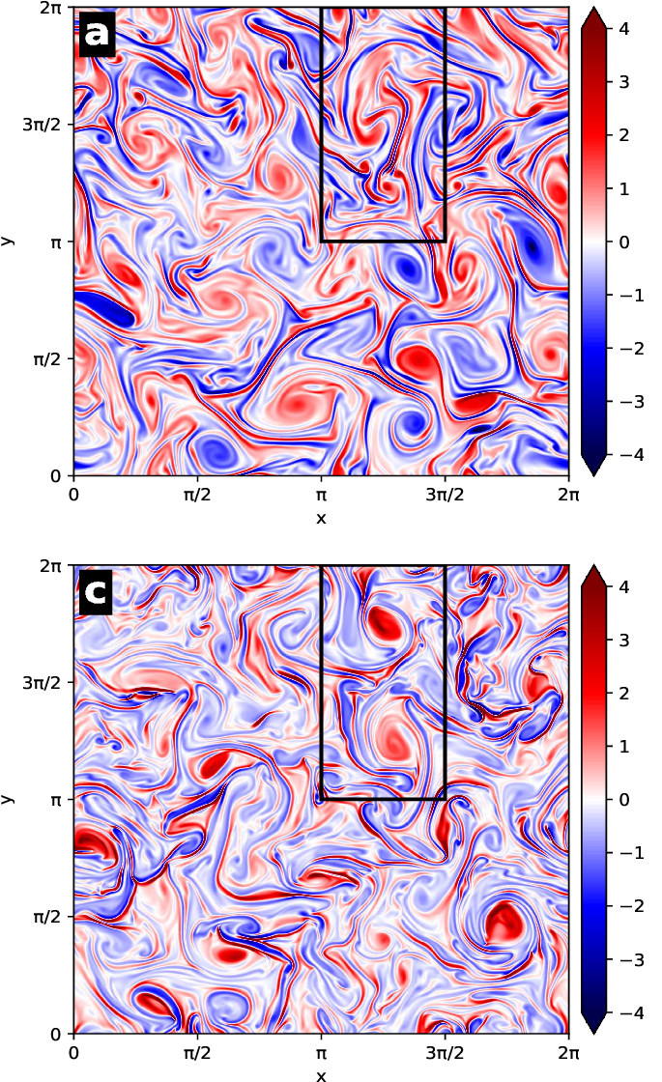
Turbulent flows are complicated!
Multiscale
Stochastic
Coherent Structures/ clustering

Slide 12
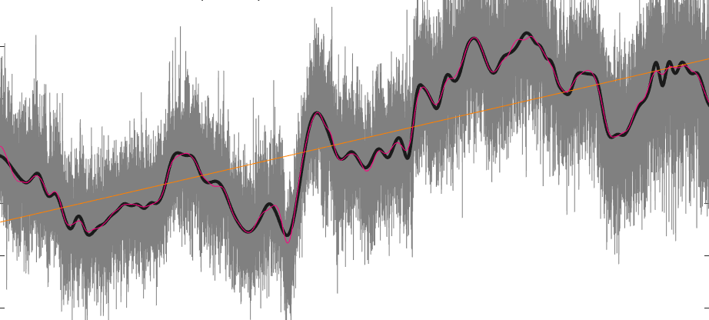
Latent + GenAI for Stable and Skillful Forecast
x = F(<x>, x’)
Mean component
Fluctuating flow
Reduced-order model
(e.g., Deep Latent Koopman)
Probabilistic ML
GenAI
(e.g., Diffusion)
Nathaniel & Gentine. "Generative emulation of chaotic dynamics with coherent prior". Computer Methods in Applied Mechanics and Engineering (2025)

Slide 13
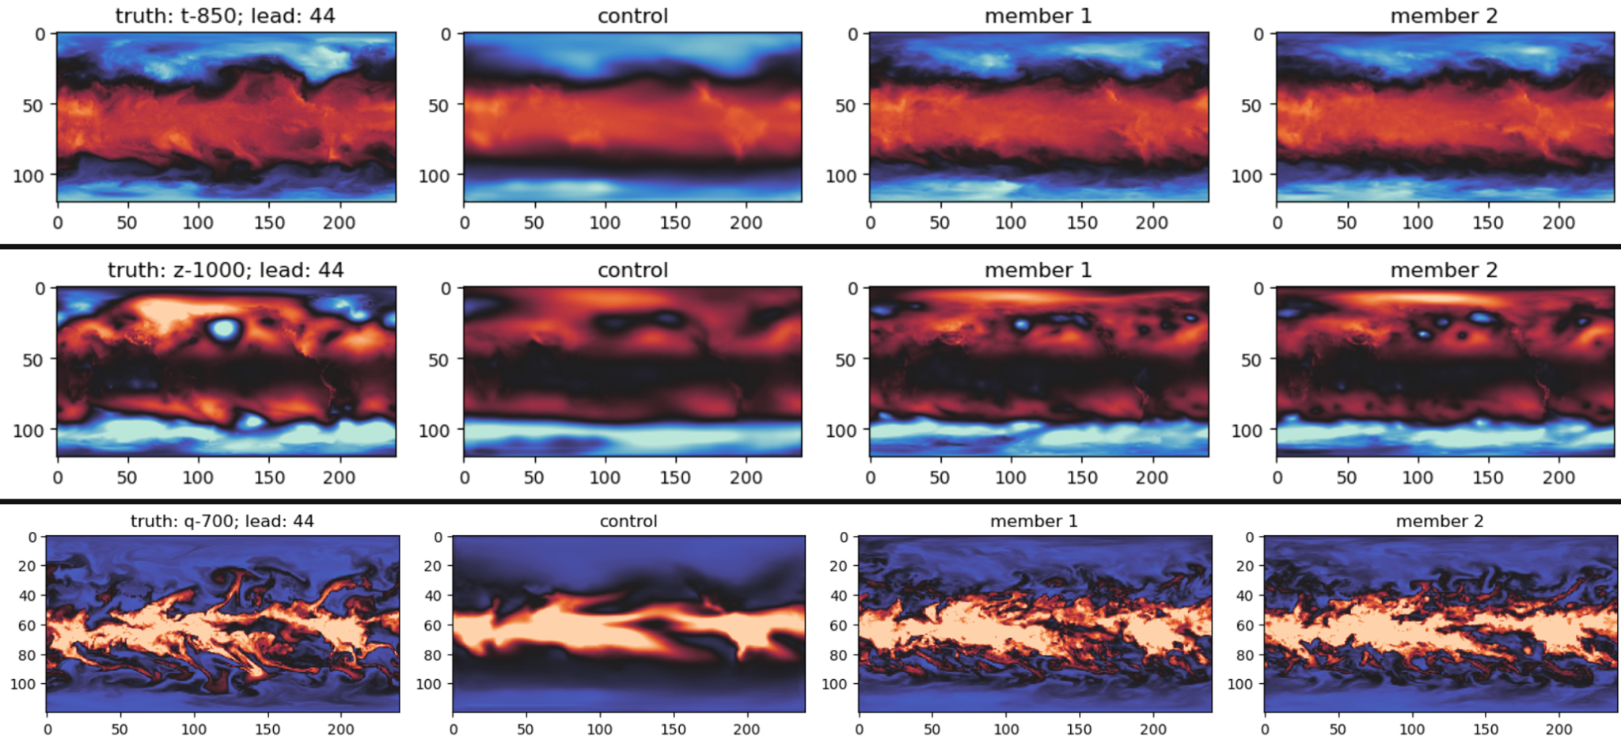
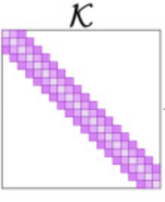
Algorithms Overview: Cohesion
ROM
…
Conditioning priors
x̄₀
x̄₁
x̄_{T}
z_{t}
Diffusion
Denoising / probabilistic “correction”…
x(x,y,z)
f
Koopman Operator
…
Forecasted Rollouts
x₀
x₁
x_{T}
Latent Space
g
Linear latent
z_{t+1} = K z_{t}
z_{t+1}
Nathaniel & Gentine. "Generative emulation of chaotic dynamics with coherent prior". Computer Methods in Applied Mechanics and Engineering (2025)
Notes:
Koopman: instead of evolving the nonlinear states (x), Koopman operator is evolving the linearized observables (i.e., function of states f(x)). The linearized transform can have several benefits e.g., one can perform linear stability analysis, etc. No free lunch, however, as according to Koopman theory, infinite-dimensional linearized transform is often needed to fully represent the nonlinear dynamics. But this is becoming increasingly possible with deep learning.

Slide 14
Result: subseasonal-to-seasonal climate
Truth
Latent Koopman
Koopman + Conditional Diffusion
Koopman run as conditioning prior (blurry, smoothed)
→ Generative process results in realistic trajectories
Nathaniel & Gentine. "Generative emulation of chaotic dynamics with coherent prior". Computer Methods in Applied Mechanics and Engineering (2025)
Notes:
Control: UNet (DLWP; Weyn et al 2018)

Slide 15
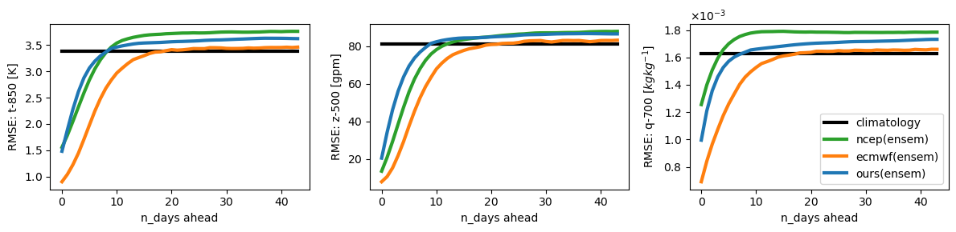
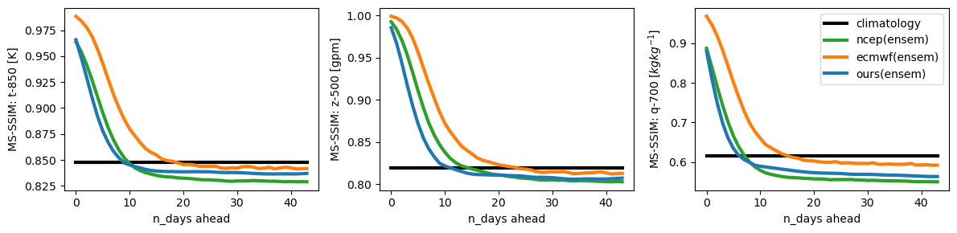
Result: subseasonal-to-seasonal climate
Better
Better
Competitive with major weather centers (ensemble) setup,
at a fraction of the cost!
Nathaniel & Gentine. "Generative emulation of chaotic dynamics with coherent prior". Computer Methods in Applied Mechanics and Engineering (2025)

Slide 16
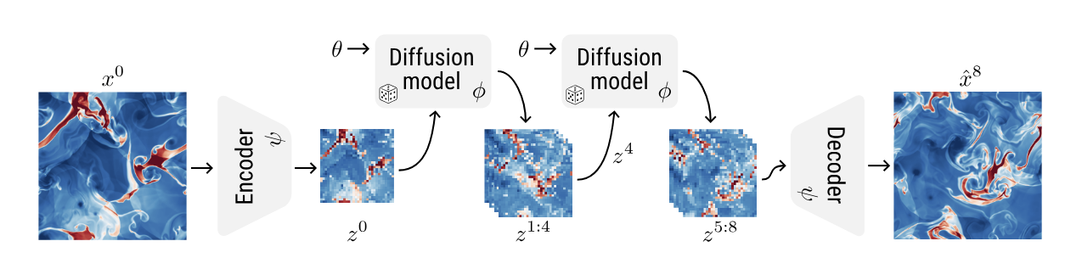
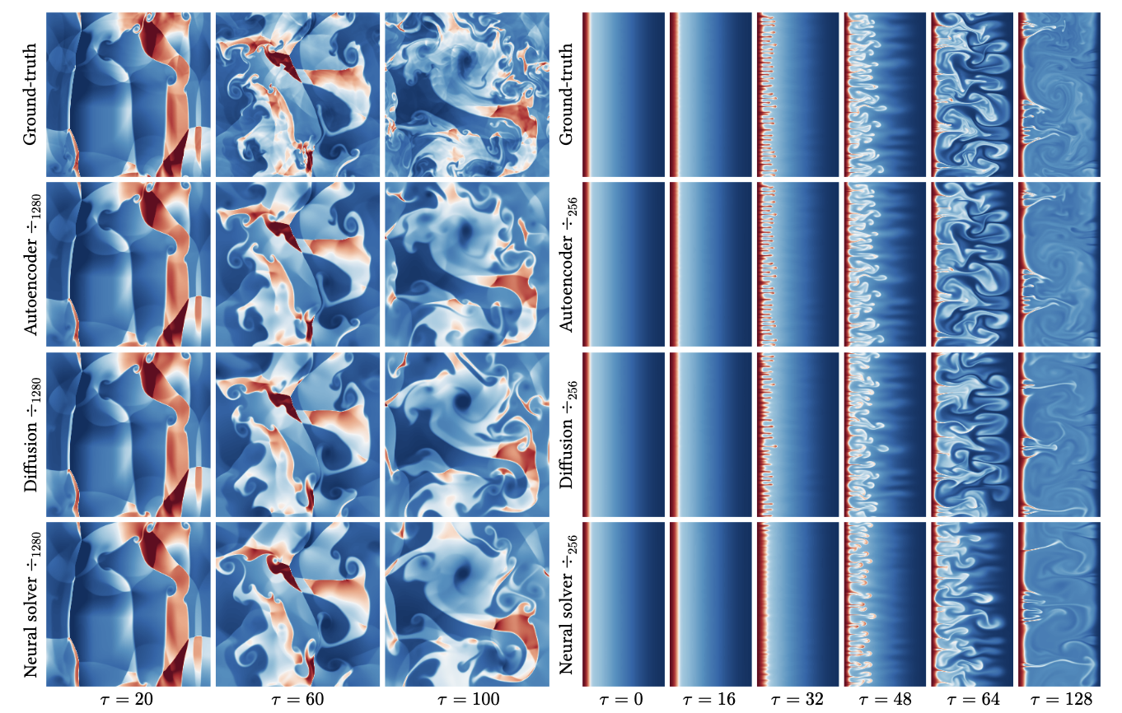
Similar results: latent diffusion for physics
Autoregressive rollout
truth
High-quality forecast of turbulent flows
Rozet … Ho. arXiv (2025)

Slide 17
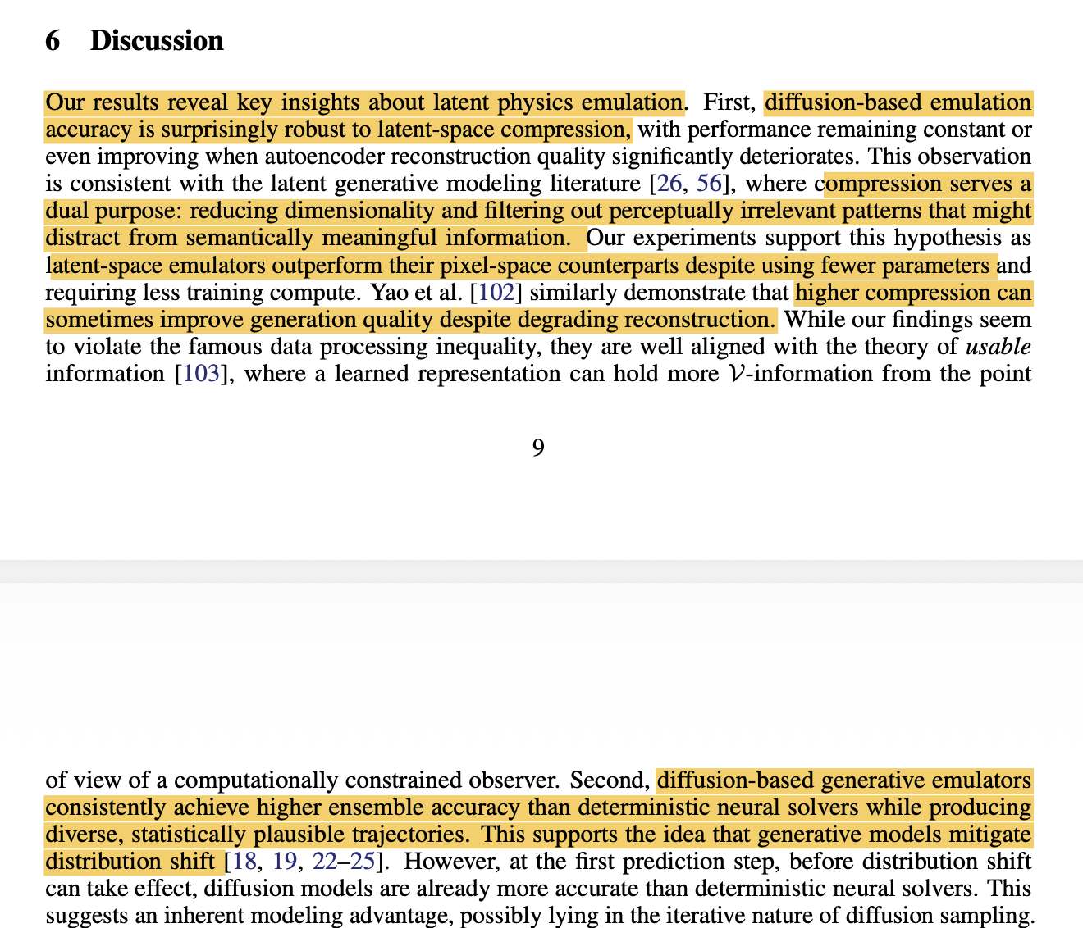
Similar results: latent diffusion for physics
Conclusion:
Turbulent flows (chaotic+stochastic) might be more predictable and lower dimensional than “expected”.
Rozet … Ho. arXiv (2025)

Slide 18
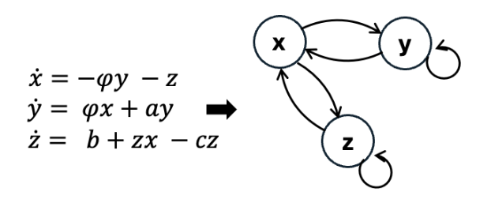
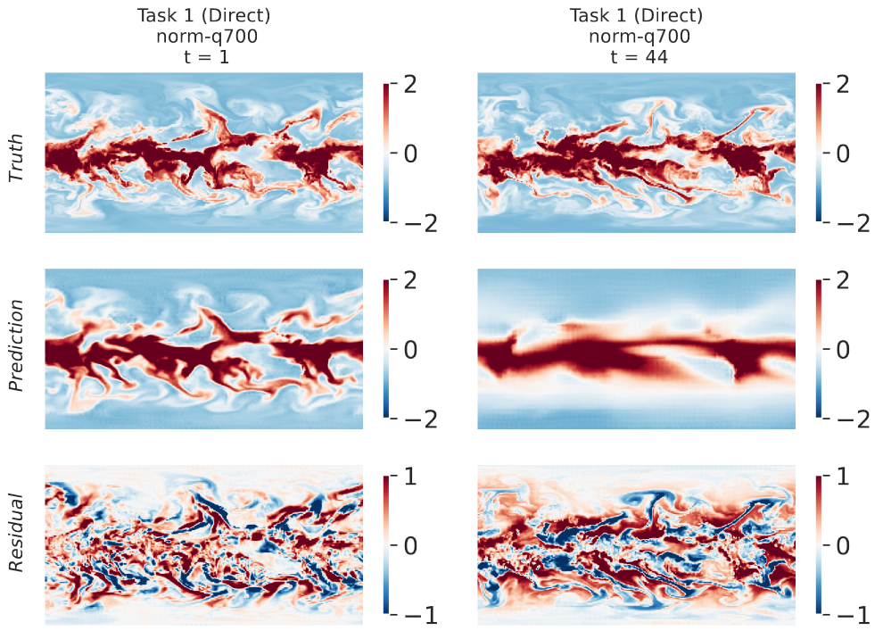
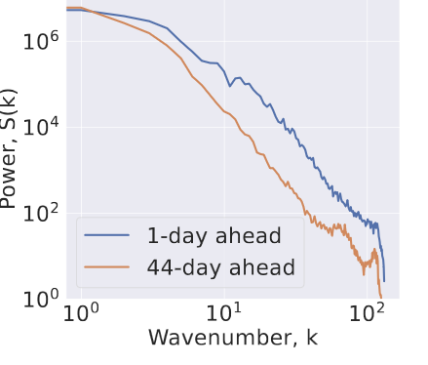
Operator Learning in Latent Space for Climate Predictability
Latent Koopman + GenAI for S2S forecast
Latent Koopman + Granger causality
1 day
44 day
True
Failure to capture high-frequency details
Pred
Blurrier as forecast time increases

Slide 19
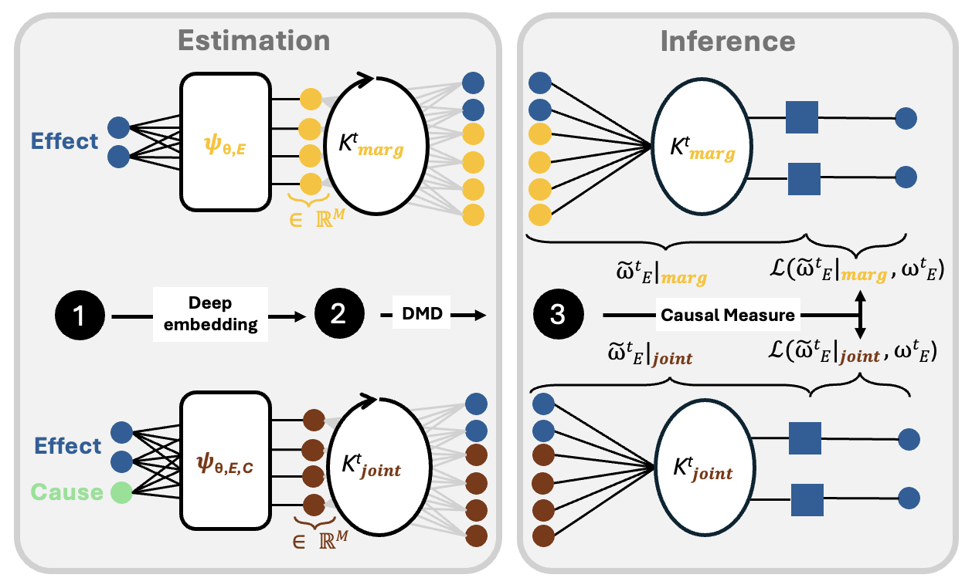
Latent Koopman Operator for Causal Inference: Kausal
Koopman theory + Granger causality → Koopman Causality
Causality in latent Koopman space → causality in data space
Rupe, et al. “Causal discovery in nonlinear dynamical systems using Koopman operators”. (2024)
Nathaniel & Roesch, et al. "Deep Koopman operator framework for causal discovery in nonlinear dynamical systems". In revision (2025)
Notes:
We infer causal measures by computing the difference in prediction error between marginal (effect-only) and joint (effect-cause) models

Slide 20
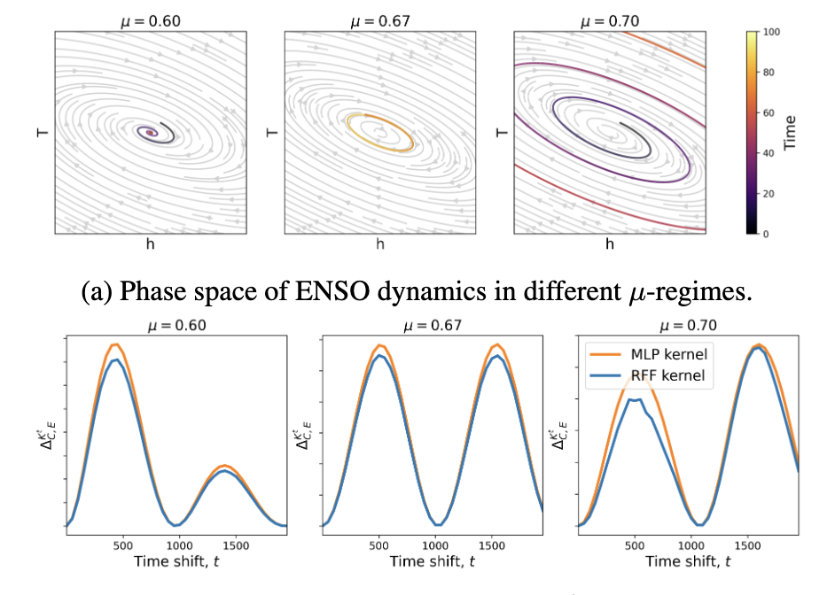
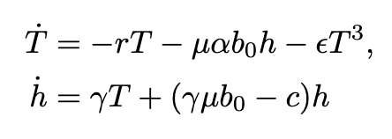
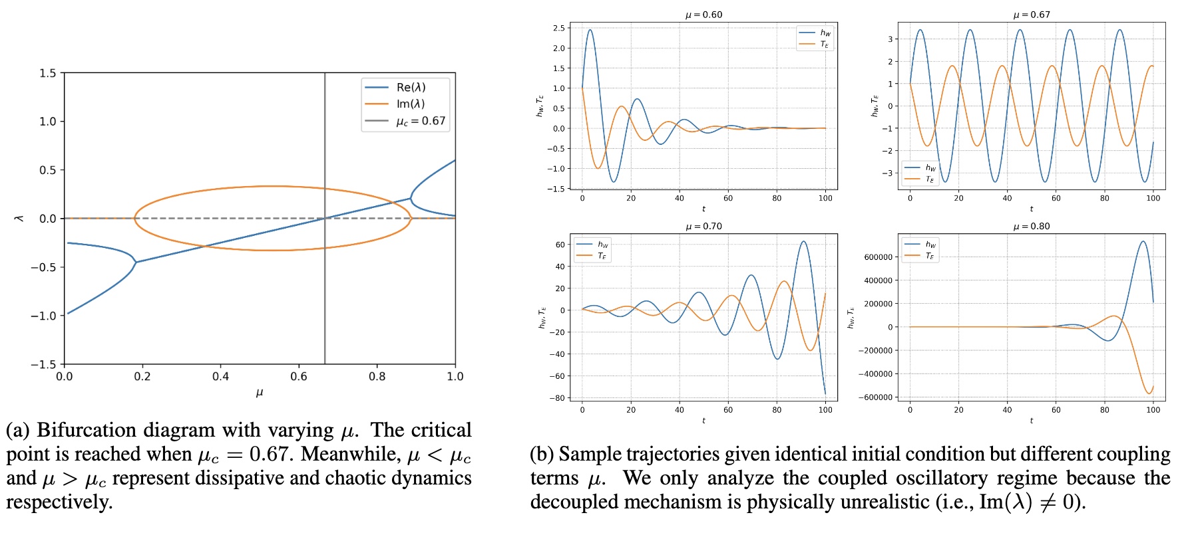
Latent Koopman Causality for Regime Detection
Jin’s ENSO model (1997)
Linear stability analysis
Koopman causal measure
Koopman causality detects different stability regime

Slide 21
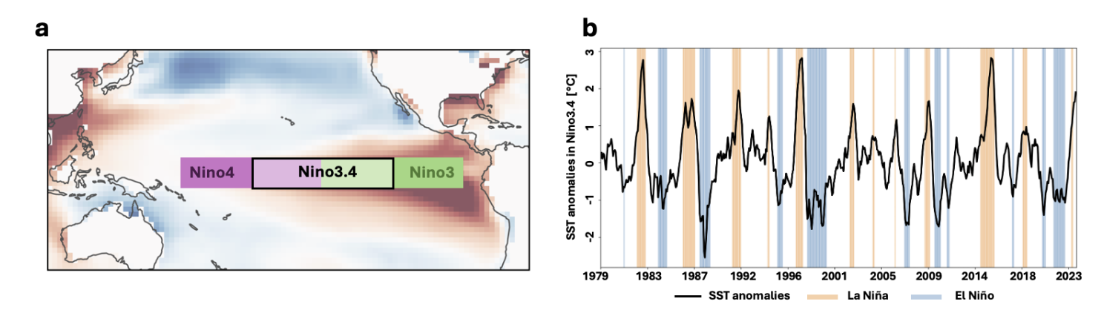
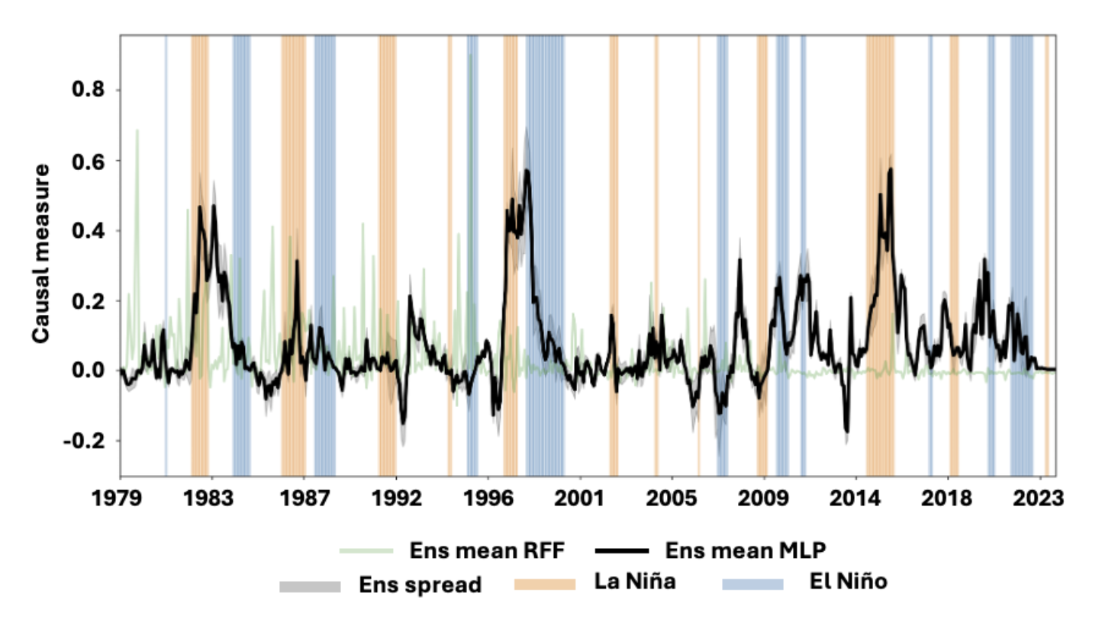
Causal Detection of Major ENSO events
Koopman causality detects statistically significant causal measure of major
El Niño events, paving the way for early detection of tipping points
(e.g., stability analysis, etc)

Slide 22
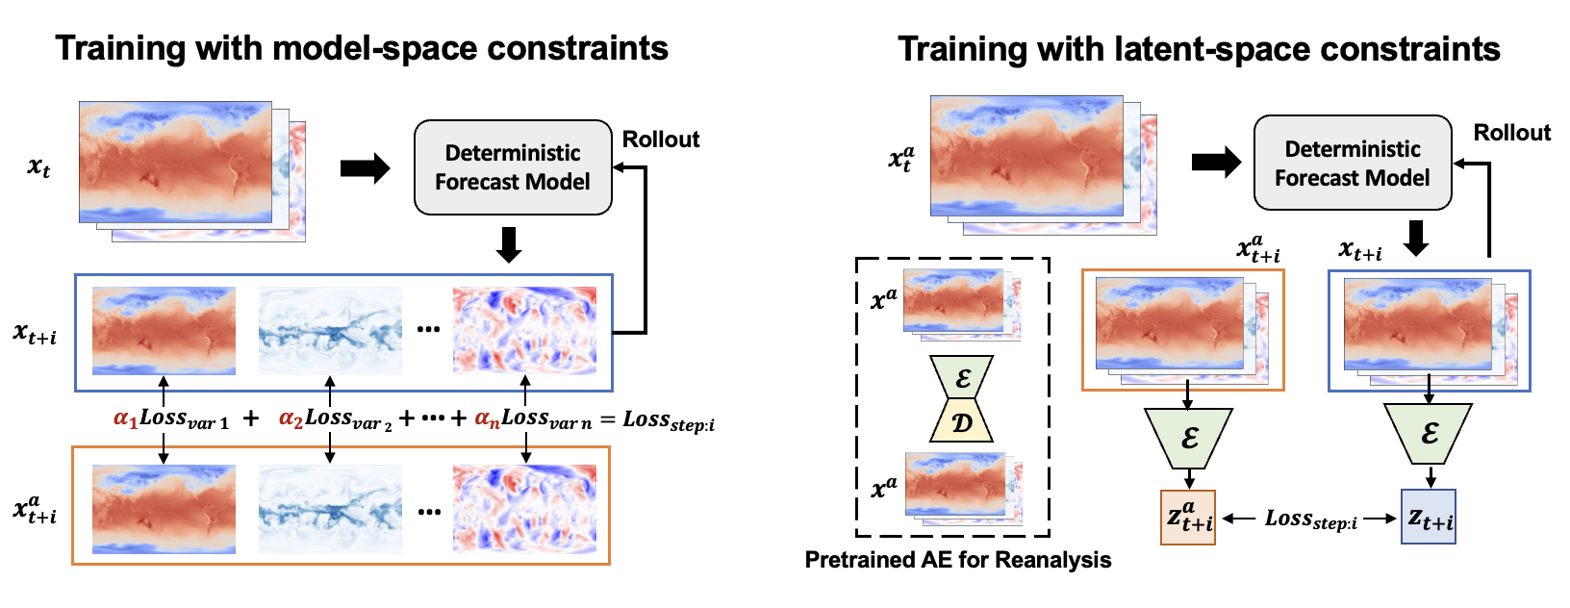
Considering Multivariate Consistency in AI forecast model

Slide 23
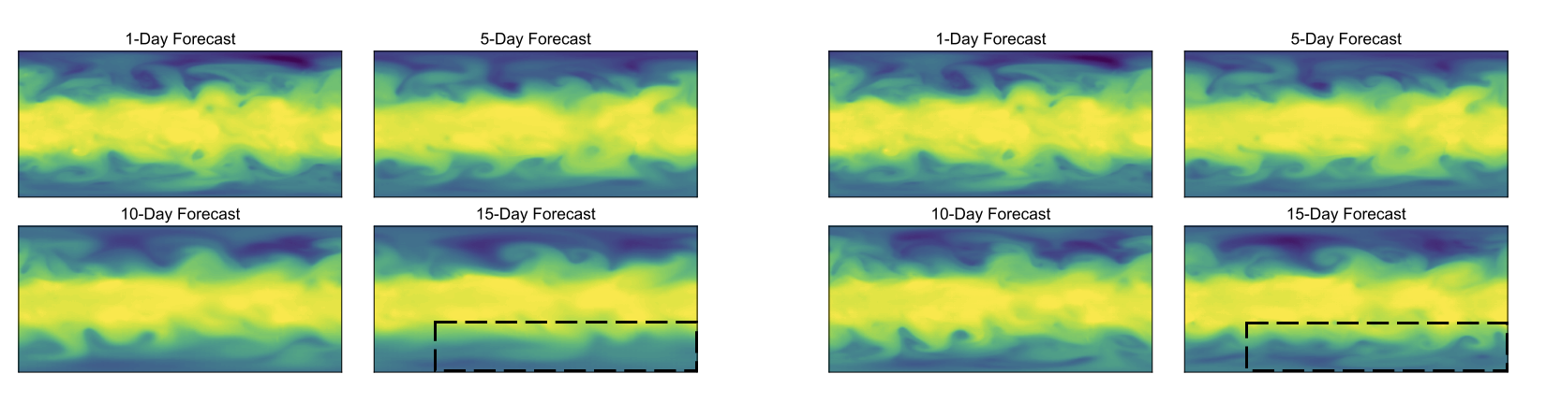
Considering Multivariate Consistency in AI forecast model
Trained with model-space MSE
Trained with latent-space MSE
Blurry
Non-blurry!

Slide 24
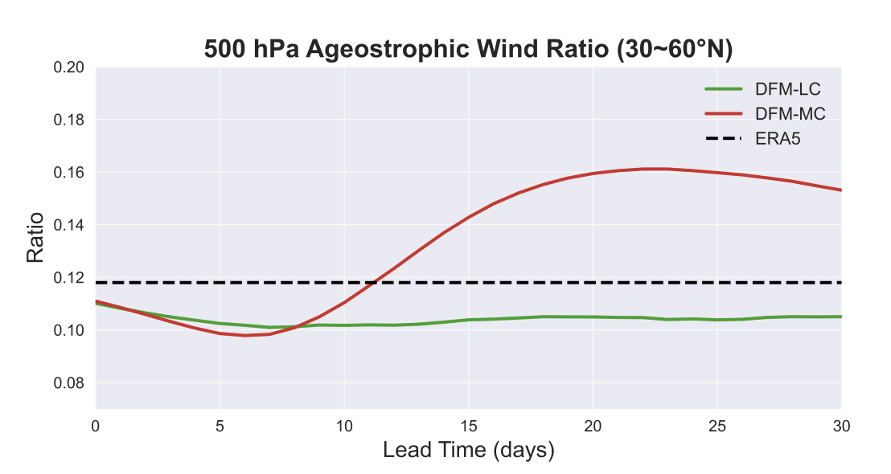
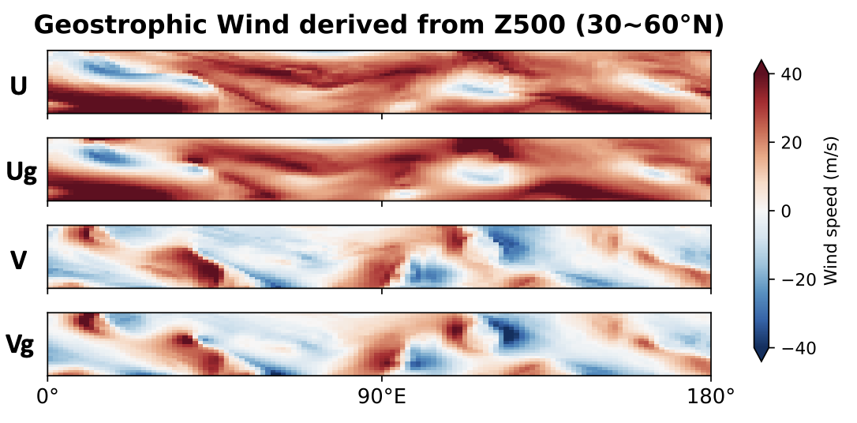
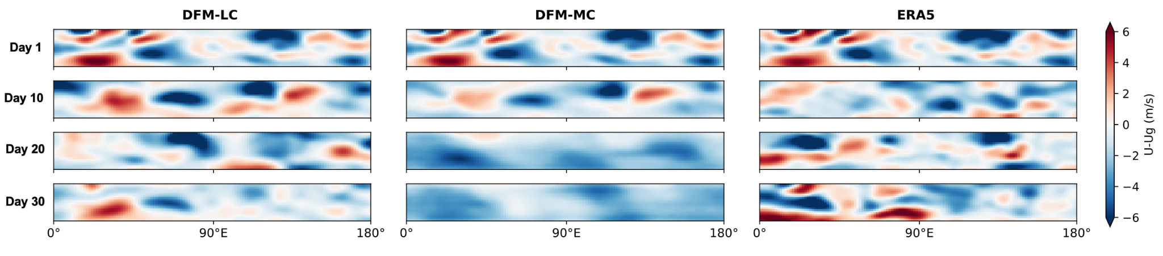
Physical realism analysis: Geostrophic balance at 500hPa
Latent
State

Slide 25
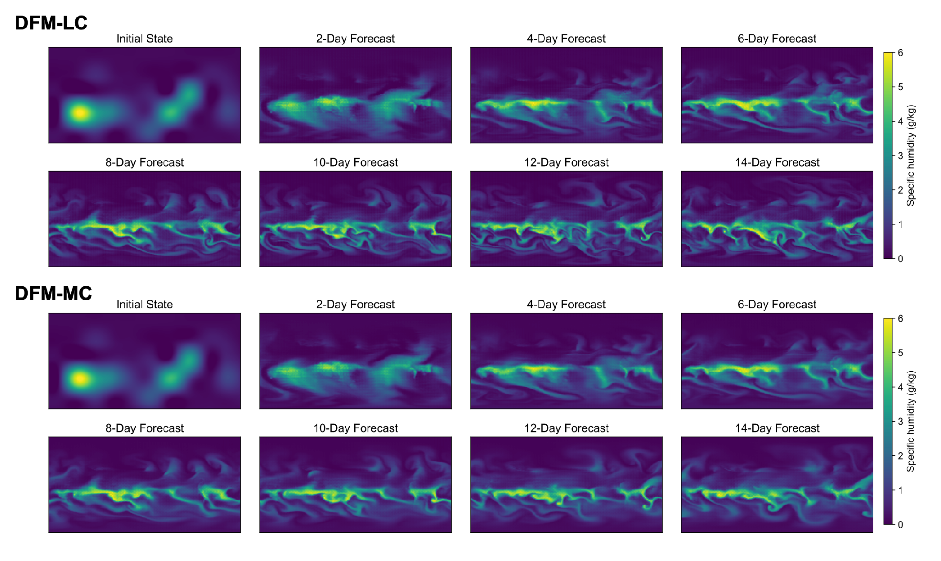
Physical realism analysis: Capability of spin-up

Slide 26
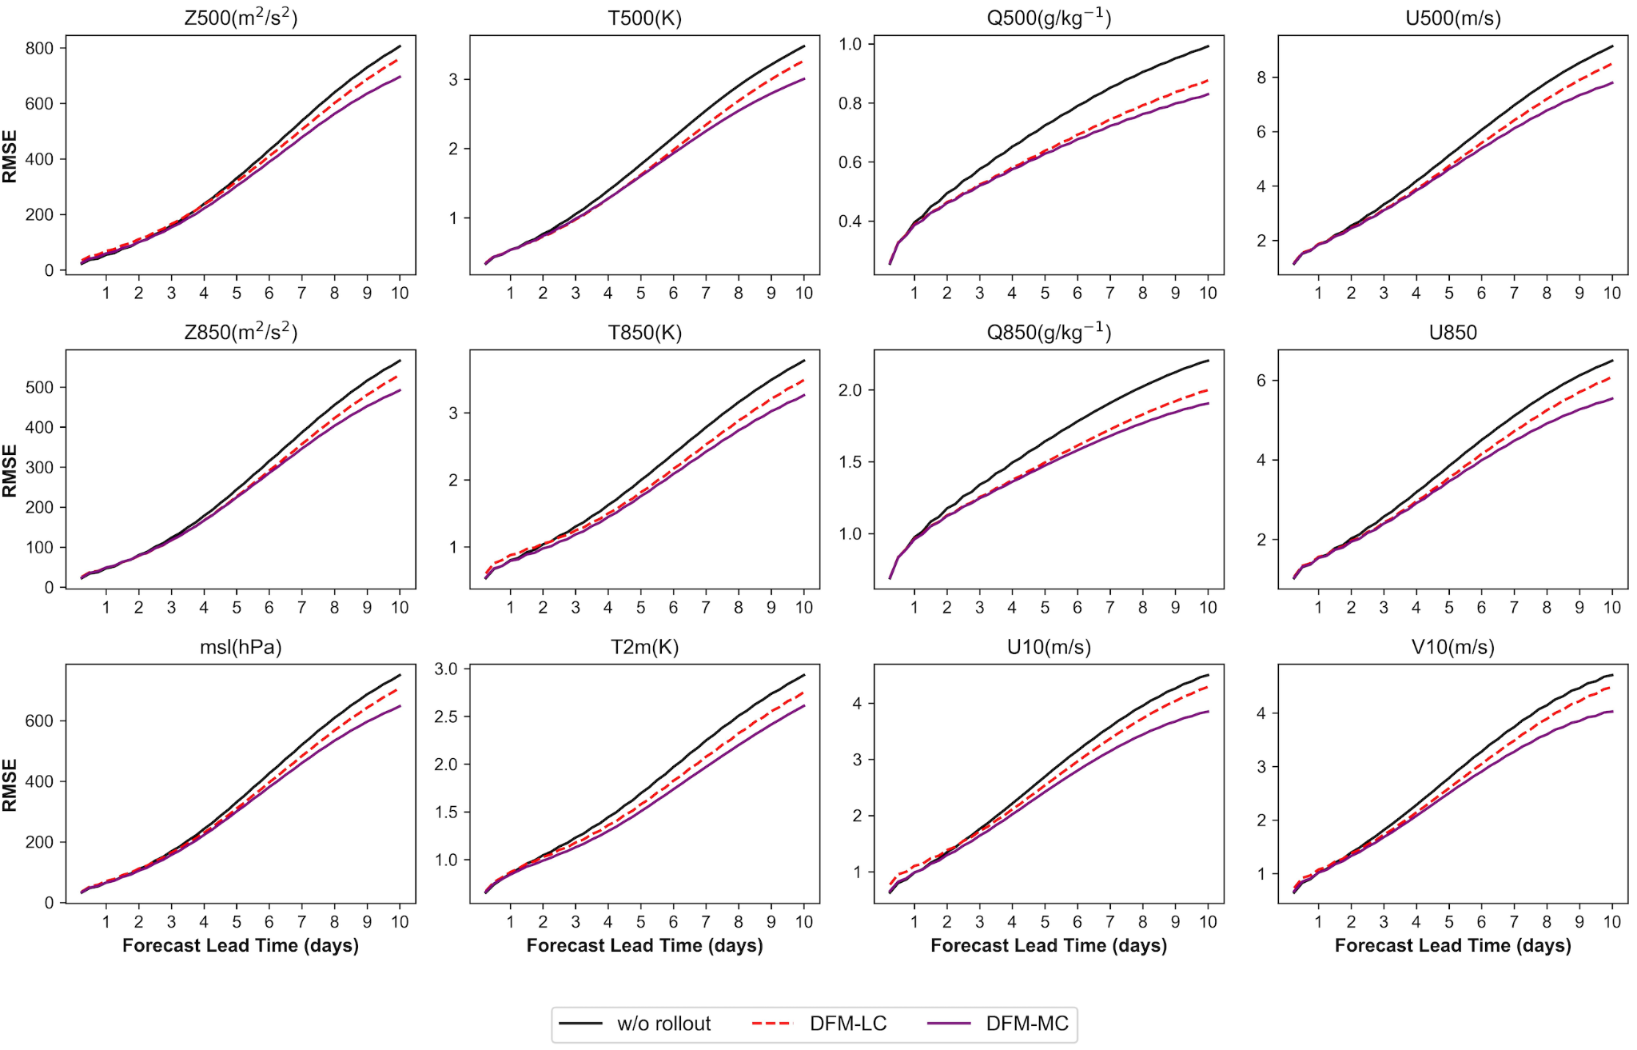
Statistic performance of latent-constrained forecast model
Averaged over 2020
RMSE is still lower
by construction
Fan et al. submitted

Slide 27
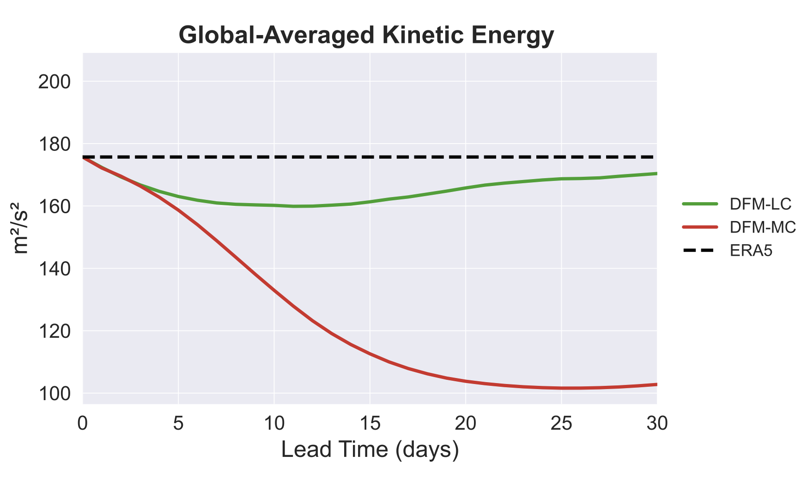
Physical realism analysis: Kinetic Energy
Averaged over 2020

Slide 28
Latent spaces are powerful for long-term prediction
Advantages of latent spaces for physical systems:
Dimensionality reduction: latent space captures main degrees of freedom, filters out noise.
Stability/sharpness: reduces error accumulation in rollouts, keeps trajectories on a more realistic manifold.
More disentangled dynamics: disentangles scales, easier to learn different scales, coherent structures better preserved.
Decoder prior: ensures outputs remain physically consistent and sharp.
Still many open questions:
accurate chaotic behavior, accurate representation of stochasticity (space and time), time horizon of predictability, long-range forecasts…

Slide 29
Examples of latent spaces in climate
1. Turbulence - Prediction
2. Latent space and data assimilation - Model-data fusion
3. (Deep) convection - Understanding

Slide 30




Bridging the Great Chasm
🛩️
Data Assimilation
📡
🔭
Physical Model
Observations
Goal: bridging the chasm with DA

Slide 31
“[S]atellite data make the biggest contribution to global forecast skill today…”
– European Centre for Medium-Range Weather Forecasts (ECMWF)
Insufficient observations in DA O_{model}(10⁹) >> O_{obs}(10⁷)
Expensive compute with large fraction of it is dedicated for DA

Slide 32
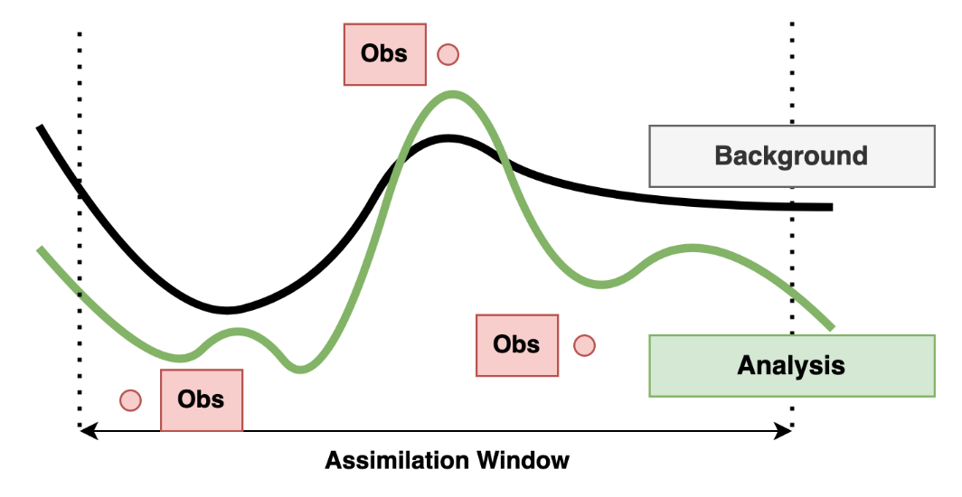
Data Assimilation In Picture
Goal: Estimate analysis/posterior of p(x|y)

Slide 33
Data Assimilation In Picture
Observations and states do not match (i.e., heterogeneous)
Prior
Posterior
Has to capture observation and model uncertainties (i.e., probabilistic)

Slide 34
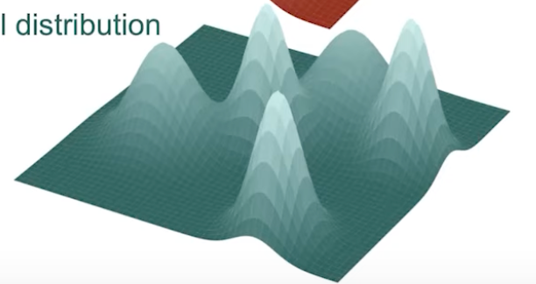
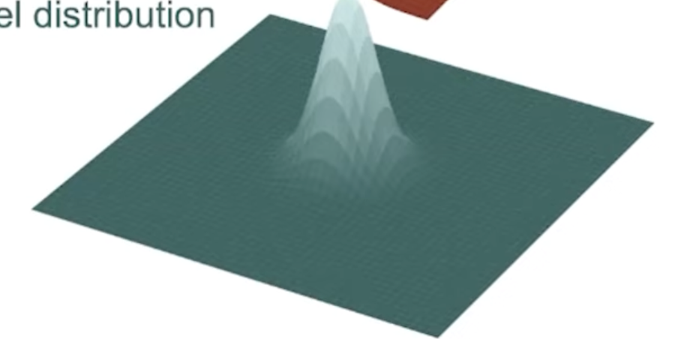
Homogeneous Space - Unified Latent Space
State Space
ℋ*
Unified Latent Space
Latent Model
Multimodal Observation Space
Generate best estimate of state
*ℋ (Observation Operator) is a functional map (e.g., closed formula)
Notes:
Fortunately, with deep learning, we are able to circum-
vent this problem by learning a sufficiently expressive func-
tion that is able to project both the states and observations
into a unified, reduced-order L-dimensional latent space. In
this work, we define fθ : R(Nx+M1+···+MK ) → RL as an
encoder that takes as input the concatenation of background
state and each observation modality along unique channels
for a single timestep. The decoder gϕ : RL → RNx then
maps the latent code back into the pixel-space.

Slide 35
Probabilistic ML - Diffusion
Conditioning-Data (Y-X)-pair:
Text-guided image generation (DALL-E)
Text-guided video generation (Sora)
Also,
Observation-guided state/parameter inference → data assimilation i.e., estimating p(x | y)
Emulating DA with diffusion principles (connection in paper)

Slide 36
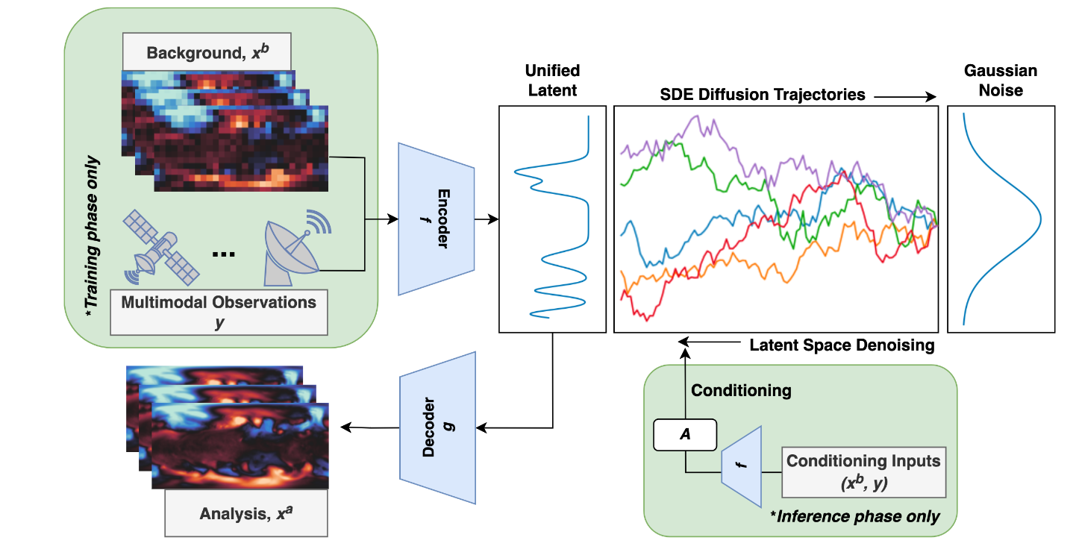
SLAMS Framework
p(z₀)
Model
p(z_{T}) ~ N(0,1)
s_{θ}(z_{t}, t)
Nathaniel, Qu, Li and Gentine CVPR Best Paper 2024; Mardani et al., 2024; Lockwood et al. 2024 JGR Atmos; Fan et al. submitted
Notes:
We use U-Net [46] with residual blocks [17], SiLU activation [14], and layer normalization [2] for our score network.

Slide 37
SLAMS Framework - Unconditional Training
p(z₀)
Model
p(z_{T}) ~ N(0,1)
s_{θ}(z_{t}, t)
Nathaniel, Qu, Li and Gentine CVPR Best Paper 2024; Mardani et al., 2024; Lockwood et al. 2024 JGR Atmos; Fan et al. submitted

Slide 38
SLAMS Framework - Conditional Inference
p(z₀|y)
p(z_{T}) ~ N(0,1)

Slide 39
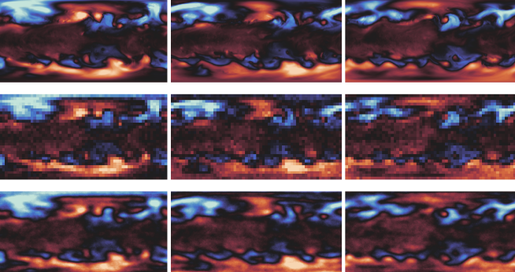
Qualitative Results - Optimistic Case
High-quality background + observations for conditioning
High quality background + observations
Truth
Condition
Analysis

Slide 40
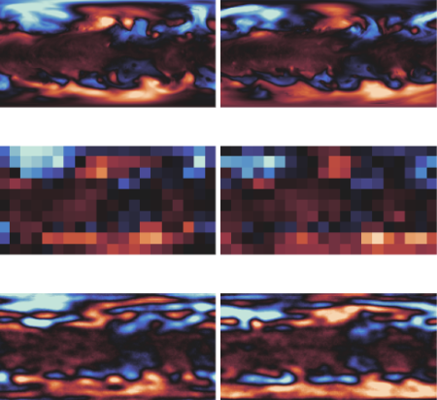
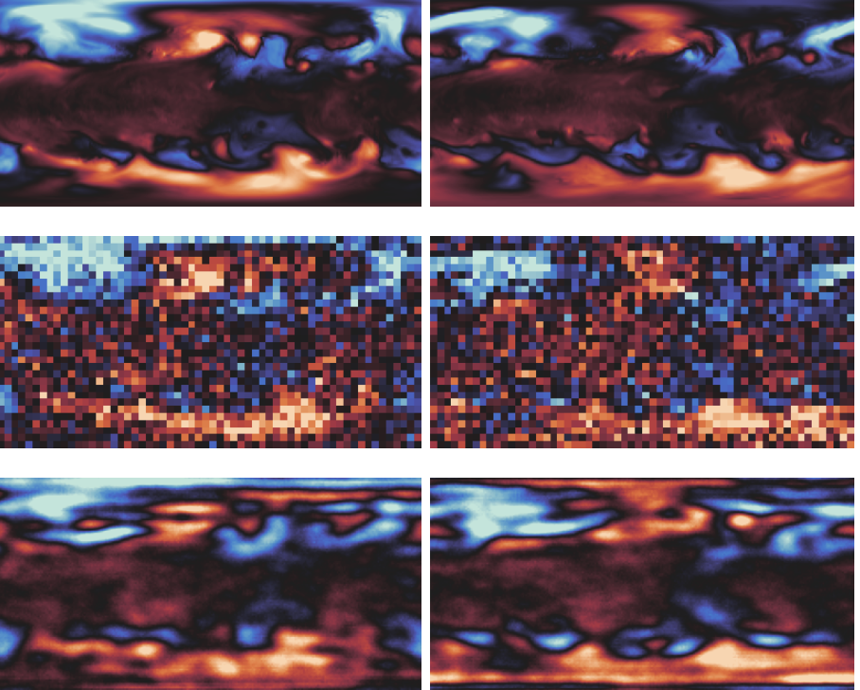
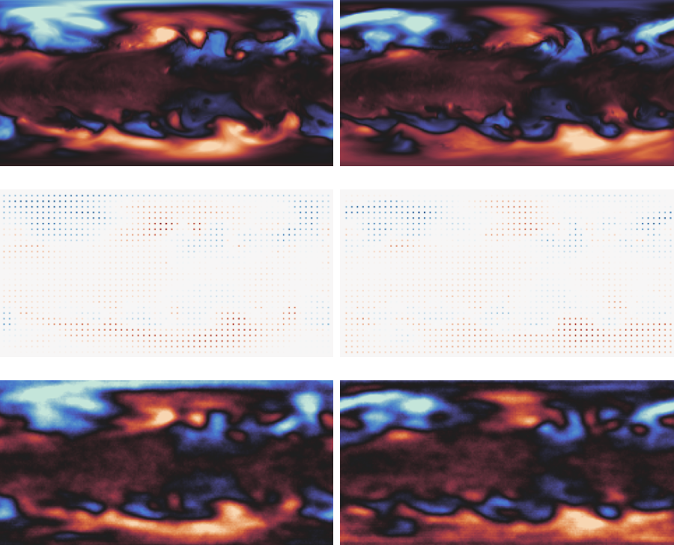
Qualitative Results - Realistic Case
Low-quality background + observations for conditioning
Coarse → Downscaling
Noise → Denoising
Sparse → Interpolation
Truth
Condition
Analysis
Physically-consistent even in non-ideal scenarios

Slide 41
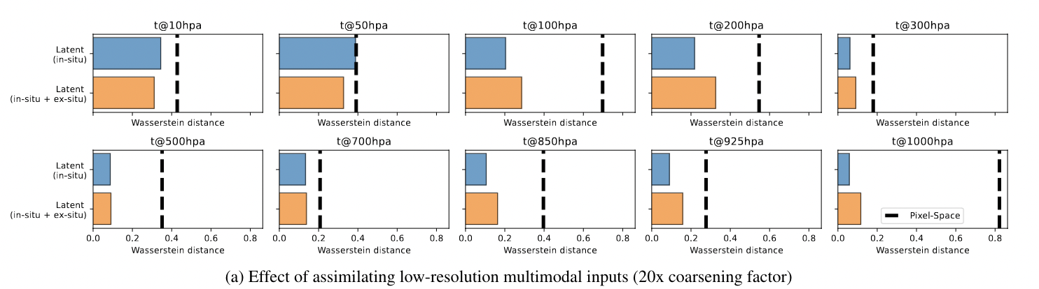
Quantitative Results
Incorporating observations through DA gives better calibration

Slide 42
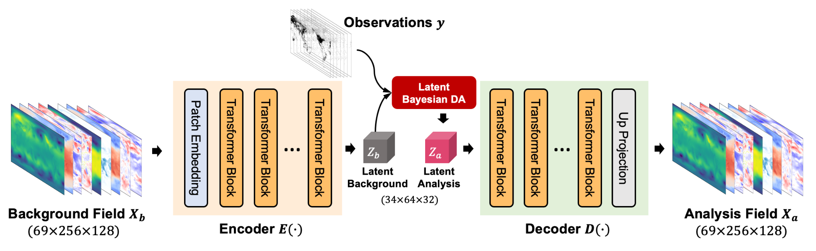
Variational Latent Data Assimilation
Z, Q, U, V ,T (13 levels) msl, u10, v10, t2m
1.41°ERA5 69×256×128 → 34×64×32 (1/32)
Background
Observation update
Latent 3DVar
Latent 4DVar
Assimilation window
Fan et al. Sci Adv minor revision

Slide 43
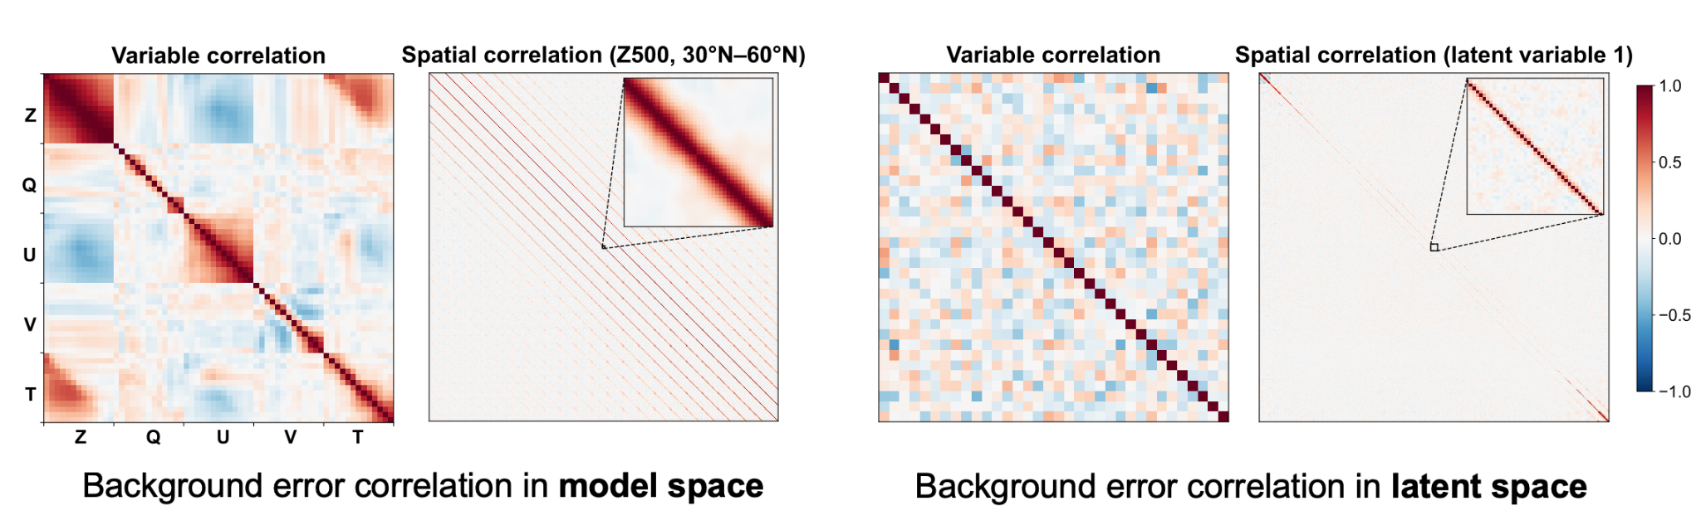


Background error covariance in the Latent space
Latent space is quasi linear!
Fan et al. Sci Adv minor revision
Notes:
National Meteorological Center (NMC) method for background covariance estimate

Slide 44


Single observation DA Exps
Z500 single observation experiments with static and diagonalized Bz
Case1
Case2
Increment of
Z and wind
Increment of T & Background wind
LDA is intrinsically physically consistent and flow-dependent.
Fan et al. Sci Adv minor revision

Slide 45


Physical consistency embedded in latent space
Latent variables represent distinct atmospheric variables in a nearly orthogonal way.
Latent variables learned the interaction between different variables
Fan et al. Sci Adv minor revision

Slide 46


DA Experiments with Idealized Observation
Obs are sampled from real conventional observation locations.
Latent-space assimilation is superior to model-space assimilation!
Fan et al. Sci Adv minor revision

Slide 47


DA Experiments with Real Observations
Assimilating real GDAS observations in 2017. ~3000 surface stations and ~400 radiosondes
DA-Forecast exps
Cyclic DA exps
Latent-space assimilation is superior to model-space assimilation.
Fan et al. Sci Adv minor revision

Slide 48


Why Latent Data Assimilation works?
The decoder of AE is locally linear.
→ The L3DVar/L4DVar and 3DVar/4DVar have similar optimal analysis.
Conclusion: latent data assimilation is both more efficient and more accurate
Fan et al. Sci Adv minor revision

Slide 49

The impact of latent size
Higher compression ratio:
Reconstruction error ↑ DA accuracy ↓ Diagonalizability of Bz ↑ DA accuracy ↑
Fan et al. Sci Adv minor revision

Slide 50

The limitation of Latent Data Assimilation (for now)
Demonstrated by an idealized convection case for T2 analysis.
LDA is unable to analyze structures that cannot be represented within its latent space.

Slide 51
Examples of latent spaces in climate
1. Turbulence - Prediction
2. Latent space and data assimilation - Model-data fusion
3. (Deep) convection - Understanding

Slide 52

Examples of latent spaces in convection
Convection can aggregate
Aggregation has a large impact on:
- Humidity
- Radiative cooling
→ Enhances radiative cooling
→ Potentially impacts climate sensitivity
- Precipitation
→ Increases accumulated precipitation

Slide 53

Examples of latent spaces in convection
Science questions:
Does P = F (X coarse-scale, subgrid scale stuff) improve prediction?
Can we explain (some of) the stochasticity? Still unclear how to model it.
Shamekh, Lamb, Huang and Gentine, PNAS 2023

Slide 54

Using high-resolution models to understand convection
Data:
DYAMOND Storm-resolving model experiment
Tropical band (20S-20N), ~2.5km resolution,
10 days of simulations
10⁸ data points
→ Predicting precipitation
Shamekh, Lamb, Huang and Gentine, PNAS 2023

Slide 55

The inner gut: Learning convection end-to-end
Strategy: Learning precipitation and organization (implicitly) in tandem
Shamekh, Lamb, Huang and Gentine, PNAS 2023

Slide 56
The inner gut: Learning convection end-to-end
Strategy: Learning precipitation and organization (implicitly) in tandem
Shamekh, Lamb, Huang and Gentine, PNAS 2023

Slide 57

The inner gut: Learning convection end-to-end
Precipitation and its stochasticity are very well predicted with org
Shamekh, Lamb, Huang and Gentine, PNAS 2023

Slide 58
The inner gut: Learning convection end-to-end
Precipitation and its stochasticity are very well predicted with org
Shamekh, Lamb, Huang and Gentine, PNAS 2023

Slide 59
The inner gut: Learning convection end-to-end
Precipitation and its stochasticity are very well predicted with org
What did we learn?
✅ Organization regulates precipitation extremes and their prediction
✅ Precipitation stochasticity is mainly due to convective aggregation
Shamekh, Lamb, Huang and Gentine, PNAS 2023

Slide 60



Extension in time → modes of convection
Low level wind shear with basal velocity = 8m/s
Can we characterize the dynamical response of convection as a function of forcing?
Objective: Capture oscillating modes of convection

Slide 61

Koopman-VAE principle
Latent Space
VAE is a universal approximation of E and D
Generative properties enable modes’ reconstruction

Slide 62

Koopman-VAE principle

Slide 63

Koopman-VAE principle

Slide 64

Koopman-VAE principle

Slide 65

Training of Koopman-VAE
-Koopman loss is turned on after 40 epochs
-Even without the koopman loss, VAE latent space is getting in the way of linear dynamic

Slide 66

Training of Koopman-VAE
-Koopman loss is turned on after 40 epochs
-Even without the koopman loss, VAE latent space is getting in the way of linear dynamic
Training is stopped after 300 epochs

Slide 67

Manifold evaluation
How this manifold relates to convective organization?

Slide 68

Manifold evaluation
How this manifold relates to convective organization?
Organization
Convective Organization is a principal axis of variability

Slide 69

Koopman modes

Slide 70

Koopman modes

Slide 71

Oscillating eigenmodes
Physical processes extracted:
-Transition shallow-congestus
-Deep convection
-Overshooting
-Stratiform rain?
-Deep convective updrafts
-Convective rain
-Gravity waves
Under a fixed external forcing low level windshear:
-One natural mode of variability that describes a canonical deep convective cycle
-The full cycle is 12h, consistent with the time duration of squall lines

Slide 72

Orbit in the latent space
What is the trajectory of the oscillating mode in the latent space?
Beyond clustering: we can (automatically) analyze the life cycle of convection

Slide 73


Latent land = wonderland
Latent spaces are powerful tools
for skillful prediction and efficient data assimilation
of chaotic/stochastic systems in weather and climate.
Not just data compression
but can also lead to new understanding
Thank you for your attention

Slide 74
Examples of latent spaces in climate
Global land carbon cycle

Slide 75


Where Is Ecological Predictability in a Diverse Biosphere?
Lower Effective Dimensionality
in the Latent Space?
Curse of Dimensionality
Famiglietti et al. (2021)
Fisher & Koven (2020)
Questions: 1. Can we learn covariations in plant traints?
2. Can we learn plant adataption to their environment?

Slide 76

Plant Adaptation as Latent Ecological Parameters
Fang et al. 2024, JAMES; Fang et al., Nature Comm in review , Qu, Bhouri and Gentine ICLR 2024

Slide 77

… and new understading on traits’ dependence on the environment

Slide 78

Trait Coordination Leads to Emergent Environment-Trait Axes

Slide 79

… and new understading on traits’ dependence on the environment

Slide 80

The times … they are a-changin’
Fear is driving many of the societal changes we are facing.
Let us be kind to each other.
Nurture the changes you want to see in society:
Be open to new ideas,
allow creativity,
Don’t be afraid to change and take risks.
Local changes can have a positive impact

