Slide 1


Climate Prediction: advances and challenges
Noel Keenlyside
Geophysical Institute, University of Bergen
Bjerknes Center for Climate Research, Norway
Nansen Environmental and Remote Sensing Centre, Norway
Uni. Bologna, 20.11.2025, Italy

Slide 2




Slide 3
What we will cover today
What is a climate prediction?
How is it related to weather forecasts?
How do we make a climate prediction?
What key phenomena can we currently predict?
What is the key challenge limiting climate prediction?
What are some approaches are being used to address these?

Slide 4
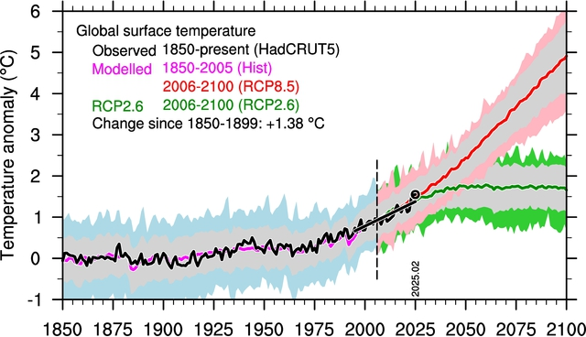
Global warming, ~1.4 degree since 1850, may expect up to 5 degrees by 2100
Updated from Medhaug and Drange (2015); Credit: Helge Drange, Bjerknes Centre
But global mean temperature is not that relevant to society

Slide 5
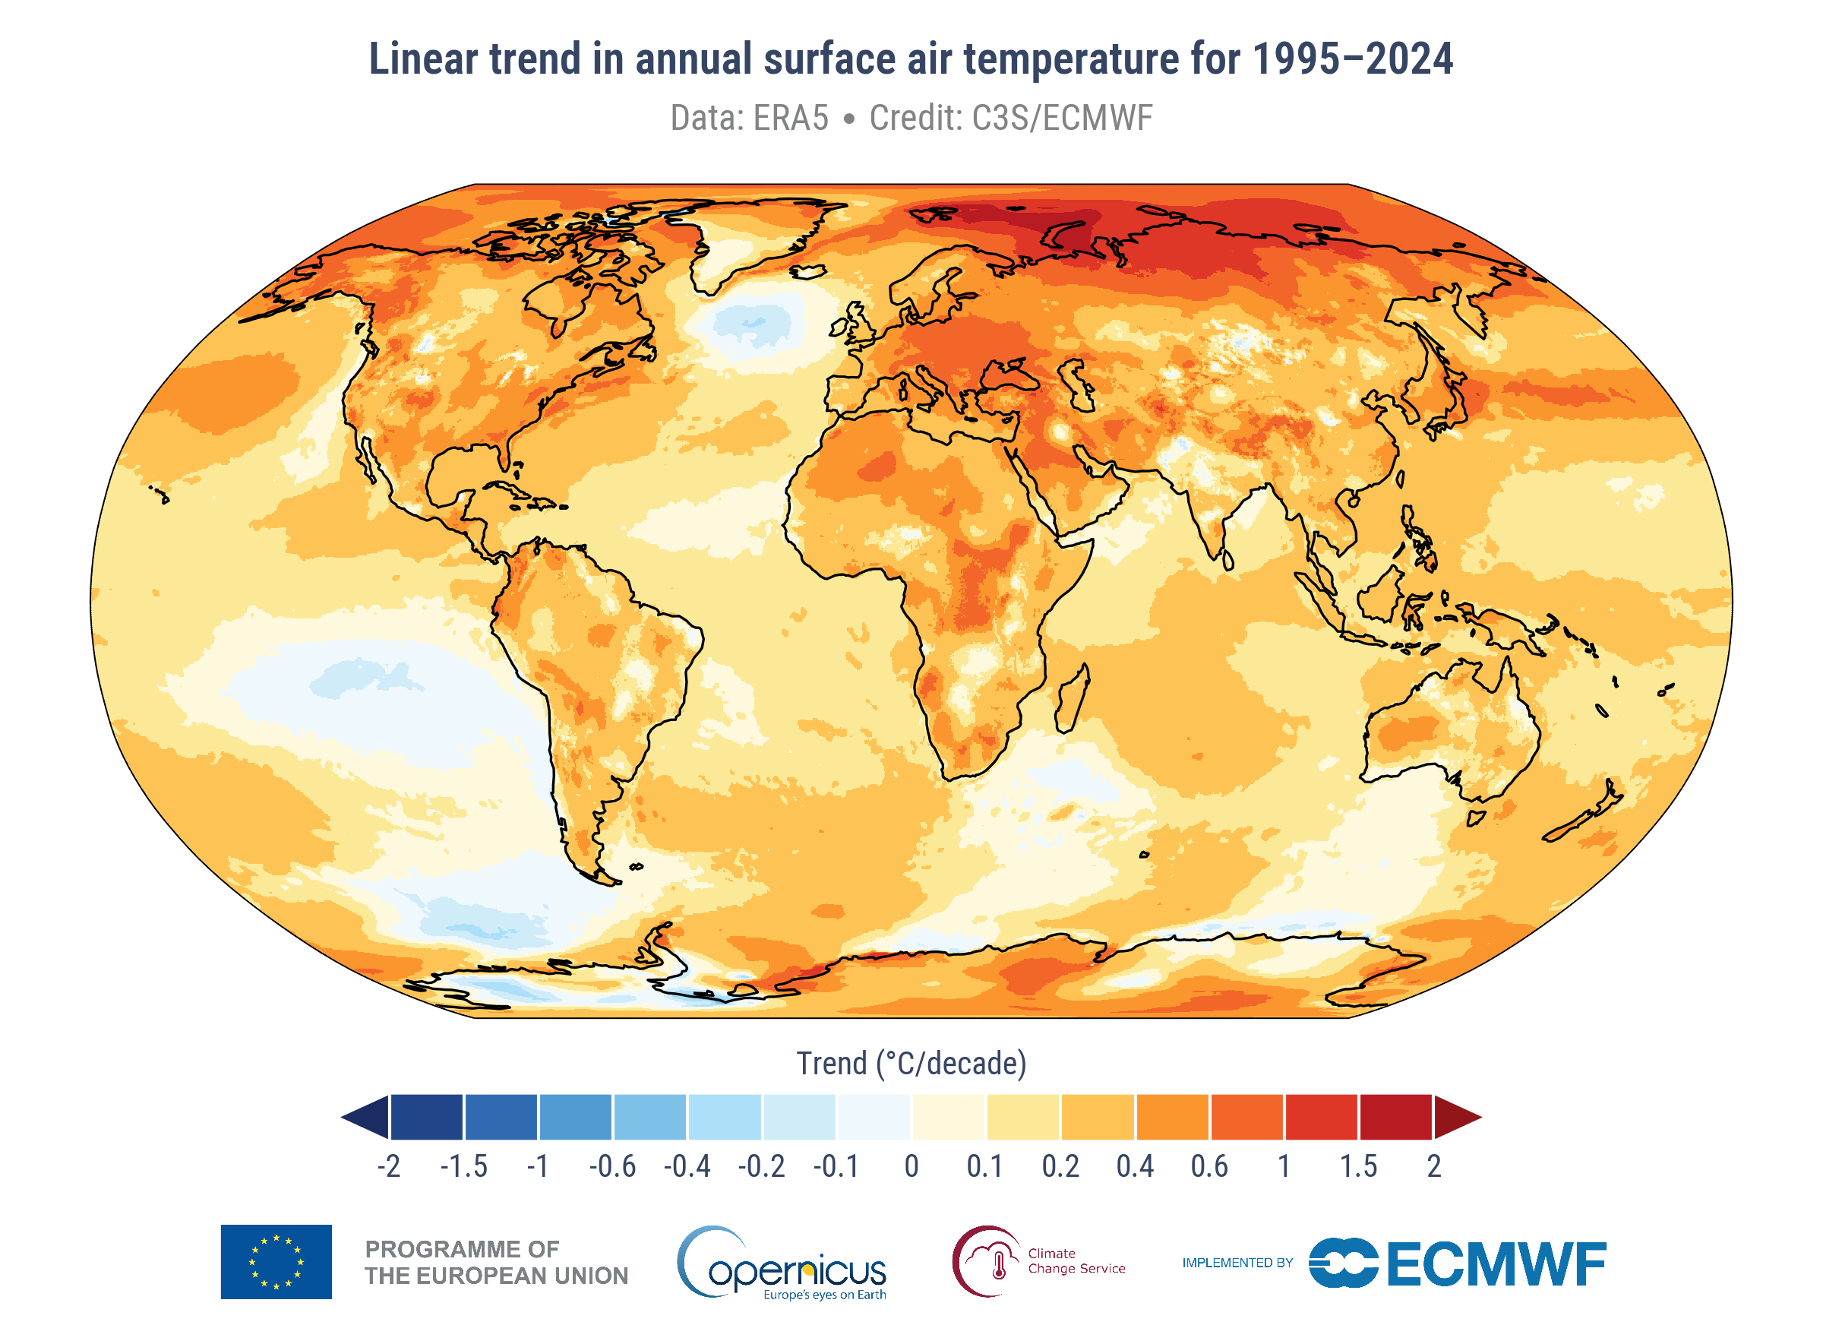
Spatial pattern over the last 30 years
Can all the spatial variations be explained by anthropogenic climate change?
What processes/phenomena determine regional patterns?

Slide 6
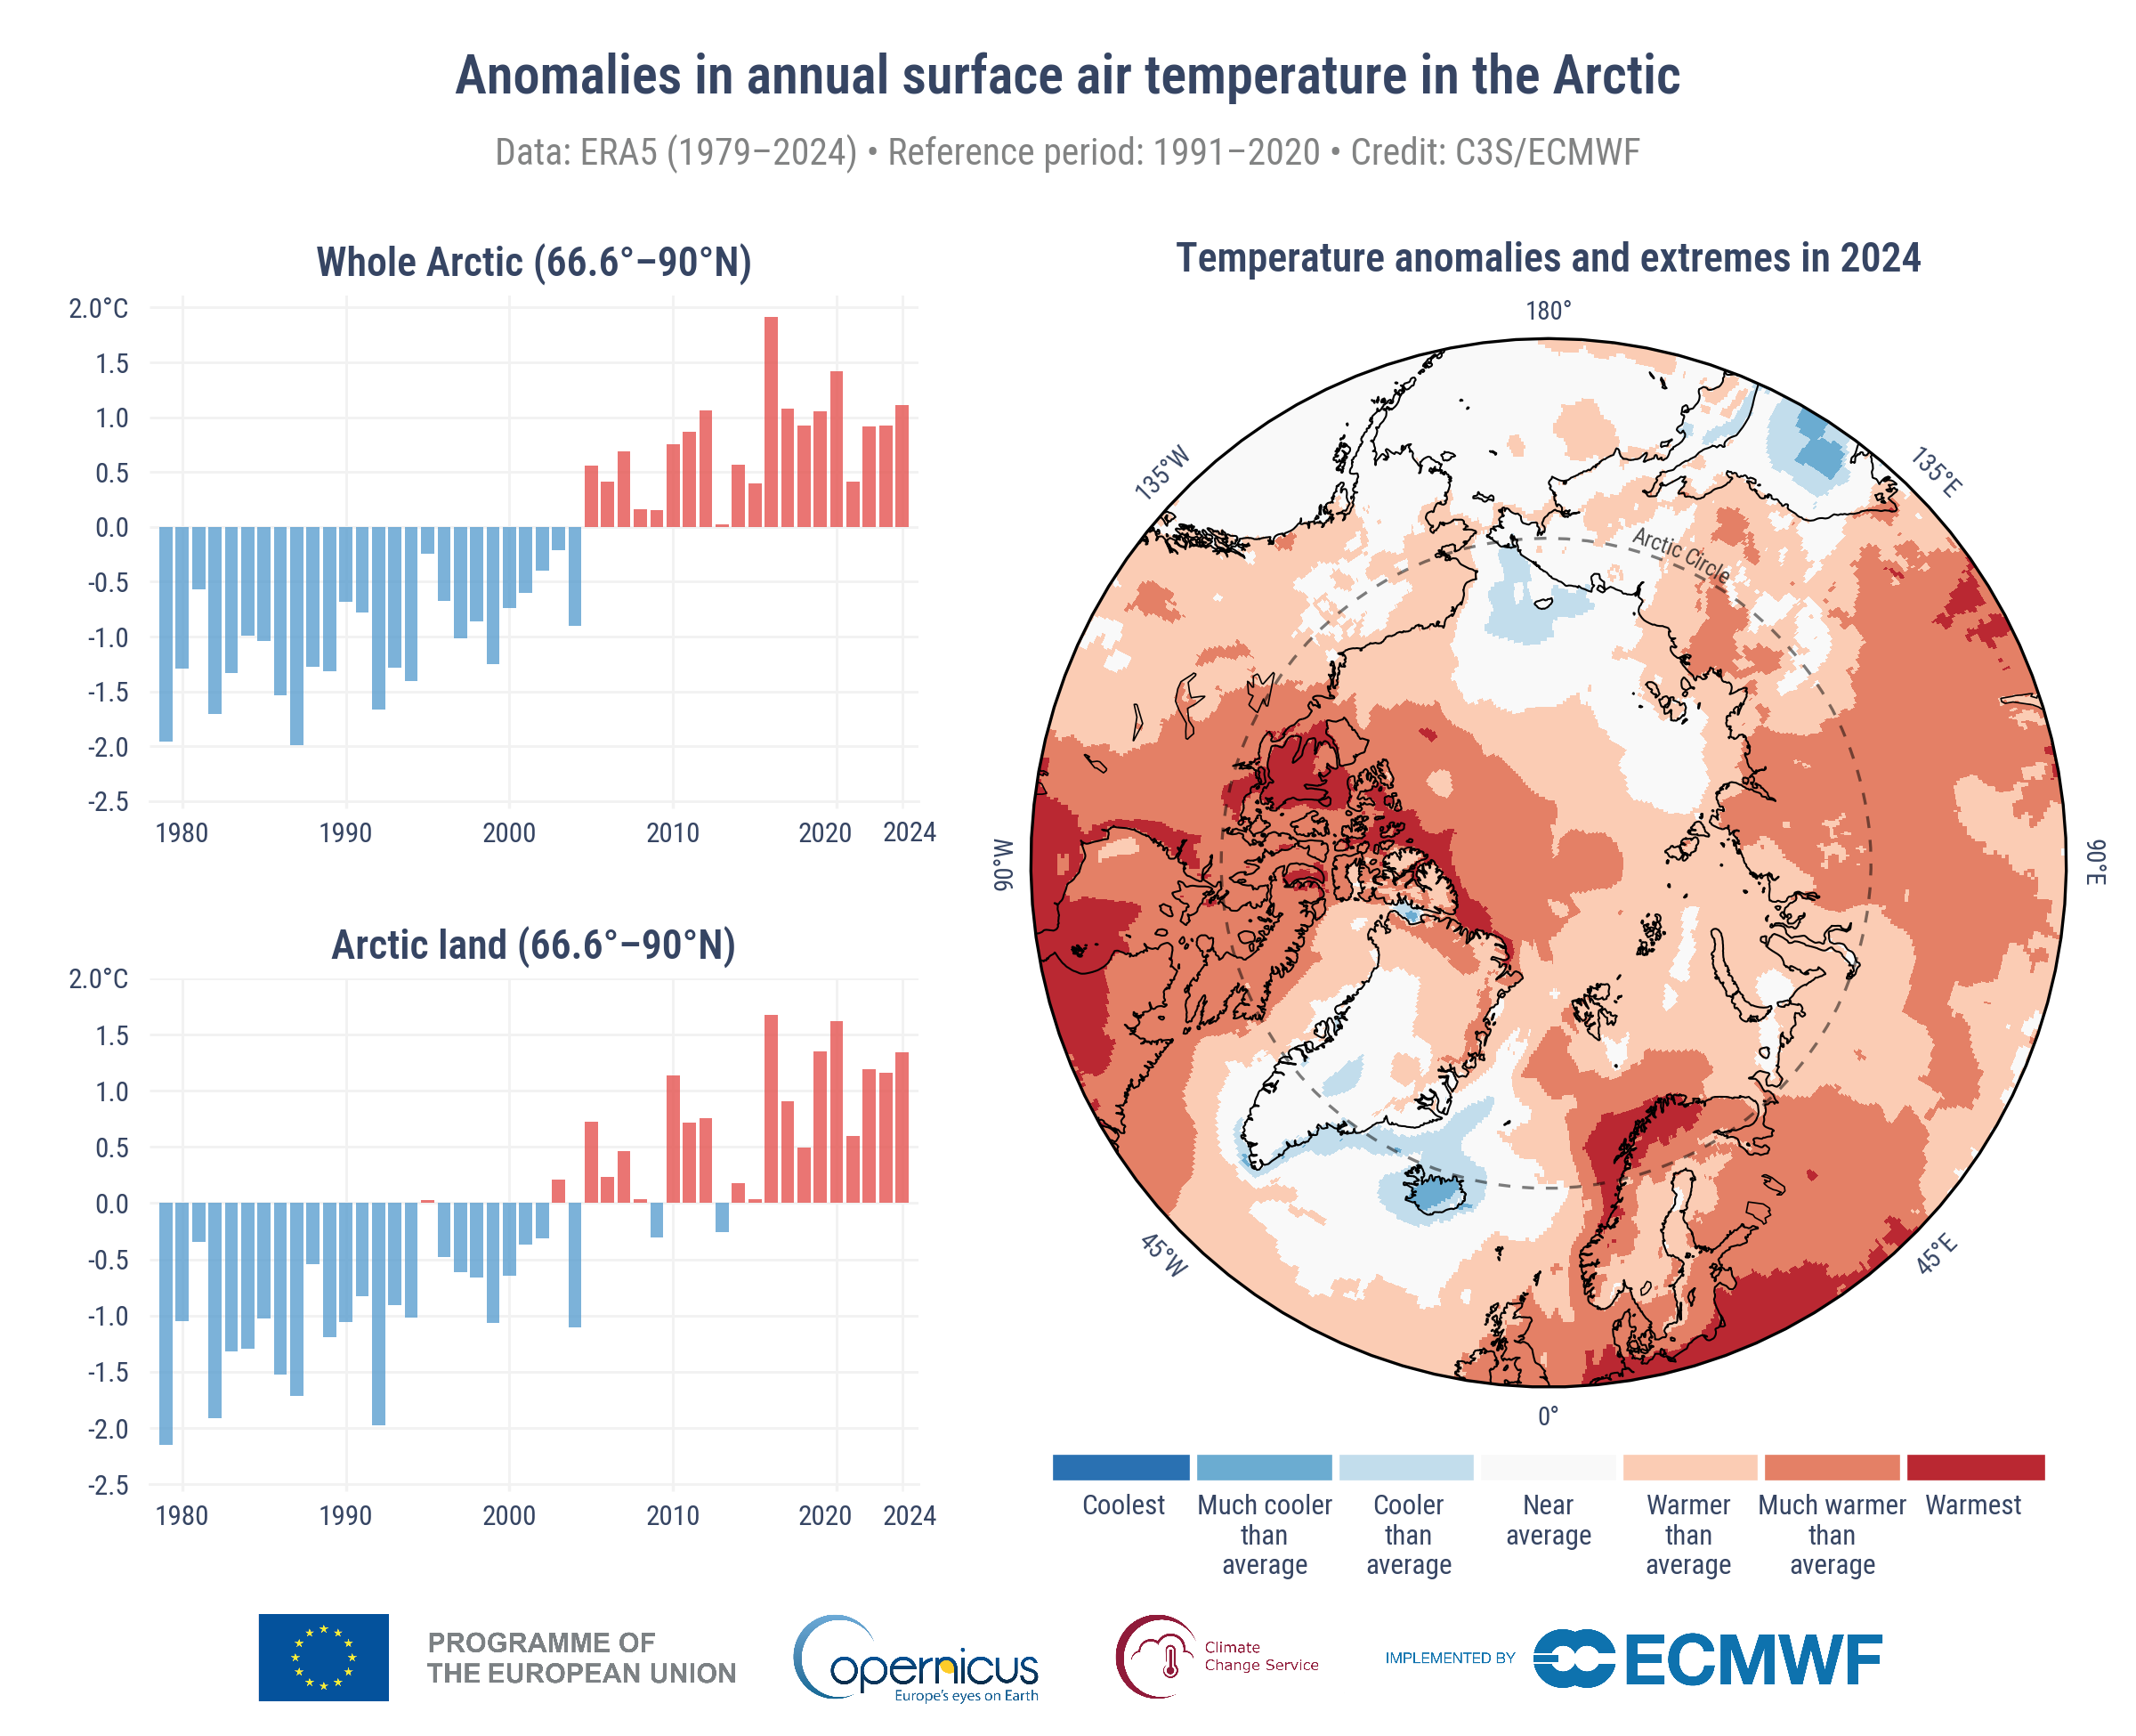
Decadal shifts seen even in icon global warming regions like the Arctic
Can we predict changes over the next decade?
https://climate.copernicus.eu/esotc/2024/arctic-temperature

Slide 7
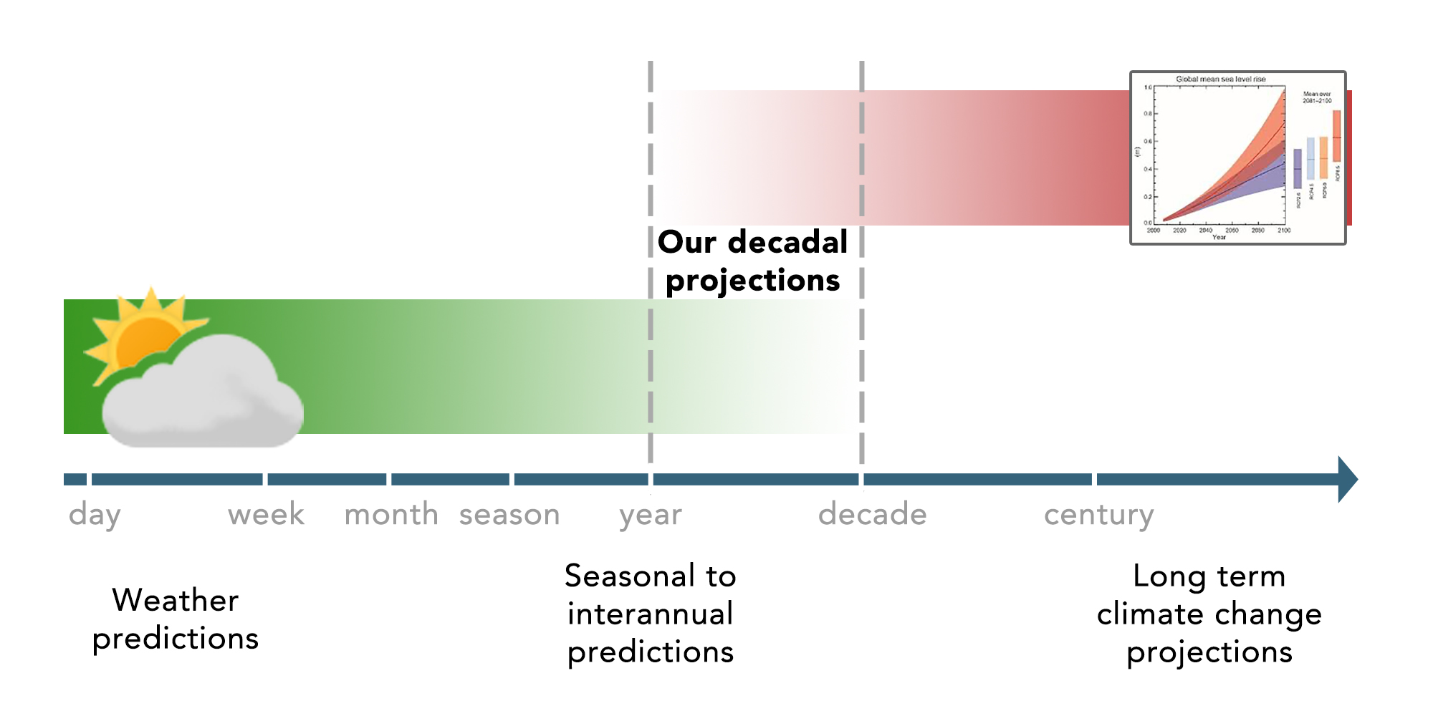
Climate prediction fills the gap between weather forecasts and climate change projections
CLIMATE PREDICTION
Adapted from Meehl et al. 2009

Slide 8
Predictability of 1st and 2nd kind: Initial value and boundary value
1st kind of predictability is from the initial state, (i.e., weather forecast)
2nd kind of predictability is from time varying parameters (e.g., CO2, global warming projection)
Prediction error stems from non-linear dynamics (i.e., sensitivity to initial conditions), and the model (including parametric responses, such as CO2 forcing)
Branstator and Teng (2010)
Time

Slide 9
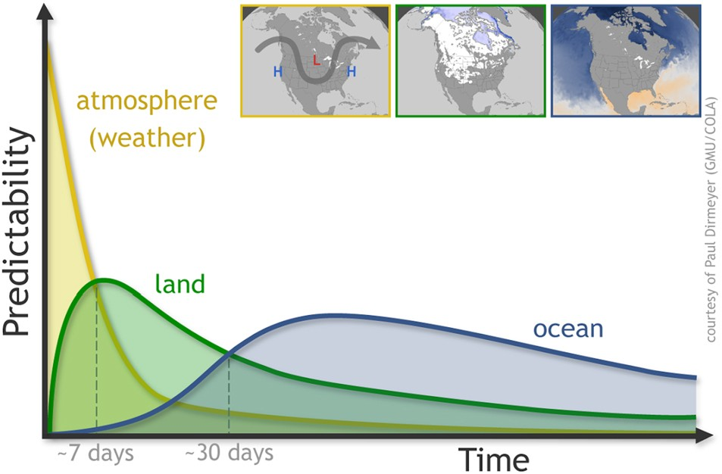
Different sources of internal predictability from weather to seasonal and longer timescales

Slide 10
Four elements of a climate prediction
Models
Observations
Data assimilation
Sufficient computing resources

Slide 11
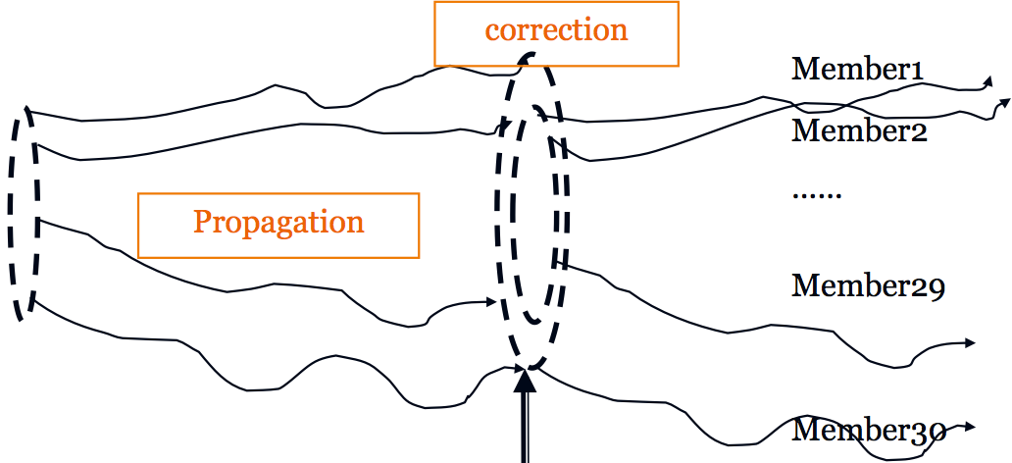
A state-of-the-art prediction system
The Norwegian Climate Prediction Model (NorCPM)
Norwegian Earth System model
Data assimilation (EnKF)
chemistry/aerosols
Atmosphere
Ensemble
Ice
Land
ice
land
Ocean
river
Ocean biochemistry
Observations
External forcing
(greenhouse gases, aerosols, etc.)
(Counillon et al. 2016)
Notes:
Add some information on resolution
11

Slide 12
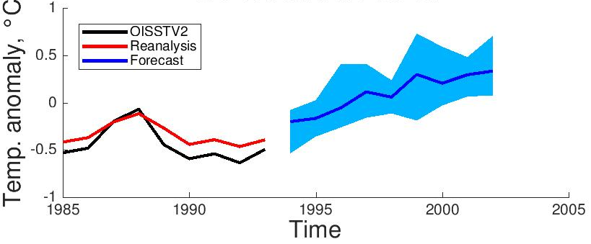
Retrospective predictions for assessing skill
Norwegian Climate Prediction Model
Prediction of North Atlantic Sea Surface Temperature, starting in October 1993
Prediction
Model adjusted to observations
Observations
Courtesy Yiguo Wang
Year

Slide 13
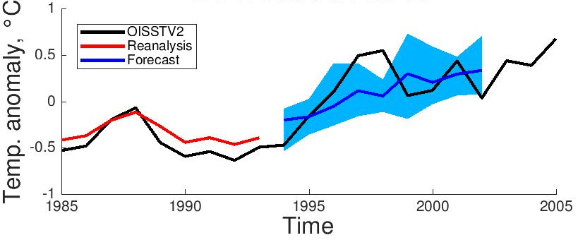
Retrospective predictions for assessing skill
Norwegian Climate Prediction Model
Prediction of North Atlantic Sea Surface Temperature, starting in October 1993
Prediction
Model adjusted to observations
Observations
Courtesy Yiguo Wang
Year

Slide 14
Measuring skill using retrospective forecasting (hindcasting)
Forecast
Lead-Time
[months]
3
2
1
1982,
Jan
1982,
Feb
1982,
Mar
1982
Apr
….1983
Jan
…..1984
Jan
Time
[months, years]
Skill can be estimated for example by the correlation or root mean square error between forecast and observed time series for different lead times
Courtesy: Mark Payne

Slide 15
2. Current status

Slide 16
ENSO events can be well predicted
Norwegian Climate Prediction Model
Wang et al. 2019

Slide 17
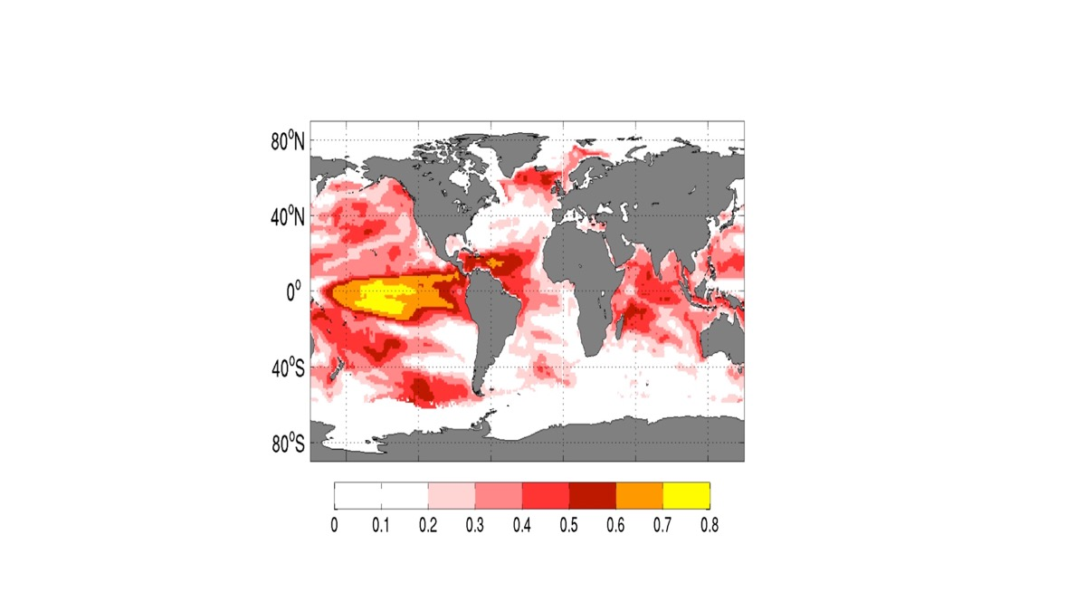
Skill of seasonal predictions for sea surface temperature
Anomaly Correlation skill in predicting sea surface temperature at six months lead
N. American Multi-Model Ensemble (ave.), period 1985-2010
Skill in NTA boreal spring
Skill in Indian Ocean (IOD, IOB)
What is going on here?
Keenlyside et al., CUP, 2020
Anomaly Correlation

Slide 18
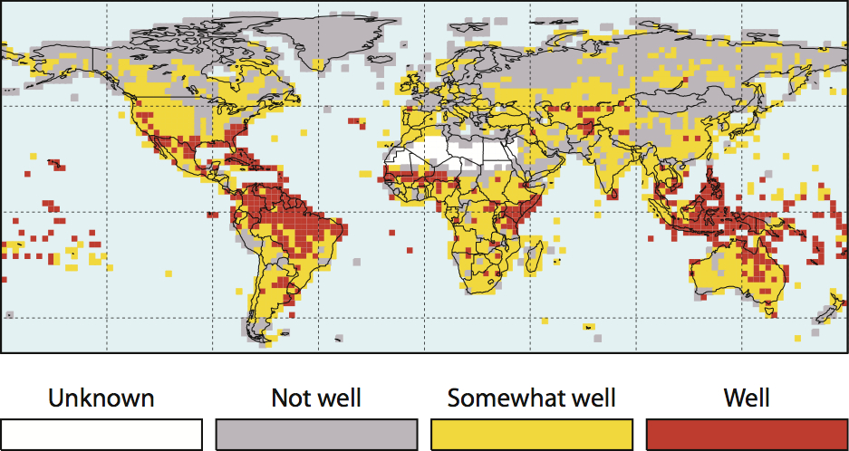
Seasonal climate prediction is skillful in the tropics
Indicates skill of 3-month forecasts of rainfall for at least one season of the year
Source: IRI-International Federation of Red Cross/Red Crescent seasonal forecasts in context

Slide 19
Prediction skill extends to decade
Correlation skill in predicting Sea Surface Temperature 6-9 years ahead
NorCPM, yearly hindcasts 1960-2010, 10 members, assim of ocean hydrography
Total skill (greenhouse gas + ocean)
Skill added by ocean data
Skill from Atlantic Multi-decadal variability
Bethke et al. 2021
Notes:
May be make a better transition

Slide 20
Atlantic Multi-decadal variability (AMV) highly predictable
Multi-model retrospective forecasting for AMV for years 1 to 9
Atlantic averaged sea surface temperature with long-term trend removed
Forecasts have been recalibrated to enhance signal to noise ratio
Smith et al. 2020

Slide 21
Prediction skill extends to rainfall
Correlation skill in predicting precipitation 6-9 years ahead
NorCPM, yearly hindcasts 1960-2010, 10 members, assim of ocean hydrography
Total skill (greenhouse gas + ocean)
Skill added by ocean data
Bethke et al. 2021
Notes:
May be make a better transition

Slide 22
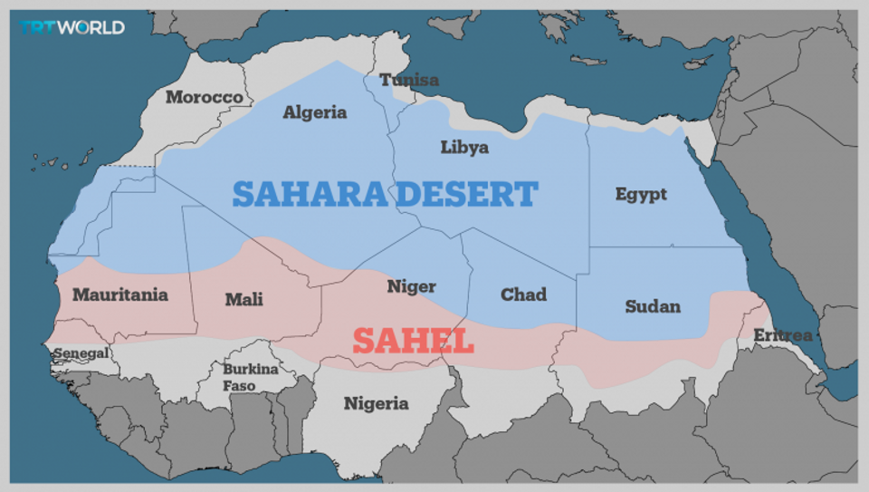
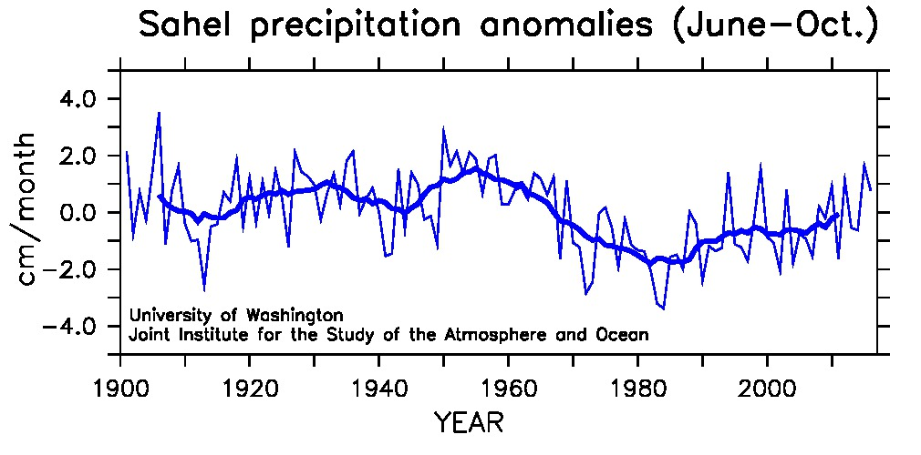
Climate prediction can increase societies resilience and ability for sustainable development
Predictions of Sahel rainfall, 2-5 years ahead
Sheen et al. 2017
Fink et al. 2010
2012 drought
18 million affected across the Sahel
Mauritania, 2012; Pablo Tosco/Oxfam

Slide 23
2. Challenges and future perspectives

Slide 24
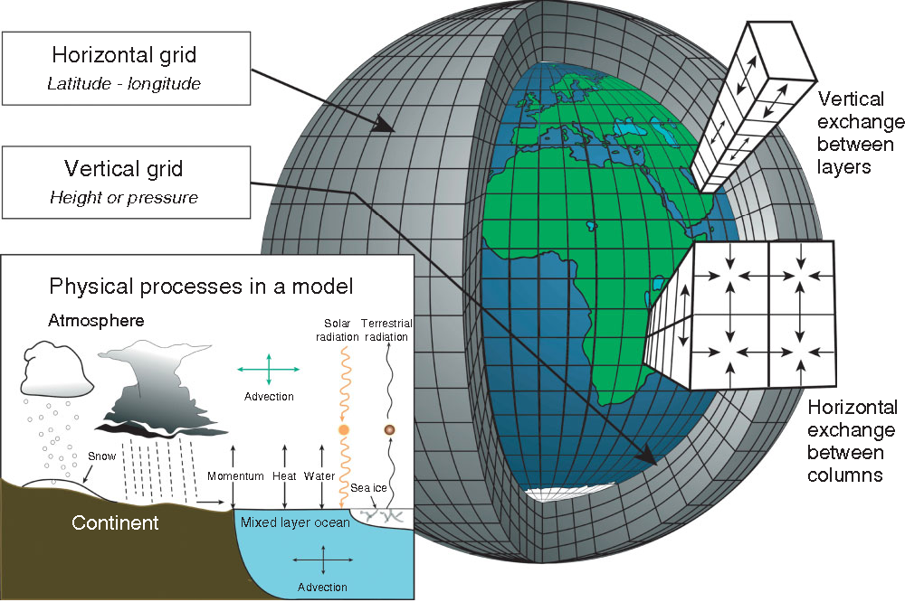
A Climate Model – uncertainties from parameterisations
Edwards, “History of climate modeling.” Wiley Interdisciplinary Reviews: Climate Change 2021

Slide 25
Model biases large than signals being predicted
CMIP5 multi-model mean sea surface temperature error
Richter, WIRES, 2015
°C

Slide 26
North Atlantic subpolar gyre – very predictable
Raw CCSM4 predictions of SPG heat content anomalies
10 year long; 10 members
Bias corrected CCSM4 predictions of SPG heat content anomalies 10 year long; 10 members
Yeager et al. 2012

Slide 27
Signal to noise issue – Models underestimate the predictable signal
Retrospective predictions for N. European winter precipitation for forecast years 1 to 9.
Raw multi-model ensemble predictions
Calibrated multi-model ensemble predictions
Smith et al. 2020

Slide 28
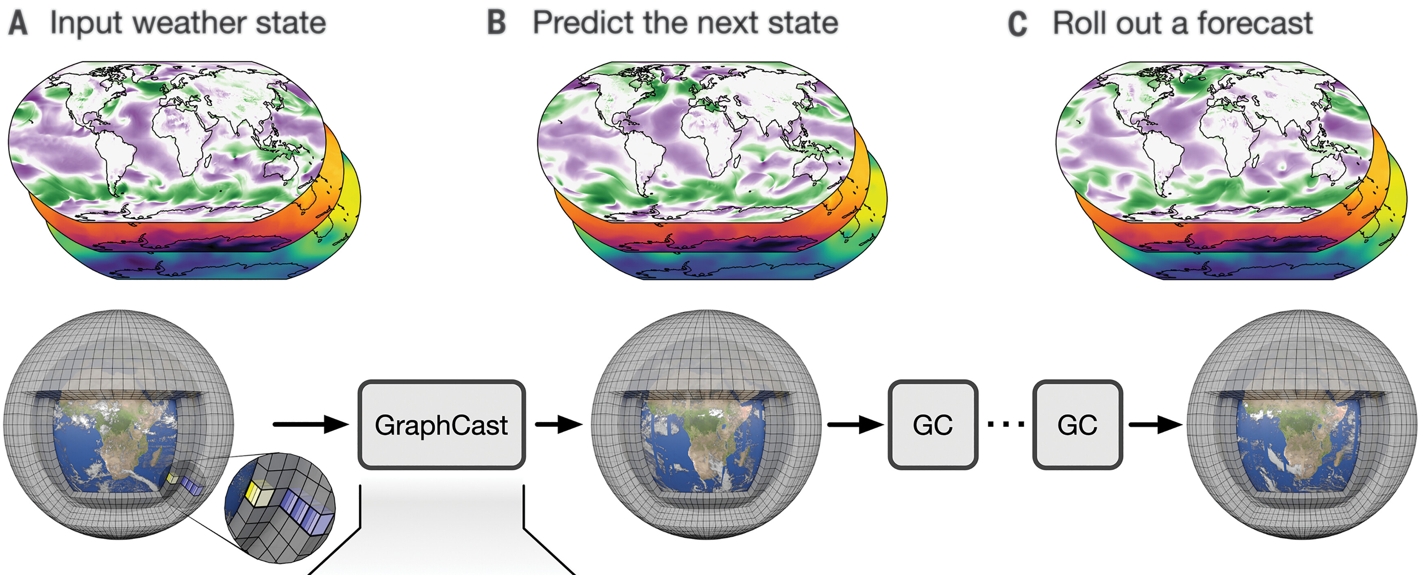
AI has revolutionized weather forecasting
AI models are as skillful as the best numerical weather forecasts,
yet they can be run on laptop in seconds, rather than hours on huge supercomputer
they are trained on huge amount of weather forecasts
Lam et al. Science, 2023

Slide 29
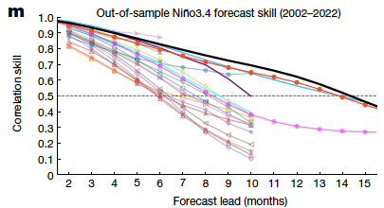
AI predictions have extended predictions of El Niño beyond a year, by accounting better for basin interactions
XRO model
explain the high-skill of AI predictions
from addition of other basins
Operational systems
Ham et al. Nature 2019
Zhao et al. Nature 2024

Slide 30

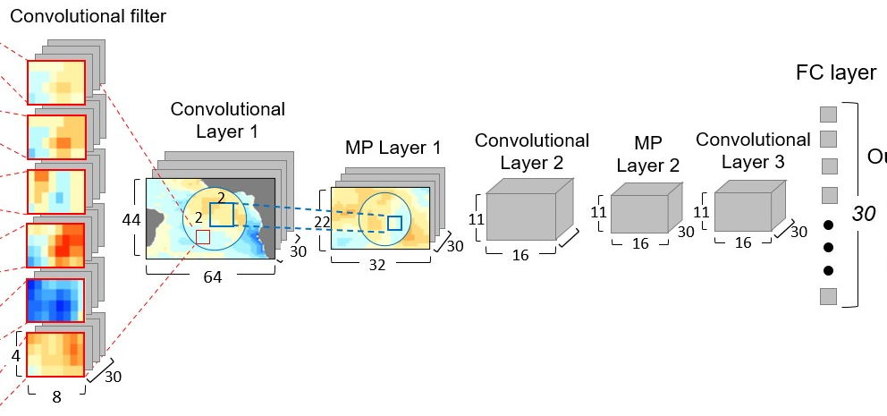
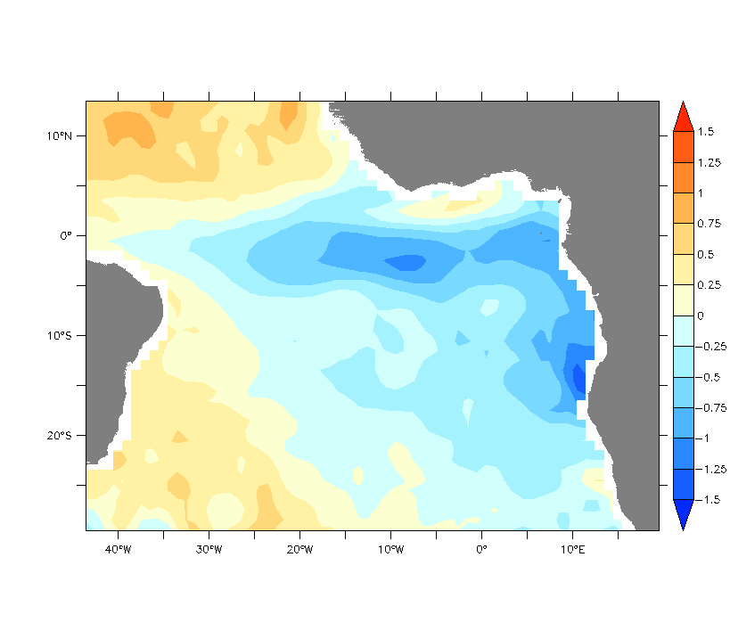
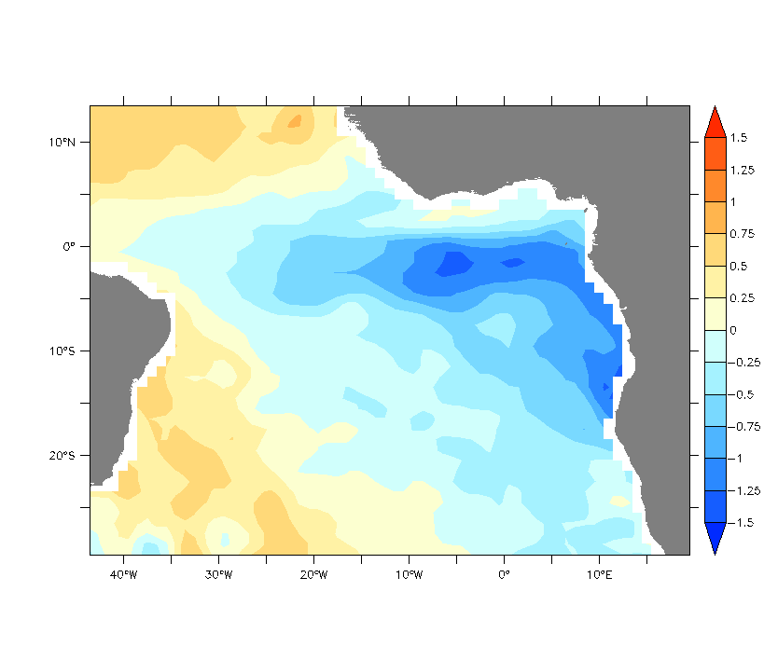

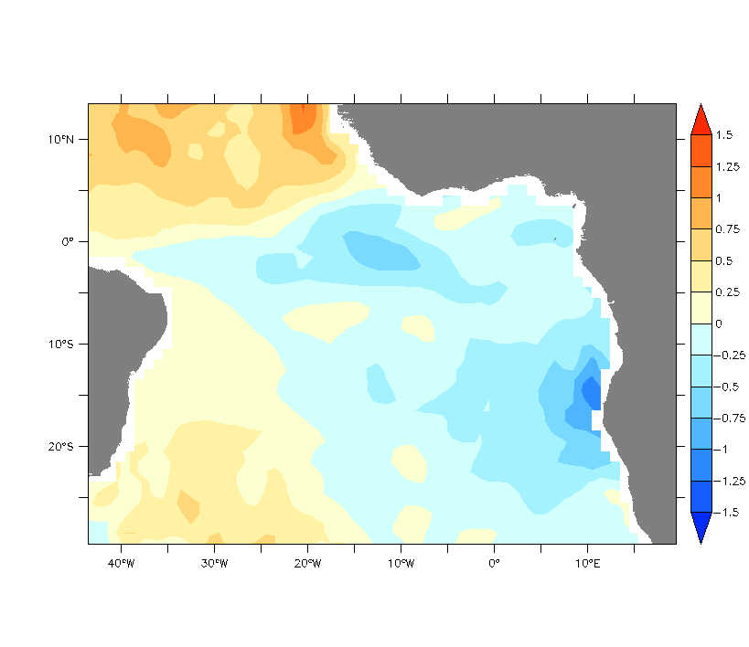
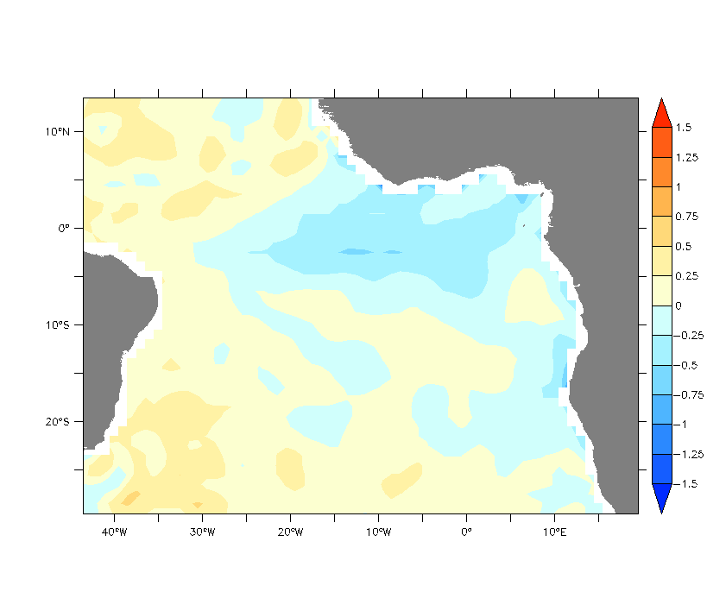
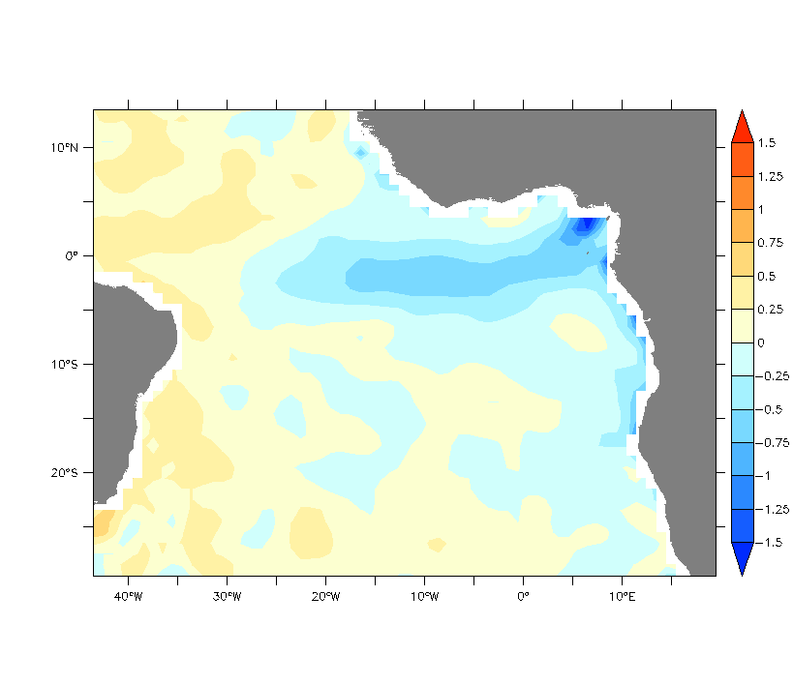
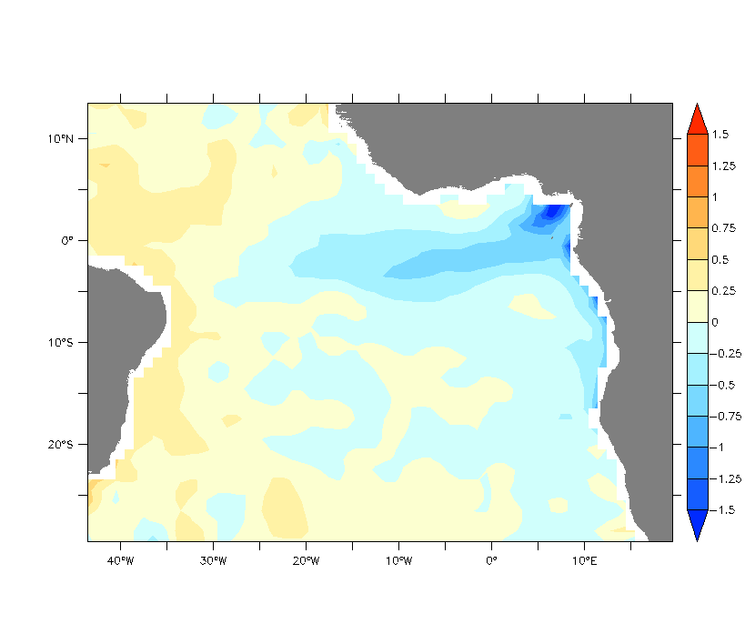
A Deep learning strategy to predict Atlantic/Benguela Niño events
Develop seasonal predictions of 2 indices from lead 1 to 12 months
Atlantic index (ANi)
Benguela index (BNi)
Marie-Lou Bachélery
Marie Skłodowska-Curie Actions
Postdoc project
Input Data:
Interannual anomalies
CNN model's Architecture (figure updated from Ham et al., 2021)
Outputs Indices
Monthly predictions of:
Atlantic index (ANi)
SST
2) Benguela index (BNi)
100m Temp
averaged
Bachèlery et al., Science Advanced, in press

Slide 31
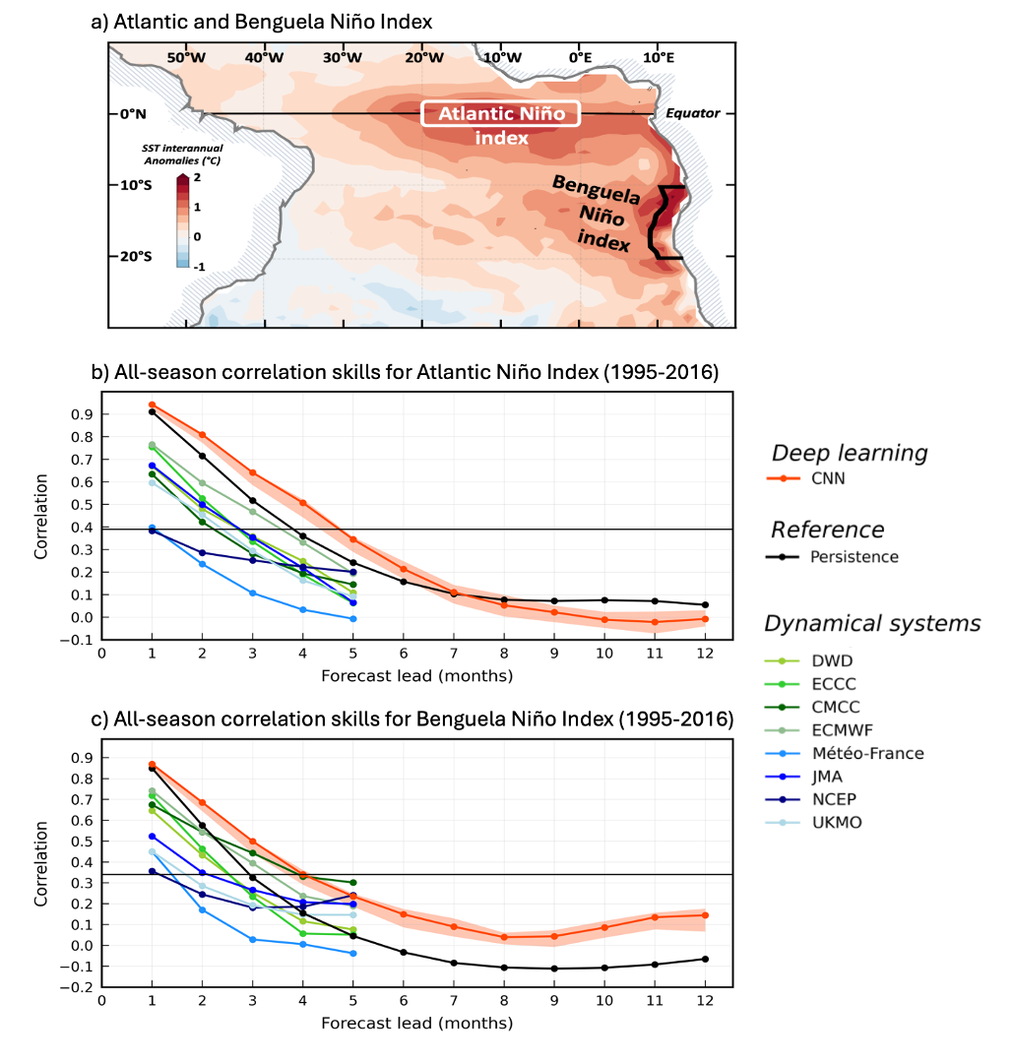
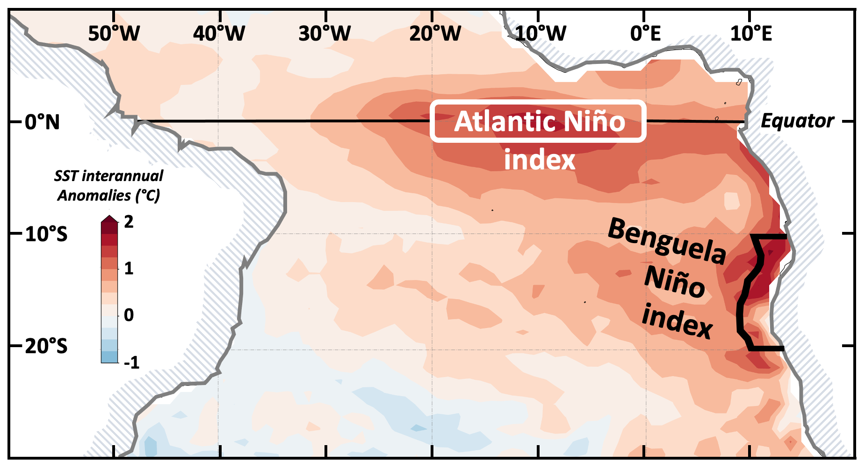
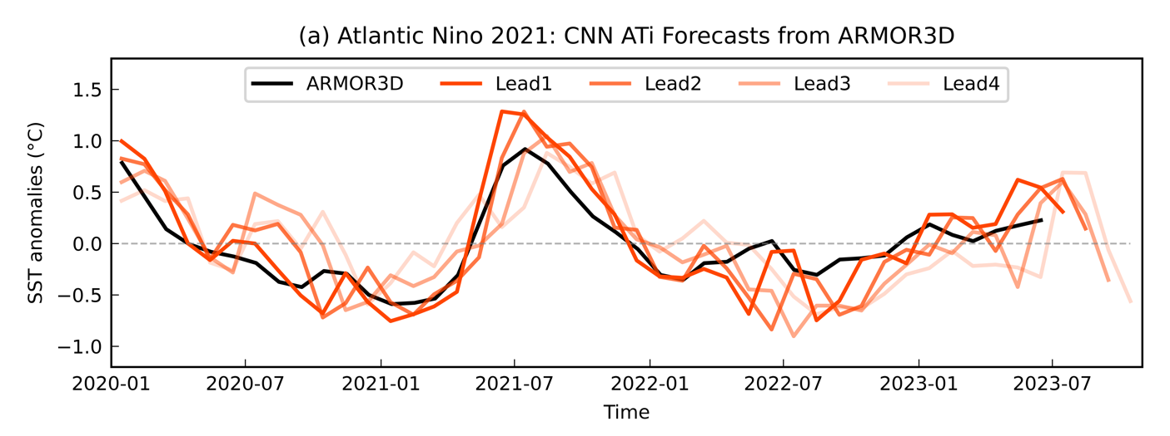
Atlantic & Benguela Niño can be predicted 2-4 months in advance
Here we show skilful prediction for a major recent event, up to 4 months in advance
Developing ML/AI climate models remains a challenge
Bachèlery et al., Science Advanced, in press

Slide 32
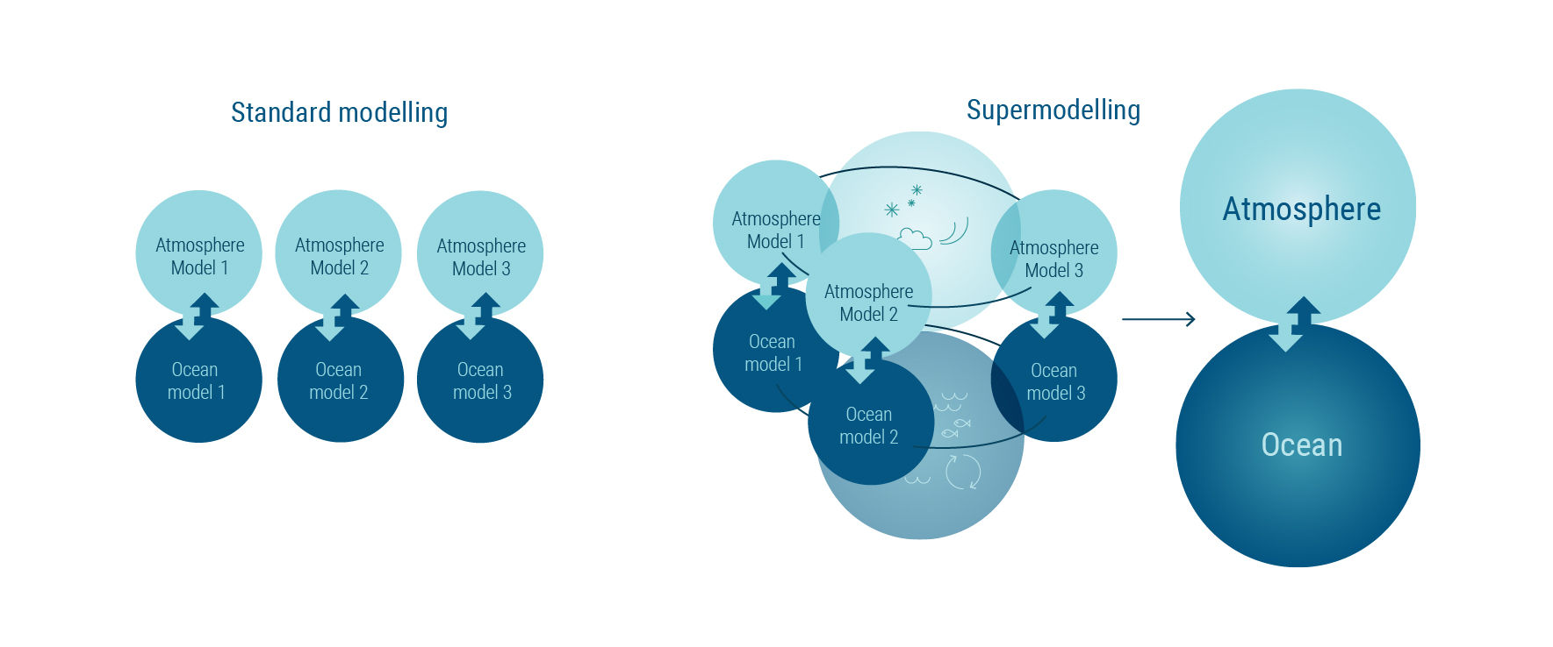
Supermodels – smarter way to utilize existing models
Supermodel: an interactive ensemble of models, models are dynamically combined
Errors corrected at an early stage compared to the standard multimodal ensemble
Supermodel is a new dynamical system.

Slide 33
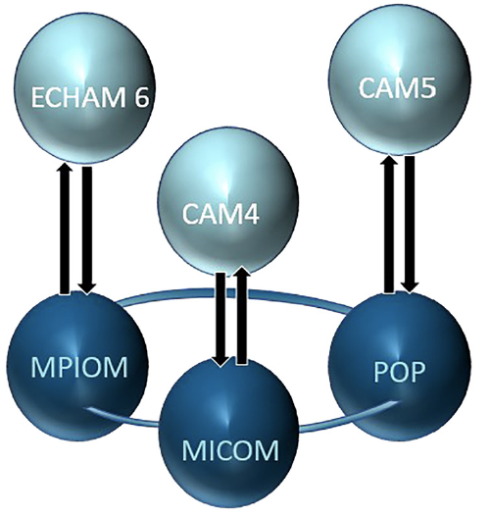
Ocean connected super Earth System Model
Connected through data assimilation of ”corrected” SST = weighted sum of the three individual models
Counillon et al. JAMES 2023

Slide 34
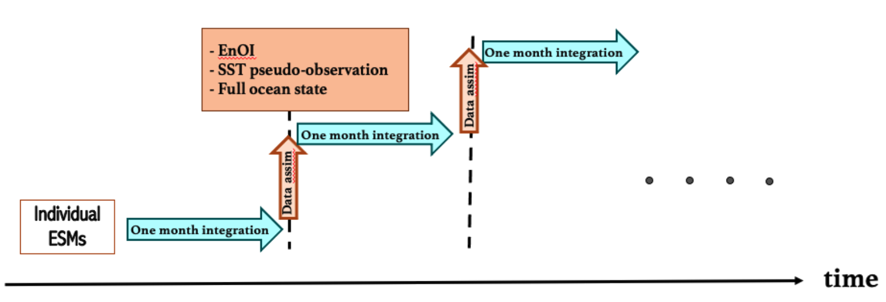
Ocean connected super Earth System Model
Connected through data assimilation of
”corrected” SST = weighted sum of the three individual models
Counillon et al. JAMES 2023

Slide 35
Ocean connected super Earth System Model
Connected through data assimilation of
”corrected” SST = weighted sum of the three individual models
Weights computed offline using observed SST, 1980-2005
Throughput ~10 years per day, 11 nodes 1408 cpu
Counillon et al. JAMES 2023

Slide 36
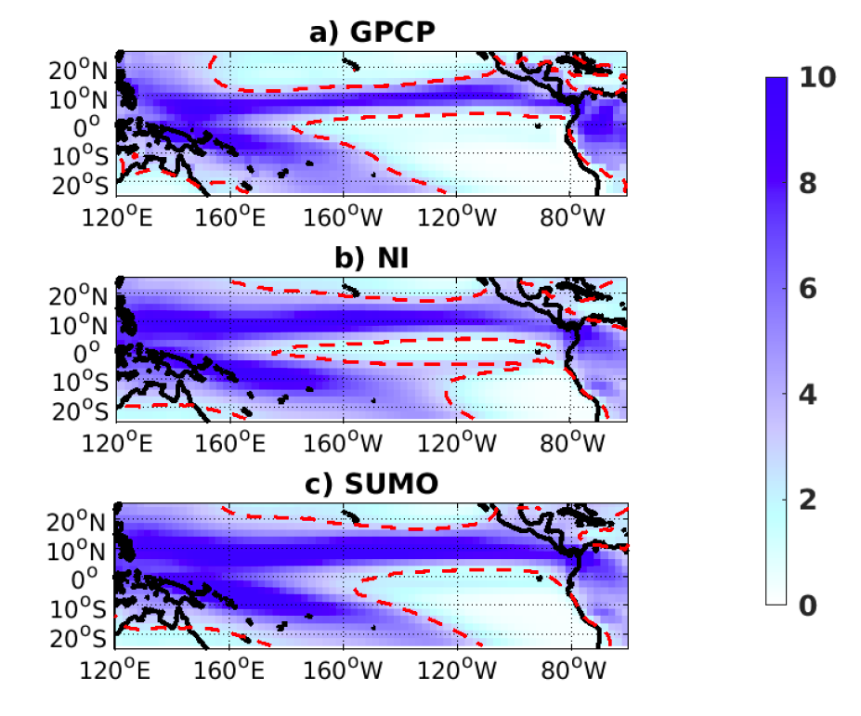
Supermodelling is a viable alternative
Rainfall climatology (GPCP)
Double ITCZ bias is mitigated by the ocean connected supermodel
(NorESM-MPIESM-CESM)
Independent period 2006-2021
Average of non-interactive ensemble
In terms of CPU hrs, the supermodel is ~4-times as expensive NorESM,
but 25000 cheaper than ICON
Ocean connected supermodel
Schevenhoven, et al. 2023

Slide 37
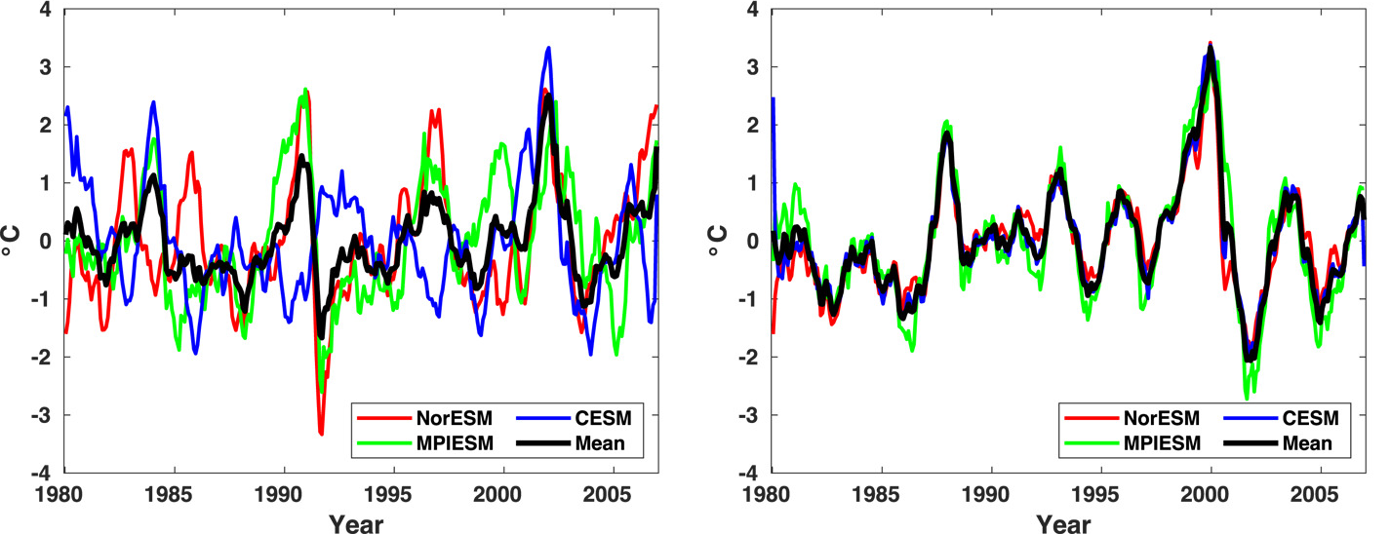
Synchronization of the variability: ENSO
Non-interactive
Supermodel (equal weights)
Counillon et al. JAMES 2023

Slide 38
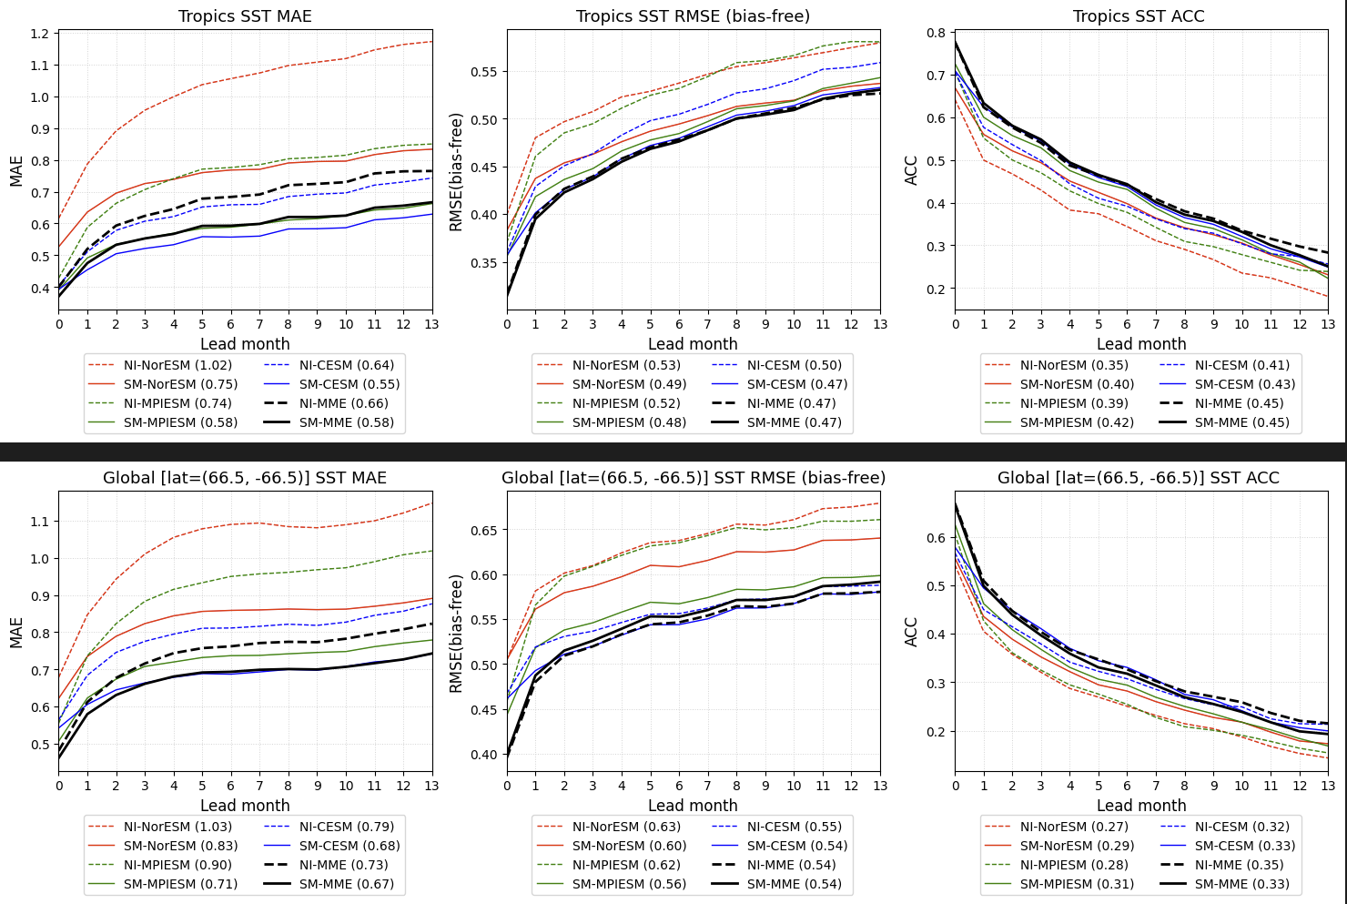
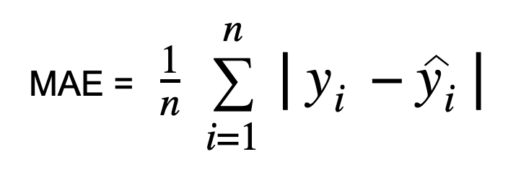
Supermodel improves seasonal predictions
Global mean absolute error
Surface temperature
Mean absolute error
Observation
Prediction
Tarkeshwar Singh

Slide 39
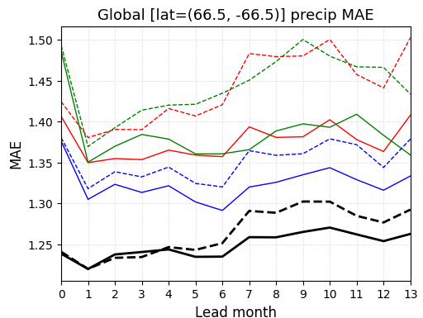
Supermodel improves seasonal predictions
Global mean absolute error
Surface temperature
Precipitation
Tarkeshwar Singh

Slide 40
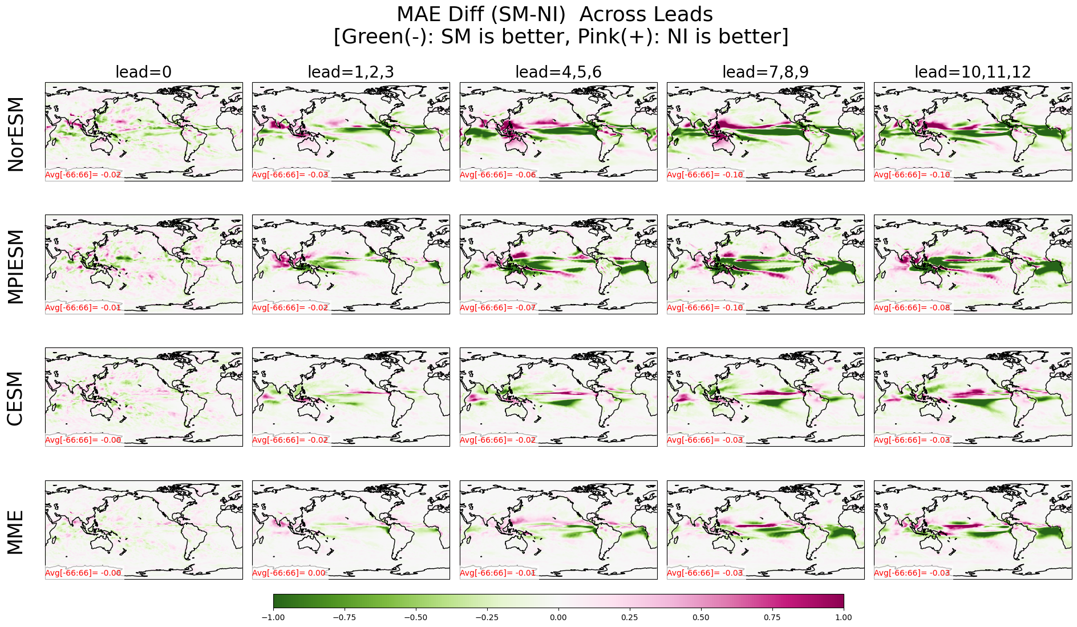
Supermodel improves precipitation forecasts across the tropics
Precipitation forecasts at 10-12 months lead time
Difference in mean absolute error, super model minus non-interactive
Tarkeshwar Singh
Supermodel has lower error
Non-interactive has lower error

Slide 41
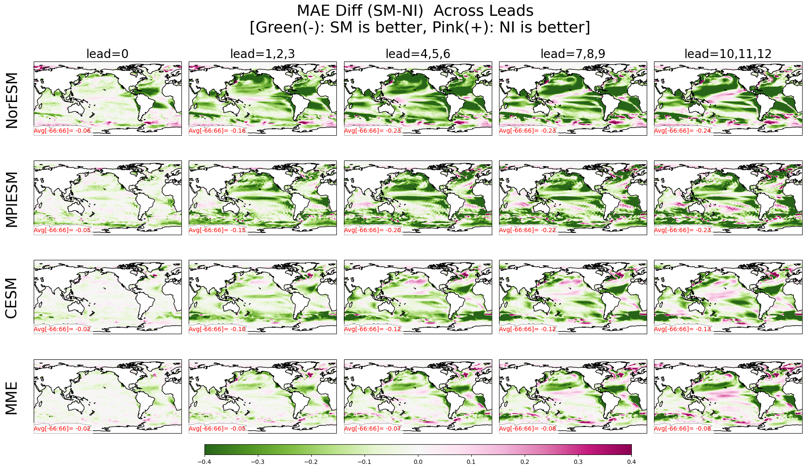
Supermodel improves SST forecasts across the tropics
Sea surface temperature forecasts at 10-12 months lead time
Difference in mean absolute error, super model minus non-interactive
Tarkeshwar Singh
Supermodel has lower error
Non-interactive has lower error

Slide 42

Supermodelling – A higher level AI
What is a climate supermodel
There many different climate models, and just like the Avengers, they each have their own powers
When they combine their powers and work together, they are even more powerful
A SUPER model
Francine Schevenhoven

Slide 43




What we covered today
What is a climate prediction?
How is it related to weather forecasts?
How do we make a climate prediction?
What key phenomena can we currently predict?
What is the key challenge limiting climate prediction?
What are some approaches are being used to address these?
Thank you for your attention

Slide 45
Climate prediction
Two types of predictability: Initial value/internal variability and boundary value/external forcing
While climate predictions is relative new field, good progress has been made and skill exists on seasonal to decadal timescales
Key challenges relate to model error, signal-to-noise, external versus internal, but approaches are being developed to resolve these (ML/supermodels, ...)

Slide 46
Experimental climate predictions are available
Multi-model Prediction of surface temperature for the 2020-2024
Cold blob?
See report: WMO Global Annual to Decadal Climate Update for 2020–2024
https://hadleyserver.metoffice.gov.uk/wmolc/

Slide 47
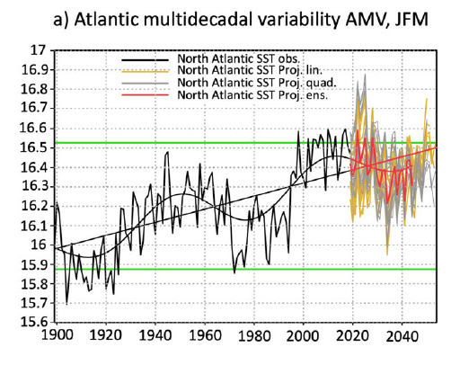
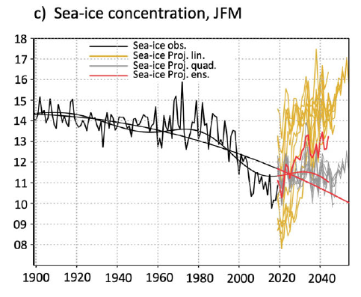
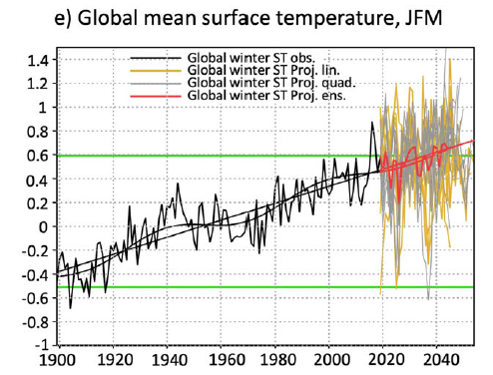
So how will climate evolve over the next 10-20 years?
Simple linear regression models are used to estimate potential future changes in the AMV and its impacts
The present and near future wintertime decadal conditions resemble those of 1950s-1970s showing:
North Atlantic cooling, weakening of the NAO, hiatus in Arctic sea-ice European and global temperature
Omrani et al. 2022

Slide 48
Sources of climate variability/predictability
Anthropogenic
(e.g., greenhouse gas emissions)
Externally forced
Natural
(e.g., solar forcing, volcanic eruptions)

Slide 49
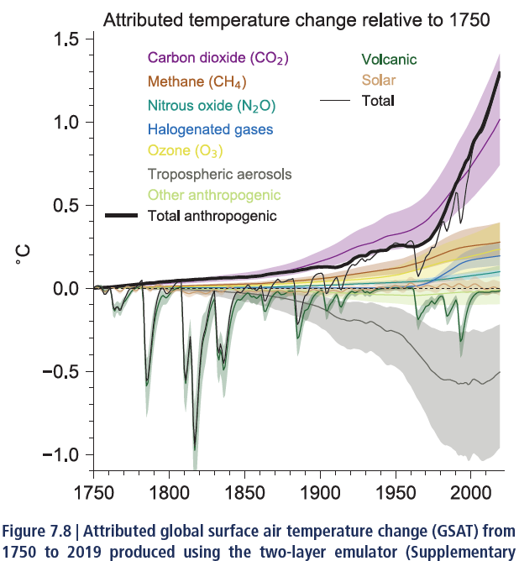
External radiative forcing – influences climate on shorter-timescales
Warming
Cooling
Large uncertainty in aerosol forcing
IPCC AR6, Ch 7

Slide 50
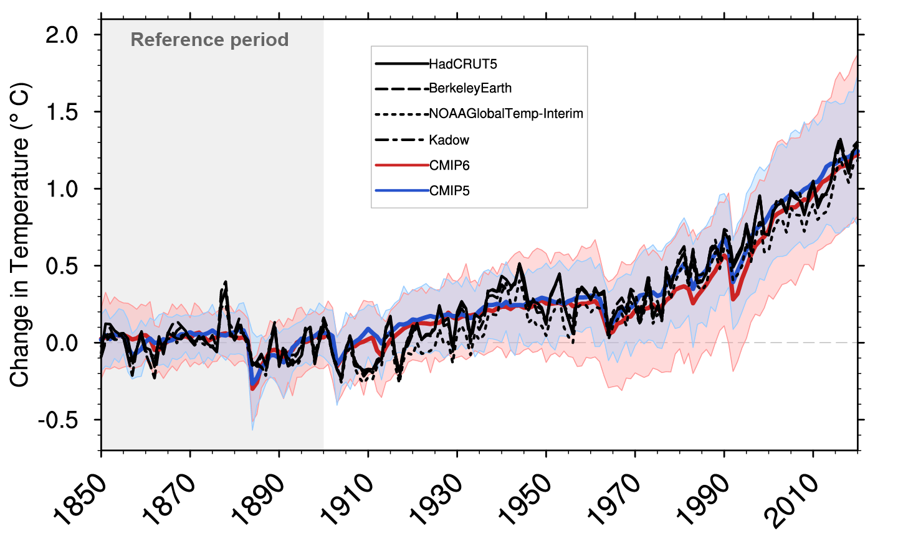
Climate models reproduce historical global mean temperature well
IPCC AR6, Ch 3
Internal variability – Climate system can generate variations from internal dynamics. These can explain some model departures from observations.
Can you name some patterns/phenomena of internal climate variability?

Slide 51
Sources of climate variability/predictability
Anthropogenic
(e.g., greenhouse gas emissions)
Externally forced
Natural
(e.g., solar forcing, volcanic eruptions)
Stochastic climate models
Internally generated
Uncoupled oscillations
(e.g., basin modes, MJO)
Coupled ocean-atmosphere oscillations

Slide 52
Sources of climate variability/predictability
Types of Predictability
Anthropogenic
(e.g., greenhouse gas emissions)
Boundary
value
(2nd kind)
Externally forced
Natural
(e.g., solar forcing, volcanic eruptions)
Stochastic climate models
Initial value
(1st kind)
Internally generated
Uncoupled oscillations
(e.g., basin modes, MJO)
Coupled ocean-atmosphere oscillations

